Slide 1
Efficiency in Use of Packing Materials and Employees’ Perceptions of Failures in Grain Flour Production Line: A Case Study
HAGK Sathsarani¹, RKC Jeewanthi¹, UP Weerasinghe²
¹Department of Agribusiness Management, Faculty of Agricultural Sciences, Sabaragamuwa University of Sri Lanka, Belihuloya
²Harischandra Mills PLC, Matara, Sri Lanka

Slide 2
Content
Introduction
Research Objectives
Conceptualization Framework
Material and Methods
Results and Discussion
Conclusion and Recommendations
References

Slide 3
Introduction
The Companies with grain mills have critical problems related to efficiency of production process due to the failures and defects. Harischandra company is one of leading flour based product manufacturing company.
There are different types of grinding mills products.
Failure Mode and Effect Analysis (FMEA) technique helps for management of the production line to identify production failures. PDCA cycle shows a great use in solving problems(Yu, 2017). PDCA cycle methodology causes to continuous improvement.
Ulundu flour
Thosai mixture
Kurakkan thosai mixture
Kurakkan flour
5.Hopper mixture
6.Rice flour
7.Red rice string hopper flour
8.White rice string hopper flour

Slide 4
Objectives
Broad Objective
To study on factors affecting to failures (based on workers’ perception), analyzing the failures/ defects and establishing process improvement methods in grain flour products processing line.
Specific Objectives
To identify the basic factors, affect to failures/defects in grain flour based product processing line (based on workers’ perception).
To evaluate the packing materials wastage percentage of each product in grinding mill section(From total weight of packing materials wastage).
To analyze failures/ defects and identify the solutions to reduce the effect of those failures/ defects in grain flour based product processing line.
To apply PDCA cycle technique to overcome the high waste percentages of the packing materials in the grinding mill section.

Slide 5
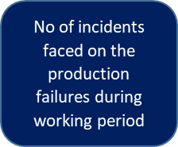
Conceptualization Framework
Figure 1- Conceptualization framework of the study

Slide 6
Material and Methods
Research Location =Grinding mill production line in Harischandra Mills PLC, Matara .
Operators
07
Harischandra Mills PLC
Grinding mill section
Other labours (Packing, bundling, filling)
43
50
Figure 2- Sample of the study

Slide 7
Material and Methods cont…
Research Design
Research strategy - Survey method, FMEA
Data collection method
Primary data – Questionnaire, Interviews
secondary data -journal articles, web sites, company records and annual reports of the company
Data analysis techniques
Quantitative analysis techniques(. SPSS 22 version, MS Excel 2013 version, FMEA technique)

Slide 8
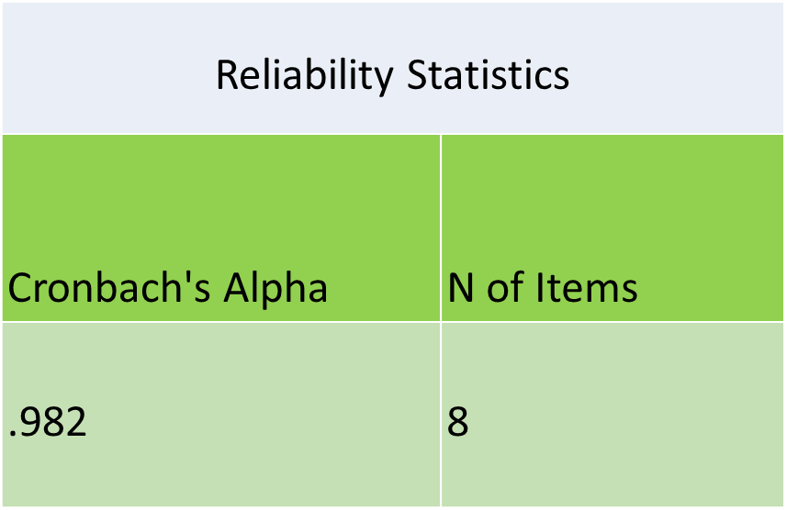
Results and Discussion
Table 1- Reliability Statistics
Geory and Malley (2003) introduced following rule of thumb.
α ≥ 0.9 -Excellent
α ≥0.8 -Good
α ≥ 0.7 -Acceptable
α ≥ 0.6 -Questionable
α ≥ 0.5 -Poor
α ≤ 0.5 - Unacceptable

Slide 9
Results and Discussion cont..
Objective 01- To identify the basic factors, affect to failures/ defects in Grain flour based product processing line (based on employees’ perception).
Table 2-Model Summary^{b}
Model | R | R Square | Adjusted R Square | Std. Error of the Estimate | Durbin-Watson
1 | .844ª | .712 | .647 | .967 | 1.450
a. Predictors: (Constant), Education background, Resources, Health issues, Lack of training, Technical issues, Forgeting , Working stress, Lack of experience, Lack of supervision
b. Dependent Variable: Complaints
Table 3-ANOVAª
Model |  | Sum of Squares | df | Mean Square | F | Sig.
1 | Regression | 92.576 | 9 | 10.286 | 10.994 | .000^{b}
 | Residual | 37.424 | 40 | .936
 | Total | 130.000 | 49
a. Dependent Variable: Complaints
b. Predictors: (Constant), Education background, Resources, Health issues, Lack of training, Technical issues, Forgeting , Working stress, Lack of experience, Lack of supervision

Slide 10
Results and Discussion
Table 4-Coefficients table
Model |  | Unstandardized Coefficients |  | Standardized Coefficients | t | Sig.
 |  | B | Std. Error | Beta
1 | (Constant) | 4.775 | 1.670 |  | 2.859 | .007
 | Technical issues | .453 | .255 | .215 | 1.776 | .083
 | Resources | -1.131 | .379 | -.308 | -2.983 | .005
 | Lack of supervision | .206 | .298 | .093 | .693 | .492
 | Working stress | .857 | .344 | .276 | 2.489 | .017
 | Lack of experience | .658 | .193 | .393 | 3.402 | .002
 | Health issues | -.247 | .245 | -.110 | -1.007 | .320
 | Forgetting | -.111 | .221 | -.051 | -.504 | .617
 | Lack of training | -.347 | .217 | -.178 | -1.602 | .117
 | Education background | -1.453 | .425 | -.449 | -3.416 | .001
a. Dependent Variable: Complaints
Y=4.775–1.131X1 + 0.857X2+ 0.658X3- 1.453X4
X1=Resources
X2= Working stress
X3= Lack of experience
X4= Education background

Slide 11
Results and Discussion
Objective 2- To evaluate the packing materials wastage percentages of each product in grinding mill section(From total weight of packing materials wastage).
Figure 3- Packing materials wastage percentages of each product

Slide 12
Results and Discussion
Objective 03- To analyze failures and identify the solutions to reduce the effect of those failures in grain flour based product processing line.
Failure mode and effect analysis (FMEA) technique helps for management of the production line to identify production failures.
Firstly list of failures were noted in the each steps of the processing line. Then impact of the every failure was measured.
Rating scales were used to measure severity, occurrence and detections of the failures. The RPN results were taken from multiplying the three ranking values of severity, occurrence and detection.
FMEA can use for product or process. For that, a special team was formed. That team included 3 supervisors and 3 operators of the grinding mill section.

Slide 13
Results and Discussion
Based on the FMEA results, it is known that majority of the production failures of the grain flour based product are due to (Critical RPN value =107)
Incorrect labelling
Poor sealing
Incorrect gas filling inside the package
Quality failures of raw materials
Figure 4- Graph on RPN values

Slide 14
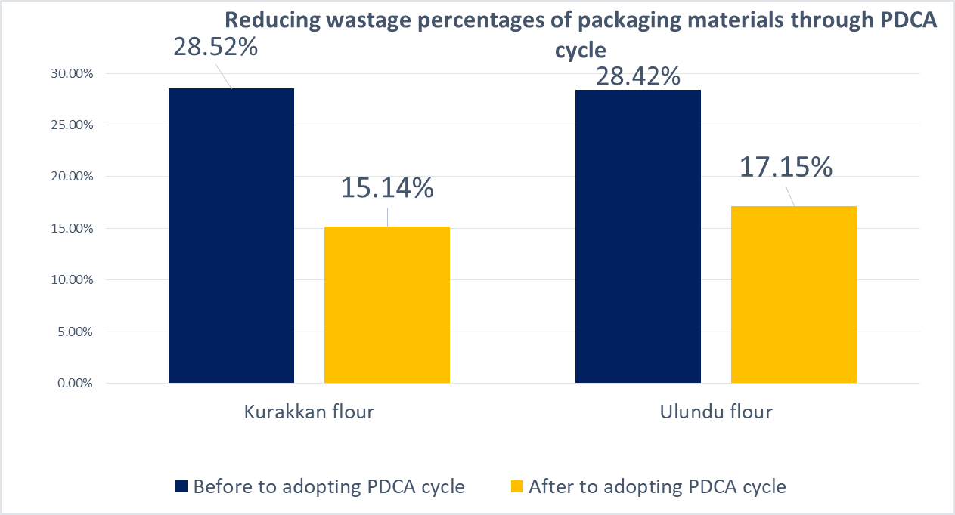
Results and Discussion
Objective 04-To apply PDCA cycle technique to overcome the high wastage percentages of the packaging materials in the grinding mill section.
In two months after adopting PDCA cycle Kurakkan flour production line was shown 13.4% of reduction in packaging wastage percentage.
Ulundu flour production was shown 10.91 % of reduction. To solve the problem with high packaging materials wastage in the grinding mill section, PDCA cycle was used.
Through adopting to PDCA cycle, grinding mill section had achieved good position by minimizing wastage percentages of packaging materials.
Figure 5- Reducing wastage percentage through PDCA cycle

Slide 15
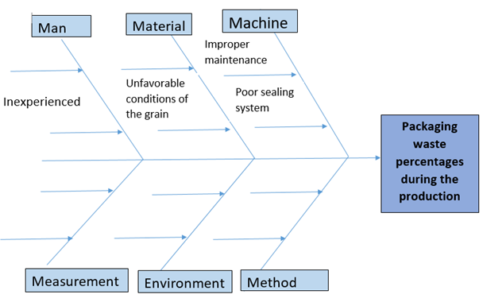
Results and Discussion
According to Ishikawa diagram mainly man/workers, materials and machines like root causes were impacted for this packaging wastage of the grinding mill section.
Figure 6- Ishikawa diagram for identification of root causes

Slide 16
Conclusion and Recommendations
Resources, education background, lack of experience and working stress have an impact on the complaints on the failures/defects of the products .
Kurakkan flour production was shown high packing materials wastage percentage (28.52% ).
As the results of the FMEA analysis in grain flour product processing line, Incorrect labelling, poor sealing, incorrect gas filling inside the packets and quality failures of raw materials were shown high RPN values.
Kurakkan flour packing materials waste percentage was decreased by 13.4% and Ulundu flour packing materials waste percentage was decreased by 11% in the grinding mill section using PDCA cycle.
There are workers, machines and raw materials. Supervisors should check whether to employees, machines and raw materials follow the recommended guidelines.
As well as a researcher recommends the PDCA cycle to overcome the failures/defects in the production line.

Slide 17
References
Arabian, H. H., Oraee, H., & Tavner, P. J. (2010). Failure Mode and Effect Analysis (FMEA) for wind turbine. International Journal of Electrical Power and Energy Systems, 32(7), 817-824.
Ates, A., Garengo, P., Cocca, P., & Bititci, U. (2013). The Development of SME Managerial Practice for EffectivePerformance Management. Journal of Small Business and Enterprise Development, 20(1), 28–54.
Burlikowska, M. D. (2011) Application of FMEA method in enterprise focused on quality.Journal of Achievements in Materials and Manufacturing Engineering, 45(1), 89-102.
Casea, K., Norb, A., & Teohc, P. C. (2010). A diagnostic service tool using FMEA.International Journal of Computer Integrated Manufacturing, 23(7), 640 – 654.
Cole, R. E. (2002). From continuous improvement to continuous innovation. Total Quality Management & Business Excellence, 13(8), 1051-1056.
Enkel, E., Bell J. & Hogenkamp H., (2011), Open Innovation Maturity Framework. International Journal of Innovation Management, 15(6), 1161–1189.
European Commission. (2003). The New SME Definition: User Guide and Model Declaration. Official Journal of the European Union, 124, 36.

Slide 18
THANK YOU!

