Slide 1
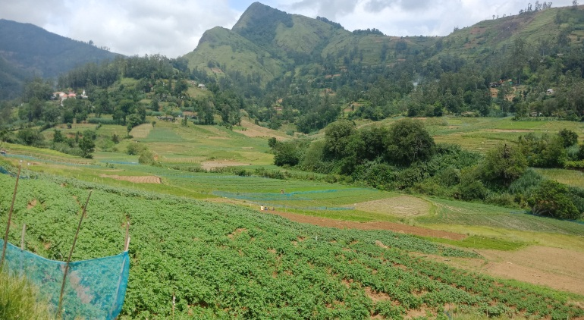
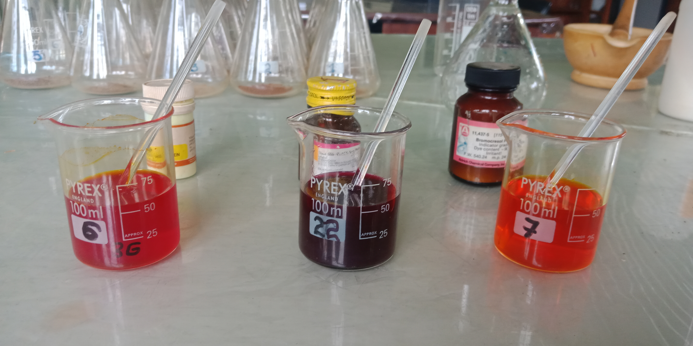
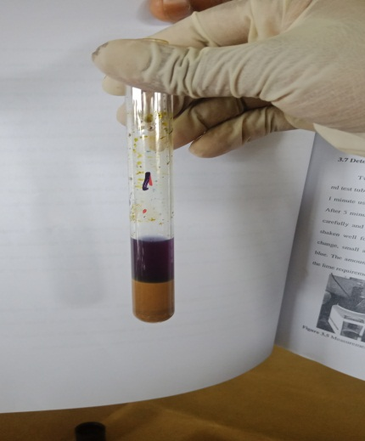
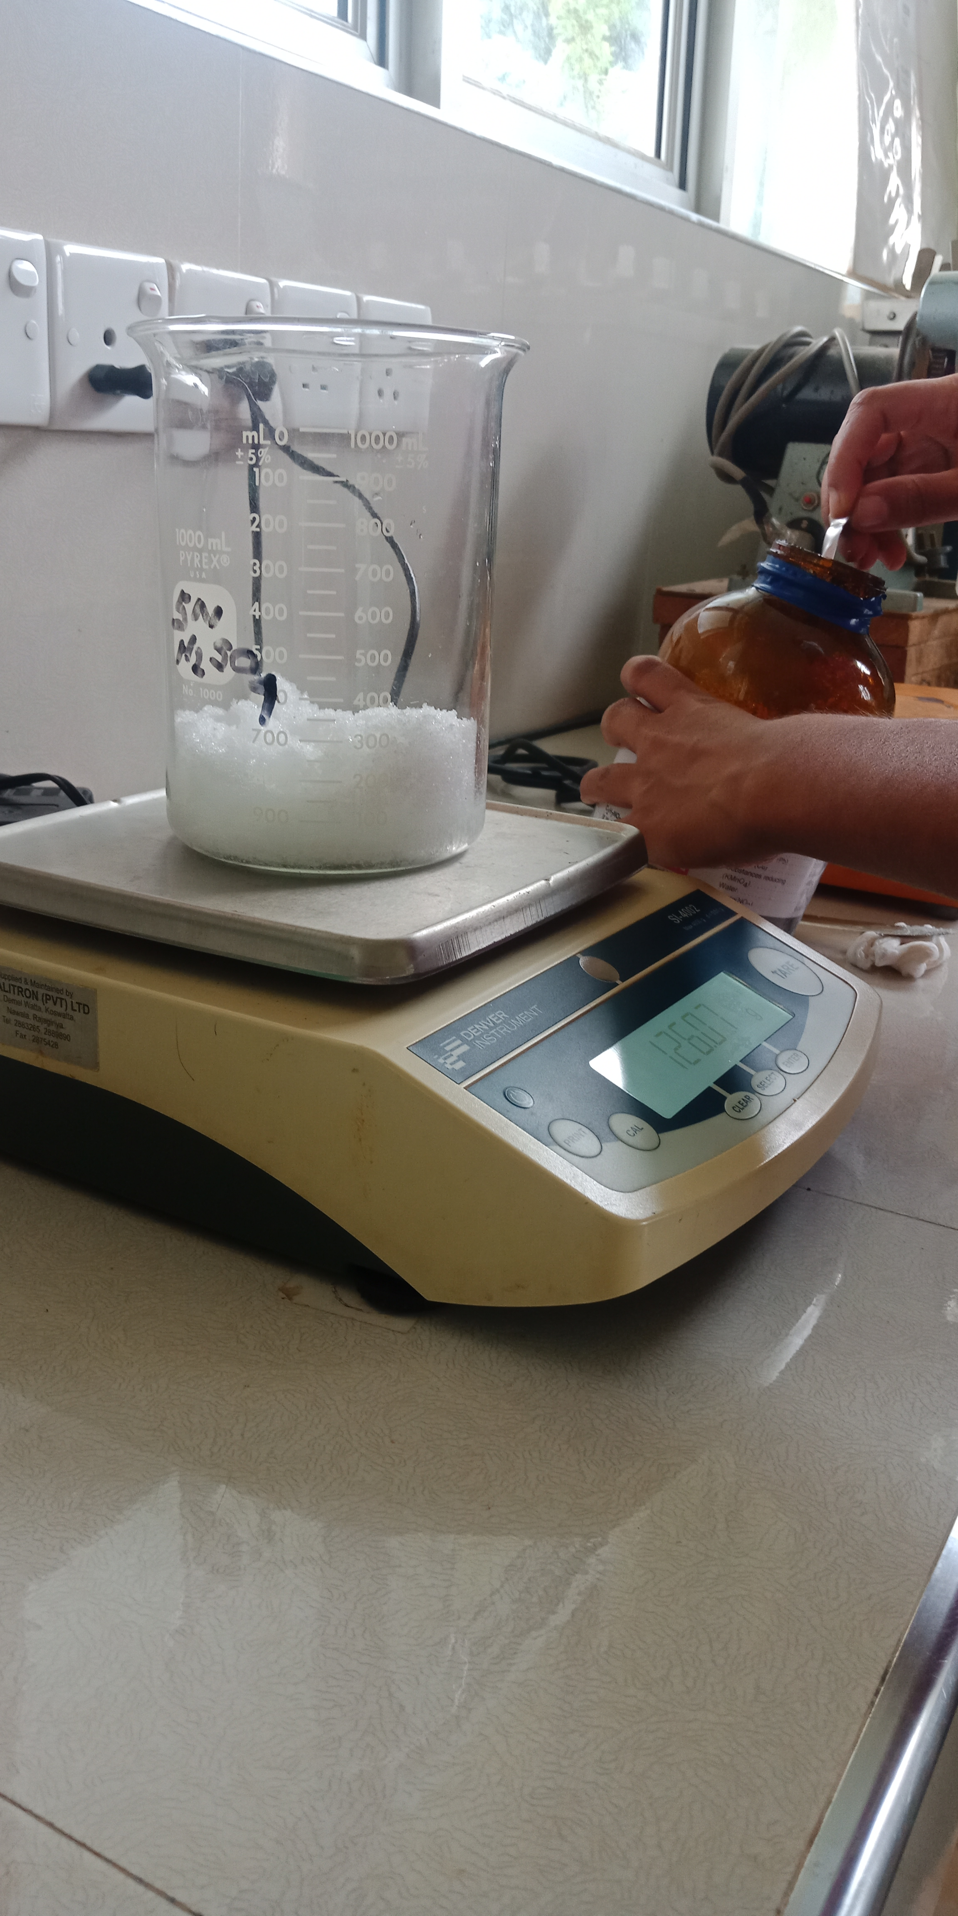
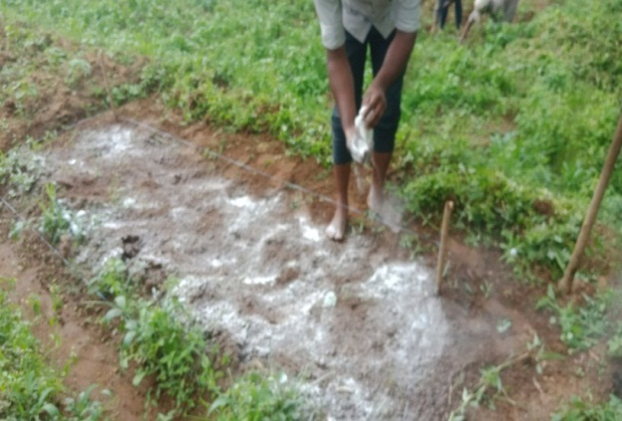
Field Validation by a Rapid Method to Determine Lime Requirement for Vegetable Cultivating Soils in Welimada ADA Segment
Marapana, W.M.W.S (16AGA1321)
Module: Crop Production Technology
Department of Export Agriculture
Faculty of Agricultural Sciences
Sabaragamuwa University of Sri Lanka

Slide 2
Content
Introduction
Methodology
Objectives
Results and Discussion
Conclusion
Suggestions
References

Slide 3
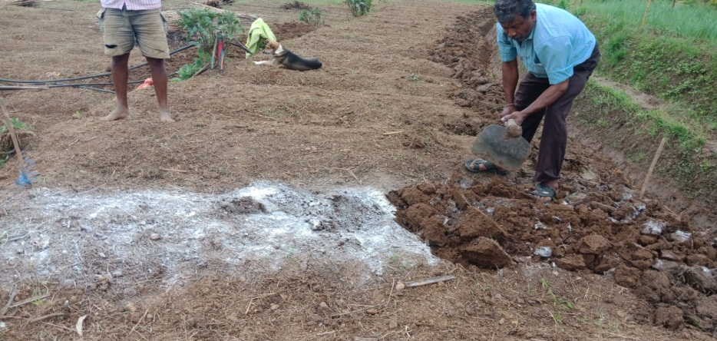
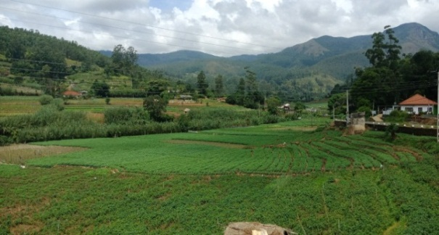
Introduction
Welimada region is one of the leading potato and vegetable growing area in upcountry region
Soil acidity is a major reason to reduce the crop productivity which may causes due to high rainfall and excessive fertilizer applications
Practical solution to remediate soil pH: Liming

Slide 4
Objectives
General objective
To validate previously developed rapid method for estimate lime requirement to increase soil pH up to 6.4 ± 0.2 in potato and vegetable cultivated fields in Welimada Assistant Director of Agriculture segment
Specific objectives
To determine the initial soil properties (ex: soil pH, electrical conductivity (EC), cation exchange capacity (CEC), organic matter content, available potassium and phosphorous of selected soils)
To identify the relationship between soil pH with other tested soil properties

Slide 5
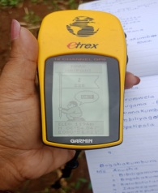
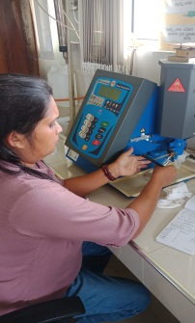
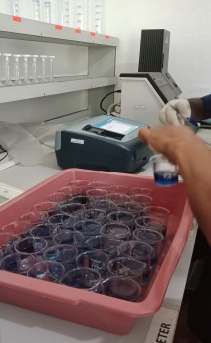
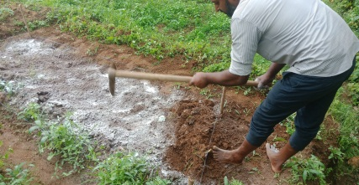
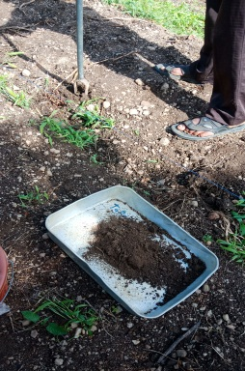
Methodology
1
Selected 45 sites
2
Collected the soil samples
3
Analyzed initial soil properties
4
Applied the required lime amount to the experimental sites by using newly established rapid method
5
Evaluated the existing pH after two weeks in treated soils
6
Data analyzed by using Minitab: Regression and correlation analysis

Slide 6
Parameters of initial soil samples
Methodology cont….
Parameter | Method
Lime requirement | by using newly developed method (Rajarathna et al., 2014)
Soil pH | by using pH meter
Cation exchange capacity | By ionic replacement method (Schollenberger method, 1945)
Soil electrical conductivity | by using EC meter
Soil organic matter | By titrimetric method (Walkley and Black method, 1934)
Available potassium | by using flame photometer method
Available phosphorous | by using Olsen method

Slide 7
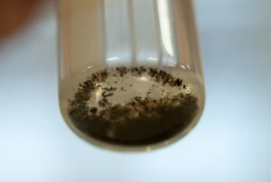
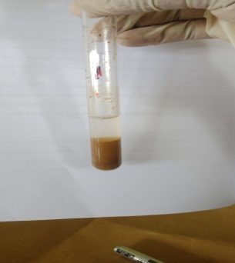
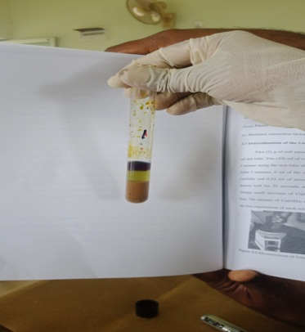
New method of calculating lime requirement
Methodology cont….
1
Soil was grinded and passed through a 2mm sieve
2
1.5g of soil sample was weighed into a 25ml test tube
3
5ml of extractant was added and shaken the tube for 1 minute
4
A drop of mixed indicator was added and observed the color change (No lime if color change to blue)
5
Neutralizing solution (Calcium hydroxide) drops and one drop of indicator were added and shaken for 1 minute
6
If color change to blue, calculate the lime requirement

Slide 8
Calculation of lime requirement
Methodology cont….
Required amount of Ca(OH)₂ to react to react with 5ml of extractant = x ml
Amount of soil = 1.5g
Required amount of Ca(OH)₂ to react to react with 1.5g of soil = x ml × 5ml = y ml
4ml
Required amount of Ca(OH)₂ to react to react with 1.5g of soil = (1000g/1.5g) × y ml
=1000y ml
Concentration of the prepared Ca(OH)₂ solution =15.42g/l
Amount of saturated Ca(OH)₂ react with 1Kg of soil = 1000y ml× 15.42g
1000ml
= z g

Slide 9
Methodology cont….
Bulk density of Bandarawela series of soils is 1.2 Mg/m³ (Mapa et al., 2005) and the effective soil depth is 0.1524m.
Soil volume of 1ha = soil depth × Area
= 0.1524 ×10000m²
= 1524 m³
Weight of 1ha of soil = Soil volume × Bulk density
= 1524m³ × 1.2 Mg/m³
= 1828.8 Mg

Slide 10
Calculated lime amounts
Methodology cont….
Blanket recommendation

Slide 11
Data analysis
Methodology cont….
Regression and correlation analysis were done by using Minitab-14 software
Graphical analysis were done by using Microsoft excel package

Slide 12
Results and Discussion
Distribution of initial soil pH and other properties

Slide 13
Result and discussion cont….

Slide 14
Response of soil after liming
Result and discussion cont….
Residual mean square error (RMSE) in initial pH was 0.13 (high variation) and final pH was 0.07 (minimum variation). The standard deviation in initial pH was 0.61 and final pH was 0.18. Therefore, this lime requirement method is significantly affected to all soils whatever initial pH.

Slide 15
According to the literature…….
Result and discussion cont….
Soil pH increased significantly with increasing levels of applied lime (Moody and Cong, 2008; Adane, 2014; Jafer and Hailu, 2017; Ryan, 2018)
Application of lime at an appropriate rate brings several chemical and biological changes in the soils which are beneficial or helpful in improving crop yields on acid soils (Geremew, Bedadi and Wogi, 2020)
Due to soil acidification some negative effects may appear in soil such as depletion of base nutrients (Dubikova, Cambier and Sucha, 2002)

Slide 16
Correlation of soil chemical properties
Result and discussion cont….
 | Initial pH | Electrical conductivity | Available Phosphorous | Available Potassium | Lime requirement | Organic matter | Cation exchange capacity
Electrical conductivity | -0.338*
Available Phosphorous | 0.168 | 0.298*
Available Potassium | 0.369 * | 0.220 | 0.358*
Lime requirement | -0.902** | 0.351* | -0.014 | -0.247
Organic matter % | 0.034 | 0.102 | -0.177 | 0.093 | 0.007
Cation exchange capacity | 0.246 | 0.058 | 0.084 | 0.220 | -0.088 | 0.790**
Final pH | 0.543** | -0.305* | -0.093 | 0.226 | -0.537 ** | 0.160 | 0.208
*Significant at p = 0.05 level; **Significant at p = 0.01 level

Slide 17
According to the literature……
Result and discussion cont….
Available potassium is low at extremely acidic soils due to the different reactions in the soil which fix the nutrients and transform them to the state that is unavailable for the plants (Brady and Weil, 2002)
High lime required soils, having the lowest pH and consequently the productivity decreases over time (Crawford et al., 2008)
Increased the pH after liming significantly (Rajarathna et al., 2014)
Strongly acidic solution will have high conductivity since the pH is a measure of the concentration of the Hydrogen ions, for an acidic solution, the lower the pH the greater the conductivity (Sahoo, 2014)
Cation exchange capacity represents the total amount of exchangeable cations that a soil can adsorb to its surfaces at the actual pH of the soil (Brady and Weil, 2016)

Slide 18
Regression analysis between initial pH and soil chemical properties
Result and discussion cont….
y = 6.22 - 8.63 X
R² = -0.338
Y= 5.44 + 0.00154x
R²= 0.168
Y = 6.33 - 0.00116x
R² = -0.902
Y= 5.22 + 0.00205x
R²= 0.369

Slide 19
Result and discussion cont….
Y = 5.60 + 0.033x
R² = 0.034
Y = 5.34 + 0.0154x
R² = 0.246
Y = - 3.36 + 1.40x
R² = 0.543
R² = -0.338

Slide 20
Conclusion
Calculated lime amounts were significantly impact for pH increase in most of sites (39 sites out of 45) and reach to the expected reference pH value. Therefore, this newly established lime requirement rapid method can be applied in the farmer fields in Welimada ADA segment
Lime requirement and initial pH, initial pH and final pH, lime requirement and final pH values have highly significant correlations

Slide 21
Suggestions
Repeat this experiment for other areas
Determine the crop performances with applying this lime requirement calculating method

Slide 22
References
Adane, B. 2014 ‘Effects of liming acidic soils on improving soil properties and yield of haricot bean’, Ethiopian Institute of Agricultural Research, Holetta ARC, Addis Ababa, Ethiopia
Brady, N.C., Weil, R.R. 2002 ‘The Nature and Properties of soils’, 13th Edition, Pearson Education Pvt. Ltd., Delhi, India
Weil, R. and Brady, N. C. 2016 ‘Nature and Properties of Soils’, Pearson New International Edition, London: Pearson Higher Ed., Delhi,India
Crawford T.W., Singh, U., and Breman, H. 2008 ‘Solving agricultural problems related to soil acidity in central Africa's great lakes region’, International center for soil fertility and agriculture development, Alabama
Dubikova, M., Cambier, and P., Sucha, V. 2002 ‘Experimental soil acidifcation’;17,.245–257
FAO.org, 2015.soil properties| FAO | Food and Agriculture Organization of the United Nations. [0nline] Available at: http://www.fao.org/soils-portal /soil-survey/soil-properties/en/ [Accessed 2 Aug. 2022]

Slide 23
Geremew, T., Bedadi, B., Wogi, L. 2020 ‘Applications of lime and phosphorus fertilizer to malt barley for improved yield and soil acidity at Welmera district’, Ethiopia ;11: 39-50
Jafer, D.G., Hailu, G., 2017 ‘Application of lime for acid soil amelioration and better soybean performance in South Western Ethiopia’;7,.95–100
Mapa, R.B., Dissanayake, A.R., Nayakekorale, H.B. 2005, ‘Soils of the intermediate zone of Sri Lanka: Morphology, Characterization and classification’, Soil Science Society of Sri Lanka, Peradeniya, Sri Lanka,120-200
Moody P.W., Cong P.T. 2008 ‘Soil constraints and management practice: guidelines for Sustainable management for tropical upland soils’ [online]: Available at: https://aciar.gov.au/publication/books-and-manuals/soil-constraints-and-management-package-scamp-guidelines-sustainable-management [Accessed 6 Nov. 2022]
Rajarathna, I.M.L.V., Kodikara, K.M.S., Wanniarachchi, S.D. 2014, ‘Developing a rapid method for calculating the lime requirement for Upcountry Intermediate Zone Soils’, International Symposium on Agriculture and Environment, university of Ruhuna

Slide 24
Ryan, P.R. 2018 ‘Assessing the role of genetics for improving the yield of Australia’s major grain crops on acid soils’, Crop Pasture Sci.,242–264
Sahoo, P., 2014. Research Gate. [Online] Available at: https://www.researchgate.net/post/Is_there_any_relationship_between_pH_and_conductivity_of_a_solution [Accessed 7 Dec. 2022]

