Slide 1
Effect of Alternative Organic and Inorganic Potting Mixtures on Early Growth of Black Pepper (Piper nigrum L) Nursery Plants.
D.M.S.S. Dissanayake (16AGA1220)
Module: Agri Environmental Resource and Management
Department of Export Agriculture
Faculty of Agricultural Sciences
Sabaragamuwa University of Sri Lanka
Internal Supervisor:
Prof. P.I Yapa
Department of Export Agriculture
Faculty of Agricultural Sciences
Sabaragamuwa University of Sri Lanka
External Supervisor:
Mrs. T. E. Weerawardena Deputy Director (Research) Soil and Plant Nutrition Division Central Research Station Department of Export Agriculture Matale

Slide 2
Content
Introduction
Problem statement
Objectives
Materials & Methods
Results and Discussion
Conclusion
Suggestion
References

Slide 3
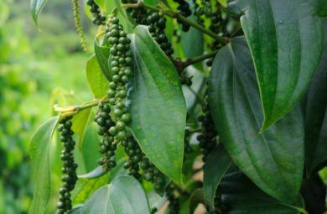
Introduction
Black Pepper (Piper nigrum L.) is a perennial climbing vine
Family - Piperaceae
Known as “King of spices”
Second mostly produced spice in Sri Lanka
It can generally be cultivated in low & mid country, wet & Intermediate agro-climate zones
Pepper is cultivated through cuttings

Slide 4
Problem statement
DEA recommended potting media of the nursery for Pepper
Top soil: sand: cow dung: coir dust
(1:1:1:1)
Pepper planting material producers are looking for an alternate potting mixture due to the expensiveness of cow dung, coir dust and sand
Cost of production is high
low quality planting materials due to poor quality potting mixtures

Slide 5
Problem statement Cont.…
Need alternates to replace coir dust and cow dung because it’s difficult to find in some regions
A previous research has revealed out that Topsoil: Coir dust: Sand in ratio 2:1:1 with added phosphate fertilizer (1 g of Diammonium phosphate /pot) also effective in the absence of cow dung in the medium

Slide 6
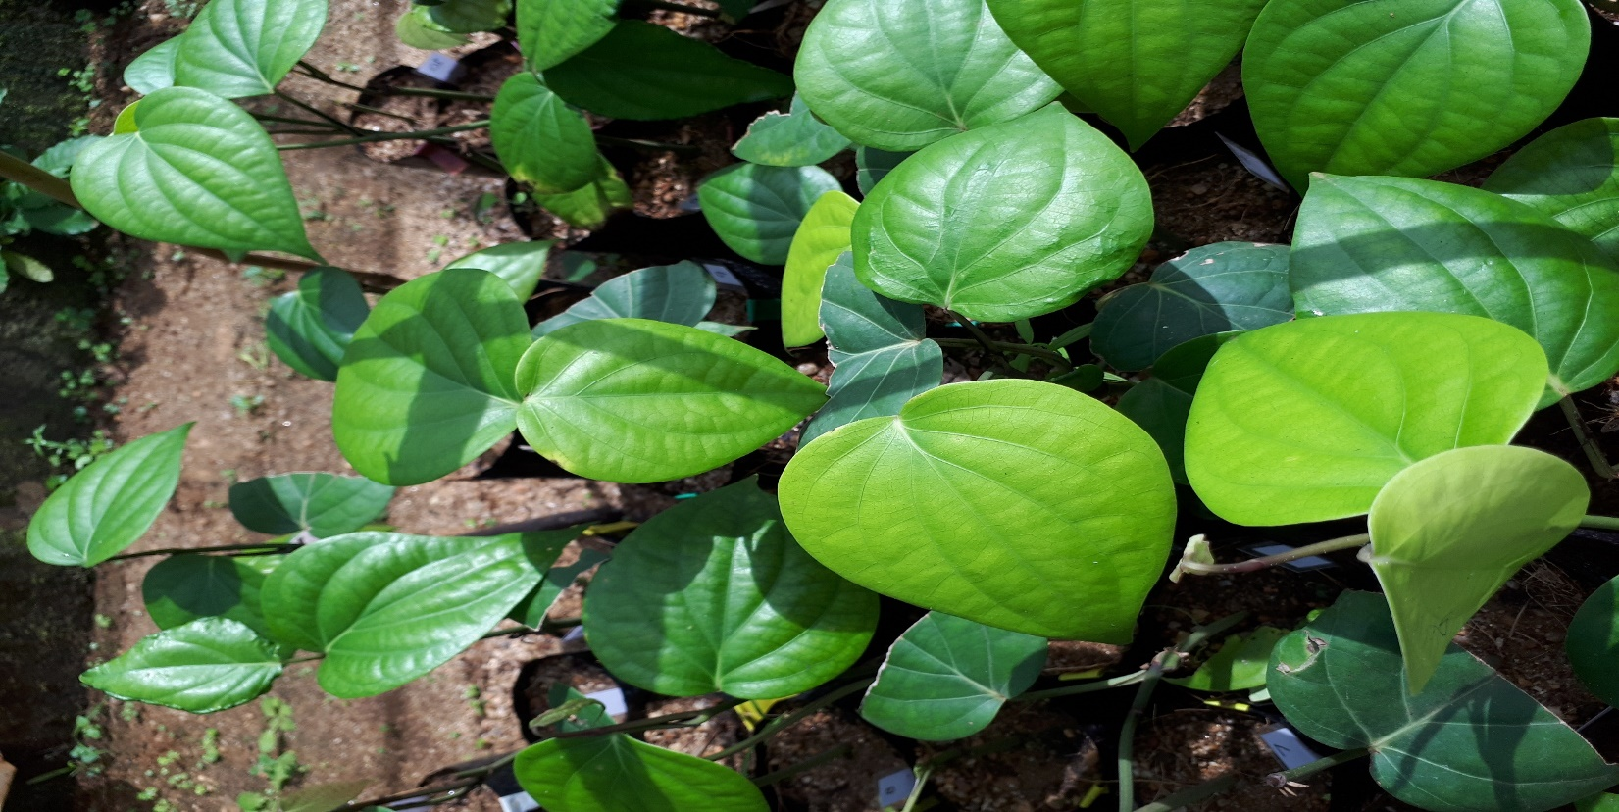
Objectives
General Objective
To find out alternative materials for potting mixtures to overcome unavailability of cow dung, sand and coir dust in black pepper potting mixtures
Specific objectives
To find out the effectiveness of partially burnt paddy husk (Biochar paddy husk), decomposed sawdust and di-ammonium phosphate as alternative materials for coir dust and cow dung on early growth of black pepper plants
To find out chemical properties of alternative potting mixtures
To overcome problem association with shortage and high cost of cow dung and coir dust in black pepper potting mixtures

Slide 7
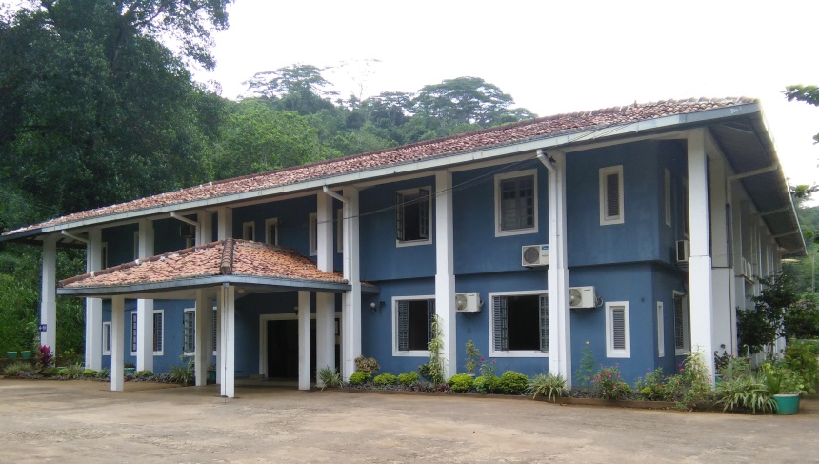
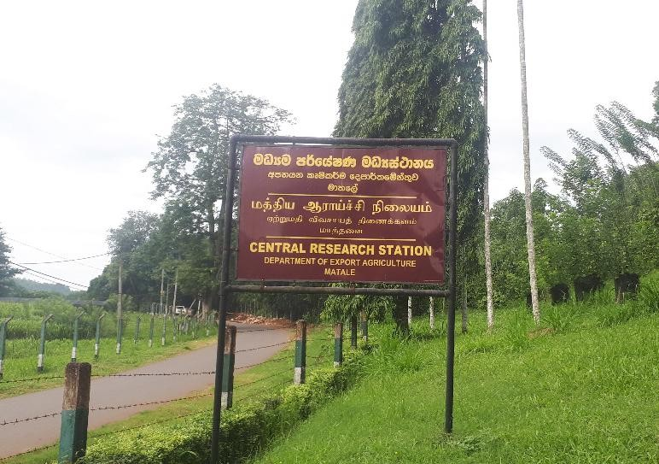
Material and Methods
Central Research Station (CRS), Department Export Agriculture, Matale, Sri Lanka
Location of study site -
Selection of Pepper cuttings
Preparation of pots and establishment of cuttings
Preparation of pots for planting
Preparation of the potting mixture
Maintenance of cuttings in pots

Slide 8
Material and Methods cont.
Preparation of pots for planting
Preparation of the potting mixture
Maintenance of cuttings in pots
Preparation of pots for planting
Preparation of the potting mixture
Maintenance of cuttings in pots
- Cuttings established in 8" length and 5" width black or transparent
polythene bags with a gauge of 250
- Top soil, cow dung, sand, coir dust, degraded saw dust, diammonium phosphate and bio char paddy husk required for making potting mixtures
- Cuttings established in the potting mixtures
- Planted pots placed in a propagator & maintained 85%-90% humidity and 40%-50% sunlight

Slide 9
Material and Methods cont.
Treatments :Materials mixed as parts /volume
 | Top Soil | Coir Dust | Decomposed Cow dung | Sand | Diammonium Phosphate (DAP) | Partially burnt Paddy husk | Decomposed Saw dust
T 1 (control1) | 1 | 1 | 1 | 1
T 2 (control 2 ) | 2 | 1 |  | 1 | 1g/pot
T 3 | 1 |  | 1 | 1 |  | 1
T 4 | 2 |  |  | 1 | 1g/pot | 1
T 5 | 1 |  | 1 | 1 |  |  | 1
T 6 | 2 |  |  | 1 | 1g/pot |  | 1

Slide 10
Material and Methods cont.
Experimental Design - RCBD
T 3
T 1
T 6
T 2
T 5
T 4
T 5
T 6
T 3
T 4
T 2
T 1
T 2
T 5
T 4
T 6
T 1
T 3
Block 1
Block 2
Block 3
Number of Plants per Treatment - 150 Number of Blocks - 3 Plot size - 50 Total no of plants required for the experiment – 900
10

Slide 11
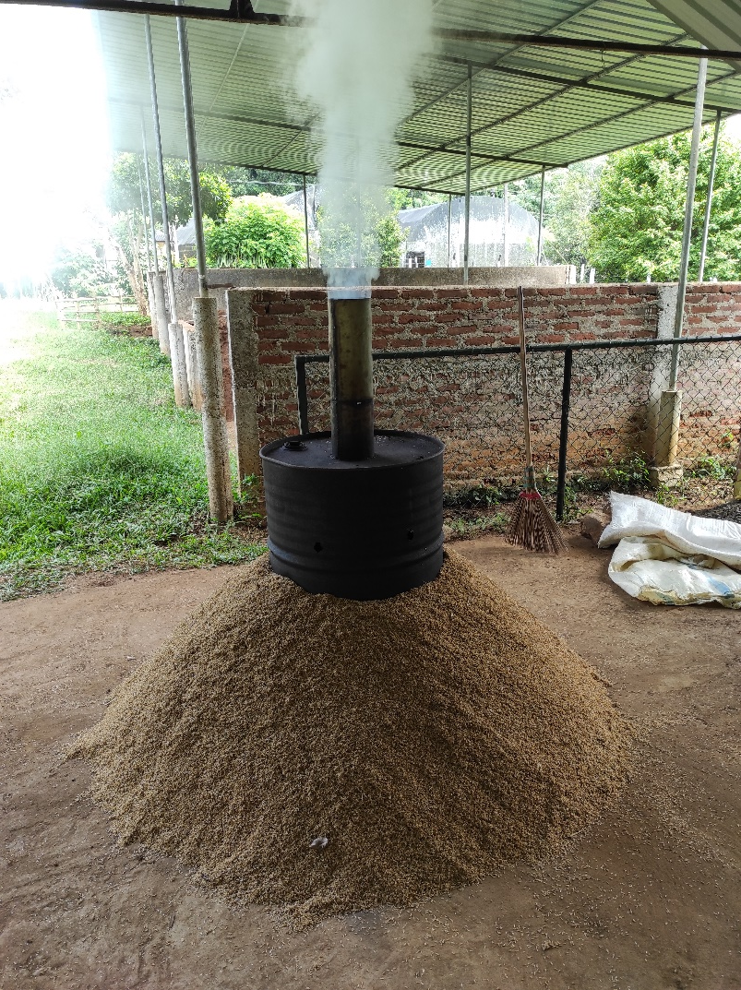
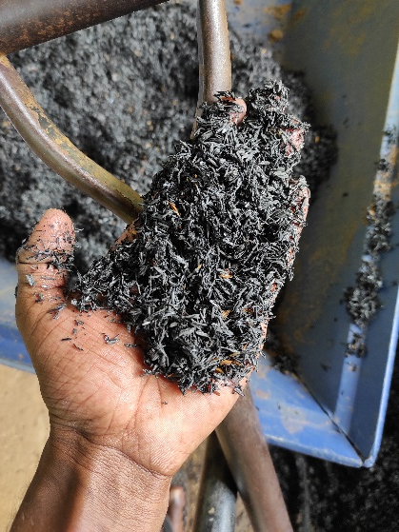
Material and Methods cont.
Preparation of Bio Char Paddy Husk (Chimney method)
Make sure to maintain 350⁰C-550⁰C during this pyrolysis process

Slide 12
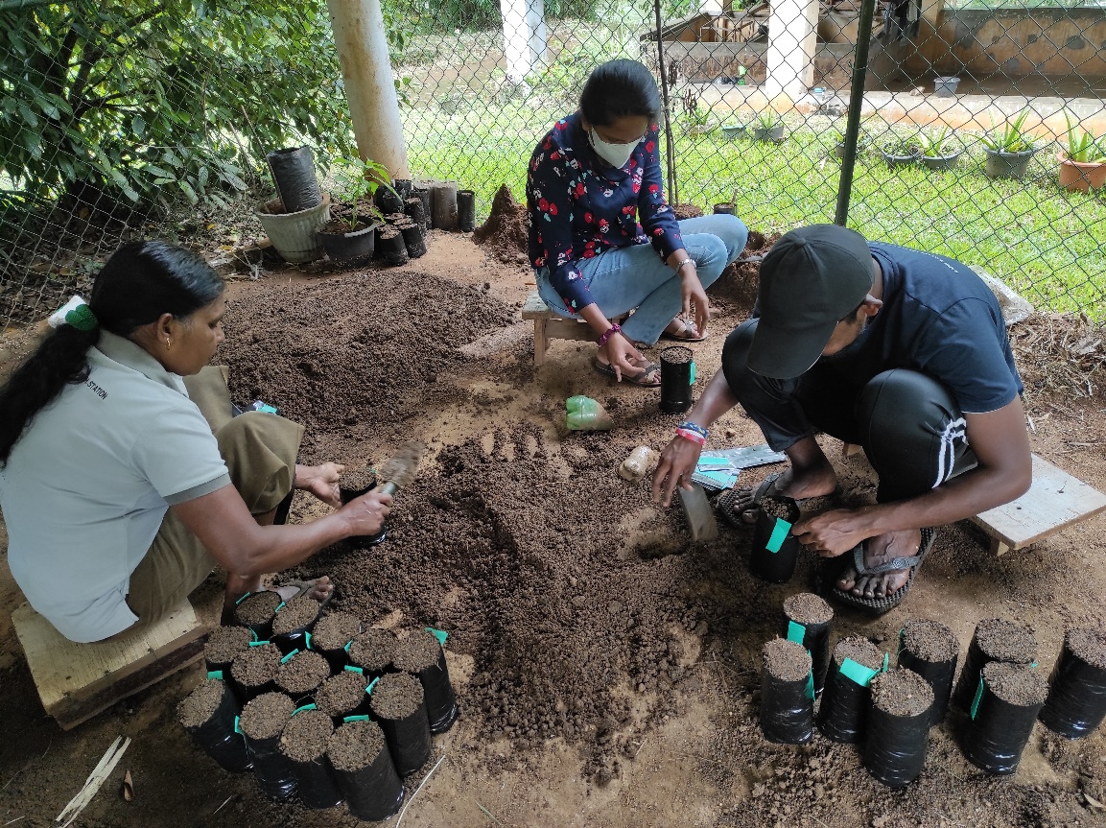
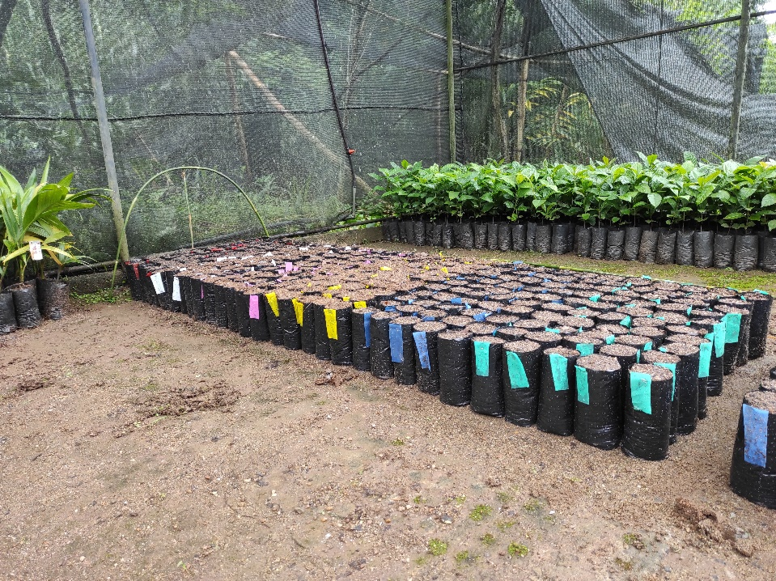
Material and Methods cont.
Preparation of poly bags and randomization
Filling up the poly bags using the prepared potting mixtures
Randomized arrangement of bags according to the block wise manner

Slide 13
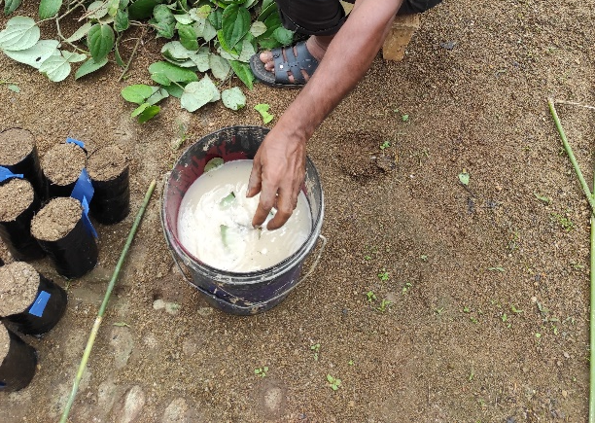
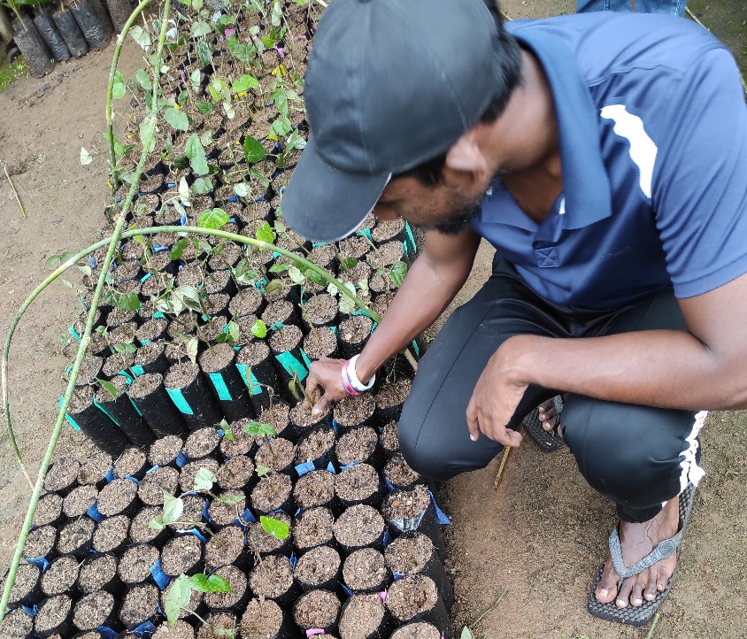
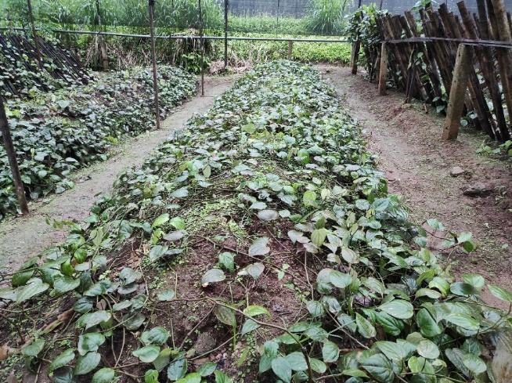
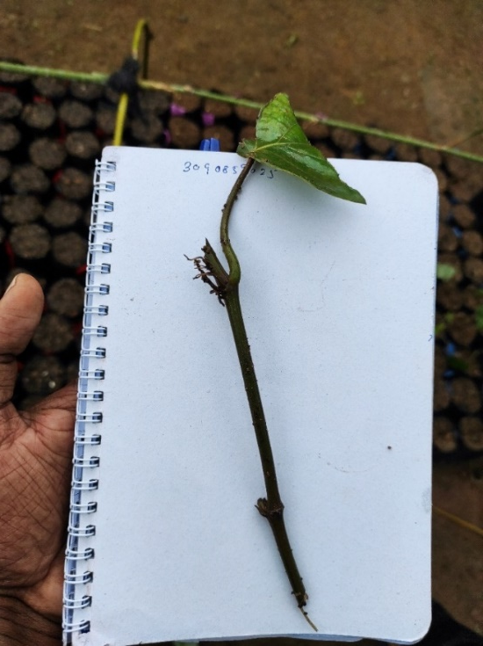
Material and Methods cont.
Dipped the Captan solution
Mother bushes
Establishment of cuttings in poly bags
Cuttings that contained 2 nodes

Slide 14
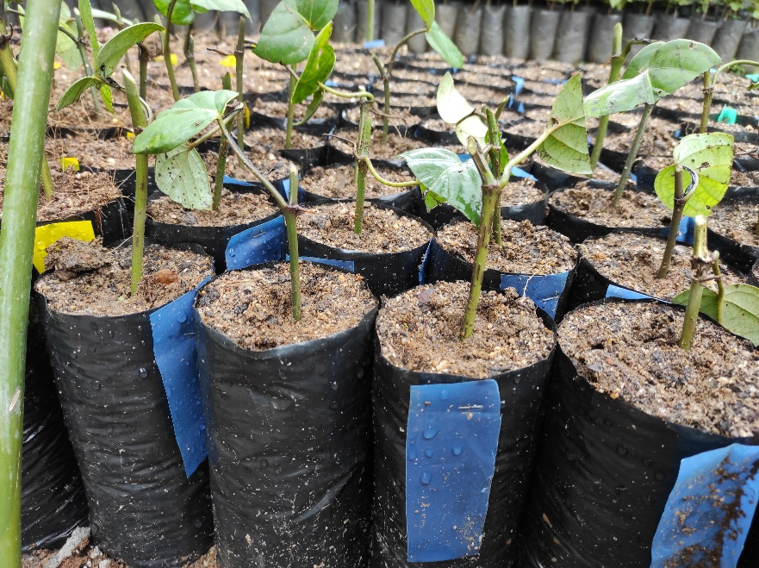
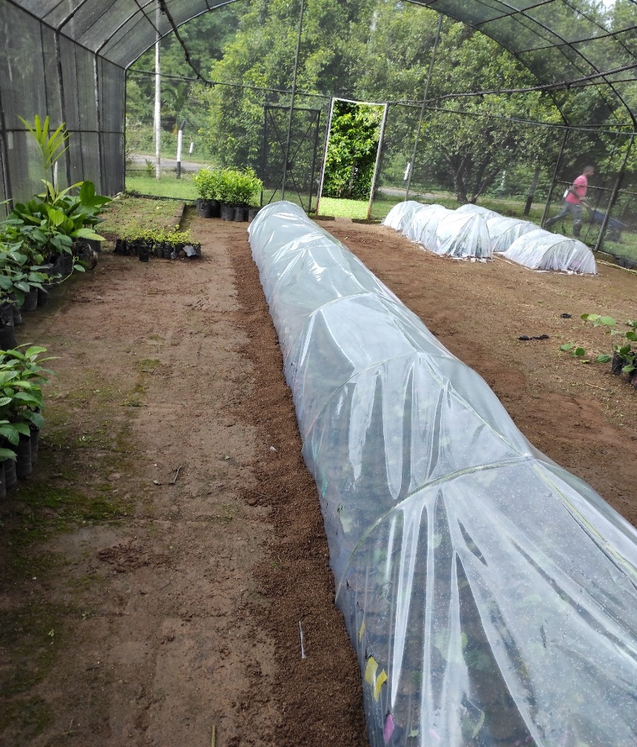
Material and Methods cont.
Pots that contained cuttings
Propagation of pots (2022/09/06)
Propagator was closed for 21 days and data was taken after 21 days

Slide 15
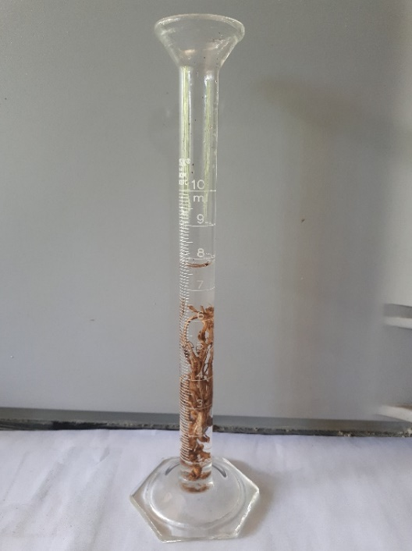
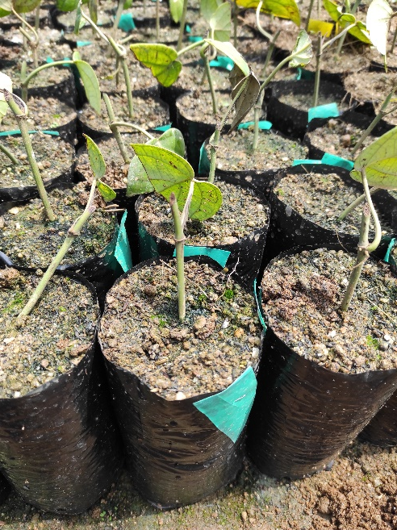
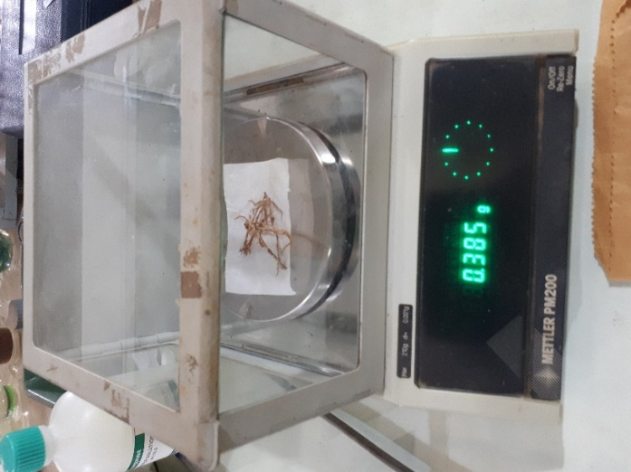
Material and Methods cont.
Data Collection
Survival Count (%)
Growth of plants (Above ground)
Shoot length (cm)
Number of leaves
Intermodal length (cm)
Destructive data (Below ground)
Root length (cm)
Root fresh weight (g)
Root dry weight (g)
Root volume (ml)
Shoot fresh weight(g)
Shoot dry weight (g)

Slide 16
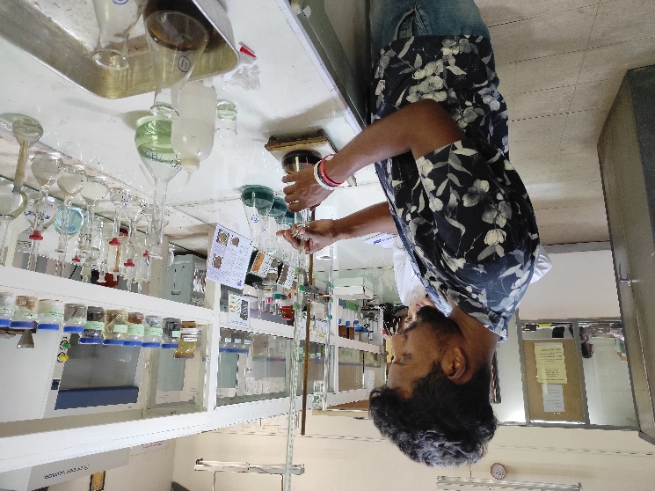
Material and Methods
Data Collection
3. Properties of potting media
pH - pH meter (1:2.5 Soil: water suspension)
EC - Electrical conductivity meter (1:2.5 Soil: water suspension)
Organic Carbon (%) – by Walkey and Black method
Total Nitrogen content (%) – by Kjeldhal method
Available phosphorus content (ppm) – by Olsen method
Exchangeable K content (ppm) – by Atomic Absorption Spectrophotometer

Slide 17
Material and Methods cont.
Data analyzing
Analysis of Variance (ANOVA) with General Linear Model (GLM) procedure of SAS, followed by Least Significant Difference test using Statistical Analysis Software (SAS) version 9.0
Graphical illustrations were done by Microsoft Excel 2016

Slide 18
Results and Discussion
Average Survival Count (%)

Slide 19
Results and Discussion cont.
P > 0.05
Mean Number of Leaves
Mean Shoot Length (cm)
Not Significant
a
a
a
a
a
a
a
a
a
a
a
a

Slide 20
Results and Discussion cont.
Mean Intermodal Length (cm)
P < 0.05
Significant
a
a
Significant difference see in between RPM (T1) with APM with saw dust (T5)
Except these two, others show no show significant difference
ab
a
a
b

Slide 21
Results and Discussion cont.
Mean Shoot Dry Weight (g)
P > 0.05
Mean Root Dry Weight (g)
Not Significant
a
a
a
a
a
a
a
a
a
a
a
a

Slide 22
Results and Discussion Cont.
P > 0.05
Mean Root Volume (ml)
Mean Root Length (cm)
Not Significant
a
a
a
a
a
a
a
a
a
a
a
a

Slide 23
Results and Discussion Cont.
Mean Electrical Conductivity (Micro Siemens)
Mean Soil pH
EC value, RPM mixture is high in fourth week
With the time, EC level decrease every treatment
Slightly change can be see in every treatment along with time

Slide 24
Results and Discussion Cont.
P < 0.05
Mean Available
Phosphorus (mg/kg)
P > 0.05
Mean Total Nitrogen (%)
Significant
Not Significant
a
a
a
a
a
ab
a
a
bc
a
c
c
T1,T3,T5 don’t show significant among each other
T2,T4,T6 don’t show significant difference among each other ,T1,T3,T5 which contain cow dung show significant difference again T2,T4,T6 that contain DAP.

Slide 25
Results and Discussion Cont.
Mean Exchangeable Potassium
(mg/kg)
Mean Organic Carbon (%)
P > 0.05
Not Significant
a
a
a
a
a
a
a
a
a
a
a
a

Slide 26
Conclusion
Recommended potting mixture by the DEA, Top soil: cow dung: coir dust: sand in 1:1:1:1, is the best as a nursery potting mixture among the mixture used in terms the growth of seedlings
Recommended potting mixture with Top soil: coir dust: sand in 2:1:1 and 1g of Diammonium phosphate (DAP)/pot is suitable to enhance early growth of black pepper nursery cutting in the absence of cow dung
Alternative recommended potting mixture with coir dust, Alternative potting mixture with bio char paddy husk, Alternative potting mixture with decomposed sawdust are ideal as alternative potting mixture for black pepper nursery plants as cost-effective mixtures

Slide 27
References
Anon, (2018). EAC Stat Book- 2018, Statistics Unit, Department of Export Agriculture. Department of Government Printing, Sri Lanka.
Anon, (2015). Pepper Technical Bulletin no: 04, Department of Export Agriculture. Department of Government Printing, Sri Lanka.
Swarnathilaka D. B. R., Kularathne R. S., Rasika Nilantha K. A., (2013). Evaluation of a low cost potting mixture for Black Pepper (Piper nigrum L.). In: proceedings – Annual Symposium on Minor Export Crops- ASMEC (Ed: B. Marambe), Peradeniya, Sri Lanka., 38-44.
Shantha K. G. P., Samaraweera D. N., Silva S. I. C., Chandrarathna W. M., (2018). Evaluation pf Different Potting Mixtures for Nursery Producion of Betel (Piper betle L.) stem cuttings. In: proceedings – Annual Symposium of Export Agriculture Crops (Ed: B. Marambe), Peradeniya, Sri Lanka., 28-35.
Thankamani, C.K., Sirinivasan, V., Hamza, S., Kandiannan,, K., Mathew, P. A., (2006). Evaluation of nursery mixture for planting material production in black pepper (Piper nigrum L.). Journal of Spices and Aromatic Crops, 16 (2) : 111–114.

Slide 28
Thank You !

