Slide 1
Impact of Digital Marketing on the Performance of SMEs: Special Reference to Kandy District
MAEK Jayasinghe^{1*}, DAM De Silva¹, SW Gamage²
¹Department of Agribusiness Management, Faculty of Agricultural Sciences, Sabaragamuwa University of Sri Lanka
²Chamber of Commerce & Industry of Central Province, Sri Lanka

Slide 2
Content
Introduction
Research Problem
Objectives
Material and Methods
Results and Discussion
Conclusion and Recommendations
References

Slide 3
Introduction
Small and medium-sized enterprises (SMEs) are crucial to the success of any economy because they generate employment, contribute to increasing GDP, engage in innovation, and encourage other economic activity
In Sri Lanka, a broader area is covered by SMEs such as Agriculture, Manufacturing (mining, construction etc.) and services (trade, transportation, education, healthcare activities, professional services etc,)
Kandy District is playing a crucial role in the development of the central region of Sri Lanka and it has a manufacturing & agriculture based economy all over the district.
There are 6144 firms registered and 60,836 people are engaged in those SMEs (Department of Census and Statistics 2013 / 2014 ) in Kandy and due to the Covid 19 pandemic, it is revealed that business owners are trying to switch to digital marketing tools instead of traditional approaches to marketing (Mehralian and Khazaee, 2022)

Slide 4
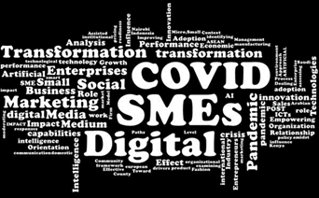
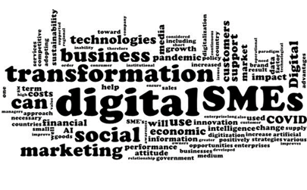
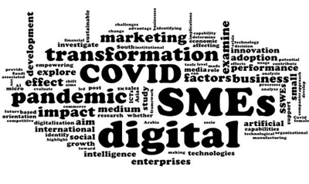
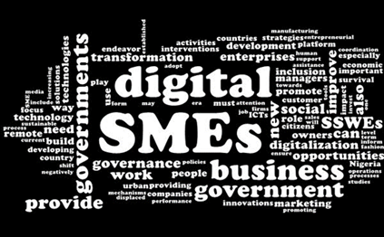
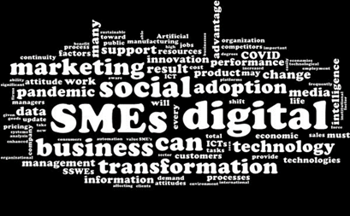
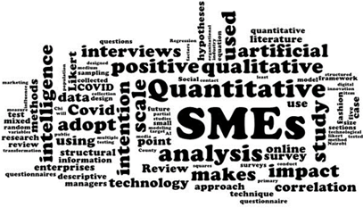
Research Problem
The adoption of digital marketing channels is likely to be more successful in large enterprises than the small (Lipiainen & Karjaluoto, 2018) but no accurate information is present with regards to digital usage by SMEs
It is important to find out the Impact of Digital Marketing Assisted by Artificial Intelligence (AI) on the Performance of SMEs
This research investigation seeks to address the relationship between Digital Marketing tools of SMEs with the performance of their firms
Fig A.Word clouds based on literature
BSc. Agricultural Sciences and Management: Department of Agribusiness Management

Slide 5
Objectives
Broad Objective
To explore the Impact of Digital Marketing on the Performance of SMEs based on growth , profitability and customer satisfaction.
Specific Objectives
To explore the use of digital marketing tools among SMEs in selected DS divisions of Kandy
To explore factors that influence moving from non-digital tools to digital tools for marketing
To examine the relationship between digital marketing tools and SMEs' performance

Slide 6
Material and Methods
Research Location
Research Approach
Research Strategy and type
Data Collection Method
Data Analysis Method
Data Analysis Tool
Sample Size
Kandy District
08 Divisional Secretariats
Survey method
Explanatory (Quantitative) Research
Deductive Approach
Primary data (Structured Questionnaire, In-depth interviews)
Secondary data (Article, Magazines, Research Journals )
Quantitative analysis
SPSS
Microsoft Excel
213 SMEs

Slide 7
Results and Discussion
Objective 01
54.9% of businesses currently use both digital marketing and traditional marketing methods for marketing, while 38.5% use only digital marketing methods
Only 6.6% use traditional marketing
Figure 1.1 Present marketing Strategy use by SMEs

Slide 8
Preference for digital marketing adoption/ shift from non-digital tools to digital tools
95.8% of SMEs owners prefer to switch from non digital to digital marketing tools/preferred fully adopting digital marketing tools
Only 4.2% prefer using traditionally marketing tools as they do already to their marketing practices
Figure 1.2 Preference for digital marketing adoption

Slide 9
Table 1.1 Digital tools usage by SMEs
Digital Marketing tools |  | Frequency | Percentage %
Website | Yes | 37 | 17.4
 | No | 176 | 82.6
Email | Yes | 8 | 3.8
 | No | 213 | 100
Facebook | Yes | 201 | 94.4
 | No | 12 | 5.6
Ticktock | Yes | 60 | 28.2
 | No | 153 | 71.8
Instagram | Yes | 93 | 43.7
 | No | 120 | 56.3
Whatsapp | Yes | 204 | 95.8
 | No | 9 | 4.2
Mobile phone | Yes | 145 | 68.1
 | No | 68 | 31.9
Majority of SMEs use Facebook and WhatsApp as marketing tools to promote their products and services

Slide 10
How digital tools help to improve performance
Figure 1.3 Digital marketing tools use to increase

Slide 11
Objective 02
Table 2.1 Results of Factors influencing moving from non-digital tools to digital tools.
Factor |  | Mean
Relative Advantage | We switch to digital tools because I, or the company's owners, see the relative advantages of doing so. | 3.85
External pressure | External pressure from competitors, suppliers, and customers has driven for Digital Marketing adoption. | 3.54
Availability of Resources | The availability of resources influences our decision to switch from non-digital to digital tool usage. | 3.41
Government decisions | The government decisions leads me to shift to digital tools | 3.42
Time effectiveness | Traditional marketing takes more time than online marketing. | 3.54
Business Orientation | We switch from non-digital tools to digital tools because of our business orientation. | 3.58
Size of enterprise | Our decision to use Digital Marketing tools over non-digital tools was influenced by the size of our company. | 3.38
Type of products/Services | Our products can easily sell through digital media platforms other than traditional | 3.43
Market trend | More digital tools are becoming popular on the market. | 3.29
Cost effectiveness | Adopting Digital Marketing is more cost effective than other tools | 3.65
Preference of customers | We shifted to digital tools because our customers prefer to make purchases online. | 3.51

Slide 12
Table 2.2 Results of Factors influencing moving from
non-digital tools to digital tools.
Table 2.2 Binary Logistic Results
 | B | Sig. | Exp(B)
Relative Advantage | 1.757 | .009 | 5.792
External pressure | .030 | .963 | 1.030
Resource availability | -2.862 | .035 | .057
Government decisions | .685 | .460 | 1.985
Time effectiveness | 1.279 | .041 | 3.592
Business orientation | -1.175 | .107 | .309
Size of enterprise | .399 | .550 | 1.490
Type of products/Services | .448 | .404 | 1.565
Market trends | 1.468 | .148 | 4.340
Cost effectiveness | 2.100 | .025 | 8.163
Customer buying preference. | .284 | .696 | 1.328
Constant | -9.640 | .042 | .000
The logistic model for this was specified as follows:
L = -9.640** +1.757***X₁ -2.862**X₂ + 2.1** X₃ +1.279**X₄
Li =Adoption preference
Bi = Regression coefficient
X₁ = Relative Advantage
X₂ = Resource availability
X₃ = Cost effectiveness
X₄ = Time effectiveness

Slide 13
Test for assumptions in binary logistic regression
Table 2.3: Results for Multicollinearity Test
Model | Collinearity Statistics
 | Tolerance | VIF
Relative Advantage | 0.863 | 1.159
External pressure | 0.912 | 1.097
Resource availability | 0.698 | 1.432
Government decisions | 0.627 | 1.596
Time effectiveness | 0.867 | 1.153
Business orientation. | 0.841 | 1.189
Size of enterprise | 0.88 | 1.136
Type of products/Services | 0.94 | 1.063
Market trends. | 0.919 | 1.088
Cost effectiveness | 0.781 | 1.281
Customer buying preference | 0.819 | 1.22
Tolerance value is not less than .2, no risk for Multicollinearity.
VIF value is not greater than 5,
no risk for Multicollinearity

Slide 14
Obj. 03
Table 3.1.1 Impact of Digital Marketing on performance of SMEs
 | Impact of Digital Marketing tools on performance | SD % | D % | N % | A % | SA % | Mean
Financial Performance | The number of customers & market share increase over time | 0 | 0 | 25.4 | 43.7 | 31 | 4.06
 | Digital marketing tools increase ROA, ROI, Net Income /Sales | 0 | 0.5 | 3.3 | 47.9 | 48.4 | 4.44
 | Digital Marketing increase firm revenue and profitability | 2.3 | 6.1 | 31.9 | 40.4 | 19.2 | 3.68
 | Implementing Digital marketing strategies leads to New Sales & new markets in my enterprise | 6.1 | 12.7 | 22.5 | 38 | 20.7 | 3.54
 | Digital marketing strategies overly Increase the Profits of my enterprise | 3.3 | 7 | 31 | 43.7 | 15 | 3.60

Slide 15
Table 3.1.2 Impact of Digital Marketing on performance of SMEs
Strategic Performance | Impact of Digital tools on performance | SD % | D % | N % | A % | SA % | Mean
 | Adopting digital marketing leads to maintaining Good Customer Relationships | 2.3 | 8 | 42.3 | 26.8 | 20.7 | 3.55
 | Adopting digital marketing leads to faster discovery of customer needs | 0.9 | 4.7 | 46.5 | 36.6 | 11.3 | 3.53
 | In my enterprise, implementing digital marketing leads to fast communication with customers | 5.2 | 15.5 | 16.9 | 37.6 | 24.9 | 3.62
 | By adopting digital marketing strategies, Can reach to distant consumers | 3.3 | 1.4 | 33.8 | 34.3 | 27.2 | 3.81
 | The adoption of digital marketing has increased customer satisfaction and retention | 0 | 0.5 | 23.9 | 46.5 | 29.1 | 4.04
 | Customer preference has increased over time, and Customers obtain the value they seek from the products | 0 | 0 | 28.2 | 42.7 | 29.1 | 4.01

Slide 16
Table 3.1.3 Impact of Digital Marketing on performance of SMEs
Digital Marketing tools | Digital marketing tools on performance | SD % | D % | N % | A % | SA % | Mean
 | Online advertising has increased the level of sales & overall performance of my business | 0 | 0.5 | 2.3 | 50.2 | 46.9 | 4.44
 | Mobile marketing has increased sales as well as market share of my business | 0 | 0.5 | 41.3 | 37.1 | 21.1 | 3.79
 | Influencer marketing has increased sales and market share of my business | 0 | 0 | 1.4 | 44.1 | 54.5 | 4.53
 | Facebook marketing has increased sales ,brand awareness and profitability of my business | 0 | 2.3 | 3.8 | 46 | 47.9 | 4.39
 | Instagram / Ticktock marketing has increased sales ,brand awareness and market share of my business | 0 | 0.5 | 38 | 31.5 | 30 | 3.91

Slide 17
Correlation Results of digital marketing tools and performance of SMEs
Table 3. 2 Correlation Results
Performance of SMEs | Performance of SMEs | Digital Marketing Methods
 | 1.000 | .600
Digital Marketing tools/Methods | .600 | 1.000
correlation results of digital marketing tools and performance of SMEs. The resulting correlation coefficient of 0.600 indicated a moderate positive relationship between digital marketing tools and SMEs' performance
With a p-value of 0.000, P<=0.01, this implied that an increase in digital marketing led to an increase SMEs Performance

Slide 18
Regression Results of digital marketing methods and performance of SMEs
Table 3.3 Model summary for regression analysis
R | R Square | Adjusted R Square | Sig. | Durbin-Watson
.600 | .360 | .357 | .000 | 1.752
R² statistics of interest being .36 with a statistical significance of P < 0.01
Digital marketing methods had a moderately positive impact on SMEs' performance.
The Durbin-Watson statistics were 1.752 and between +1 and +3, indicating that the observation's independence was met.

Slide 19
Coefficient results of regression analysis
Table 3.4 Coefficient Results
 | Unstandardized Coefficients | Sig.
(Constant) | 2.233 | .000
Digital Marketing methods/Tools | .406 | .000
The significance value of digital marketing methods (0.000) is p < 0.01
Digital marketing tools variable is statistically significant and is making a significant unique contribution to the prediction of SMEs performance
Digital marketing had a significant positive effect on the performance of SMEs

Slide 20
Regression Results of digital marketing methods and performance of SMEs
Bivariate linear regression technique was used to test cause-and-effect relationship between digital marketing tools and SMEs performance .
Below equation represents the model's summary
Y = β₀ + β₁X₁ + ε
Y = 2.233*** + 0.406***X₁ + ε
Y = Performance of SMEs
β₀ = Constant
β₁ = Regression coefficient
X₁ = Digital marketing methods
μ = Level of confidence

Slide 21
Regression Results of digital marketing tools and performance of SMEs
Table 3.5 Coefficient results of regression analysis
 | B | Sig.
(Constant) | 2.277 | .000
Online advertising | .075 | .091
Mobile marketing | .033 | .123
Influencer marketing | .108 | .002
Facebook marketing | .115 | .002
Instagram / Tick Tok marketing | .075 | .000
These variables are individually statistically significant variables and are making a significant unique contribution to the prediction of performance of SMEs
Model summary
Y = 2.277*** +.75*X₁ + .108***X₂+.115***X₃+.075***X₄
Y = Performance of SMEs
X₁ = Online advertising
X₂ = Influencer marketing
X₃ = Facebook marketing
X₄ = Instagram / Tick Tok marketing

Slide 22
Conclusion and Recommendations
Digital marketing methods; online advertising, mobile marketing, and social media marketing with Facebook, Whatsapp, Instagram / Tik Tok were identified as common strategies used.
Based on the model results, it can be concluded that the company's shift to digital tools from non-digital tools is mostly directed by relative advantage, resource availability, time effectiveness, and cost effectiveness.
Online advertising, influencer marketing and social media sites like Facebook ,Instagram and Tik Tok play critical roles in attracting/reaching and retaining customers, resulting in increased sales volumes and profitability
According to multiple regression results, Influencer marketing, Facebook marketing, online advertising and Instagram/Tick Tok marketing significantly affected by the performance of SMEs. In contrast, mobile marketing is not significantly affect the performance of SMEs.

Slide 23
Recommendations
Online advertising, influencer marketing and social media sites like Facebook ,Instagram and Tik Tok should use as digital marketing strategy to improve SMEs performance in Kandy.
Relevant authorities should take actions to increase the knowledge regarding digital marketing because , some SMEs were unaware of the relative advantages/benefits of shifting digital tools, and available digital tools that can be used to improve their performance.
Research findings show that the usage of all accessible digital tools were low, SME owners should focus on other digital tools also and firms should only invest in digital strategies that have a greater impact on business performance.

Slide 24
References
Achieng, B. (2016). HOW SMEs ARE USING ONLINE MARKETING TO IMPROVE THEIR COMPETITIVENESS IN KENYA: A CASE STUDY OF TEMBEA EAST AFRICA SAFARIS.
Al-Matari, E. M., Al-Swidi, A. K., & Fadzil, F. H. B. (2014). The Measurements of Firm Performance’s Dimensions. Asian Journal of Finance & Accounting, 6(1), 24.
El-Gohary, H. O. A. S. (2010). The impact of E-marketing practices on market performance of small business enterprises. An empirical investigation. Bradscholars.brad.ac.uk.
Mulunda, A. M., Mukabi, M., & Macharia, R. (2021). The Effect of Social Media Marketing on Sales Growth of Small and Medium Enterprises in the Fashion Industry in Nairobi County, Kenya. International Journal of Business Management, Entrepreneurship and Innovation, 3(2), 62–71.
NATIONAL STRATEGY FOR SMALL AND MEDIUM ENTERPRISE SECTOR DEVELOPMENT IN SRI LANKA White Paper Task Force for Small & Medium Enterprise Sector Development Program. (2002).
Siraj, A. S. M., Vajra, M., & Pretheeba, P. (2021). Social Media Usage and Business Performance among Small and Medium Scale Marketers in Batticaloa, Sri-Lanka. Wayamba Journal of Management, 12(2), 297

Slide 25
Thank You

