Slide 1
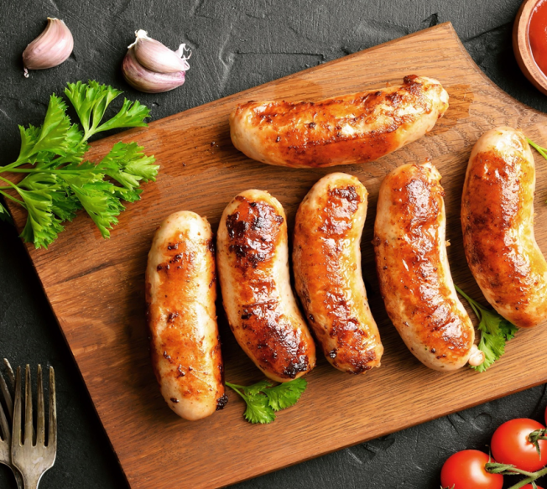
Traditional red rice flour(Oryza sativa L.) and Mung bean (Vigna radiata L.) flour as alternatives for soy protein binder in pork sausage
W.H.H. Madhumali , Prof. D.M.A. Gunarathne
M.P. Senanayake
Department of Livestock Production, Faculty of Agricultural Sciences, Sabaragamuwa University of Sri Lanka
ADM Food Products (Pvt) Ltd, Badalgama, Sri Lanka

Slide 2
Content for the presentation
Introduction
1
Objectives
2
3
Material and Methods
4
Result and Discussion
Conclusion and Recommendation
5
References
6

Slide 3
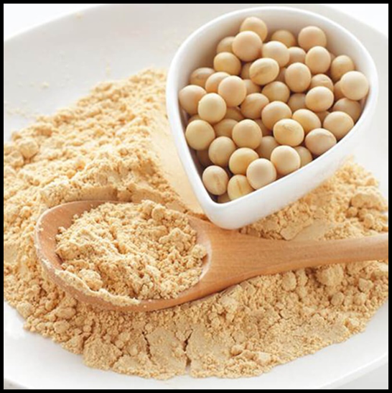
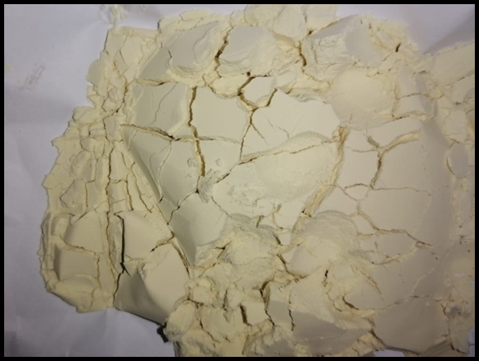
Introduction
Pork sausage is made from ground meat of pork with other non-meat ingredients.
Binders are substances that may be added to food to thicken or improve texture
Soy proteins, one of non meat proteins, are widely used as meat binders because of their several functionalities. such as water-holding, binding and emulsifying properties (Arrese et al., 1991). But ISP is expensive and less nutritive.

Slide 4
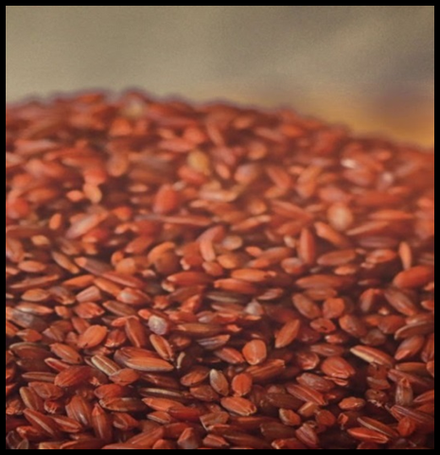
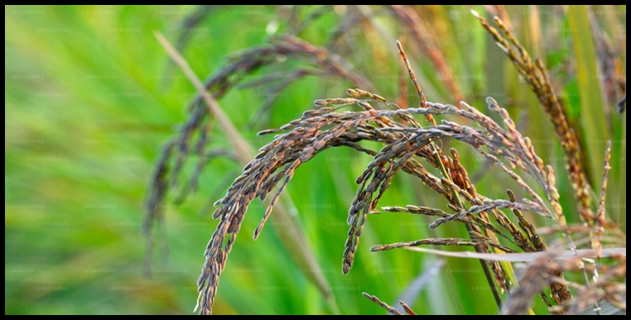
Madathawalu Red Rice
Madathawalu is a very popular short-grain red rice variety traditionally cultivated in Sri Lanka.
The rice variety is rich in vitamin E (tocopherols and tocotrienols) bioactive compounds (polyphenolic compound (Gunaratne et al. (2013).
The health benefits of red rice are attributed in part to their phytochemicals, mainly phenolic compounds, (Gunaratne et al. (2013).
Several studies have shown that rice flour/starch possess gelling, water binding, and thickening abilities and thus may use as a binder for sausage.

Slide 5
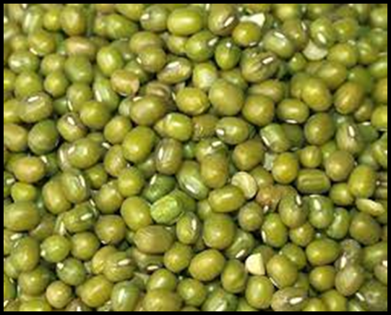
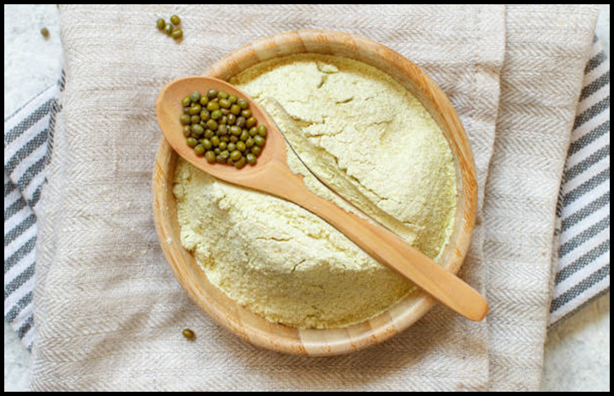
Mung Bean
Mung beans (Vigna radiata L.) are important dietary grain legumes rich in protein, fiber and bioactive compounds with excellent gelling, pasting , water binding and thickening capacities (Gunaratne et al. (2018).

Slide 6
Significance of the study
Isolated soy proteins traditionally used as a sausage binder. But it is very expensive.
Potential benefits of replacement of isolated soy protein with traditional red rice flour and mung bean flour
Cost effective
High nutritive value
Consumer health benefit/bioactive compounds
Benefits for farmers and processers
However, little is known about their application as binder/thickening agents in sausage making

Slide 7
Objectives
To produce pork sausage and evaluate the suitability of mung bean flour and traditional red rice (Madathawalu) flour as replacer for isolated soy protein in pork sausage

Slide 8
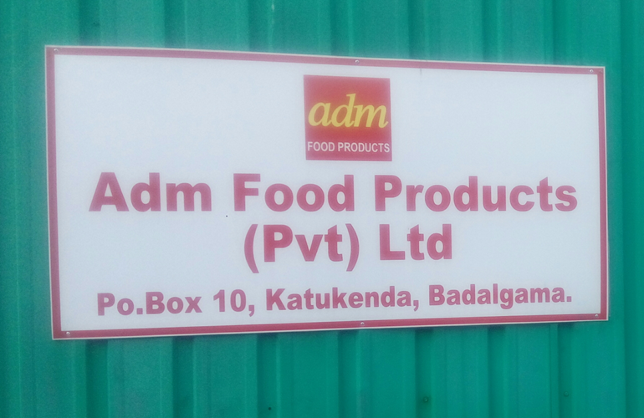
Material and Methods
Experimental site-
The research was conduct in ADM food Products (Pvt) Ltd in Katukenda and Livestock laboratory of faculty of Agricultural sciences in Sabaragamuwa university of Sri Lanka.

Slide 9
Materials and Equipment
Pork meat and Pork back fat
Isolate soy protein
Madathawalu rice flour
Mung bean flour
Spices and other ingredients in formula
8mm meat mincer
casing
Stuffer
Oven

Slide 10
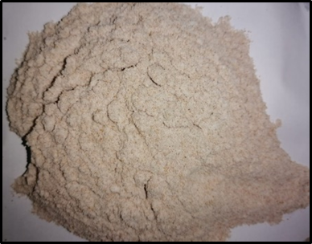
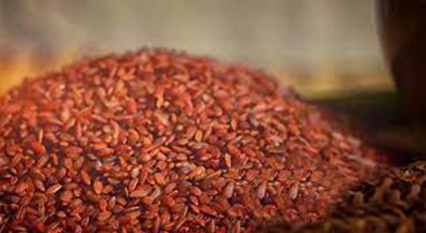
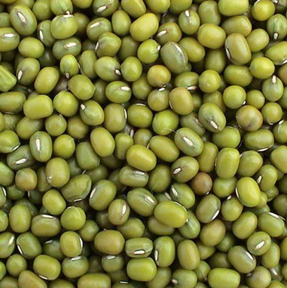
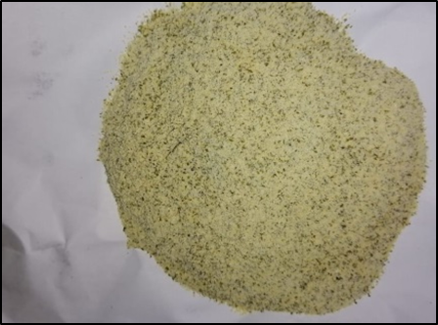
Preparation of flours
Madathawalu red rice flour
Mung bean flour

Slide 11
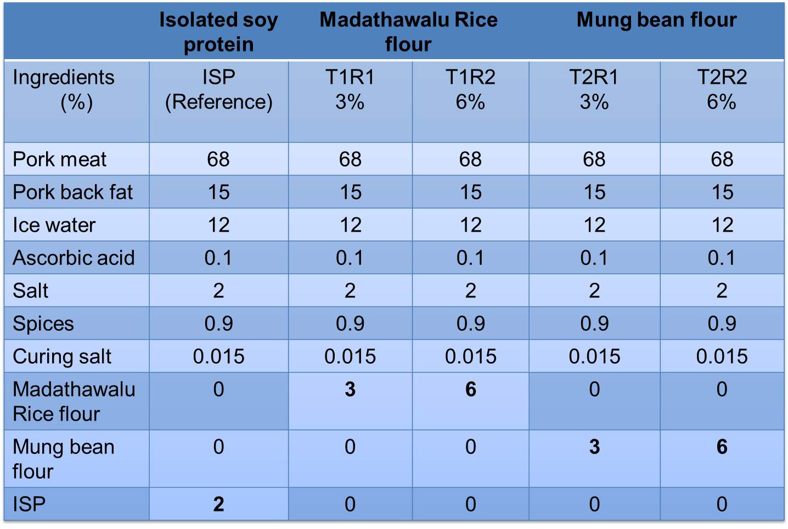
Research design
Treatments were designed based on the previous studies

Slide 12
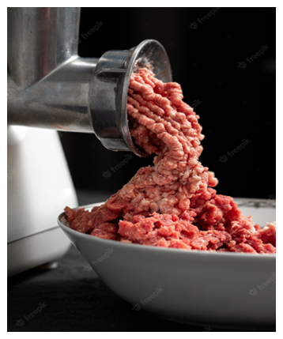
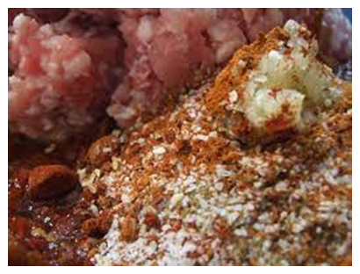
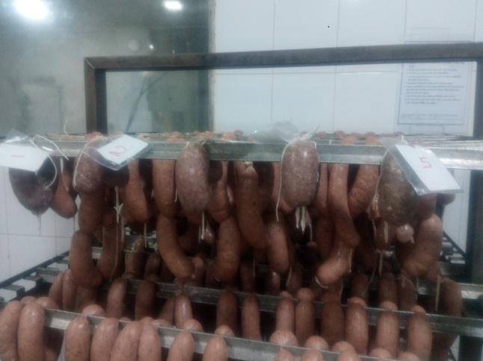
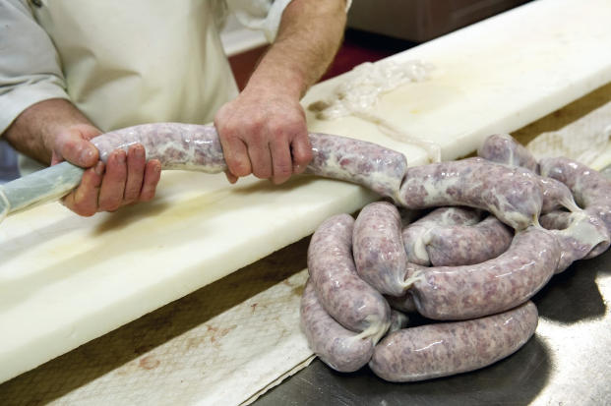
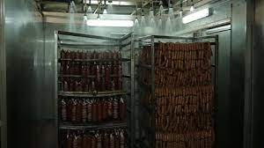
Preparation of sausage
Meat mincing
Stuffing and linking 10cm length
Cooking
Bowl chopping
showering
Freezing
(-18 degrees of Celsius)
Vaccum packaging
chilling

Slide 13
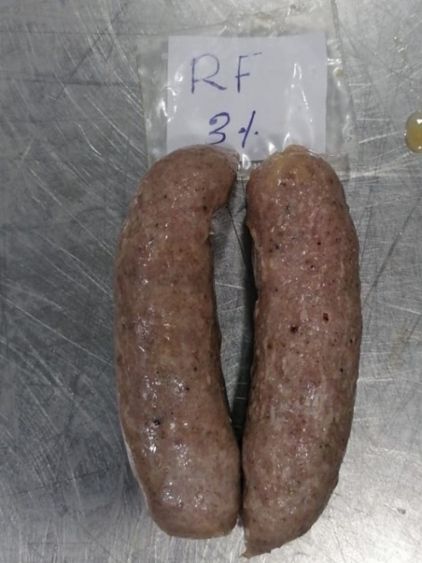
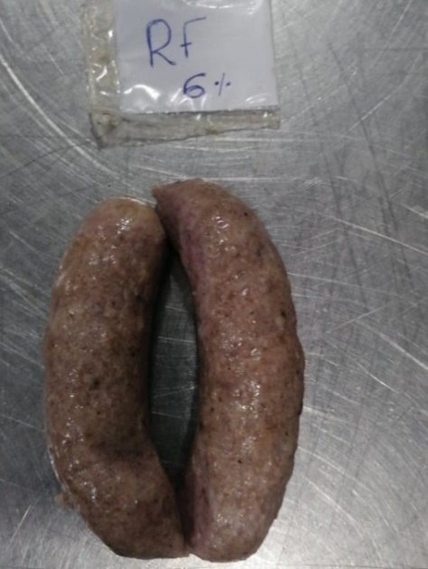
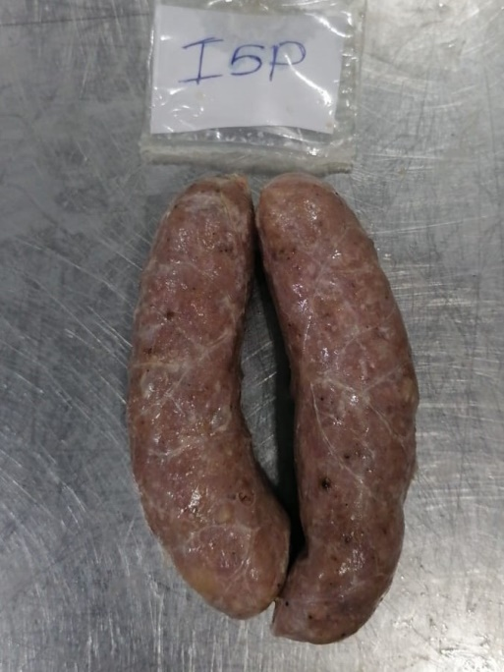
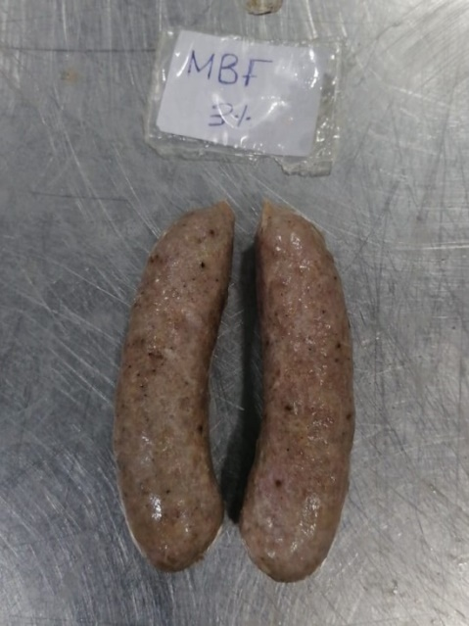
6% RF sample
3% RF sample
ISP (control ) sample
3% MBF sample
6% MBF sample

Slide 14
Laboratory analysis
Proximate analysis –AOAC (2012)
Protein
Fat
Fiber
Moisture
Ash
Physiochemical analysis
Water Holding capacity (WHC) as described by Jane et al, (2021)
Emulsion stability according to method described by Yaro et al, (2021)
pH :using digital pH meter (Hach, Germany)
Cooking loss according to the method described by Jane et al, (2021)

Slide 15
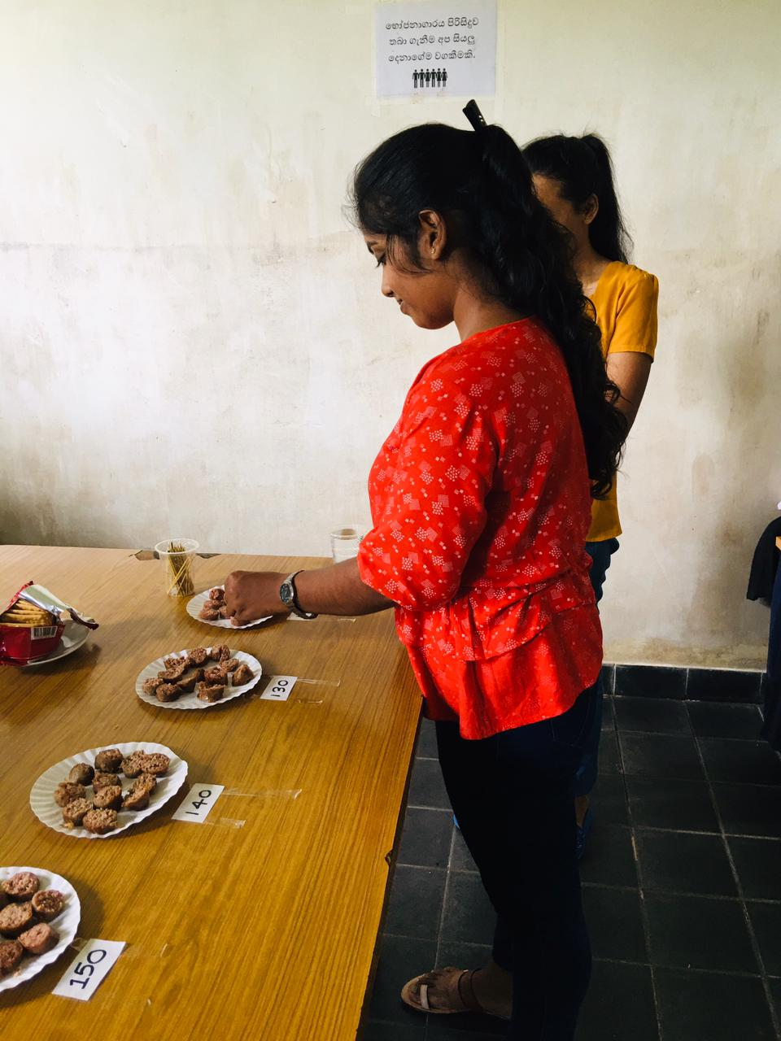
Sensory evaluation
Five point hedonic scale with seven sensory attributes were evaluated.
Texture
Tenderness
Color
Juiciness
Flavor
Overall acceptability
Appearance
Were analyzed by using the five-point hedonic scale
(5 = Like extremely, 1= Extremely dislike) with 30 untrained
panalists .

Slide 16
Data Analysis
One way analysis of variance (ANOVA) in SAS 9.0 version
Mean separation –Tukey test (ANOVA) at p<0.05
Sensory evaluation – Friedman test (SPSS)
Graphically illustration of the data were done by Microsoft Excel package

Slide 17
Results and Discussion
Proximate analysis results
Treatment Moisture (%) crude Protein (%) crude Fat (%) Ash (%) crude Fiber (%)
ISP 52.276$±0.390$ª 19.270$±0.551$ª 21.860$±0.941$^{ab} 2.838$±0.079$ª 0.0010$±0.002$^{c} 3% MBF 53.656$±5.140$ª 16.564$±0.070$ ^{b} 19.450$±0.475$^{c} 2.839$±0.551$ª 0.022$±0.004$ª 6% MBF 52.700$±1.770$ª 17.720$±0.311$^{ab} 23.010$±0.113$ª 2.460$±0.150$ª 0.012$±0.0007$^{ab} 3% RF 51.666$±2.716$ª 15.921$±$0.0.10^{bc} 20.440$±0.070$^{bc} 2.719$±0.371$ª 0.007$±0.001$^{b} 6% RF 49.346$±1.018$ª 15.155$±0.102$^{c} 19.330$±0.098$^{c} 2.414$±0.070$ª 0.005$±0.0007$^{b}
The highest protein content was found with ISP followed by 6%MBF and the lowest in RF treated samples. The addition with 3% mung bean flour produced sausage with high fiber

Slide 18
Results and Discussion
Water Holding capacity of pork sausage
The highest WHC was found in the control followed by 6% MBF treated sample and the lowest in RF treated samples
Figure 1: .Data express as mean $±$SEM.Statistical differences p<0.05

Slide 19
Results and Discussion
Cooking loss of pork sausage
Sausages with lowest cooking loss was exhibited from MBF treated samples and this is more in 6% MBF treatment
Figure 2 : Data express as mean $±$SEM.Statistical differences p<0.05

Slide 20
Results and Discussion
Emulsion stability of pork sausage
The addition of 3% RF had the highest total fluid release (TFR) indicating weaker emulsion stability among the tested treatments.
It is apparent that the WHC has a negative correlation with emulsion stability
Figure 3:Data express as mean $±$SEM.Statistical differences p<0.05

Slide 21
Results and Discussion
pH of pork sausage
3% MBF and 6%MBF incorporation significantly reduce the pH.The highest pH from 3% RF treated samples.
Figure 4: .Data express as mean $±$SEM.Statistical differences p<0.05)

Slide 22
Results and Discussion
Sensory evaluation of pork sausage
There is not significantly difference (p>0.05) in the Tenderness, Juiciness and appearance.
There is a significantly difference (p<0.05) in the colour, flavor, texture, and overall acceptability.
1=Dislike extremely
2=Dislike moderately
3= Like/dislike
4=Like slightly
5=like extremely

Slide 23
Conclusion and Recommendations
Conclusion
The addition of mung bean flour and rice flour had a significant effect on some nutritional, Physical and sensory Properties of pork sausage compared with ISP reference. In overall evaluation of physical and sensory attributes it can be concluded that product with 3% MBF gave the most desirable quality characteristics over the control and thus could be considered as an potential alternative for ISP.
Recommendation
Further experiment are necessary to conduct microbial analysis of pork sausage.

Slide 24
Acknowledgement
Prof D.M.A. Gunarathne,(internal supervisor) Senior Professor, Department of Livestock Production, Sabaragamuwa University of Sri Lanka
Mr.Manula Prabath (External supervisor) Quality Consultant, ADM food Products (PVT) Ltd –Katukenda, Badalgama.
Board of directors, other staff members of ADM food Products (PVT) Ltd Katukenda, Badalgama
Finally, I wish to kindly remember the help Provided by all the workers at ADM Food Products during these three month period of my industrial training.
Prof.T.S.P.Jayaweera Head of the Department Department of Livestock Production, Sabaragamuwa University of Sri Lanka
Mrs.G.D.Yasawathi and laboratory staff, Department Department of Livestock Production, Sabaragamuwa University of Sri Lanka

Slide 25
References
Abbas, M., & Shah, H. U. (2007). Proximate and mineral composition of mung bean. Sarhad J. Agric., 23(2), 2005–2008.
Arrese, E. L., Wagner, J. R., Añón, M. C., & Sorgentini, D. A. (1991). Electrophoretic, Solubility, and Functional Properties of Commercial Soy Protein Isolates. Journal of Agricultural and Food Chemistry, 39(6), 1029–1032. https://doi.org/10.1021/jf00006a004
Dahiya, P. K., Linnemann, A. R., Van Boekel, M. A. J. S., Khetarpaul, N., Grewal, R. B., & Nout, M. J. R. (2015). Mung Bean: Technological and Nutritional Potential. Critical Reviews in Food Science and Nutrition, 55(5), 670–688. https://doi.org/10.1080/10408398.2012.671202
Gunaratne, A., Wu, K., Li, D., Bentota, A., Corke, H., & Cai, Y. Z. (2013). Antioxidant activity and nutritional quality of traditional red-grained rice varieties containing proanthocyanidins. Food Chemistry, 138(2–3), 1153–1161. https://doi.org/10.1016/j.foodchem.2012.11.129
Jane, M., Talknice, J., Charles, M., Amiel, M., Pepukai, M., & Shepherd, M. (2021). Proximate , physico-chemical , functional and sensory properties OF quinoa and amaranth flour AS potential binders in beef sausages. Food Chemistry, 365(June), 130619. https://doi.org/10.1016/j.foodchem.2021.130619

Slide 26
References
Jin, S. keun, Kim, S. H., Choi, J. S., & Yim, D. G. (2019). Effect of diverse binder materials and their addition levels on physico-chemical characteristics of sausages. Journal of Food Measurement and Characterization, 13(2), 1558–1565. https://doi.org/10.1007/s11694-019-00071-1
Mohan, A. (2014). Basics of sausage making, formulation, processing & safety. UGA Extension, 1–48. https://secure.caes.uga.edu/extension/publications/files/pdf/B 1437_1.PDF
Pereira, J., Hu, H., Xing, L., Zhang, W., & Zhou, G. (2020). and Tapioca Starch on the Functional Properties and.
Yang, Q., Ge, Y., Gunaratne, A., Kong, K., Li, H., Gul, K., Kumara, K., Arachchi, L. V., Zhu, F., & Corke, H. (2020). Phenolic profiles, antioxidant activities, and antiproliferative activities of different mung bean (Vigna radiata) varieties from Sri Lanka. Food Bioscience, 100705. https://doi.org/10.1016/j.fbio.2020.100705
Yaro, J., Adzitey, F., & Huda, N. (2021). Roasted Pearl Millet Flour (RoPMF) Improved the Mineral Composition of Beef Sausages. 11(2).

