Slide 1
Effect of Environmental Enrichments on Lameness and Other Welfare Indicators of Broiler Chickens.
N Wanigasekara : Department of Livestock Production, Faculty of Agricultural Sciences, Sabaragamuwa University of Sri Lanka
RMAS Bandara : Department of Livestock Production, Faculty of Agricultural Sciences, Sabaragamuwa University of Si Lanka
TS Samarakone : Department of Animal Science, Faculty of Agriculture, University of Peradeniya, Sri Lanka
MP Senanayake : JP Poultry Products (Pvt) Ltd, Walovitawatta, Badalgama, Sri Lanka

Slide 2
Content for the Presentation
Introduction
Objectives
Methodology
Results and Discussion
Conclusion
References

Slide 3
Introduction…
Broiler chickens has been the fastest growing sector in animal production worldwide.
Rapid growth results in skeletal deformities including problems caused by leg weakness that result in lameness.
The poor leg health is considered a major concern impairing broiler welfare.
In order to reduce the extent of welfare problems, it has been suggested to provide stimulating, enriched environments (Riber et al., 2018; Mocz et al., 2022).
The control of these problems not only would contribute to a better accountability of bird welfare, but also to a higher efficiency of industry.

Slide 4
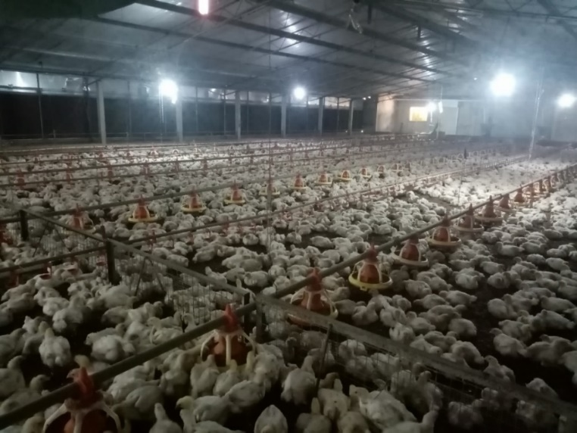
Identification of Research Problem…
JP poultry Products (PVT) Ltd. is one of the rapidly improving broiler meat producer in the country.
Several leg problems were observed in their farm.
Identified leg problems which causing lameness were categorized as,
Foot Pad Dermatitis (FPD)
Hock burns
Splay footed
Stretching both legs forward
Complete paralysis

Slide 5
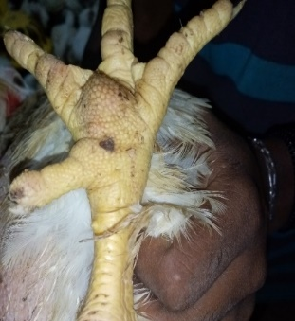
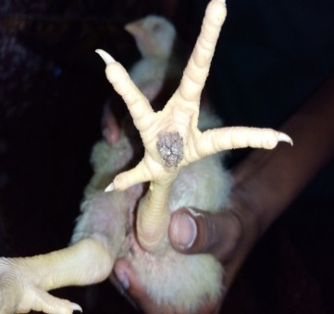
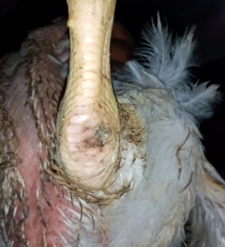
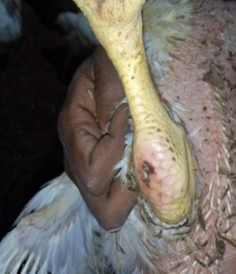
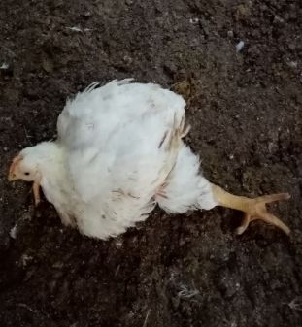
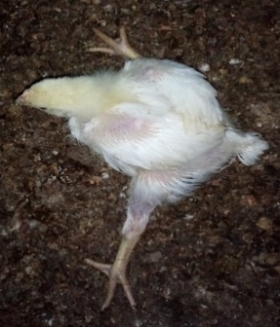
Footpad Dermatitis (FPD) : Ulcerated lesions can be characterized on the pad of the foot
Hock burns : Marks found on the upper joints of the chickens
Splay footed : Stretching one leg aside and difficult in moving

Slide 6
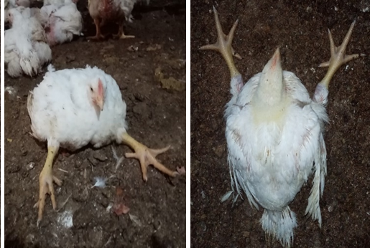
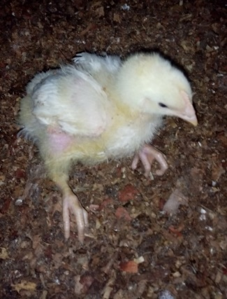
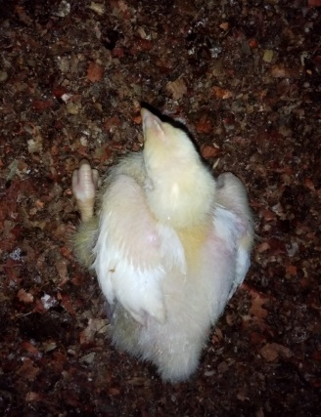
Stretching both legs forward : Directed both legs forward. Difficult in moving and use wings for movements.
Complete paralysis : Birds are unable to move even with applying a pressure

Slide 7
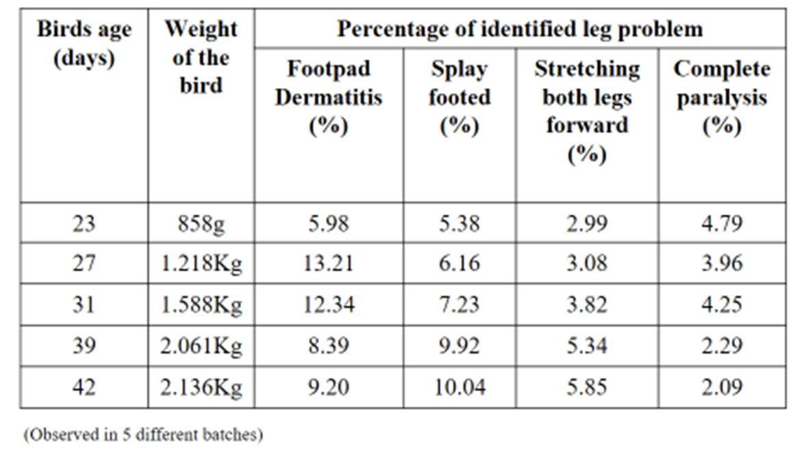
Percentage of observed leg problems which causing lameness,

Slide 8
Leg weakness lead to high morbidity and mortality causing poor welfare in chickens.
Enrichment of the broiler house can contribute to greater activity and it can improve the bones of chickens, including their welfare (Weeks and Kestin., 1997)
Hypothesis,
Providing environmental enrichments in the broiler house with facilitating play behaviour will improve the leg bones of the chickens by enhancing the activity level and will improve their welfare.

Slide 9
Objectives…
Main objective
To asses the effect of environmental enrichments on lameness, plumage cleanliness, footpad dermatitis, hock burns, litter quality and behaviour of broiler chickens.
Specific objective
To asses the effect of environmental enrichments on body weight of broiler chickens.

Slide 10
Methodology…
Research location.
The research was carried on JP poultry farm, closed house, Sinhagiriwatta, Elibichchiya, Kotadeniyawa.
Temperature : 26˚C - 24˚C (from day 10 – 42)

Slide 11
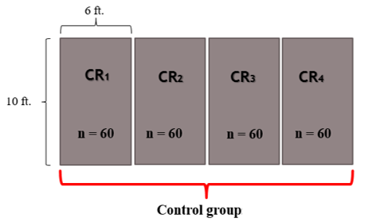
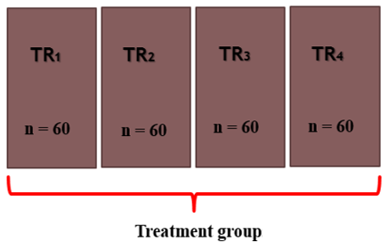
Research Design…
Complete randomized design was used.
Data collected on 2 broiler batches from day 10 - 38.
In one batch included two replicates for control group and two replicates for treatment group each containing 60 birds.
(With environmental enrichments)

Slide 12
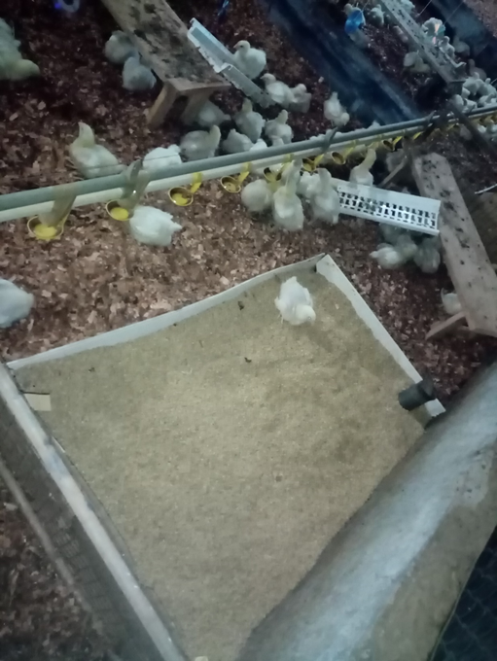
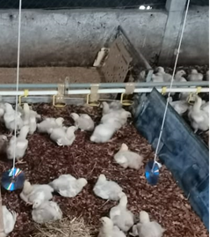
Environmental enrichments used in treatment group,
Elevated platforms (3 x 1ft) (Kaukonen et al., 2016) were provided with plastic ramp to facilitate easy access.
Paddy husk area (3 x 2ft) was provided for facilitate dust bathing (Shields et al., 2004)
Straw bales (Bailie et al., 2013) were provided
CDs were hanged as strings (Riber et al., 2018)

Slide 13
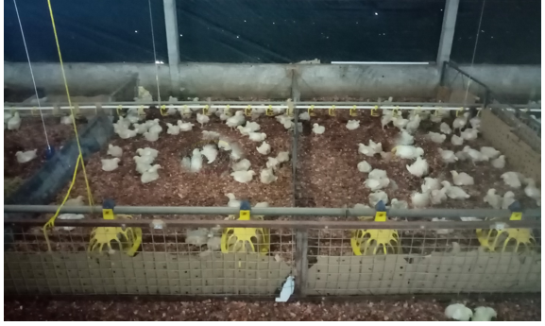
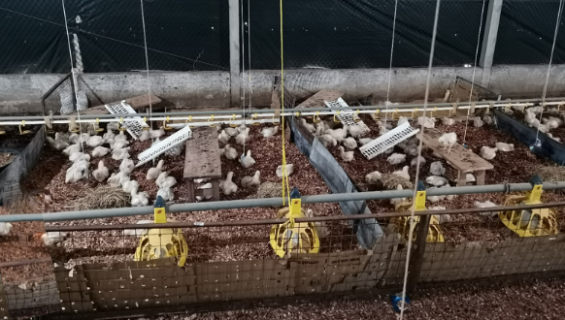
Control group : No environmental enrichments
Treatment group : With environmental enrichments
Treatment distribution

Slide 14
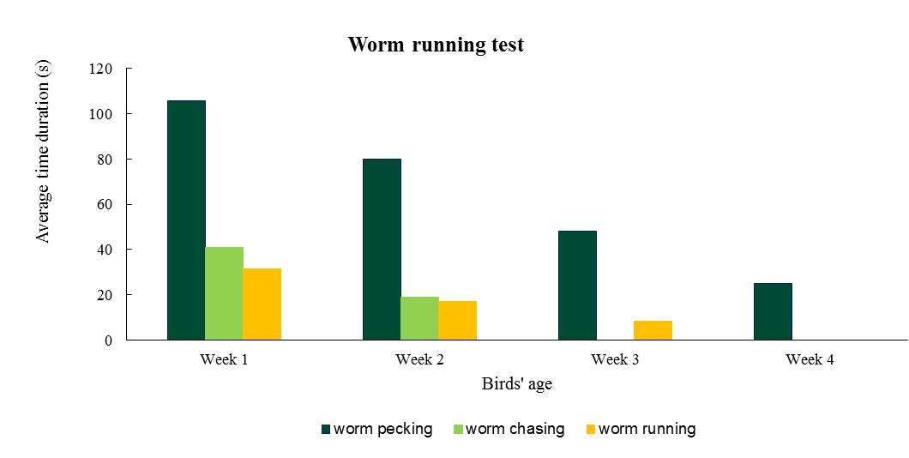
Worm Running Test to Facilitate Play Behaviour (to enhance leg health by increasing activity)
Worm running test (Liu et al., 2020) was performed in each replicate in only the treatment group on every four weeks in the morning (8.00am - 8.20am) during the experimental period.
Worm pecking
Worm chasing
Worm running

Slide 15
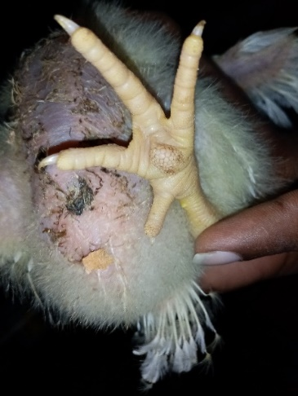
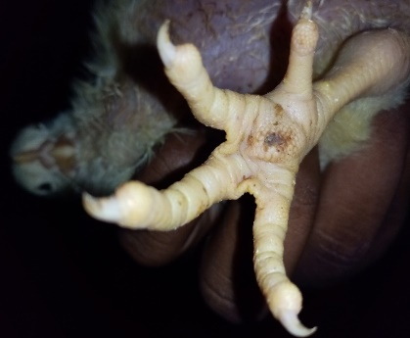
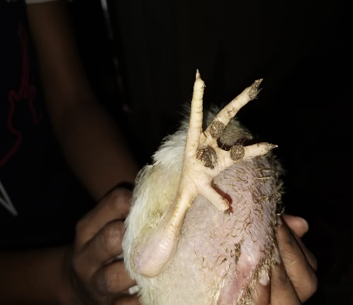
Food Pad Dermatitis Assessment…
Randomly selected 20 birds per replicate
Observed in weekly basis
(Hunter et al., 2017)
Score | Foot pad lesions
0 | No blemish or discoloration of foot pad
1 | Small black lesion (<25% of foot pad) or keratosis of foot pad.
2 | Moderate lesion (25-50% of foot pad) with black coloration
3 | Severe lesion (>50% of foot pad). Black coloration may extend to toes.
Score 0
Score 1
Score 2
Score 4

Slide 16
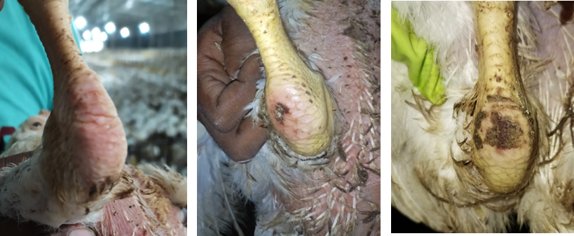
Hock Burns Assessment …
Randomly selected 20 birds per replicate
Observed in weekly basis
(Kaukonen et al., 2016)
Score 0
Score 1
Score 2

Slide 17
Gait Score (Walking ability) Assessment …
Randomly selected 20 birds per replicate
Observed in weekly basis
(Mocz et al., 2022)

Slide 18
Plumage Cleanliness (Head, back, wings and tail area) Assessment …
Randomly selected 20 birds per replicate
Total scores were used for the analysis
(Malchow et al., 2019)

Slide 19
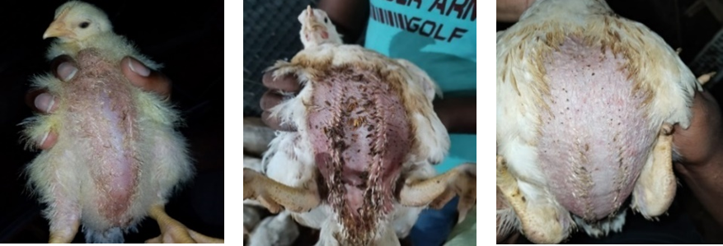
Abdominal Cleanliness Assessment...
Randomly selected 20 birds per replicate
Observed in weekly basis
Score 0
Score 1
Score 2

Slide 20
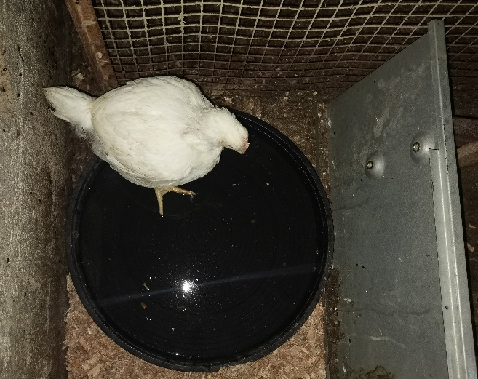
Latency (time duration) to lie test…
Randomly selected 6 birds (10%) per replicate (Aydin, 2018)
Time duration that birds stayed standing in water was measured
Performed in 35th day
Injury Assessment…
Randomly selected 20 birds per replicate
Used dichotomous scale (Yes/No) system

Slide 21
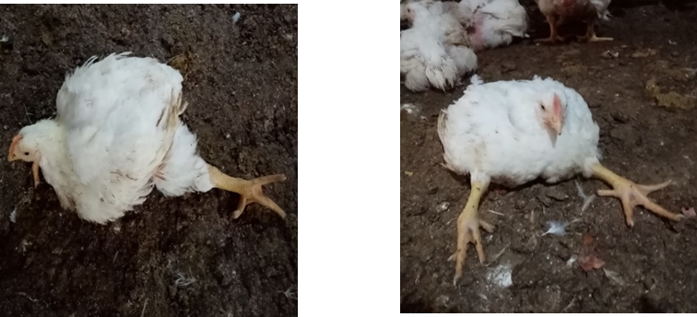
Assessment of Leg Deformities…
Performed in 38th day
Used dichotomous scale (Yes/No) system
Splay footed
Stretching both legs forward

Slide 22
Behaviour Observation…
Behaviour observation - Two days per week ( Scan sampling method)
Three periods per day - Morning (9am-11am)
Afternoon (1pm-3pm)
Night (9pm-10pm)

Slide 23
Modified ethogram used to observe the behaviours of birds (Silva et al., 2021)

Slide 24
Litter Quality Assessment …
Four locations were sampled from each replicate (middle, corner, in between two feeders, under drinker line) observed in weekly basis
Scores of all four locations were totaled for statistical analysis
(Hunter et al., 2017)
Score 0
Score 1
Score 2
Score 3
Score 4

Slide 25
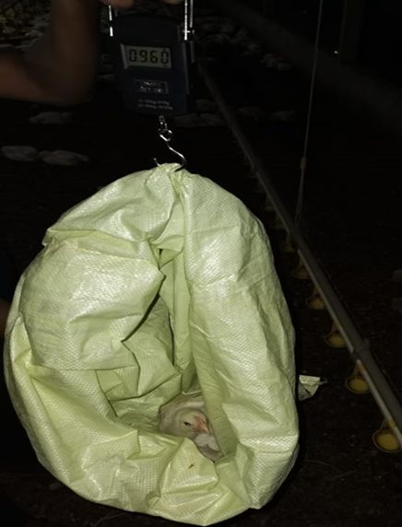
Recording Body Weight of the Birds…
Randomly selected 20 birds per replicate
Weighing by digital electronic hanging scale
Observed in weekly basis

Slide 26
Statistical Analysis…
Scored data : Mann Whitney U Test
Behaviour data : Generalized Linear Model Method
Body weight : ANOVA
SAS 9.0 and IBM SPSS Statistics 25 statistical analysis software were used for the analysis.
Graphs were illustrated by using Microsoft Excel 2013.

Slide 27
Results…
Food Pad Dermatitis (score)
Control group
Treatment group
P = 0.002

Slide 28
Hock Burns (score)
Control group
Treatment group

Slide 29
Gait Score - Walking ability (score)
Control group
Treatment group

Slide 30
Plumage Cleanliness - Head, back, wings and tail area (score)
Control group
Treatment group

Slide 31
Abdominal Cleanliness (score)
Control group
Treatment group

Slide 32
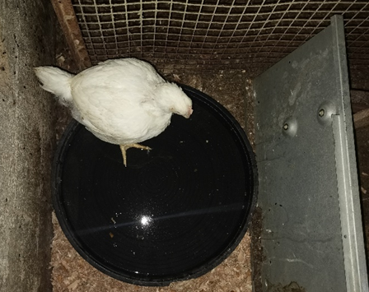
Latency (duration) to lie test

Slide 33
Injury Assessment…
Any injury wasn’t observed in both control and treatment groups
No effect of environmental enrichments (including elevated platform, hanging CDs as strings, straw bales and paddy husk area for dust bathing)

Slide 34
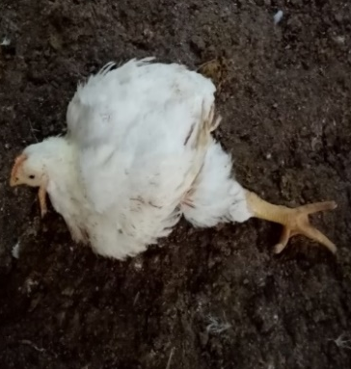
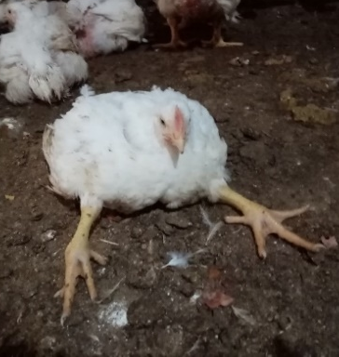
Leg Deformities
There were 11 birds with leg deformities out of 240 birds in control group and no birds were observed with leg deformities in treatment group.
Splay footed – 7 Birds
Stretching both legs forward – 4 Birds

Slide 35
Behaviour observation
The frequency of preening behaviour was significantly (P<0.05) higher in treatment group than the control group during both day and night time in all four weeks.
The frequency of resting behaviour was significantly (P<0.05) higher in control group than the treatment group during both day and night time in all four weeks.
Performing dust bathing behaviour was more in paddy husk area over the saw dust in treatment group.

Slide 36
Litter Quality (score)
Control group
Treatment group

Slide 37
Weight of the Birds
Control group
Treatment group

Slide 38
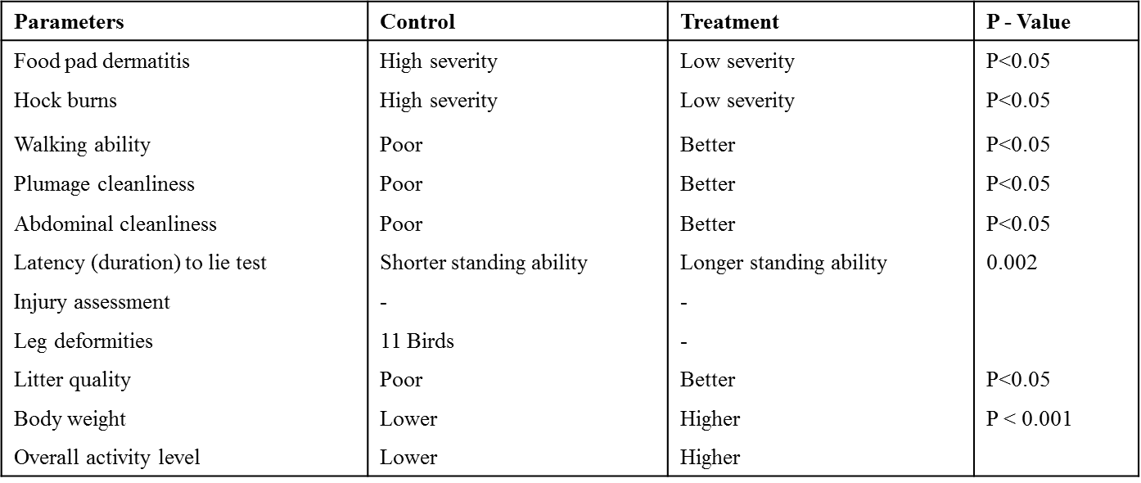
Summary of the results…
Conclusion…
Providing environmental enrichments reduced the lameness and enhanced the other welfare indicators of broiler chickens reared under closed house conditions.
Providing environmental enrichments enhanced the body weight of broiler chickens reared under closed house conditions.

Slide 39
References…
Aydin, A. (2018) ‘Leg Weaknesses and Lameness Assessment Methods in Broiler Chickens’, Archives of Animal Husbandry & Dairy Science, 1(2). Available at: https://doi.org/10.33552/aahds.2018.01.000506.
Bailie, C.L., Ball, M.E.E. and O’Connell, N.E. (2013) ‘Influence of the provision of natural light and straw bales on activity levels and leg health in commercial broiler chickens’, Animal, 7(4), pp. 618–626. Available at: https://doi.org/10.1017/S1751731112002108.
Hunter, J.M. et al. (2017) ‘Practical assessment and management of foot pad dermatitis in commercial broiler chickens: A field study’, Journal of Applied Poultry Research, 26(4), pp. 593–604. Available at: https://doi.org/10.3382/japr/pfx019.
Kaukonen, E., Norring, M. and Valros, A. (2016) ‘Effect of litter quality on foot pad dermatitis, hock burns and breast blisters in broiler breeders during the production period’, Avian Pathology, 45(6), pp. 667–673. Available at: https://doi.org/10.1080/03079457.2016.1197377.
Liu, Z. et al. (2020) ‘Play behaviour reduced by environmental enrichment in fast-growing broiler chickens’, Applied Animal Behaviour Science, 232, pp. 1–34. Available at: https://doi.org/10.1016/j.applanim.2020.105098.
Lourenço da Silva, M.I. et al. (2021) ‘Behaviour and animal welfare indicators of broiler chickens housed in an enriched environment’, PloS one, 16(9), p. e0256963. Available at: https://doi.org/10.1371/journal.pone.0256963.
Malchow, J. et al. (2019) ‘Effects of elevated grids on growing male chickens differing in growth performance’, Frontiers in Veterinary Science, 6(JUN), pp. 1–9. Available at: https://doi.org/10.3389/fvets.2019.00203.
Mocz, F. et al. (2022) ‘Positive Effects of Elevated Platforms and Straw Bales on the Welfare of Fast-Growing Broiler Chickens Reared at Two Different Stocking Densities’, Animals, 12(5). Available at: https://doi.org/10.3390/ani12050542.
Riber, A.B. et al. (2018) ‘Review of environmental enrichment for broiler chickens’, Poultry Science, 97(2), pp. 378–396. Available at: https://doi.org/10.3382/ps/pex344.
Shields, S.J., Garner, J.P. and Mench, J.A. (2004) ‘Dust bathing by broiler chickens: A comparison of preference for four different substrates’, Applied Animal Behaviour Science, 87(1–2), pp. 69–82. Available at: https://doi.org/10.1016/j.applanim.2004.01.003.

Slide 40
Acknowledgement…
We would like to extend our sincere gratitude to,
Mr. Nilan Muthumala, Farm manager, JP Poultry Farm, Kotadeniyawa.
All the farm staff and workers who helped me at JP Poultry Products (Pvt) Ltd.

Slide 41
Thank You…

