Slide 1
FIELD EVALUATION OF PLANT EXTRACTS AGAINST RICE SHEATH BLIGHT (Rhizoctonia solani) DISEASE
R. S. S. Rathambalage¹, K. R. D. Gunapala² and W. M. A. U. K. M. Wijesekara¹
¹Department of Export Agriculture, Faculty of Agricultural Sciences, Sabaragamuwa University of Sri Lanka
² Rice Research and Development Institute, Batalagoda, Ibbagamuwa, Sri Lanka

Slide 2
Content
Introduction
Objectives
Material and Methods
Results and Discussion
Conclusion and Recommendations
References

Slide 3
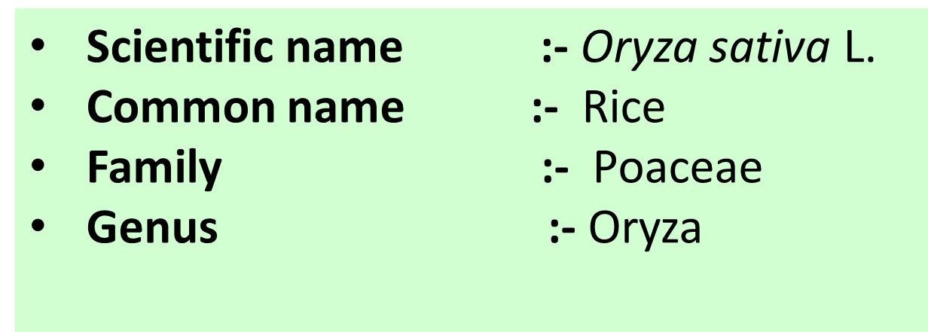
Introduction
Rice (Oryza sativa L.) is one of the three major food crops in the world.
It is the staple food and principle crop in terms of food security in Sri Lanka.

Slide 4
Introduction cont..
Sheath blight - Rhizoctonia solani (Teleomorph: Thanatephorus cucumeris)
A fungal disease
- Symptoms of sheath blight disease -

Slide 5
Introduction cont..
Economic crisis
Undesirable effects for the environment
Alternatives for the management
Plant extracts
Banning of agrochemicals

Slide 6
Objectives
General Objective
To study about the potentials of using plant extracts in managing sheath blight in rice
Specific Objectives
To isolate the pathogen Rhizoctonia solani
To study the efficacy of the different plant extracts and its combinations against the sheath blight (Rhizoctonia solani) of rice
To introduce an environmental friendly method to control the sheath blight of rice

Slide 7
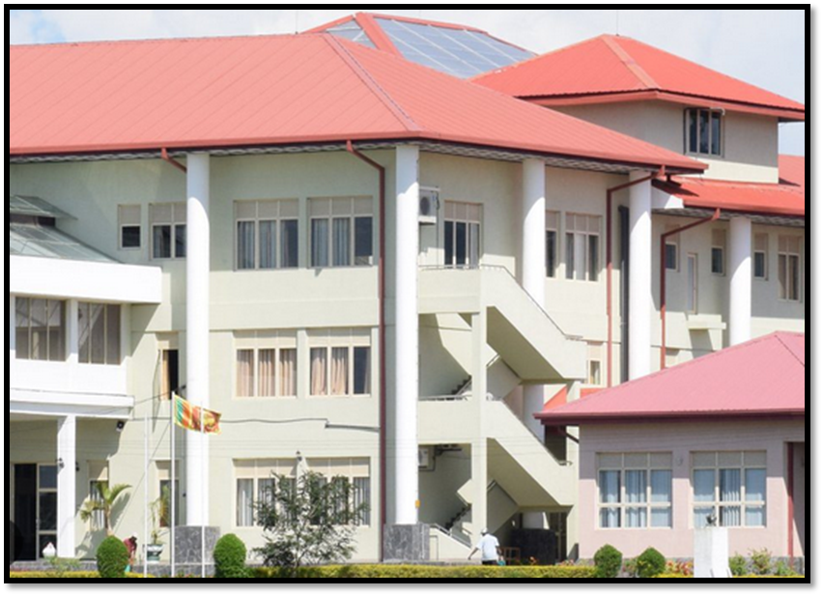
Material and Methods
Selection of rice variety
Bg 379 -2
Experimental location
Pathology laboratory and the research field of Rice Research and Development Institute (RRDI), Bathalagoda

Slide 8
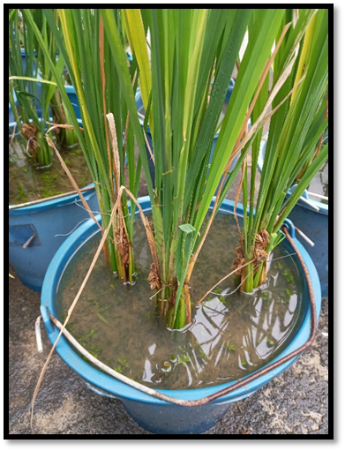
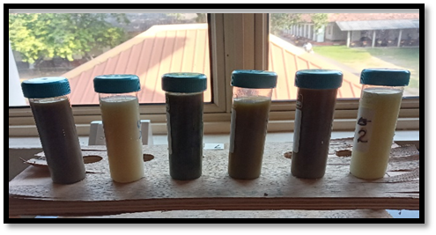
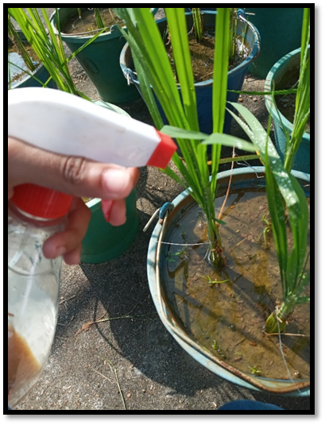
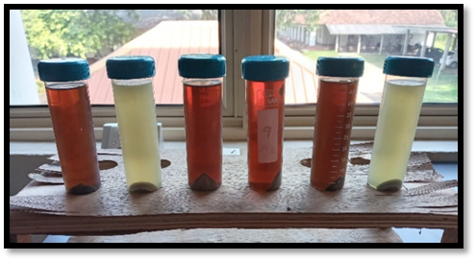
Material and Methods cont..
Isolation
Preparation of plant extracts
Spraying
Inoculation

Slide 9
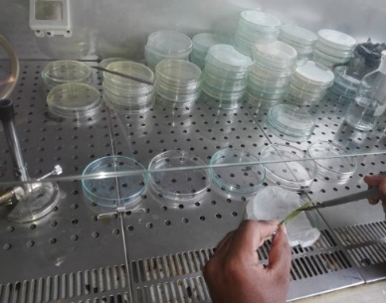
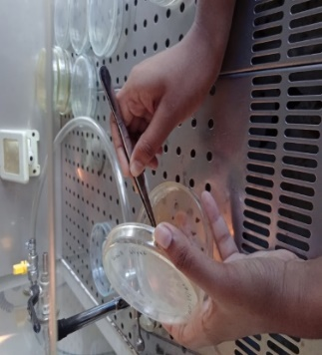
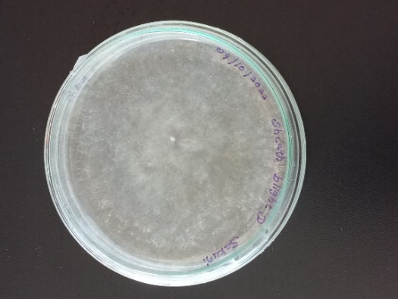
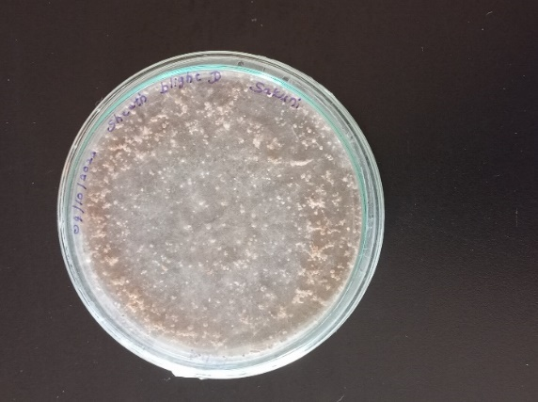
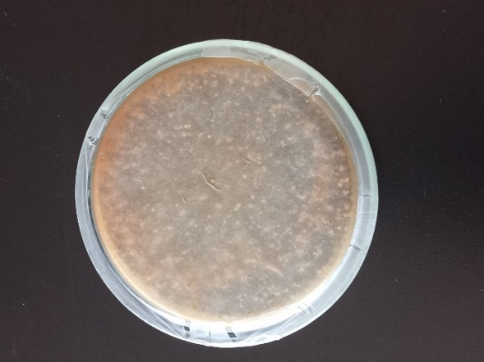
Material and Methods cont..
1. Isolation of the pathogen
Collection of diseased samples
Preparation of PDA (Potato Dextrose Agar) media and culturing of the pathogen
Sub-culturing
Identification of isolated fungi
Morphological and Cultural

Slide 10
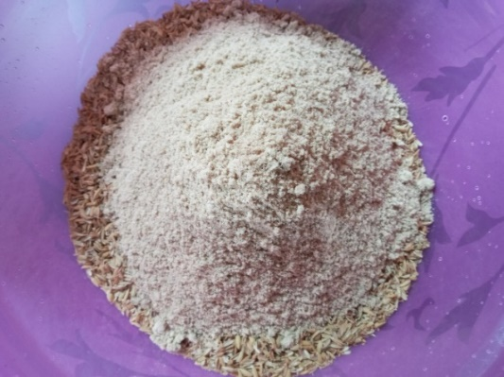
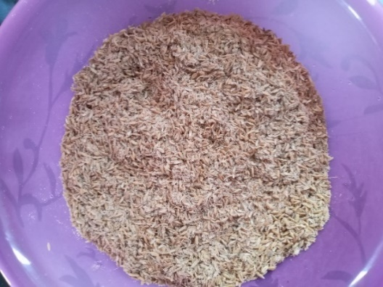
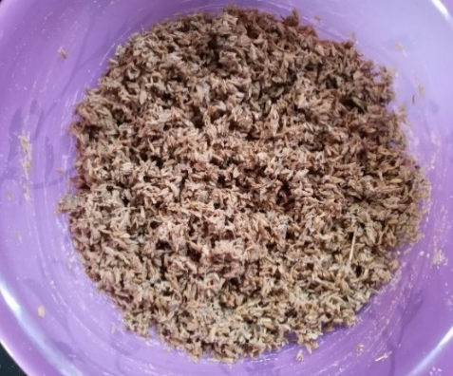
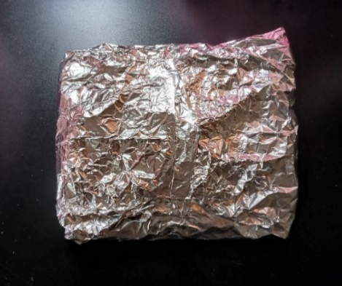
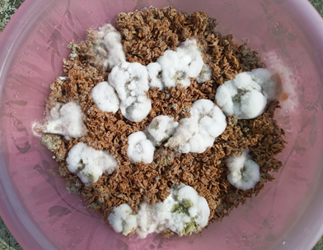
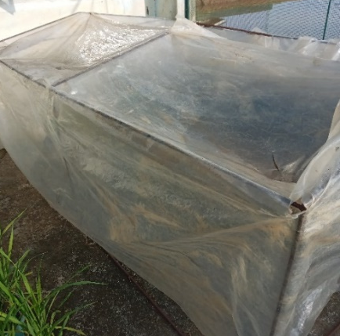
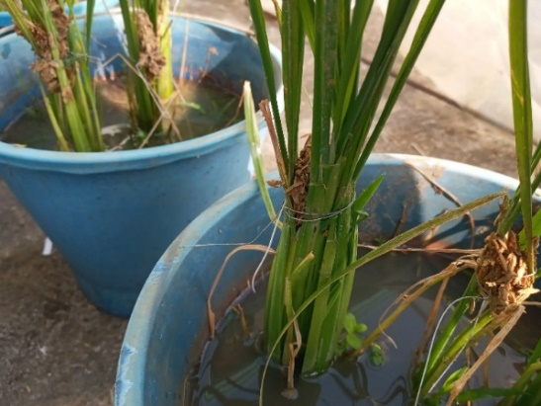
2. Inoculation of the Sheath blight pathogen (Rhizoctonia solani)
(At 45 days after transplanting of the rice plants)
Rice bran and rice husk 1:1
Mixture of rice bran and rice husk
Wrapped from an Aluminium foil
Mixture with Agar
Kept in an incubator
Inoculated plants
7 days old R. solni

Slide 11
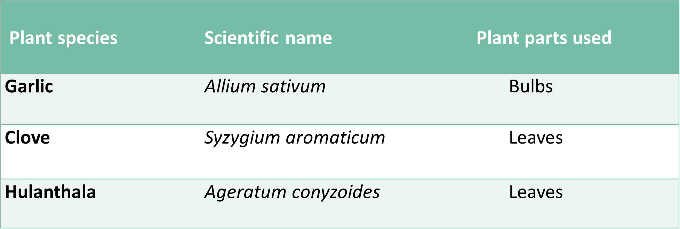
Material and Methods cont..
3. Preparation of plant extracts
Plant extracts were selected according to the findings of in vitro evaluation, which was done previously by RRDI, Bathalagoda.
(Gunapala et al., 2022)

Slide 12
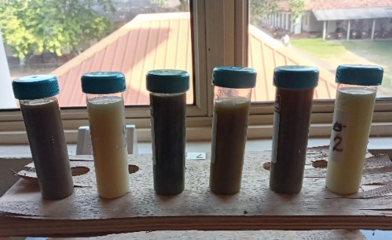
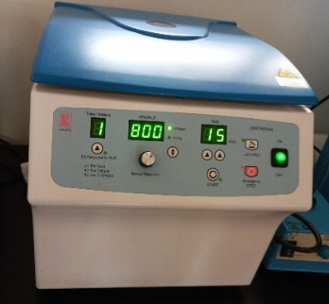
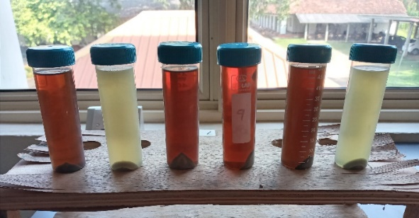
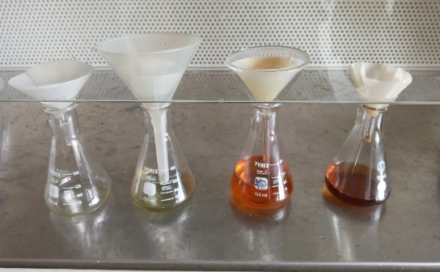
Material and Methods cont..
200 g of fresh mature leaves of Clove, Hulanthala and bulbs of Garlic
Washed with tap water and surface sterilization
Cut in to small pieces and grinded by adding 200 ml of sterilized distilled water as the extracting agent
Filtered through two layers of muslin cloth
The filtrate was centrifuged at 8000 rpm for 15 minutes in room temperature
Supernatant was collected and filtered using a Whatman No 01 filter paper
(Harish et al., 2008).

Slide 13
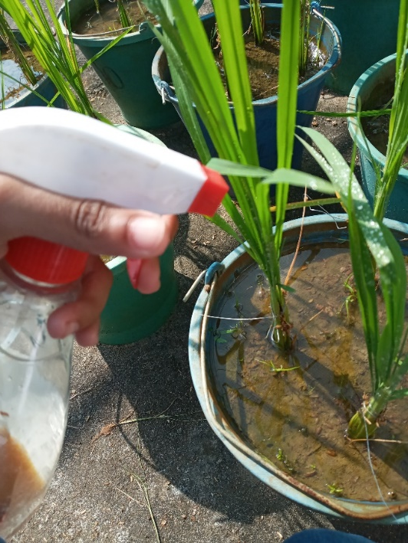
Material and Methods cont..
4. Spraying plant extracts for the inoculated plants
Plant extracts were sprayed as solution of 100 % concentration and Carbendazim (50 % WG) was sprayed in the rate of 6 ml/10 l by using 1 l hand sprayer to the experimental pots as per treatments.
Spraying was done one week after inoculation around 4 pm.
Adequate precautions were taken to avoid drifting of spray materials from one plot to the neighboring ones.

Slide 14
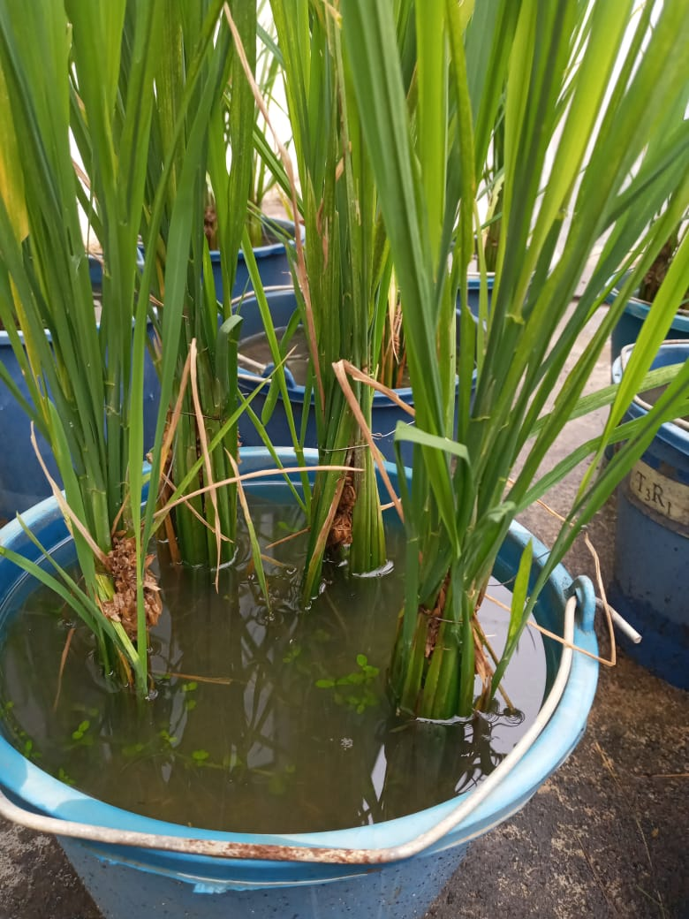
Material and Methods cont..
T₁ - Bulbs of Garlic (Allium sativum)
T₂ - Bulbs of Garlic + Leaves of Clove (Syzygium aromaticum)
T₃ - Bulbs of Garlic + Leaves of Clove + Leaves of Hulanthala (Ageratum conyzoides)
T₄ – Carbendazim (50% WG)
T₅ - Water
Randomized Complete Block Design used
Replicated three times
Pot experiment of fifteen pots with four plants

Slide 15
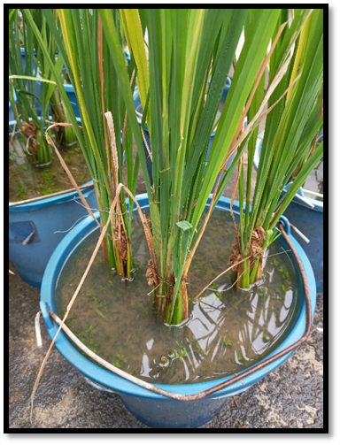
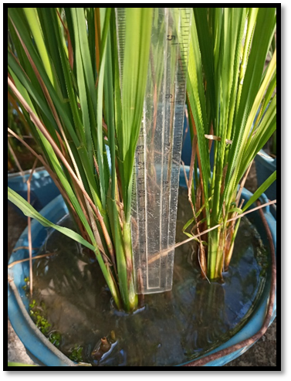
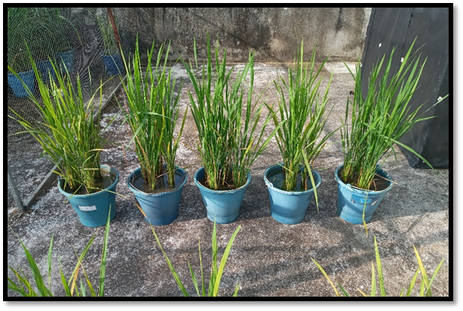
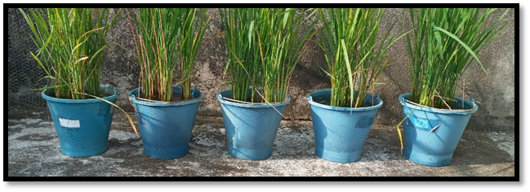
Data collection
15

Slide 16
Data analysis
The treatment comparisons were done by using one -way ANOVA with Duncan’s Multiple Range Test (DMRT) by using Statistical Analysis System (SAS) 9.1 version.
Graphical illustrations were done by Microsoft Excel (2013).

Slide 17
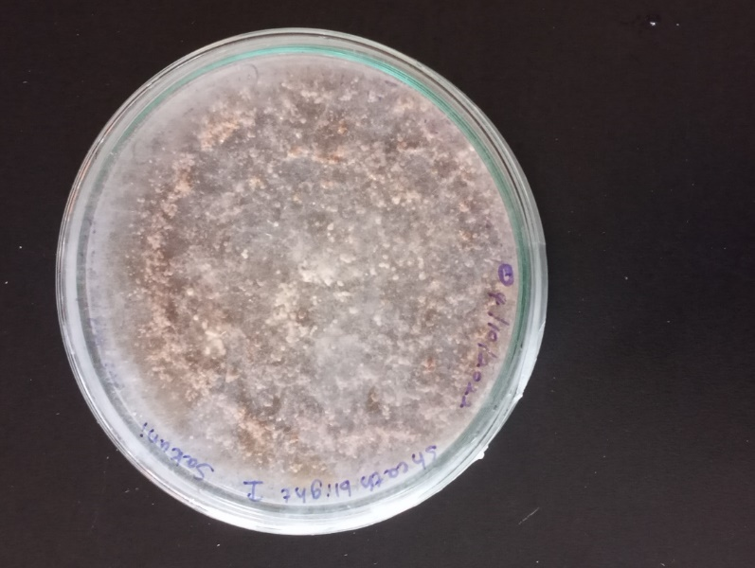
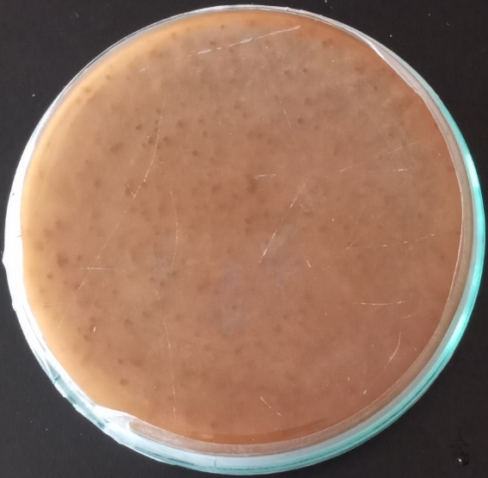
Results and Discussion
Identification of isolated fungi
(Morphological and cultural characteristics of the isolate)
-Top-
-Bottom-
Microscopic view of the mycelia under ×100
Sclerotia were brown to dark brown.
Produced sclerotia near the inoculum, scattered isolate, near margin and also abundant sclerotia.
The findings are in accordance with (Moni et al., 2016).

Slide 18
T₁ - Bulbs of Garlic T₃ - Bulbs of Garlic + Clove+ Hulanthala T₅ - Water
T₂ -Bulbs of Garlic +Clove T₄ – Carbendazim (50% WG)

Slide 19
T₁ - Bulbs of Garlic T₃ - Bulbs of Garlic + Clove+ Hulanthala T₅ - Water
T₂ -Bulbs of Garlic +Clove T₄ – Carbendazim (50% WG)

Slide 20
T₁ - Bulbs of Garlic T₃ - Bulbs of Garlic + Clove+ Hulanthala T₅ - Water
T₂ -Bulbs of Garlic +Clove T₄ – Carbendazim (50% WG)

Slide 21
Conclusion and Recommendations
Pathogen was identified as Rhizoctonia solani
Out of all plant extracts, A. sativum (Garlic) was proved to be the most effective in inhibiting the growth of R. solani
Effectiveness varies as,
Garlic > Garlic +Clove > Garlic + Clove + Hulanthala
Therefore out of these plant extracts, A. sativum (Garlic) can be introduced as an environmental friendly method to control the sheath blight of rice
Further studies need to be carried out for identification and isolation of the active (antifungal) compounds in the most effective plant extract.

Slide 22
References
Choudhury, D. et al. (2017) ‘Effect of plant extracts against sheath blight of rice caused by Rhizoctonia Solani’, ~ 399 ~ Journal of Pharmacognosy and Phytochemistry, 6(4), pp. 399–404.
Gunapala, K.R.D. et al. (2022) ‘Annals of Sri Lanka Department of Agriculture’, 24, pp. 124–127.
Harish, S. et al. (2008) ‘Use of plant extracts and biocontrol agents for the management of brown spot disease in rice’, BioControl, 53(3), pp. 555–567. doi:10.1007/s10526-007-9098-9.
Mahmud, H., Hossain, I. and Dey, P. (2020) ‘Advances in Crop Science and Technology Organic Management of Brown Spot and Sheath Blight of Rice Cultivar BRRIdhan29 under Field Condition Enhancing Grain Yield’, 8(4).
Moni, Z.R. et al. (2016) ‘Morphological and Genetical Variability among Rhizoctonia solani Isolates Causing Sheath Blight Disease of Rice’, Rice Science, 23(1), pp. 42–50. doi:10.1016/j.rsci.2016.01.005.
Suprapta, D.N. (2016) ‘A Review of Tropical Plants with Antifungal Activities against Plant Fungal Pathogens’, Preprints, (October), pp. 1–13. doi:10.20944/preprints201610.0049.v1.
Tamuli, P., Das, J. and Boruah, P. (2014) ‘Antifungal activity of Vitex negundo linn. against some phytopathogenic fungi’, Plant Archives, 14(2), pp. 981–982.

Slide 23
Thank You

