Slide 1
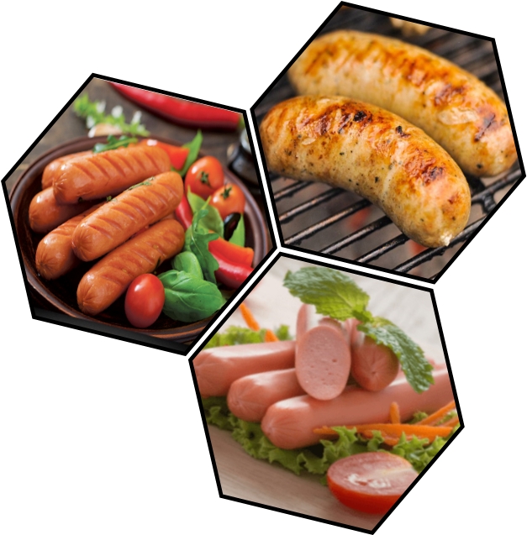
Impact of Selected Vegetable Mixture Incorporation on Physicochemical, Nutritional and Organoleptic Properties of Chicken Sausages
MKDH Lakshika^{1*}, RK Mutucumarana¹, WAAS Weerasooriya²
¹Department of Livestock Production, Faculty of Agricultural Sciences, Sabaragamuwa University of Sri Lanka
2. Gills International [Pvt.] Ltd., Katunayake, Sri Lanka

Slide 2
Content
Introduction
Objectives
Material and Methods
Results and Discussion
Conclusion and Recommendations
References

Slide 3
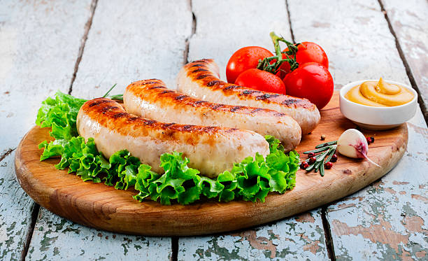
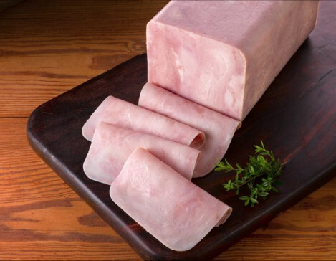
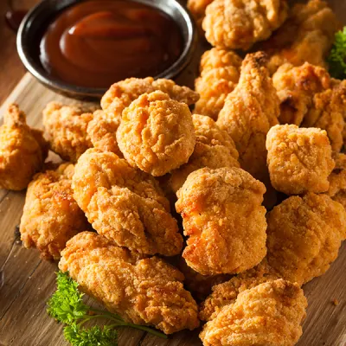
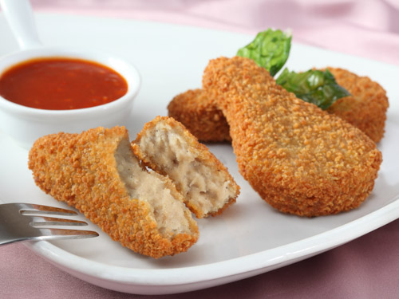
Introduction
Chicken products
Widely spreaded all over the world
In Sri Lanka, chicken sausages have been identified as one of the most popular foodstuffs
Dietary fibres are the key ingredient deficient in meat and meat products
Regular consumption of meat products therefore may lead to various health disorders.

Slide 4
Strategies to achieve healthier meat and meat products..
Modification of carcass composition
Manipulation of meat raw materials
Reduction of fat content and modification of the fatty acid profile
Reduction of cholesterol
Reduction of calories
Reduction of sodium content
Incorporation of health beneficial or functional ingredients
Carballo et al. (2001)

Slide 5
Carrot (Daucus carota)
Contains high amounts of alpha and beta carotene, ascorbic acid other phytochemical including phenolic compounds and organic acids (Crude fiber- 1.2%)
Moringa oleifera (Murunga/Drumstic) leaves
Strong antioxidant and antibacterial activity, high amount of ascorbic acid, estrogenic substances, beta sitosterol, iron, calcium, phosphorus, copper, vitamin A, C, E), riboflavin, nicotinic acid, pyridoxine, beta carotene, protein, and amino acids (Crude fiber-11.23%)
Pumpkin (Cucurbita maxima)
A good source of carotenoids, minerals, dietary fiber and ascorbic acid when it ripes, also have several health benefits. Fruit's pulp has sedative, emollient, and cooling properties (Crude fiber 2.85%)

Slide 6
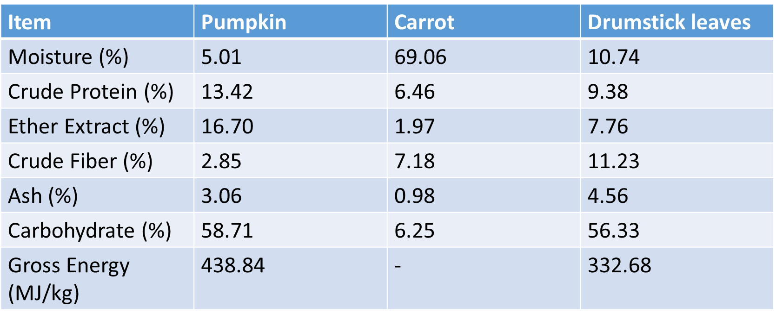
Nutritional profile of pumpkin, carrot and drumstick leaves
Sources: Mohaammed et al. (2014); Khatib et al. (2020 ); Sobhy et al. (2015).

Slide 7
Objectives
To evaluate the proximate composition, physicochemical and sensory characteristics of chicken sausage incorporated with different levels of vegetable mixture containing Cucurbita maxima, Daucus carota and Moringa oleifera, respectively at 6%, 12% and 18% levels

Slide 8
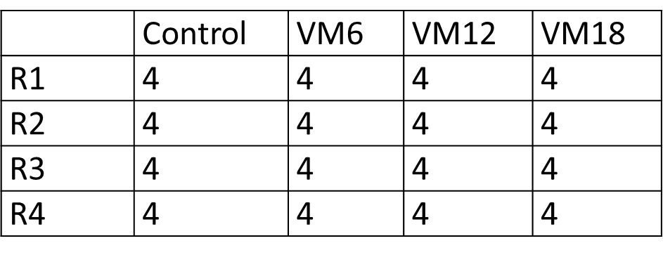
Materials and Methods
Location - Laboratories of the Faculty of Agricultural Sciences, Sabaragamuwa University of Sri Lanka
The experimental design: CRD
Control: Sausages incorporated with the vegetable mixture at 0% inclusion level.
VM6: Sausages incorporated with the vegetable mixture at 6% inclusion level.
VM12: Sausages incorporated with the vegetable mixture at 6% inclusion level.
VM18: Sausages incorporated with the vegetable mixture at 18% inclusion level.

Slide 9
Formulae of prepared vegetable-chicken sausages (per 100g)
Formulation of vegetable mixture
Vegetable | % of vegetable
Pumpkin | 54%
Carrot | 45.25%
Drumstick leave powder | 0.75%

Slide 10
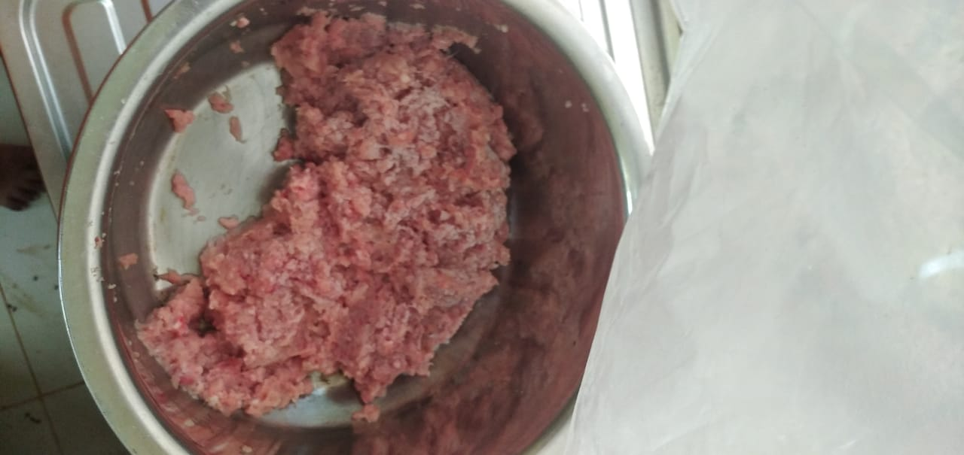
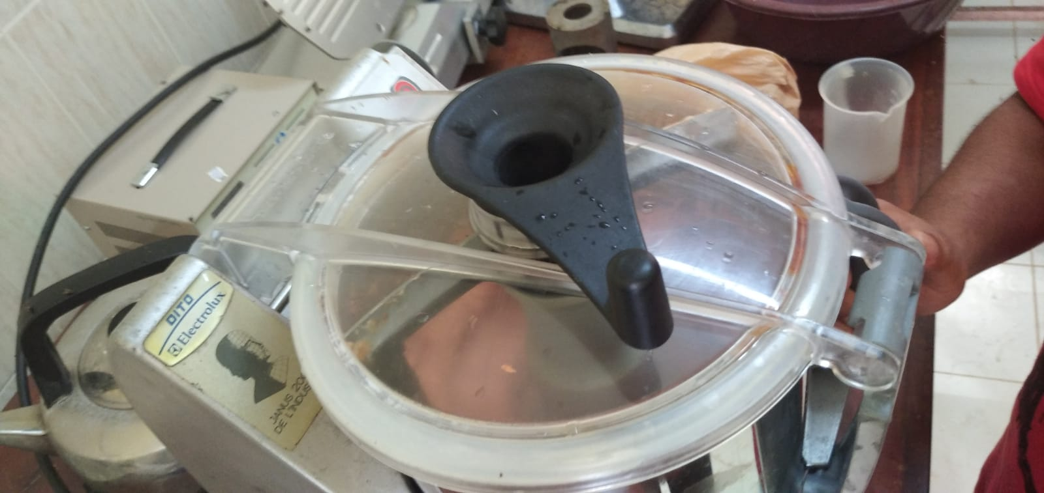
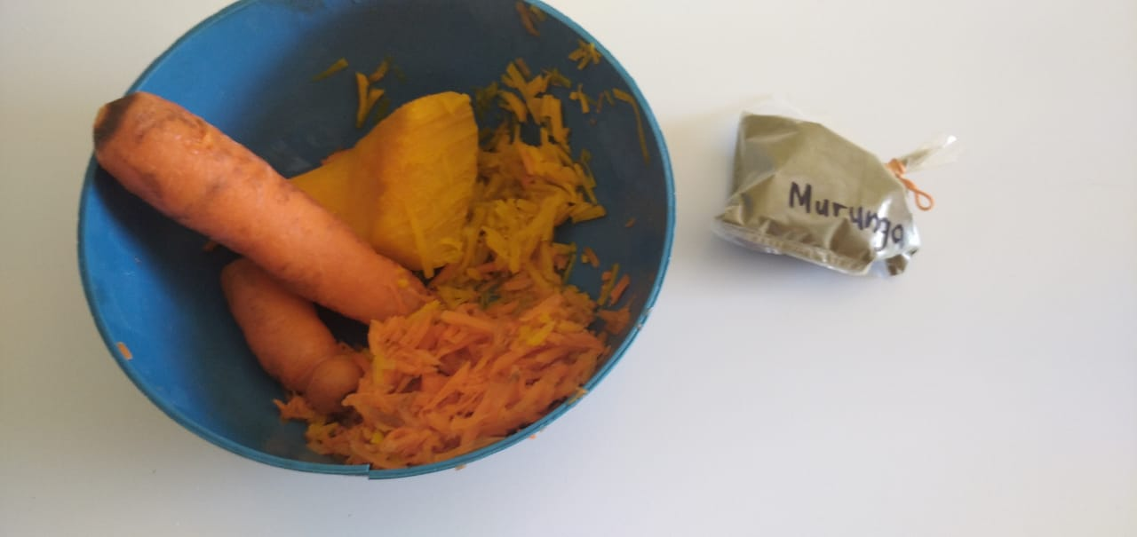
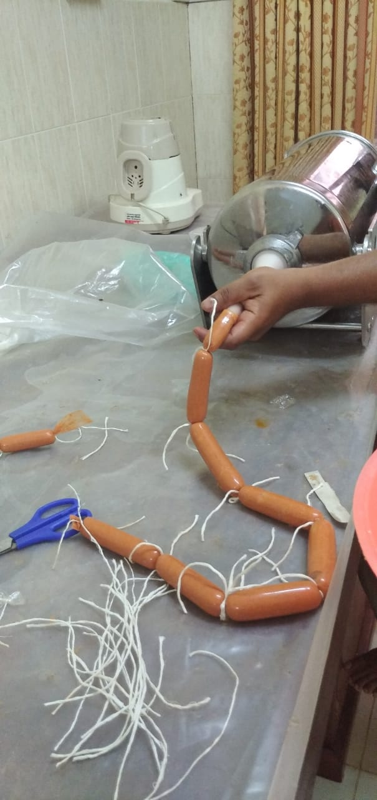
Lean meat cutting in to smaller chunks and mincing
Bowl chopping meat with non meat ingredients
Preparation of the vegetable mixture
Stuffing into cellulose casings
Cooking until core temperature reaches to
72 ± 2°C
Showering, peeling, vacuum packing and freezing

Slide 11
Analytical procedures
Gross energy (GE) and proximate analysis (AOAC, 2005)
Physicochemical parameters including pH, Cooking yield and Cooking loss, Water Holding Capacity (WHC), Texture (hardness), Juiciness, Moisture-retention, Colour measurements (CIE-L*a*b), Folding test, Extract release volume (ERV),
Sensory evaluation- Toughness, colour, appearance, aroma, flavour, juiciness and overall acceptability
Statistical analysis
The data were statistically analysed using one-way ANOVA procedure using SAS version 9.0- and the sensory data were analysed using Freidman test, Minitab
All the graphs were illustrated using Microsoft Excel 2010 version

Slide 12
Results and Discussion
1. Proximate composition and Gross energy
Parameters¹ | Levels of incorporation of the vegetable mixture
 | Control | VM6% | VM12% | VM18%
Moisture % | 63.23+0.14 | 66.52 + 0.12 | 66.83+ 0.19 | 67.22+ 0.68
Crude protein % | 16.95+ 0.07 | 16.66+ 0.22 | 16.24+0.11 | 15.92+0.14
Ether extract % | 13.61+0.03 | 13.12+0.10 | 12.77+0.24 | 12.45+0.01
Crude fiber % | 0.32+0.32 | 0.52+0.33 | 0.68+0.01 | 1.38+0.02
Ash % Gross energy | 2.84+0.01 16.19 MJ/kg | 2.72+0.01 15.99 MJ/kg | 2.58+0.01 17.68 MJ/kg | 2.39+0.01 18.12 MJ/kg

Slide 13
2. Cooking yield %
Cooking yields of the control and the chicken sausages incorporated with 6% vegetable mixture were similar (P>0.05)
Increasing inclusion levels from 6% to 18% reduced the cooking yield significantly (P<0.05)

Slide 14
3. pH value
Sausage pH was declined (P<0.05) with increasing levels of the vegetable mixture

Slide 15
4. Water holding capacity %
The highest (P<0.05) WHC was reported from the sausage incorporated with 18% vegetable mixture
WHC of sausage samples from the control and 6% inclusion rate were similar (P>0.05)

Slide 16
5. Sausage colour
External surface lightness (L*) values were different (P<0.05)
The highest L* was reported from the control and this finding indicates that the control has the lightest colour

Slide 18
6. Texture (Hardness value) and Folding test

Slide 19
7. Juiciness
The juiciness of chicken sausages incorporated with the vegetable mixture ranged from 14.51 to 15.9 %.
Chicken sausages had 18% vegetable mixture showed the highest juiciness (P<0.05) value

Slide 20
8. Extract release volume
Chicken sausages incorporated with 18% vegetable mixture showed the highest ERV (P<0.05)
ERV of the control, chicken sausages with 6% and 12% vegetable mixture were similar (P>0.05)

Slide 21
9. Moisture retention
The moisture retention of chicken sausages with vegetables were similar (P>0.05)
Moisture retention of the control sample was lower (P<0.05) than the other three treatments

Slide 22
10. Sensory attributes
The highest toughness score - control.
The lowest toughness score - VM18%
The highest score for colour - VM12%
The lowest score for colour - VM18%
The highest score for appearance- VM12%
The lowest appearance score- VM18%.
The highest score for aroma - Control sample than the other three treatments.
The highest score for flavour- VM12%
The lowest score for flavour - VM18%.
An increasing trend of juiciness from control to VM18%
Highest overall acceptability –VM12%

Slide 23
Conclusion
Inclusion of the vegetable mixture favourably altered the physicochemical properties of sausages and therefore can be used as a substitute to chicken at any level tested
In overall the present study concluded that the inclusion of minced vegetable mixture in the sausage formulation at 18% level maximally contributes to the development of physicochemical properties tested
Substitution of chicken with 6% and 12% of vegetable mixture attracted panellists the most

Slide 24
Further studies
Focus on the use of carrot and pumpkin in other meat products particularly in dehydrated powder form
Identify the shelf life of the chicken sausages incorporated with vegetables
Microbiological characteristics
Market survey

Slide 25
References
Abdolghafour, B. and Saghir, A. (2014) Effect of whey protein concentrate on quality and shelf life of buffalo meat emulsion sausage. Scholars Journal of Agriculture and Veterinary Sciences, 1(4), pp.201-210.
AOAC (2005) Official Methods of Analysis, 17th edn. Association of Official Analytical Chemists, Washington DC
Ayo, J., J. Carballo, M.T. Solas and F. Jimenez-Colmenero (2008). Physicochemical and sensory properties of healthier frankfurters as affected by walnut and fat content. Food Chem., 107: 1547-1552.
Ikhlas, B., Huda, N., & Noryati, I. (2011). Chemical composition and physicochemical properties of meatballs prepared from mechanically deboned quail meat using various types of flour. International Journal of Poultry Science, 10(1), 30–37. https://doi.org/10.3923/ijps.2011.30.37
Lanier TC (1992) Measurement of surimi composition and functional properties. In: Lanier TC, Lee CM (eds.) Surimi technology. Marcel Dekker Inc., New York, pp. 123–163.
Lin, K.W. and H.Y. Huang, (2003). Konjac/gellan gum mixed gels improve the quality of reduced-fat frankfurters. Meat Sci., 65: 749-755.
Lynda, D.C. (2018) Effect of Cooking Method on Meat Texture in Normal and Woody Broiler Breast Fillets Using Instrumental Analysis and Descriptive Sensory Analysis, Scholarworks@UARK
El Khatib, S. and Muhieddine, M., 2020. Nutritional profile and medicinal properties of pumpkin fruit pulp. The Health Benefits of Foods-Current Knowledge and Further Development, pp.1-20

Slide 26
Thank You…

