Slide 1
A Comparison of the Effect of Sugarcane Bagasse-based Biochar and Boiler ash on Soil Physicochemical Properties and Initial Growth of Sugarcane
K.G.K. Madhushani, A.D. Ampitiyawatta, B.R. Kulasekara
Faculty of Agricultural Sciences, Sabaragamuwa University of Sri Lanka, Belihuloya, Sri Lanka
Sugarcane Research Institute, Uda Walawe, Sri Lanka

Slide 2
Content for the presentation
Introduction
Objectives
Material and Methods
Results and Discussion
Conclusion and Recommendations
References

Slide 3
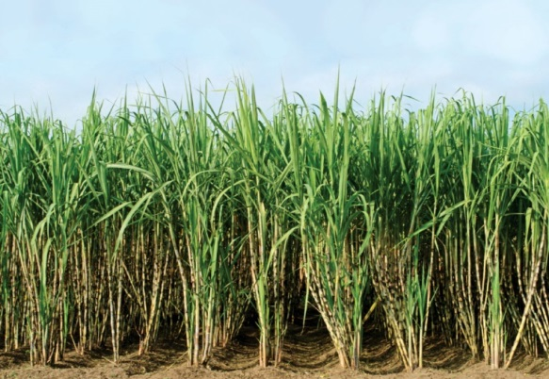
Introduction
Sugarcane is long duration cash crop.
Mono culture
Continues/intensive cropping
Higher Nutrient removal
Soil degradation
Sustainability of the cropping system
Required - soil rehabilitation & correct nutrient management
Ex. Use of soil organic amendments – Biochar & etc.

Slide 4
Introduction cont..
Preparation of biochar is energy consuming process.
Biochar
Substitute
Boiler ash
Factory with 1250t of cane per day - produces about 3-5t of boiler ash per day.
Under Sri Lankan soil conditions - Limited information on
Physical & chemical characteristics
Effect on soil and sugarcane plant growth for boiler ash
Correct levels for application
Correct handling of boiler ash recyclable manner.

Slide 5
Objectives
Main objective
To compare the effect of boiler ash and biochar on soil physicochemical properties and the initial growth of the sugarcane variety of SL 96 128.
Specific objectives
To analyze the physicochemical properties of biochar and boiler ash.
To identify the best amount of boiler ash that should be added to the sugarcane growing soils as a soil amendment.

Slide 6
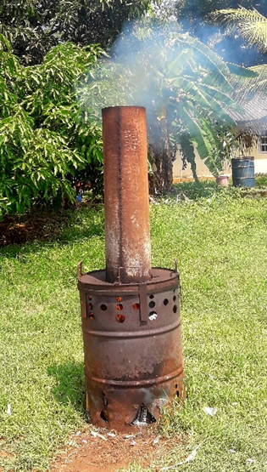
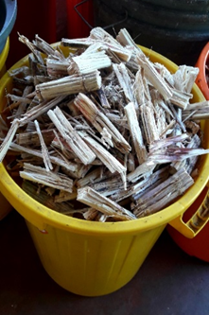
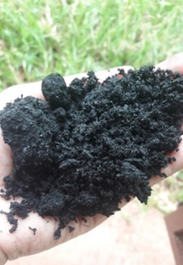
Materials and Methods
Experimental location
Sugarcane Research Institute, Uda Walawe.
Sugarcane bagasse and boiler ash
Sugar Company (PVT) Limited, Pelwatte
Biochar
Sugarcane bagasse
Barrel method

Slide 7
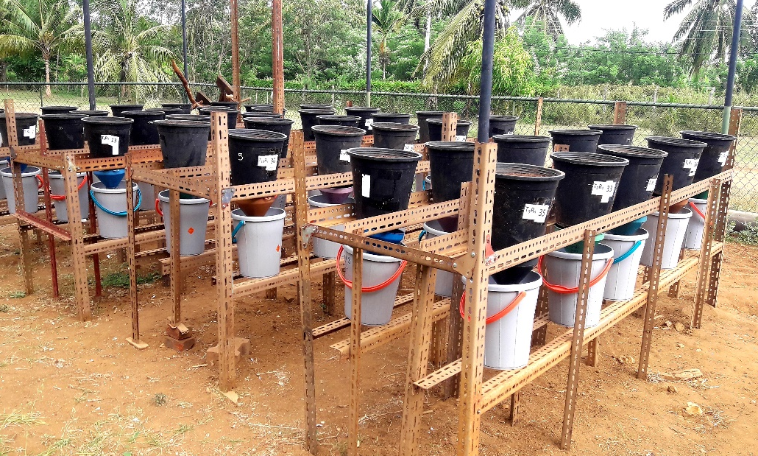
Materials and methods cont.…
Research design
Randomized complete block design (RCBD)
Experimental details
Pot culture under shade house condition
SL 96 128 single budded set
Ten treatments
4 levels of biochar
4 levels of boiler ash
4 replicates

Slide 8
Materials and methods cont.…
Treatment number | Treatment
T₁ | 1.0t/ha Biochar + N:P:K recommendation of SRI
T₂ | 2.0t/ha Biochar + N:P:K recommendation of SRI
T₃ | 4.0t/ha Biochar + N:P:K recommendation of SRI
T₄ | 6.0t/ha Biochar + N:P:K recommendation of SRI
T₅ | 1.0t/ha Boiler ash + N:P:K recommendation of SRI
T₆ | 2.0t/ha Boiler ash + N:P:K recommendation of SRI
T₇ | 4.0t/ha Boiler ash + N:P:K recommendation of SRI
T₈ | 6.0t/ha Boiler ash + N:P:K recommendation of SRI
T₉ | N:P:K recommendation of SRI (Control-1)
T₁₀ | Zero amendments (Control-2)

Slide 9
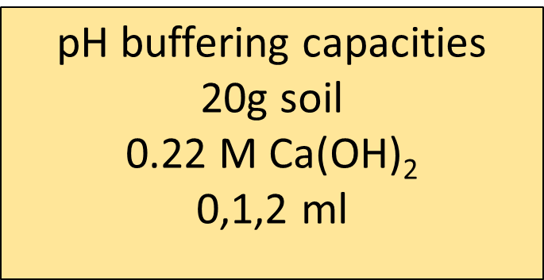
Materials and methods cont.…
pH buffering capacities
The resulting pH was measured with time durations required for maximum neutralization.

Slide 10
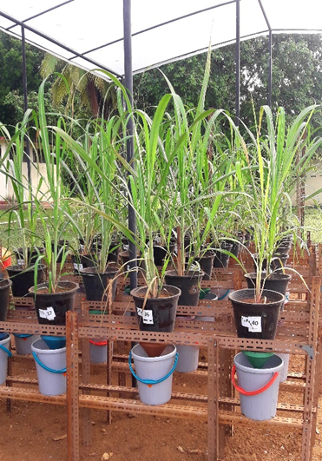
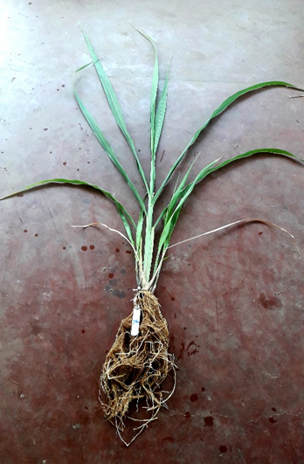
Materials and methods cont.…
Plant growth parameters
3 months after planting,
Plant height
Shoot dry weight (SDW)
Root dry weight (RDW)
Total dry weight (TDW)
Soil samples were collected from each pot to analyze soil for their physical and chemical parameters

Slide 11
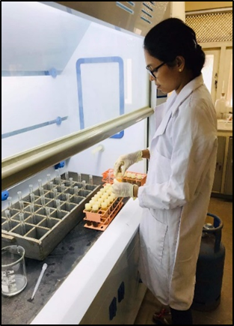
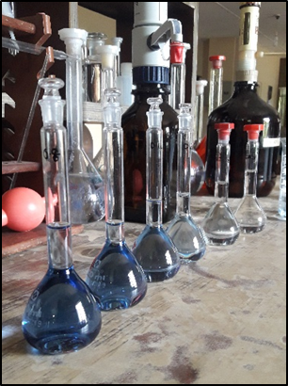
Materials and methods cont.…
Soil physicochemical properties analysis
Soil pH
pH meter
Soil EC
Electrical conductivity meter
Soil CEC
95 % ethanol and standard Na stock solution method
Soil organic carbon
Walkley and Black method
Modified colorimetric method by using UV Spectrophotometer
Available P
Standard Olsen method by using UV Spectrophotometer
Exchangeable K
Ammonium acetate extraction method by using AAS
Available Zn
DTPA extraction method by using AAS

Slide 12
Results and Discussion
Biochar and boiler ash chemical analysis
Parameter | Biochar | Boiler ash
pH EC (mS/cm) Organic carbon % Total N (mg kg⁻¹) Available P (mg kg⁻¹) Exchangeable K(mg kg⁻¹) Exchangeable Ca (mg kg⁻¹) Exchangeable Mg (mg kg⁻¹) Available Zn (mg kg⁻¹) Available Cu (mg kg⁻¹) Available Fe (mg kg⁻¹) | 10.65 1.923 1.56 % Nil 85 337 15.85 10.56 0.259 0.0492 3.29 | 9.41 0.5625 14.09% Nil 390 364 24.84 21.38 0.445 0.1374 10.25

Slide 13
Results and discussion cont.…
T1 - 1t/ha Biochar + N:P:K recommendation of SRI
T2 - 2t/ha Biochar + N:P:K recommendation of SRI
T3 - 4t/ha Biochar + N:P:K recommendation of SRI
T4 - 6t/ha Biochar + N:P:K recommendation of SRI
T5 - 1t/ha Boiler ash + N:P:K recommendation of SRI
T6 - 2t/ha Boiler ash + N:P:K recommendation of SRI
T7 - 4t/ha Boiler ash + N:P:K recommendation of SRI
T8 - 6t/ha Boiler ash + N:P:K recommendation of SRI
T9 - N:P:K recommendation of SRI (control)
T10 – Zero amendments (control)

Slide 14
Results and discussion cont.…
Soil CEC
Organic carbon
a
a
a
a
a
a
a
a
a
a
a
a
a
a
a
a
a
a
a
a
T1 - 1t/ha Biochar + N:P:K recommendation of SRI
T2 - 2t/ha Biochar + N:P:K recommendation of SRI
T3 - 4t/ha Biochar + N:P:K recommendation of SRI
T4 - 6t/ha Biochar + N:P:K recommendation of SRI
T5 - 1t/ha Boiler ash + N:P:K recommendation of SRI
T6 - 2t/ha Boiler ash + N:P:K recommendation of SRI
T7 - 4t/ha Boiler ash + N:P:K recommendation of SRI
T8 - 6t/ha Boiler ash + N:P:K recommendation of SRI
T9 - N:P:K recommendation of SRI (control)
T10 – Zero amendments (control)

Slide 15
Results and discussion cont.…
Total N
Available P
a
a
a
a
a
a
a
a
a
a
a
bc
T1 - 1t/ha Biochar + N:P:K recommendation of SRI
T2 - 2t/ha Biochar + N:P:K recommendation of SRI
T3 - 4t/ha Biochar + N:P:K recommendation of SRI
T4 - 6t/ha Biochar + N:P:K recommendation of SRI
T5 - 1t/ha Boiler ash + N:P:K recommendation of SRI
T6 - 2t/ha Boiler ash + N:P:K recommendation of SRI
T7 - 4t/ha Boiler ash + N:P:K recommendation of SRI
T8 - 6t/ha Boiler ash + N:P:K recommendation of SRI
T9 - N:P:K recommendation of SRI (control)
T10 – Zero amendments (control)

Slide 16
Results and discussion cont.…
Exchangeable K
Available Zn
T1 - 1t/ha Biochar + N:P:K recommendation of SRI
T2 - 2t/ha Biochar + N:P:K recommendation of SRI
T3 - 4t/ha Biochar + N:P:K recommendation of SRI
T4 - 6t/ha Biochar + N:P:K recommendation of SRI
T5 - 1t/ha Boiler ash + N:P:K recommendation of SRI
T6 - 2t/ha Boiler ash + N:P:K recommendation of SRI
T7 - 4t/ha Boiler ash + N:P:K recommendation of SRI
T8 - 6t/ha Boiler ash + N:P:K recommendation of SRI
T9 - N:P:K recommendation of SRI (control)
T10 – Zero amendments (control)

Slide 17
Buffering capacities of treated soils

Slide 18
Buffering capacities of treated soils

Slide 19
Buffering capacities of treated soils

Slide 20
High buffering capacity
(0.99-1.08)
Treatment 3 (1.01)
Treatment 4 (1.07)
Medium buffering capacity
(1.09-1.18)
Treatment 2 (1.14)
Treatment 6 (1.115)
Treatment 7 (1.155)
Treatment 10 (1.185)
Low buffering capacity
(1.19-1.28)
Treatment 1 (1.25)
Treatment 5 (1.21)
Treatment 8 (1.19)
Treatment 9 (1.255)

Slide 21
Plant growth parameters
Plant height
Shoot dry weight
T1 - 1t/ha Biochar + N:P:K recommendation of SRI
T2 - 2t/ha Biochar + N:P:K recommendation of SRI
T3 - 4t/ha Biochar + N:P:K recommendation of SRI
T4 - 6t/ha Biochar + N:P:K recommendation of SRI
T5 - 1t/ha Boiler ash + N:P:K recommendation of SRI
T6 - 2t/ha Boiler ash + N:P:K recommendation of SRI
T7 - 4t/ha Boiler ash + N:P:K recommendation of SRI
T8 - 6t/ha Boiler ash + N:P:K recommendation of SRI
T9 - N:P:K recommendation of SRI (control)
T10 – Zero amendments (control)

Slide 22
Plant growth parameters
Root dry weight
Total dry weight
T1 - 1t/ha Biochar + N:P:K recommendation of SRI
T2 - 2t/ha Biochar + N:P:K recommendation of SRI
T3 - 4t/ha Biochar + N:P:K recommendation of SRI
T4 - 6t/ha Biochar + N:P:K recommendation of SRI
T5 - 1t/ha Boiler ash + N:P:K recommendation of SRI
T6 - 2t/ha Boiler ash + N:P:K recommendation of SRI
T7 - 4t/ha Boiler ash + N:P:K recommendation of SRI
T8 - 6t/ha Boiler ash + N:P:K recommendation of SRI
T9 - N:P:K recommendation of SRI (control)
T10 – Zero amendments (control)

Slide 23
Conclusion and Recommendations
Bagasse-based boiler ash is rich in plant nutritional characteristics compared to bagasse-based biochar.
Higher amount of biochar ( 4 & 6t/ha) added soils lead to improve the soil pH buffering capacities
Higher amount of boiler ash (6t/ha) and only chemical fertilizer added soils lead to reduce soil pH buffering capacities.
Up to 6t/ha of boiler ash with inorganic fertilizers not badly affected to the initial growth of the sugarcane variety of SL 96-128

Slide 24
Conclusion and Recommendations cont..
The direct soil application of boiler ash should be practiced under well-monitored conditions.
It is required a field level experiment with complete cropping cycle of sugarcane for further clarifications and confirmations.
It is required to test the effect of boiler ash on soil physiochemical and plant growth by applying different rates of boiler ash with more than 6 t/ha level.

Slide 25
References
Aslam, Z., Khalid, M., & Aon, M. (2014). Impact of Biochar on Soil Physical Properties. Scholarly Journal of Agricultural Science, 4(5), 280–284.
Aytenew, M., & Bore, G. (2020). Effects of Organic Amendments on Soil Fertility and Environmental Quality: A Review. Journal of Plant Sciences, 8(5), 112. https://doi.org/10.11648/j.jps.20200805.12
Bajirao, G., Nitinkumar, R., & Durgude, S. A. (2021). Effect of Bagasse Ash on Physico-Chemical Properties of Soil Effect of Bagasse Ash on Physico-Chemical Properties of Soil. January.
Bodhinayake, W. L., & Dharmawardene, N. (2001). Studies on Nutrient removal from alfisols by sugarcane variety CO 775 under irrigation. Journal of Soil Sciences Society Sri Lanka, vol 13.
Boschiero, B. N., Mariano, E., Torres-Dorante, L. O., Sattolo, T. M. S., Otto, R., Garcia, P. L., Dias, C. T. S., & Trivelin, P. C. O. (2020). Nitrogen fertilizer effects on sugarcane growth, nutritional status, and productivity in tropical acid soils. Nutrient Cycling in Agroecosystems, 117(3), 367–382. https://doi.org/10.1007/s10705-020-10074-w
Ding, Y., Liu, Y., Liu, S., Li, Z., Tan, X., Huang, X., Zeng, G., Zhou, L., & Zheng, B. (2016). Biochar to improve soil fertility. A review. Agronomy for Sustainable Development, 36(2). https://doi.org/10.1007/s13593-016-0372-z
Gopalasundaram, P., Bhaskaran, A., & Rakkiyappan, P. (2012). Integrated Nutrient Management in Sugarcane. Sugar Tech, 14(1), 3–20. https://doi.org/10.1007/s12355-011-0097-x
Inyang, M., Gao, B., Pullammanappallil, P., Ding, W., & Zimmerman, A. R. (2010). Biochar from anaerobically digested sugarcane bagasse. Bioresource Technology, 101(22), 8868–8872. https://doi.org/10.1016/j.biortech.2010.06.088

Slide 26
References
Khan, M. J., & Qasim, M. (2008). Integrated use of boiler ash as organic fertilizer and soil conditioner with NPK in calcareous soil. Songklanakarin Journal of Science and Technology, 30(3), 281–289.
Kulasekara, B., Lanka, S., Weerasinghe, A., Lanka, S., Ariyawansha, S., & Lanka, S. (2021). Research Article Production of Organic Fertilisers by Using Sugarcane Industry By- products of Sri Lanka : A Preliminary Investigation. 3(June), 76–89.
Liyanage, M., & Jayakody, A. N. (2012). Feasibility of using soil pH Buffering Capacity for Dolomite Recommendation for tea growing soils in Sri Lanka Feasibility of using soil pH Buffering Capacity for Dolomite Recommendation for tea growing soils in Sri Lanka 1 – Tea Research Institute of Sri. November 2016.
Mapa, R., Somasiri, S. and Dassanayaka, A.R., (2010). Soils of the dry zone of Sri Lanka - Morphology, Characterisation and Classification (pp. 319). Sarvodaya Publishers, Sri Lanka.
Prabhath, N., Kumara, B. S., Vithanage, V., Samarathunga, A. I., Sewwandi, N., Maduwantha, K., Madusanka, M., & Koswattage, K. (2022). A Review on the Optimization of the Mechanical Properties of Sugarcane-Bagasse-Ash-Integrated Concretes. Journal of Composites Science, 6(10), 283. https://doi.org/10.3390/jcs6100283
Prem, K., Ghosh, A.K., & Kumar, D., (2010). Use of Flyash in Agriculture: A Way to Improve Soil Fertility and its Productivity. Asian Journal of Agricultural Research 4(1): 1-14.

Slide 27
References
Khan, M. J., & Qasim, M. (2008). Integrated use of boiler ash as organic fertilizer and soil conditioner with NPK in calcareous soil. Songklanakarin Journal of Science and Technology, 30(3), 281–289.
Kulasekara, B., Lanka, S., Weerasinghe, A., Lanka, S., Ariyawansha, S., & Lanka, S. (2021). Research Article Production of Organic Fertilisers by Using Sugarcane Industry By- products of Sri Lanka : A Preliminary Investigation. 3(June), 76–89.
Liyanage, M., & Jayakody, A. N. (2012). Feasibility of using soil pH Buffering Capacity for Dolomite Recommendation for tea growing soils in Sri Lanka Feasibility of using soil pH Buffering Capacity for Dolomite Recommendation for tea growing soils in Sri Lanka 1 – Tea Research Institute of Sri. November 2016.
Mapa, R., Somasiri, S. and Dassanayaka, A.R., (2010). Soils of the dry zone of Sri Lanka - Morphology, Characterisation and Classification (pp. 319). Sarvodaya Publishers, Sri Lanka.
Prabhath, N., Kumara, B. S., Vithanage, V., Samarathunga, A. I., Sewwandi, N., Maduwantha, K., Madusanka, M., & Koswattage, K. (2022). A Review on the Optimization of the Mechanical Properties of Sugarcane-Bagasse-Ash-Integrated Concretes. Journal of Composites Science, 6(10), 283. https://doi.org/10.3390/jcs6100283
Prem, K., Ghosh, A.K., & Kumar, D., (2010). Use of Flyash in Agriculture: A Way to Improve Soil Fertility and its Productivity. Asian Journal of Agricultural Research 4(1): 1-14.

Slide 28
Thank You

