Slide 1
Determination of the most suitable spawning substrate for Neon tetra (Paracheirodon innesi) in captive condition
MKTW Jinadasa1 , CN Walpita1, AR Mudalige 2, KPNNS Jayarathne 2
¹Department of Livestock Production, Faculty of Agricultural Sciences, Sabaragamuwa University of Sri Lanka
² National Aquaculture Development Authority of Sri Lanka (NAQDA)

Slide 2
Content
Introduction
Objectives
Material and Methods
Results and Discussion
Conclusion and Recommendations
References

Slide 3
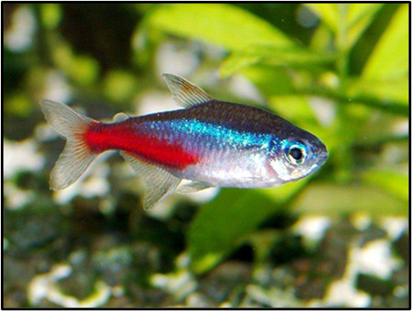
Introduction
Family : Characidae
Order : Characiformes
Life expectancy : 6 – 8 years
Diet : Omnivore
Temperature : 21–27°C
pH : 5.0 –7.0
Hardness : 2 - 10 dGH
Breeding : Egg scatterer

Slide 4
Introduction
The Neon tetra (Paracheirodon innesi) is one of the most valuable fish species in the ornamental fish trade.
P. innesi which inhabits blackwater streams of the Amazon basin.
Development of captive breeding and larval rearing are important to increase the commercially available stock.
The spawning of P. innesi in captivity is bit difficult if environmental conditions are not ideal.
And more important if providing effective substrate for spawning.

Slide 5
Objectives
To Identify the best spawning substrate for Neon tetra in captive condition.
To Identify the hatchability of eggs and the survival rate of fry at free swimming stage.

Slide 6
Material and Methods
Brood stock were obtained from domesticated stock from Ornamental Fish Breeding Center , Ginigathhena.
Steps,
1.Breeding Tank Preparation
2.Spawning Substrates Stabilization
3.Males And Females Introduction And Breeding
4.Larval Rearing & Nursery Period

Slide 7
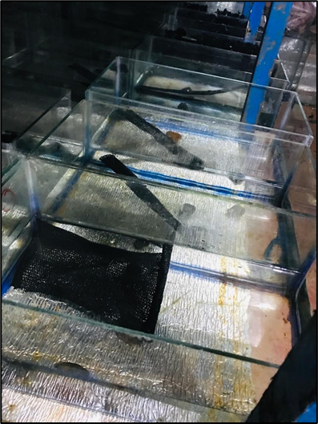
1.Breeding Tank Preparation
15 inches × 8 inches × 6 inches sized 16 glass tanks were supplied for this study. (including 4 treatments and 4 replicates)
Sterilization of tanks (KMnO4 solution -5g/50ml)
Water level 4 inches
Dark room was allocated for neon tetra breeding.

Slide 8
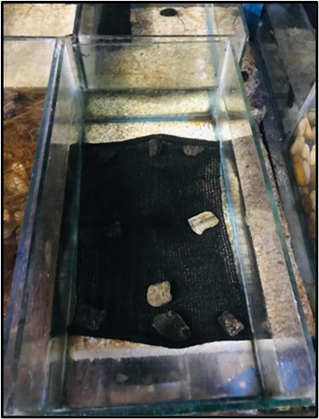
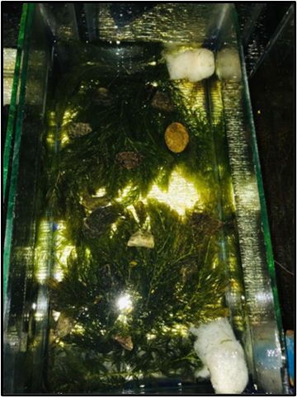
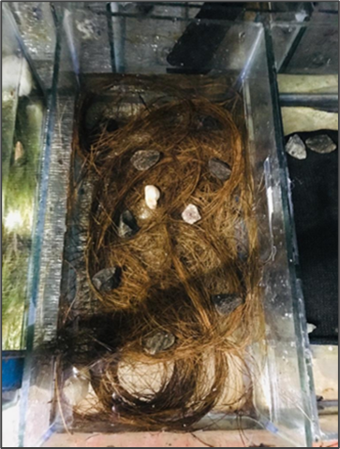
2. Spawning Substrates Stabilization

Slide 9
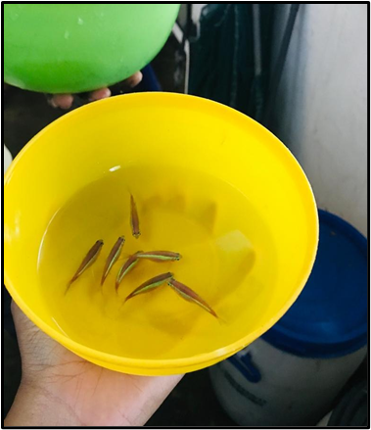
3.Males and females introduction and breeding
Females and males ratio - 1:1
Brood stock introduction
Females -morning
Males - evening
Each of these tanks was observed on next morning for eggs.
Parent fish were removed at observed time to avoid eating their own eggs.
Methylene Blue (2ppm) treatment

Slide 10
4.Larval rearing & nursery period
At free swimming stage (about 4-5 days) newly hatched artemia was given twice a day.
14 days old fry - transfer to nursery tanks
Nursery tanks 2 feet × 1 feet sized four cement tanks (stocking density 200 PL /ft2).
Water level - 2-3 inches
Uniform management practices were done throughout the study period.

Slide 11
Results and Discussion

Slide 12
Hatchability

Slide 13
Number of fry

Slide 14
Survival rate of larvae

Slide 15
pH

Slide 16
Dissolved oxygen level (mg/l)

Slide 17
Conclusion and Recommendations

Slide 18
Suggestions

Slide 19
References
Kucharczyk, D. et al. (2010) ‘The reproduction of neon tetra, Paracheirodon innesi (Myers, 1936), under controlled conditions’, Polish Journal of Natural Sciences, 25(1), pp. 81–92. Available at: https://doi.org/10.2478/v10020-010-0006-x.
De Silva, M.W.R.N. (1976) Experiments on breeding the Neon Tetra (Hyphessobrycon innesi Myers), J. Natn. Sci. Coun. Sri Lanka.
Pathirana, P.R.A. and Jayamanne, S.C. Development of a Low Cost Method for Breeding Paracheirodon innesi (Neon Tetra) in Captivity.
Cole, B. and Haring, M. (1999) Spawning and Production of the Serpae Tetra, Hyphessobrycon serpae Center for Tropical and Subtropical Aquaculture Publication Number 138.

Slide 20
Thank You

