Slide 1
Maturity Determination of Plant and Ratoon Crops of Sugarcane (Saccharum officinarum) Plantations Based on Unmanned Aerial Vehicle (UAV) Images
BLY Rangeshwari^{1*}, JBDAP Kumara¹ , NMPM Piyasena²
¹Department of Export Agriculture, Faculty of Agricultural Sciences, Sabaragamuwa University of Sri Lanka
²Department of Surveying and Geodesy, Faculty of Geomatics, Sabaragamuwa University of Sri Lanka
ons

Slide 2
Content for the presentation
Introduction
Objectives
Material and Methods
Results and Discussion
Conclusion and Recommendations
References

Slide 3
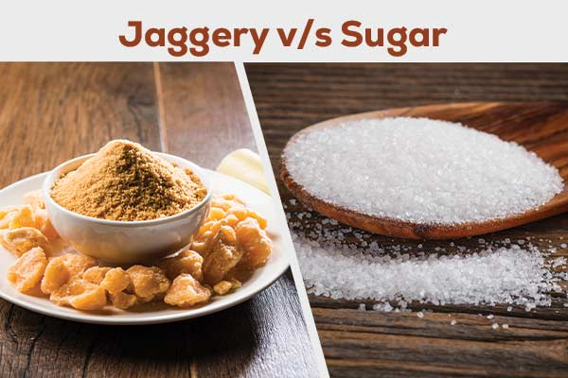
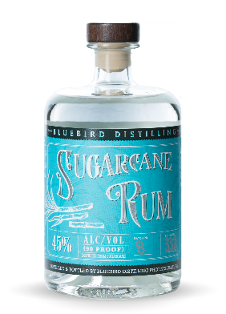
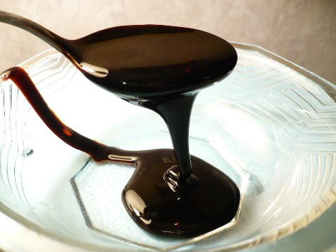
Introduction
Botanical Classification
Scientific Name : Saccharum officinarum
Family: Poaceae
Genus: Saccharum
Economic Importance
Sugar jaggery production
Ethanol production
Molasses
- Alcoholic beverages

Slide 4
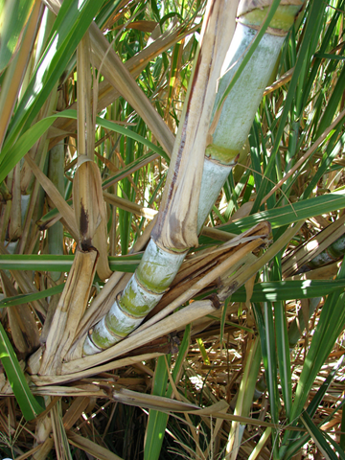
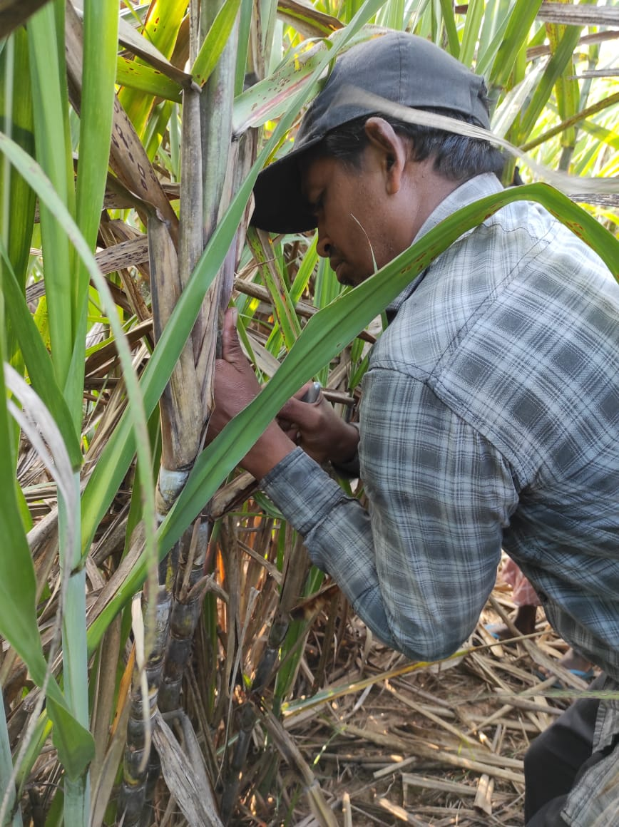
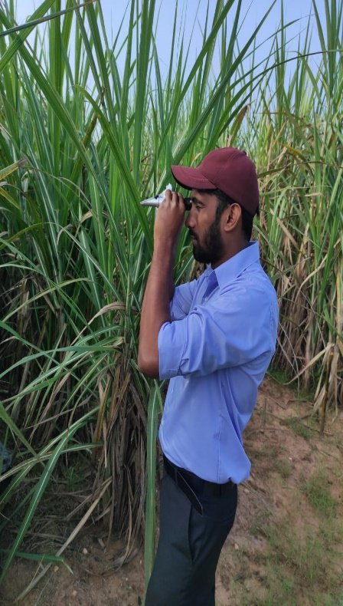
Maturity signs in sugarcane
Problems
Time consuming
Labor consuming
High cost

Slide 5
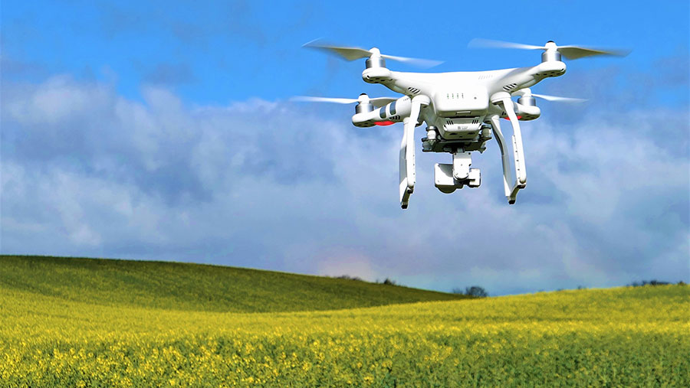
Unmanned Aerial Vehicle (UAV)
Globally used in,
Yield prediction
Soil and field monitoring
Crop monitoring
Fertilizer application
Pest monitoring

Slide 6
Objectives
Broad Objective
To recognize a method for timely estimation maturity of sugarcane by using DJI Phantom 4 drone-based multispectral images and Vegetative Indices (VIs).
Specific Objectives
To identify the relationships between VIs and sugar recovery with spectral images both plant and ratoon crops.
To identify most fitted VI for estimation of the maturity of sugarcane cultivations.

Slide 7
Material and Methods
Primary data – Ratoon (Intermediate zone)
2. Secondary data obtained from the previously conducted research
Time period - January to April 2022)
Plant crop ( Both Intermediate and Dry zone)

Slide 8
Research Methodology
Site Selection
Meteorological Data Collection
Flight Planning
Data Collection Using DJI Phantom 4 Drone
Image Processing
Data Analysis

Slide 9
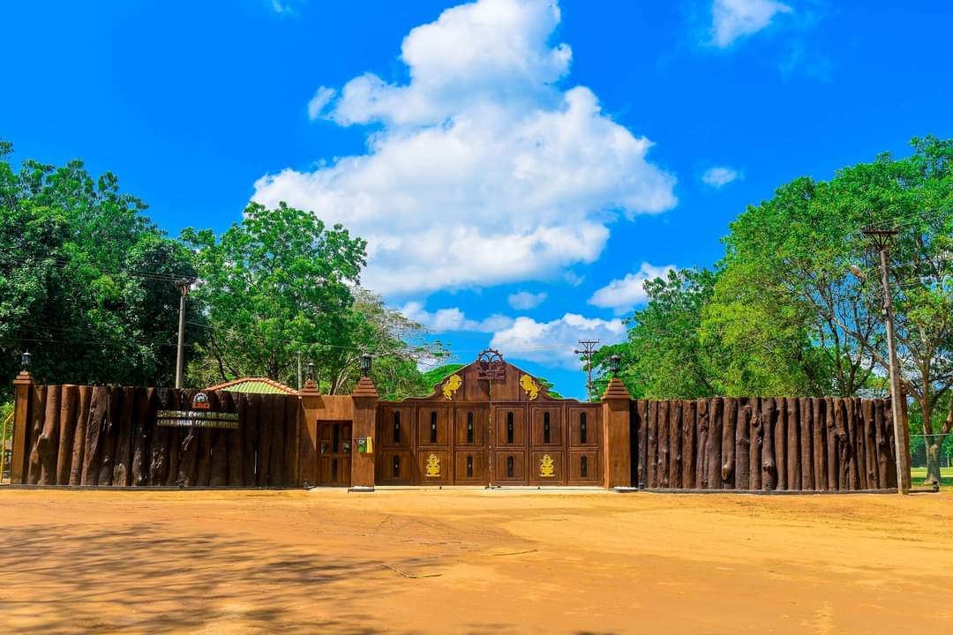
Research Location
Research was conducted at the Lanka Sugar Company Private Limited, Pelwatte
SL 96-128 Clone was selected
Image processing was done at the Faculty of Geomatics at Sabaragamuwa University of Sri Lanka

Slide 10
Sample and sites selection
Ratoon Plot
Intermediate Zone
Age (Months) | 9 | 11 | 12
Number of plots
 | 03 | 03 | 01
Number of destructive samples
 | 05 | 05 | 05

Slide 11
Field Data Collection
Estimation of Brix value
Five sugarcane plant samples were collected & Brix values were taken from using a Refractometer
Recovery Cane Sugar (RCS) values
Destructive five samples were used to get RCS values from the Pelwatte milling plant

Slide 12
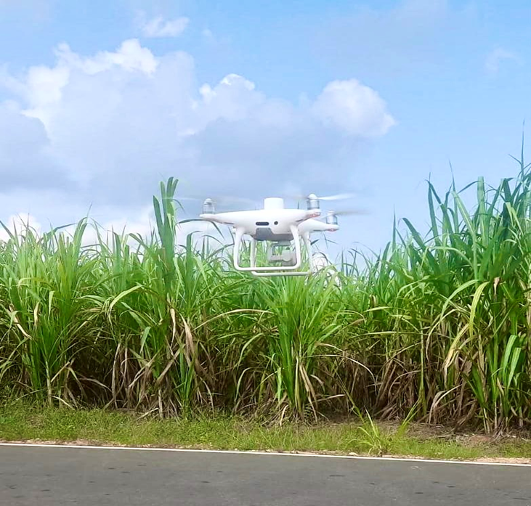
Meteorological Data Collection
Meteorological data were collected from the meteorological station at Pelwatte Sugar Company
Flight Planning
Overlap -80%
Flight height -60m
Flight time- 8 a.m.-12 p.m.

Slide 13
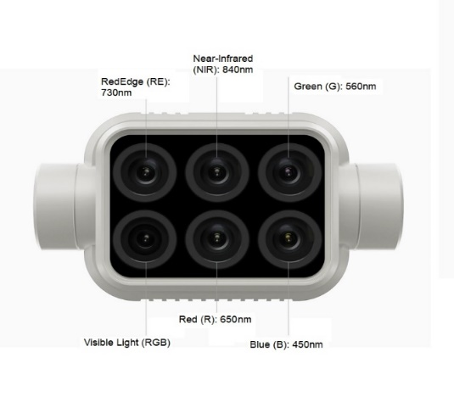
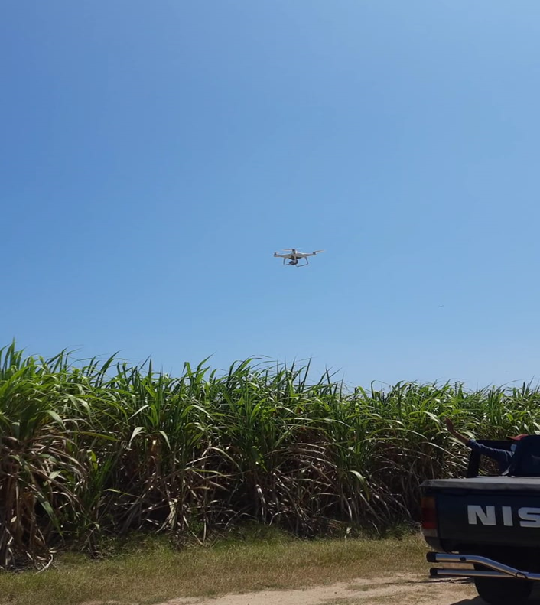
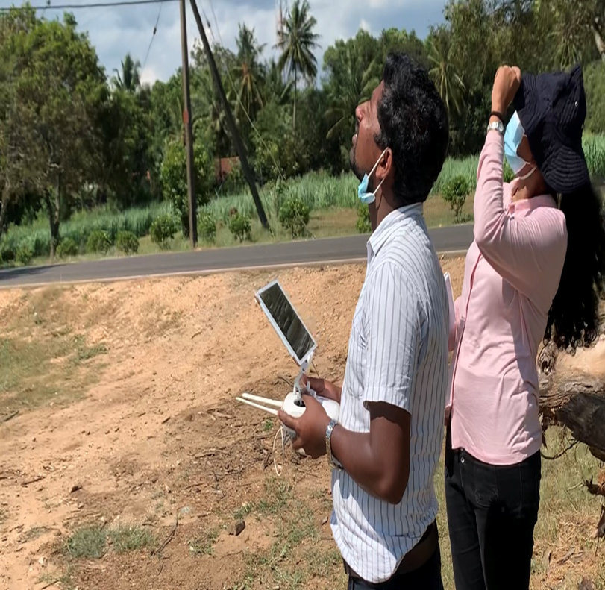
Multispectral images were collected by using the DJI Phantom 4 Drone
Sensors:
Blue(B) : 450 nm ± 16 nm
Green(G) : 560 nm ± 16 nm
Red(R) : 650 nm ± 16 nm
Red edge(RE) : 730 nm ± 16 nm
Near-infrared(NIR) : 840 nm ± 26 nm

Slide 14
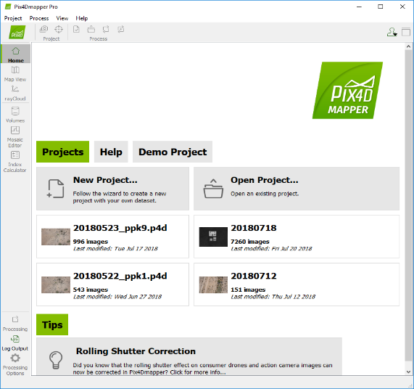
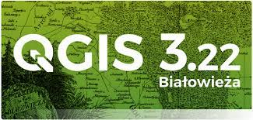
Image processing
Multispectral images were processed using the Pix4D mapper software to generate Orthomosaic image
Used QGIS software http://www.qgis.org/to calculate NDVI, GNDVI and NDRE values

Slide 15
Vegetation index
Normalized Difference Vegetation Index (NDVI)
Green Normalized Vegetation Index (GNDVI)
Normalized Difference Red Edge (NDRE)
NDVI GNDVI NDRE
Value ranges from −1.0 to +1.0
NDVI = $\frac{\text{(}\text{NIR}\text{ – }\text{Red}\text{) }}{\text{(}\text{NIR}\text{ + }\text{Red}\text{)} }$
GNDVI = $\frac{\text{(}\text{NIR}\text{ − }\text{Green}\text{)}}{\text{(}\text{NIR}\text{ + }\text{Green}\text{)}}$
NDRE = $\frac{\text{(}\text{NIR}\text{ – }\text{Red} \text{Edge}\text{)}}{\text{(}\text{NIR}\text{ + }\text{Red} \text{Edge}\text{)}}$

Slide 16
Data analysis
UAV image data and field sample data were organized and analyzed using Microsoft Excel 2016 for Windows
Correlation were done for variables to determine the relationships between NDVI, GNDVI, NDRE and maturity indices such as Brix and RCS

Slide 17
Results and Discussion
Determination of vegetation in the Ratoon sample plots
Reflectance maps
Index maps
Index scale Values
NDVI
NDRE
NDVI
NDRE
GNDVI
GNDVI

Slide 18
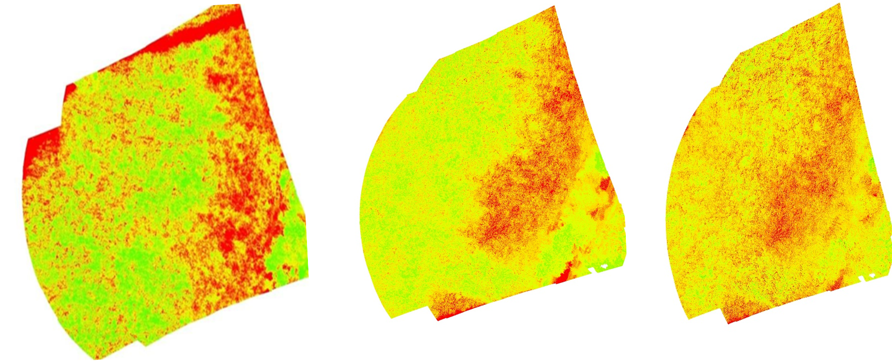
NDVI Index map GNDVI Index map NDRE Index map

Slide 19
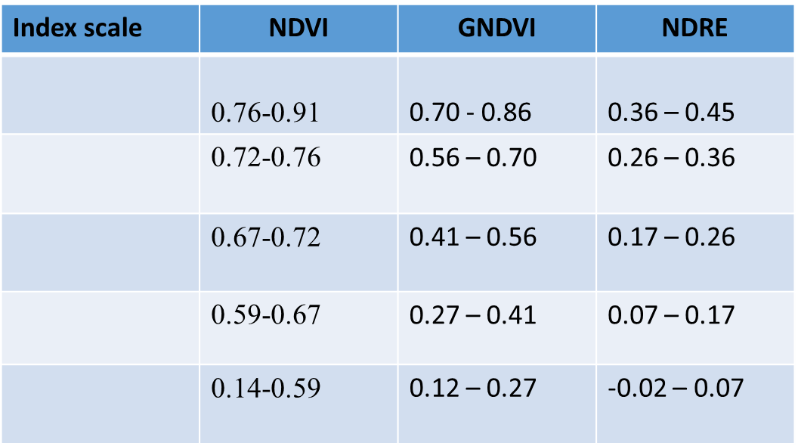
For Primary data set

Slide 20
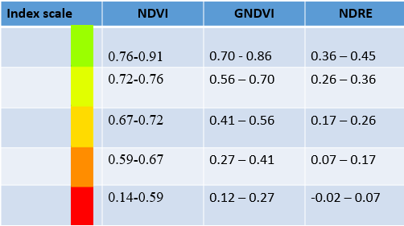
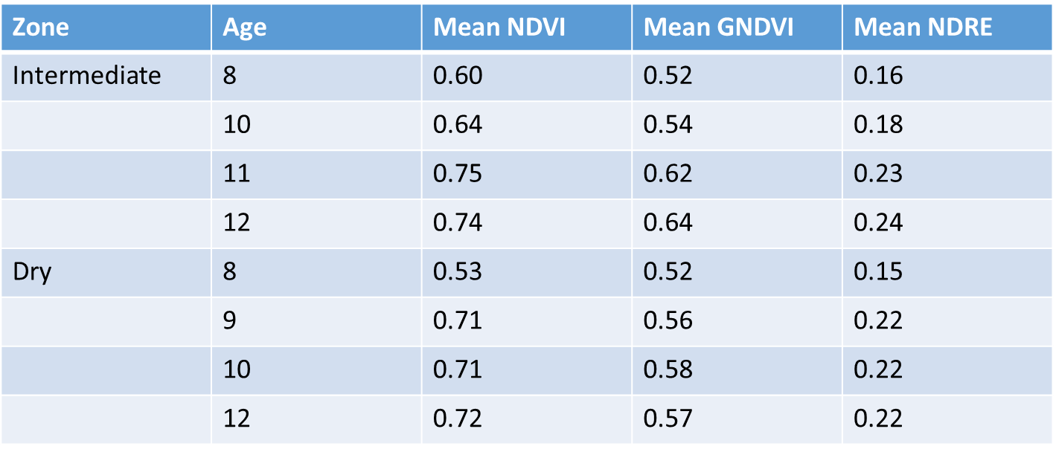
For Secondary Data Set

Slide 21
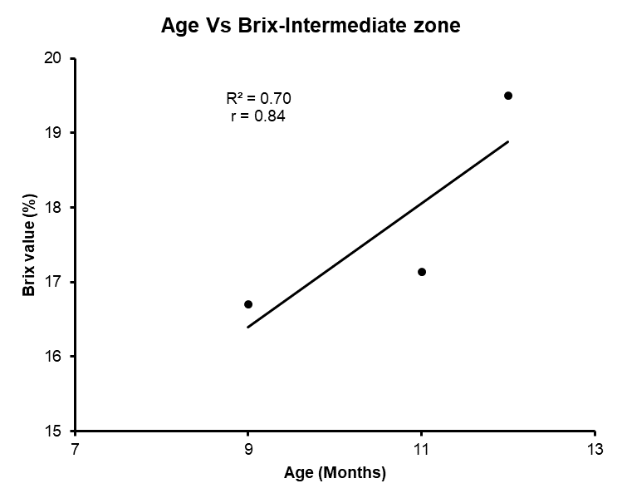
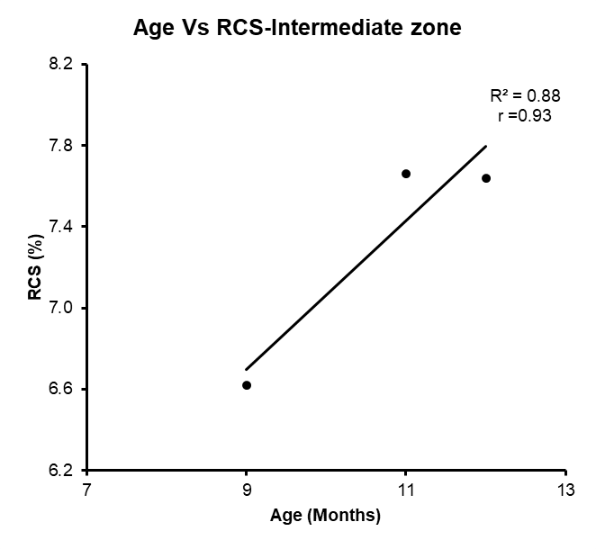
Using the Primary Data
Relationship between Age and Brix value (%) in Ratoon crops
Intermediate zone

Slide 22
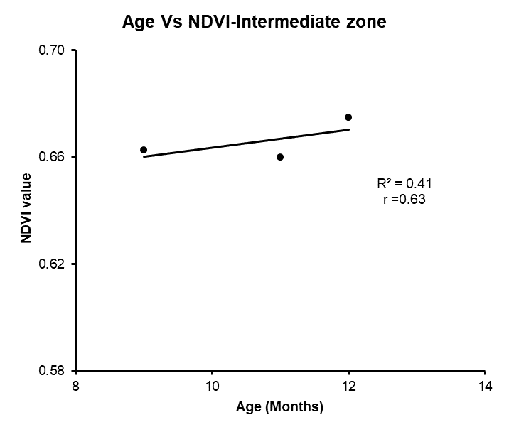
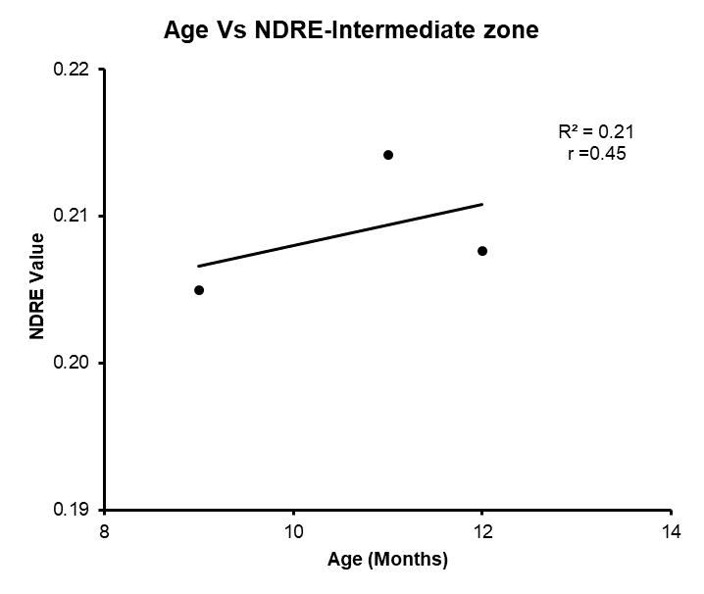
Relationship between Age with NDVI, NDRE

Slide 23
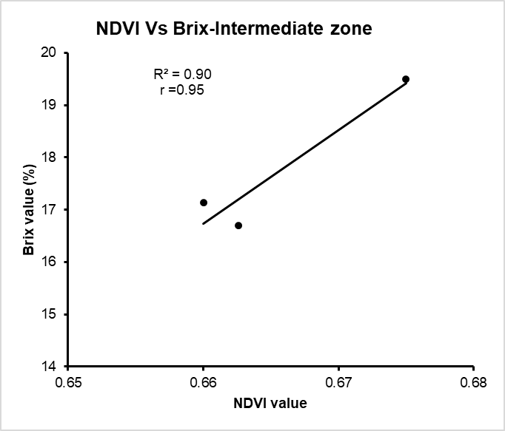
Relationship between Brix with NDVI, GNDVI

Slide 24
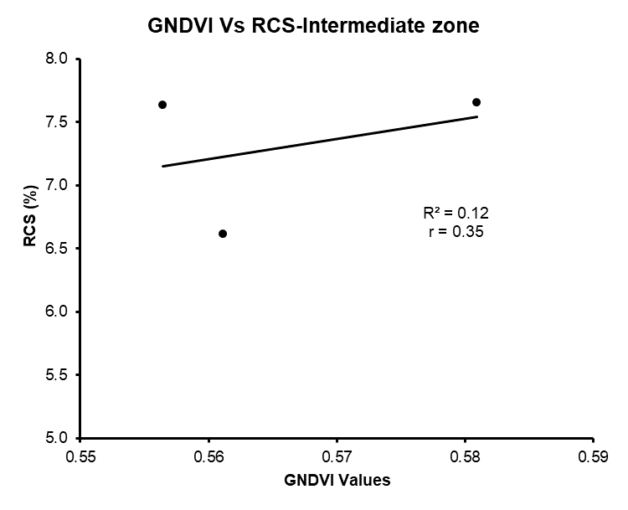
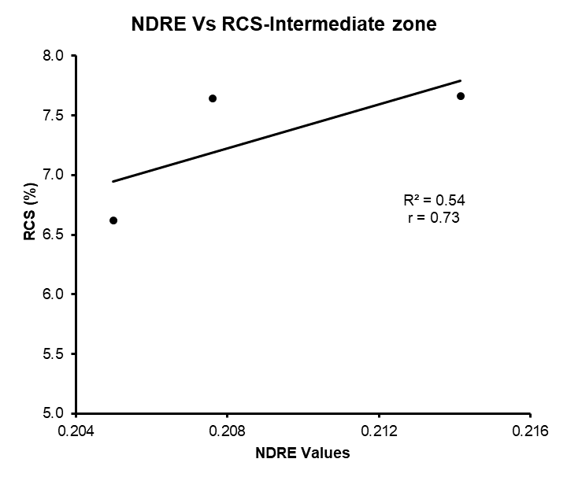
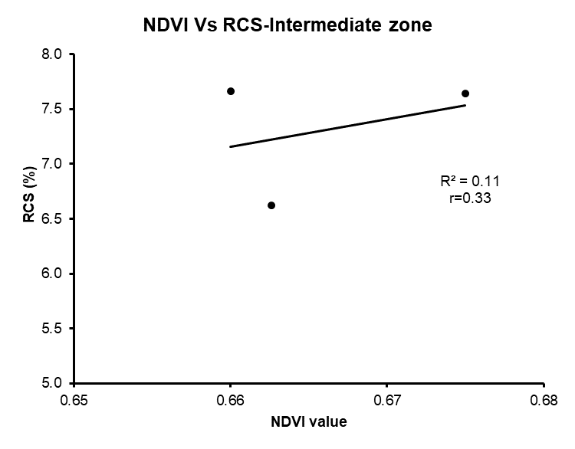
Relationship between RCS (%) with NDVI, GNDVI and NDRE

Slide 25
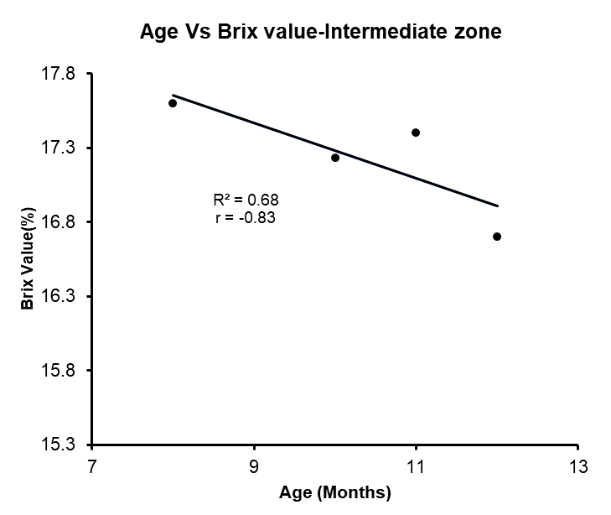
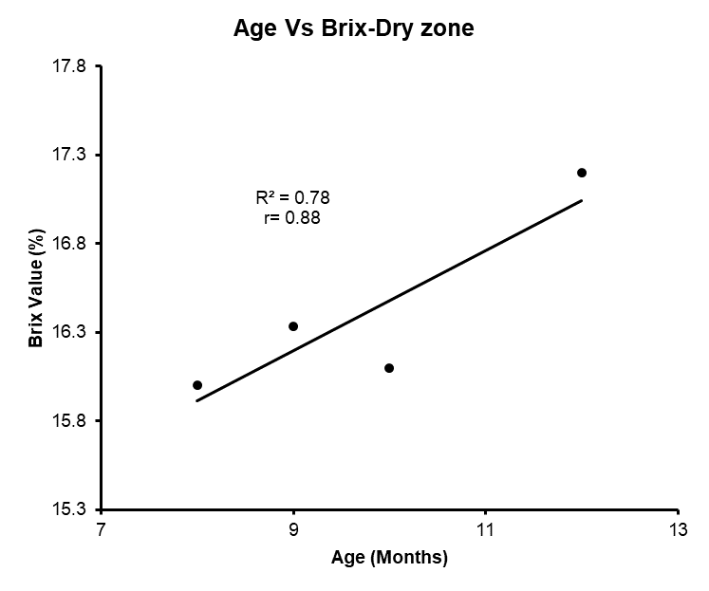
From using the Secondary Data set Plant crop

Slide 26
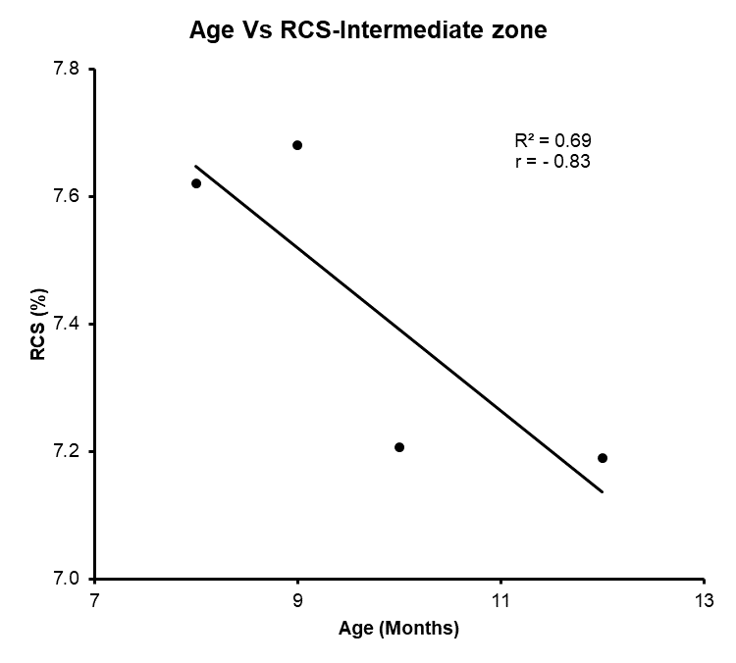
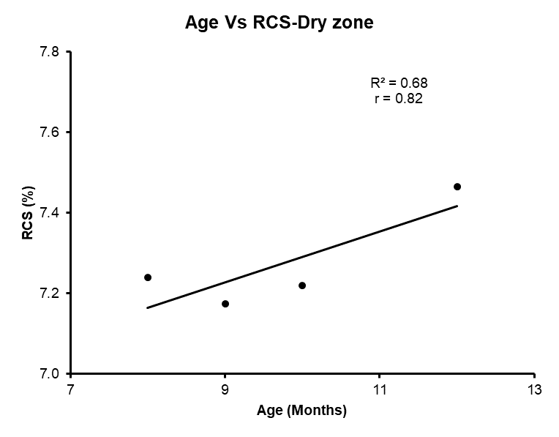
Relationship between the Age with RCS(%)

Slide 27
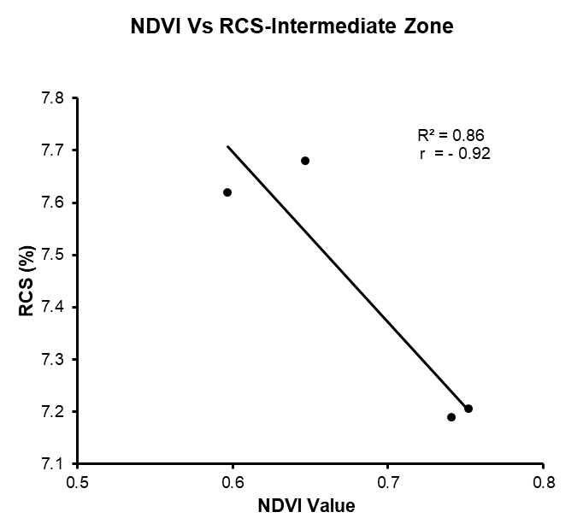
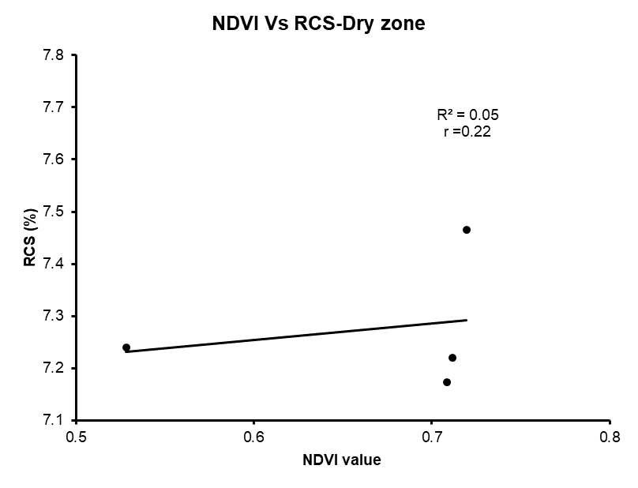
Relationship between NDVI with RCS (%)

Slide 28
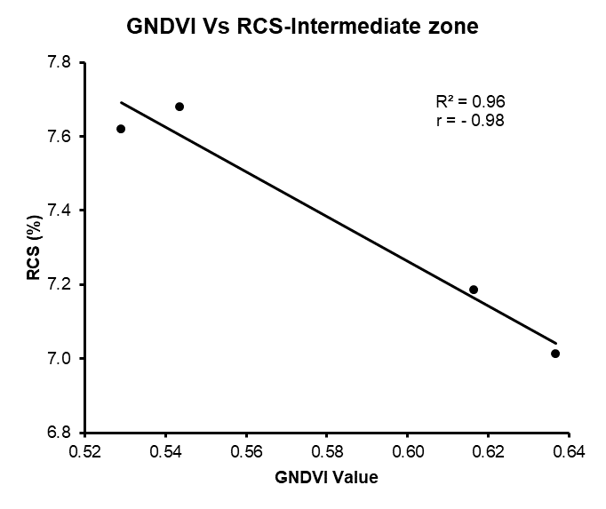
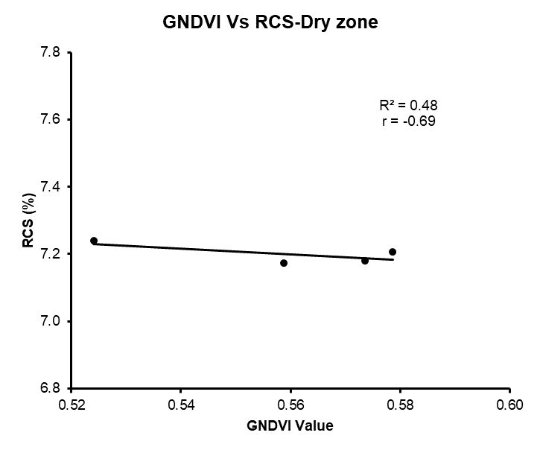
Relationship between GNDVI with RCS (%)

Slide 29
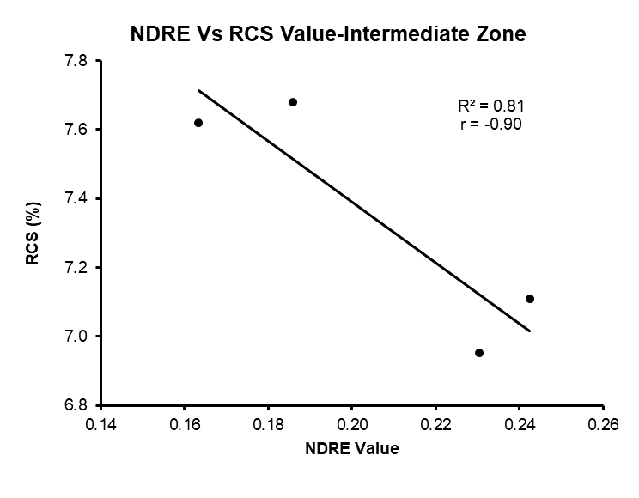
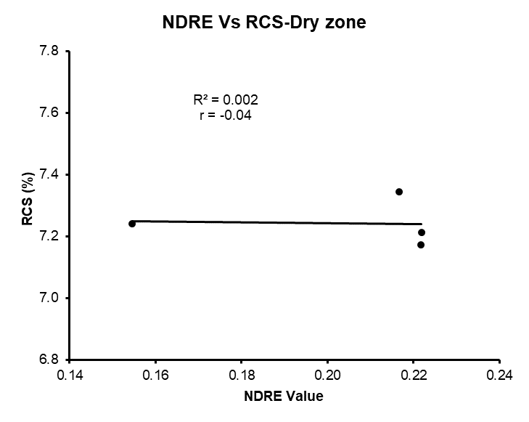
Relationship between NDRE with RCS (%)

Slide 30
Conclusion and Recommendations
Though the relationship between RCS (%) with the Vegetative Indices show a positive relationship in ratoon crops, plant crops showed both positive and negative relationship
So due to that could not be emphasize a proper conclusion
So further study is required to confirm the relationships between VIs and sugar recovery
This study requires more data to identify the most fitted VI for the estimation of the maturity of sugarcane cultivations

Slide 31
References
Akbarian, S., Xu, C., Wang, W., Ginns, S. and Lim, S., 2022. An investigation on the best-fit models for sugarcane biomass estimation by linear mixed-effect modelling on unmanned aerial vehicle-based multispectral images: A case study of Australia. Information Processing in Agriculture.
Akbarian, S., Xu, C.Y. and Lim, S., 2020. Analysis on the effect of spatial and spectral resolution of different remote sensing data in sugarcane crop yield study. ISPRS Annals of the Photogrammetry, Remote Sensing and Spatial Information Sciences, 3, pp.655-661.
Barbosa Júnior, M.R., Moreira, B.R.D.A., Brito Filho, A.L.D., Tedesco, D., Shiratsuchi, L.S. and Silva, R.P.D., 2022. UAVs to Monitor and Manage Sugarcane: Integrative Review. Agronomy, 12(3), p.661.
Chohan, M., 2019. Impact of climate change on sugarcane crop and remedial measures-a review. Pakistan Sugar Journal, 34(1), pp.15-22.

Slide 32
Thank You

