Slide 1
Early Characterization of Selected Hevea Genotypes Using Morphological and Physiological Parameters to Accelerate the Clone Recommendation
LU Pelagewaththa¹*, SP Withanage², JBDAP Kumara¹
¹Department of Export Agriculture, Faculty of Agricultural Sciences, Sabaragamuwa
University of Sri Lanka
²Department of Genetics & Plant Breeding, Rubber Research Institute of Sri Lanka, Substation Nivithigalakele, Mathugama

Slide 2
Content for the presentation
Introduction
Objectives
Material and Methods
Results and Discussion
Conclusion and Suggestions
References

Slide 3
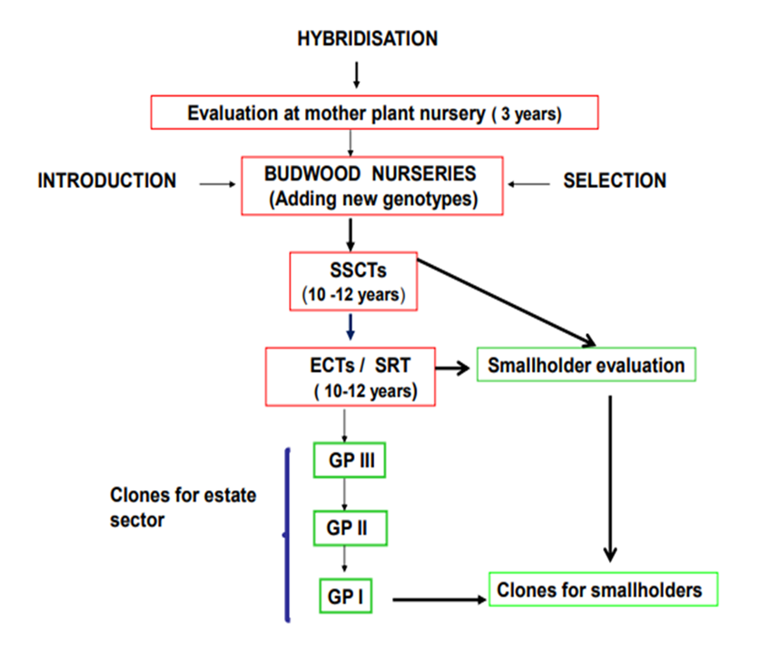
Introduction
Rubber is a perennial crop
All together 25 years its required complete one breeding cycle and introduce promising clone to the industry
It is one of the main problems in rubber breeding and genetic improvement
Figure: Conventional breeding process of rubber
Source: Withanage et al., 2014

Slide 4
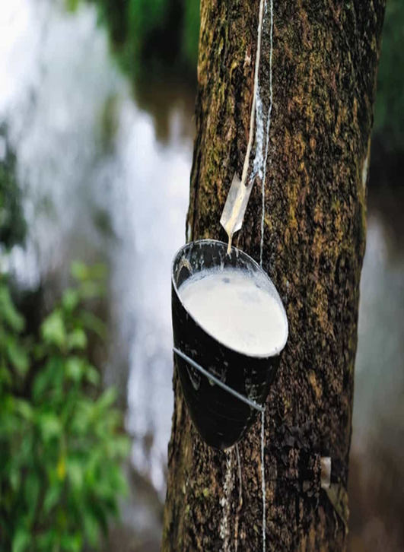
To reduce the length of breeding cycle SSCT step has been skipped and directly ECT step followed
Physiological and morphological parameters can be used as early selection

Slide 5
Objectives
Broad objective
To strengthen the clone recommendation
Specific objectives
To characterize selected genotypes which have been already established directly in ECT level from 2011 HP progeny
To study variations among promising genotypes

Slide 6
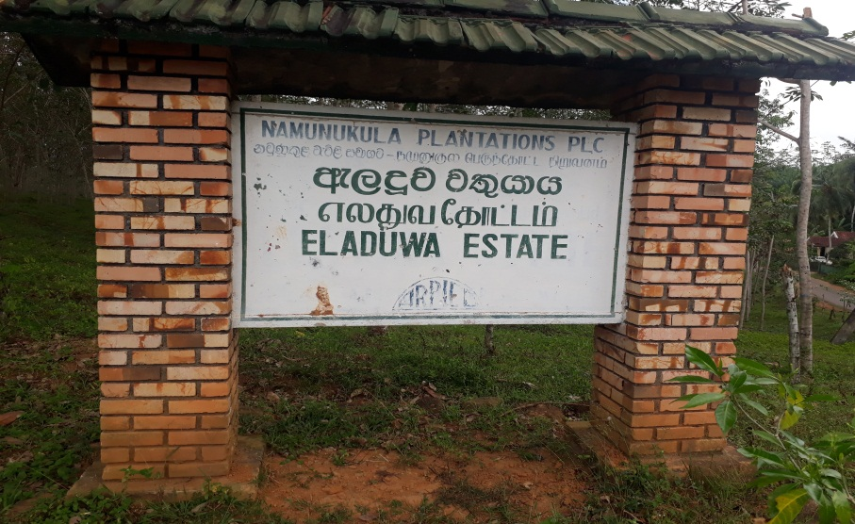
Material and Methods
Research Location
The research was conducted at Eladuwa Estate, Matugama, Kalutara
Low country Wet zone
Rainfall is >2400 mm during May to September
Red Yellow Podsolic soil
(Anushka and Liyanage, 2017)

Slide 7
2. Plant Material

Slide 8
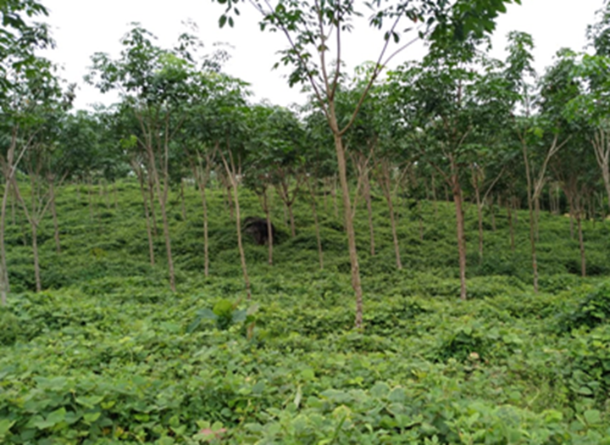
Plant Material cont..
Plant materials were planted in 2018 as Estate Collaborative Trial
2011 hand pollinated progeny
Each genotypes represent 75 plants
12 plants were selected randomly

Slide 9
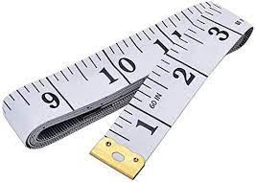
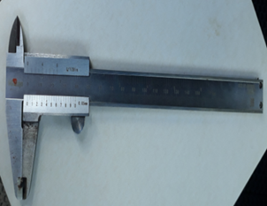
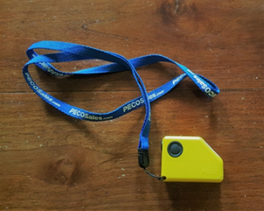
3. Data collection
Morphological Parameters | Photograph of instruments | Instruments
Girth |  | Measuring tape
Bark thickness |  | Vernier caliper
First branching height |  | Clinometer

Slide 10
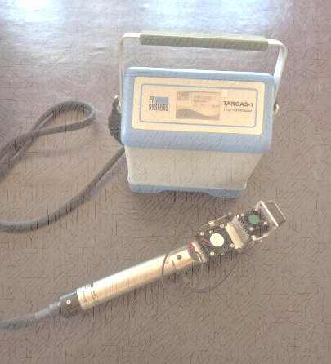
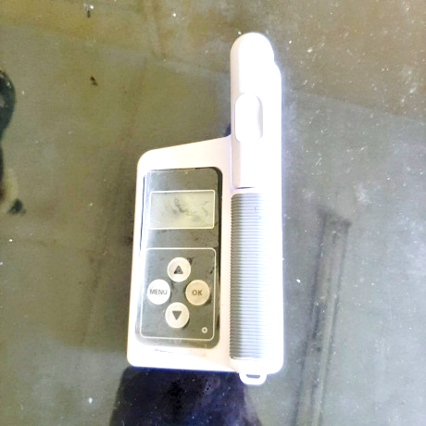
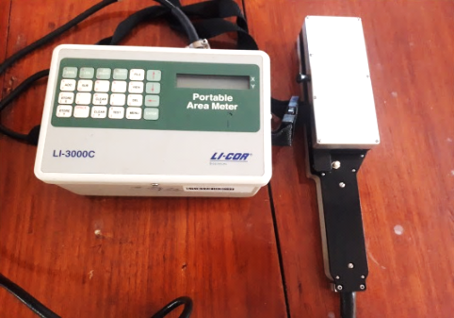
Data collection cont..
Physiological Parameters | Photograph of instruments | Instruments
Photosynthesis rate Stomatal conductance |  | Portable photosynthesis meter (TARGAS-1)
Chlorophyll content |  | Chlorophyll meter (SPAD-502)
Leaf area |  | Leaf area meter (LI-3000C, L1-Cor, Nebraska, USA)

Slide 11
Data collection cont..
Girth
Bark thickness
At 120cm from the highest point of bud union
120 cm

Slide 12
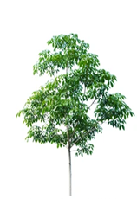
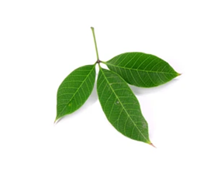
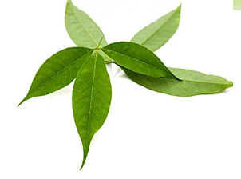
Data collection cont..
Lower canopy position
Middle leaves of the trifoliate
3 leaves of each tree
Photosynthesis rate
Stomatal conductance
Chlorophyll content
Leaf area

Slide 13
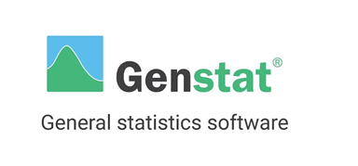
4. Data Analysis
Data entry and processing was done in Microsoft excel 2010
Principal component analysis was done Genstat 20
Cluster analysis was done by using factor scores

Slide 14
Characterization of genotypes
Mean values of parameters were used
Genotypes | Stomatal conductance | Photosynthesis rate | Chlorophyll content | Leaf area | Girth | Bark thickness | First branching height
2011HP 42 | 231.10 | 8.87 | 55.63 | 82.79 | 20.83 | 4.19 | 3.06
2011HP 202 | 247.80 | 11.76 | 56.60 | 96.48 | 17.50 | 3.14 | 2.76
2011HP 297 | 320.00 | 10.01 | 53.93 | 97.58 | 23.17 | 3.92 | 2.75
2011HP 300 | 272.60 | 10.57 | 57.05 | 83.63 | 15.58 | 3.10 | 2.55
RRISL 2006 | 420.00 | 11.76 | 53.92 | 80.23 | 25.92 | 3.96 | 2.68

Slide 15
Table : Rotated Component Matrix of 5 genotypes for 7 studied variables
Principal component analysis (PCA)
Three components were extracted from seven studied parameters by PCA
The number of component shown by the Rotated Component Matrix
 | Component
 | 1 | 2 | 3
Zscore (stomatal conductance) | .798 | -.544 | -.252
Zscore (photosynthesis rate) | .080 | -.898 | .103
Zscore (chlorophyll content ) | -.988 | -.055 | -.085
Zscore (leaf area) | -.073 | -.041 | .995
Zscore(Girth) | .991 | .071 | -.083
Zscore(bark thickness) | .752 | .630 | -.195
Zscore (branching height) | .120 | .919 | .060

Slide 16
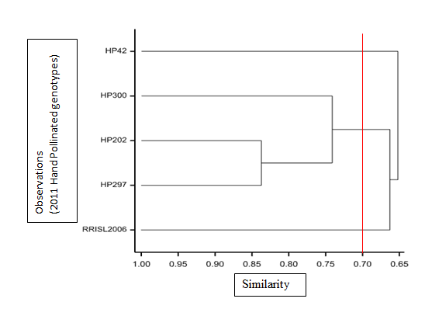
Cluster analysis
Cluster analysis was done based on PCA
Table: The cluster compositions of different genotypes
Cluster No. | Number of genotypes | Genotypes
1 | 1 | 2011HP 42
2 | 1 | RRISL 2006
3 | 3 | 2011HP 202 2011HP 297 2011HP 300
Figure: Dendogram of hierarchical cluster analysis

Slide 17
Conclusions
Collected parameters were added to strengthen the clonal recommendation programme
Girth, bark thickness and stomatal conductance have contributed most for clustering
2011HP 42 and RRISL 2006 genotypes were deviated due to the 30% variation and share at least one parent in every treatment but these were considered as similar characteristics

Slide 18
Suggestions
Evaluation of their yield performances is needed before taking the decision on recommendation
To strengthen the characterization, can apply molecular screening approaches
However, it is emphasizing the expansion of genetic diversity in breeding pool to raise the better clones

Slide 19
Amarasekara, I.N., Withanage, S.P. and Palihakkara, I.R., 2020. Quantitative gene expression analysis of selected genes to screen drought tolerance of selected Hevea Clones. International Journal for Research in Applied Sciences and Biotechnology, 7(6), pp.46-53.
Anushka, P.V.A., Liyanage, K.K., Withanage, S.P. and Baddewithana, B.W.A.N., 2017. Analysis of phenotypic diversity of selected hevea accessions from irrdb 1981 germplasm collection conserved in Sri Lanka. International Proceedings of IRC 2017, pp.203-212.
Baddewithana, B.W.A.N., Withanage, S.P., Subasinghe, S. and Anushka, P.V.A., 2017. Characterization of selected accessions of 1981 germplasm of Hevea for early growth performance using morphological and physiological parameters. IOSR Journal of Agriculture and Veterinary Science, pp.2319-2372.
Cho, K., Goldstein, B., Gounaridis, D. and Newell, J.P., 2022. Hidden risks of deforestation in global supply chains: A study of natural rubber flows from Sri Lanka to the United States. Journal of Cleaner Production, 349, p.131275.
Iqbal, S.M.M., Rodrigo, V.H.L. and Karunathilake, P.K.W., 2010. Feasibility of rubber (Hevea brasiliensis Muell. Arg.) cultivation in Eastern province of Sri Lanka with the peasant community. Journal of the Rubber Research Institute of Sri Lanka, 90, pp.18-30.
Jiang, C., Johkan, M., Hohjo, M., Tsukagoshi, S. and Maruo, T., 2017. A correlation analysis on chlorophyll content and SPAD value in tomato leaves. HortResearch, 71, pp.37-42.

