Slide 1
Development of Efficient In-vitro Regeneration Protocol for Transgenic Papaya (Carica papaya L.)
KGU Madumali^{1*}, BMVS Basnayake² , PK Dissanayake¹
¹Department of Export Agriculture, Faculty of Agricultural Sciences, Sabaragamuwa University of Sri Lanka, Belihuloya
²Molecular Virology Division, Plant Virus Indexing Centre, Gabadawatta, Homagama,
Sri Lanka

Slide 2
Content of the presentation
Introduction
Research Problem
Objectives
Material and Methods
Results and Discussion
Conclusion and Recommendations
References

Slide 3
Introduction
Scientific Name - Carica papaya L.
Family- Caricaceae
Origin
South Mexico
Distribution
Tropical and sub tropical regions
3rd most produce fruit crop in world wide

Slide 4
Major threat of papaya
Pest and diseases
Post harvest losses
Papaya ring spot virus disease is the most economically important disease in papaya.

Slide 5
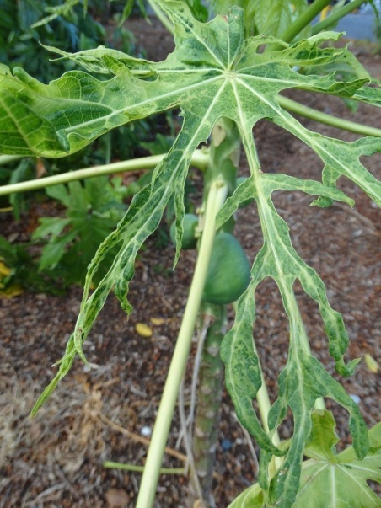
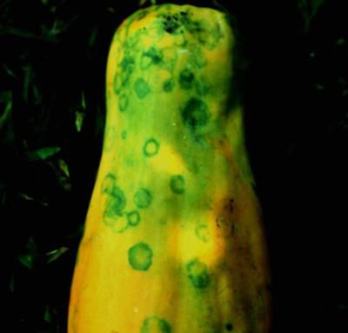
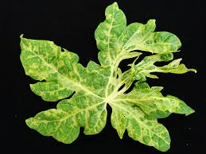
Symptoms
Mosaic and chlorosis in leaf lamina
Water-soaked streaks appear on stems and petioles
Leaves of infected trees become mottled and distorted
Plant becomes stunted and producing small fruits
Ringspots appear on fruit
Mosaic and chlorosis in Stunted plant Ringspots on fruit
leaf lamina

Slide 6
Research problem
Total annual world production
– 11.22 Mt
Total annual production in Sri Lanka - 72,782 t
Total hectors covered in Sri Lanka
-6,271 ha
(Agstat 2019)
Yield loss due to papaya ringspot virus disease
100% yield loss within 3-7 months

Slide 7
Transgenic plants which is resistant to papaya ring spot virus disease though recombinant technology can be used to solve the problem.
To produce transgenic plants of papaya with gene transfer system require efficient plant regeneration protocol.
Lack of high efficient regeneration protocol for transgenic papaya become a major problem for production of transgenic plants

Slide 8
Objectives
General Objective
To develop an efficient protocol for in-vitro regeneration of transgenic papaya (Carica papaya L.)
Specific Objective
To investigate the efficacy of different concentrations of polyethylene glycol (PEG) on somatic embryogenesis of putative transgenic papaya (Carica papaya L. )

Slide 9
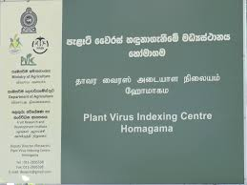
Material and Methods
Experimental Location
Plant Virus Indexing center, Pitipana , Homagama.
Tissue culture Division
Microbiology Division
Molecular virology Division

Slide 10
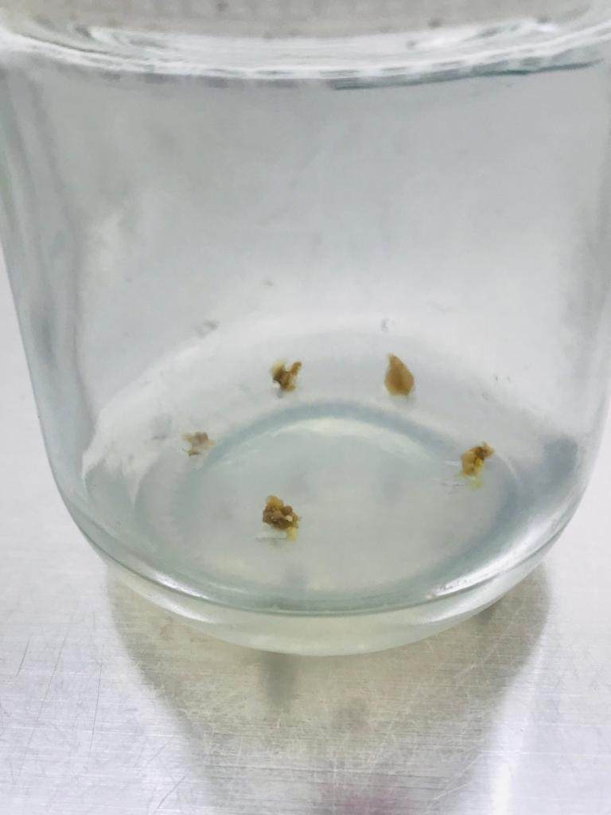
Media Preparation
Full strength Murashige and Skoog (MS) medium
Half strength Murashige and Skoog (MS medium

Slide 11
Induction medium | Co – cultivation medium | Regeneration medium
Half strength MS basal medium | MS basal medium with out hormones | MS basal medium
Myoinositol 0.1 g/L | Myoinositol 0.1 g/L | Myoinositol 0.1g/l
Sugar 60 g/L | Sugar 30 g/L | Sugar 30g/L
Glutamine 400mg/L | Glutamine 400mg/L | PEG 60,50,40 mg/L
2,4- D 10mg/L | - | Kinetin 2ml/l
Agar 7g/l | Agar 7g/l | Agar 7g/l
 | Kanamycin 50mg/L | Cefotaxime 500mg/L Kanamycin 50mg/L

Slide 12
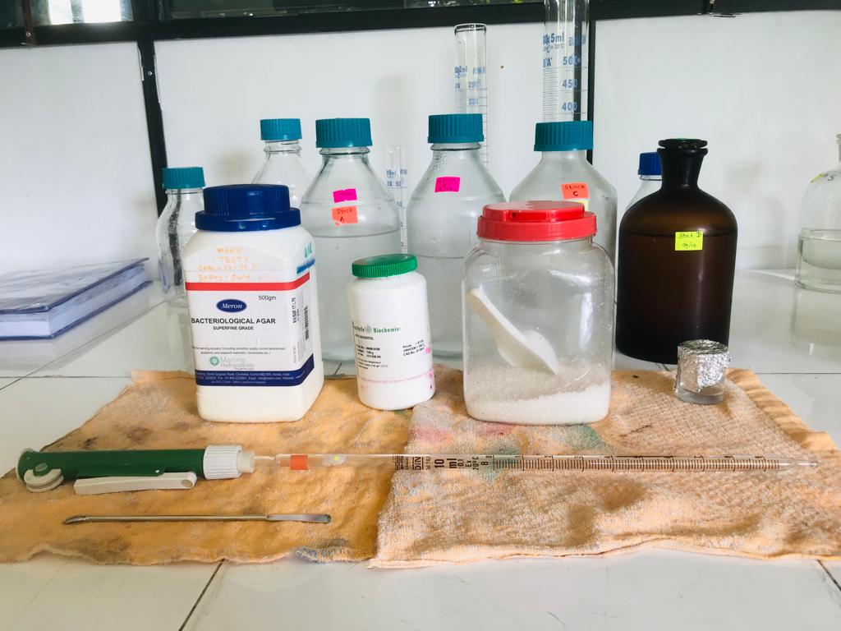
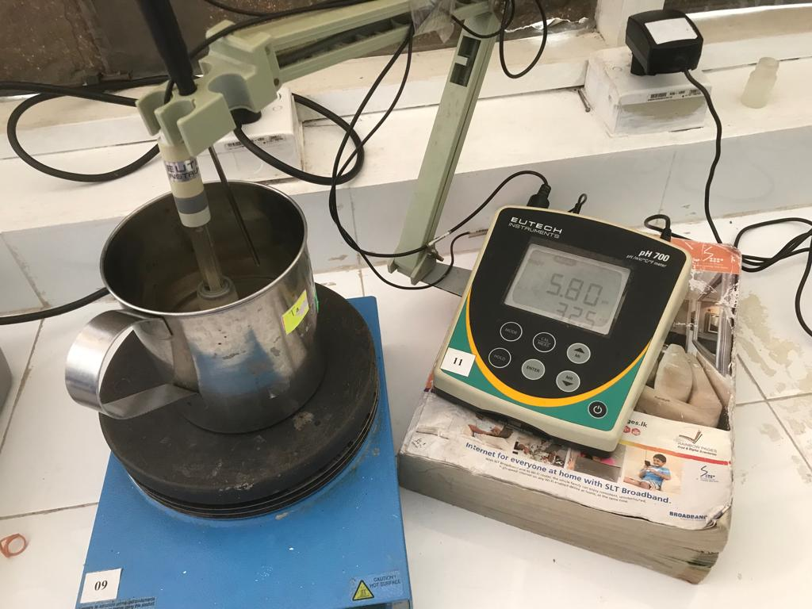
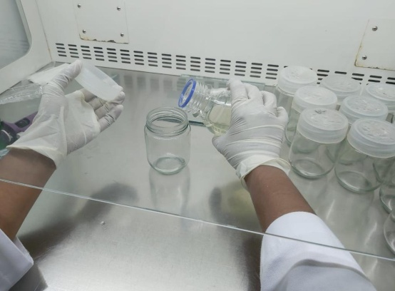
Required
amounts were measured and dissolved
Volume
up
and adjusted the pH
Agar
was
added while boiling
the medium
Antibiotics
were added to medium in aseptic conditions and poured to bottles

Slide 13
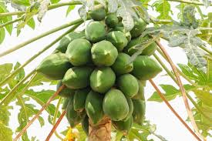
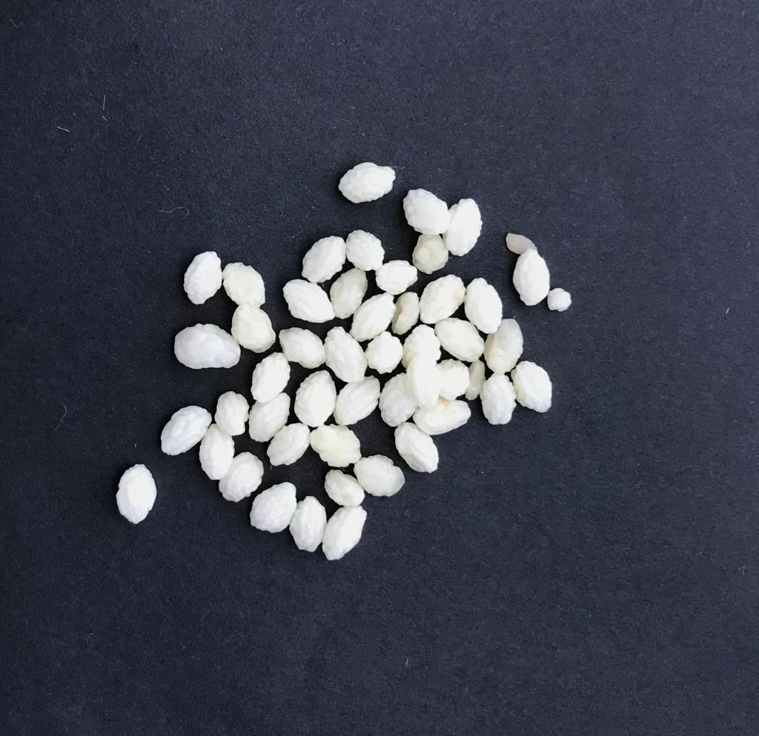
Experiment 01
Planting material and explant source
From plant virus indexing center
Immature fruit of papaya (Rathna)
Explant- zygotic embryos of papaya seeds

Slide 14
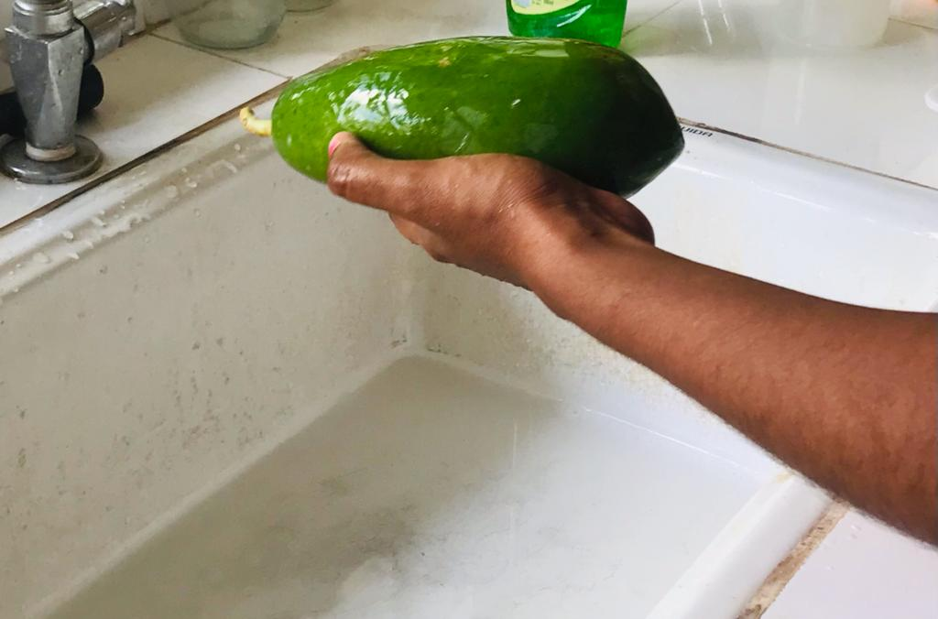
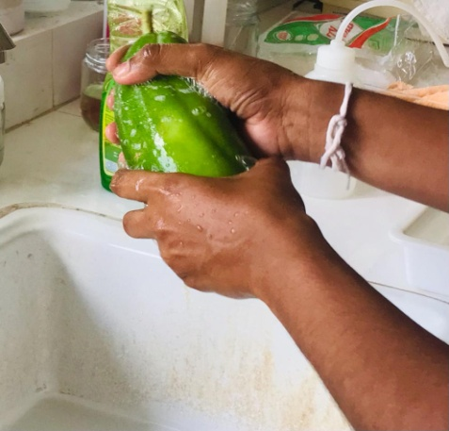
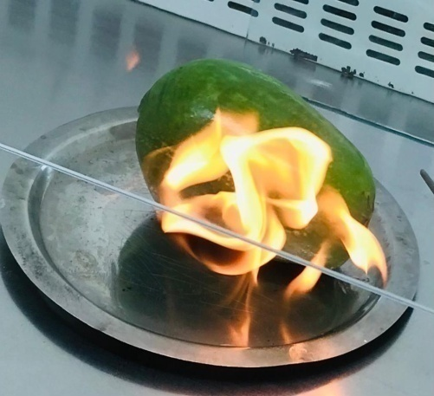
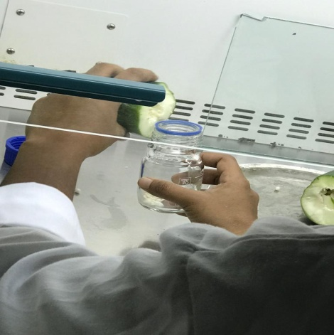
Sterilization of explant
Washed
with
running tap water
Washed
with
liquid soup solution
Burned
the
peel using ethanol
Stored the seeds in sterilized bottle

Slide 15
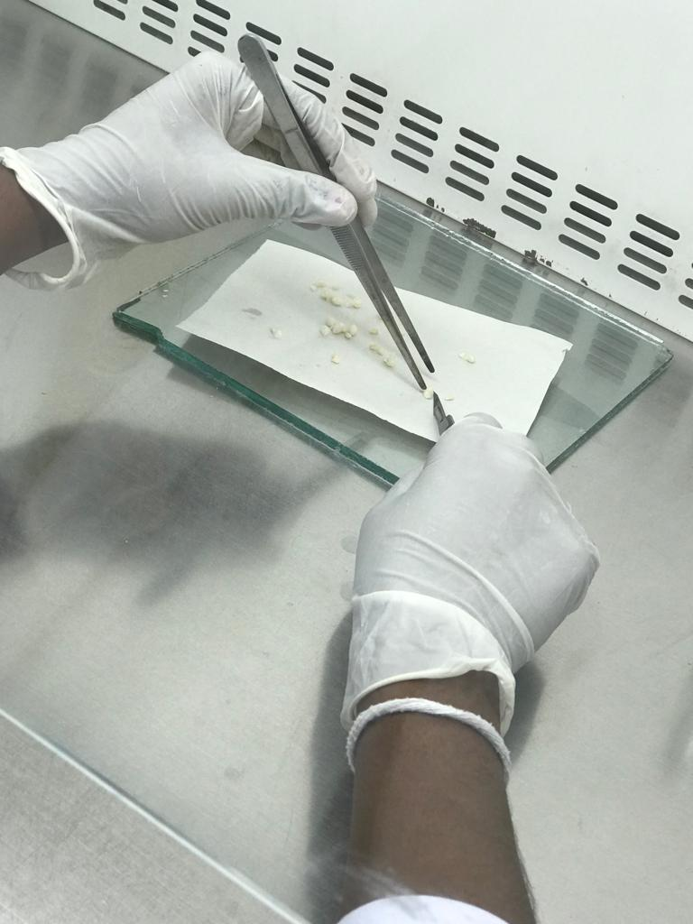
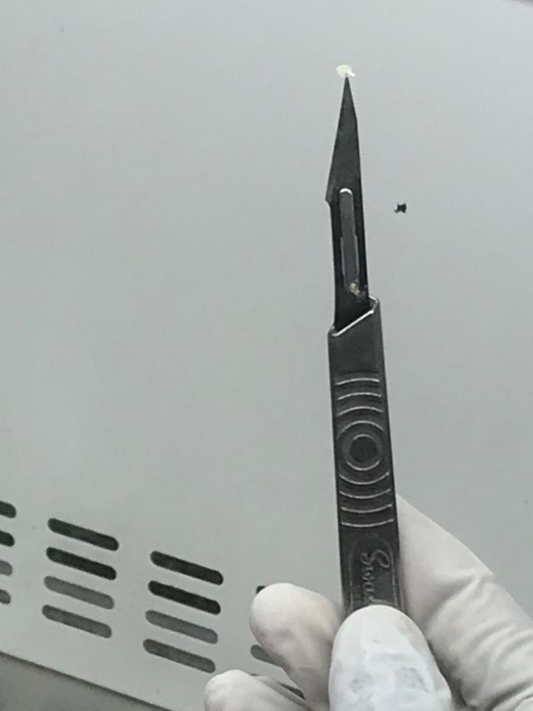
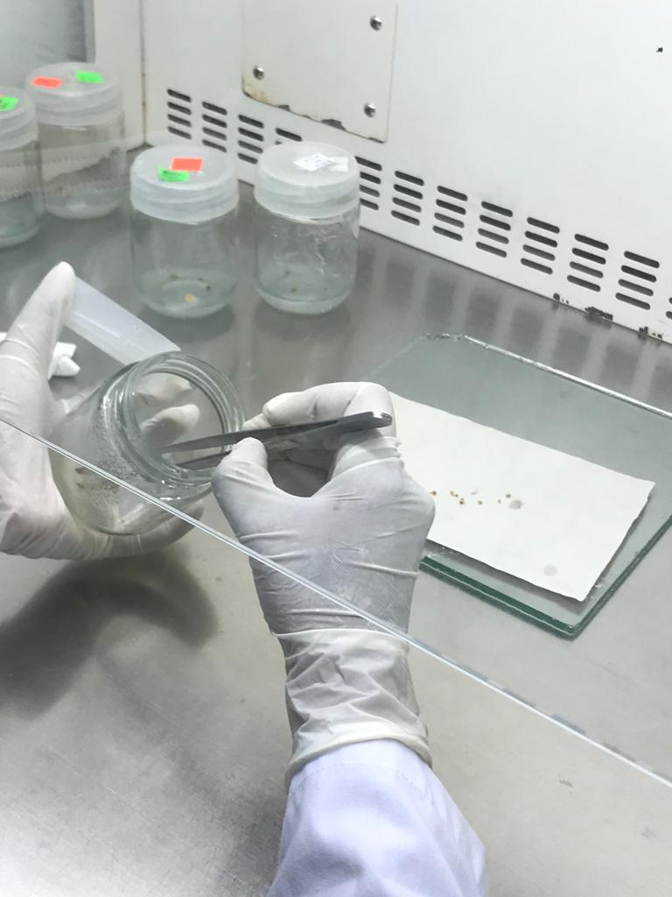
Zygotic embryo excision
Seeds
cut in
to
two halves
Squeezed
the
embryo using forceps
Immature zygotic
embryo
Inoculated to callus induction medium

Slide 16
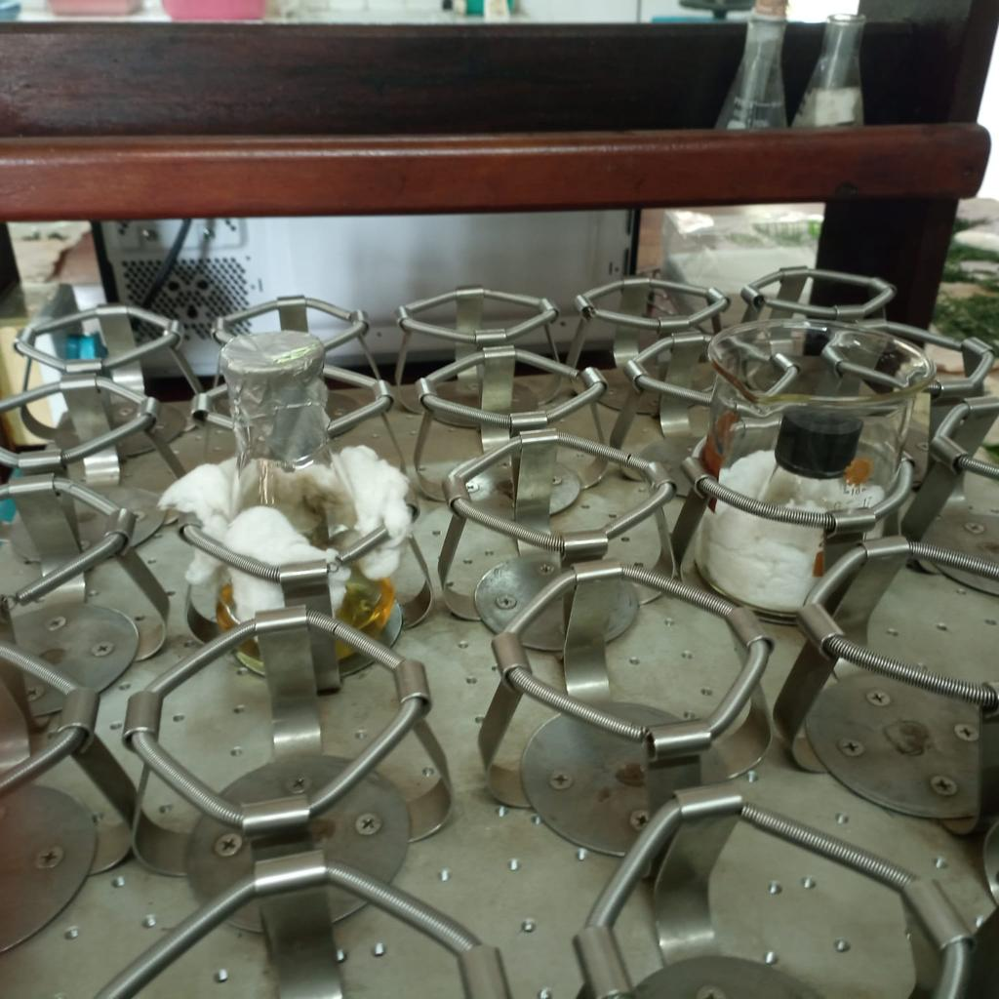
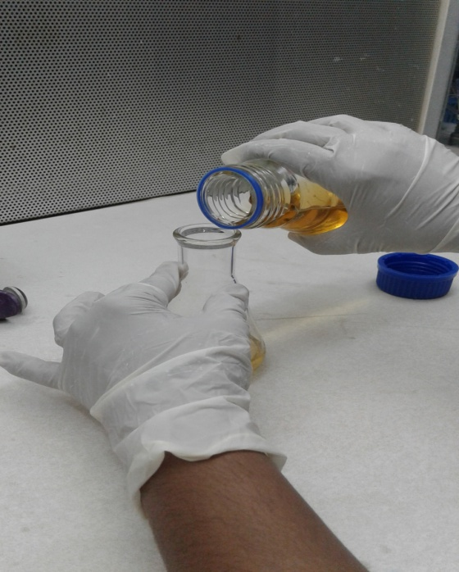
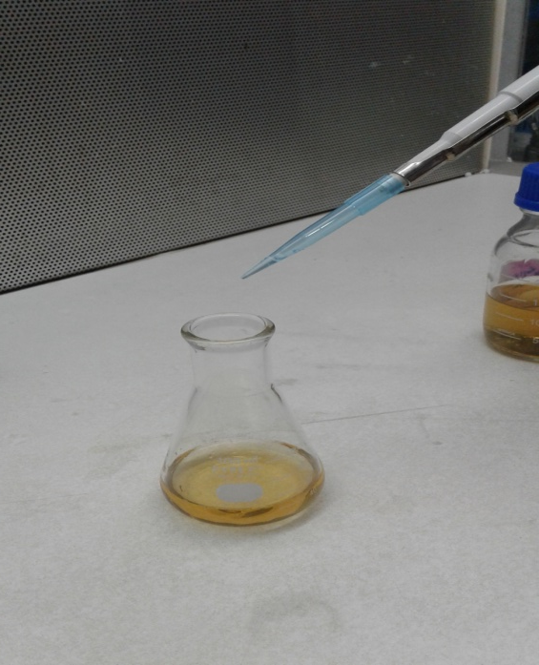
Agrobacterium mediated calli transformation
LB
medium
40 ml
was used
Transformed Agrobacterium tumefacien with desired gene
Kanamycin 50mg/L
was
added
Shaked
for
24 hours

Slide 17
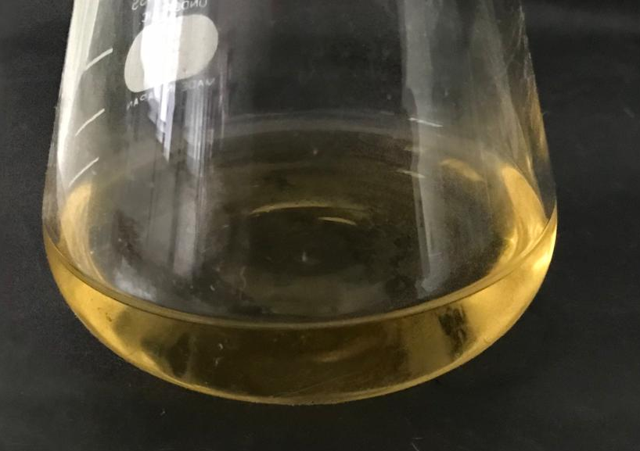
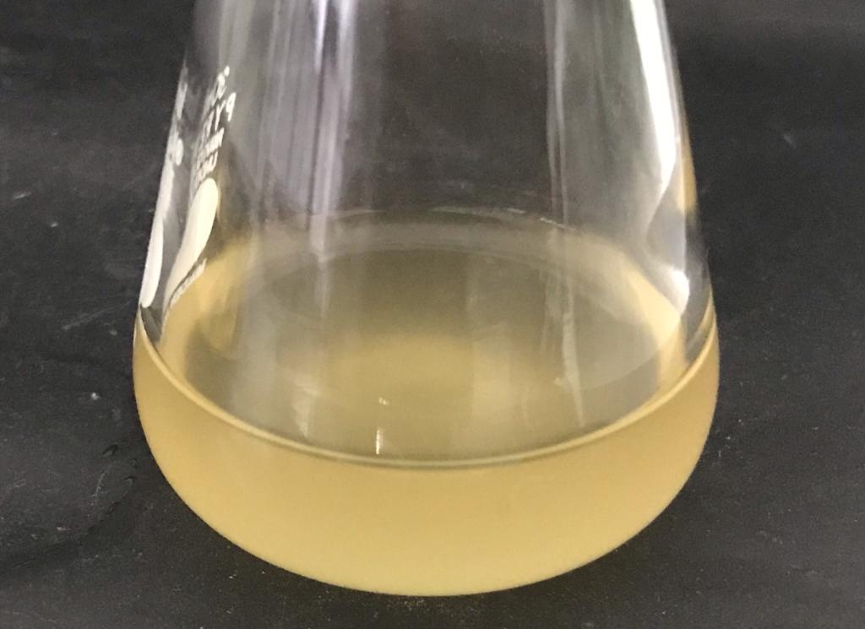
After 24 hours,
LB medium
After Agrobacterium infection

Slide 18
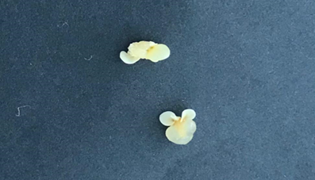
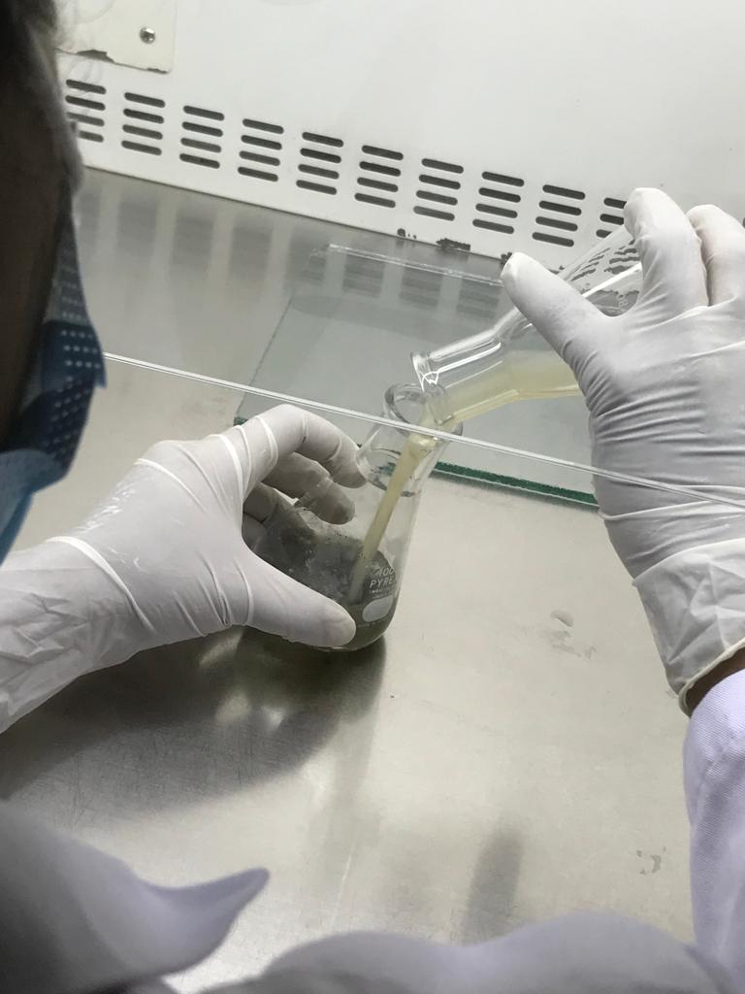
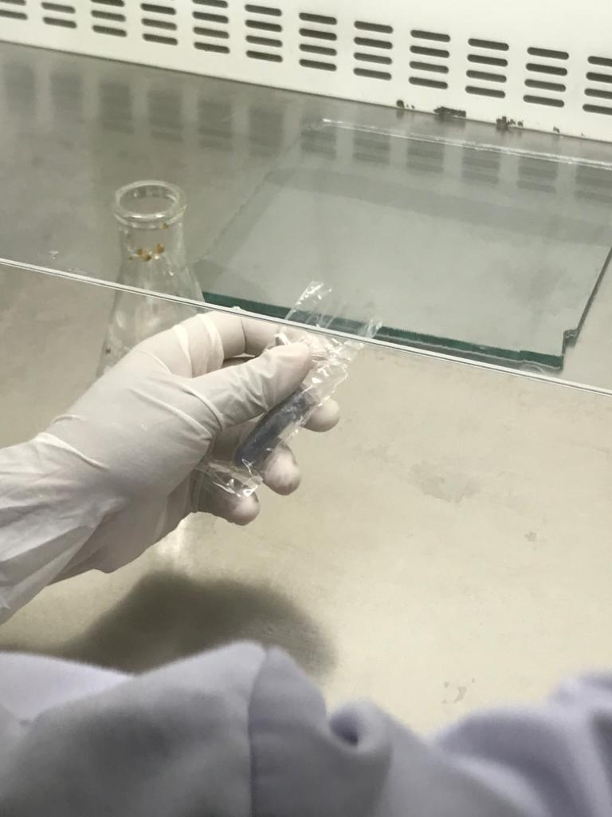
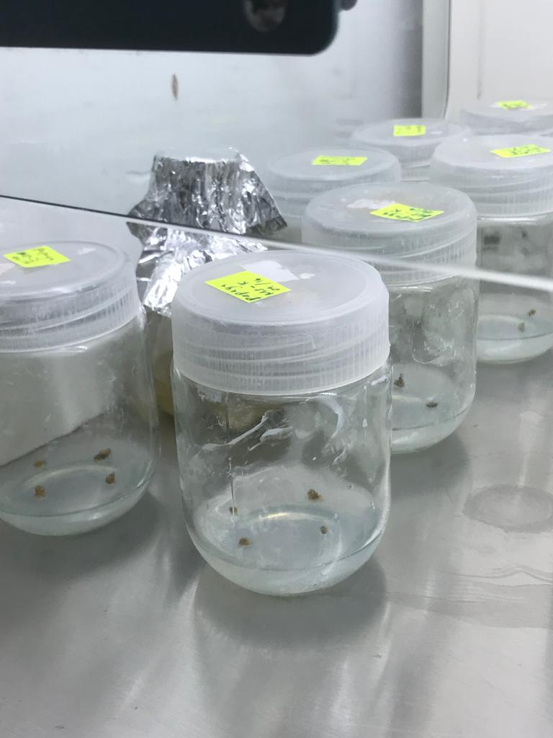
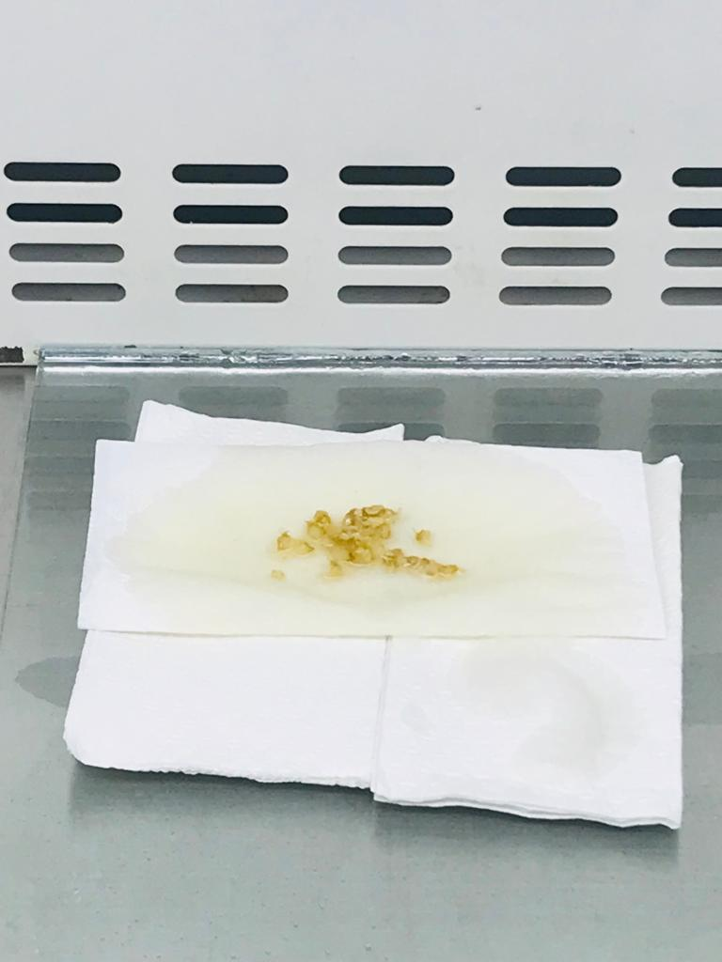
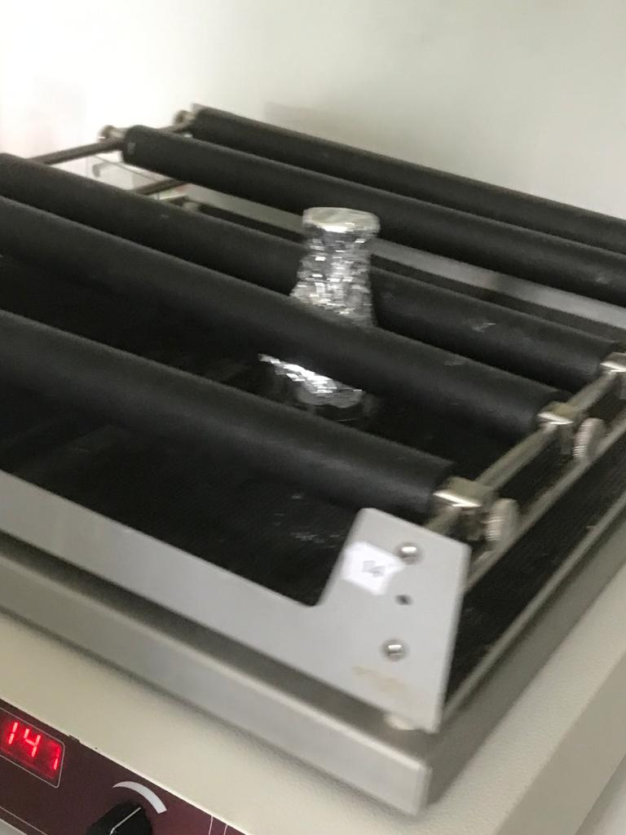
Yellowish
callus
Poured Agrobacterium suspension to callus
Carborundum
was added
Shaked 10 minutes
Blotting with sterilized tissues
Inoculated to
co cultivation medium

Slide 19
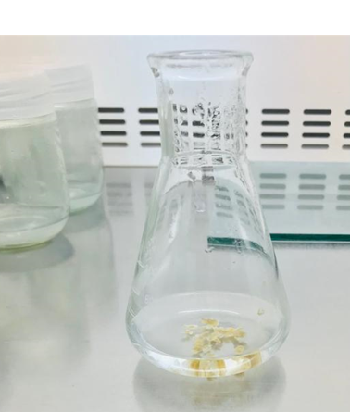
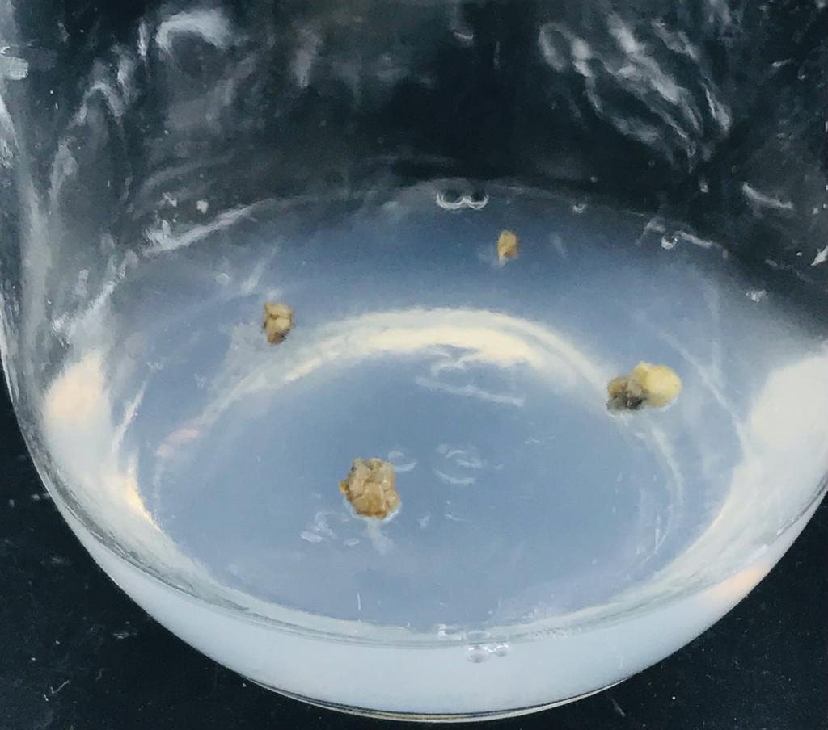
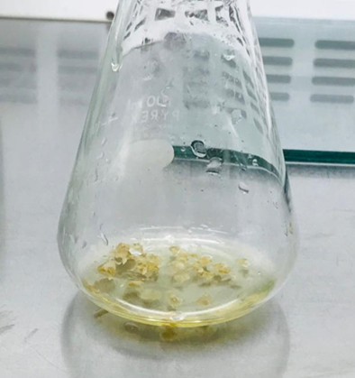
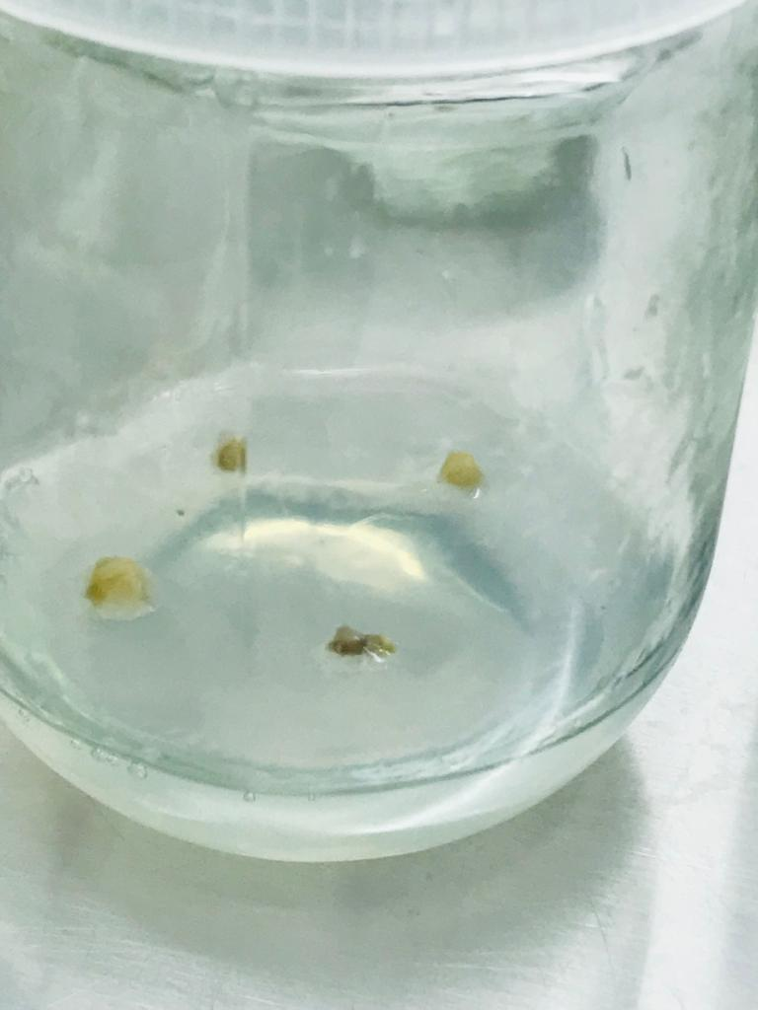
After 2 days;
Co-cultivated
callus
Washed
with sterile water
Washed with cefotaxime 500mg/L
Transferred
to MS medium

Slide 20
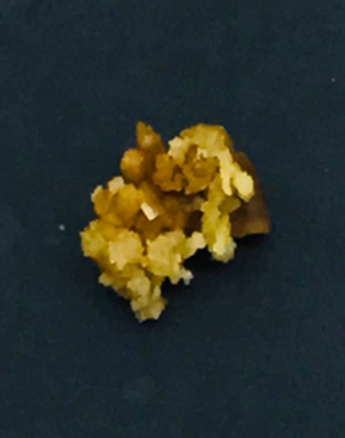
Experiment 2
Embryonic callus with matured somatic embryos were used.
Agrobacterium mediated callus transformation was done.
Transformed callus were transferred to regeneration medium.
Subculturing was done with 3 weeks of interval.
After 6 weeks ,callus were transferred to medium with kinetin 4mg/L.

Slide 21
Polymerase chain reaction (PCR) protocol for confirmation of putative transformants
The putative transformed callus was subjected to PCR for further confirmation.
The DNA was extracted from phenol extraction method.
PCR mixture - 10× PCR buffer 7.5 μL, dNTP's 3 μL, primers (forward XbaI 3 μL, reverse Bam HI 3 μL), Taq DNA polymerase 0.9 μL and deionized water 9.72 μL
PCR mixture 13.2 μL was added to the 1.8 μL of DNA template of each sample.

Slide 22
Experimental Design
The data were arranged according to completely randomized design (CRD).
Number of treatment=4 ,Each treatment was replicated 10 times.
Experiment 1
Treatment | PEG Level
T1 | MS basal medium + myoinositol 0.1g/l +agar 7g/l + 60mg/l PEG
T2 | MS basal medium + myoinositol 0.1g/l +agar 7g/l + 50mg/l PEG
T3 | MS basal medium + myoinositol 0.1g/l +agar 7g/l + 40mg/l PEG
T4 | MS basal medium + myoinositol 0.1g/l +agar 7g/l + without PEG- Control

Slide 23
Experiment 2
Treatment | PEG Level
T1 | MS basal medium +kinetin 2ml/l + myoinositol 0.1g/l +agar 7g/l + 60mg/l PEG
T2 | MS basal medium +kinetin 2ml/l + myoinositol 0.1g/l +agar 7g/l + 50mg/l PEG
T3 | MS basal medium +kinetin 2ml/l + myoinositol 0.1g/l +agar 7g/l + 40mg/l PEG
T4 | MS basal medium +kinetin 2ml/l + myoinositol 0.1g/l +agar 7g/l without PEG- Control

Slide 24
Observation and data collection
Area of of callus - Using ImageJ software
Number of survived callus after co-cultivation
Number of regenerated callus per each treatment
Data analysis
One -way ANOVA procedure of statistical Analysis System (SAS)
Mean separation –Duncan’s Multiple Range Test (DMRT)

Slide 25
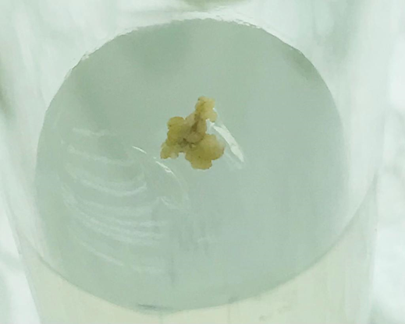
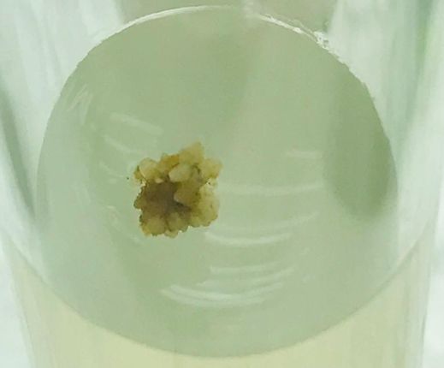
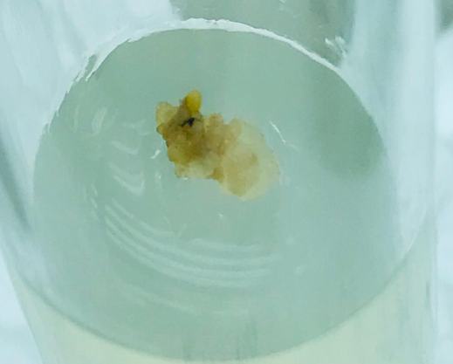
Results and discussion
Experiment 1
Number of callus used for co-cultivation – 60
Number of callus survived after co-cultivation – 27
Survived callus after co cultivation

Slide 26
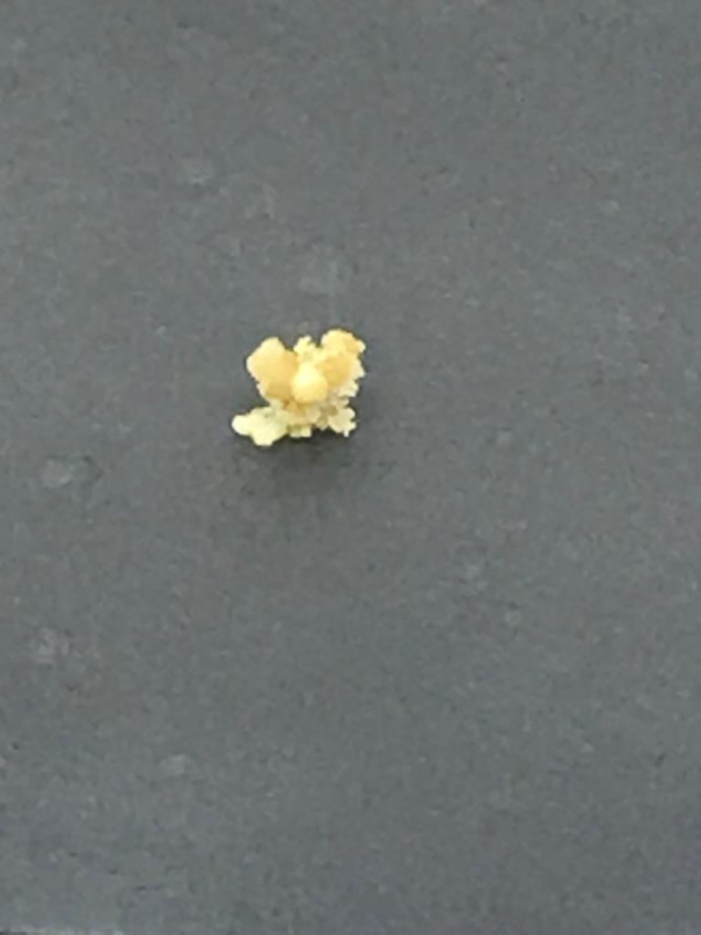
Experiment 2
Number of callus used for co-cultivation – 60
Number of callus survived after co-cultivation – 42
Survived callus after co cultivation

Slide 28
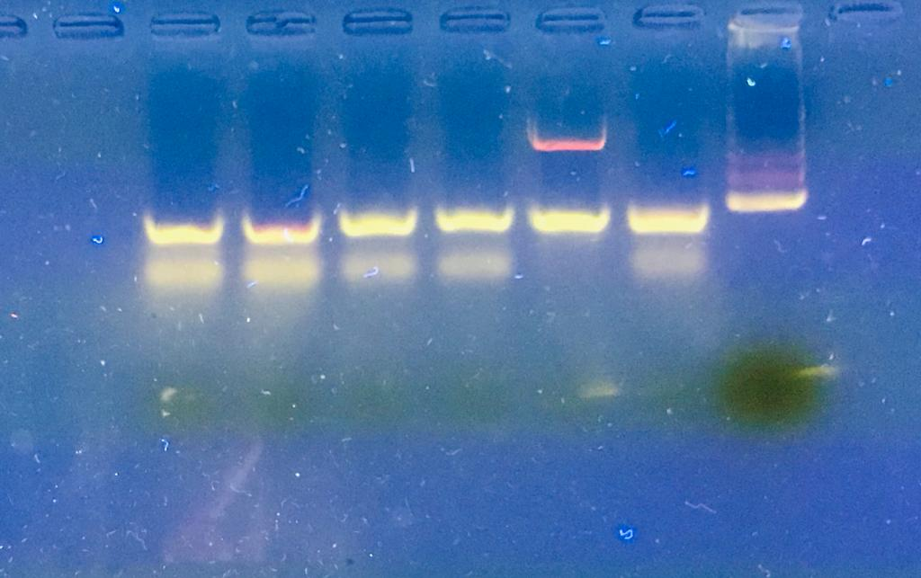
Transformed callus were confirmed by PCR.
300 bp
400 bp
L

Slide 29
P<0.05

Slide 30
PEG 60 mg/L
PEG 50mg/L
PEG 40 mg/L
PEG 0 mg/L

Slide 32
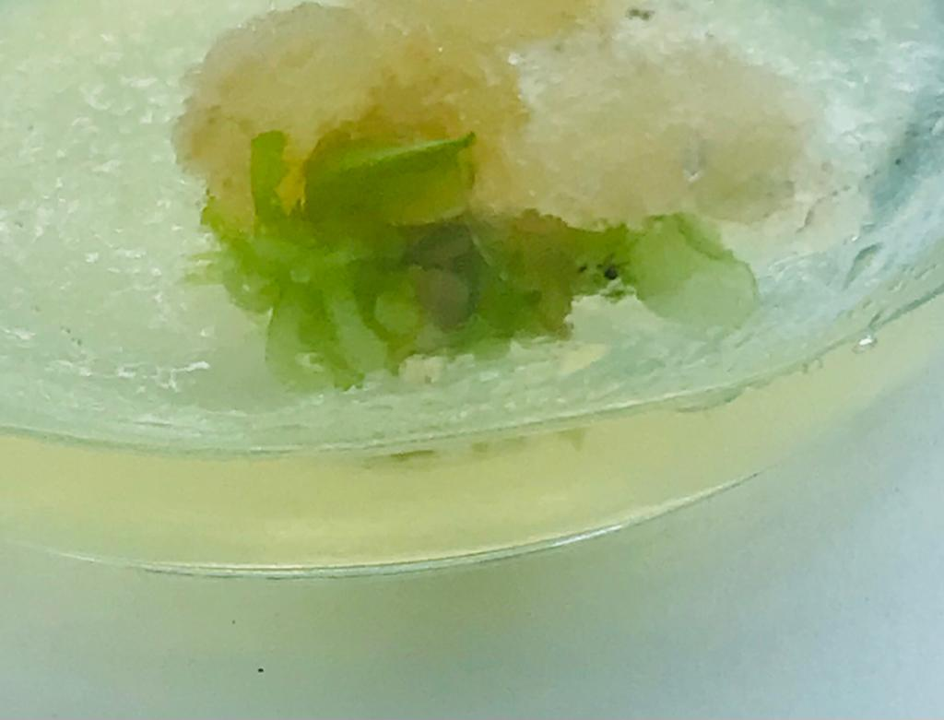
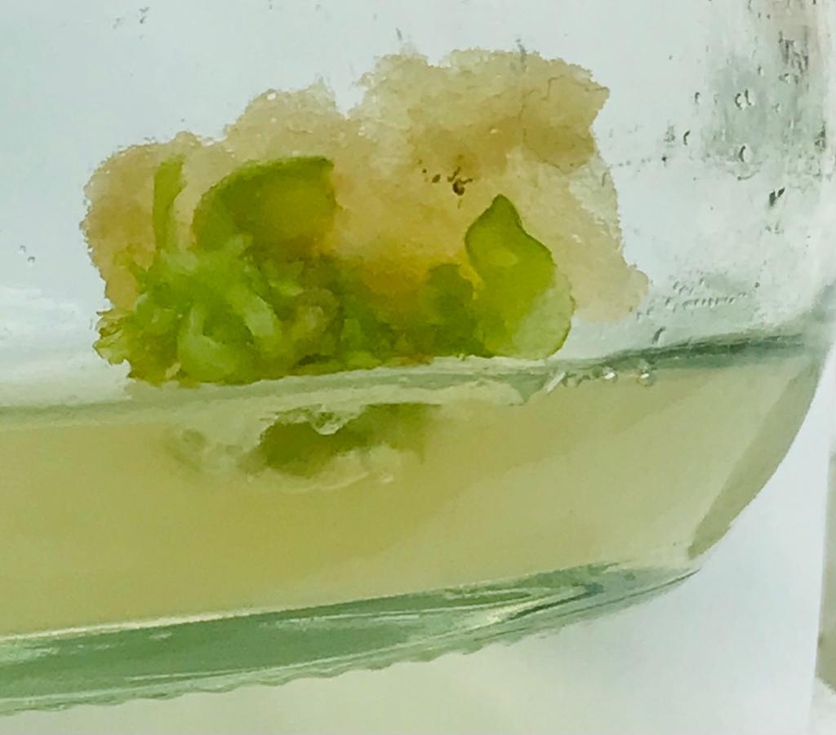
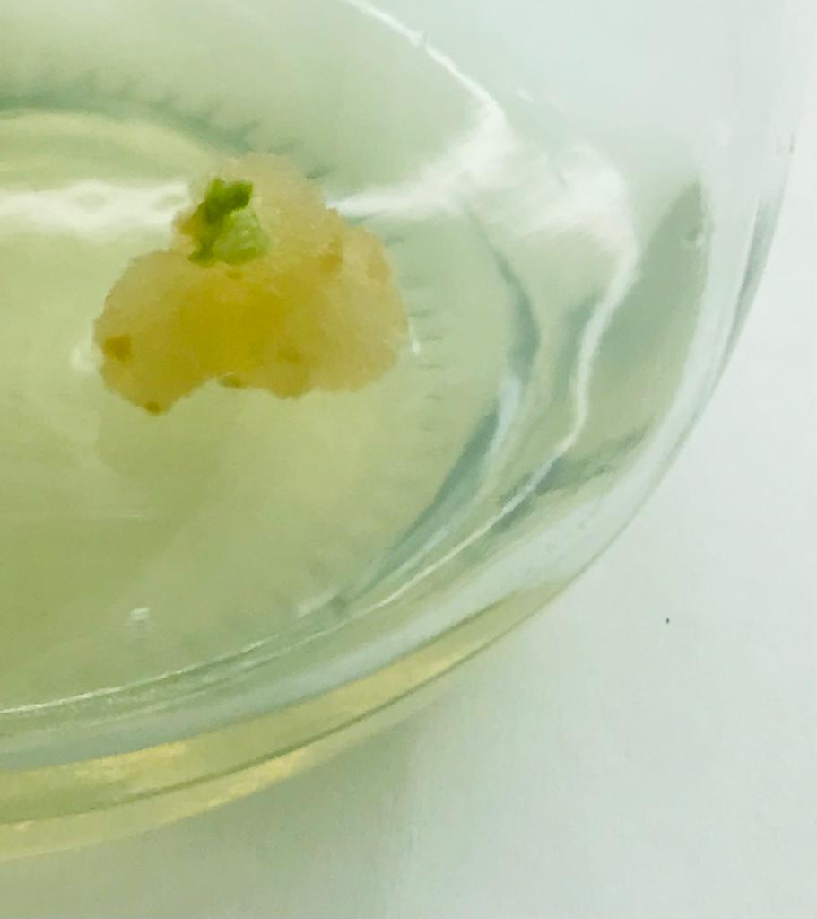
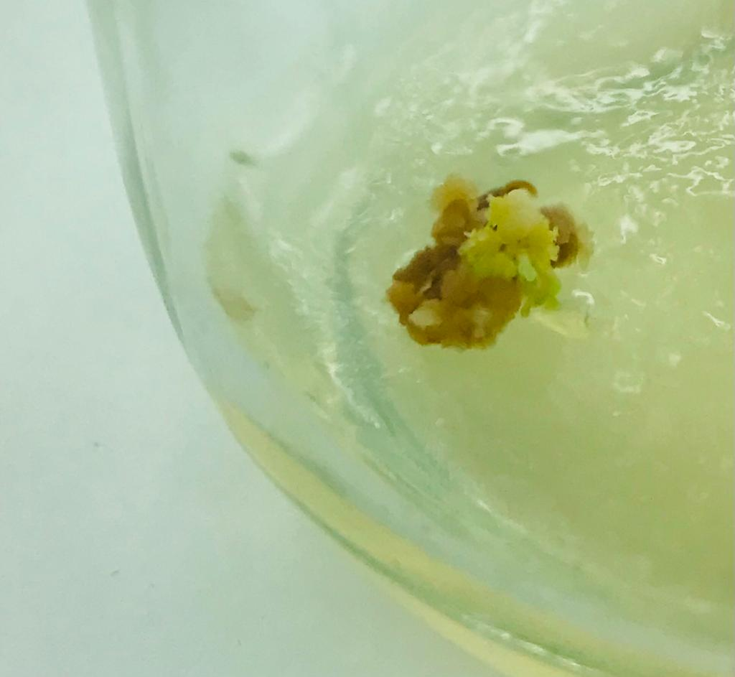
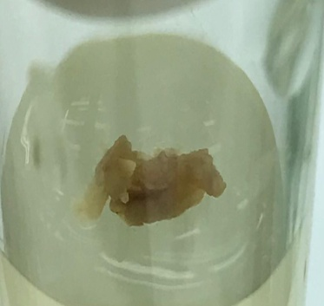
Regenerated callus
After transferred to medium with 4mg/L kinetin,

Slide 33
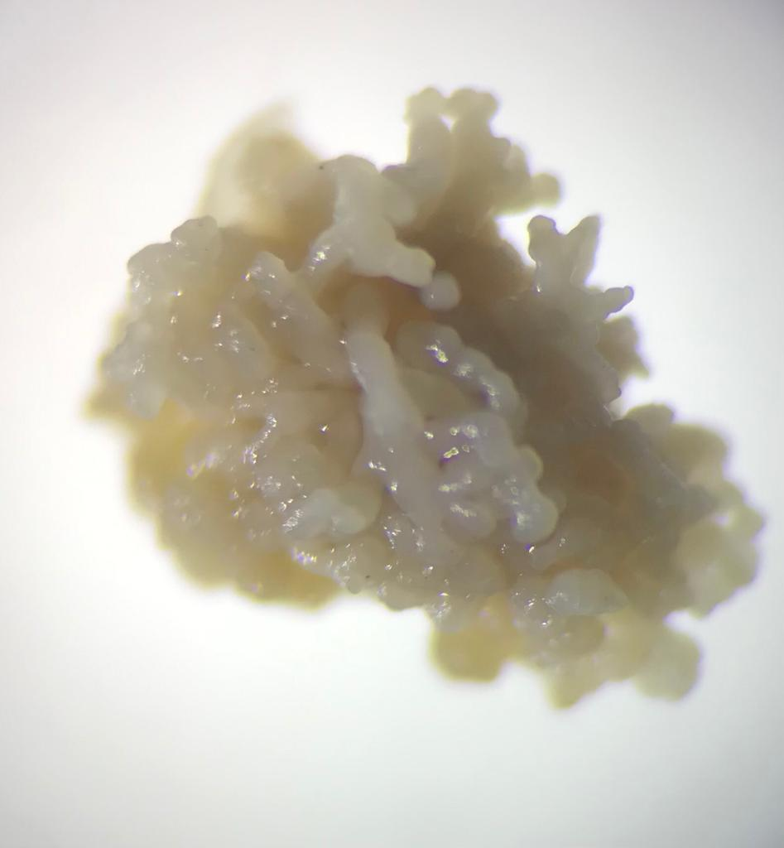
Microscopic view of somatic embryos

Slide 34
Conclusion
A protocol for in-vitro regeneration of putative transgenic papaya (Carica papaya L.) was developed.
T1 , polyethylene glycol (PEG) 60 mg/L was the most suitable concentration for somatic embryogenesis.
Comparing to 3 weeks old callus , callus which have matured somatic embryos had highest transformed callus after co-cultivation.

Slide 35
Recommendations
Further studies need to be carried out, to develop a protocol for in-vitro regeneration of transgenic papaya to obtain a complete transgenic papaya plant through somatic embryogenesis.
Should be find the most effective kinetin concentration for regeneration of putative transgenic papaya plants.

Slide 36
References
Al-Shara, B.,Taha,R.M .,Mohomad,J.,Elias, H.,and Khan, A.(2020) ‘Somatic embryogenesis and plantlet regeneration in the carica papaya L. Cv. eksotika’, Plants, 9(3), pp. 1–20. Available at: https://doi.org/10.3390/plants9030360.
Ascencio-Cabral, A.,Gutiérrez-Pulido,H., Rodríguez-Garay,B., and Gutiérrez-Mora,A. (2008) ‘Plant regeneration of Carica papaya L. through somatic embryogenesis in response to light quality, gelling agent and phloridzin’, Scientia Horticulturae, 118(2), pp. 155–160. Available at: https://doi.org/10.1016/j.scienta.2008.06.014.
Agstat 2019
Fitch, M.M.M. and Manshardt, R.M. (1990) ‘Somatic embryogenesis and plant regeneration from immature zygotic embryos of papaya (Carica papaya L.)’, Plant Cell Reports, 9(6), pp. 320–324.

Slide 37
Thank You !!!

