Slide 1
Screening of Antagonistic Fungi against Rigidoporus microporus causing White Root Disease in Cinnamon
HAP Windula^{1*}, HMTT Madhurangi² , MLMC Dissanayake¹
¹Department of Export Agriculture, Faculty of Agricultural Sciences, Sabaragamuwa University of Sri Lanka
2National Cinnamon Research & Training Center, Department of Export Agriculture, Thihagoda, Matara, Sri Lanka

Slide 2
Content
1.Introduction
2.Research Problem
3.Objectives
4.Methodology
5.Results and discussion
6.Conclusions
7.Suggestions
8.References
9.Acknowledgement

Slide 3
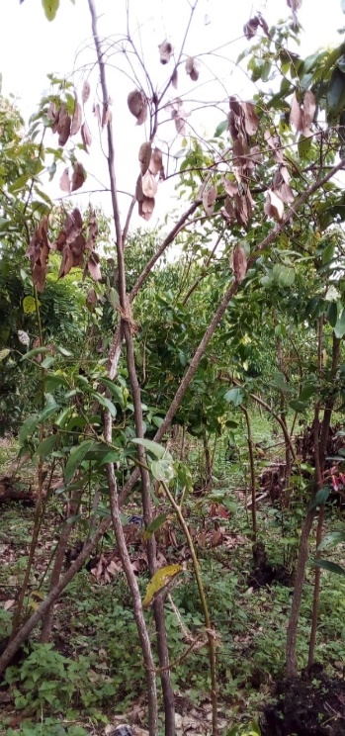
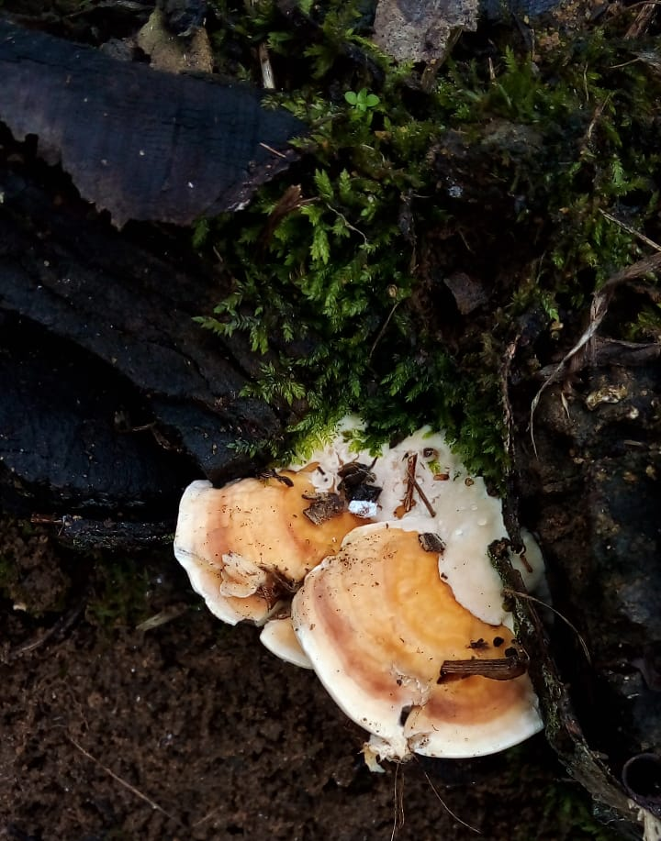
Introduction
White root disease is one of the most destructive root disease in cinnamon
Causal organism: Rigidoporus microporus
It is recorded frequently from the lands when the previous cultivation is rubber

Slide 4
Research Problem
Effects of the White root disease and its association with yield reduction is significant in cinnamon industry
Tebuconazole & hexaconazole can be used as systemic fungicides
Due to the toxicity of these chemicals antagonistic fungi can be used as an environmentally friendly solution
Despite, the timely importance, minimum number of studies were carried out to determine appropriate biological control of WRD

Slide 5
Objectives
General Objectives
Isolation and confirmation of identity of causative agent of white root disease from cinnamon fields
Screening of bio-controlling ability of different strains of Trichoderma as antagonistic fungi against causative agent of white root disease
Specific Objective
Selection of suitable growth medium for the isolated Rigidoporus microporus

Slide 6
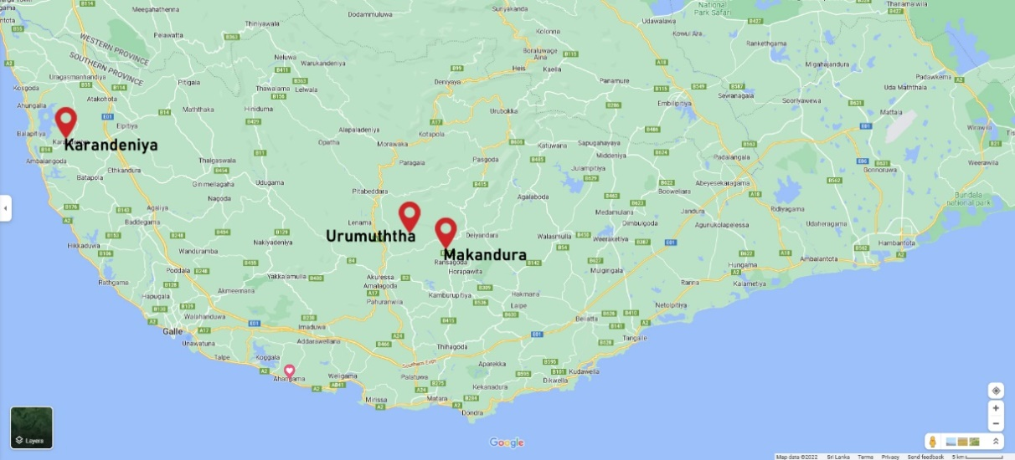
Methodology
Location of the study – Laboratory of the Division of Plant Pathology in the NCRTC
Sampling locations – Matara & Galle districts in the Southern Province of Sri Lanka

Slide 7
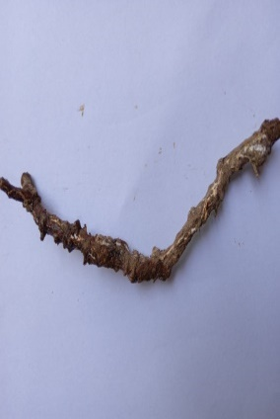
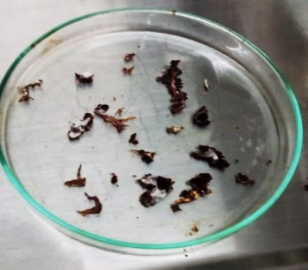
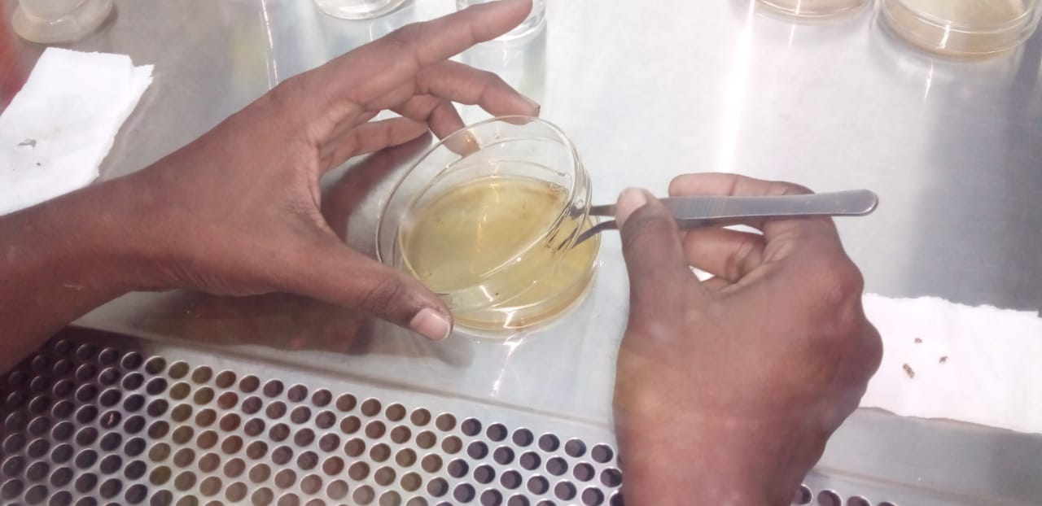
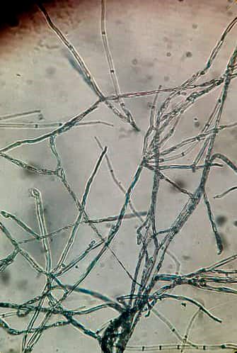
Methodology
Collection of WRD infected root samples
Isolation of morphologically different fungi on Potato Dextrose Agar (PDA) medium using direct plate method
Obtaining pure cultures from each by hyphal tip transfer technique
Identification of causative agent of WRD using morphological screening

Slide 8
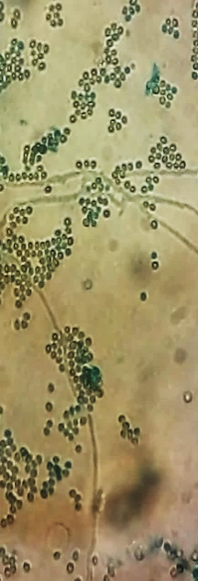
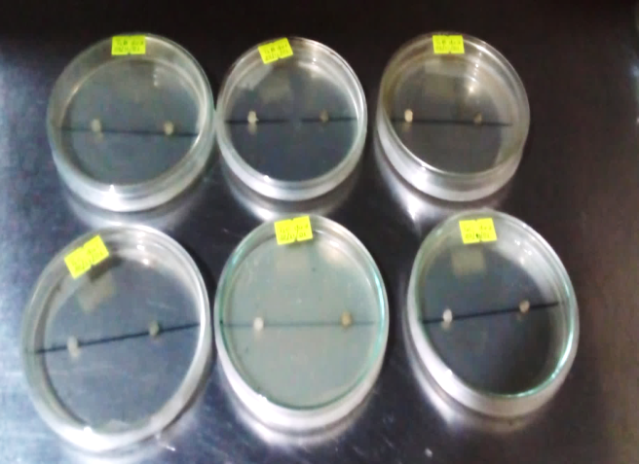
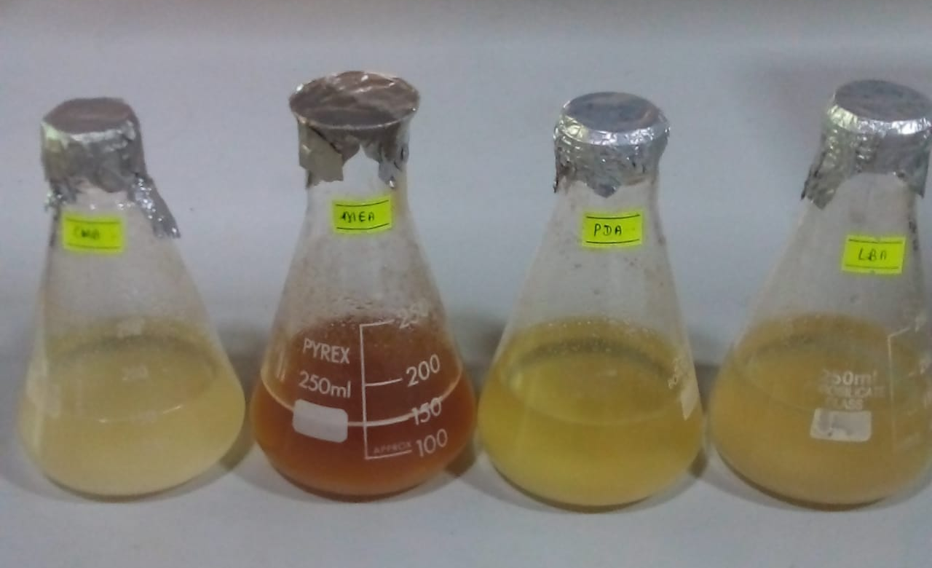
Methodology Cont..
Isolation of bio control agents – Trichoderma spp
Identification of antagonists using morphological screening
Dual culture assay
Selection of best nutrient media for the growth of isolated WRD pathogen

Slide 9
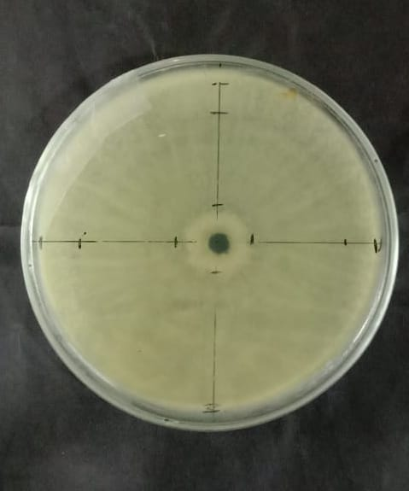
Data collection
The percentage inhibition of radial growth of isolated pathogen
Inhibition % = [(C-T)/C]x100
C- Colony diameter of the mycelium on control plate (cm)
T- Colony diameter of the mycelium on treatment plate (cm)
The colony diameter of the pathogen in different media

Slide 10
Data analysis
One-way ANOVA procedure of MINITAB 19
Mean separation-Tukey Test
Graphical illustrations – The Microsoft Excel (2010) computer software

Slide 11
Results and Discussion

Slide 12
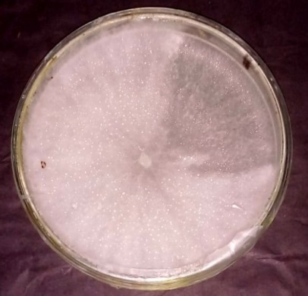
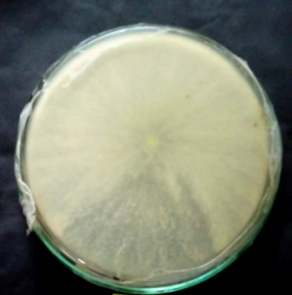
Identification of isolated pathogens
Macroscopic and microscopic features of isolate 1
a b c
Figure 1 :Colony features on PDA (a-upper surface, b -lower surface) of 10 days old culture on PDA, c - Hyphae under (x 40 magnification) Scale bar=10µm

Slide 13
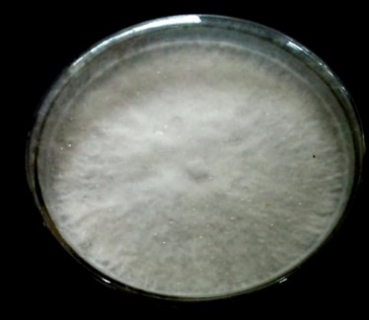
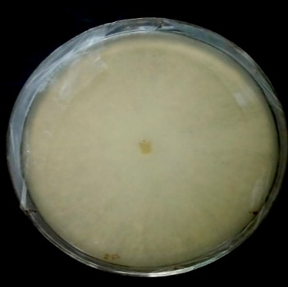
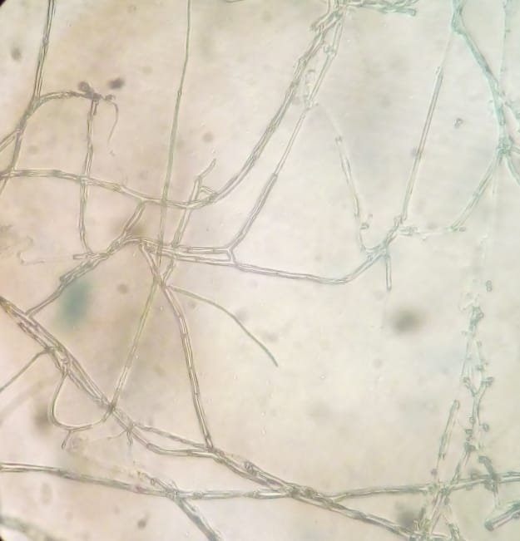
Macroscopic & microscopic features of isolate 2
a b c
Figure 2 :Colony features on PDA (a- upper surface, b-lower surface of 10days old culture on PDA, c-hyphae under (x40 magnification) Scale bar=10µm

Slide 14
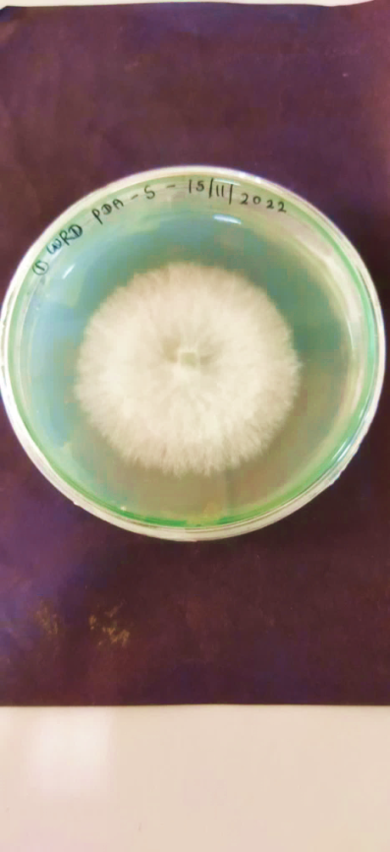
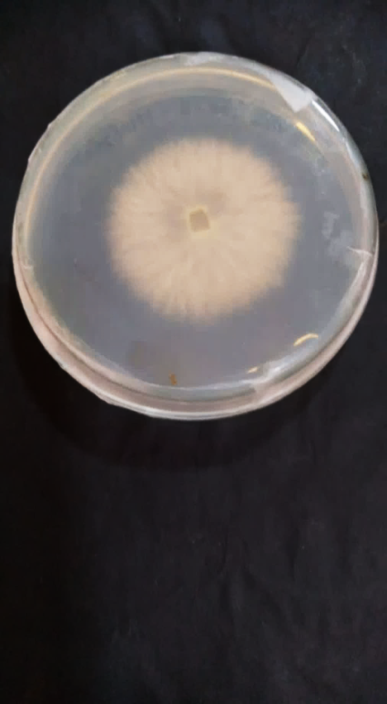
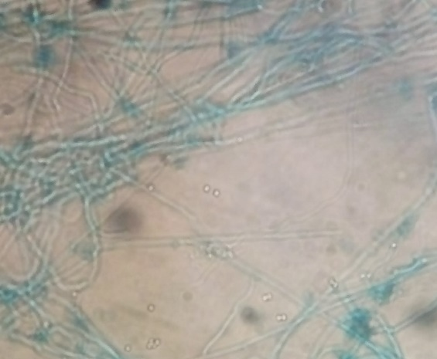
Macroscopic & microscopic features of isolate 3
a b c
Figure 3 : Colony features on PDA (a - upper surface, b- lower surface) of 5 days old colony on PDA, c- hyphae under (x 40 magnification) Scale bar = 20µm

Slide 15
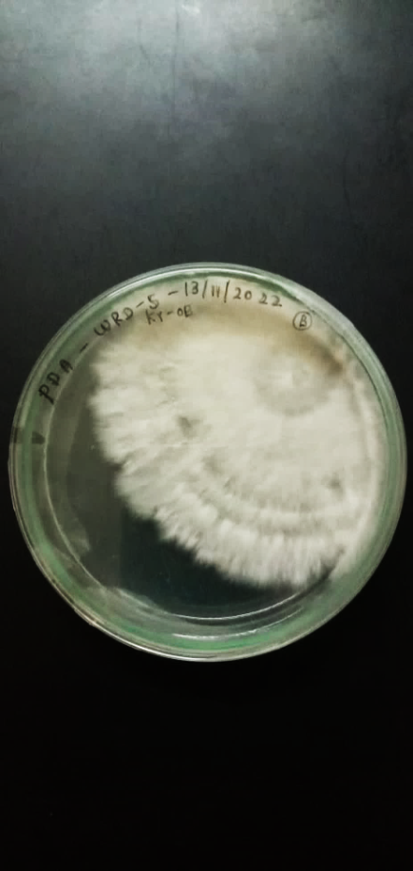
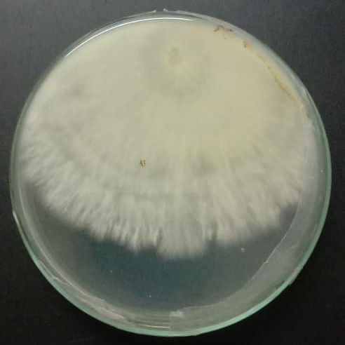
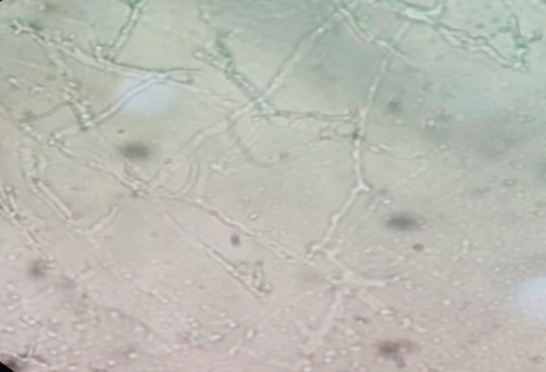
Macroscopic & microscopic features of isolate 4
a b c
Figure 4 : Colony features on PDA (a- upper surface , b – lower surface) colony on PDA after 7 days of incubation, c- hyphae under( x40 magnification) Scale bar = 10µm

Slide 16
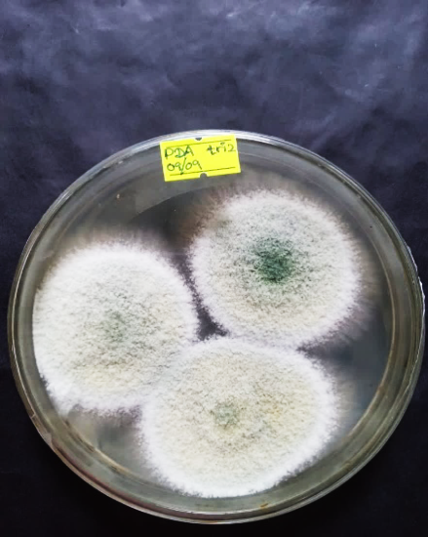
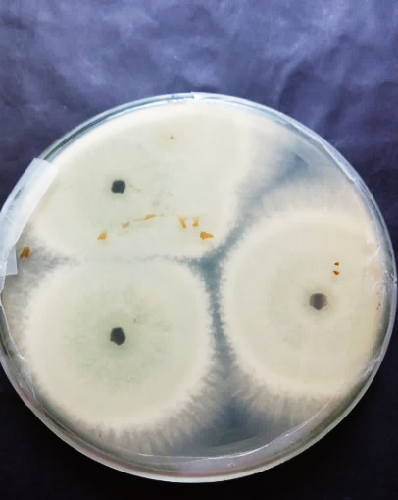
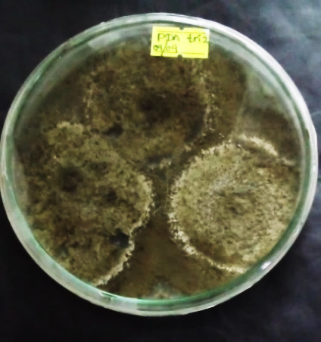
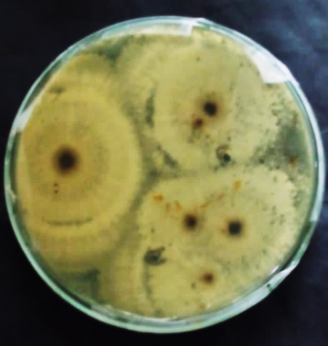
Macroscopic features of isolated antagonist strain 01
a b c d
Figure 5: Colony features on PDA (a- upper surface, b- lower surface) isolated Trichoderma strain 01 grown for 05 days, c- (upper surface, b- lower surface) grown for 10 days

Slide 17
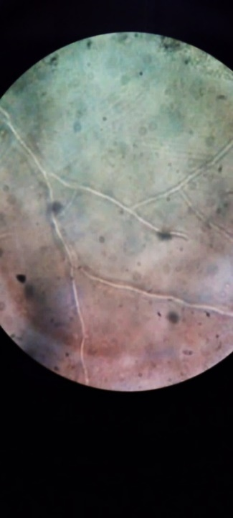

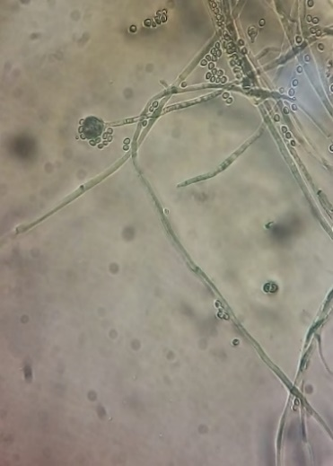
Microscopic features of isolated antagonist strain 01
a b c
Figure 6: a- aseptate hyphae of isolated Trichoderma strain 01, b- green color conidia structures, c- chlamydospore structure (Scale bars: A=25µm, B & C = 5µm, D=15µm

Slide 18
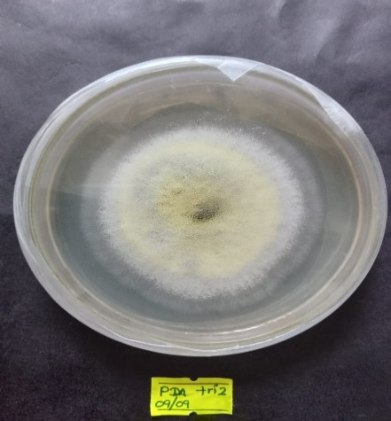
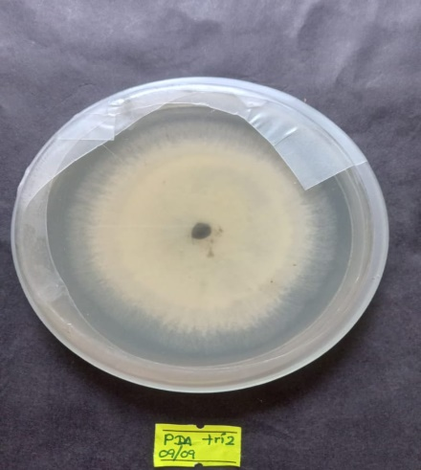
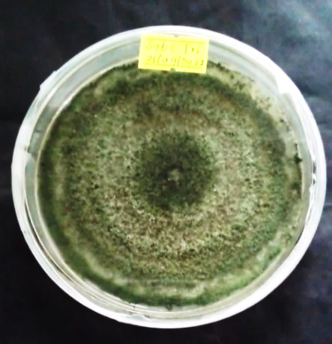
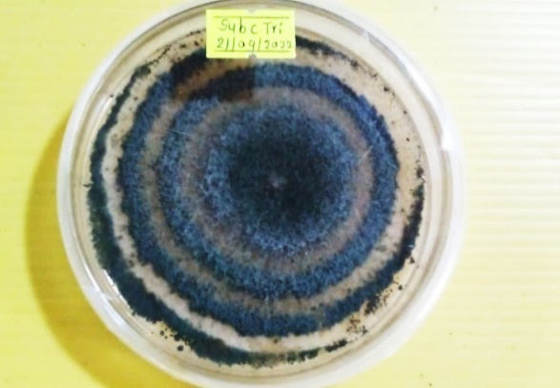
Macroscopic features of isolated antagonist strain 02
a b
a b c d
Figure7: Colony features on PDA (a – upper surface, b- lower surface) grown for 5 days, c-upper surface colony appearance of isolated Trichoderma strain 02 grown for 10 days ,d- extended growth with concentric rings

Slide 19
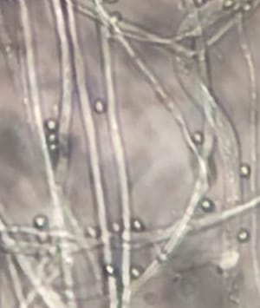
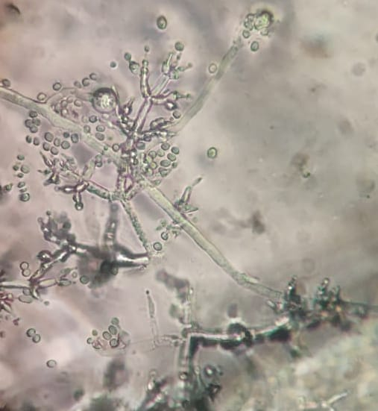
Microscopic features of isolated antagonist strain 02
a b
Figure 8:a- hyphae with conidia of isolated Trichoderma strain 02 ,b- septate hypha, C-branch conidiophore, d-flask –shaped phialides, e- green conidia (Scale bars: a=20µm, b=10µm)
e
d
c
b

Slide 20
Assay of antagonism of Trichoderma spp. against R.microporus in vitro

Slide 21
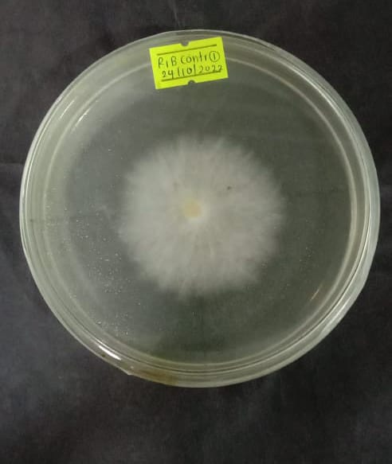
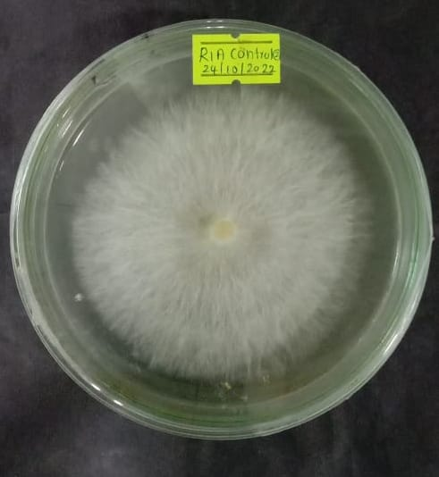
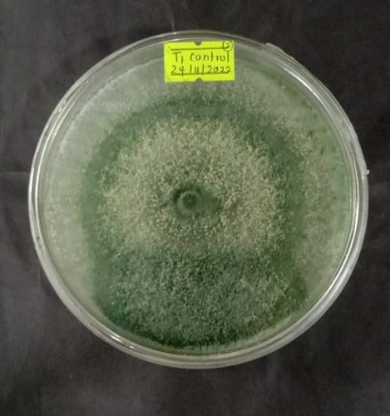
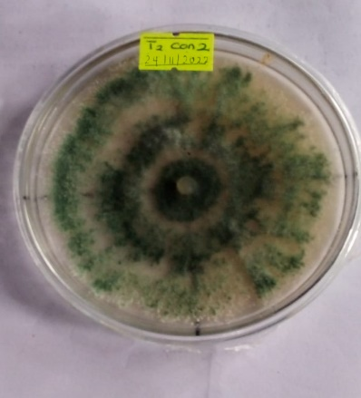
Control plates in Dual culture assay
a b
a b c d
Figure10: Control plates of R. microporus and Trichoderma in dual culture; a: control plate of Rigidoporus isolate -02, b: control plate of Rigidoporus isolate -01, c: control plate of Trichoderma isolate -01, d: control plate of Trichoderma isolate-02

Slide 22
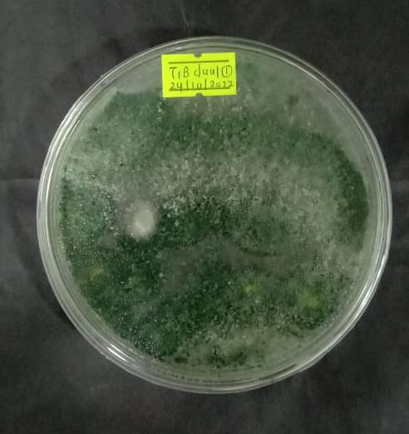
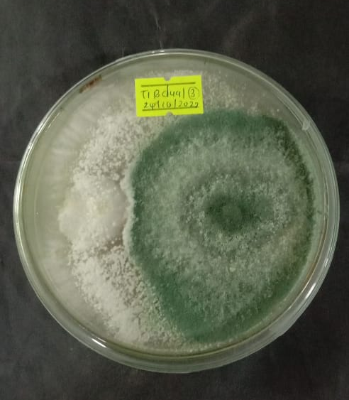
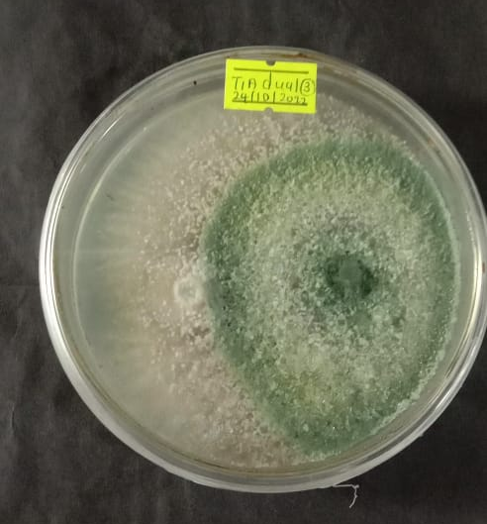
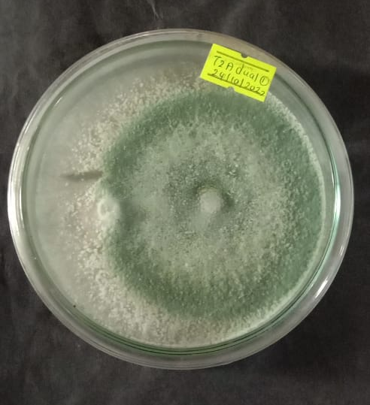
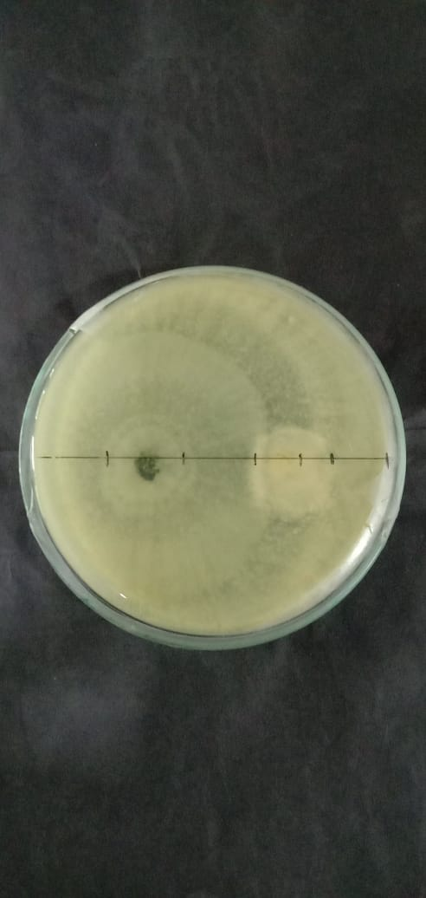
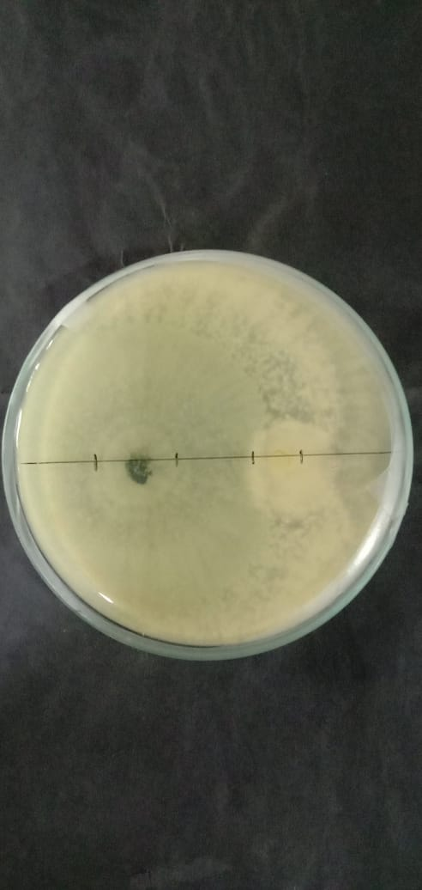
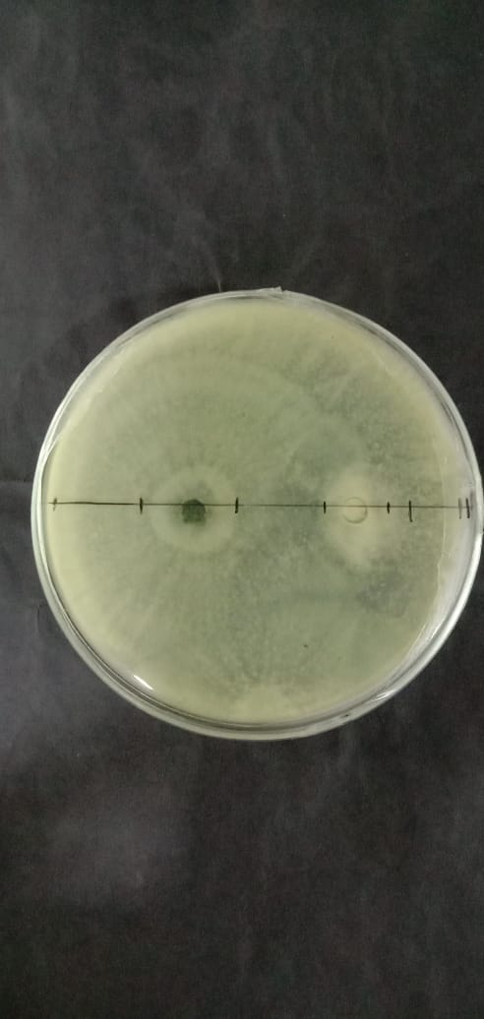
Figure 11: Dual culture plates

Slide 23
Selection of the suitable growth medium for the isolated Rigidoporus microporus

Slide 24
Growth of pathogen isolate – 02 in different media after 03 days of incubation

Slide 25
Growth of pathogen isolate-01 in different media after 05 days of incubation

Slide 26
Growth of pathogen isolate -02 in different media after 05 days of incubation

Slide 27
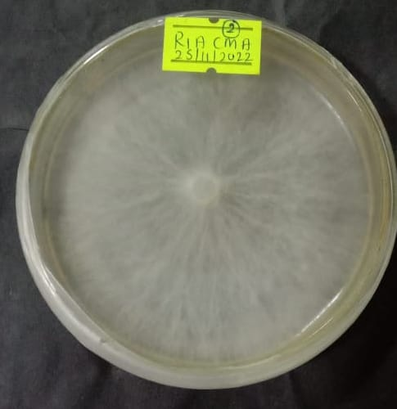
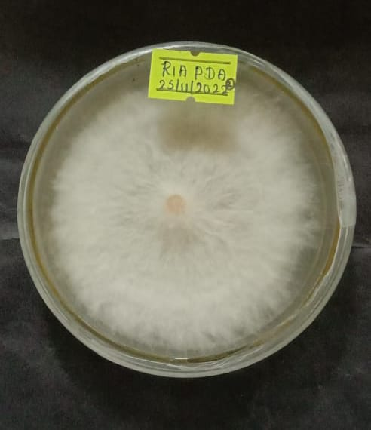
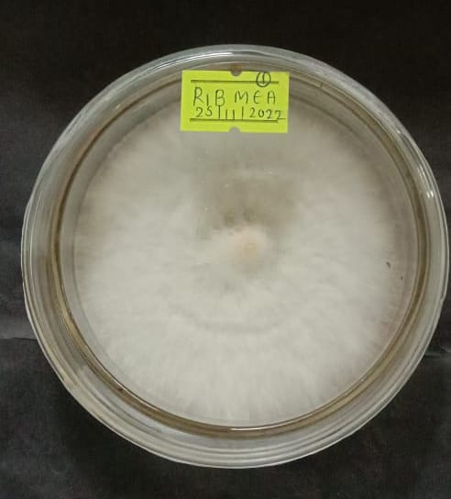
a b c
Figure 12 : Mycelial growth of R microporus in different media after (7-10) days of incubation; a: mycelial growth of isolate 01 in Corn Meal Agar medium, b: mycelial growth of isolate 01 in Potato Dextrose Agar medium, c: mycelial growth of isolate 02 in Malt Extract Agar medium

Slide 28
Conclusions
Trichoderma spp. were particularly effective against Rigidoporus microporus of cinnamon WRD.
In in vitro screening of Trichoderma strains, strain 2 was the most effective towards the R. microporus
In selection of suitable growth medium , the highest growth rate of R. microporus was observed in Corn Meal Agar medium.

Slide 29
Suggestions
Further studies need to be carried out,
To accurately identify Rigidoporus microporus using molecular base techniques.
To continue the in vivo screening for determination of the effectiveness of the antagonistic Trichoderma strains to control white root disease in cinnamon.

Slide 30
References
Chaiharn, M., Pathom-aree, W., & Lumyong, S. (2019). Biological Control of Rigidoporus microporus the Cause of White Root Disease Biological Control of Rigidoporus microporus the Cause of White Root Disease in Rubber Using PGPRs In vivo. November.
Farhana, A. H. K. F., Bahri, A. R. S., Thanh, T. A. V., & Zakaria, L. (2017). Morphological features of Rigidoporus microporus isolated from infected Malaysian rubber clones Morphological features of Rigidoporus microporus isolated from infected Malaysian rubber clones. December.
Go, W. Z., H, P. S., Wong, M. Y., Chin, K. L., & Ujang, S. (2019). Archives of Phytopathology and Plant Protection Evaluation of Trichoderma asperellum as a potential biocontrol agent against Rigidoporus microporus Hevea brasiliensis Evaluation of Trichoderma asperellum as a potential biocontrol agent against Rigidoporus microporus in Hevea brasiliensis. Archives of Phytopathology and Plant Protection, 52(7–8), 639–666. https://doi.org/10.1080/03235408.2019.1587821
Golafrouz, H., Safaie, N., & Khelghatibana, F. (2020). The reaction of some apple rootstocks to bio control of white root rot Rosellinia necatrix by Trichoderma harzianum in greenhouse. 9(4), 577–589.
Gor, Y. K., Marzuki, N. F., Liew, Y. A., Gor, Y. K., & Gor, K. J. (2018). Antagonistic Effects of Fungicolous Ascomycetous Cladobotryum Semicirculare on Rigidoporus Microporus White Root Disease in Rubber Trees ( Hevea Brasiliensis ) under in vitro. 21(1), 62–72.
Hhmau, H., Rlc, W., Nv, C., & Hs, K. (2015). Isolation and characterization of Trichoderma erinaceum for antagonistic activity against plant pathogenic fungi . 5(May), 120–127. https://doi.org/10.5943/cream/5/2/5

Slide 31


