Slide 1
Bio-efficacy of Lantana camara Leaf Extracts on White Leaf Disease Vector; Deltocephalus menoni
A. M. S. M. Sewwandika
16AGA1304
Crop Improvement and Plant Protection Module
Department of Export Agriculture
Internal supervisor
Dr W. M. A. U. K. M. Wijesekara
Senior Lecturer
Department of Export Agriculture
Faculty of Agricultural Sciences and Management
Sabaragamuwa University of Sri Lanka
External supervisor
Dr. K. M. G. Chanchala
Research Officer
Division of Crop Protection
Sugarcane Research Institute
Uda Walawa

Slide 2
Content for the presentation
Introduction
Objectives
Material and Methods
Results and Discussion
Conclusion and Recommendations
References

Slide 3
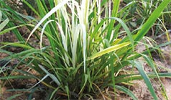
Introduction
Sugarcane; Saccharum officinarum
Family ; Poaceae
(Wanasinghe and Chanchala, 2020)
White leaf disease vector;
Scientific name: Deltocephalus menoni
Order: Hemiptera
Family: Cicadellidae
White Leaf Disease (WLD)
(Ariyarathna et al., 2007).
Deltocephalus menoni

Slide 4
Objectives
Overall objective
To evaluate the efficacy of Lantana camara leaf extract on White Leaf Disease (WLD) vector ; Deltocephalus menoni.
Specific objective
To evaluate the best extraction method of L. camara leaves.
To determine the efficacy of the different concentrations of L. camara leaf extracts against its different life stages.
To evaluate the anti - feeding effect of L. camara leaf extracts.

Slide 5
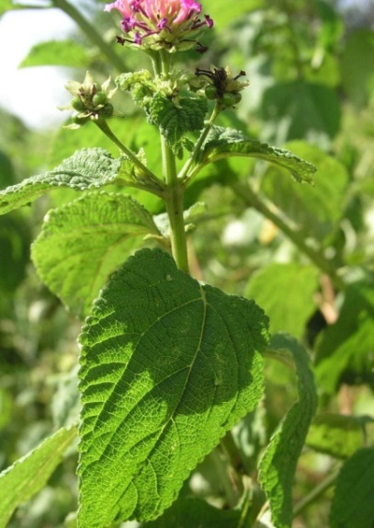
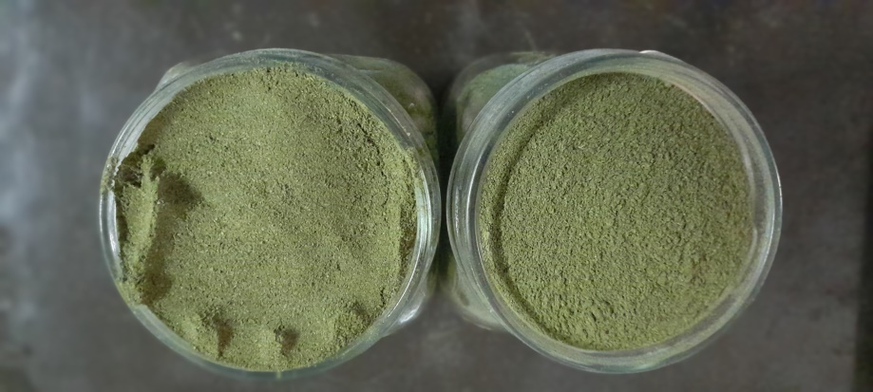
Material and Methods
Study location
Sample collection and preparation
Leaf collection
Powdering
Entomology laboratory of Sugarcane Research Institute (SRI)- Uda Walawe
Washing and air drying

Slide 6
Extraction procedure
1
Methanolic extract (warthen et al. 1984)
2
Decoction method
(Dehou et al., 2021)
Water extract
4
Maceration method
(Kalita et al., 2011)
3
Ethanolic extract
(Klotoe et al., 2021)

Slide 7
1
2
Samples stirred on magnetic stirrer for 1 hrs.
Samples boiled in water bath at 60 ⁰C for 30 minutes.
10 g of L. camara leaf powder per
each conical flask
3
4
Samples soaked and shaken for 6 hrs.
Filtered through Whatman
No 1 filter papers

Slide 8
Filtered extracts were evaporated in water bath at 60 ⁰C.
The dried extract were then diluted in distilled water for 25 g/ l as a concentration and kept under 4 ⁰C temperature.
At the application, the stock solution was used to prepare dilution series.

Slide 9
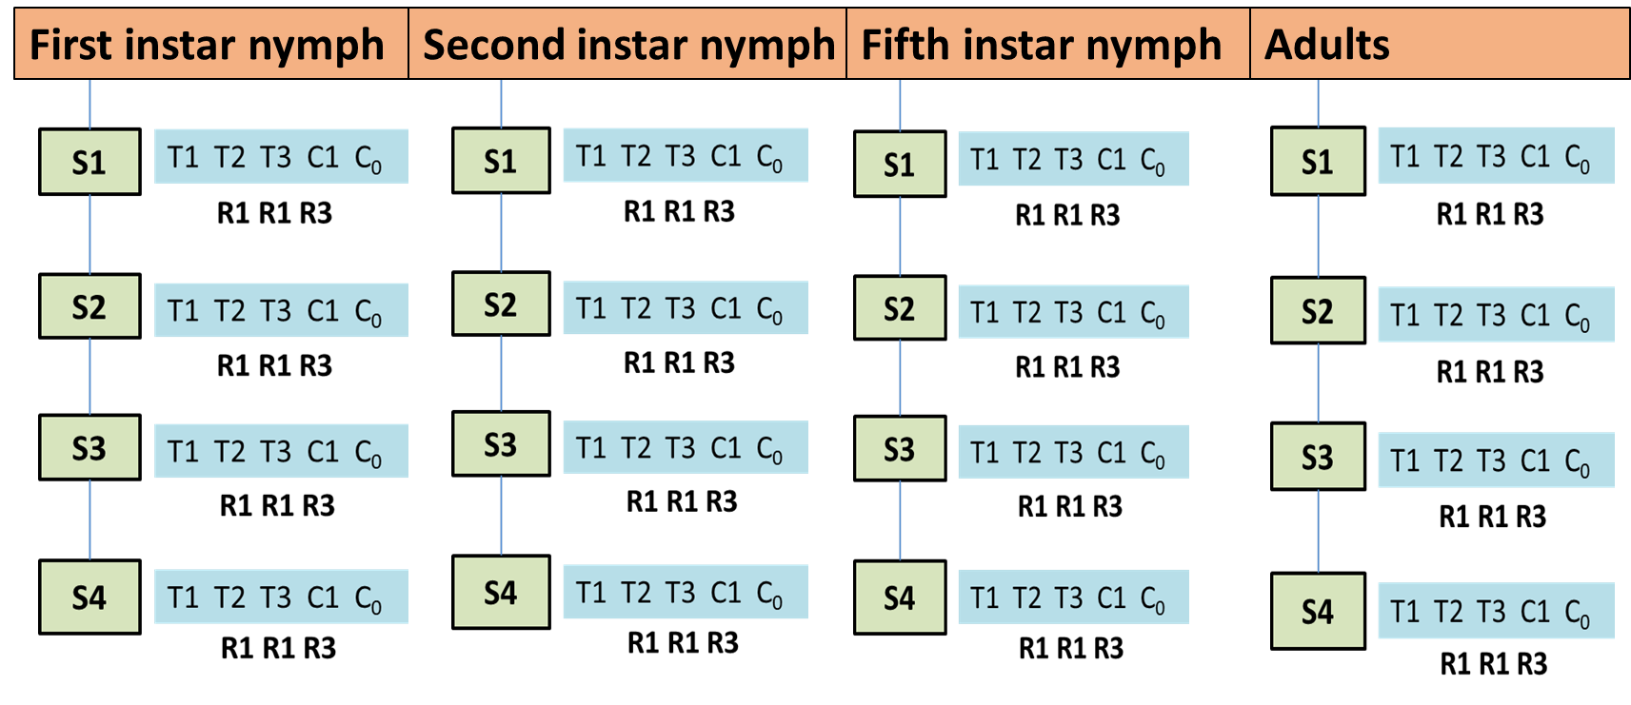
Experimental design for mortality test- CRD
S1- Maceration
S2- Decoction
S3- Ethanol
S4- Methanol
T1- 10 g/l
T2- 15 g/l
T3- 25 g/l
C1- (Actara 5 g/16 l)
C₀- 0 g/l

Slide 10
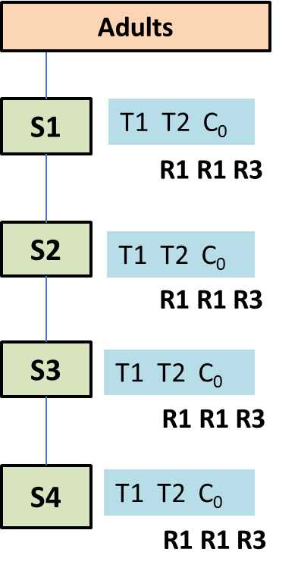
Experimental design for anti-feeding test- CRD
Second instar nymph
Fifth instar nymph
Adults
S1- Maceration
S2- Decoction
S3- Ethanol
S4- Methanol
T1- 10 g/l
T2- 25 g/l
C0- 0 g/l

Slide 11
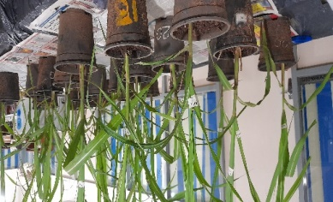
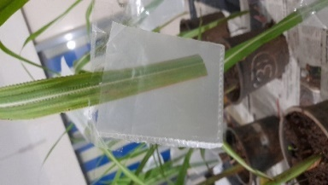
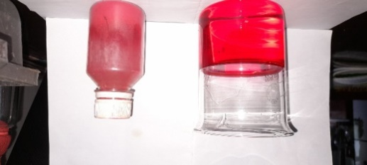
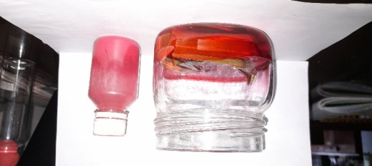
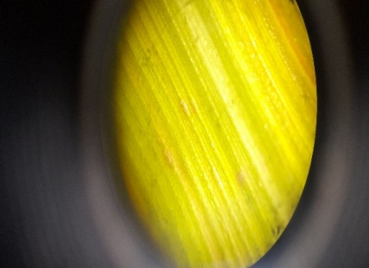
Anti-feeding test
(Heinrichs et al., 1985)
a. Bromocrysol green stained filter paper test
Three months age plants
Parafilm sachet
D. Menoni adult
Bromocrysol green filter papers
b. Erythrosine dye test of salivary flangues
0.01% w/v Erythrosine dye solution
Leaves dipped for 15min
Microscopic identification

Slide 12
DATA ANALYSIS AND VISUALIZATION
Percentage mortality of each stage under deferent treatment combination was calculated and corrected according to the Abbott’s formula (Fleming & Retnakaran, 1985).
Percentage population reduction (R ) = 1- ( (T2 x C1)/(T1 x C2) ) x 100%
T1= Pre-treatment population in treatment,
T2= Post treatment population In treatment,
C1= pre-treatment population in check
C2= post-treatment population in check
The treatment comparisons were done by using either one-way or two-way ANOVA with Tukey’s Multiple mean comparison test by using SAS OnDemand software.

Slide 13
Results and Discussion
Mortality test
Anti- feeding test

Slide 14
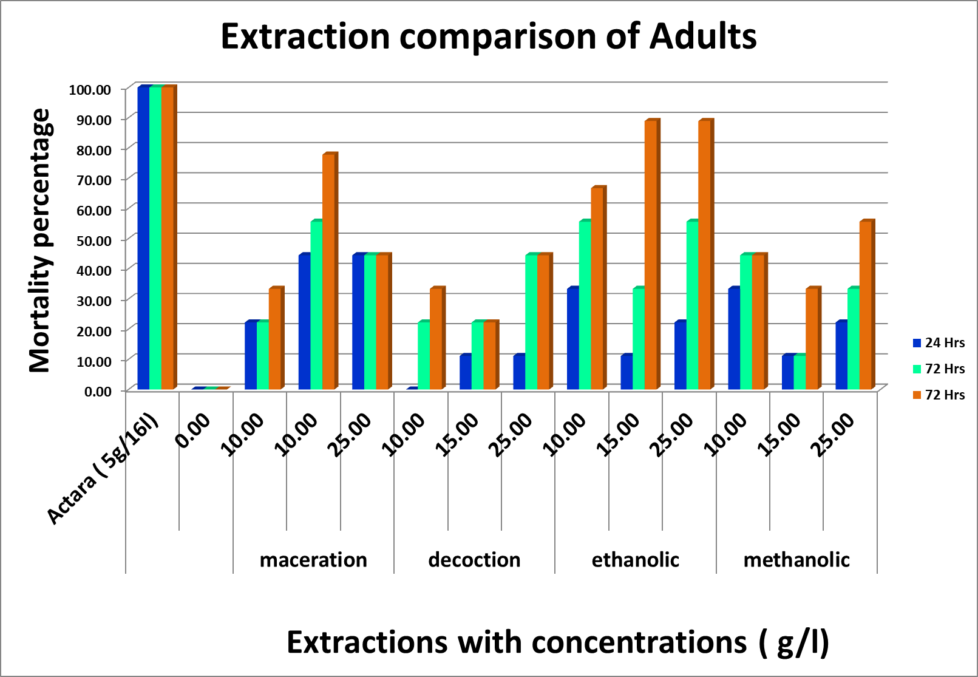
Extraction Comparison of Mortality Test
Effect of Extractions on Adults
24 Hrs p < 0.2399
S1 vs S2 ns
S1 vs S3 ns
S1 vs S4 ns
S2 vs S3 ns
S2 vs S4 ns
S3 vs S4 ns
48 Hrs p < 0.0041
S1 vs S2 ns
S1 vs S3 ns
S1 vs S4 ns
S2 vs S3 ns
S2 vs S4 ns
S3 vs S4 ns
72 Hrs p < 0.0007
S1 vs S2 ns
S1 vs S3 ns
S1 vs S4 ns
S2 vs S3 **
S2 vs S4 ns
S3 vs S4 ns
ns p > 0.05
** p ≤ 0.05
*** p ≤ 0.001
**** p ≤ 0.0001
S1 Maceration S2 Decoction
S3 Ethanolic S4 Methanolic

Slide 15
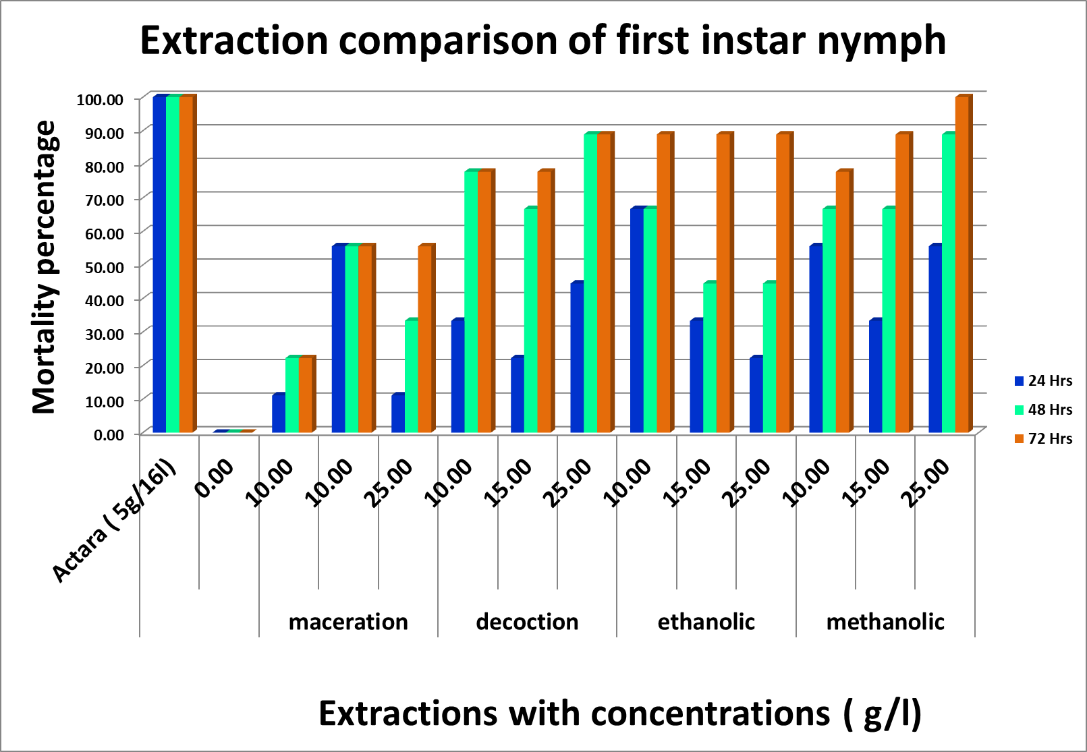
Effect of Extractions on First Instar Nymph
24 Hrs p < 0.0002
S1 vs S2 ns
S1 vs S3 ns
S1 vs S4 ns
S2 vs S3 **
S2 vs S4 **
S3 vs S4 ns
48 Hrs p < 0.0001
S1 vs S2 **
S1 vs S3 ns
S1 vs S4 **
S2 vs S3 **
S2 vs S4 ns
S3 vs S4 **
72 Hrs P < 0.0001
S1 vs S2 **
S1 vs S3 ns
S1 vs S4 **
S2 vs S3 **
S2 vs S4 ns
S3 vs S4 **
ns p > 0.05
** p ≤ 0.05
*** p ≤ 0.001
**** p ≤ 0.0001
S1 Maceration S2 Decoction
S3 Ethanolic S4 Methanolic

Slide 16
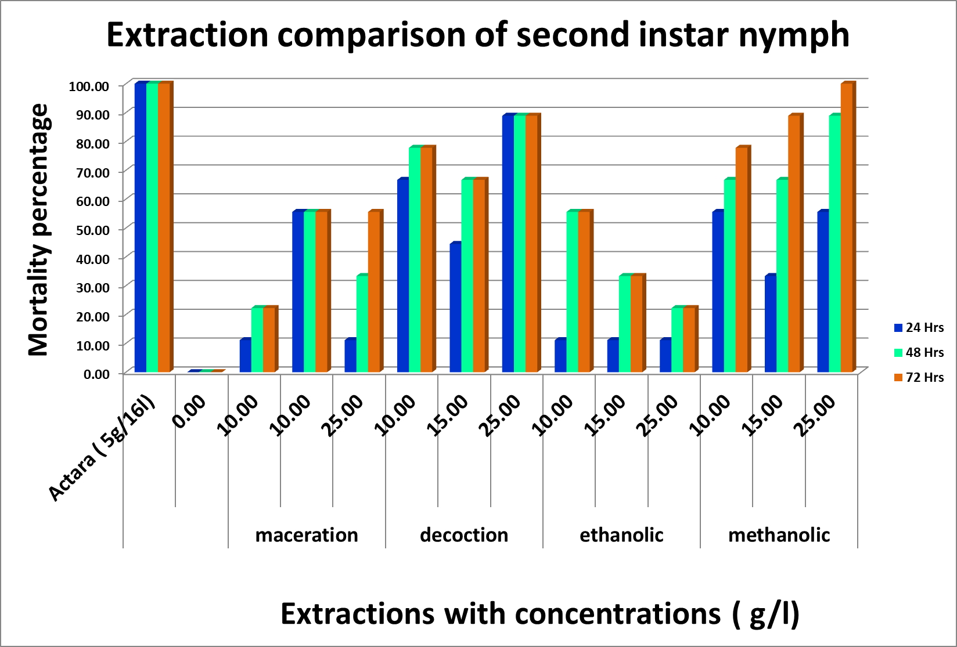
Effect of Extractions on second Instar Nymph
24 Hrs p < 0.0001
S1 vs S2 **
S1 vs S3 na
S1 vs S4 ns
S2 vs S3 **
S2 vs S4 ns
S3 vs S4 **
48 Hrs p < 0.0001
S1 vs S2 **
S1 vs S3 ns
S1 vs S4 **
S2 vs S3 **
S2 vs S4 ns
S3 vs S4 **
72 Hrs P < 0.0001
S1 vs S2 **
S1 vs S3 ns
S1 vs S4 **
S2 vs S3 **
S2 vs S4 ns
S3 vs S4 **
ns p > 0.05
** p ≤ 0.05
*** p ≤ 0.001
**** p ≤ 0.0001
S1 Maceration S2 Decoction
S3 Ethanolic S4 Methanolic

Slide 17
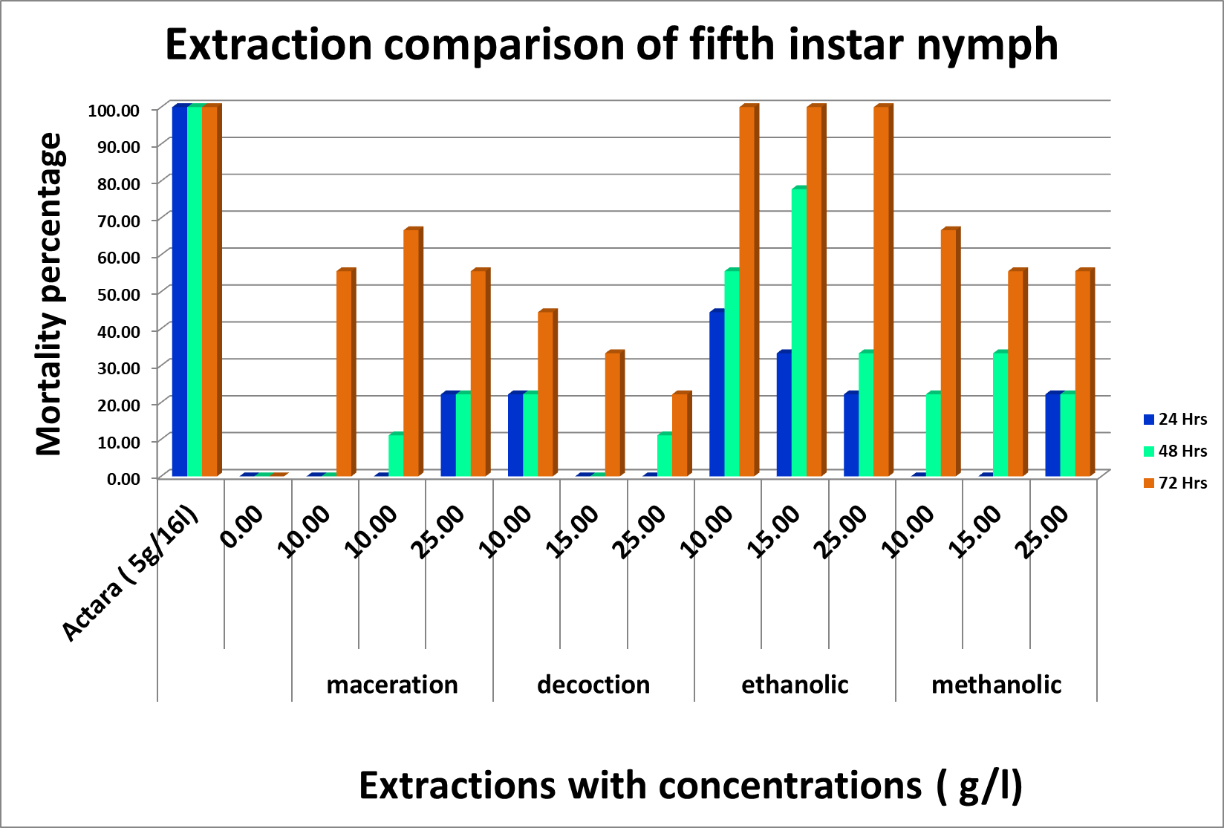
Effect of Extractions on Fifth Instar Nymph
72 Hrs P < 0.0001
S1 vs S2 ns
S1 vs S3 **
S1 vs S4 ns
S2 vs S3 **
S2 vs S4 **
S3 vs S4 **
24 Hrs p < 0.0431
S1 vs S2 ns
S1 vs S3 ns
S1 vs S4 ns
S2 vs S3 ns
S2 vs S4 ns
S3 vs S4 ns
48 Hrs p < 0.0431
S1 vs S2 ns
S1 vs S3 **
S1 vs S4 ns
S2 vs S3 **
S2 vs S4 **
S3 vs S4 **
ns p > 0.05
** p ≤ 0.05
*** p ≤ 0.001
**** p ≤ 0.0001
S1 Maceration S2 Decoction
S3 Ethanolic S4 Methanolic

Slide 18
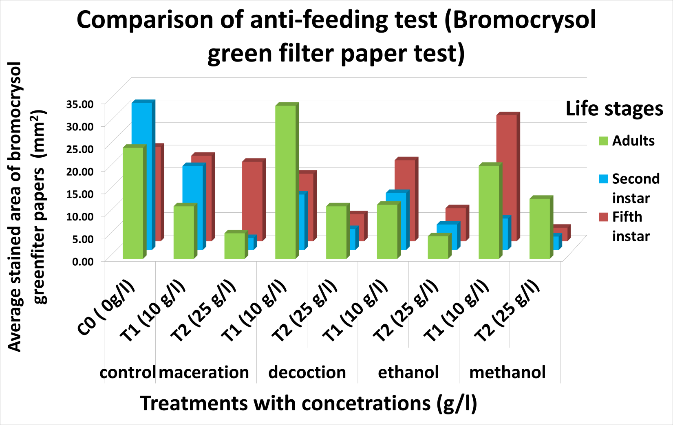
Extraction Comparison of Anti-Feeding Test
Comparison of anti-feeding test (Bromocrysol green filter paper test)
SECOND INSTAR
MACERATION
T1 vs T2 ****
T1 vs C0 ****
T2 Vs C0 ****
DECOCTION
T1 vs T2 ****
T1 vs C0 ****
T2 Vs C0 ****
ETHANOL
T1 vs T2 ****
T1 vs C0 ****
T2 Vs C0 ****
METHANOL
T1 vs T2 ns
T1 vs C0 ns
T2 Vs C0 ****
FIFTH INSTAR
MACERATION
T1 vs T2 ns
T1 vs C0 ns
T2 Vs C0 ns
DECOCTION
T1 vs T2 ns
T1 vs C0 ns
T2 Vs C0 **
ETHANOL
T1 vs T2 ns
T1 vs C0 ns
T2 Vs C0 **
METHANOL
T1 vs T2 ns
T1 vs C0 ns
T2 Vs C0 ***
ADULTS
MACERATION
T1 vs T2 ****
T1 vs C0 ****
T2 Vs C0 ****
DECOCTION
T1 vs T2 ****
T1 vs C0 ****
T2 Vs C0 ****
ETHANOL
T1 vs T2 ns
T1 vs C0 ***
T2 Vs C0 ***
METHANOL
T1 vs T2 ns
T1 vs C0 ns
T2 Vs C0 **
ns p > 0.05
** p ≤ 0.05
*** p ≤ 0.001
**** p ≤ 0.0001
FIFTH INSTAR
S1 vs S2 ****
S1 vs S3 ns
S1 vs S4 ns
S2 vs S3 ns
S2 vs S4 ns
S3 vs S4 ns
SECOND INSTAR
S1 vs S3 ns
S1 vs S2 ns
S1 vs S4 ****
S2 vs S3 ns
S2 vs S4 ns
S3 vs S4 ns
ADULTS
S2 vs S4 ****
S2 vs S1 ****
S2 vs S3 ****
S4 vs S1 ****
S4 vs S3 ****
S1 vs S3 ns
S1 Maceration S2 Decoction S3 Ethanolic S4 Methanolic

Slide 19
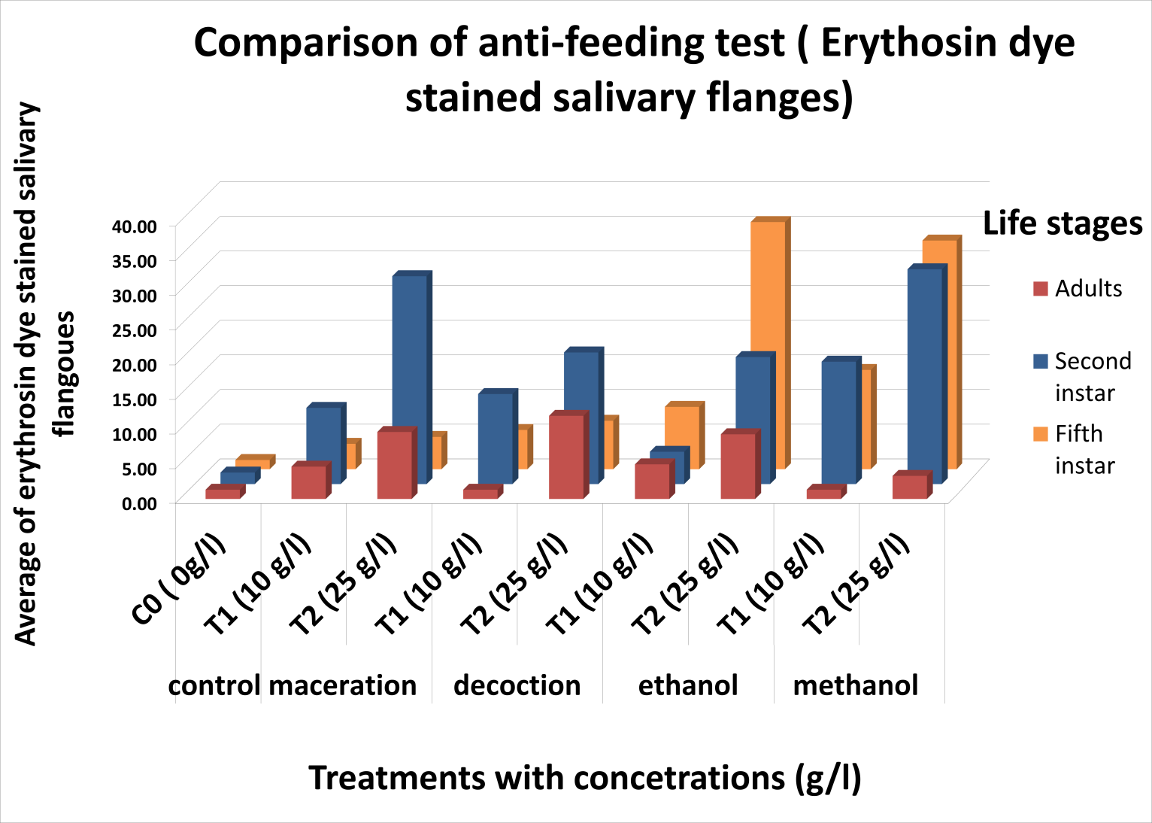
Comparison of anti-feeding test (Erythrosin dye stained salivary flanges)
ADULTS
MACERATION
T1 vs T2 ns
T1 vs C0 ns
T2 Vs C0 **
DECOCTION
T1 vs T2 **
T1 vs C0 ns
T2 Vs C0 **
ETHANOL
T1 vs T2 ns
T1 vs C0 ns
T2 Vs C0 ns
METHANOL
T1 vs T2 **
T1 vs C0 ns
T2 Vs C0 **
SECOND INSTAR
MACERATION
T1 vs T2 **
T1 vs C0 ns
T2 Vs C0 **
DECOCTION
T1 vs T2 **
T1 vs C0 **
T2 Vs C0 **
ETHANOL
T1 vs T2 **
T1 vs C0 ns
T2 Vs C0 **
METHANOL
T1 vs T2 **
T1 vs C0 **
T2 Vs C0 **
FIFTH INSTAR
MACERATION
T1 vs T2 ns
T1 vs C0 ns
T2 Vs C0 **
DECOCTION
T1 vs T2 ns
T1 vs C0 ns
T2 Vs C0 **
ETHANOL
T1 vs T2 **
T1 vs C0 ns
T2 Vs C0 **
METHANOL
T1 vs T2 **
T1 vs C0 **
T2 Vs C0 **
ns p > 0.05
** p ≤ 0.05
*** p ≤ 0.001
**** p ≤ 0.0001
ADULTS
S2 vs S4 ns
S2 vs S1 ns
S2 vs S3 ns
S4 vs S1 ns
S4 vs S3 ns
S1 vs S3 ns
SECOND INSTAR
S1 vs S3 **
S1 vs S2 ns
S1 vs S4 ns
S2 vs S3 ns
S2 vs S4 **
S3 vs S4 **
FIFTH INSTAR
S1 vs S2 ns
S1 vs S3 **
S1 vs S4 **
S2 vs S3 **
S2 vs S4 **
S3 vs S4 ns
S1 Maceration S2 Decoction S3 Ethanolic S4 Methanolic

Slide 20
Conclusion
Efficacy of L. camara extraction depends on the life stages and time of exposure D. menoni.
Ethanolic extract showed significant mortality on adult stage and fifth instar nymph while methanolic and decoction extracts for first instar and second instar
15 g/l and 25 g/l of ethanolic extract induce significant mortality on adults and fifth instar while all concentrations of methanolic extract for first instar and second instar
Significant anti-feeding effect was recorded for adults by ethanolic extract and methanolic extract for second and fifth instar

Slide 21
Recommendations
Further studies should be conducted with more replicates and high concentrations.
Phytotoxic effect could be evaluated.
Phytochemical analysis could be done for determining chemicals which are present in extractions.

Slide 22
References
Chanchala, G. et al. (2019) ‘ESTIMATING THE FLYING DISTANCE OF Deltocephalus menoni ; ( Hemiptera : Cicadellidae ) THE VECTOR OF SUGARCANE WHITE LEAF DISEASE IN SRI LANKA’, (January)
Fleming, R., & Retnakaran, A. (1985). Evaluating Single Treatment Data Using Abbott’s Formula With Reference to Insecticides. Journal of Economic Entomology, 78(6), 1179–1181. https://doi.org/10.1093/jee/78.6.1179
Kalita, S. et al. (2011) ‘Phytochemical Composition and In Vitro Hemolytic Activity of Lantana Camara L. (Verbenaceae) Leaves’, Pharmacologyonline Newsletter Kalita et al, 1, pp. 59–67.
Keerthipala, A.P. (2016) ‘Development of Sugar Industry in Sri Lanka’, Sugar Tech, 18(6), pp. 612–626. doi:10.1007/s12355-016-0485-3.
Klotoe, J.R. et al. (2021) ‘Antifungal activity of Ocimum gratissimum L ., Lantana camara L . & Pteleopsis suberosa Engl . & Dies used in the treatment of vulvovaginal candidiasis in Benin’, Future Journal of Pharmaceutical Sciences [Preprint]. doi:10.1186/s43094-021-00383-4.
Wanasinghe, V.K.A.S.M. and Chanchala, K.M.G. (2020) ‘Pests of Sugarcane in Sri Lanka’.
Warthen, J D; Stokes, JB; Jacobson, M andKozempel, MP (1984). Estimation of azadirachtin content in neem extracts and formulations. J. Liq. Chromatogr.,7: 591-598 Dehou, R.J. et al. (2021) ‘Bactericidal effect of the aqueous extract of the leaves of Lantana camara L . ( Verbenaceae ), a plant used in Benin in the treatment of skin infections .’, pp. 17406–17412.

Slide 23
Thank You

