Slide 1
Effect of Marination Method and Holding Time on Physicochemical and Sensory Characteristics of Breast Meat from Spent Laying Hens
C.G.W. Abeysekara¹, R.K. Mutucumarana^{1*}, P. Kakunamulla²
¹Department of Livestock Production, Faculty of Agricultural Sciences, Sabaragamuwa University of Sri Lanka, Belihuloya, Sri Lanka
²Bairaha Farms PLC, Kandalanda, Urapola, Sri Lanka

Slide 2
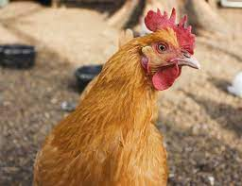
Content for the Presentation
Introduction
Materials and Methods
Results and Discussion
Conclusion
References

Slide 3
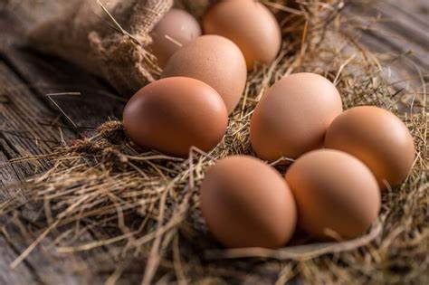
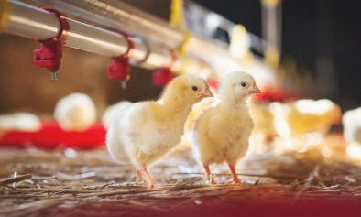
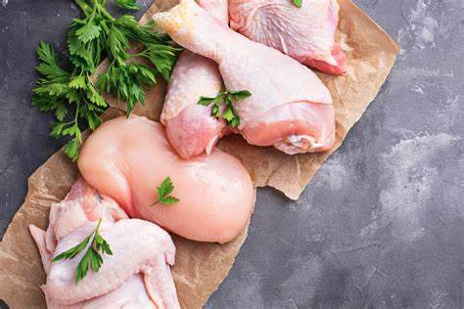
Introduction
Spent laying hens have more commercial value
The poultry sector consists of:
Feed mills, Hatcheries Breeder farms and Processing plants
Poultry Sector

Slide 4
There is a growing concern of commercialization of spent laying hen meat for human consumption
Problem Statement
Unacceptably high hardness and fragile bones
Farmers are having trouble of selling unproductive layers for low prices

Slide 5
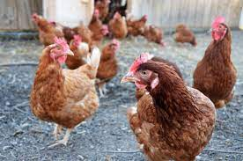
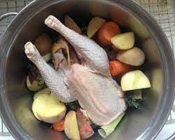
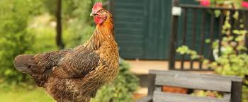
Global Human Consumption
Because of:
Low fat content
Tougher
Not succulent
Spent Laying Hens
Pet Food Industry
The most crucial meat organoleptic trait is considered as the tenderness

Slide 6
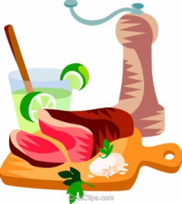
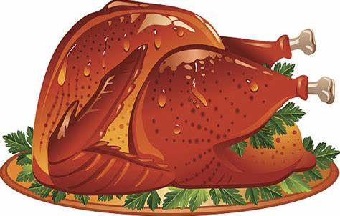
Alter toughness and tenderness
Add more value to spent hen meat
Marinade methods have long been recognized as a practical method which is used to improve the tenderness and flavor
Marination is known to improve the meat appearance, product quality, product yield, juiciness and tenderness and also the shelf-life of meat

Slide 7
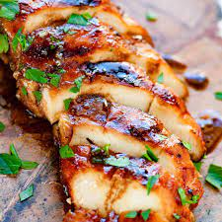
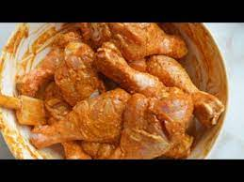
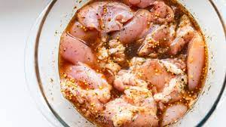
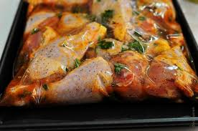
Marination methods
Immersion: Meat is submerged in the marinade solution
Injection: Marinade solution is forced injected into meat
Tumbling: Meat is rotated and dropped into a drum with metal paddles
Examined the interactive effect between holding time (4 h, 8 h and 12 h) and marinating method

Slide 8
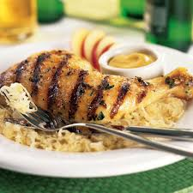
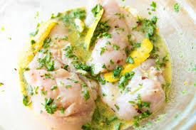
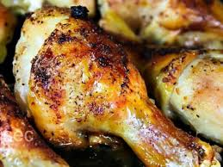
Objectives
To identify the most suitable marinating method and holding time combination for spent hen meat based on physicochemical and sensory qualities

Slide 9
Materials and Methods
pH
Cooking Yield
Cooking
Loss
Texture
Marinade Uptake
Physicochemical
Parameters

Slide 10
External / Uncooked
L* - Lightness
Internal / Uncooked
L* - Lightness
External / Uncooked
L* - Lightness
Internal / Uncooked
a* - Redness
Colour
External / Uncooked
b* - Yellowness
Internal / Uncooked
b* - Yellowness
External / Cooked
L* - Lightness
Internal / Cooked
L* - Lightness
External / Cooked
a* - Redness
Internal / Cooked
a* - Redness
External / Cooked
b* - Yellowness
Internal / Cooked
b* - Yellowness

Slide 11
Location
Laboratories of the Faculty of Agricultural Sciences and Faculty of Applied Sciences of Sabaragamuwa University of Sri Lanka

Slide 12
Experimental Design
A total of 60 spent laying hen breast meat samples
4 x 3 factorial design with four marination methods (unmarinated control, tumbling, injection and immersion) and three holding times (4 h, 8 h and 12h) combinations
Arranged in a Complete Randomized Design (n=5).

Slide 13
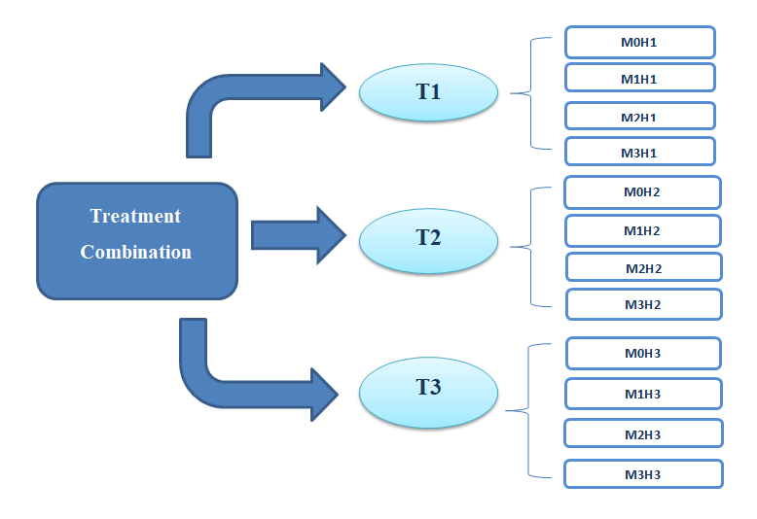
Figure: Experimental design

Slide 14
Sampling Technique
Fresh deboned breast meat of Shaver Brown spent hens (90-weeks old) were obtained from the Faculty layer farm
Right and left Pectoralis major and minor spent hen breast meat muscles
Meat: Cut into 20 g cubes
All the samples were frozen below -18°C for 24 h and were labeled

Slide 15
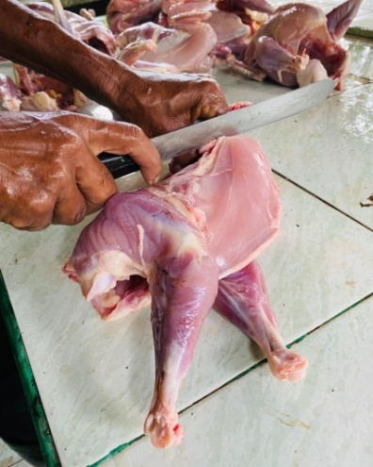
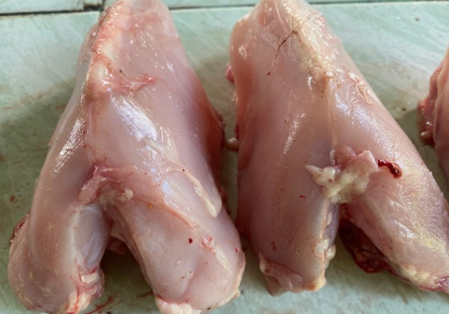
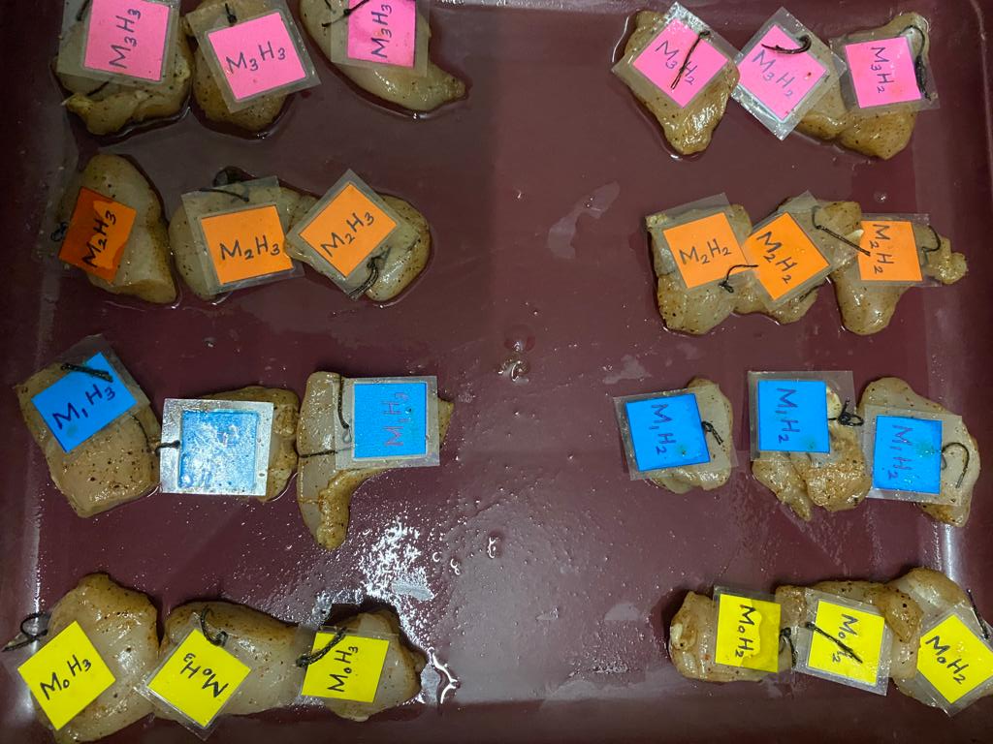
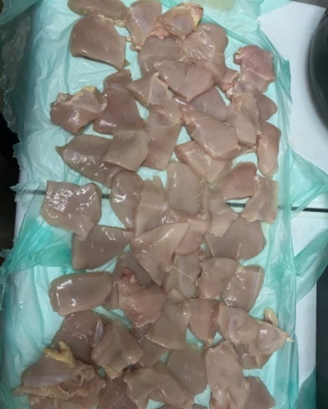
Fresh deboned breast meat
Cut into 20 g cubes
Labeled samples
Figure: Sample processing

Slide 16
Preparation of the Marinade
A commercially available marinade mixture
Marinade mixture: Dissolved in distilled water and prepared a solution of a concentration of 20%
The mixture was prepared in a ratio of meat: solution of 10:1 (w/w)

Slide 17
Uptake of Marinade
The excess marinade mixture was removed from the sample surface using a tissue paper and the percentage of marinade uptake was calculated
$$\text{Uptake} \text{of} \text{marinade}\text{ \% =}\frac{\text{W}\text{2}\text{−}\text{W}\text{1}}{\text{W}\text{1}}\text{x}\text{100}$$
W1- Weight of the meat sample before marination (g).
W2 - Weight of the meat sample just after marination (g).

Slide 18
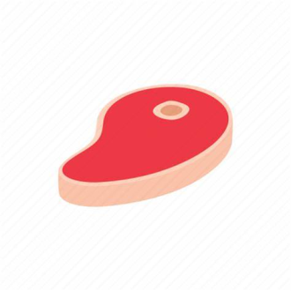
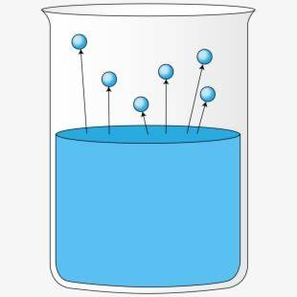
Determination of pH
pH values of the samples were determined using a glass electrode pH meter
Spent hen breast meat sample (2g)
10 ml of distilled water
Meat samples were mixed with distilled water at a ratio of 1:5 (w/w).

Slide 19
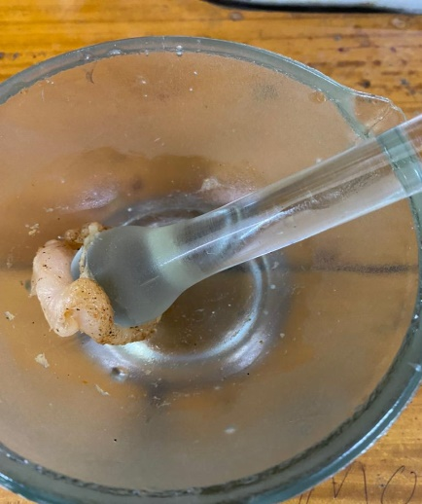
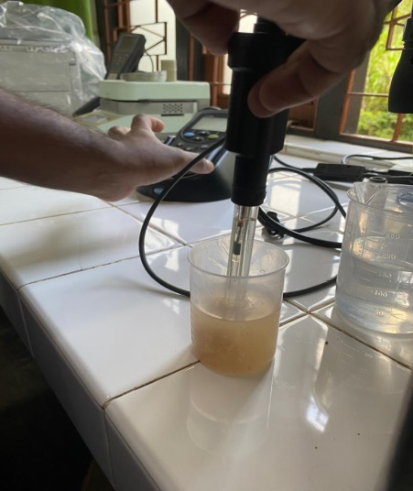
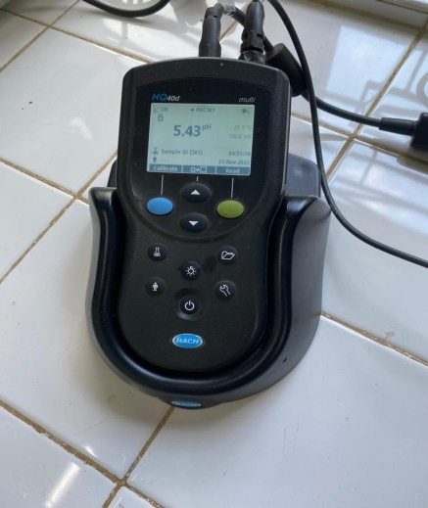
Figure: Measuring the pH

Slide 20
Cooking Yield
Following appropriate holding times, marinated spent hen breast meat samples were cooked in an electric oven at 218 °C
Cooking yield % = (W2 /W1) x 100
Where,
W1 = Weight before marination (g).
W2 = Weight after cooking (g).

Slide 21
Cooking Loss
Each marinated meat samples were slightly blotted with paper towels, weighed (W1) and placed in an electric oven at 218˚C
Cooked meat samples were blotted with the paper towels and the final weight was recorded (W2)
Cooking loss % = [(W1 -W2)/W1] x 100

Slide 22
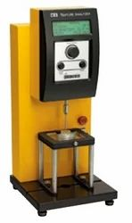
Texture Analysis
Cooked spent hen breast meat samples were evaluated using a texture analyzer
The raw breast meat samples were equilibrated to room temperature, and then each sample was measured individually for hardness level
Figure: Texture Analyzer

Slide 23
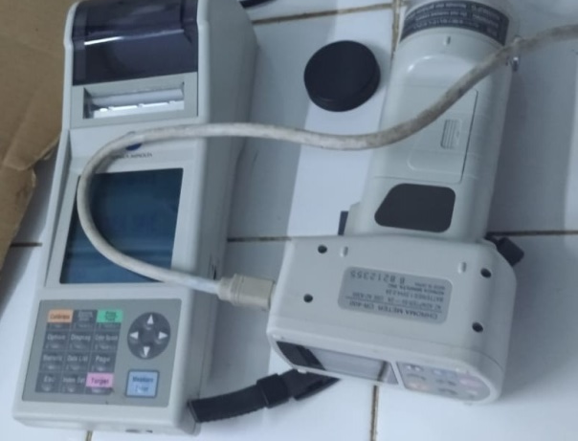
Colour Measurements
External and internal surface meat color of uncooked and cooked meat samples in terms of CIE L*, a*, and b* values were measured using a colorimeter
L*
Lightness
Figure: Colorimeter
a*
Redness
b*
Yellowness

Slide 24
Sensory Evaluation
30 untrained panelists
Toughness, color, aroma, flavor, marinade penetration and overall acceptability of spent hen breast meat samples were evaluated using a 6-point hedonic scale

Slide 25
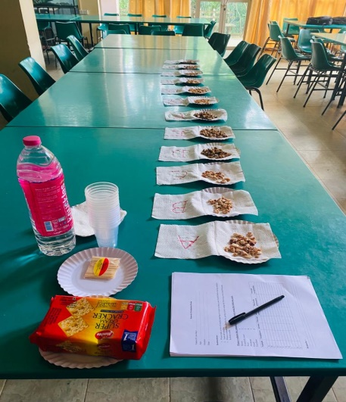
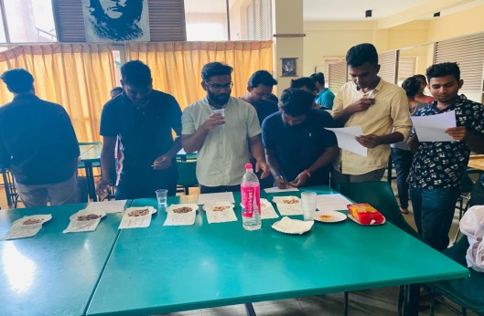
Figure: Sensory evaluation

Slide 26
Cost Benefit Analysis
Cost benefit analysis to produce 1kg marinated meat was done to determine the most cost effective treatment in the experiment

Slide 27
Data Analysis
Physicochemical data were analysed using two-way analysis of variance (ANOVA) using the General Linear Models procedure of SAS (2002)
Differences were considered significant at P<0.05
The data of marinade uptake was analysed using one-way ANOVA
The sensory data were analysed using Friedman test in Minitab 17 software

Slide 28
Results and Discussion
Marinade Uptake
Treatment | Uptake of Marinade
Control | -4.009d
Immersion | 6.7c
Ingection | 18.68a
Tumbling | 10.1b
SEM | 0.946
Probabilities, P˂
Method | ˂ .0001

Slide 29
pH
Treatments | pH
C 4 | 5.63
C 8 | 5.49
C 12 | 5.47
Im 4 | 5.3
Im 8 | 5.43
Im 12 | 5.51
Inj 4 | 5.43
Inj 8 | 5.41
Inj 12 | 5.4
T 4 | 5.49
T 8 | 5.81
T 12 | 5.59
SEM | 0.036
Method | ˂ .0001
Holding Time | 0.028
Method x Holding Time | ˂ .0001

Slide 30
Cooking Yield
Treatments | Cooking Yield
 | (%)
C 4 | 53.5
C 8 | 49.8
C 12 | 50.1
Im 4 | 42
Im 8 | 67.5
Im 12 | 55.8
Inj 4 | 44.1
Inj 8 | 56.7
Inj 12 | 63.2
T 4 | 45.8
T 8 | 41.9
T 12 | 54.5
SEM | 6.051
Method | 0.376
Holding Time | 0.072
Method x Holding Time | 0.114

Slide 31
Cooking Loss
Treatments | Cooking Loss
 | (%)
C 4 | 44.3
C 8 | 47.9
C 12 | 48.2
Im 4 | 60.7
Im 8 | 41.2
Im 12 | 40.1
Inj 4 | 62.9
Inj 8 | 48.4
Inj 12 | 43.1
T 4 | 58.4
T 8 | 64.7
T 12 | 42.8
SEM | 3.486
Method | 0.014
Holding Time | ˂ .0001
Method x Holding Time | 0.0002

Slide 32
Hardness
Treatments | Hardness
 | (N)
C 4 | 2.73
C 8 | 2.61
C 12 | 2.93
Im 4 | 1.3
Im 8 | 2.21
Im 12 | 3.15
Inj 4 | 1.43
Inj 8 | 1.89
Inj 12 | 3.72
T 4 | 3.38
T 8 | 3.9
T 12 | 1.16
SEM | 0.232
Method | 0.005
Holding Time | 0.005
Method x Holding Time | ˂ .0001

Slide 33
External Colour (L*)
Treatments | Uncooked L* | Cooked L*
C 4 | 60.39 | 66.77
C 8 | 60.64 | 67.93
C 12 | 59.37 | 60.73
Im 4 | 50.72 | 37.86
Im 8 | 44.41 | 20.39
Im 12 | 42.92 | 43.95
Inj 4 | 50.06 | 51.61
Inj 8 | 49.2 | 50.5
Inj 12 | 54.03 | 45.21
T 4 | 43.01 | 66.77
T 8 | 45.57 | 67.93
T 12 | 46.54 | 60.73
SEM | 2.07 | 2.71
Method | ˂ .0001 | ˂ .0001
Holding Time | 0.746 | 0.096
Method × Holding Time | 0.076 | ˂ .0001

Slide 34
External Colour (L*)
Treatments | Uncooked L* | Cooked L*
C 4 | 60.39 | 66.77
C 8 | 60.64 | 67.93
C 12 | 59.37 | 60.73
Im 4 | 50.72 | 37.86
Im 8 | 44.41 | 20.39
Im 12 | 42.92 | 43.95
Inj 4 | 50.06 | 51.61
Inj 8 | 49.2 | 50.5
Inj 12 | 54.03 | 45.21
T 4 | 43.01 | 66.77
T 8 | 45.57 | 67.93
T 12 | 46.54 | 60.73
SEM | 2.07 | 2.71
Method | ˂ .0001 | ˂ .0001
Holding Time | 0.746 | 0.096
Method × Holding Time | 0.076 | ˂ .0001

Slide 35
External Colour (a*)
Treatments | Uncooked a* | cooked a*
C 4 | 3.73^{c} | 4.77^{ef}
C 8 | 3.23^{c} | 4.28^{f}
C 12 | 4.10^{bc} | 4.18^{f}
Im 4 | 3.45^{c} | 11.23ab
Im 8 | 8.48ª | 8.14^{cd}
Im 12 | 5.55^{b} | 8.85^{c}
Inj 4 | 3.91^{bc} | 6.45de
Inj 8 | 5.03^{bc} | 9.03^{c}
Inj 12 | 3.82^{bc} | 12.07ª
T 4 | 5.87^{b} | 9.32^{bc}
T 8 | 4.48^{bc} | 8.14^{cd}
T 12 | 3.55^{c} | 8.36^{cd}
SEM | 0.736 | 0.716
Method | 0.007 | ˂ .0001
Holding Time | 0.074 | 0.171
Method × Holding Time | 0.002 | ˂ .0001

Slide 36
External Colour (b*)
Treatments | Uncooked b* | cooked b*
C 4 | 7.97e | 24.41^{bcd}
C 8 | 8.22e | 22.62^{cd}
C 12 | 8.75e | 21.70^{d}
Im 4 | 11.39de | 24.51^{bcd}
Im 8 | 21.94ª | 10.00e
Im 12 | 14.50^{bcd} | 25.39^{bc}
Inj 4 | 9.46e | 28.88ª
Inj 8 | 9.33e | 25.62^{abc}
Inj 12 | 7.96e | 26.56^{ab}
T 4 | 16.10^{b} | 27.02^{ab}
T 8 | 15.52^{bc} | 10.00e
T 12 | 11.54^{cde} | 24.86^{bcd}
SEM | 1.44 | 1.15
Method | ˂ .0001 | ˂ .0001
Holding Time | 0.01 | ˂ .0001
Method × Holding Time | 0.002 | ˂ .0001

Slide 37
Internal Colour (L*)
Treatments | Uncooked L* | cooked L*
C 4 | 62.29 | 69.52ª
C 8 | 63.41 | 70.0ª
C 12 | 61.34 | 64.70^{ab}
Im 4 | 53.18 | 39.61de
Im 8 | 48.61 | 21.82^{f}
Im 12 | 46.9 | 46.22^{cde}
Inj 4 | 48.86 | 50.88^{cd}
Inj 8 | 47.43 | 50.72^{cd}
Inj 12 | 52.58 | 43.87^{cde}
T 4 | 45.92 | 49.54^{cd}
T 8 | 48 | 36.88e
T 12 | 49.68 | 55.38^{bc}
SEM | 2.05 | 4.37
Method | ˂ .0001 | ˂ .0001
Holding Time | 0.844 | 0.023
Method × Holding Time | 0.14 | 0.007

Slide 38
Internal Colour
Treatments | Uncooked L* | cooked L*
C 4 | 62.29 | 69.52ª
C 8 | 63.41 | 70.0ª
C 12 | 61.34 | 64.70^{ab}
Im 4 | 53.18 | 39.61de
Im 8 | 48.61 | 21.82^{f}
Im 12 | 46.9 | 46.22^{cde}
Inj 4 | 48.86 | 50.88^{cd}
Inj 8 | 47.43 | 50.72^{cd}
Inj 12 | 52.58 | 43.87^{cde}
T 4 | 45.92 | 49.54^{cd}
T 8 | 48 | 36.88e
T 12 | 49.68 | 55.38^{bc}
SEM | 2.05 | 4.37
Method | ˂ .0001 | ˂ .0001
Holding Time | 0.844 | 0.023
Method × Holding Time | 0.14 | 0.007

Slide 39
Treatments | Uncooked a* | cooked a*
C 4 | 3.71^{cd} | 4.17^{bcd}
C 8 | 3.28^{d} | 3.65^{cd}
C 12 | 4.12b^{cd} | 4.37^{bcd}
Im 4 | 3.01^{d} | 3.03^{d}
Im 8 | 8.44ª | 8.61ª
Im 12 | 5.71^{bc} | 5.95^{b}
Inj 4 | 3.81^{cd} | 3.76^{cd}
Inj 8 | 4.95^{bcd} | 5.08^{bc}
Inj 12 | 3.70^{cd} | 3.53^{cd}
T 4 | 6.04^{b} | 5.83^{b}
T 8 | 4.59^{bcd} | 4.45^{bcd}
T 12 | 3.64^{d} | 3.50^{cd}
SEM | 0.708 | 0.709
Method | 0.007 | 0.011
Holding Time | 0.047 | 0.032
Method × Holding Time | 0.0003 | 0.0003

Slide 40
Treatments | Uncooked b* | cooked b*
C 4 | 7.86^{d} | 8.74^{ef}
C 8 | 8.13^{d} | 9.80^{def}
C 12 | 8.71^{d} | 10.06^{def}
Im 4 | 10.75^{cd} | 12.05de
Im 8 | 20.76ª | 22.37ª
Im 12 | 14.21^{bc} | 16.22^{bc}
Inj 4 | 9.57^{d} | 9.70^{def}
Inj 8 | 9.46^{d} | 8.37^{ef}
Inj 12 | 7.97^{d} | 7.28^{f}
T 4 | 15.29^{b} | 17.66^{b}
T 8 | 14.45^{bc} | 16.19^{bc}
T 12 | 10.72^{cd} | 13.03^{cd}
SEM | 1.37 | 1.39
Method | ˂ .0001 | ˂ .0001
Holding Time | 0.012 | 0.029
Method × Holding Time | 0.002 | 0.0009

Slide 41
Sensory Evaluation
Treatment | Toughness | Aroma | Flavor | Surface Color | Marinade Penetration | Overall acceptability
C (4h) | 3.9 | 3.7 | 3.9 | 3.6 | 3.1 | 3.7
C (8h) | 4 | 3.8 | 3.9 | 3.5 | 3.8 | 3.8
C (12h) | 3.2 | 3.7 | 3.8 | 3.8 | 3.4 | 3.7
IM (4h) | 4.8 | 4.6 | 5.1 | 4.7 | 4.9 | 4.7
IM (8h) | 4.4 | 4.6 | 5.1 | 4.7 | 4.8 | 4.8
IM (12h) | 4.5 | 4.6 | 4.8 | 5 | 4.6 | 5
INJ (4h) | 4.3 | 4 | 4 | 4.4 | 3.9 | 4
INJ (8h) | 4.6 | 3.7 | 4.2 | 4 | 4.2 | 4.4
INJ (12h) | 4.5 | 3.9 | 4.6 | 4 | 4.3 | 4.4
T (4h) | 4.5 | 4.4 | 4.7 | 4.6 | 4.8 | 4.8
T (8h) | 4.4 | 4.3 | 4.7 | 4.9 | 4.7 | 4.5
T (12h) | 4.7 | 4.6 | 4.7 | 4.9 | 4.5 | 4.9

Slide 43
Conclusion
Holding meat at 4 ℃ for 8-h after immersion marination is the best in developing breast meat quality of spent hens
Spent hen breast meat when held at 4℃ for 12h after immersion marination attracts panelists the most

Slide 44
References
Alvarado, C. and Mckee, S. (2007) Marination to Improve Functional Properties and Safety of Poultry Meat. Journal of Applied Poultry Research. 16:113–120. DOI: http://dx.doiorg/10.1093/japr/16.1.113
Fenton, F.L. Hand, L.W. and Berry, J.G. (1993). Effect of marination holding time and temperature on chicken breast halves. Oklahoma Agricultural Experiment Station. Pp 99-94. DOI: http://dx.doi.org/10.4148/2378-5977.1779
Gamage, H.G.C.L., Mutucumarana, R.K. and Andrew, M.S. (2017) ‘Effect of Marination Method and Holding Time on Physicochemical and Sensory Characteristics of Broiler Meat’, Journal of Agricultural Sciences, 12(3), p. 172. Available at: https://doi.org/10.4038/jas.v12i3.8264
Gao, T. et al. (2015) ‘Effect of different tumbling marination methods and time on the quality characteristics of prepared pork chops’, Food Science and Technology (Brazil), 35(3), pp. 445–451. Available at: https://doi.org/10.1590/1678-457X.6710
Koggala Hewage, A.P.K., Mutucumarana, R.K. and Andrew, M.S. (2022) ‘Effect of Marination Method, Holding Temperature and Time on Physicochemical Parameters, Sensory Attributes and Microbial Quality of Broiler Chicken Breast Meat’, Tropical Agricultural Research, 33(2), p. 151. Available at: https://doi.org/10.4038/tar.v33i2.8472
Newberry, R.C. et al. (1999) ‘Journal of Applied Animal Management of Spent Hens’, (December 2014), pp. 37–41. Available at: https://doi.org/10.1207/s15327604jaws0201

Slide 45
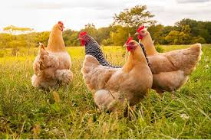
Thank You !!!

