Slide 1
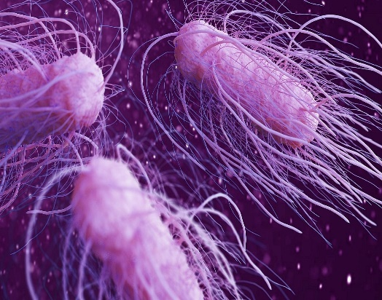
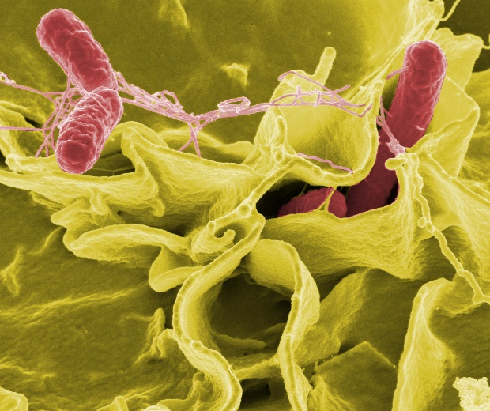
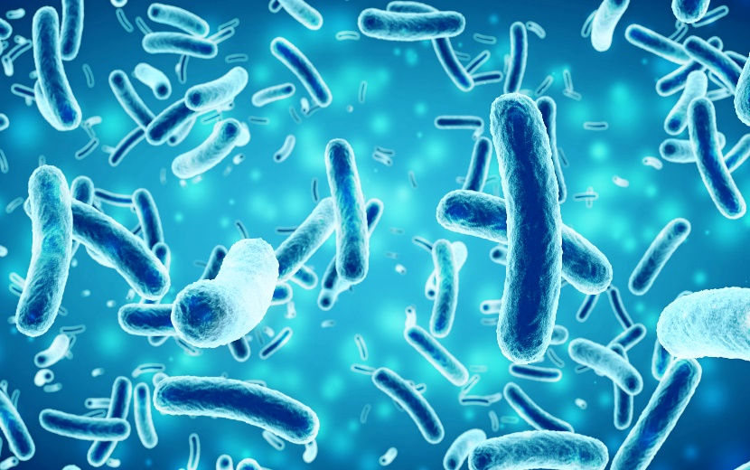
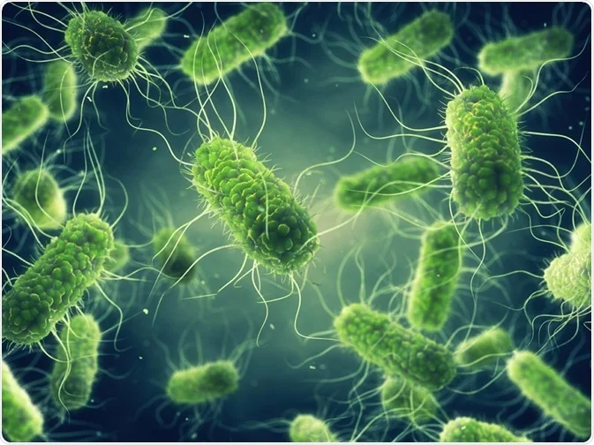
BIOFILM FORMATION BY E.COLI, PROTEUS, SALMONELLA ISOLATED FROM PORK, BEEF AND BROILER CHICKEN AND THEIR SIGNIFICANCE AS MONO AND DUAL SPECIES
TWMSM Senarathna¹, SU Pathiranage¹, GKNG Thilakarathna¹ JLCS Perera¹, DNN Madushanka¹, S Thiranagamage², TSP Jayaweera¹ and HAD Ruwandeepika^{1*}
¹Department of Livestock Production, Faculty of Agricultural Sciences, Sabaragamuwa University of Sri Lanka, ²New Anthoney’s Farm Pvt. Ltd, Hanwella

Slide 2
Content for the presentation
Introduction
Objectives
Material and Methods
Results and Discussion
Conclusion and Recommendations
References

Slide 3
Introduction
Biofilms
Self-produced matrix of extracellular polymeric substances
To survive under unfavorable conditions such as acidic pH, low temperatures, heat, antimicrobials and different atmospheric conditions

Slide 4
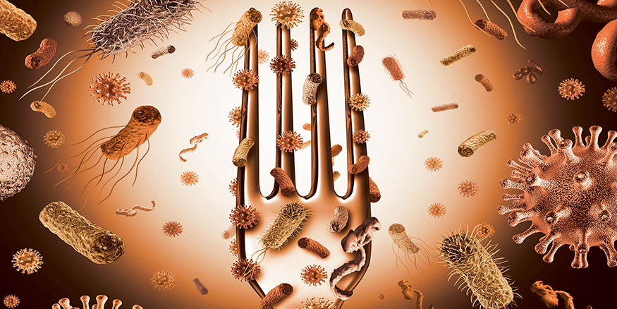
Introduction
Biofilms can be,
Mono-species (Single species)
Multispecies (Two or more species)
Microorganisms
Cooperative behaviours
Competitive behaviours

Slide 5
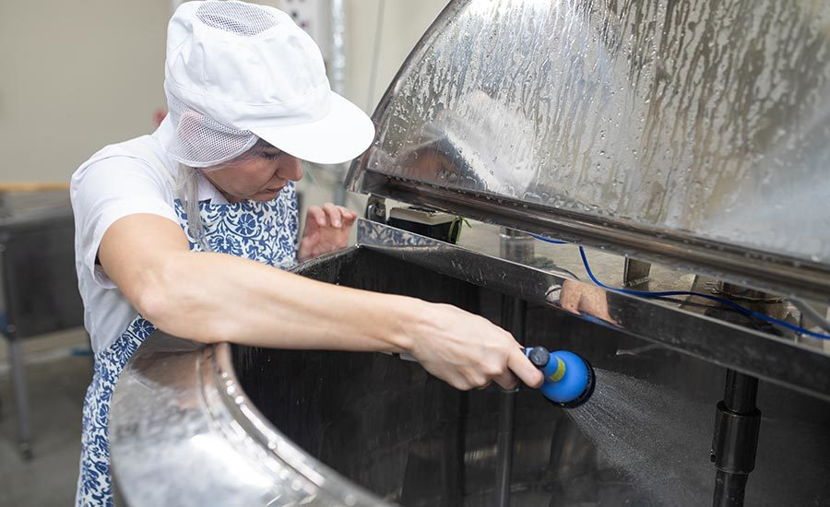
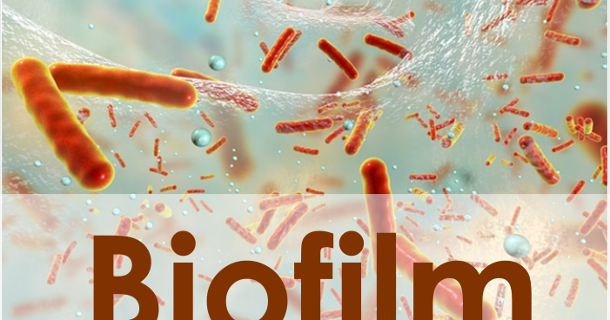
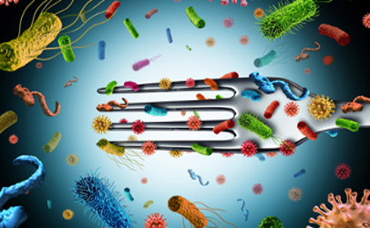
Why it is important to study about biofilms?
Continuous contamination source
Resistant to disinfectants and sanitizers
Food spoilage and Foodborne diseases

Slide 6
Objective
To investigate the biofilm forming ability of Salmonella, E. coli, and Proteus spp. Isolated from Broiler chicken meat, beef and pork when they are present as mono species and in combinations as a time series analysis

Slide 7
Material and Methods
Experiment was carried out in the Livestock Laboratory, Department of Livestock Production, Sabaragamuwa University of Sri Lanka.

Slide 8
Data collection and analysis
Isolates recovery - Salmonella, E coli, Proteus spp.
Microtiter Plate Assay for biofilm quantification

Slide 9
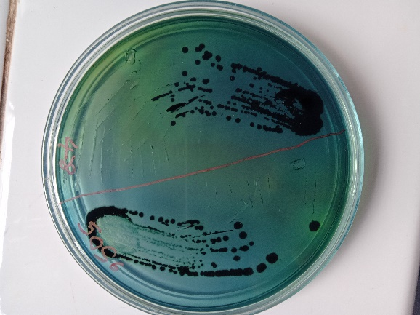
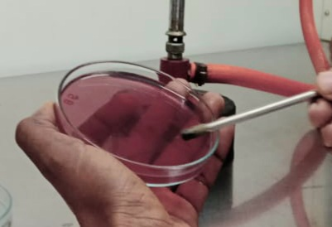
Isolates recovery
Recovered from -80°C repository maintained in Glycerol Broth
Cultured on Macconkey Agar, and HEA (Hi-Media Laboratories, India)
Picked a single colony for the further studies

Slide 10
Bacterial isolates and combinations
The interaction effects were tested in 05 different time durations of incubation (24hr, 48hr, 72hr, 96hr, 120hr)
Pork
Proteus (PP)
Salmonella (SP)
E.coli (ECP)
Proteus + Salmonella (PP + SP)
Proteus+ E.coli (PP+ECP)
Salmonella + E.coli (SP+ECP)
Beef
Proteus (PP)
Salmonella (SP)
E.coli (ECP)
Proteus + Salmonella (PP + SP)
Proteus+ E.coli (PP+ECP)
Salmonella + E.coli (SP+ECP)
Broiler chicken
Proteus (PP)
Salmonella (SP)
E.coli (ECP)
Proteus + Salmonella (PP + SP)
Proteus+ E.coli
(PP+ECP)
Salmonella + E.coli (SP+ECP)

Slide 11
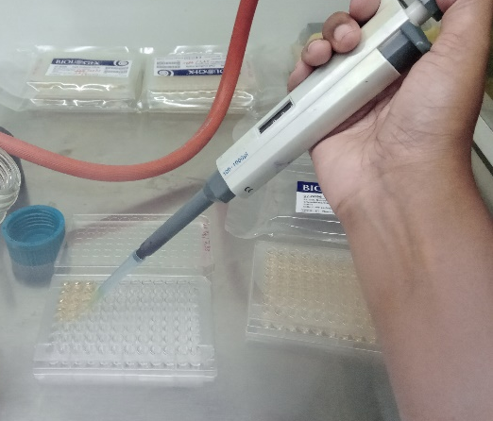
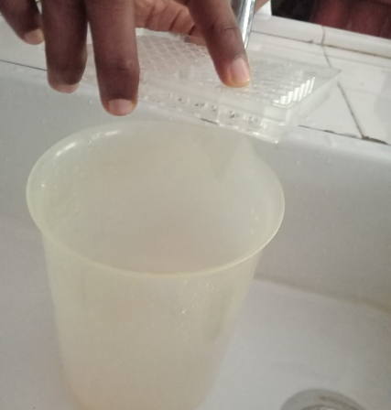
Microtiter Assay for biofilm quantification

Slide 12
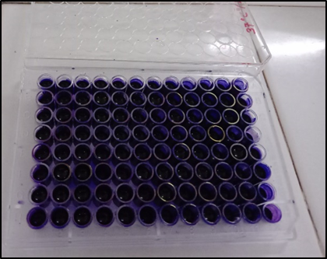
Excess stain removed and dried
Fixed the remaining attached bacterial cells with 99% methanol
Stained using 2% crystal violet for 05 minutes
Resolubilized with 33% glacial acetic acid

Slide 13
Data collection and analysis
Optical density (O.D.)- using ELISA plate reader at the end of the each time points 570nm wavelength, each time points
Statistical analysis-SAS 9.0 version
Graphical illustrations-Microsoft Office Excel (2016)

Slide 14
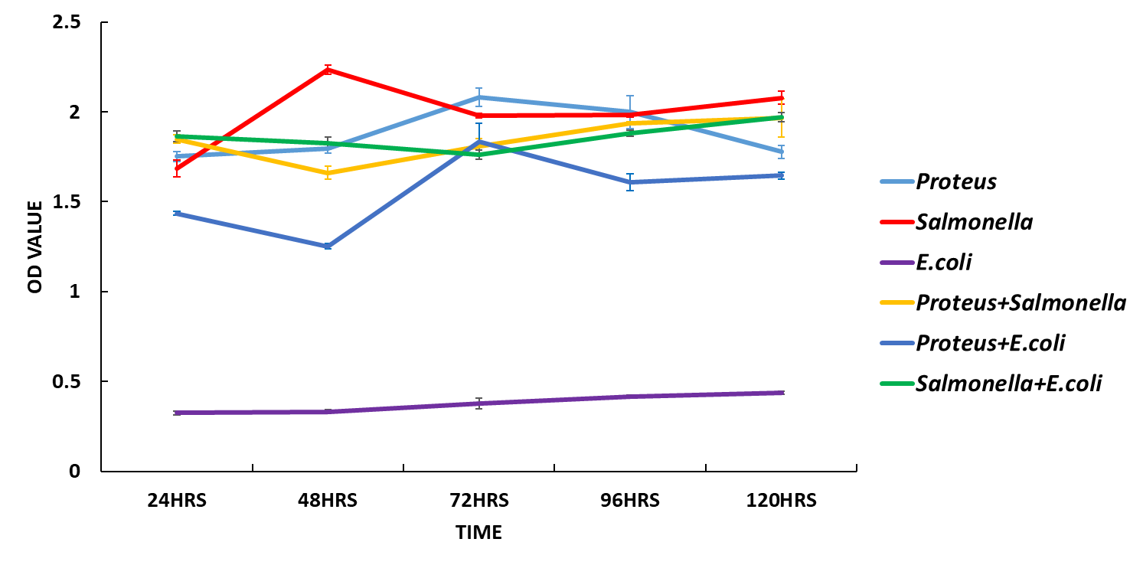
Results and Discussion
Mono Biofilm formation abilities and the interaction of Salmonella, E.coli and Proteus isolated from pork.

Slide 15
Mono Biofilm formation abilities and the interaction of Salmonella, E.coli and Proteus isolated from beef.

Slide 16
Mono Biofilm formation abilities and the interaction of Salmonella, E.coli and Proteus isolated from broiler chicken meat.

Slide 17
Conclusion
Bacterial species isolated from the broiler chicken meat, beef and pork have varying capacities of biofilm formation as mono species and mixed species in different incubation time periods.

Slide 18
References
Stepanović, S., Ćirković, I., ... Švabić-Vlahović, M., 2004. Biofilm formation by Salmonella spp. and Listeria monocytogenes on plastic surface. Letters in Applied Microbiology 38, 428–432. doi:10.1111/j.1472-765X.2004.01513.x
Yang, Y., Mikš-Krajnik, M., ... Yuk, H.G., 2016. Biofilm formation of Salmonella Enteritidis under food-related environmental stress conditions and its subsequent resistance to chlorine treatment. Food Microbiology 54, 98–105. doi:10.1016/j.fm.2015.10.010
Pathiranage, S.U., Madushanka, D.N. N., ... Ruwandeepika, H.A. D., 2021. Interaction of Salmonella with E. coli and Proteus spp. in Biofilm Formation. Journal of Advances in Microbiology 30–45. doi:10.9734/jamb/2021/v21i1230411
Chen, D., Zhao, T., Doyle, M.P., 2015. Single- and mixed-species biofilm formation by Escherichia coli O157: H7 and Salmonella, and their sensitivity to levulinic acid plus sodium dodecyl sulfate. Food Control 57, 48–53. doi:10.1016/j.foodcont.2015.04.006

Slide 19
Thank You

