Slide 1
Effect of Egg Storage Period on Maternal Antibody Level Against New Castle Disease in Cobb 500 Broiler Chicks
PGNH Nanayakkara¹, MAJP Munasinghe¹, KP Kumara²
¹ Department of Livestock Production, Faculty of Agricultural Sciences, Sabaragamuwa University of Sri Lanka
² New Anthoney’s Farm (Pvt) Ltd, Hanwella, Sri Lanka

Slide 2
Content for the presentation
Introduction
Research Problem
Objectives
Material and Methods
Results and Discussion
Conclusion and Recommendations
References
Acknowledgement

Slide 3
Introduction
Newcastle disease is the one of most common poultry disease in Sri Lanka.
Preventive vaccination program.
5.57 million doses of vaccine(DAPH 2021)
2.91 million birds received vaccinations(DAPH 2021)
Both parents and their progeny immunized by vaccine.

Slide 4
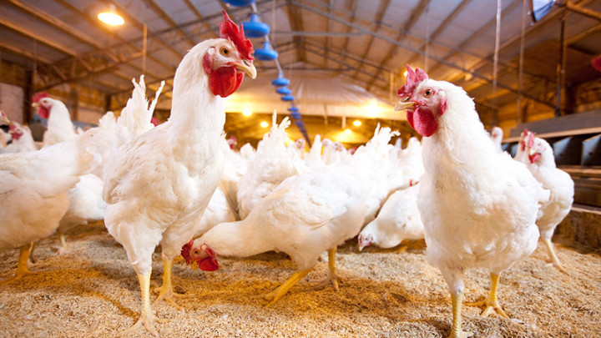
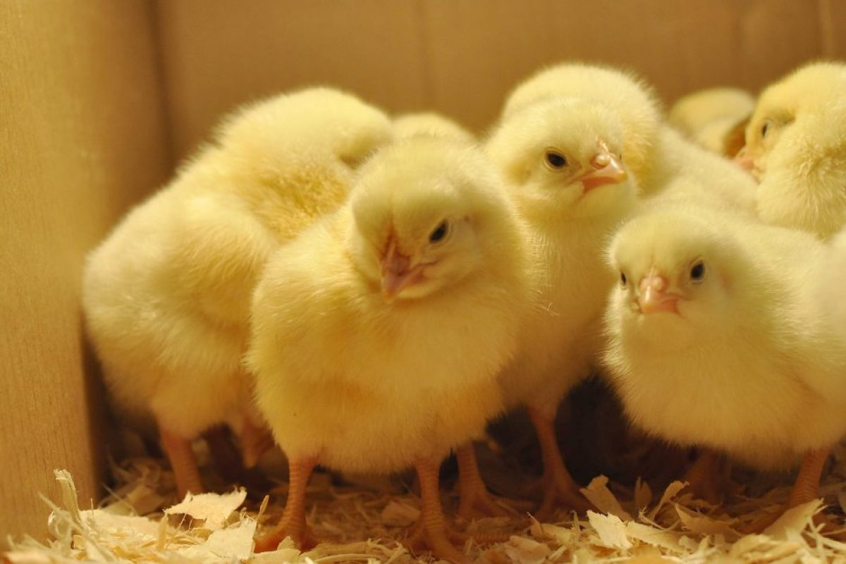
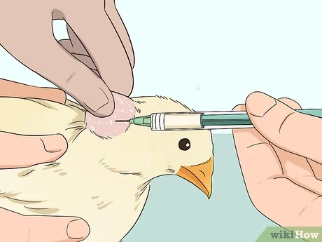
Maternal Antibody
Passive Immunity(Natural)
Artificial Active Immunity
Vertical transmission
Antibody
IgG
IgA
IgD
IgM
IgE
Anti-ND
Parents (Hens)
Offspring

Slide 5
Research Problem
More cost is spent on the vaccination process for disease prevention in poultry farms, so this research was done to ensure that after parental vaccination, antibodies pass to chicks through the maternal effect and that enough maternal immunity is provided for chicks until vaccination.

Slide 6
Objectives
Main objective
Specific objective
To determine if pre-incubate storage time period have any effect on the level of maternal antibodies (Anti ND) that pass from layers to chicks.
To determine the maternal antibody transfer percentage against Newcastle disease in Cobb500 broiler chicks.

Slide 7
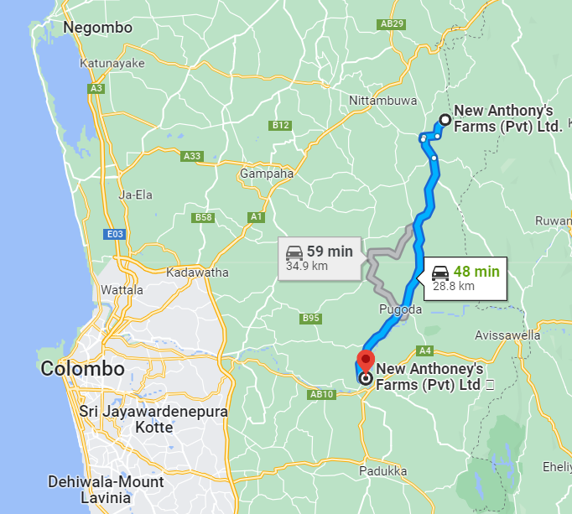
Methodology
Location of study
Random blood samples were taken from layers, and eggs were collected at New Anthony breeder farm, Attanagalla.
Selected eggs were stored for different periods, and incubated; then blood samples were taken randomly from each sample at the New Anthony hatchery unit , Indolamulla.

Slide 8
Sample collection
Cobb 500 Peak level (29wks) Same Mng
180 Layers
Egg
Collection
40 eggs
40 eggs
40 eggs
40 eggs
1 Day Stored
A DOC
N=30
5 Day stored
B DOC
N=30
10 day stored
C DOC
N=30
D DOC
N=30
15 day stored
Cage
30 layers
Get blood
Bio check ELISA test
T 18℃
RH 70%
30 chicks
Get blood
Bio check ELISA test
Mean value
(layer antibody)
Mean value
(Chick antibody)

Slide 9
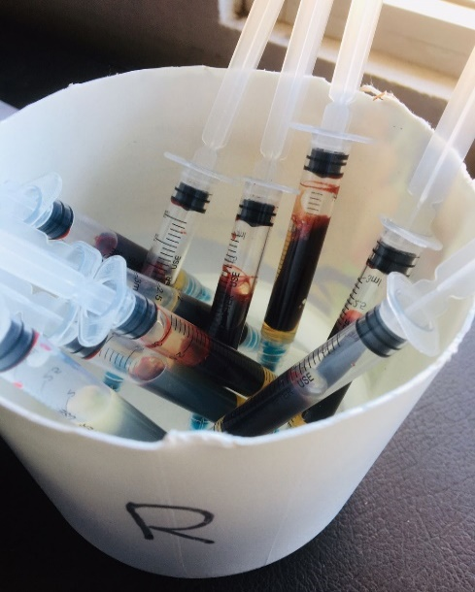
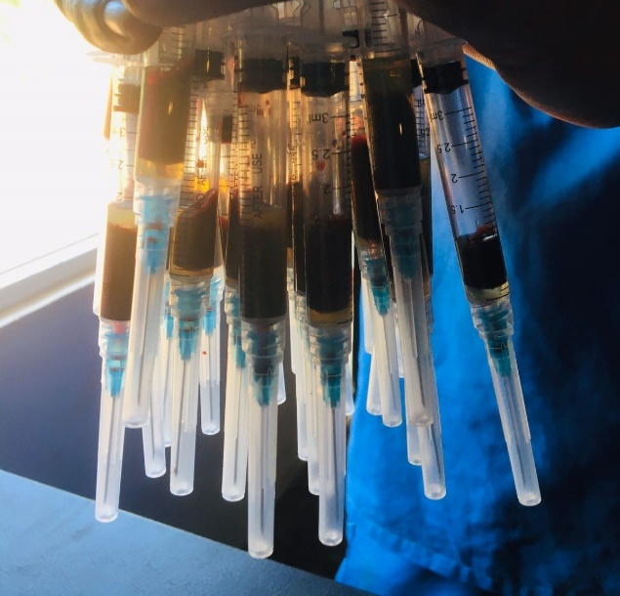
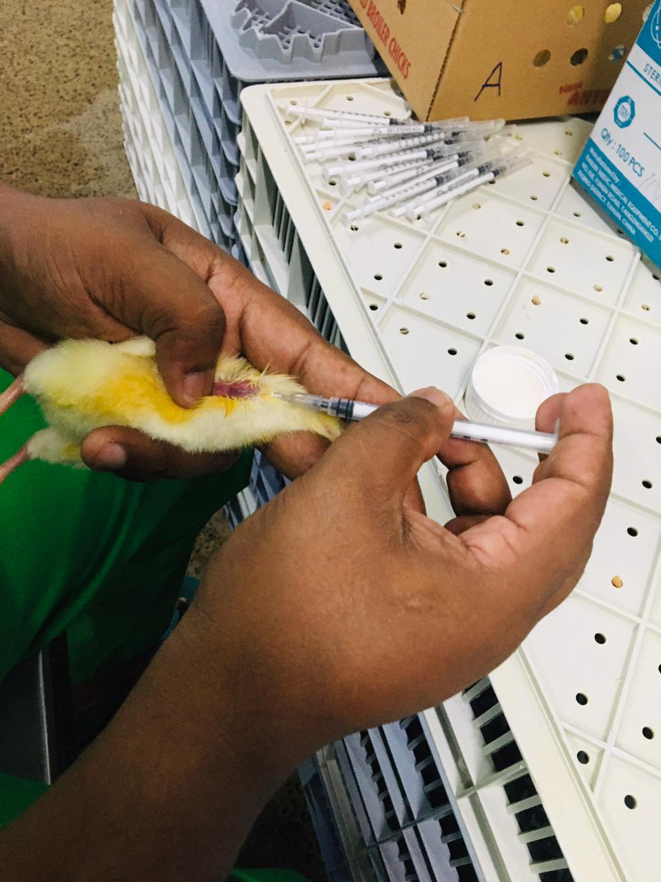
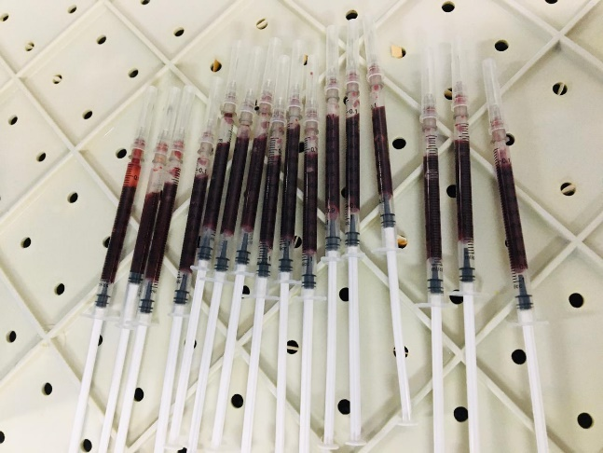
Blood Sample Collection
layers 30 blood samples
3-ml syringe with a 23-gauge needle
Chicks 30 blood samples
1 ml syringe with a 27 gauge needle

Slide 10
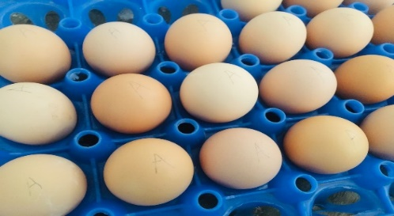
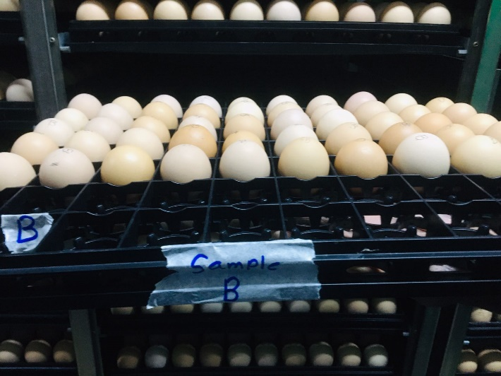
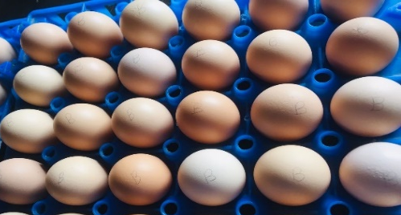
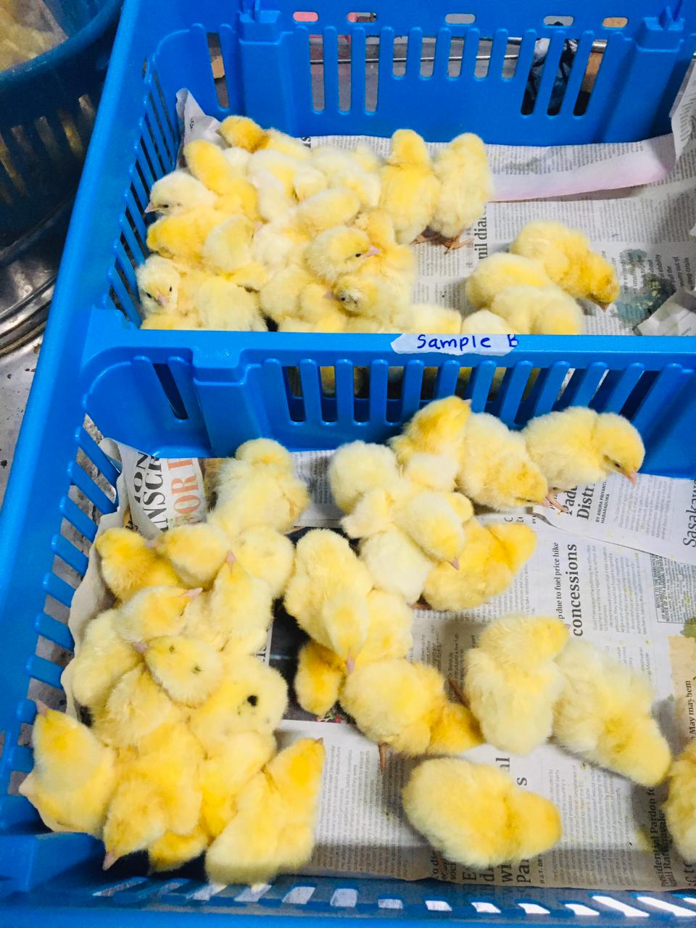
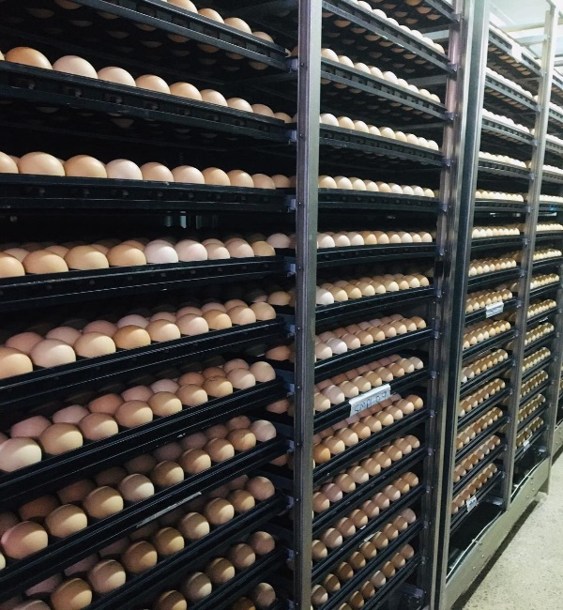
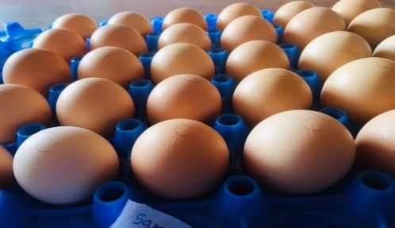
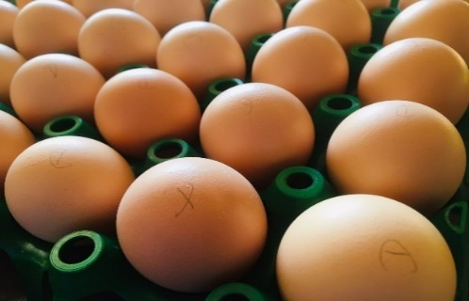
Egg storage and hatchling
A
1d
B
5d
C
10d
D
15d
T 18℃
RH 70%

Slide 11
Statistical Analysis
One way ANOVA in a completely randomized design.
Data were processed SAS on Demand for Academics, Version 9.04 (2014).
Significant at p < 0.05
Mean significance differences found by using multiple comparison,
Duncan’s multiple Test
Descriptive statistics were calculated using Microsoft Excel for windows 10

Slide 12
Results and Discussion
ELISA Test Interpret
Al layers and chicks treatments (4 treatments) – positive
Positive cut off ≥ 1159(Titer value)
 | Layers | A Treatment Chicks (1 day) | B Treatment Chicks (5 day) | C Treatment Chicks (10 day) | D Treatment chicks (15 day)
Mean titer | 12876 | 7095 | 8317 | 12432 | 7485
GMT | 12340 | 6584 | 8031 | 11856 | 6701
CV% | 28% | 39% | 26% | 29% | 46%
VI | 457 | 181 | 321 | 428 | 162
S/P value | Titer Range | Antibody status
0.349 or less | 1158 or less | Negative
0.350 or greater | 1159 or greater | Positive
GMT=Geometric mean titer [$\sqrt[\text{n}]{\text{X}\text{1}\text{×}\text{X}\text{2}\text{×}\text{X}\text{3……}\text{×}\text{Xn}}$ ]
CV% = Coefficient variance [(Standard Deviation/Average) ×100%]
VI = Vaccination Index (mean titer/CV %)

Slide 13
Maternal Antibody Transfer%
$$\text{Maternal} \text{Antibody}\text{ \%= }\frac{\text{Chick}{\text{s}}^{\text{′}}\text{GMT} \text{level}}{\text{Parent}{\text{s}}^{\text{′}}\text{GMT} \text{level}}\text{×}\text{ 100}$$
GMT =Geometric Mean Titer
(Hamal et al., 2006)

Slide 14
Contrast the maternal antibody levels of the chicks with those of their parents

Slide 15
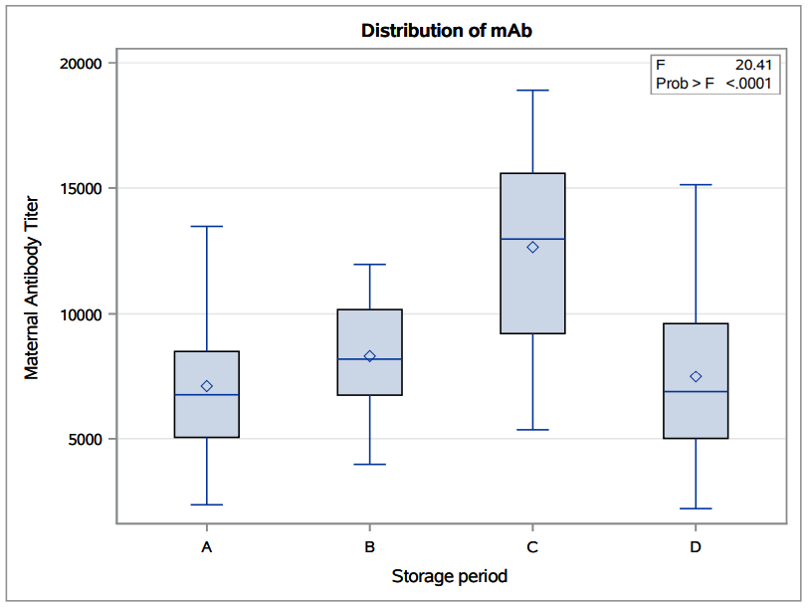
Storage Period affect on Maternal Antibody
A Treatment - 1 day stored
B Treatment – 5 day stored
C Treatment – 10 day stored
D Treatment - 15 day stored
Storage period
P<0.0001
Box plot of maternal antibody titer value against ND by
pre-incubation storage time period interpreted by SAS

Slide 16
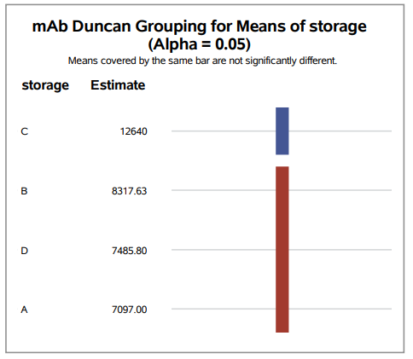
Multiple comparison
Duncan Test
C Treatment (10 day storage) was significant difference from others.
A Treatment - 1 day stored
B Treatment – 5 day stored
C Treatment – 10 day stored
D Treatment - 15 day stored
P < 0.05
Significant

Slide 17
Conclusion
Vaccination program was success (can apply for Cobb500 breeder farm)
layers are positive
Maternal antibody transfer more than 50%
Pre-incubation storage time period for Cobb 500 broilers.
If farms targeted to increased maternal antibody transfer level(ND)
10 day stored in 18℃ T & 70% RH.

Slide 18
Recommendation
For future researchers:
To get a clear picture of the effect of antibody transfer rate on storage length, investigate how the maternal antibody transfer amount changes with day-to-day storage periods in suitable storage conditions (temperature & Relative Humidity).

Slide 19
References
Decuypere, E. et al. (2001) ‘The day-old chick: A crucial hinge between breeders and broilers’, World’s Poultry Science Journal, 57(2), pp. 135–138. doi:10.1079/wps20010010
Ebeid, T.A. et al. (2017) ‘Influence of pre-storage incubation on hatchability traits, thyroid hormones, antioxidative status and immunity of newly hatched chicks at two chicken breeder flock ages’, Animal, 11(11), pp. 1966–1974. doi:10.1017/S1751731117000738.
Fasenko, G.M. et al. (2001) ‘Prestorage Incubation of Long-Term Stored Broiler Breeder Eggs : 1 . Effects on Hatchability’, Poultry Science, 80(10), pp. 1406–1411. doi:10.1093/ps/80.10.1406.
Gharaibeh, S. and Mahmoud, K. (2013) ‘Decay of maternal antibodies in broiler chickens’, Poultry Science, 92(9), pp. 2333–2336. doi:10.3382/ps.2013-03249.
Goliomytis, M., Tsipouzian, T. and Hager-Theodorides, A.L. (2015) ‘Effects of egg storage on hatchability, chick quality, performance and immunocompetence parameters of broiler chickens’, Poultry Science, 94(9), pp. 2257–2265. doi:10.3382/ps/pev200.
Hamal, K.R. et al. (2006) ‘Maternal antibody transfer from dams to their egg yolks, egg whites, and chicks in meat lines of chickens’, Poultry Science, 85(8), pp. 1364–1372. doi:10.1093/ps/85.8.1364
Kowalczyk, J. et al. (2019) ‘Field evaluation of maternal antibody transfer from breeder turkey hens to egg yolks, egg whites, and poults’, Poultry Science, 98(8), pp. 3150–3157. doi:10.3382/ps/pez126
Nilsson, E., Stålberg, J. and Larsson, A. (2012) ‘IgY stability in eggs stored at room temperature or at +4°C’, British Poultry Science, 53(1), pp. 42–46. doi:10.1080/00071668.2011.646951
Reform, P. (2012) ‘Pas Reform Academy’, pp. 16–17. Available at: www.pasreform.com

Slide 20
Acknowledgment
All the lecturers of the Faculty of Agricultural Sciences, Sabaragamuwa University of Sri Lanka.
The staff and labors of Hatchery of New Anthony Farm, Indolamulla.
Thanks to all for their valuable guidance and great support.

Slide 21
Thank You

Slide 22
Vaccination program for Cobb500 breeders

Slide 23
Interpret Biochek ELISA test
CV% guideline(‘Interpretation and Application of Results Manual’)
CV % | Uniformity
<40% | Excellent
40-60% | Good
>60% | Need to improve
CV% = (Sd/Average)× 100
Vaccination Index
$\text{VI} \text{=}\frac{{(Mean Titer)}^{2}}{(St Dev ×100)}$ = $\frac{Mean Titer }{CV \%}$
(‘Interpretation and Application of Results Manual’)

Slide 24
Calculations of S/P ratio
$$\frac{\text{s}}{\text{p}}\text{=}\frac{\text{Mean} \text{of} \text{test} \text{sample}\text{−}\text{mean} \text{of} \text{negative} \text{control}}{\text{Mean} \text{of} \text{positive} \text{control}\text{−}\text{mean} \text{of} \text{negative} \text{control}}$$
The S/P of a sample at a dilution of 1:500 and a titer are given by the following equation.
Log10 Titer = 1.0 * Log (S/P) + 3.52
Antilog = Titer
Negative < 0.30 (s/p)
Positive > 0.35 (s/p)
GMT calculate (Geometric Mean Titer)
$$\text{GMT}\text{=} \sqrt[\text{n}]{\text{X}\text{1}\text{×}\text{X}\text{2}\text{×}\text{X}\text{3……}\text{×}\text{Xn}}$$

Slide 25
LITERATURE REVIEW
Flock age (week) | Pre-incubation storage (day) | Maternal anti-NDV (log₂ )
32 | 4 | 6.50
30.5 | 12 | 6.60
30 | 16 | 6.34
Effect of egg storage on broilers (Ross308) passive immunity parameters.
(Goliomytis, Tsipouzian and Hager-Theodorides, 2015)

Slide 26
The pre-incubation storage period affected broiler chicks' immunity
Age (week) |  | EST(day) × PSI (hrs)
 |  | 4d×0hr | 4d×4hr | 4d×6hr | 4d×8hr | 14d×0hr | 14d×4hr | 14d×6hr | 14d×8hr
29 weeks | Ig (mg/mm) | 1.29 | 1.34 | 1.85 | 1.47 | 1.10 | 1.18 | 1.55 | 1.66
50 weeks | Ig (mg/mm) | 1.49 | 1.45 | 1.73 | 1.50 | 1.21 | 1.65 | 1.58 | 1.87
Effect of egg storage time (EST) and pre-storage incubation (PSI) on chick immunoglobulin Y (IgY) in newly hatched chicks in Egyptian local strain chickens (Inshas) at 28 and 50weeks of age.(Ebeid et al., 2017)
Optimum condition
storage
period
Thyroid
Hormones
Absorb Yolk sac
Transfer mAb%

Slide 27
The pre-incubation period affects on layer chicks' immunity
Antibody activity in IgY preparations from three hens A, B C. The storage time in days is on the x-axis. Storage at room temperature, storage at +4℃. Error bars represent ± 2 x mean of the standard deviations of duplicate samples for each hen.(Nilsson, Stålberg and Larsson, 2012)

Slide 28
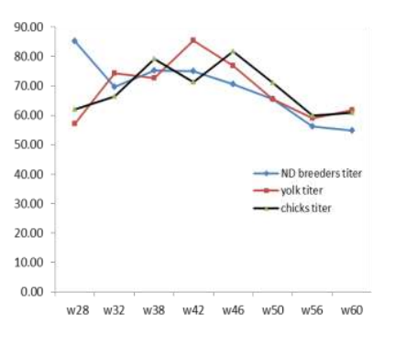
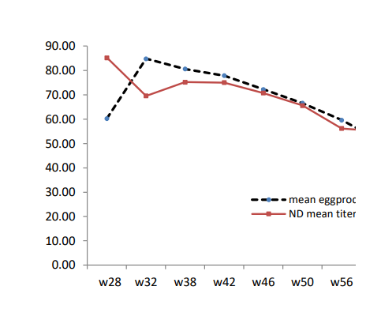
Maternal Antibody transfer level depending on the age group of the parents and egg production
Egg production
(Peak)
Immunoglobulin catabolize
mAb transfer %
The relationship between means of ND antibody titer in breeders’ sera, egg yolk and hatched chicks.
(Al and Al, 2014)
The relationship between the mean of egg production and mean of ND antibody titer in breeders’ sera.(Al and Al, 2014)
(Bunchasak et al.,2005)
(Kowalczyk et al., 2019)

