Slide 1
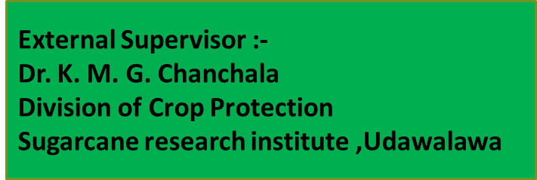

Slide 2
Contents
Introduction and Research Problem
Justification of research problem
Overall objective and Specific objectives
Material and Methods
Experiment procedure
Data Collection
Results and Discussion
Conclusion
Suggestions
References

Slide 3
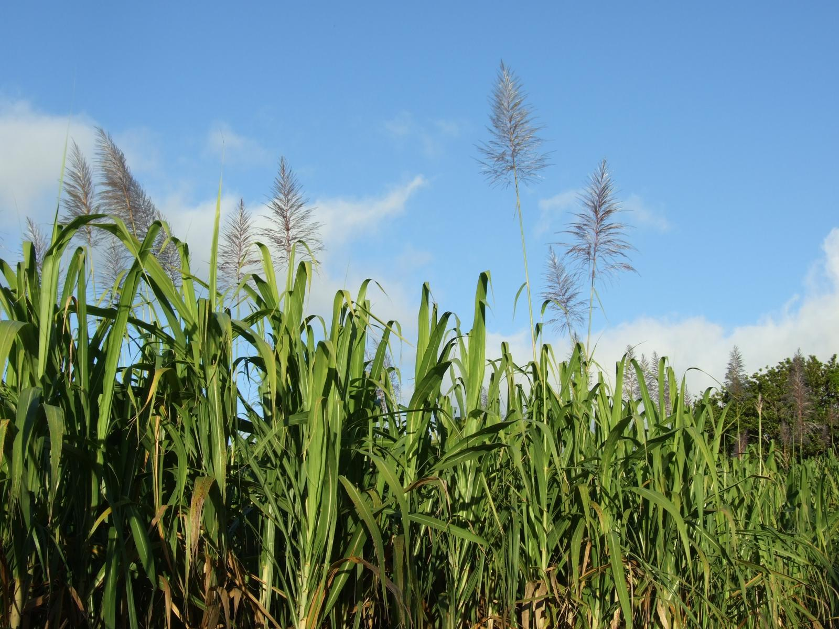
Introduction and Research Problem
As the vector of diseases
103 Insect pest Species
in Sri Lanka's sugarcane plantations
Among them 18 species are homopterans
…….
……..
……
……
Sugarcane (Saccharum officinarum) plantation is fulfilling 60 % of world sugar requirement.
Sugarcane plantation of Sri Lanka will be potential to produce at least 50 % of the domestic requirement of sugar in Sri Lanka.

Slide 4
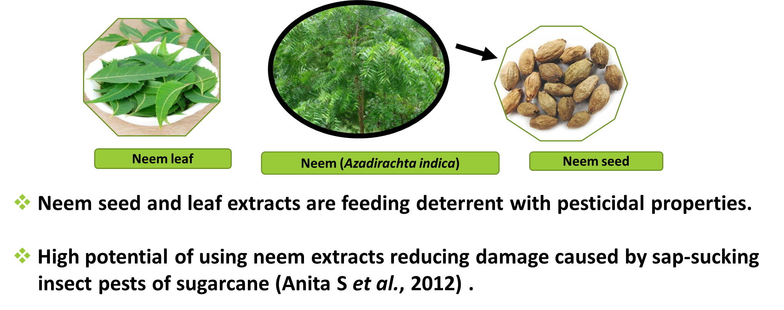
Justification of research problem

Slide 5
Overall objective
Determine the toxicity and anti-feeding effect of neem seed and leaf extract on sap-sucking insect pests in sugarcane cultivation,
Sugarcane Woolly Aphid -Ceratovacuna lanigera Zehntner
Pyrilla Plant Hopper -Pyrilla perpusilla Walker
Sugarcane Pink Mealy Bug -Saccharicoccus sacchari
Specific objectives
Identification of effective concentrations and time of neem seed and leaf extracts on each pest.
Determine the effective extract of the neem leaf and seed extracts on each pest.

Slide 6
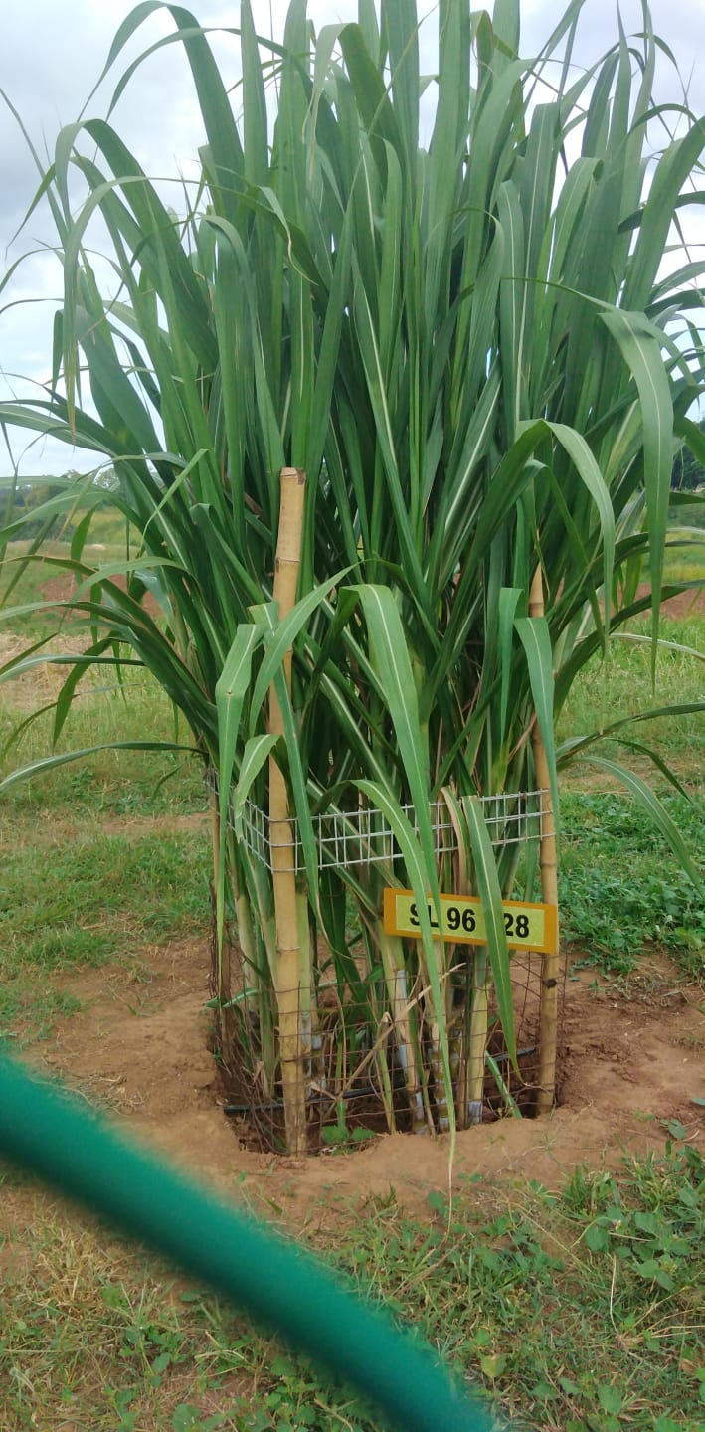
Material and Methods
Study location
In Sugarcane Research Institute (SRI), Udawalawe, Sri Lanka
Research farm and the entomology laboratory
Plant material
Sugarcane - Variety SL 96 128 was selected for the study.

Slide 7
Experiment procedure
Experimental design : Complete Randomize Design (CRD)
This was conducted three experiment to each pest
Sugarcane Woolly Aphid
Ceratovacuna lanigera
Pink Mealy Bug Saccharicoccus sacchari
Pyrilla Plant Hopper Pyrilla perpusilla

Slide 8
Experiment procedure cont.…
1. The collected insects was mass-reared separately
2. Material collection
3. Preparation plant extracts
4. Prepared extracts were applied for test insect pest

Slide 9
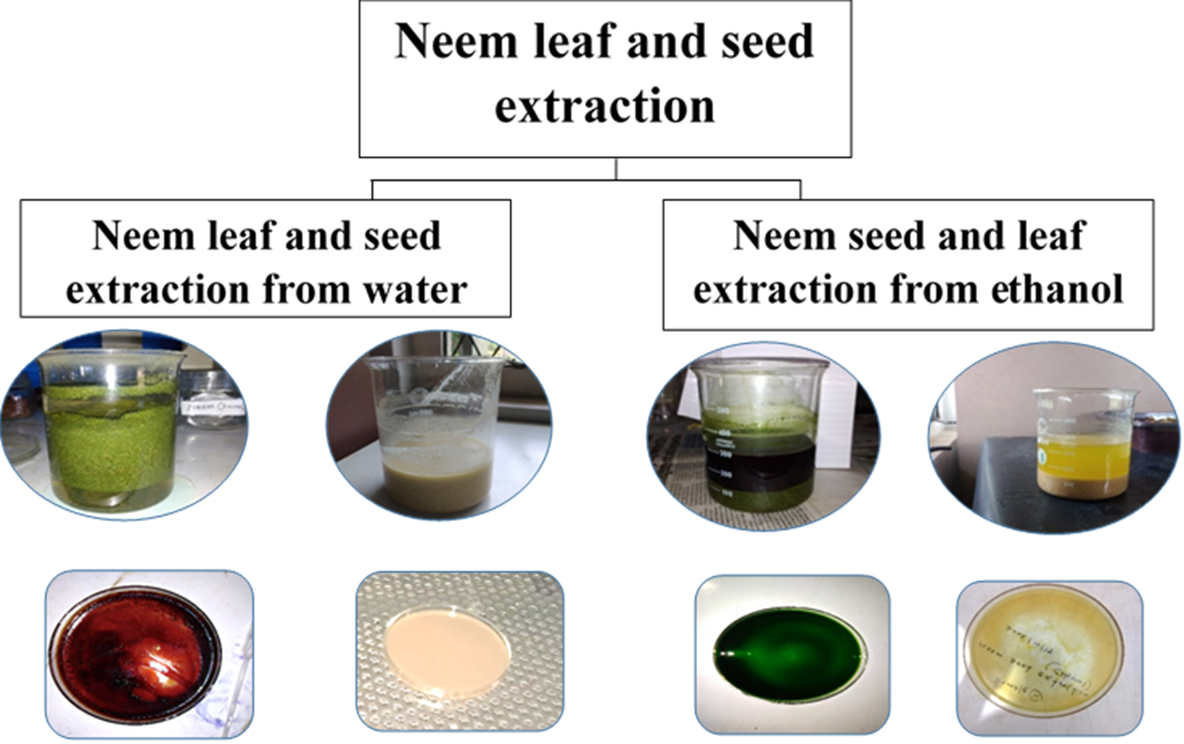
Experiment procedure cont.…
Neem leaf water extraction
Neem seed extraction water
Neem leaf extraction ethanol
Neem seed extraction water

Slide 10
Experiment procedure cont.…
Treatment combination
Each treatment contents with three replicates
Neem leaf water extraction
LW 2 % (W/V)
LW 5 % (W/V)
LW 10%(W/V)
LE 2% (W/V)
LE 5% (W/V)
LE10%(W/V)
Neem leaf ethanol extraction
CN
CP
CP
CN
Neem seed water extraction
SW 2 %(W/V)
SW 5 %(W/V)
SW10%(W/V)
CP
SE 2 % (W/V)
SE 5 % (W/V)
SE10%(W/V)
Neem seed ethanol extraction
CP
CN
CN
LW - Neem leaf water extracts
LE - Neem leaf ethanol extracts
SW - Neem seed Water extracts
SE - Neem seed ethanol extracts
CN – Negative Control
CP - Positive control Thiomethoxam(Actara 25 WG)

Slide 11
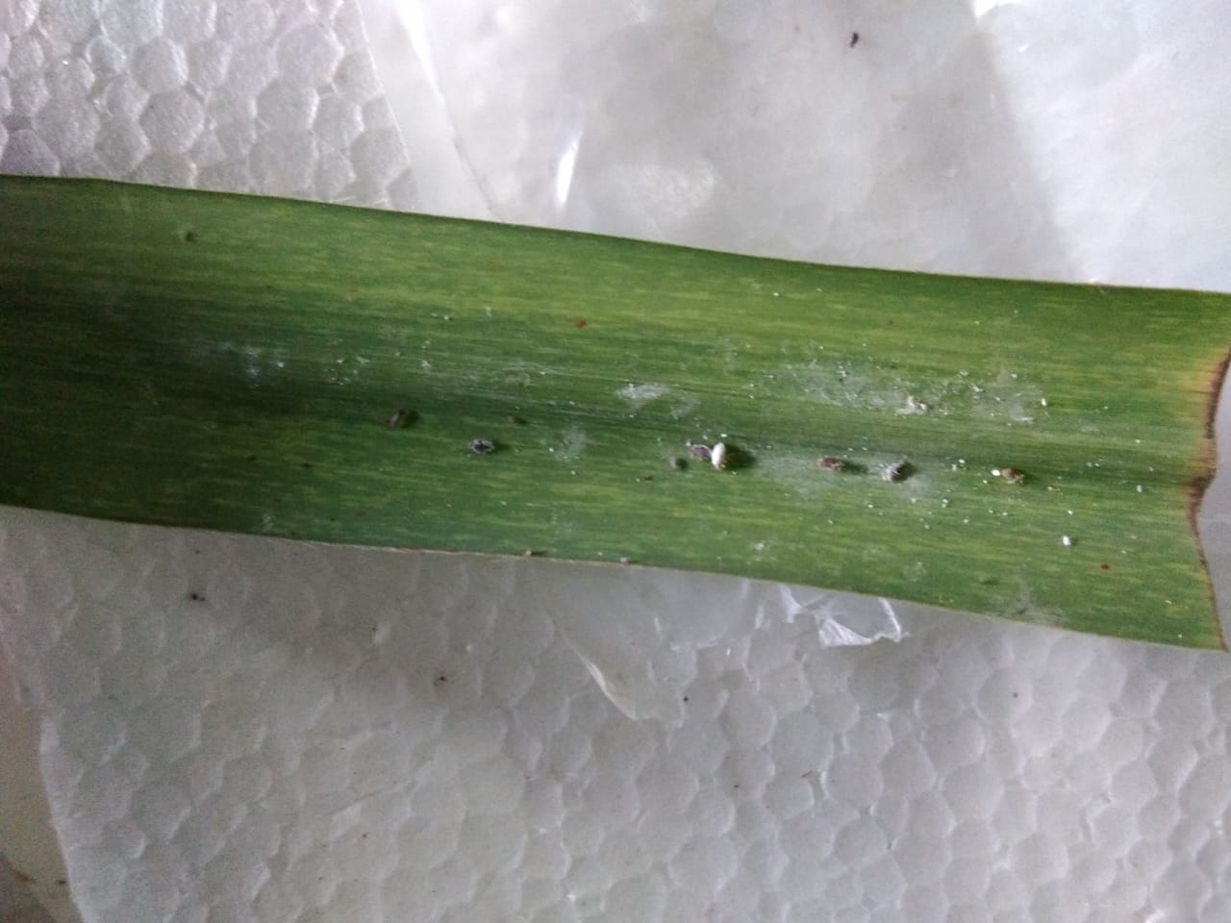
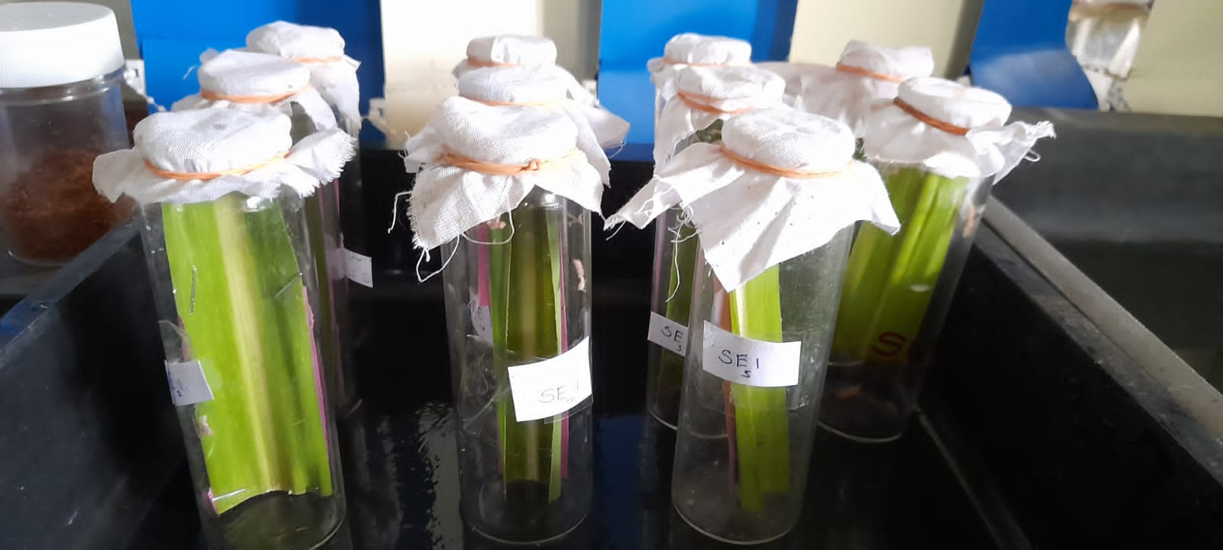
Experiment procedure cont.…
Two Type
I. Effect of Toxicity
II. Effects of anti-feeding
Mortality test
Parafilm Sachet Technique (Heinrichs et al., 1985).
Mortality Test Pyrilla Plant Hopper
Death Woolly Aphids
Parafilm Sachet

Slide 12
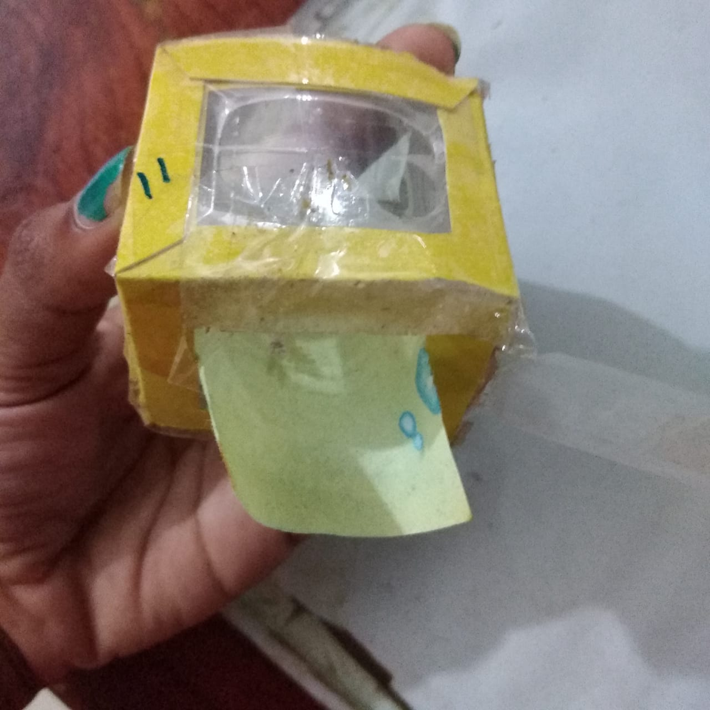
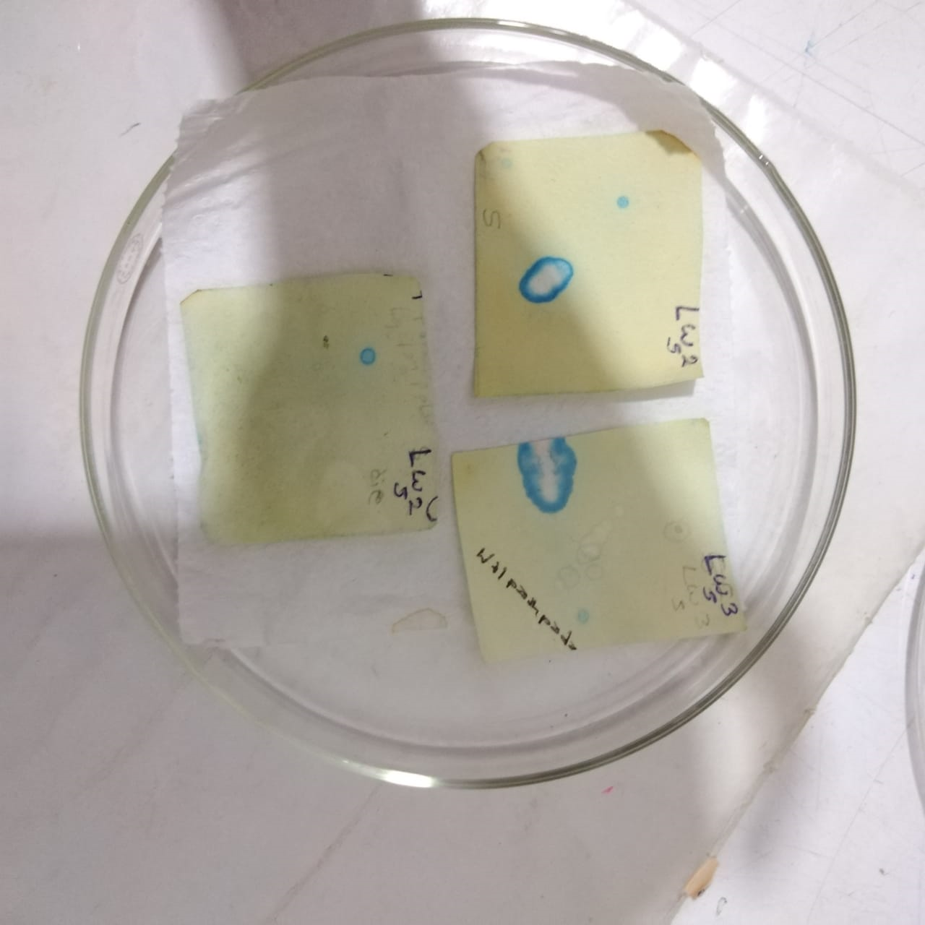
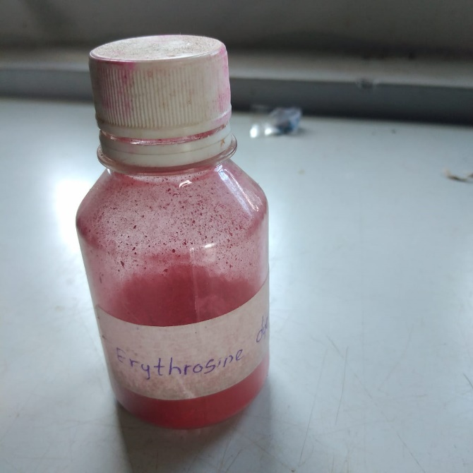
Experiment procedure cont.…
Feeding amount
The honey dew were stained with the bromocresol green-treated filter papers (Heinrichs et al., 1985) .
Erythrosine dye test (Heinrichs et al., 1985).
Pyrilla plant hopper in Feeding chamber
Stained honey dew on treated filter paper
Erythrosine dye
Woolly aphids in Parafilm Sachet

Slide 13
Data Collection
Toxicity Effect
Mortality count of the insect– 24 hrs., 48 hrs., and 72 hrs.
Percentage population reduction (R) = 1- ((T2 x C1)/ (T1 x C2)) x 100%
T1= Pre-treatment population in treatment
T2= Post treatment population in treatment
C1= pre-treatment population in check
C2= post-treatment population in check
(Fleming and Retnakaran, 1985)

Slide 14
Anti-feeding Effect
Area of the honey dew stained was measured using square millimeter grids after 24 hrs.
The stained salivary flanges on each plant sample was counted.

Slide 15
Data Analysis
Comparison between control and treatments were done using either one - way or two – way ANOVA with Tukey’s multiple comparison.
5% probability level was used to detect the significance of differences between control and treatments.

Slide 16
Results and Discussion

Slide 17
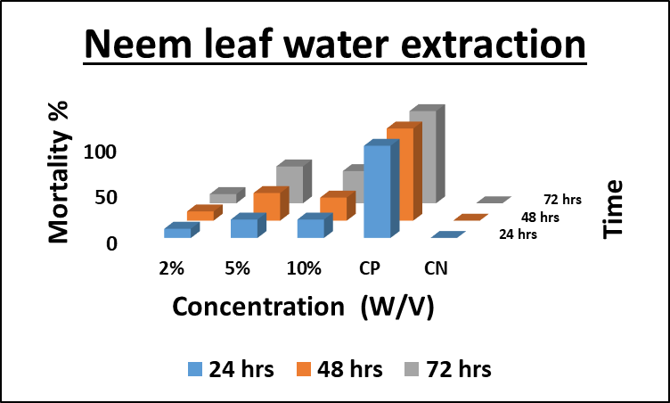
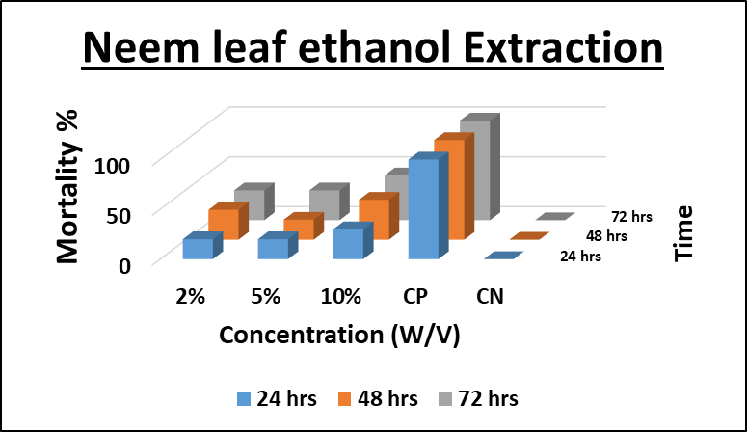
Pyrilla Plant Hopper
p < 0.05
NS = p > 0.05
Effective concentration and time
Neem leaf water extraction
 |  |  | 24 hrs | 48 hrs | 72 hrs
10% | vs | 5% | Ns | Ns | Ns
2% | vs | 5% | Ns | Ns | Ns
10% | vs | 2% | Ns | Ns | Ns
C | vs | 5% | Ns | Ns | Ns
C | vs | 2% | Ns | Ns | Ns
C | vs | 10% | NS | Ns | Ns
Neem leaf ethanolr extraction
 |  |  | 24 hrs | 48 hrs | 72 hrs
10% | vs | 5% | Ns | Ns | Ns
2% | vs | 5% | Ns | Ns | Ns
10% | vs | 2% | Ns | Ns | Ns
C | vs | 5% | Ns | Ns | Ns
C | vs | 2% | Ns | Ns | Ns
C | vs | 10% | NS | Ns | Ns
CN – Negative control
CP - Positive control Thiomethoxam (Actara 25 WG)

Slide 18
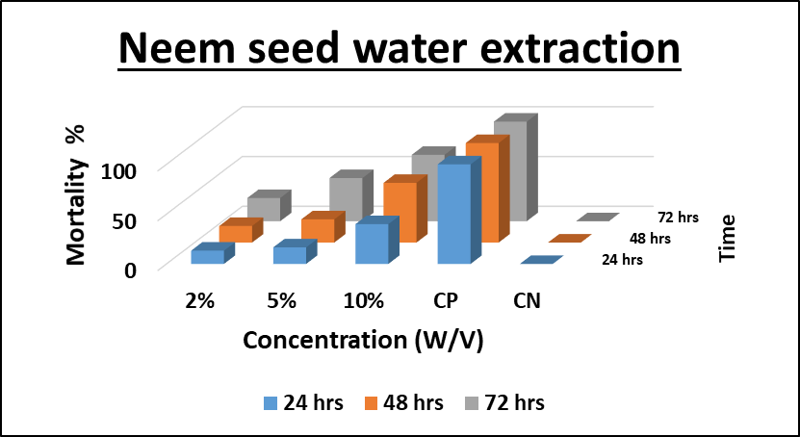
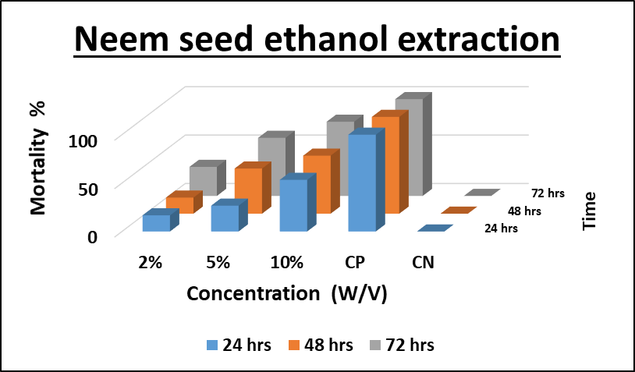
Pyrilla Plant Hopper
*= p < 0.05
NS = p > 0.05
Neem Seed water extraction
 |  |  | 24 hrs | 48 hrs | 72 hrs
10% | vs | 5% | Ns | Ns | *
2% | vs | 5% | Ns | Ns | Ns
10% | vs | 2% | Ns | Ns | Ns
C | vs | 5% | Ns | Ns | Ns
C | vs | 2% | Ns | Ns | Ns
C | vs | 10% | * | * | *
Neem seed ethanol extraction
 |  |  | 24 hrs | 48 hrs | 72 hrs
10% | vs | 5% | Ns | Ns | *
2% | vs | 5% | Ns | Ns | Ns
10% | vs | 2% | Ns | Ns | Ns
C | vs | 5% | Ns | Ns | Ns
C | vs | 2% | Ns | Ns | Ns
C | vs | 10% | Ns | Ns | *
CN – Negative control
CP - Positive control Thiomethoxam (Actara 25 WG)

Slide 19
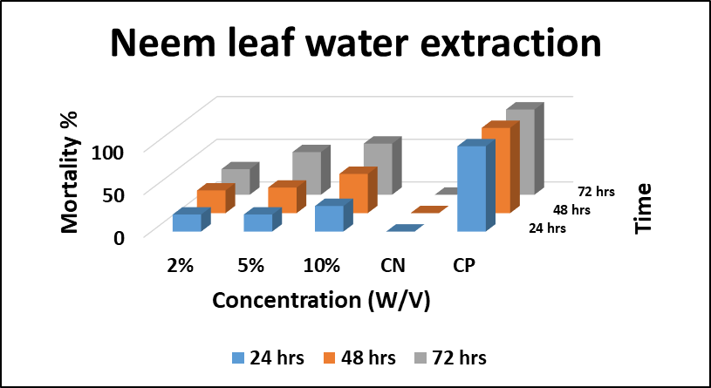
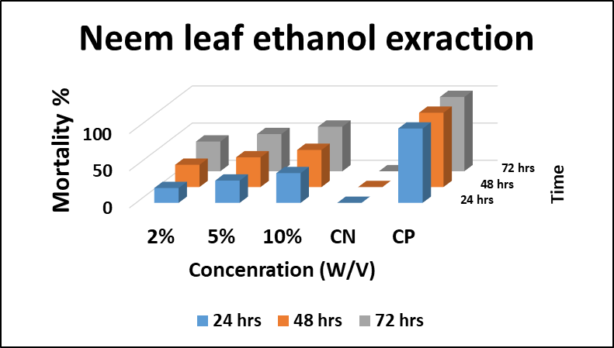
Woolly Aphid
p < 0.05
NS = p > 0.05
Effective concentration and time
Neem leaf water extraction
 |  |  | 24 hrs | 48 hrs | 72 hrs
10% | vs | 5% | Ns | Ns | Ns
2% | vs | 5% | Ns | Ns | Ns
10% | vs | 2% | Ns | Ns | Ns
C | vs | 5% | Ns | Ns | *
C | vs | 2% | Ns | Ns | Ns
C | vs | 10% | NS | * | *
Neem leaf ethanolr extraction
 |  |  | 24 hrs | 48 hrs | 72 hrs
10% | vs | 5% | Ns | Ns | Ns
2% | vs | 5% | Ns | Ns | Ns
10% | vs | 2% | Ns | Ns | Ns
C | vs | 5% | Ns | * | *
C | vs | 2% | Ns | Ns | Ns
C | vs | 10% | * | * | *
CN – Negative control
CP - Positive control Thiomethoxam (Actara 25 WG)

Slide 20
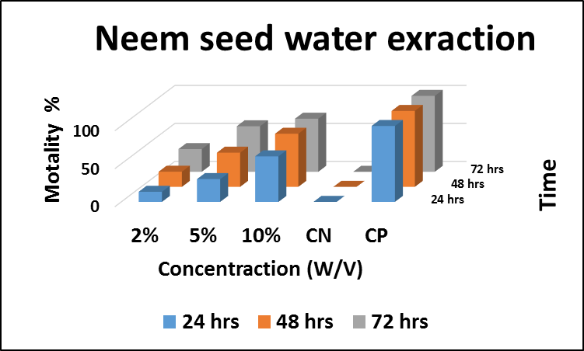
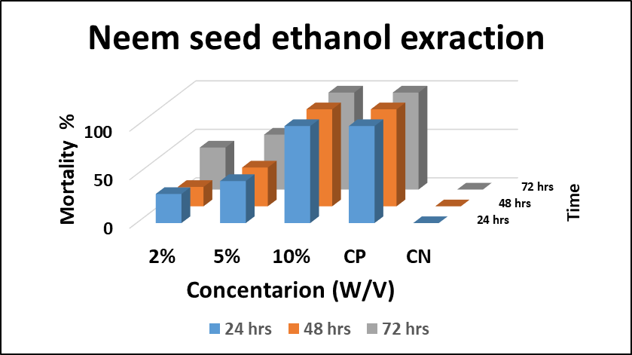
Woolly Aphid
* = P < 0.05
NS = p > 0.05
Effective concentration and time
Neem Seed water extraction
 |  |  | 24 hrs | 48 hrs | 72 hrs
10% | vs | 5% | Ns | Ns | Ns
2% | vs | 5% | Ns | Ns | Ns
10% | vs | 2% | Ns | Ns | Ns
C | vs | 5% | Ns | Ns | *
C | vs | 2% | Ns | Ns | Ns
C | vs | 10% | * | * | *
Neem seed ethanol extraction
 |  |  | 24 hrs | 48 hrs | 72 hrs
10% | vs | 5% | Ns | Ns | *
2% | vs | 5% | Ns | Ns | Ns
10% | vs | 2% | Ns | Ns | Ns
C | vs | 5% | * | * | *
C | vs | 2% | Ns | Ns | *
C | vs | 10% | * | * | *
CN – Negative control
CP - Positive control Thiomethoxam (Actara 25 WG)

Slide 21
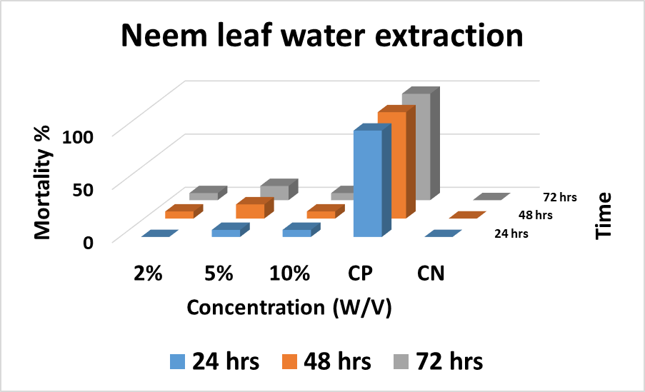
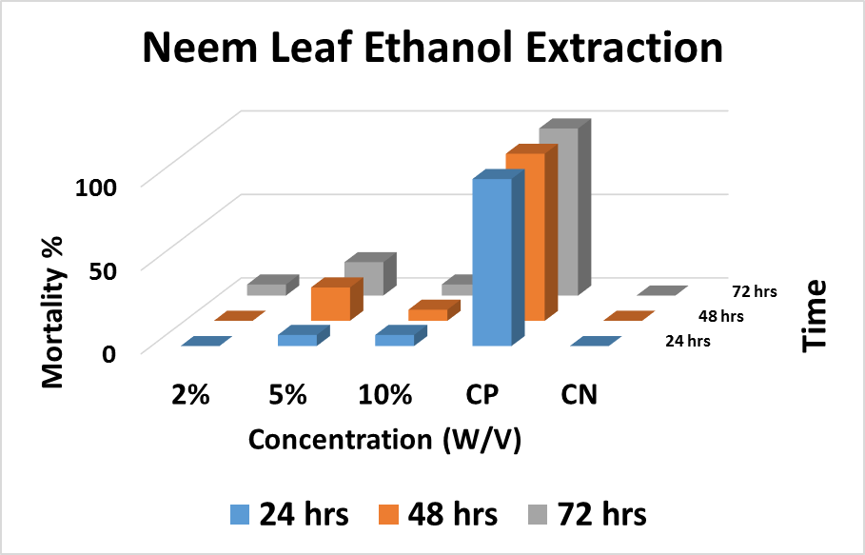
Pink mealy bug
P < 0.05
NS = p > 0.05
Effective concentration and time
Neem leaf water extraction
 |  |  | 24 hrs | 48 hrs | 72 hrs
10% | vs | 5% | Ns | Ns | Ns
2% | vs | 5% | Ns | Ns | Ns
10% | vs | 2% | Ns | Ns | Ns
C | vs | 5% | Ns | Ns | Ns
C | vs | 2% | Ns | Ns | Ns
C | vs | 10% | NS | Ns | Ns
Neem leaf ethanolr extraction
 |  |  | 24 hrs | 48 hrs | 72 hrs
10% | vs | 5% | Ns | Ns | Ns
2% | vs | 5% | Ns | Ns | Ns
10% | vs | 2% | Ns | Ns | Ns
C | vs | 5% | Ns | Ns | Ns
C | vs | 2% | Ns | Ns | Ns
C | vs | 10% | NS | Ns | Ns
CN – Negative control
CP - Positive control Thiomethoxam (Actara 25 WG)

Slide 22
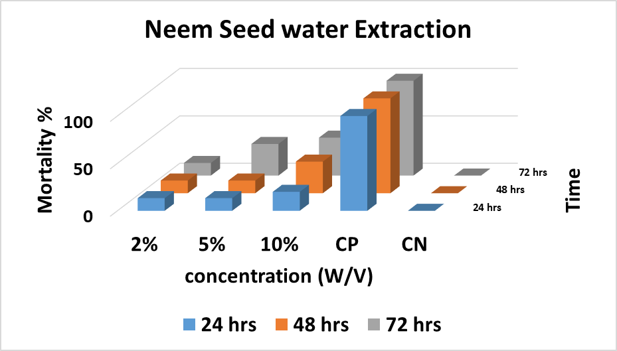
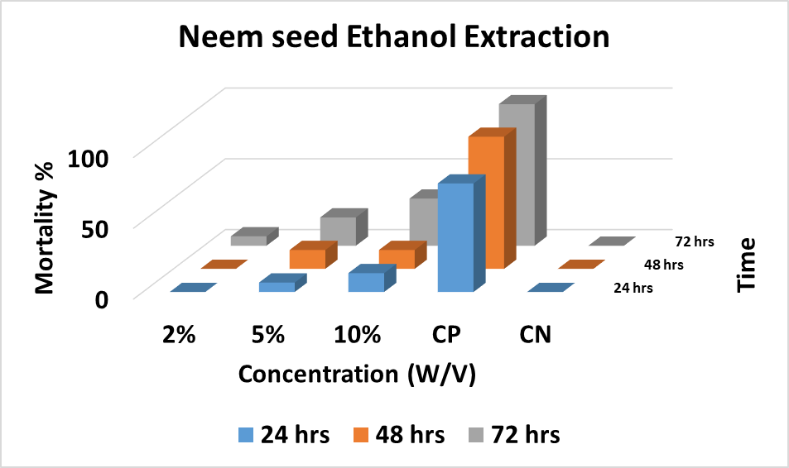
Pink mealy bug
P < 0.05
NS = p > 0.05
Effective concentration and time
Neem Seed water extraction
 |  |  | 24 hrs | 48 hrs | 72 hrs
10% | vs | 5% | Ns | Ns | NS
2% | vs | 5% | Ns | Ns | Ns
10% | vs | 2% | Ns | Ns | Ns
C | vs | 5% | Ns | Ns | Ns
C | vs | 2% | Ns | Ns | Ns
C | vs | 10% | Ns | Ns | Ns
Neem seed ethanol extraction
 |  |  | 24 hrs | 48 hrs | 72 hrs
10% | vs | 5% | Ns | Ns | Ns
2% | vs | 5% | Ns | Ns | Ns
10% | vs | 2% | Ns | Ns | Ns
C | vs | 5% | Ns | Ns | Ns
C | vs | 2% | Ns | Ns | Ns
C | vs | 10% | Ns | Ns | Ns
CN – Negative control
CP - Positive control Thiomethoxam (Actara 25 WG)

Slide 23
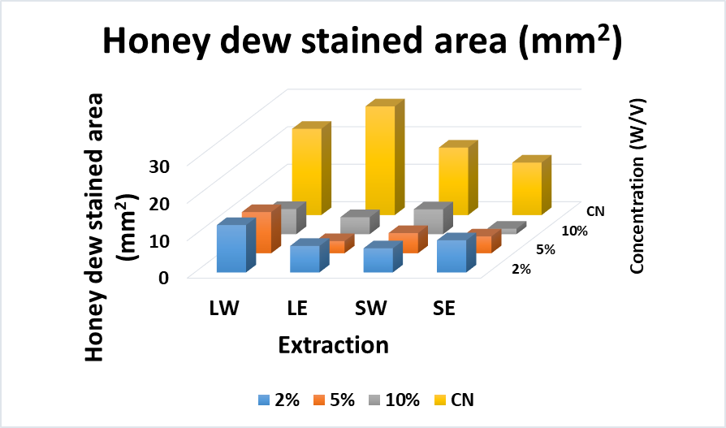
P < 0.05
Anti-feeding Effect
Effective Extract for Pyrilla plant hopper
If honey dew stained area (mm²) is increase , feeding amount is increase.
Neem seed ethanol extraction has highest anti-feeding affect.
LW - Neem leaf water extracts
LE - Neem leaf ethanol extracts
SW - Neem seed Water extracts
SE - Neem seed ethanol extracts
CN – Negative Control

Slide 24
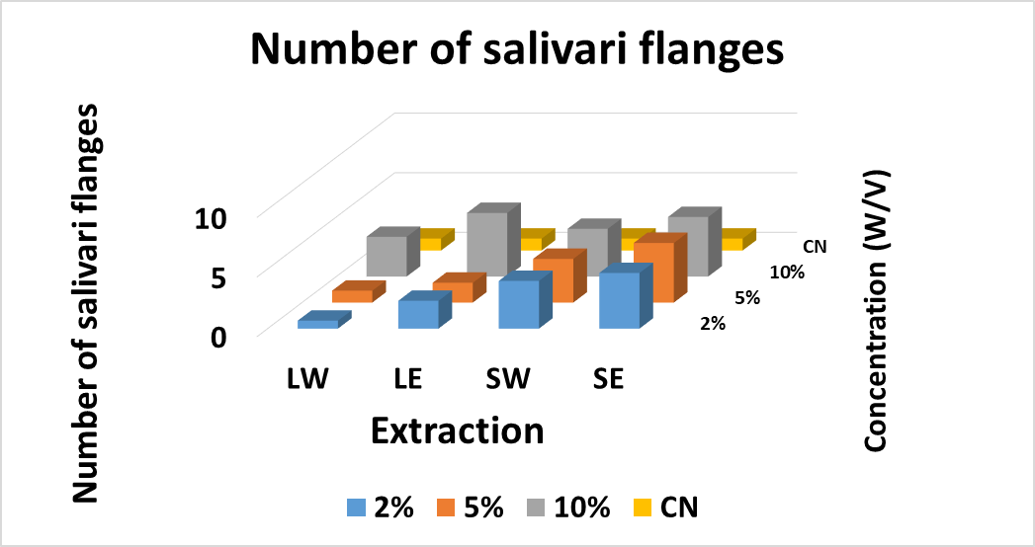
P < 0.05
Erythrosine dye test
Effective Extract for Pyrilla plant hopper
The number of stained salivary flanges is higher
Anti- Feeding Effect is Highest
LW - Neem leaf water extracts
LE - Neem leaf ethanol extracts
SW - Neem seed Water extracts
SE - Neem seed ethanol extracts
CN – Negative Control

Slide 25
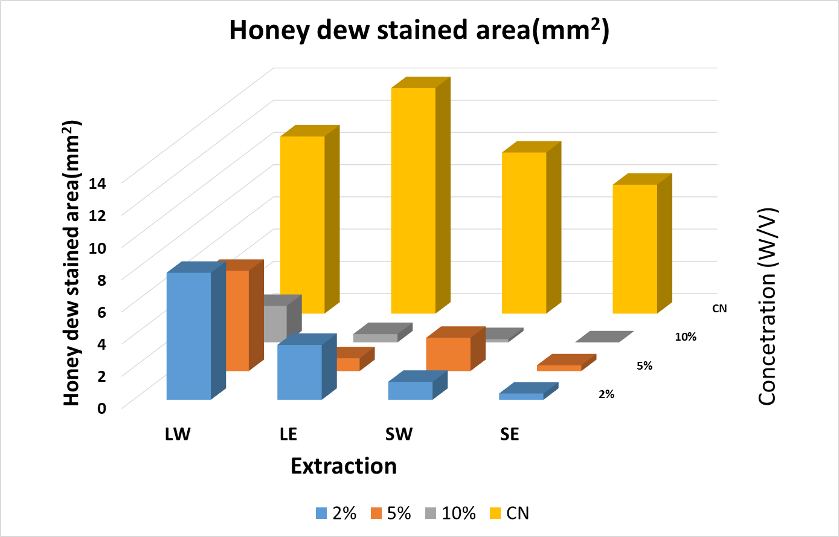
P < 0.05
Effect of Anti-feeding
Effective Extract for Woolly aphid
Bromocresol green-treated filter paper test
LW - Neem leaf water extracts
LE - Neem leaf ethanol extracts
SW - Neem seed Water extracts
SE - Neem seed ethanol extracts
CN – Negative Control

Slide 26
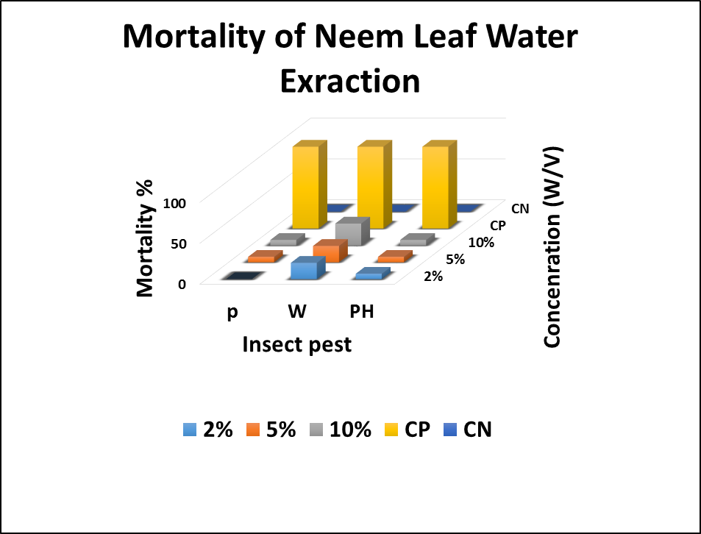
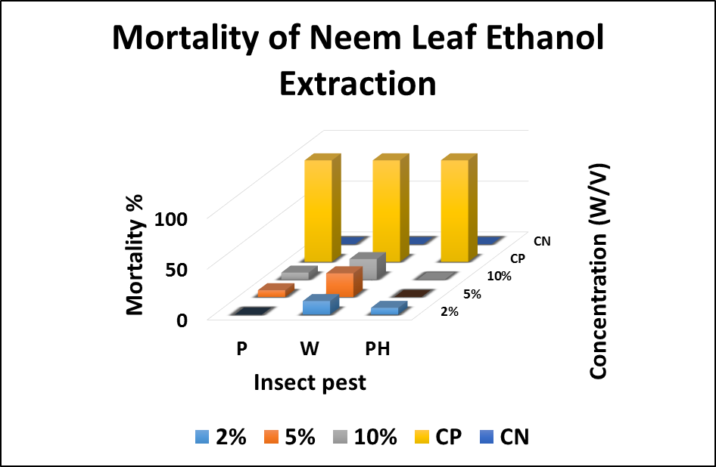
NS = p > 0.05
* = p < 0.05
Effective Extract for Woolly aphid, Pyrilla plant hopper and Mealy Bug
After 24 hrs. : Pyrlla plant Hopper
SE vs SW | NS
LW vs LE | NS
LE vs SE | *
LE vs SW | NS
LW vs SE | NS
After 24 hrs. : Woolly Aphids
SE vs SW | NS
LW vs LE | NS
LE vs SE | *
LE vs SW | NS
LW vs SE | NS
After 24 hrs. : Pink Mealy Bug
SE vs SW | NS
LW vs LE | NS
LE vs SE | NS
LE vs SW | NS
LW vs SE | NS
P = Pink Mealy Bug
W = Woolly aphid
PH = Pyrilla plant hopper

Slide 27
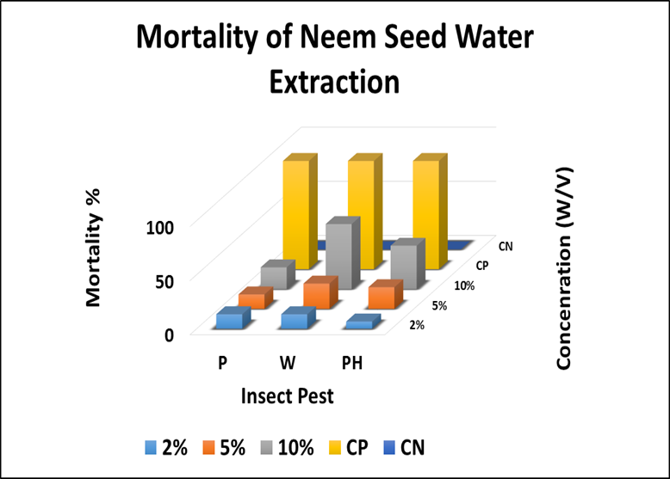
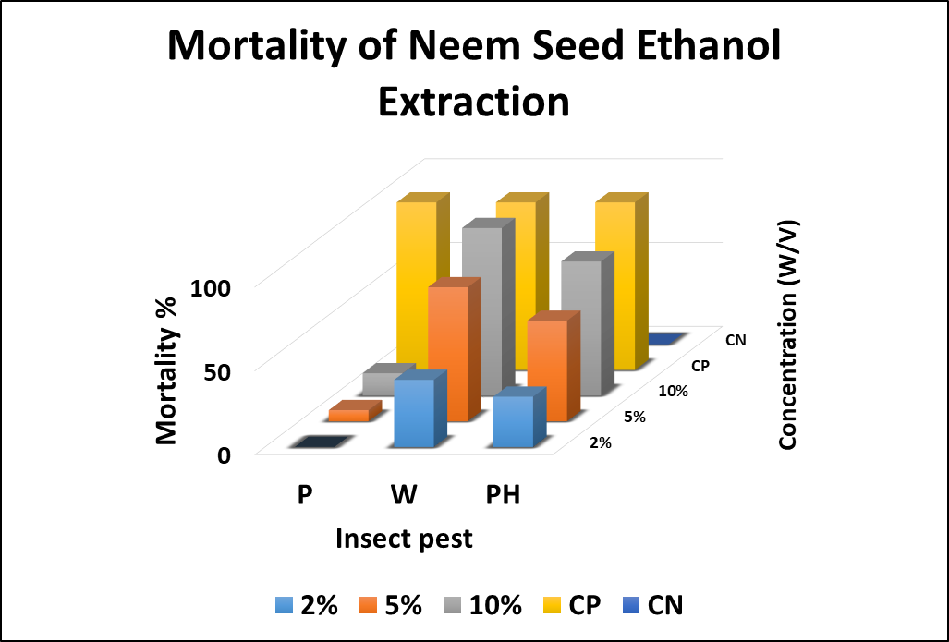
Effective Extract for Woolly aphid, Pyrilla plant hopper and Mealy Bug
NS = p>0.05
* = p<0.05
After 24 hrs. : Pyrlla plant Hopper
SE vs SW | NS
LW vs LE | NS
LE vs SE | *
LE vs SW | NS
LW vs SE | NS
After 24 hrs. : Woolly Aphids
SE vs SW | NS
LW vs LE | NS
LE vs SE | *
LE vs SW | NS
LW vs SE | NS
After 24 hrs. : Pink Mealy Bug
SE vs SW | NS
LW vs LE | NS
LE vs SE | NS
LE vs SW | NS
LW vs SE | NS
P = Pink Mealy Bug
W = Woolly aphid
PH = Pyrilla plant hopper

Slide 28
Conclusions
Neem seed extract has highest anti-feeding effect (p < 0.05) and toxicity effect (p < 0.05) for controlling Sugarcane Woolly Aphid (mean mortality, 100 %),Pyrilla Plant Hopper -Pyrilla perpusilla Walker (mean mortality,76 %) and there is no significant effect on mortality of pink mealy bug.
The most effective concentration is 10 % (W/V) of the extraction
Neem seed ethanol extraction is the best extract according to the this experiment.

Slide 29
Suggestions
Higher concentration of extractions should be evaluated on pink mealy bug.
Wider range of concertation should be evaluated to under laboratory and field conditions to interpolate the LC₅₀ values.
Further studies are required to identify the active compounds that give the pesticidal effect on sap sucking insects.

Slide 30
References
Anita, S., Ruchika, K. and Dolly, K., 2012. Repellence property of traditional plant leaf extracts against Aphis gossypii Glover and Phenacoccus solenopsis Tinsley. African Journal of Agricultural Research, 7(11), pp.1623-1628.
Chanchala, K.G.M., Hemachandra, K.S., Nugaliyadde, L., Wanasinghe, V.K.A.S.M. and Witharama, W.R.G., 2021. Varietal Screen for Susceptible stage of Saccharum hybrids for Deltocephalus menoni (Hemiptera: Cicadellidae), vector of sugarcane White Leaf Disease. Tropical Agricultural Research, 33(1).
Chanchala, K.M.G., Wanasinghe, V.K.A.S.M., Hemachandra, K.S., Nugaliyadde, L. and Witharama, W.R.G., 2020. Effect of the epicuticular wax level of leaf lamina on the behaviour of leaf hopper Deltocephalus menoni (Hemiptera: Cicadellidae); A vector of sugarcane white leaf disease..
De Silva, A.G.S.D., Sanotharan, N., Senevirathna, C.J. and Perera, S.K., 2019. Analysis of the factors affecting farmers’ perception toward the sugarcane cultivation of small-scale farmers in Monaragala District of Sri Lanka. International Journal of Advances and Research, 4(1), pp.35-38.
Elanchezhyan K., Vinothkumar B., 2015. Neem: An Eco-Friendly Botanical Insecticide in Pest Management. The Journal of Insect Science.116 (2015), 207-21
Heinrichs, E.A., 1985. Genetic evaluation for insect resistance in rice. Int. Rice Res. Inst.
Kumar, A. and Pal, S., 2019. Survey and surveillance of sugarcane insect pests under Terai zone of Northern West Bengal.
Lokanadhan, S., Muthukrishnan, P. and Jeyaraman, S., 2012. Neem products and their agricultural applications. Journal of Biopesticides, 5, p.72.
Muhammad, A. and Kashere, M.A., 2020. Neem, azadirachta indica l.(a. Juss): an eco-friendly botanical insecticide for managing farmers’insects pest problems-a review. FUDMA Journal of Sciences, 4(4), pp.484-491.
Narejo, N., Shah, S.R.U., Ali, A. and Muhammad, F., 2018. Influence of different sowing dates and wheat (Triticum aestivum) genotypes on aphid infestation and its predation in agro-climate of Lasbela region.

Slide 31
Acknowledgement
Internal supervisor Dr. W. M. A. U. K. M. Wijesekara ,senior lecturer, Department Of Export Agriculture, Faculty Of Agricultural Sciences ,Sabaragamuwa University of Sri Lanka.
External supervisor Dr. Dr. K. M. G. Chanchala ,Division Of Crop Protection Sugarcane Research Institute ,Udawalawa.
Everybody who helped me

Slide 32
Thank You

