Slide 1
Early Detection of High Yielding Rubber Genotypes (Hevea brasiliensis) Based on the Expression of Rubber Elongation Factor(Ref)Gene
S.A.C.Sathsarani, J.B.D.A.P.Kumara, P.W.M.Tharindi, S.P.Withanage
Faculty of Agriculture Sciences, Sabaragamuwa University of Sri Lanka, Belihuloya,Sri Lanka
Rubber Research Institute, Genetics and Plant Breeding Department, Nivithigalakale Substation,
Mathugama, Sri Lanka

Slide 2
Content for the Presentation
Introduction
Material and Methods
Results and Discussion
Conclusion and Recommendations
References

Slide 3
Introduction
Scientific name- Hevea brasiliensis (Wild.ex A.Juss) Mull.-Arg
Key gene involve rubber biosynthesis
Ref gene(Rubber Elongation Factor)
Previous studies found that positive effect on Ref gene expression and latex yield(Priya et al.,2006)

Slide 4
Problem statement
20-25 years required for the field selection of clones reaching to the stage RRISL recommendation
Perennial nature
Molecular study
Early selection of high yielding genotypes

Slide 5
Material and Methods
1
Sample collection
2
RNA extraction and quantification
3
Optimize best annealing temperature for Ref gene
4
cDNA synthesis
5
Quantitative gene expression
6
Data analysis
-Gene expression data
-Yield data

Slide 6
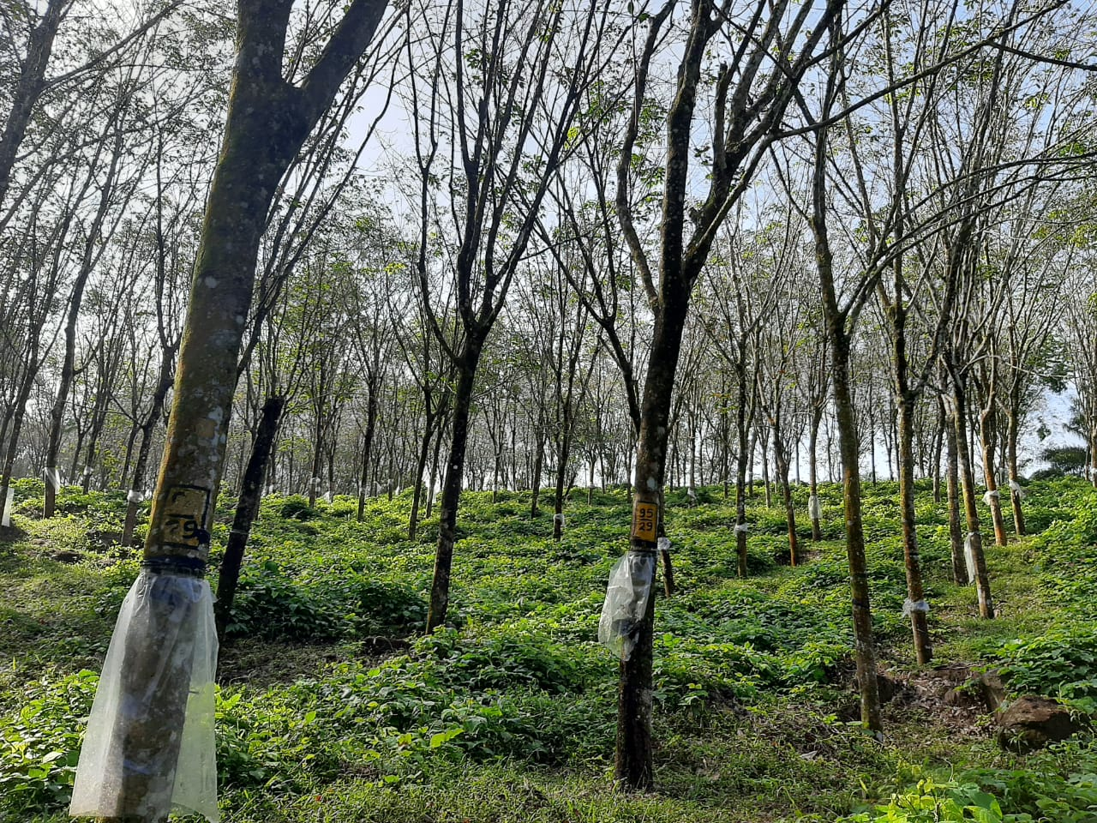
Experiment location
Yatadolawatta estate,Mathugama.Sri Lanka

Slide 7
1) Sample collection
HP 95-55
HP 95-01
HP 95-41
RRISL 203
(control clone)
Genotypes were developed by 1995 Hand Pollination progeny
All plants were 11 years old as a Estate Collaborative Trial(ECT)
Yatadolawatta estate
High yielding clone including in group 1 clone recommendation

Slide 8
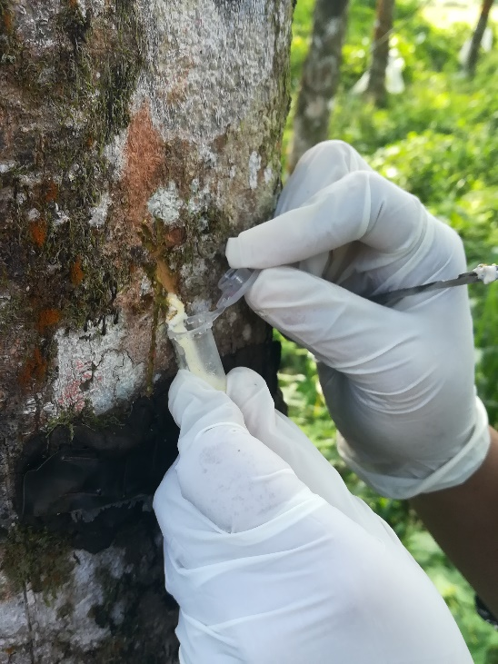
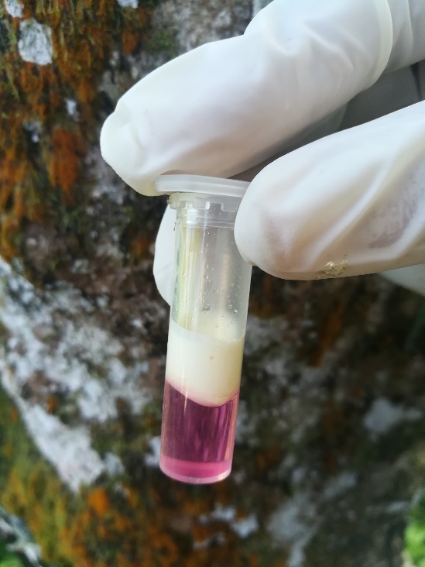
Sample collection cont..
Two plants from each three genotypes and clone were selected to get latex samples
4-5 drop of latex were collected in TRIzol reagent containing eppendrof tube
Latex sample
TRIzol reagent
Latex with TRIzol reagent containing eppendrof tube
Taken of Latex samples

Slide 9
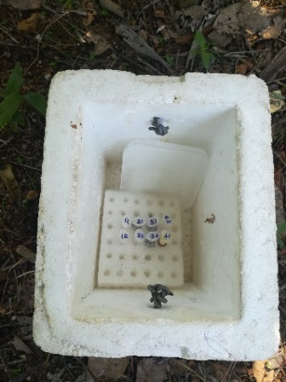
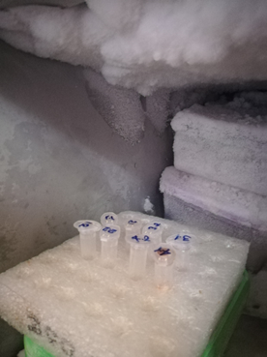
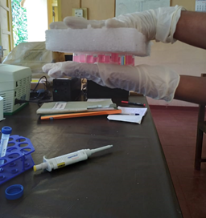
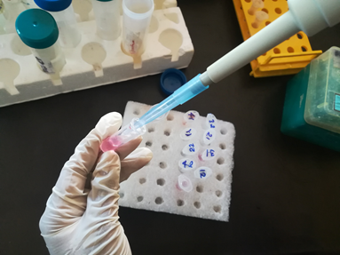
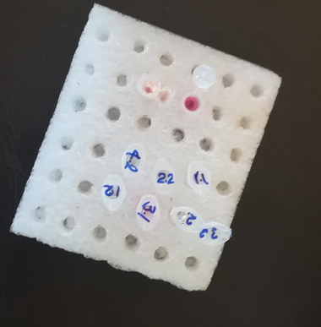
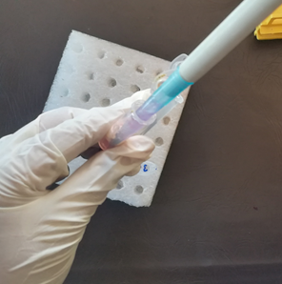
2) RNA extraction
RNA extraction TRIzol reagent RNA extraction protocol (Nagahawatta et al.,2017,Gunasekara et al.,2019)
Latex samples were taken in laboratory by using ice Box
Centrifuged the sample at 14,500 rpm
Crushed the samples by using pipette tip
Stored samples at -20$℃$ for 15 min
Added 200$μl$ Chlorofoam
Samples were kept in room Temperature for 10 min
Solution transfer new eppendorf tube
Gently mixed sample

Slide 10
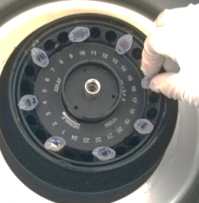
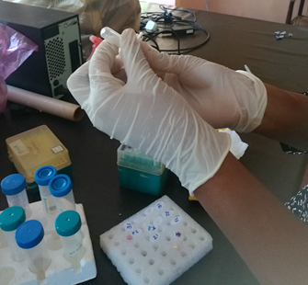
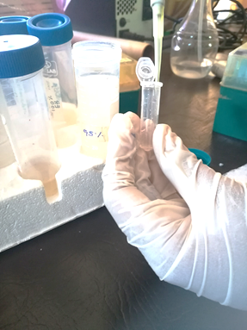
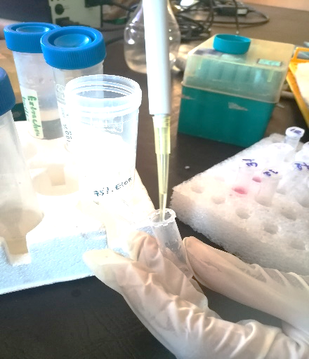
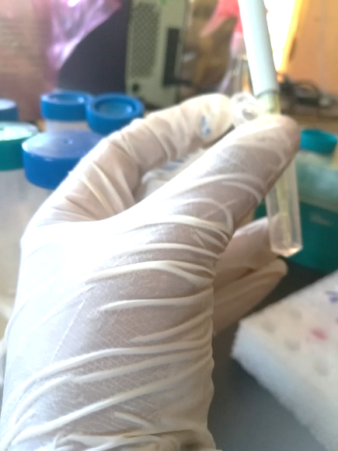
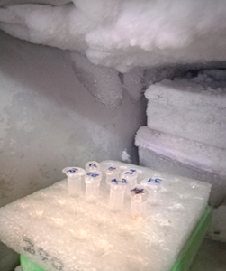
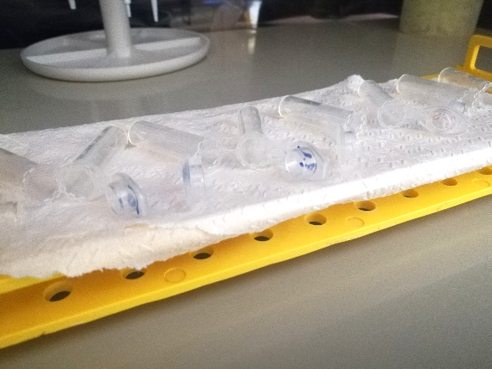
Samples centrifuged at 14,500 rpm for 10 min
Discard supernant
Added 95% Ethanol
Added 75% Ethanol
Samples stored in -20℃
Added 25-50𝜇L Nuclease free water
Samples were kept to air dried

Slide 11
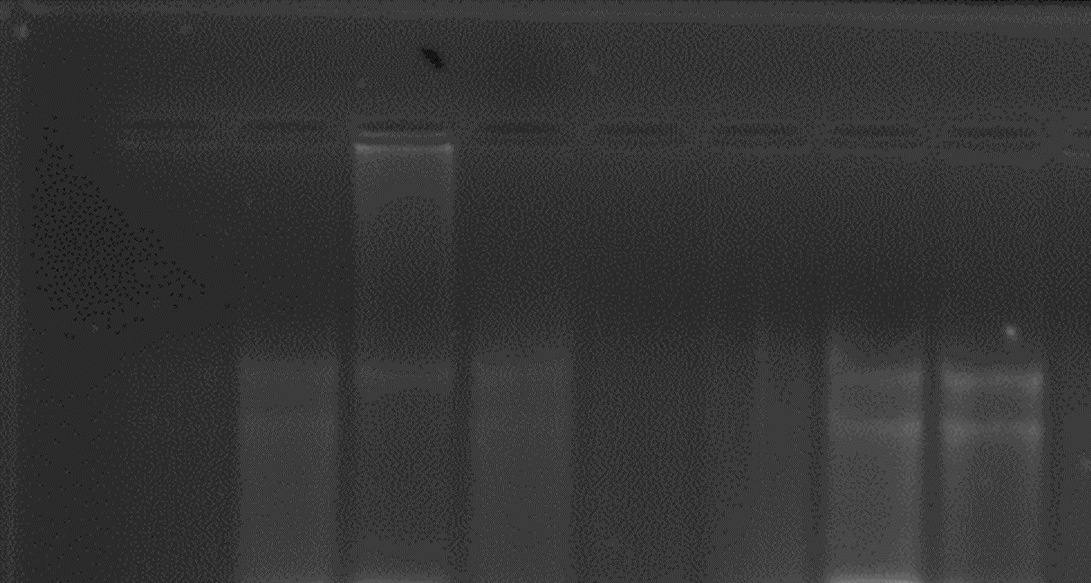
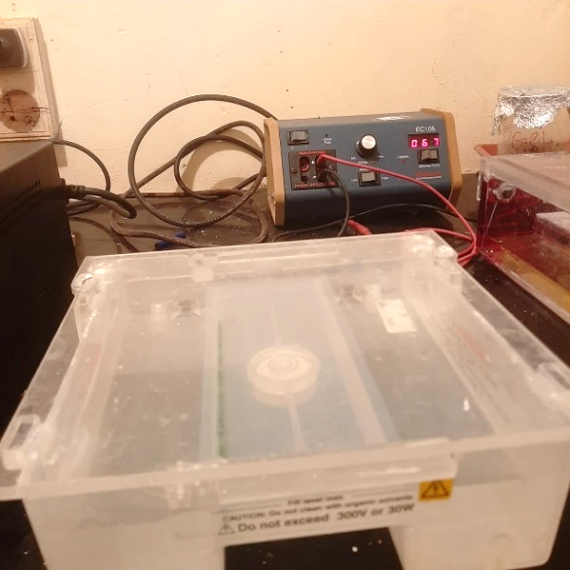
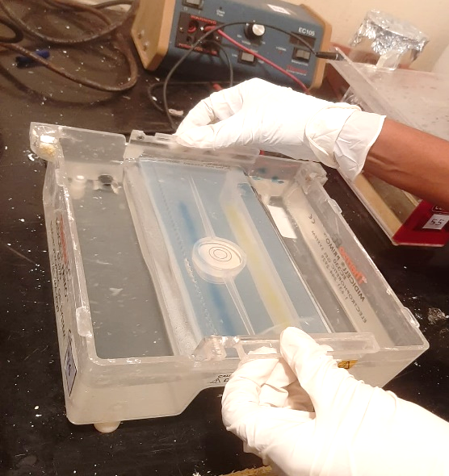
RNA quantification
RNA quantification done by using agarose gel electrophoresis
1 1 2 2 3 3 4 4
Agarose Gel Electrophoresis apparatus
RNA quantification
1- HP 95-41
2-HP 05-01
3-RRISL 203
4-HP 95-55
Agarose Gel

Slide 12
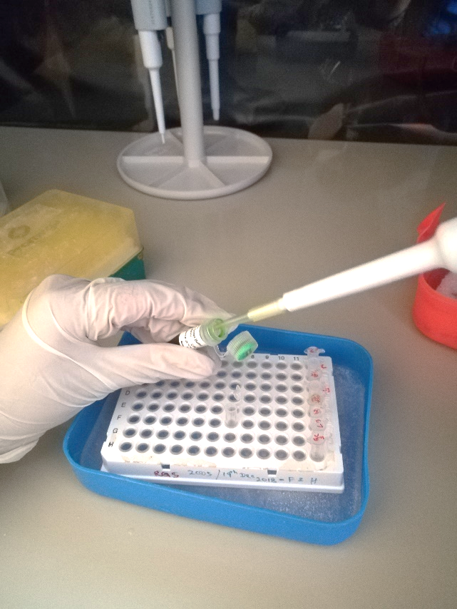
3) Optimization best annealing temperature for Ref gene
Preliminary trials were conducted to find out best annealing temperature
58$℃ −$ 68℃ eight temperatures used to optimize annealing temperature
Nuclease free water 14.1μl
1X PCR green Taq buffer 0.1μl
dNTPs 0.3μl
Ref gene forward primer 1μl
Ref gene reverse primer 1μl
DNA pellet 2μl
Total volume 20μl
Master mixture for gradient PCR
PCR samples preparation for gradient PCR

Slide 13
4) cDNA synthesis
cDNA was synthesized by using a Reverse Transcription Kit according to the manufacturing instructions
Nuclease free water 4.2μl
RT Random primers 2μl
RT buffer 2μl
dNTPs 0.8μl
Reverse Transcriptase 1μl
Total Volume 20μl
Mater mixture-
PCR protocol for cDNA synthesis

Slide 14
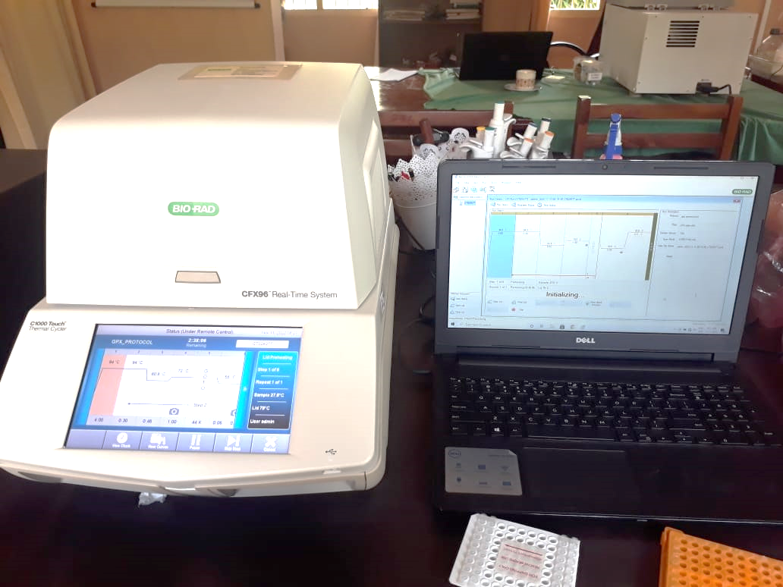
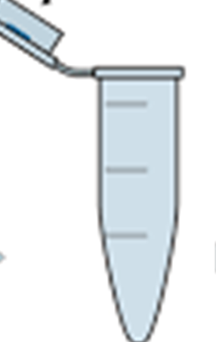
5) Quantitative gene expression
Perform to express gene expression level
The data presented as the fold changes in transcript level normalized to the housekeeping gene, GAPDH
Master mixture was preparation for three replicate samples from each genotypes
Nuclease free water 5.4μl
cDNA- 2μl
Forward REF gene primer-0.3μl
Reverse REF gene primer -0.3μl
Eva green buffer-2μl
Quantitative real time PCR
Total volume-20μl

Slide 15
6)Quantitative gene expression data analysis
The Livak method used to analysis quantitative gene expression of Ref gene,(Livak and Schmittgen et al.,2001)
∆CT_{Control} = Ct_{control REF}- Ct_{Control GAPDH}
∆CT_{Treatment}= Ct_{Treatment REF}-Ct_{treatment GAPDH}
∆∆Ct = ∆Ct_{treatment}-∆Ct_{Control}
Fold difference=2^{-∆∆CT}
CT-Cycle threshold Value

Slide 16
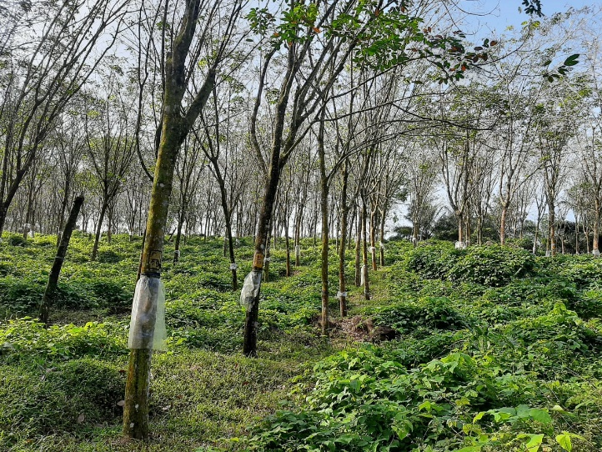
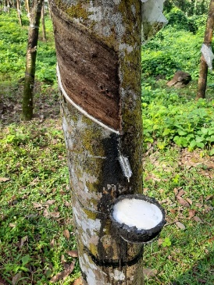
Yield data collection and analysis methods
Three months yield data collection(September-November in 2022)
d/2 tapping panel system
One way ANOVA test was done
Mean separation done by Dennett test
By using SAS software version 9.4

Slide 17
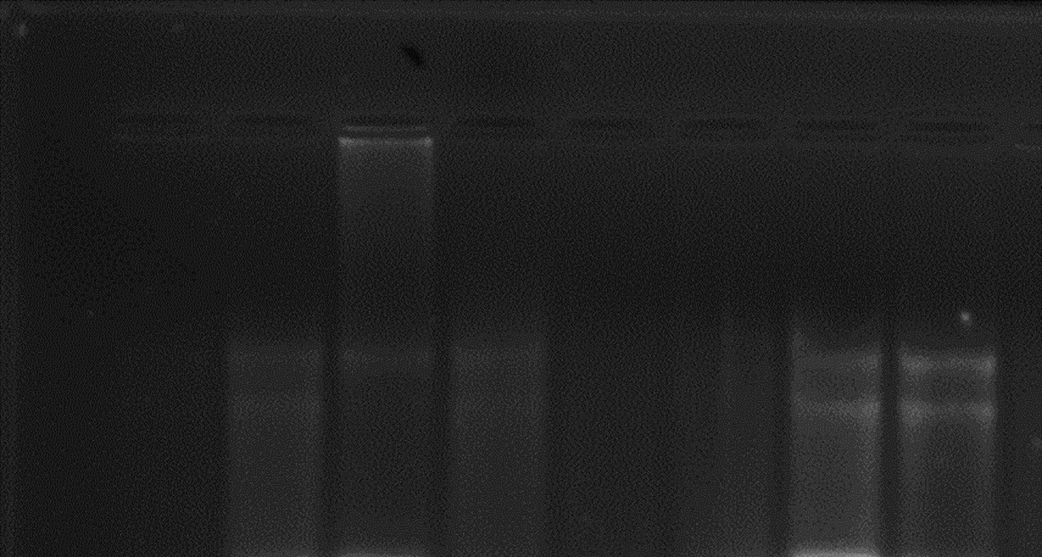
Results and Discussion
1- HP 95-41
2- HP 95-01
3- RRISL 203
4- HP 95-55
Confirmation of the quality of extracted RNA samples
1 1 2 2 3 3 4 4
28 S
14 S
Quantification of extracted RNA samples by using agarose gel electrophoresis

Slide 18
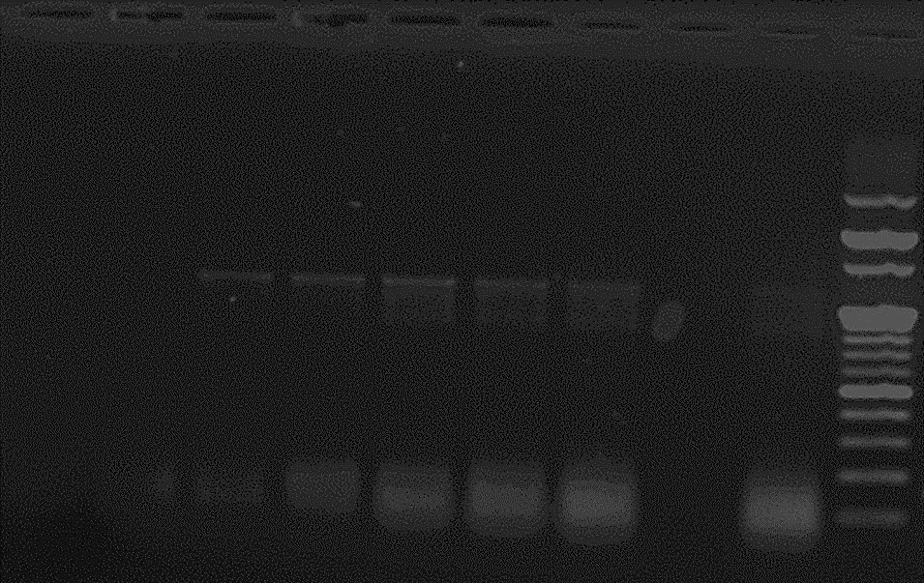
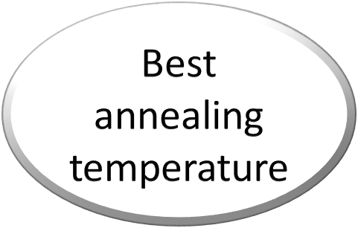
Gradient PCR-amplification outputs
1 2 3 4 5 6 7 8 L
58$℃$
58.7℃
60℃
62℃
64.4℃
66.4℃
67.5℃
68℃
L- 100 bp ladder

Slide 19
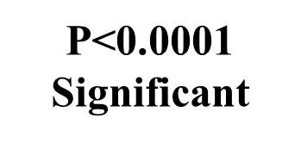
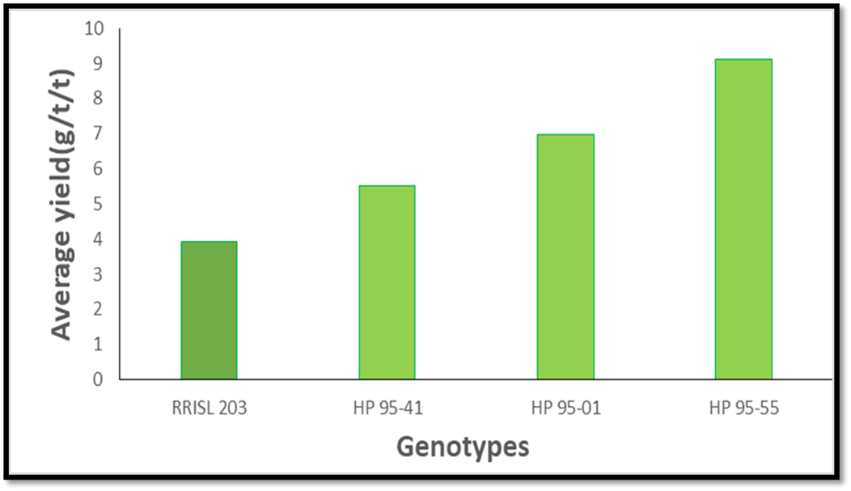
Yield data analysis results

Slide 20
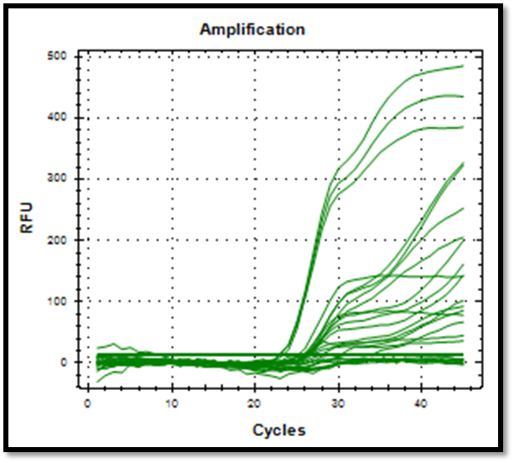
Quantitative gene expression data outputs

Slide 21
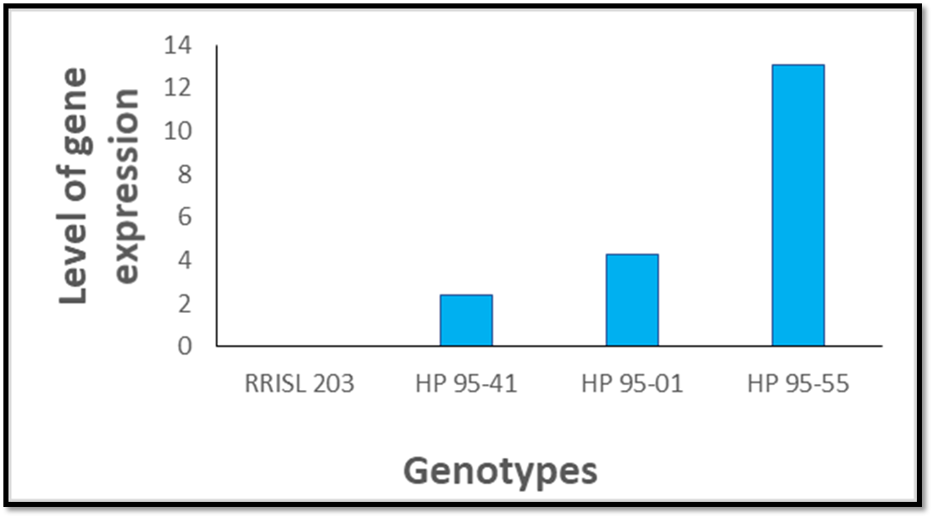
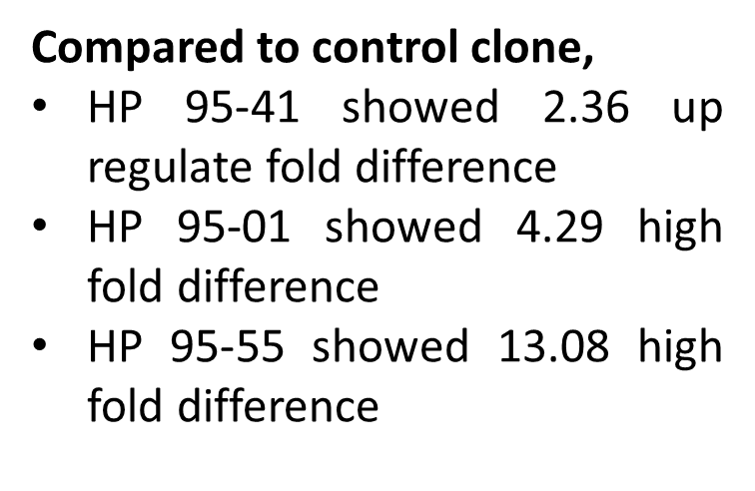
Quantitative gene expression data analysis

Slide 23
Conclusion and Recommendations
Conclusions
Ref gene expression was up-regulated for HP 95-55, HP 95-41 and HP 95-01 genotypes compared to control clone RRISL 203
Average yield of HP 95-55, HP 95-41 and HP 95-01 in Yatadolawatta estate was higher than comparatively RRISL 203,It means gene expression level was higher in the all tested genotypes
Can observed Ref gene expression positively co-related with latex yield
There is potential a using of selection high yielding genotypes of using Ref gene expression at an early stage of the Hevea breeding cycle

Slide 24
Recommendations
Ref gene expression should be evaluated for other remaining genotypes, which developed by 1995HP progeny
Ref gene expression could be studied in different growth stages (Younger and mature) Hevea brasiliensis
The Ref gene expression levels should be tested for newly selected genotypes according to different agro-climatic regions(Multi-location trials) in the country

Slide 25
References
1) Annual Report of Rubber Research Institute of Sri Lanka. (2017)
2) by S. D. T. S. Gunasekara1, I. R. Palihakkara2 and S. P. Withanage Study toward the Development of Relationship between Ref Gene Expression and Yield Potential of Hevea Clones
3) P. Priya 1, P. Venkatachalam 1, A. ThulaseedharanMolecular cloning and characterization of the rubber elongation factor gene and its promoter sequence from rubber tree (Hevea brasiliensis): A gene involved in rubber biosynthesis
4) Bandara H.M.C.S Early selection of High Yeilding Rubber(Heavea brasilliencis) genotypes based on rubber elongation factor (REF) gene expression

Slide 26
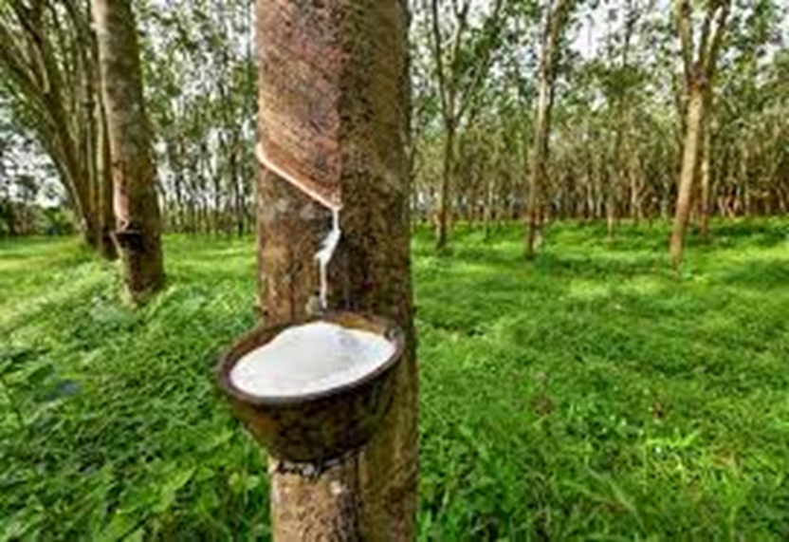
Thank You

