Slide 1
Did the Overnight Ban Smash the Sri Lankan Paddy Farmers?
Evidence from Chemical Fertilizer Policy Reform
SS Niwarthana1*, M Thibbotuwawa2, HSR Rosairo1
1 Department of Agribusiness Management, Sabaragamuwa University of Sri Lanka
2Institute of Policy Studies of Sri Lanka, Colombo 7

Slide 2
Content for the presentation
Introduction
Objectives
Material and Methods
Results and Discussion
Conclusion and Recommendations
References

Slide 3
Introduction
Agriculture is an important sector which makes a significant contribution to the economic and social development of Sri Lanka while contributing significantly to national and household food and nutrition security.
Primary production in agriculture accounted for 7% of the country’s Gross Domestic Product (GDP). Rice which is the staple food in Sri Lankan population contributed 0.8% of the total GDP in 2019 (CBSL, 2020).
About 69.7% only chemical fertilizers have been applied to the sown extent while only organic fertilizers usage was 0.1% during 2019/20 Maha season (DCS, 2020).

Slide 4
Cont..
The overnight ban of chemical fertilizer on 27th April 2021, immediately disrupted the fertilizer supply which is procured as major raw material in paddy cultivation in Sri Lanka.
As such, farmers had been pushed to the status of confusion and been insecure to overcome the loss of production.
As the substitution for continued agricultural operations, the nation was widely pushed to organic fertilizers over months.

Slide 5
Objectives
The primary objectives :
To map the rice value chain after chemical fertilizer ban
To analyze the major challenges faced by paddy farmers during 2021/22 Maha season due to the chemical fertilizer ban

Slide 6
Material and Methods
Research Location
This study was conducted in four districts; Anuradhapura, Polonnnaruwa, Kurunegala and Kaluthara to cover the Dry zone (DZ), Intermediate Zone (IZ) and Wet Zone (WZ) in Sri Lanka.

Slide 7
Sample Size- 406
Sampling frame- The paddy farmers targeting those who used organic fertilizers as well as chemical fertilizers during the 2021/22 Maha Season.
Sampling Techniques-
Two-stage sampling technique was used to identify respondents.
In the first stage, purposive sampling of Divisional Secretary Divisions (DSD)/Grama Niladhari Divisions (GND) was done leading to the selection of the specific area of data collection.
In the second stage, systematic sampling was used to choose a sample of adopters of organic fertilizer whereas a simple random sampling technique was used to sample non-adopters.

Slide 8
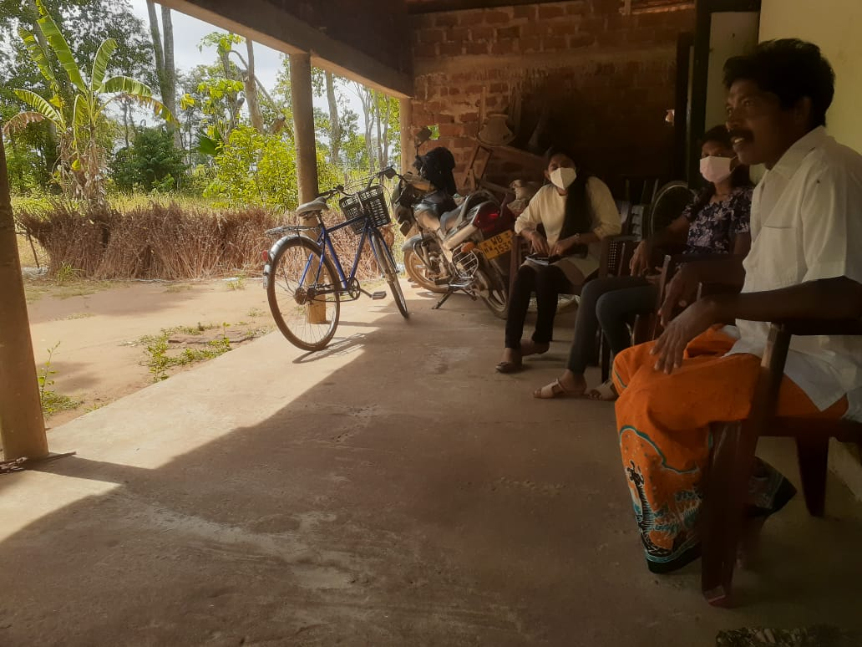
Data Collection Methods
FGD
Four Focus Group Discussions(FGDs) were conducted for paddy farmers.
KII
Key informant interviews were conducted for value chain stakeholders such as millers, farmers organizations, collectors, retailers and wholesalers.
Survey
With a questionnaire
Figure 2: KII with farmer

Slide 9
Data Analysis Method
Originally defined by Porter in 1985, the value chain analysis (VCA) has emerged as a powerful analytical tool in development policymaking, and it has been widely adopted by researchers, industry, and development practitioners to understand the different production systems (Kaplinsky R. &., 2001).
The standard VCA method developed by the United States Agency for International Development (USAID) was applied in this study (Figure 3).
This framework consists of 4 steps:
1) data collection;
2) value chain mapping;
3) analysis of opportunities and constraints and
4) vetting findings and proposing recommendations.
Accordingly, both secondary and primary data were collected in the first step. These collected data were analyzed in the mapping exercise in the second step and the constraints and opportunities were identified in the third step. Finally, the findings were vetted through consultation in the final step.

Slide 10
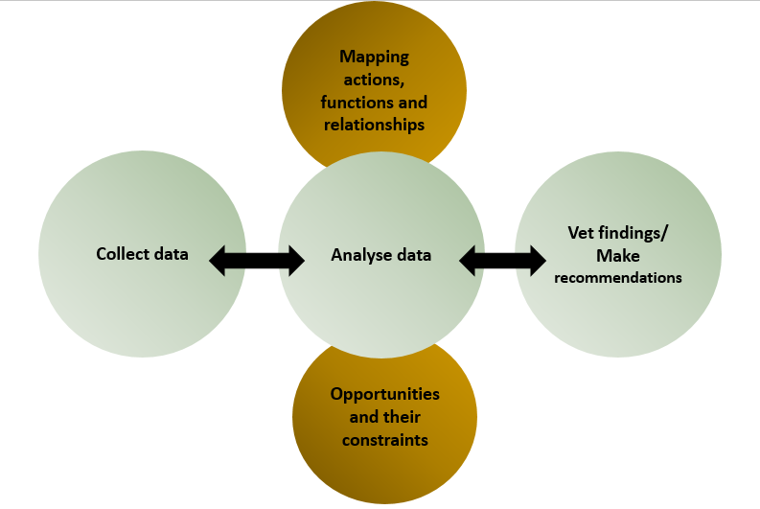
Figure 3: Process for the VCA
Source: Authors’ compilation.

Slide 11
Results and Discussion
Table 1. Conceptual framework for rice value chain
Segment | Actor | Assets | Inputs (buy) | Making | Outputs (sell)
Upstream | Large scale farmers and small scale farmers | Land, storage spaces (household), machinery, vehicles, farm hauling animals and carts | Land, water, fertilizer, agro-chemicals, labor, seeds | Growing crops | Rice grain
Midstream | Collectors (ex; Paddy marketing board, cooperatives and private collectors) | Land, warehousing, vehicles, carts | Rice seeds and grains, transportation- fuel, labor | Collecting grains | Rice grain
 | Processors/Millers (private and cooperative) | Machinery (grading, sorting, refining, packaging), warehousing, buildings, vehicles | Rice seeds and grains, electricity for operating machinery and silos, electrical tools and equipment, labor (technicians) | Processing, value addition, packaging ex; cleaning | Refined rice or value added rice (bran, oil etc.)
 | Wholesalers, super markets and commission agents | Warehousing, vehicles, buildings | Rice seeds and grains, transportation- fuel, labor | Selling to retailers | Value added rice
Downstream | Retailers (private and cooperative) | Vehicles, retail outlets/buildings | Rice seeds and grains, transportation-fuel, labor | Selling to end consumers | Value added rice

Slide 12
Figure 4: Rice value chain map in Sri Lanka

Slide 13
Table 2. Different participants in Rice Value Chain
Core Actors | Service Suppliers
Input suppliers (paddy seed, land, labor, agro-chemicals, fertilizer, machinery, water irrigation, extension etc.) Conventional farmers Organic farmers Large scale/Town collectors Village collectors Brokers Paddy Marketing Board (PMB) Small & medium scale millers Large-scale millers Government co-operatives Commission-agents Wholesalers Super market chains Retailers Importers End consumers | Agrarian services centers Provincial council and municipal council Private sellers (fertilizers, agro-chemicals) Private fertilizer manufacturing firms (Hayleys, CIC) Small and medium organic fertilizer manufactures (Compost, liquid fertilizer) Government Farmer organizations Banks
Source: compiled by author, 2022.

Slide 14
Figure 5. Farmer perceptions of Organic Farming

Slide 15
Table 3. Challenges for value chain actors due to the fertilizer ban
Value Chain Actors | Challenges
Paddy farmers | Government fertilizer distribution was not on time. No sufficient fertilizers for cultivation Adequate organic fertilizer inputs were not available in specific areas to produce organic fertilizers. Quality issues of organic fertilizers No sufficient agro chemicals Black market prices for fertilizers No proper organic fertilizer subsidy program implementation Harvest loss Low profit of income Supply issues of paddy seeds No favorable price for harvest Lack of extension No suitable paddy seeds for organic farming No reasonable period for organic adoption Lack of governance

Slide 16
Value Chain Actors | Challenges
2. Collectors | Reducing harvest received.
3. Millers | Reducing harvest received. Increasing the competition of large millers. Small and medium millers move away from industry.
4. Traders | Changing the rice price immediately by time to time Difficulties of supplying rice under government policies (control price)

Slide 17
Table 4. Opportunities for value chain actors due to the fertilizer ban
Value chain actor | Opportunities
Input suppliers | Farmers who engage large scale rice production are not in a position to procure organic fertilizer on large scale but are willing to pay for quality organic fertilizers if available. Therefore, Organic fertilizer manufacturers should offer quality certified production and immediately enhance distribution channels in respective areas.
Farmers | The willingness to do organic farming for paddy farmers has been enhanced due to the ban. Farmers are willing to transform gradually into organic rice production with the required farming conditions for this modern technology. Hence, there is an opportunity to develop an action plan to convert farmlands into organic and build up a developed flow of organic rice in the value chain.
Traders | The traders can have the possibility to promote quality certified organic fertilizers for marketing opportunities. The niche market of value-added organic rice flow can be expanded further beyond supermarket chains.
Source: Compiled by author based field data, 2022.

Slide 18
Conclusion
The lack of adequate raw materials for organic fertilizers, quality issues and no proper organic subsidy program were key constraints identified in the study.
Moreover, the reduction of harvest, low profit, market price fluctuations, government unsystematized price control, illegal market transactions and artificial shortage by hoarding were reasons for to temporary drop of maintaining an efficient rice value chain in the country.
The poor knowledge of organic farming techniques and adverse market opportunities happening in the society were threatening to current agricultural operations. They should be mitigated to implement the organic farming conversion as a feasible operation.
Moreover, the supply of quality fertilizers, implementing advanced farming methods, developing farmer base and value-added product flow regards to organic would be wide future opportunities to meet.
Therefore, sufficient fertilizers to secure harvest and favourable floor prices are much needed to ensure the national rice production process is alive. Then it will strengthen the paddy farmers’ living conditions in order to establish the sustainable rice value chain in Sri Lanka.

Slide 19
Recommendations
if the future government policies decide to go for transformation to organic farming, the government should establish a specific national policy for organic farming with a comprehensive action plan including strategies and outcomes which need to be achieved during a specific period.
Quality standards and guidelines for organic fertilizers manufacturing and use should be established and promoted with incentives for adoption.
Extension programmes related to plant nutrient management should be strengthened with modern knowledge, expertise and techniques.
Chemical fertilizer should be offered in the short term at market prices to the registered farmers and integrated plant nutrition management (IPNM) and site-specific application techniques should be promoted to gradually reduce the overuse of chemical fertilizer.
Further investments should be made in the R&D in organic, chemical, and IPNM techniques.

Slide 20
References
CBSL (2020). Annual Report 2020, Central Bank of Sri Lanka. Colombo.
Chala, M. and Tilahun, U. (2014). Determinants and Impacts of Modern Agricultural Technology Adoption in West Wollega: The Case of Gulliso District. Journal of Biology, Agriculture and Healthcare, 4 (20): 63 - 77.
DCS (2020). Paddy Statistics 2019/2020 MAHA SEASON. Department of Census and Statistics of Sri Lanka. Colombo.
Paddy statistics 2019/2020 Maha season, Department of Census and Statistics of Sri Lanka, pg.2-3
Rosenbaum, P.R., and D.B. Rubin. 1983. "The central role of the propensity score in observational studies for causal effects." Biometrika 70(1):41-55.

Slide 21
Thank You

