Slide 1
A Study Of Challenges In Coconut Procurement Process Among Small Scale And Large Scale Coconut Growers In Sri Lanka, A Study In Kurunagala District
Amarasena S.K.G
16AGA1249
Department of Agribusiness Management, Faculty of Agricultural Sciences, Sabaragamuwa University of Sri Lanka.

Slide 2
Content
Introduction
Material and Methods
Results and Discussion
Conclusion and Recommendations
References

Slide 3
Introduction
Sri Lanka is the 4th largest country that export coconut to the global market.
As an agricultural commodity, coconut must undergo a series of operations before they reach to the market as a raw material and a value added material.
One of the major initial steps in the supply chain of coconut is the process of procurement. Ceasing to be a secondary business function, procurement has played a fundamental role in organization's management by being responsible for purchasing specific resources
Particularly, intra- and inter-organizational issues from activities which are responsible for managing the flow of goods and information in the upstream supply chain. This, therefore, raises questions on the role of procurement in creating supply chain resilience
In Sri Lankan Context coconut procurement process has many constraints to achieve supply chain sustainability. Therefore, this topic was aid to explore about the procurement stage issues of coconut in supply chain

Slide 4
Research Problem
There are limited research attention have paid on agricultural sector procurement performance of supply chain specially on coconut industry. This research is to bridge the gap and it has huge potential to identify some constraints on coconut procurement , initiate solutions , develop the knowledge base and facilitate decision making including sustainability of the whole sector .

Slide 5
Broad objectives
To understand the role of procurement in identifying and managing intra and inter organizational issues which impact supply chain performance
Specific objectives
To find out the status of coconut production in Sri Lanka
To find out the inter and intra organizational problems and issues hinder the procurement process
To find and rating the leading factors for those problems in procurement process of supply chain in coconut production in Sri Lanka
To find out initiatives which will aid to develop systematic procurement process

Slide 6
Material and Methods
Research Location
Research Strategy and type
Data Collection Method
Data Analysis Method
Data Analysis Tool
Research Approach
Sample Size
Kurunegala District
Deductive Approach
Survey method
Primary data (Structured Questionnaire, In- depth interviews)
Secondary data (Article, Magazines, Annual reports (central Bank), reports of census Research Journal for coconut industry
Quantitative and Quantitative Analysis methods
SPSS
Microsoft Excel
100
Respondents
Explanatory (Quantitative) Research

Slide 7
Results and Discussion
Figure 4 : coconut production , Kernel exportation and Domestic consumption
Figure 3 : coconut Yield per hectare

Slide 8
Table 9: Coefficient Result
Model | Unstandardized Coefficients |  | Standardized Coefficients | t | Sig.
 | B | Std. Error | Beta
Constant | 12.936 | 1.290 |  | 10.028 | .000
Product sourcing issue | .033 | .125 | .032 | .263 | .793
Price instability issue | -.244 | .113 | -.242 | -2.149 | .034
Overspending issue | .024 | .052 | .030 | .472 | .638
Forecasting errors issue | -.012 | .089 | -.014 | -.137 | .892
Technology issue | .015 | .047 | .015 | .318 | .751
Regulatory factors issue | -.051 | .059 | -.055 | -.867 | .388
Supplier Performance issue | -.247 | .059 | -.371 | -4.197 | .000
Process Complexity issue | -.599 | .169 | -.571 | -3.556 | .001
Risk Management issue | -.153 | .133 | -.139 | -1.149 | .254
Logistic and transport disruptions | -.709 | .061 | -.718 | -11.617 | .000

Slide 9
Multiple liner regression technique was used to test cause and effect relationship coconut procurement and factors interference to procurement process variables under the following equation
Y = α + + βX₂ + βX₇ + βX₈ + βX₁₀+ µ
Y = 12.936+ (-0.244X₂ ) + (0.247X₇ ) + (-0.599)X₈ + (-0.709) X₁₀ µ
α = Constant
Y = Procurement performance
βX2 = price instability issue
βX7 = supplier performance issue
βX8 = process complexity issue
βX10 = logistic and transport disruptions
µ = Level of confidence

Slide 10
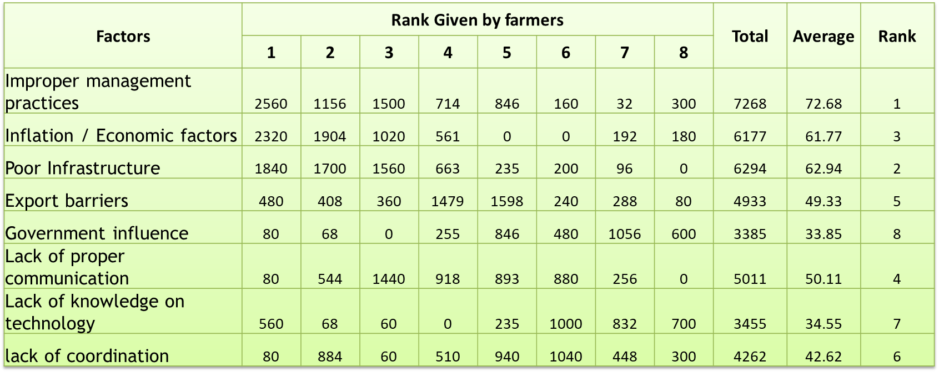
Objective 2 To find and rating the leading factors for those problems in procurement process of supply chain in coconut production in Sri Lanka

Slide 11
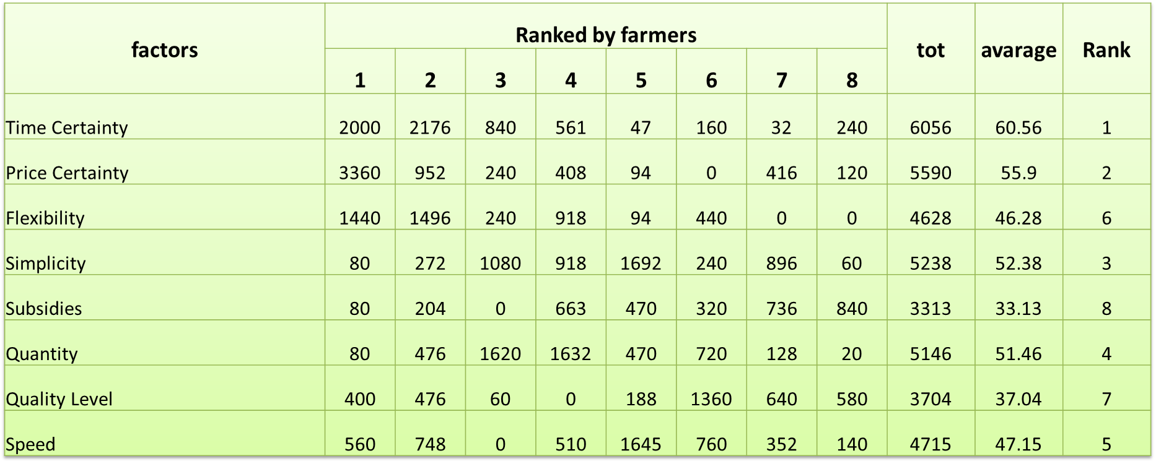
Objective 3 To find the factors that person expected from procurement process in supply chain of coconut production in Sri Lanka

Slide 12
04. To identify initiatives for procurement process sustainability
Strategic Sourcing
Prioritize supplier relationships
Establish clear expectations for the supply base
Assess key performance indicators
Accelerate Procurement cycle time with an automated system
Develop strong risk management policies
Streamline Suppliers/Sourcing Selection
Take advantage of outsourcing opportunities
Simplify supplier onboarding processes
Establish Clear Expectations
Invest in Professional Development of participants
Educate Workforce
Centralize Information
Establish a Feedback System
Identify Inefficient Processes

Slide 13
Conclusion
The current economic crisis has seriously affected to the coconut industry in Sri Lanka .
There is a strong relation between factors such as issues of supplier performance, logistic and transport , price instability and process complexity comparing issues in the procurement process
When ranking the leading factors affect for the above issues highest rank occupied by the improper management practices. Secondly poor infrastructure facilities and countries current economic situation ( inflation ) factors direct them to availability in procurement performance.
Considering the personal expectation from procurement process , time certainty ranked as most expected factor and price certainty, simplicity , speed and flexibility ranked accordingly.
There is a strong positive relationship between rejection of nuts with poor quality of nuts.
There are some can be practiced to overcome from the problems and it directly influence the for procurement performance sustainability and increase the coconut supply chain resilience.

Slide 14
Recommendations
Implement a National Pricing formula for coconut .
Centralized system for gathering information regarding coconut
Create a Standard procurement policy on coconut purchasing
Increase the infrastructure facilities for like warehouses , proper road facilities
Introducing new technology to the farmers based on procurement success

Slide 15
References
Samarakoon, S. M. M., Gunarathne, L. H. P., & Weerahewa, J. (2022). Estimating Technical Efficiency and its Determinants in the Coconut Plantations: The Case of Kurunegala Plantations Limited, Sri Lanka. CORD, 38, 9-17.
Pereira, C. R., Christopher, M., & Da Silva, A. L. (2014). Achieving supply chain resilience: the role of procurement. Supply Chain Management: an international journal.
Sepala, A. C. (1986). Socio-economic conditions of coconut small-holding sector in Sri Lanka: A baseline study of the pre-project conditions of Colombo, Galle, Gampaha, Kegalle, Kalutara and Ratnapura districts
Walker, D., & Hampson, K. (Eds.). (2008). Procurement strategies: A relationship-based approach. John Wiley & Sons
Jap, S. D. (2001). Perspectives on joint competitive advantages in buyer–supplier relationships. International journal of research in marketing, 18(1-2), 19-35.
Jayalath, K. (2018). Weather variability and coconut production in Sri Lanka: State-contingent Analysis.
Jayawardhana, M. B. S. M. T., & Warnakulasooriya, B. N. F. (2020). Impact of Problems associated with Supply Chain Management Practices of Wholesalers on their Business Performance in the Coconut Industry in Sri Lanka with special reference to Kurunegala District. Vidyodaya Journal of Management
Hebbar, K. B., Balasimha, D., & Thomas, G. V. (2013). Plantation crops response to climate change: coconut perspective. In Climate-resilient
horticulture: adaptation and mitigation strategies (pp. 177-187). Springer, India
Deepradit, S., Ongkunaruk, P., & Pisuchpen, R. (2020). Tactical Procurement Planning under Uncertainty in Aromatic Coconut Manufacturing.
International Journal of Technology, 11(4), 698-709.

Slide 16
Thank You

