Slide 1
Study on the Effect of Gamma Irradiation on Turmeric ( Curcuma longa L.) Callus Cultures as an Approach for Inducing Mutagenesis
H.D.S.I.Gunawardana (16AGA1262)
Module: Crop Improvement and Plant Protection
Department of Export Agriculture
Faculty of Agricultural Sciences
Sabaragamuwa University of Sri Lanka
Internal Supervisor:
Ms.P.W.M.Tharindi
Lecturer
Department of Export Agriculture
Faculty of Agricultural Sciences
Sabaragamuwa University of Sri Lanka
External Supervisor:
Mr.Harsha Dissanayake Assistant Director (Research) Genetics & Plant Breeding Division Central Research Station Department of Export Agriculture Matale
Notes:
Hello everyone, let me share the information about the research, which the topic is..

Slide 2
Content for the presentation
Introduction
Problem Statement
Objectives
Material and Methods
Results and Discussion
Conclusion
Suggestion
References
Notes:
This is the content of my presentation

Slide 3
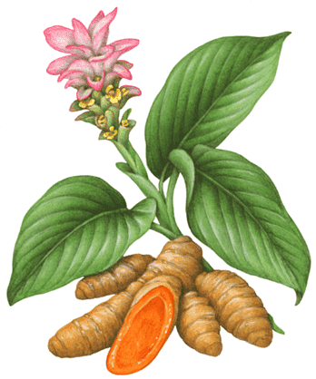
Introduction
Turmeric (Curcuma longa L.) is a member of family Zingiberaceae
The plant is a perennial, rhizomatous, herbaceous plant
Widely grown in South-East Asian countries
Grown as a mono-crop and as an intercrop under coconut, papaya, okra in Sri Lanka’s Wet, Intermediate and Dry zones
Notes:
Turmeric which belongs to family Z.. Is a perennial… that widely…. This can be grown as a mono crop as well as an intercrop….

Slide 4
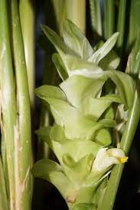
Problem Statement
Turmeric, triploid (3n) is an asexually propagated plant
The genetic diversity is extremely limited
Genetic variation has not been identified yet, number of
landraces exist
To overcome this limitation mutation breeding can be used
Still no recorded studies in related to the induce mutation in Sri Lanka
Notes:
Here is the reason why I learn to do this kind of research.
Turmeric is an asexually propagated plant. Even though it produce flowers and seeds it can’t have sexual propagation because of flower’s sterility and non viability of seeds due to incompatibility and high pollen sterility.
There fore the genetic…
Even though there are number of land races exist in the world, yet the genetic variation has not been identified
So to overcome this limitation can use mutation breeding.
When it comes to turmeric, still no….
Therefore as a solution hope to induce any kind of mutation by exposing the turmeric plants to a radiation therapy

Slide 5
Objectives
Main Objective
To study the effect of gamma irradiation induced mutagenesis on morphological and genetic variation of turmeric (Curcuma longa L.) callus cultures
Specific Objectives
To determine the effective dosage of gamma radiation that need to initiate a mutation
To observe the effect of different dosages of gamma irradiation on turmeric callus cultures
To determine the oxidative stress caused by induced mutagenesis
To identify molecular variation caused by induced mutagenesis
Notes:
These are my objectives

Slide 6
Material and Methods
1
Site Selection
8
Physiological and Morphological Analysis
Molecular Analysis
9
7
2
3
4
5
6
Site Selection
Selection of Planting Material
Preparation of Plant Material
In Vitro Multiplication
Gamma Irradiation Treatment
Maintenance of Samples
Notes:
I planned to carry out the research under following topics. They are…
And finally the

Slide 7
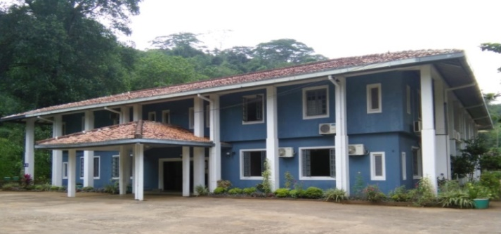
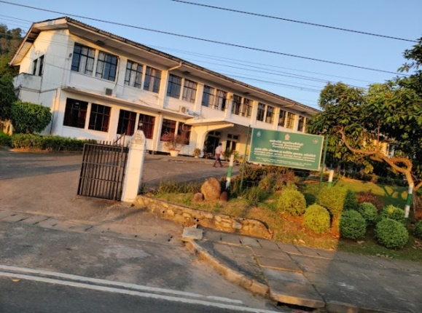
Material and Methods
In vitro multiplication - Central Research Station (CRS),
Department of Export Agriculture,
Matale, Sri Lanka
Gamma Irradiation –
Molecular Study – Faculty of Agricultural Sciences & Faculty
of Technology
Horticultural Crops Research and Development Institute (HORDI), Peradeniya, Sri Lanka
Notes:
The research was conducted under 3 different locations.
Th in vitro multiplication process was performed at CRS in Matale.
& the gamma irradiation process was carried out at HORDI in Peradeniya
As the final step, the molecular study was performed at…

Slide 8
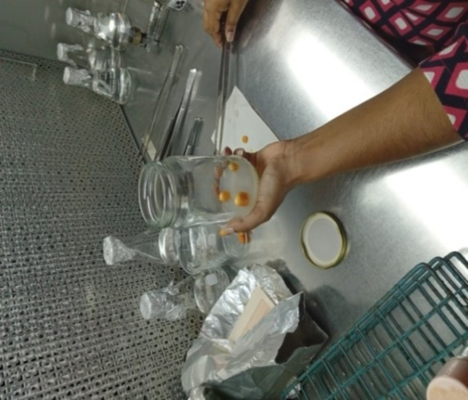
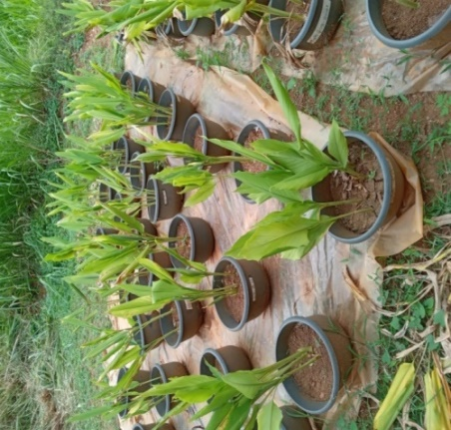
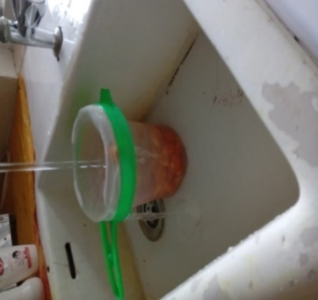
Material and Methods
Selection of planting materials
Preparation of plant material
In vitro multiplication
60 Gy
Maintenance of Samples
Gamma Irradiation Treatment
Notes:
First I collected mature finger rhizomes from 7-8 month old…
Then I prepared the plant material by following the proper sterilization procedures.
After 4 weeks of in vitro multiplication, shoots were exposed to gamma radiation from Co-60 at doses of 0,40,50,60,70 & 80 grays.
Then few samples were randomly selected & maintained under lab conditions while other were under net house conditions

Slide 9
Material and Methods
Morphological parameters:-
Survival Rate
The number of shoots
The total number of leaves
The leaf area
Any observable malformations (lobular developments, chimera)
Physiological parameters :-
Malondialdehyde (MDA) content
Measuring the Leaf Area
Determination of MDA Content
Notes:
…………………… were measured under morphological parameters & as for the physiological parameters I measured the MDA content

Slide 10
Material and Methods
Equation for MDA calculation
MDA (μmol g⁻¹FW) = [((A532-A600) x (155 x 1)⁻¹) x (3.0 x 10⁻³) x (4x1.0⁻¹)] x 0.25
1mL of 0.1% tricholoroacetic acid (TCA) solution will be added to 0.1 g sample of fresh leaves
Mixture will be centrifuged at 12,500 rpm for 20 min at 5°C
1mL of 0.5% tiobarbituric acid (TBA) in 20% TCA will be added to 0.5mL of supernatant
0.5mL portion of the supernatant will be then taken out
Will be incubated at 98°C for 30 minutes
The absorbances at 532 and 600 nm will be measured with the spectrophotometer
Notes:
This is the procedure that I followed to get the MDA content. As for the final step I substitiute the spectrophotometer reading for this equation in order to measure the MDA content

Slide 11
Material and Methods
Young tender leaves from one replicate of each treatment
DNA Extraction – Modified CTAB Method
Quantification is done in 0.8% Agarose Gel
PCR Amplification by SSR markers
Product Visualization by 2% Agarose Gel
Notes:
As for the molecular study I carried out these steps.
First I collected…. & proceed the DNA extraction using the …

Slide 12
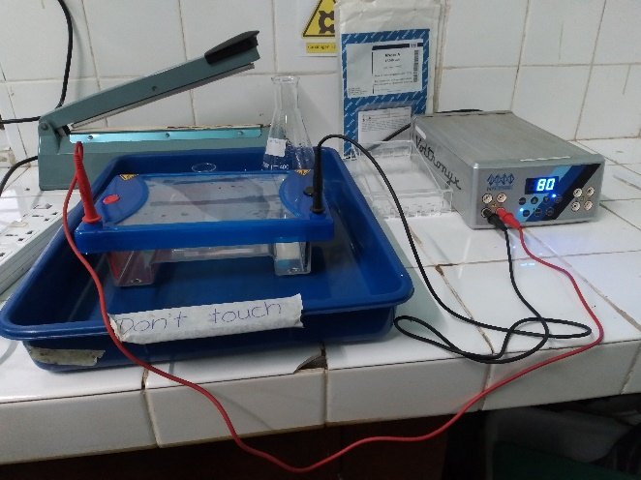
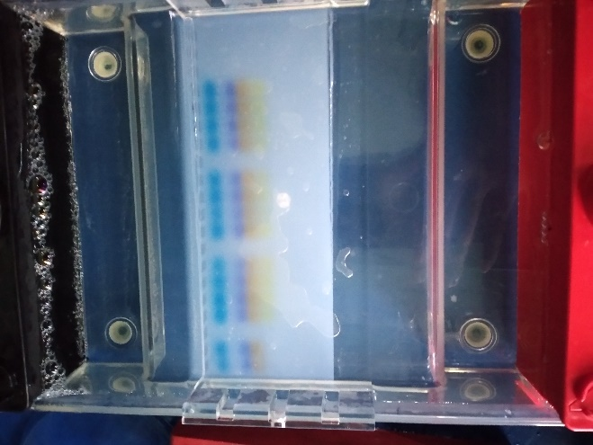
Material and Methods
DNA Quantification
Proven by using 0.8% Agarose Gel with 80 voltage for one hour
1% Agarose Gel also used with 80 voltage for one hour
2µl of 5X Loading dye and 5µl of DNA
Agarose Gel Electrophoresis Apparatus
Agarose Gel
Gel picture under the UV light
Notes:
For the Quantification process I used ..

Slide 13
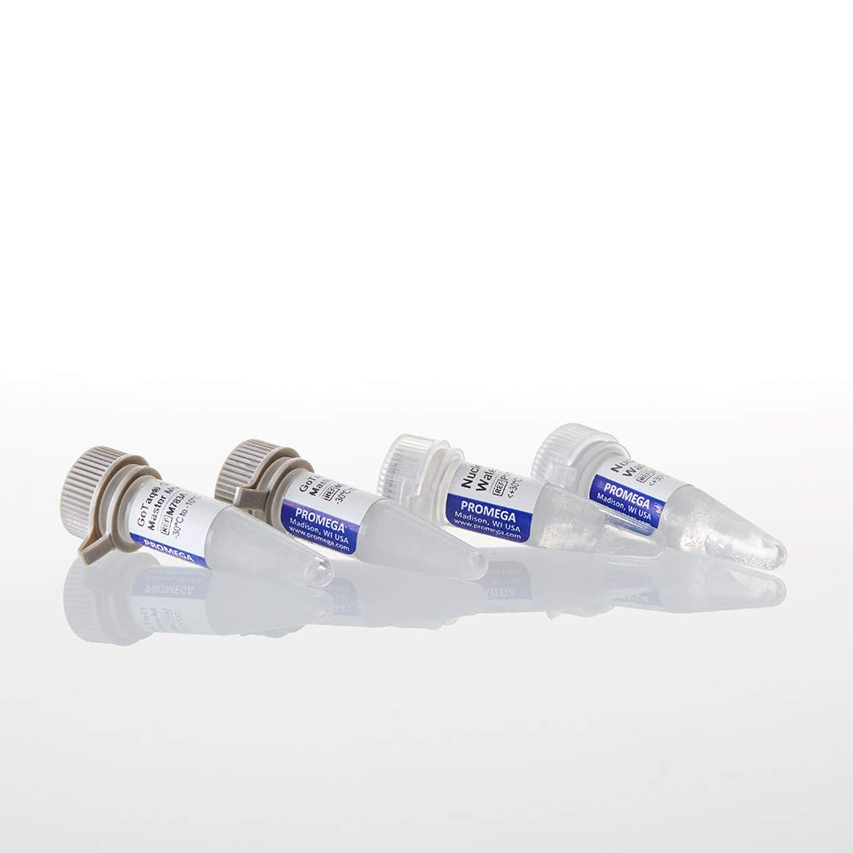
Material and Methods
Mixture | Volume
Go Taq Master Mix 2X | 12.5µl
Forward Primer | 1µl
Reverse Primer | 1µl
DNA template | 5µl
Nuclease Free Water | 5.5µl
 | 25µl
MgCl₂
Buffer
dNTPs
Taq Polymerase Enzyme
Promega MM
Notes:
These are the ingredients that I used for the PCR amplification process

Slide 14
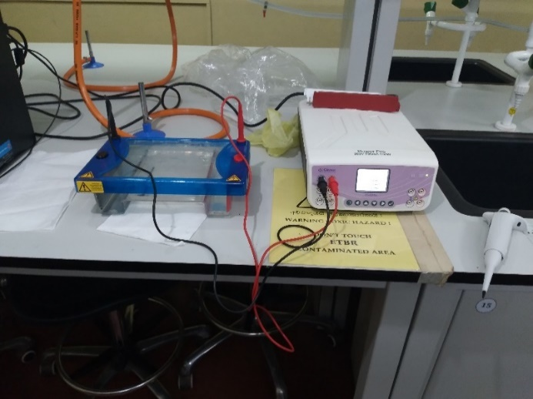
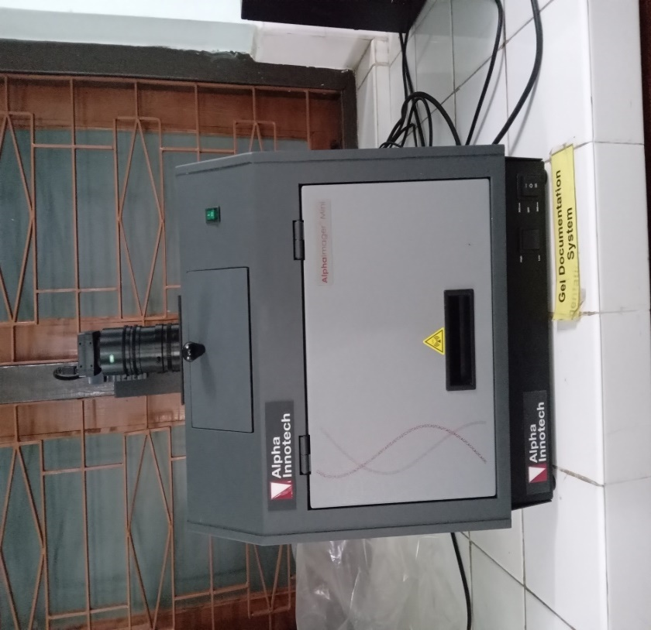
Material and Methods
PCR products were run through 2% Agarose Gel with 80 V for 1 hour and 30 minutes
Gel image was visualized using Gel Documentation Unit under the Ultra Violet light
Gel Documentation Unit
Gel Electrophoresis Apparatus
Notes:
Finally PCR products were run… & visualized gel image under UV light

Slide 15
Material and Methods
Data analysis
Parametric parameters - Analysis of Variance (ANOVA) with general linear model (GLM) procedure of SAS, followed by Least Significance Difference (LSD) test.
Non parametric parameters – Kruskal-Wallis test
Graphical illustrations were done using Microsoft Excel 2010
Notes:
As for the data analysis part I used…. To analys parametric parameters
& non parametric

Slide 16
Results and Discussion
1. Morphological & Physiological Study (Lab Experiment)
Plant Survival Percentage
Variation of plant survival with dosage of gamma irradiation
Notes:
Now let’s move to the results and the discussion part
I analysed the observations that I obtained from the lab and net house separately
First let’s see the results of the lab experiment
As you can see all the plants which were at the culture room show 100% survival %

Slide 17
Results and Discussion
Number of Leaves Number of Shoots
P > 0.05
No Significant
Variation of average number of leaves with dosage of gamma irradiation
Variation of average number of shoots with dosage of gamma irradiation
Notes:
According to these graphs, both number of leaves & shoots don’t show significant difference. Under in vitro, it has reform conditions. In order to has plat vise differentiation it need to carry out field trials. Before undergo field trials, it need to follow up the hardening process before the introduction of plants to the field & in addition to that it’s unable to observe the variations that occur I tissues under in vitro conditions.

Slide 18
Results and Discussion
Net House Experiment
Plant Survival Percentage
P < 0.05
Significant
Variation of plant survival with dosage of gamma irradiation
Notes:
Let’s move towards the results of the net house experiment
Plant survival show significant difference. As you can see lower survival % can be seen in all the other treatment dosages when compared to the control.

Slide 19
Results and Discussion
Number of Leaves
P < 0.05
Significant
a
ab
ab
ab
c
d
Variation of average number of leaves with dosage of gamma irradiation
Notes:
When it comes to number of leaves it also show significant difference. 40,50 and 80 grays don’t show significant difference among each other while control, 60, and 70 show difference

Slide 20
Results and Discussion
Number of Shoots
P > 0.05
No Significant
a
a
a
a
a
a
Variation of average number of shoots with dosage of gamma irradiation
Notes:
As you can see number of shoots don’t show significant difference among each other treatment as well as compared with the control.

Slide 21
Results and Discussion
P < 0.05
Leaf Area
Significant
Variation of average leaf area with dosage of gamma irradiation
Notes:
According to this graph leaf area show significant difference. All the treatment dosages show difference when compared to the control but no difference among each other.

Slide 22
Results and Discussion
P > 0.05
MDA Content
No Significant
Raw data of MDA content
a
Variation of average MDA content with dosage of gamma irradiation
Notes:
When it comes to the MDA content it don’t show significant difference, but according to the raw data table we can clearly see a considerable increase when compared to control.
According to the statistical information, it need minimum 3 replicates in order to carry out statistical analysis.
Otherwise it will show no significant difference even though a significant difference is present.

Slide 23
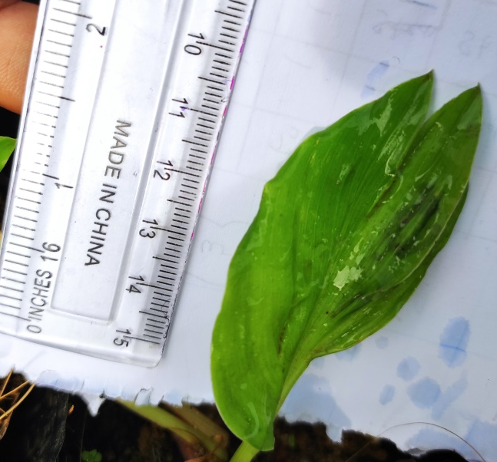
Results and Discussion
Other Morphological Observations
Lobes
Chimera
T4 – 70Gy
T2 – 50Gy
Notes:
In addition to that lobes & chimera were observed 70 &50 grays respectively.

Slide 24
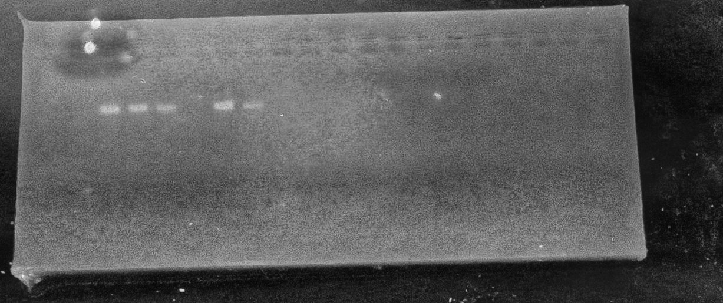
Results and Discussion
Results for the Molecular Study
 | Dosages of Treatments
T0 | 0 Gy (Control)
T1 | 40 Gy
T2 | 50 Gy
T3 | 60 Gy
T4 | 70 Gy
T5 | 80 Gy
GF0099462
GF0099464
T0 T1 T2 T3 T4 T5 T0 T1 T2 T3 T4 T5
1 2 3 4 5 6 7 8 9 10 11 12 13 14
 | Primers
1 | GF0099462
2 | GF0099464
Notes:
These are the two SSR primers that I used. According to the gel profile, amplification was observed only for one primer.
No difference can be seen between irradiation & un irradiated samples.

Slide 25
Conclusion
Plant survival, number of leaves, leaf area were significantly affected with the increasing doses of gamma ray
MDA content was increased but not significantly affected by increasing doses of gamma rays
50Gy is the minimum effective dosage of gamma radiation that need to initiate a effect among the selected dosages
Prominent molecular variation did not observed among control & mutated plants
Notes:
These are the things that I concluded after the research

Slide 26
Suggestions
A Significant difference for MDA content would be able to observe by using three or more replicates
Further research needed to be carried out with a bulk population to determine the effective & lethal dosages of mutagenesis
To detect any molecular variation ISSR or RAPD markers are ideal to use in mutation breeding
In mutation breeding, it is ideal to conduct morphological observations up to at least M1V4 generation to detect molecular variation analysis
Notes:
Here are my suggestions..
ISSR & RAPD markers are ideal for mutation breeding rather than using SSR markers
When it comes to mutation breeding it need to obtqain morphological obs up to at least M1V4 gen in order to detect any molecular variation

Slide 27
References
Ravindran, P. N., Babu, K. N., & Shiva, K. N. (2007). In turmeric—The genus Curcuma. In P. N. Ravindran, K. N. Babu, & K. N. Shiva (Eds.), Botany and crop improvement of turmeric (pp. 15–70). Boca Raton: CRC Press.
Balachandran, S.M., Bhat, S.R. and Chandel, K.P.S., 1990. In vitro clonal multiplication of turmeric (Curcuma spp.) and ginger (Zingiber officinale Rosc.). Plant cell reports, 8(9), pp.521-524.
Sasikumar, B., 2005. Genetic resources of Curcuma: diversity, characterization and utilization. Plant Genetic Resources, 3(2), pp.230-251.
Chusreeaeom, K. and Khamsuk, O., 2019, August. Effects of gamma irradiation on lipid peroxidation, survival and growth of turmeric in vitro culture. In Journal of Physics: Conference Series (Vol. 1285, No. 1, p. 012003). IOP Publishing.
Joseph, R., Joseph, T. and Jose, J., 1999. Karyomorphological studies in the genus Curcuma Linn. Cytologia, 64(3), pp.313-317.
Notes:
These are some of references that I used during the study

Slide 28
Thank You
Notes:
Thank you every one for you attention

