Slide 1
Mortality and Phytotoxic Effect of Selected Biopesticides on Plesispa Beetle (Plesispa reichei) Under Laboratory Conditions
WHYS Fernando^{1*}, NS Aratchige², WMAUKM Wijesekara¹, DH Dilrukshika² and DPM Silva²
¹Department of Export Agriculture, Faculty of Agricultural Sciences, Sabaragamuwa University of Sri Lanka, Belihuloya, Sri Lanka
²Crop Protection Division, Coconut Research Institute, Lunuwila, Sri Lanka

Slide 2
Content for the presentation
Introduction
Objectives
Material and Methods
Results and Discussion
Conclusion and Recommendations
References

Slide 3
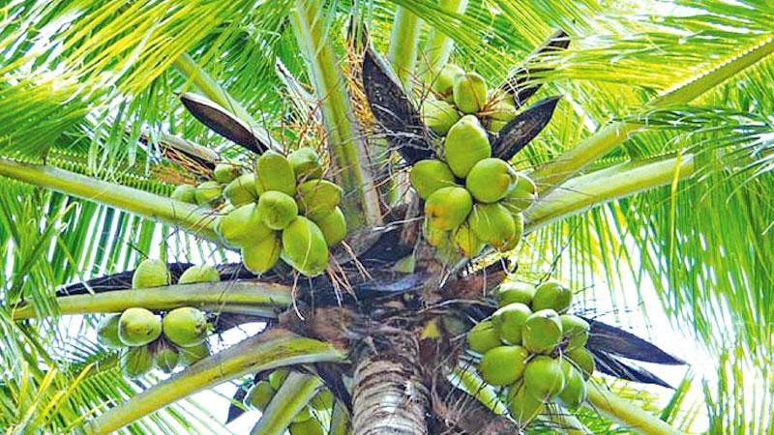
Introduction
Problem
Mortality of Coconut Seedlings
Reasons
Cocos nucifera (L)
Climatic Factors
Pest and Diseases
Soil Factors
(Nainanayake et al, 2002)

Slide 6
Integrated pest management program
The recommendation is only on chemical control
As another control strategy
(Anon, 2006)

Slide 7
Objectives
General Objective
Identify the effect of selected biopesticides to control Plesispa beetle (Plesispa reichei) under laboratory conditions
Specific Objectives
Identify the pesticide effect on mortality of Plesispa beetle
Identify the median lethal (LC50) concentration
Comparison of the phytotoxic effect on any aspect of the growth of coconut palm

Slide 8
Material and Methods
Experimental Site
Crop Protection Division, Coconut Research Institute, Lunuwila, Sri Lanka
Experiment Design
Completely Randomized Design (CRD)

Slide 9
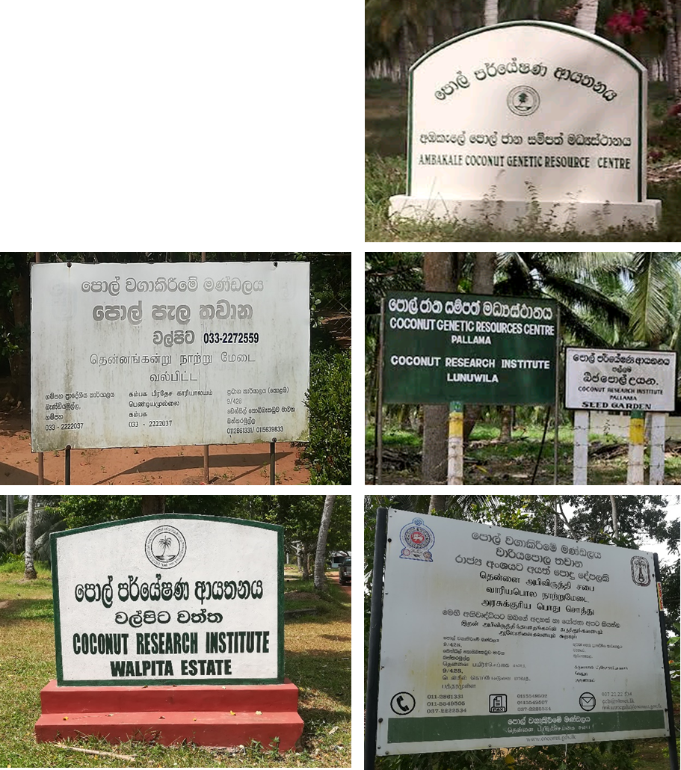
Plesispa reichei Field Collection
Coconut Research Institute Seed Garden- Pallama
Coconut Research Institute Seed Garden- Ambakale
Coconut Research Institute- Walpita Estate
Coconut Cultivation Board Seedling Nursery- Walpita
Coconut Cultivation Board Seedling Nursery- Wariyapola

Slide 10
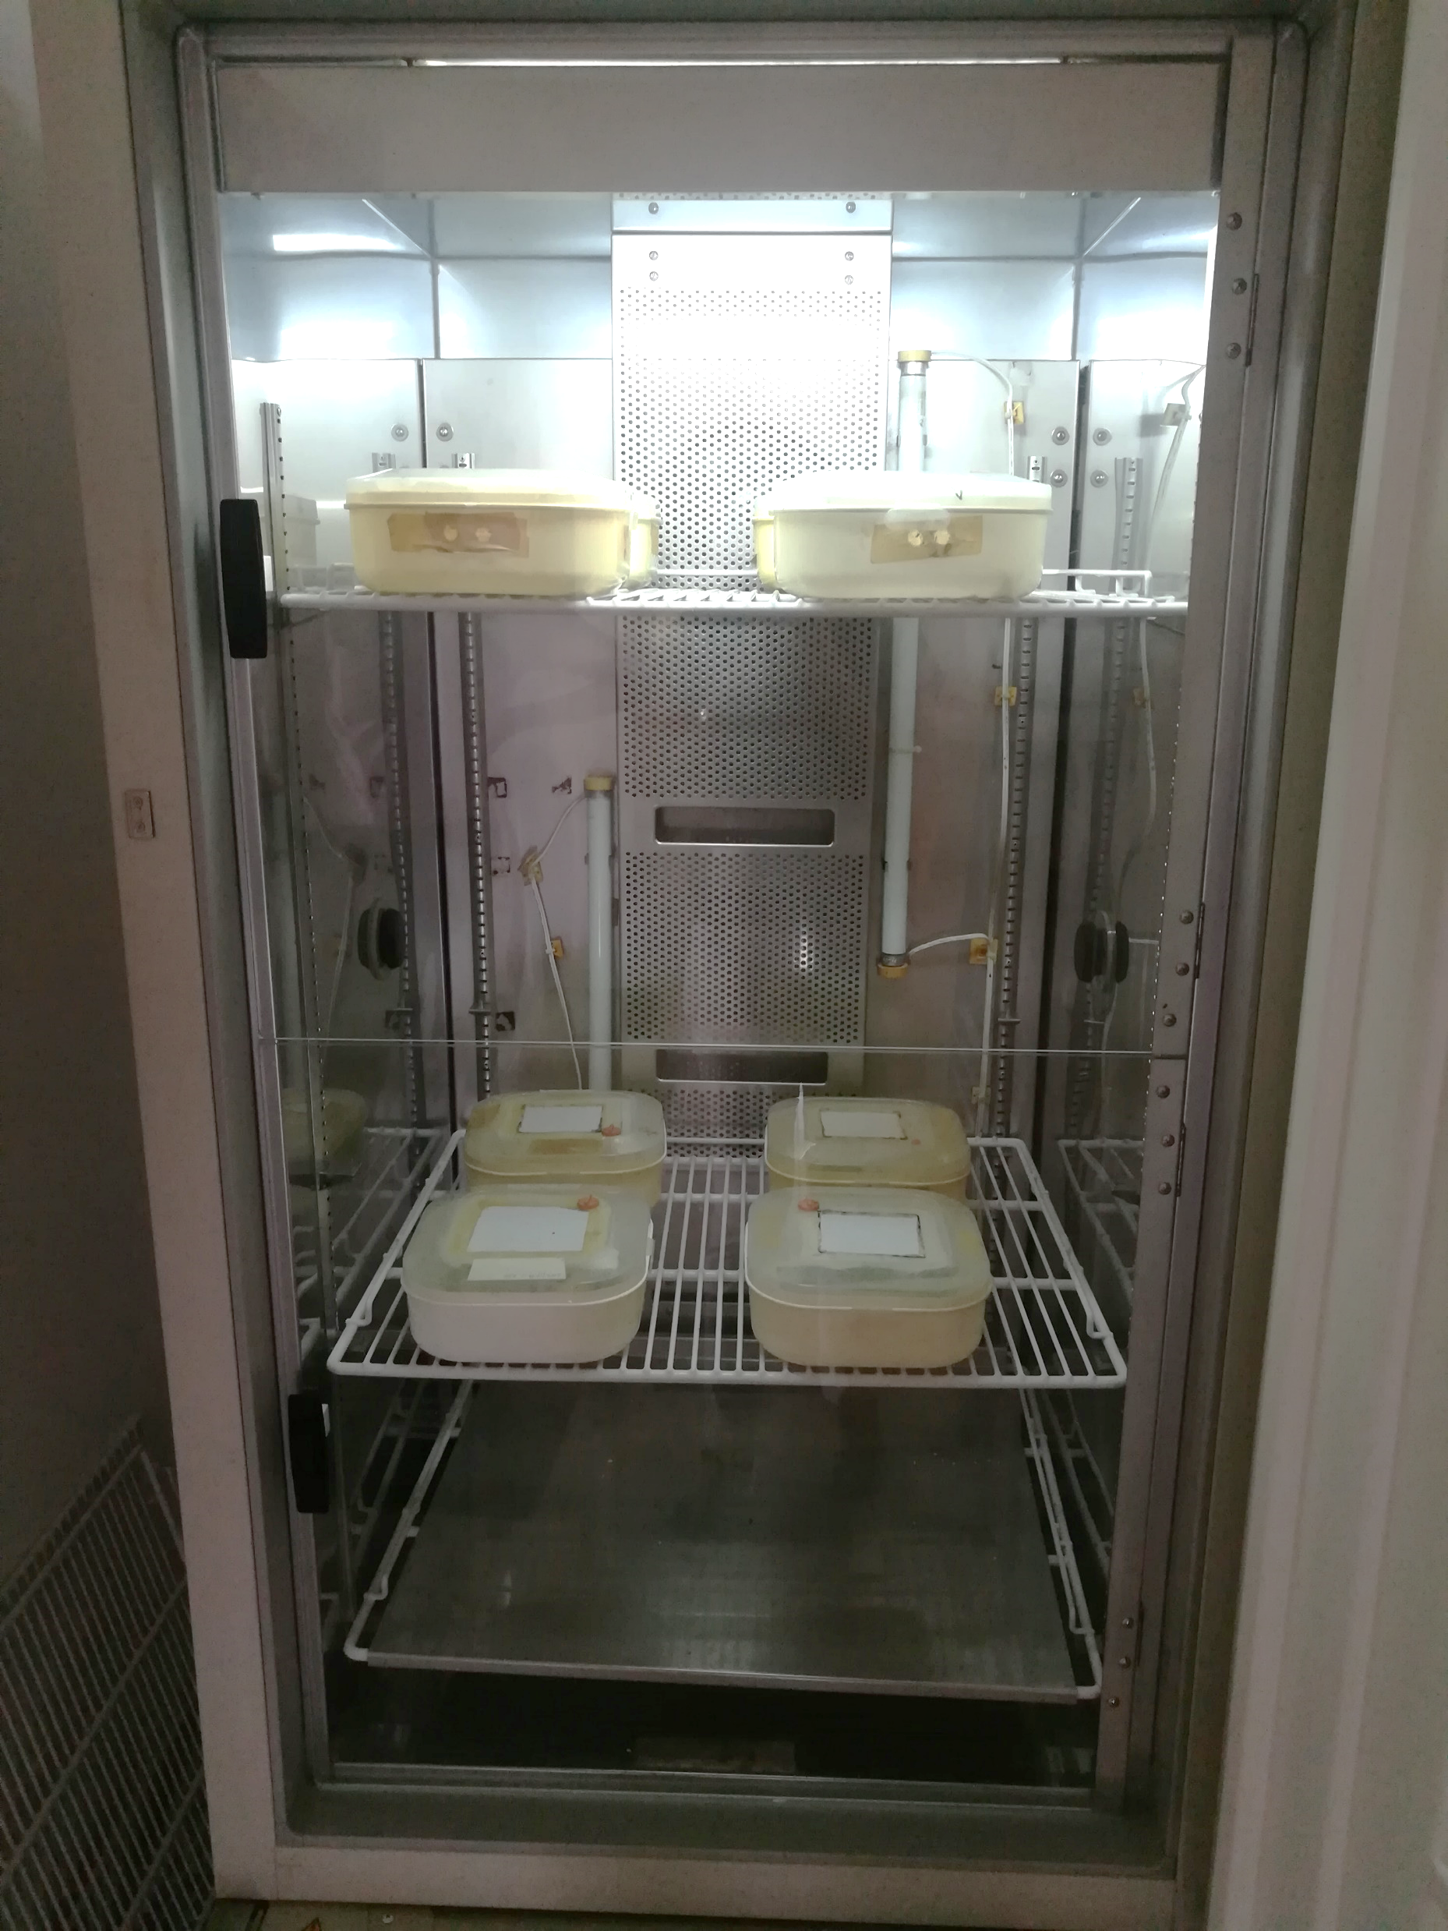
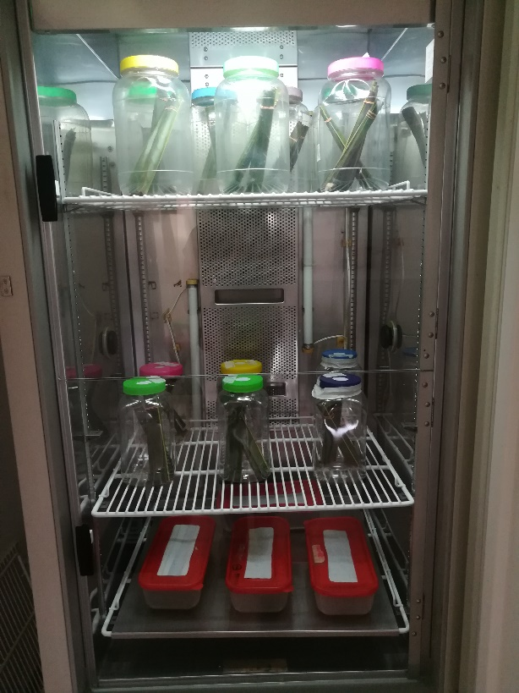
Rearing Insect
Incubator conditions:
12:12 Photoperiod
75 % Relative Humidity
22°C Temperature for larvae and pupae
28°C Temperature for adult and eggs
Larvae and pupae boxes
Adult and egg boxes
(Rajapaksha et al., 2016)

Slide 11
Treatments for adult and larvae
T1
T1: Biopesticide 1 (BioSolex)
T2: Biopesticide 2 (Flipper)
T3: Biopesticide 3 (Agro Safe Liquid)
C1: Possitive Control (Carbosulfan 20 %) (4 ml/l)
C2: Vehicle control (Distilled Water)
a, b, etc. : Concentration
T1
T2
T2
T3
C1
C2
a
a
k
k
r
b
b
l
l
s
c
c
m
m
t
n
d
n
d
u
e
e
o
o
v
Etc.
Etc.
Etc.
Etc.
Etc.
Three replicates for each concentration
(Rajapaksha et al., 2016)

Slide 12
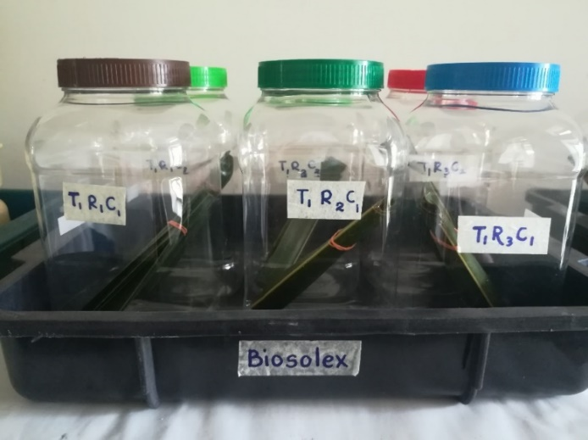
Procedure - adult
Mature coconut leaves cut into pieces
Introduced the adult beetle into the bottle
Bundles placed inside the bottles
Make into bundle of 10 samples for each

Slide 13
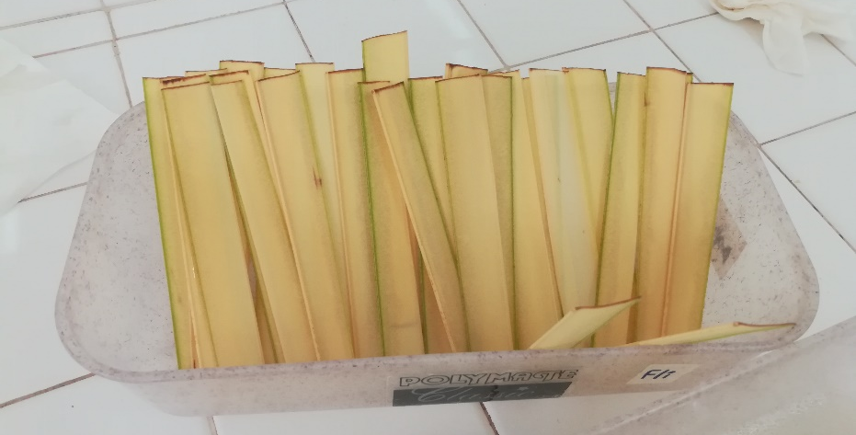
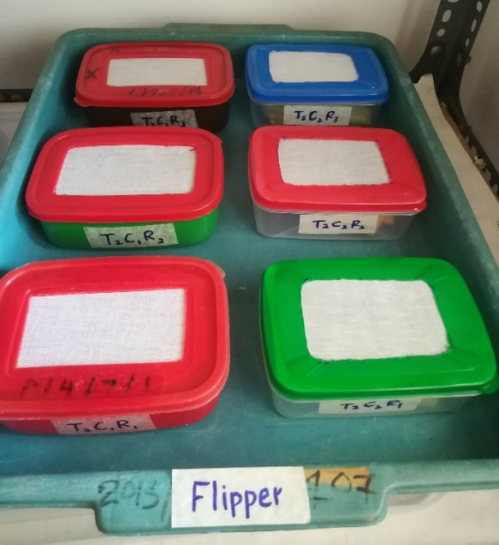
Procedure - larvae
Immature coconut leaves cut into pieces
Dipped in the prepared concentration
Introduced the adult beetle into the bottle
Bundles placed inside the bottles
Make into bundle of 10 samples for each

Slide 14
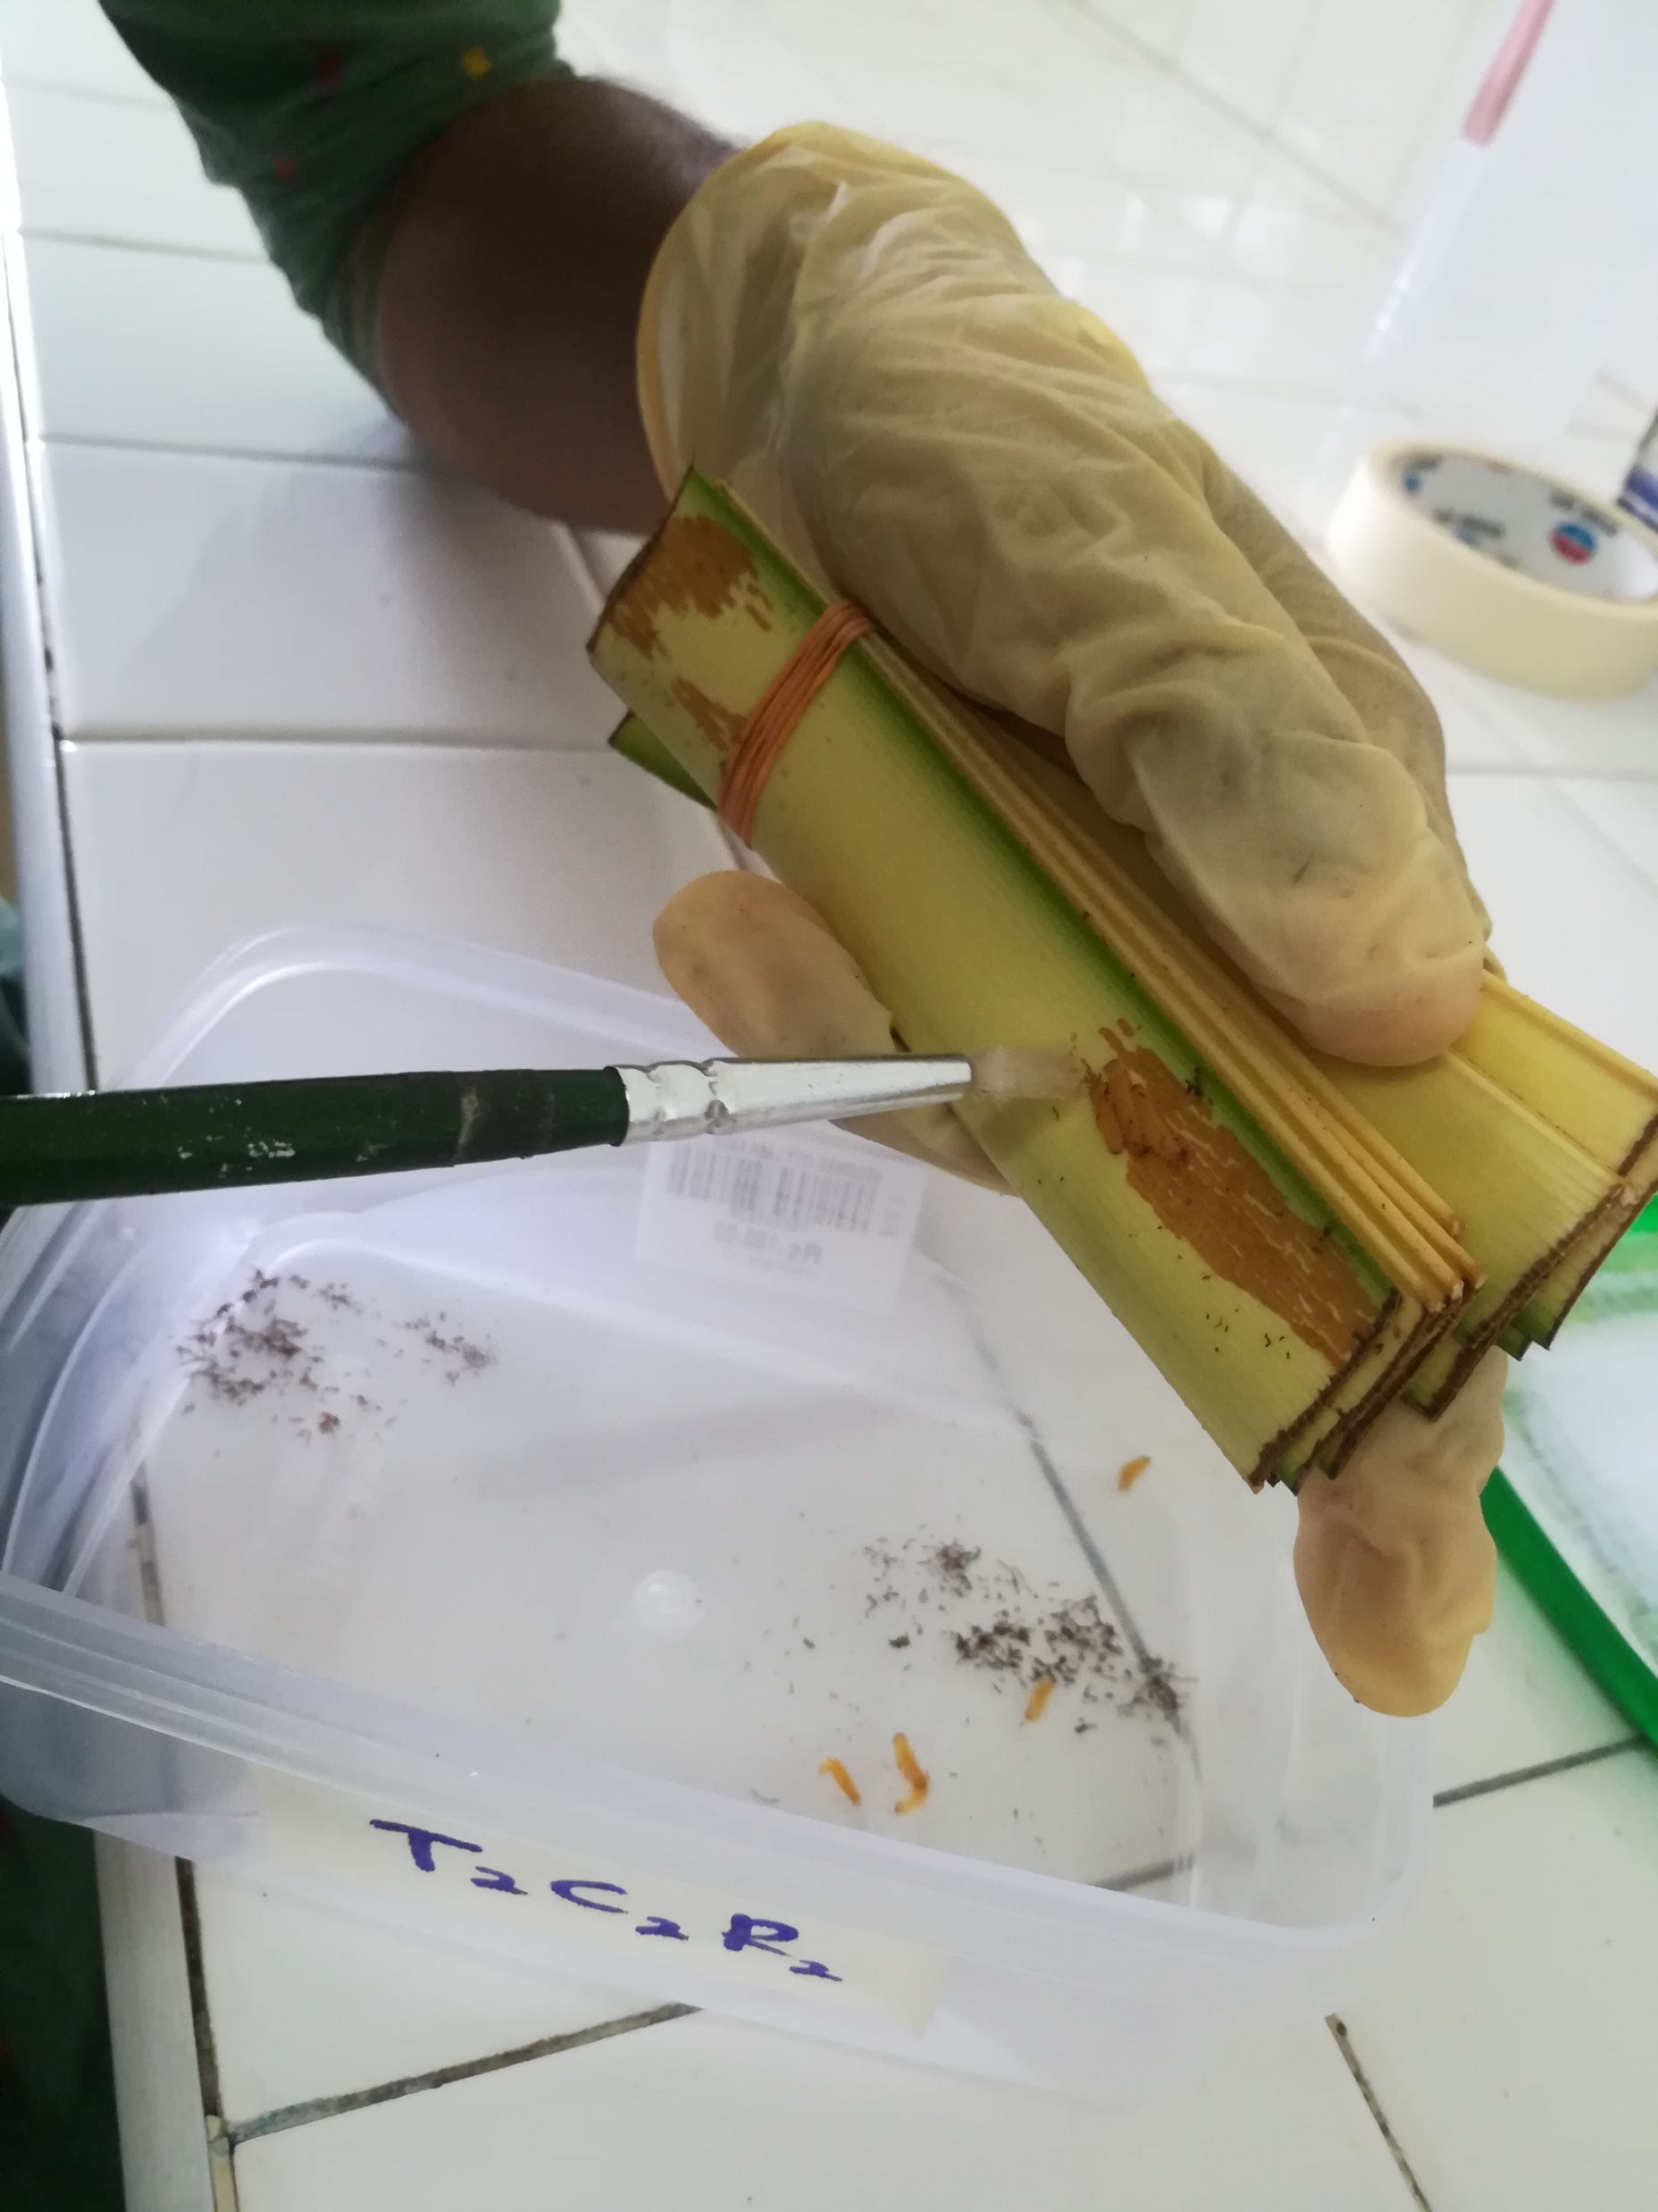
Data Collection- Mortality
Percentage mortality were recorded 24, 48, and 72 hours after the introduction.
(Percentage of mortality in treatment)
(Percentage of mortality in control)
-
Corrected mortality
x
100%
=
100%
-
(Percentage of mortality in control)

Slide 15
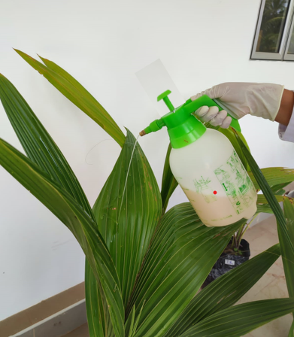
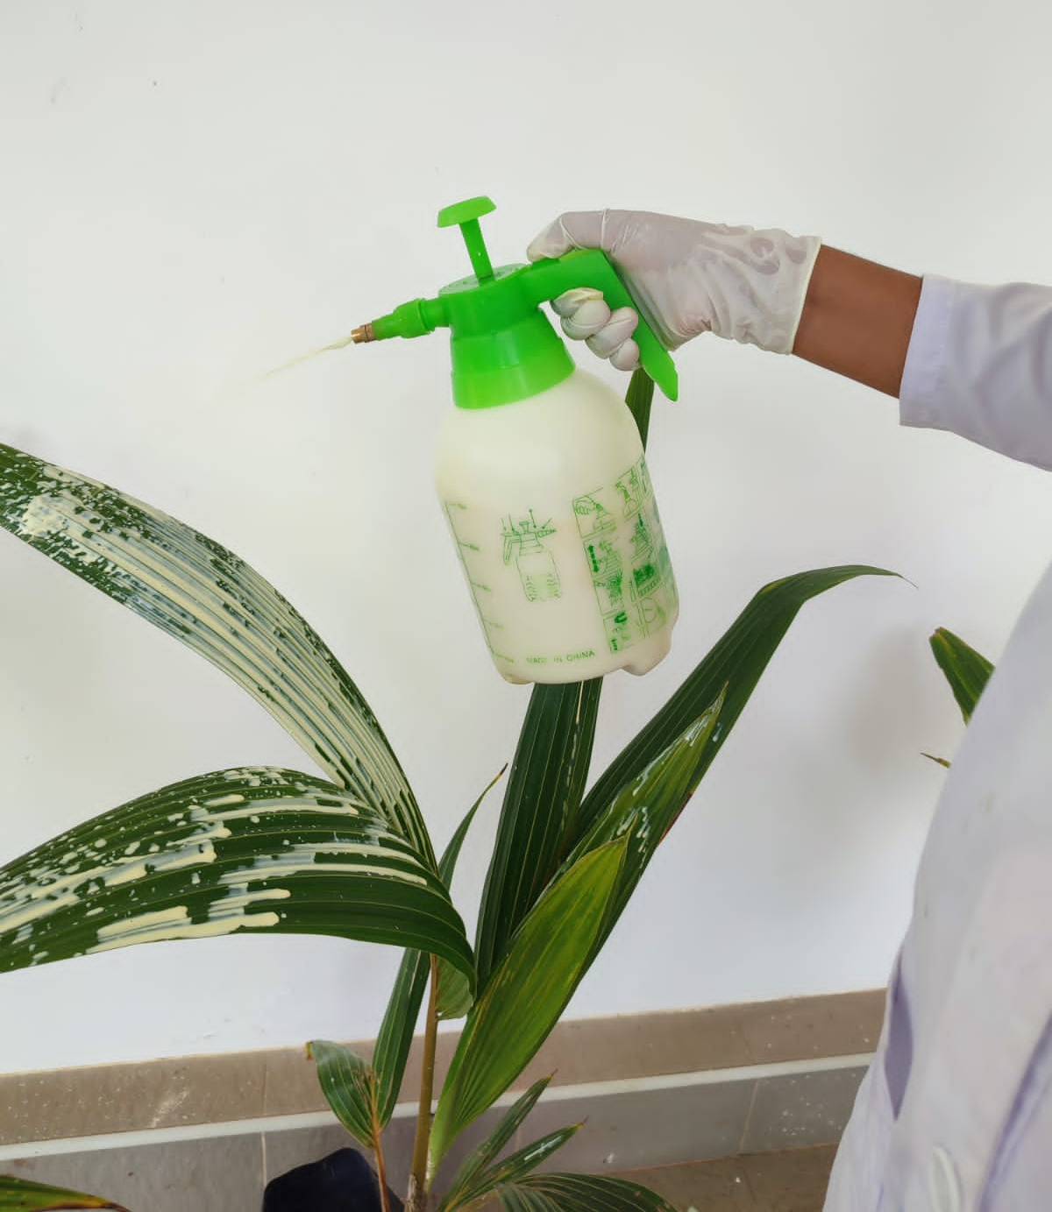
Observing Phytotoxic Effect
BioSolex
Flipper
Agro Safe Liquid (ASL)

Slide 16
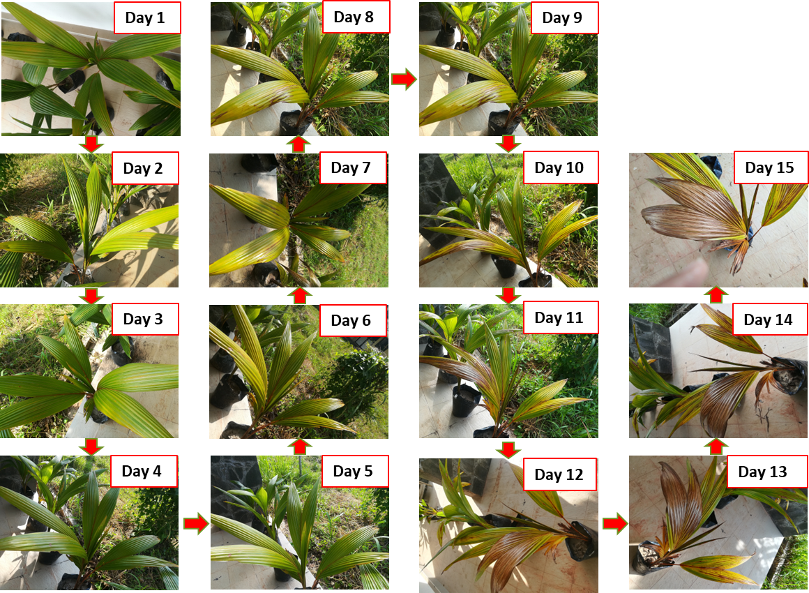
Data Collection- Phytotoxic Effect
Affected leaf area out of the whole leaf were taken from analysing the photographs by ImageJ software

Slide 17
Statistical Analysis
The data on mortality and the data on phytotoxic effect were statistically analysed
by comparison of treatment mean with control means by one-way ANOVA Dunnet’s multiple mean comparison test by using SAS OnDemand for Academics version 9.4.
The LC50 and LC90 values were interpolated
from non-linear regression curve fit model by using GraphPad Prism version 9.5.1.
Graphical data illustration was taken from Microsoft Excel 2019

Slide 18
Results and Discussion
ns p > 0.05
*** p < 0.001
Mortality Rate
Concentration Comparison | 24hr | 48hr | 72hr
0.1 vs 0 | ns | *** | ***
0.2 vs 0 | ns | *** | ***
0.25 vs 0 | ns | *** | ***
0.3 vs 0 | ns | *** | ***
0.4 vs 0 | ns | *** | ***
0.5 vs 0 | *** | *** | ***
1 vs 0 | *** | *** | ***
2 vs 0 | *** | *** | ***
3 vs 0 | *** | *** | ***
4 vs 0 | *** | *** | ***
5 vs 0 | *** | *** | ***
7 vs 0 | *** | *** | ***
10 vs 0 | *** | *** | ***

Slide 19
ns p > 0.05
*** p < 0.001
Concentration Comparison | 24hr | 48hr | 72hr
0.1 vs 0 | *** | *** | ***
0.2 vs 0 | *** | *** | ***
0.25 vs 0 | ns | *** | ***
0.3 vs 0 | ns | *** | ***
0.35 vs 0 | ns | *** | ***
0.4 vs 0 | ns | *** | ***
0.5 vs 0 | ns | *** | ***
1 vs 0 | *** | *** | ***
1.5 vs 0 | ns | *** | ***
2 vs 0 | ns | *** | ***
5 vs 0 | *** | *** | ***
10 vs 0 | *** | *** | ***

Slide 20
ns p > 0.05
*** p < 0.001
Concentration Comparison | 24hr | 48hr | 72hr
2 vs 0 | ns | ns | ns
3 vs 0 | ns | ns | ns
4 vs 0 | ns | ns | ns
5 vs 0 | ns | ns | ns
7 vs 0 | ns | ns | ns
10 vs 0 | ns | ns | ns
15 vs 0 | ns | ns | ns
20 vs 0 | ns | ns | ***
25 vs 0 | *** | *** | ***
30 vs 0 | *** | *** | ***
35 vs 0 | *** | *** | ***
40 vs 0 | *** | *** | ***

Slide 21
ns p > 0.05
*** p < 0.001
Concentration Comparison | 24hr | 48hr | 72hr
1 vs 0 | ns | ns | ns
3 vs 0 | ns | ns | ***
5 vs 0 | ns | ns | ns
7 vs 0 | ns | *** | ***
10 vs 0 | ns | ns | ns
15 vs 0 | ns | *** | ***
20 vs 0 | ns | *** | ***
25 vs 0 | *** | *** | ***
30 vs 0 | *** | *** | ***

Slide 22
ns p > 0.05
*** p < 0.001
Concentration Comparison | 24hr | 48hr | 72hr
2 vs 0 | ns | ns | ns
4 vs 0 | ns | ns | ns
6 vs 0 | ns | ns | ns
8 vs 0 | ns | ns | ns
10 vs 0 | ns | ns | ns
15 vs 0 | ns | ns | ns
20 vs 0 | ns | ns | ns
25 vs 0 | ns | ns | ns
30 vs 0 | ns | ns | ns
35 vs 0 | ns | ns | ***
45 vs 0 | *** | *** | ***
50 vs 0 | *** | *** | ***
60 vs 0 | *** | *** | ***
70 vs 0 | *** | *** | ***
90 vs 0 | *** | *** | ***

Slide 23
ns p > 0.05
*** p < 0.001
Concentration Comparison | 24hr | 48hr | 72hr
2 vs 0 | ns | ns | ns
4 vs 0 | ns | ns | ns
6 vs 0 | ns | ns | ns
8 vs 0 | ns | ns | ***
10 vs 0 | ns | ns | ***
15 vs 0 | ns | ns | ns
20 vs 0 | ns | ns | ns
25 vs 0 | ns | ns | ns
30 vs 0 | ns | ns | ***
35 vs 0 | ns | ns | ns
45 vs 0 | *** | *** | ***
50 vs 0 | ns | *** | ***
60 vs 0 | ns | *** | ***
70 vs 0 | *** | *** | ***
90 vs 0 | *** | *** | ***

Slide 24
Median Lethal Concertation
Biopesticide | LC₅₀ (ppm) |  |  | LC₉₀ (ppm)
 | 24 h | 48 h | 72 h | 24 h | 48 h | 72 h
BioSolex for Adult | 1.071 | 0.1425 | ND | 7.25 | 0.655 | ND
BioSolex for Larvae | 0.7816 | 0.02892 | ND | 22.85 | 0.5 | ND
ND- Not Detected

Slide 25
Biopesticide | LC₅₀ (ppm) |  |  | LC₉₀ (ppm)
 | 24 h | 48 h | 72 h | 24 h | 48 h | 72 h
Flipper Adult | 22.24 | 19.42 | 18.46 | 27.6 | 18.84 | 22.32
Flipper Larvae | 22.36 | 15.6 | 13.82 | 29.1 | 30.83 | 41.8

Slide 26
Biopesticide | LC₅₀ (ppm) |  |  | LC₉₀ (ppm)
 | 24 h | 48 h | 72 h | 24 h | 48 h | 72 h
ASL Adult | 48.54 | 39.59 | 34.9 | 59.52 | 59.32 | 41.87
ASL Larvae | 70.96 | 36.71 | 18.57 | 188.44 | 66.51 | 111.49

Slide 27
Phytotoxic Effect
ns P > 0.05
*** P < 0.001
Treatment Comparison
T1R1 vs C | ns
T1R2 vs C | ns
T1R3 vs C | ns
T1R4 vs C | ns
T1R5 vs C | ns
T2R1 vs C | ns
T2R2 vs C | ns
T2R3 vs C | ns
T2R4 vs C | ***
T2R5 vs C | ***
T3R1 vs C | ns
T3R2 vs C | ns
T3R3 vs C | ns
T3R4 vs C | ns
T3R5 vs C | ns
T1- BioSolex
T2- Flipper
T3- Agro Safe Liquid (ASL)
C- Control
27

Slide 28
Conclusion and Recommendations
BioSolex offered high mortality at low concentrations without any phytotoxic effect.
Therefore, BioSolex can be suggested as biopesticide that effective on Plesispa beetle compared to Flipper and ASL.

Slide 29
Extend the study
Before recommending to the growers, field trials should be conducted in coconut seedling nurseries to find whether the pest can be controlled under normal environmental conditions
A cost-benefit analysis should conduct before recommending
Since BioSolex contains 95% of other ingredients, a Gas chromatography-mass spectrometry (GC-MS) analysis study should be conducted to identify the substances within the BioSolex test samples

Slide 30
References
Anon (2006) Plesispa Beetle. Available at: https://cri.gov.lk/wp-content/uploads/2021/10/b15.pdf (Accessed: 25 August 2022).
Nainanayake, N. P. A. D., Bandara, D. C. and Ranasinghe, C. S. (2002) ‘The Impact of Soil type, Soil Compaction and Water Stress on above and below ground components of Coconut (Cocos nucifera L.) Seedlings’, COCOS, 14, pp. 53–68.
Rajapaksha, R.P.K.M., Suwandharathne, N.I., Amarasinghe, K.G.A.P.K. and Aratchige, N.S., 2016. Effect of selected botanical extracts for the control of Plesispa beetle (Plesispa reichei Coleoptera: Chrysomelidae) in laboratory bioassays.

Slide 31
Thank You

Slide 32
BioSolex
An eco-safe wood guard termite prevention and treatment
Agrosafe Liquid
A herbal pest repellent concentrate for plants
Flipper
A carboxylic acid potassium salt
A Mahagedra Herbal Product
Manufactured by EcoHealth Product Pvt Ltd
Manufactured by Bayer SAS
Neemsal (2.5%), Organic acids (0.5%), Camper (2%), and Other ingredients (95%).
Fatty acids, C14-20, Potassium salts 479
liquid extracts of Neem, Ginger, Tobacco, and Garlic

Slide 33
Concentrations tested
For Adults
BioSOLEX Concentrations (ppm) | Flipper Concentrations (ppm) | Agro Safe Liquid Concentrations (ppm)
0.1𝗑10⁴ | 2𝗑10⁴ | 2𝗑10⁴
0.2𝗑10⁴ | 3𝗑10⁴ | 4𝗑10⁴
0.25𝗑10⁴ | 4𝗑10⁴ | 6𝗑10⁴
0.3𝗑10⁴ | 5𝗑10⁴ | 8𝗑10⁴
0.4𝗑10⁴ | 7𝗑10⁴ | 10𝗑10⁴
0.5𝗑10⁴ | 10𝗑10⁴ | 15𝗑10⁴
1𝗑10⁴ | 15𝗑10⁴ | 20𝗑10⁴
2𝗑10⁴ | 20𝗑10⁴ | 25𝗑10⁴
3𝗑10⁴ | 25𝗑10⁴ | 30𝗑10⁴
4𝗑10⁴ | 30𝗑10⁴ | 35𝗑10⁴
5𝗑10⁴ | 35𝗑10⁴ | 45𝗑10⁴
7𝗑10⁴ | 40𝗑10⁴ | 50𝗑10⁴
10𝗑10⁴ |  | 60𝗑10⁴
 |  | 70𝗑10⁴
 |  | 90𝗑10⁴

Slide 34
For Larvae
BioSOLEX Concentrations (ppm) | Flipper Concentrations (ppm) | Agro Safe Liquid Concentrations (ppm)
0.1𝗑10⁴ | 1𝗑10⁴ | 2𝗑10⁴
0.2𝗑10⁴ | 3𝗑10⁴ | 4𝗑10⁴
0.25𝗑10⁴ | 5𝗑10⁴ | 6𝗑10⁴
0.3𝗑10⁴ | 7𝗑10⁴ | 8𝗑10⁴
0.35𝗑10⁴ | 10𝗑10⁴ | 10𝗑10⁴
0.4𝗑10⁴ | 15𝗑10⁴ | 15𝗑10⁴
0.5𝗑10⁴ | 20𝗑10⁴ | 20𝗑10⁴
1𝗑10⁴ | 25𝗑10⁴ | 25𝗑10⁴
1.5𝗑10⁴ | 30𝗑10⁴ | 30𝗑10⁴
2𝗑10⁴ |  | 35𝗑10⁴
5𝗑10⁴ |  | 45𝗑10⁴
10𝗑10⁴ |  | 50𝗑10⁴
 |  | 60𝗑10⁴
 |  | 70𝗑10⁴
 |  | 90𝗑10⁴

