Slide 1
Effect of Essential Oils on Biofilms formed by Salmonella spp. Isolated from Broiler Chicken Meat
R M M S Jayathilaka^{1*}, S U Pathiranage¹, G K N G Thilakarathna¹, J L C S Perera¹, D D Wickramanayake¹ , D N N Madushanka¹, J K Dissanayake² ,T S P Jayaweera¹ and H A D Ruwandeepika¹
¹Department of Livestock Production, Faculty of Agricultural Sciences, Sabaragamuwa University of Sri Lanka, ²CIC Poultry Farm, Horakandawila, Badalgama, Sri Lanka

Slide 2
Content for the presentation
Introduction
Objectives
Material and Methods
Results and Discussion
Conclusion and Recommendations
References

Slide 3
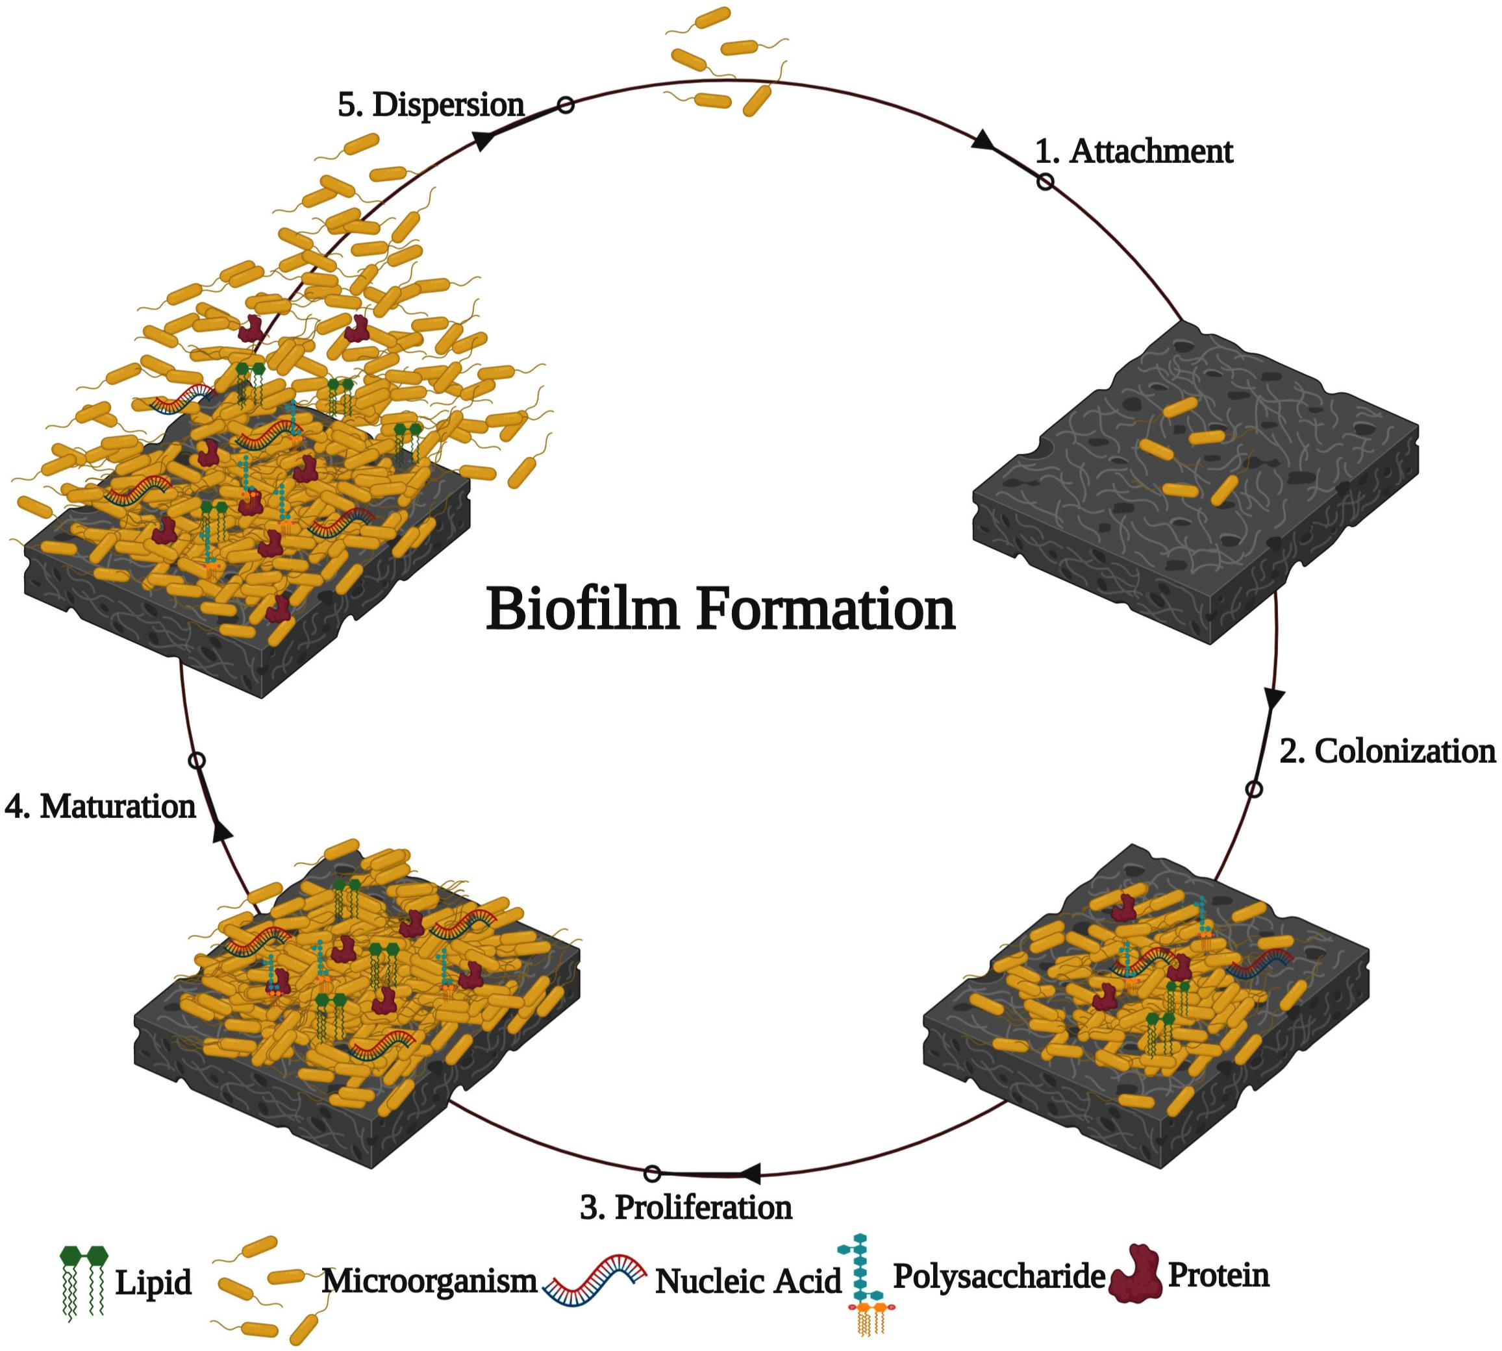
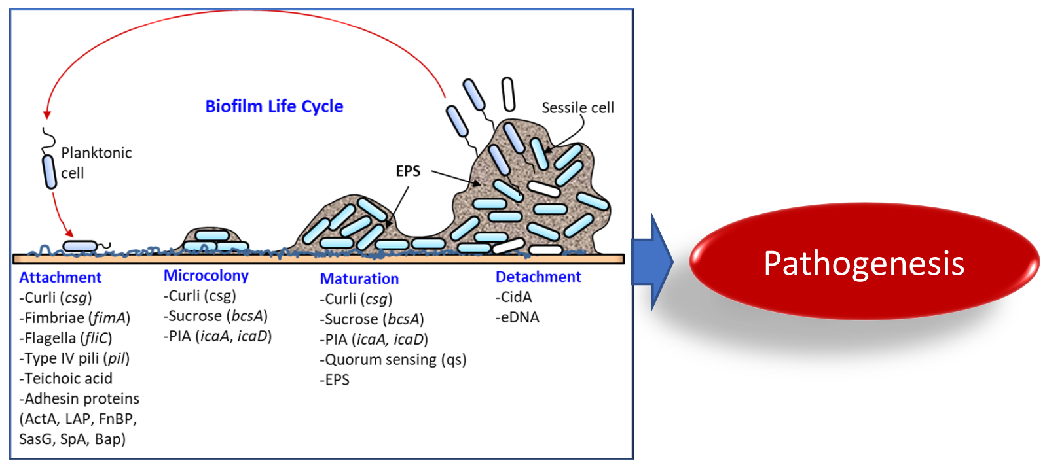
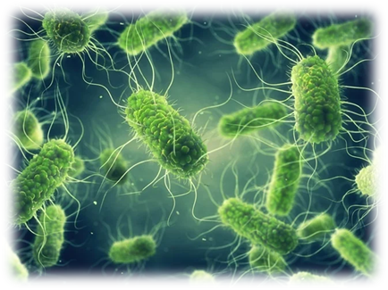
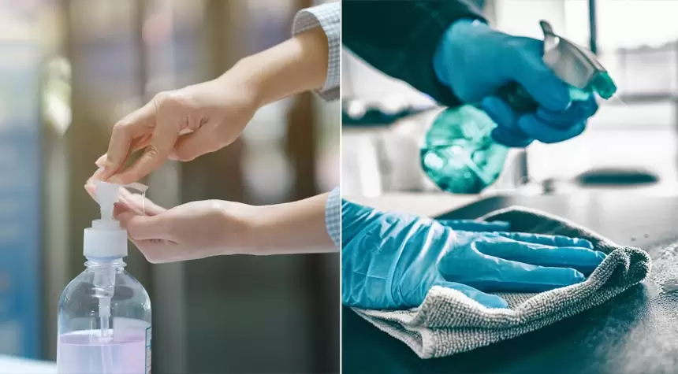
Introduction
Salmonella spp.

Slide 4
A growing zoonotic bacterial concern in the poultry industry, salmonella is a significant issue for worldwide public health.
Typhoidal and paratyphoidal Salmonella lead to typhoidal fever.
Non typhoidal Salmonella spp lead to salmonellosis ranging from mild to severe gastro enteritis.
Nearly 100 million Salmonellosis cases have been reported annually worldwide, resulting 160,000 deaths every year.

Slide 5
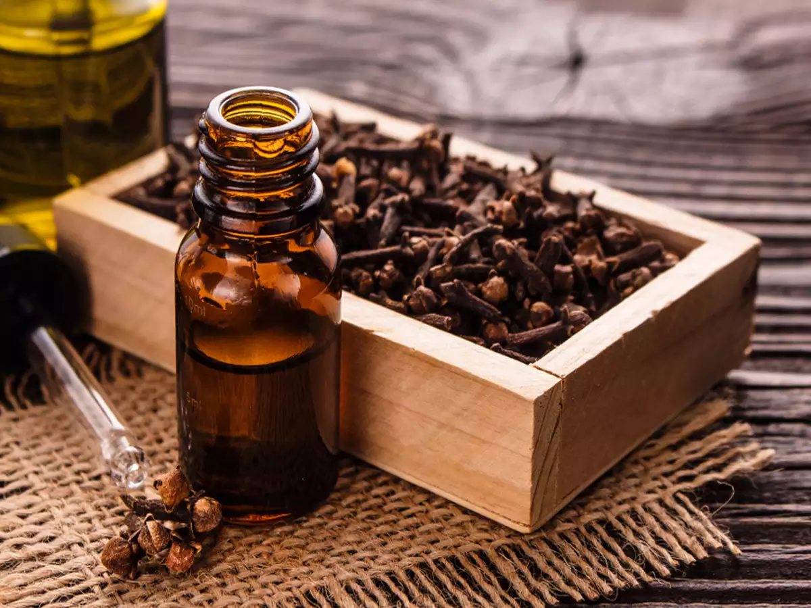
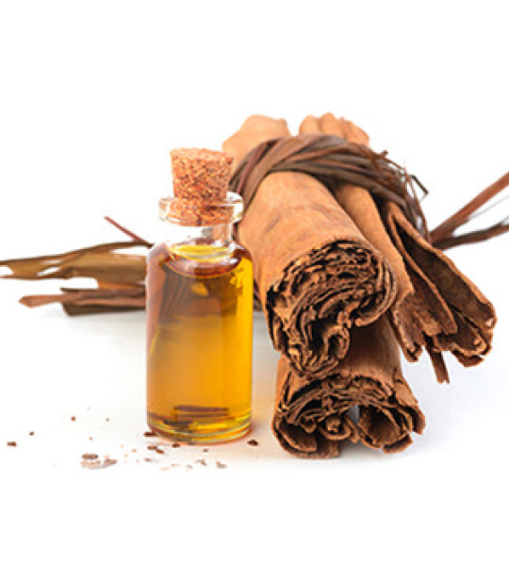
Essential oils
Clove Oil
Cinnamon Bark Oil
Cinnamon Leaf Oil

Slide 6
Objectives
To investigate the effect of essential oils (cinnamon leaf oil, cinnamon bark oil, clove oil) on biofilms formed by Salmonella isolated from broiler chicken meat

Slide 7
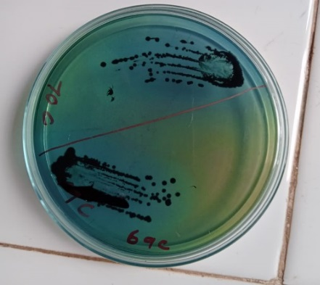
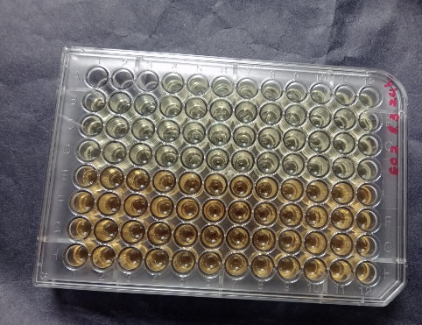
Material and Methods
pick single colony
Inoculated in Luria Bertani Broth
Salmonella spp. recovered
- 80 ºC
Cultured in HEA media
Glycerol Broth
37 ºC 24 hours
37 ºC 24 hours
(16 cultures were recovered)
Microtiter Assay

Slide 8
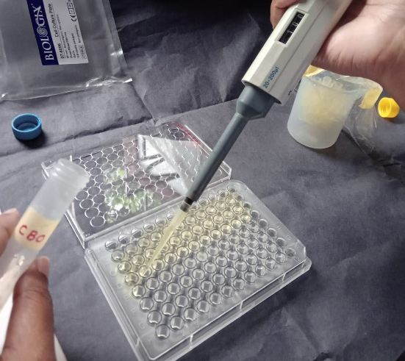
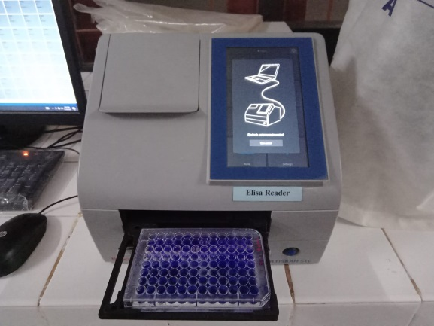
Microtiter Assay for Biofilm Quantification
Incubated for 48 hours at (28ºC)
Treated with essential oils
Discarded the content and fix the remaining biofilm cells
Quantification – Thermo Scientific TM Multiskan Sky Microplate Spectrophotometer(570 nm)
Biofilm formation on microtitre plates
Staining
Re solubilization

Slide 9
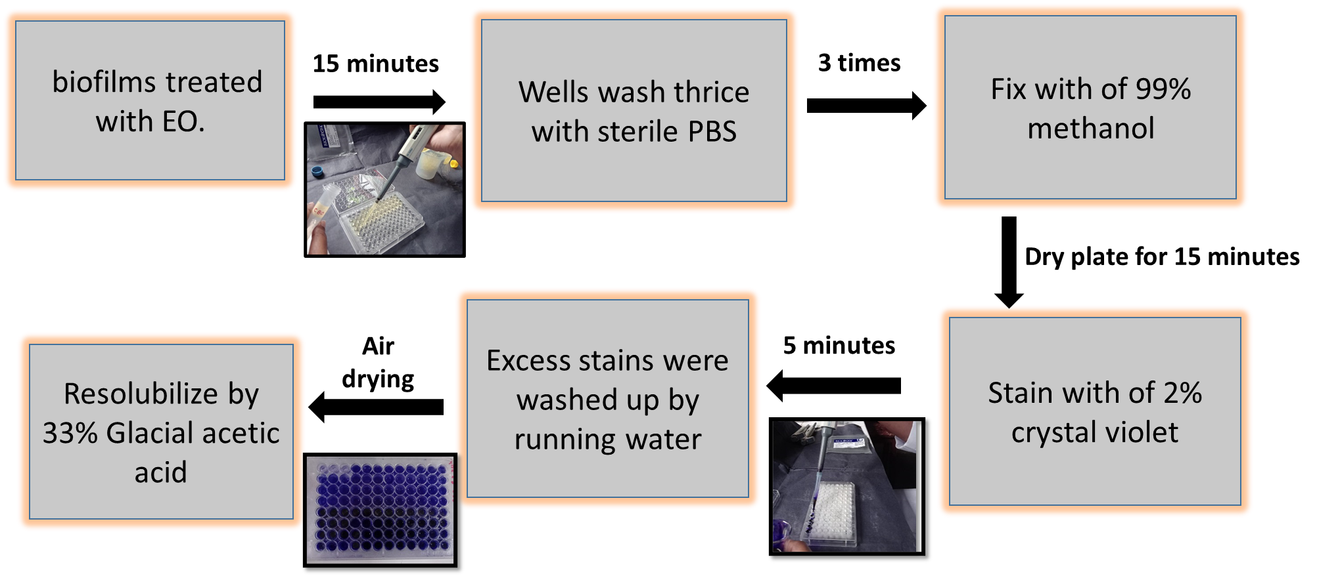
Treating essential oil and Staining Procedure

Slide 10
Data collection and Analysis
The optical density (O.D.) measured at 570 nm wavelength using spectrophotometer at the end of the time point.
Statistical Analysis system(SAS Version 9.4)
Graphical illustrations – Microsoft Office Excel (2013)

Slide 11
Results and Discussion
Effect of different Essential oils on Salmonella biofilm
Isolate | Without EO | Cinnamon leaf oil | Cinnamon bark oil | Clove oil
S1 | 1.550 ± 0.0720ª | 0.2540 ± 0.0480^{b} | 0.1960 ± 0.0055^{b} | 0.1470 ± 0.0125^{b}
S2 | 1.4690 ±0.0729ª | 0.3561 ± 0.0097^{b} | 0.2076 ± 0.0378^{c} | 0.1584 ± 0.0148^{c}
S3 | 0.8594 ± 0.0436ª | 0.1669 ± 0.0944^{b} | 0.0345 ± 0.0279^{b} | 0.0423 ± 0.0176^{b}
S4 | 1.4801 ± 0.0899ª | 0.3662 ± 0.0231 ^{b} | 0.1137 ± 0.0443 ^{c} | 0.0164 ± 0.0090 ^{c}
S5 | 0.2211 ± 0.0236 ª | 0.0666 ± 0.0163^{b} | 0.2182 ± 0.0353 ª | 0.0152 ± 0.0052 ^{b}
S6 | 0.2413 ± 0.0089 ª | 0.0700 ± 0.0046^{b} | 0.8550 ± 0.0374 ^{b} | 0.0270 ± 0.0153 ^{b}
S7 | 0.6114 ± 0.0326 ª | 0.0639 ± 0.0131^{b} | 0.0779 ± 0.0316 ^{b} | 0.0737 ± 0.0127^{b}
S8 | 0.6108 ± 0.0027ª | 0.1017 ± 0.0395 ^{b} | 0.1181 ± 0.0478 ^{b} | 0.0937 ± 0.0476 ^{b}
S9 | 0.9357 ± 0.0470ª | 0.1448 ± 0.0546 ^{b} | 0.1739 ±0.0706 ^{b} | 0.1179 ± 0.0148^{b}
S10 | 0.9784 ± 0.0052 ª | 0.3670 ±0.0489^{b} | 0.4038 ± 0.0498 ^{b} | 0.2785 ± 0.0386 ^{b}
S11 | 1.3271 ± 0.0474 ª | 0.4601 ± 0.0904 ^{b} | 0.4828 ± 0.1747 ^{b} | 0.3879 ± 0.0381 ^{b}
S12 | 1.7980 ± 0.0503 ª | 0.4702 ± 0.0901 ^{b} | 0.2542 ± 0.0313 ^{c} | 0.2136 ± 0.0223^{c}
S13 | 0.8514 ± 0.0055 ª | 0.3036 ± 0.0622 ^{b} | 0.2406 ± 0.0547 ^{b} | 0.2200 ± 0.0419 ^{b}
S14 | 0.6434 ± 0.0116ª | 0.1383 ± 0.0510 ^{b} | 0.1185 ± 0.0831 ^{b} | 0.05549 ± 0.0065 ^{b}
S15 | 1.0632 ± 0.0060 ª | 0.2964 ± 0.0736 ^{b} | 0.2138 ± 0.0412 ^{b} | 0.1902 ± 0.0267 ^{b}
S16 | 0.9187 ± 0.0052 ª | 0.5716 ± 0.0212 ^{b} | 0.2346 ± 0.0490 ^{c} | 0.2423 ± 0.694 ^{c}

Slide 12
Effect of clove oil on biofilms formed by different Salmonella isolates

Slide 13
Effect of Cinnamon leaf oil on biofilms formed by different Salmonella isolates

Slide 14
Effect of Cinnamon Bark oil on biofilms formed by different Salmonella isolates

Slide 15
Conclusion and Recommendations
Cinnamon leaf oil, Cinnamon bark oil and Clove oil have anti-biofilm activity against Salmonella isolates tested.
Biofilms formed by different Salmonella isolates have different sensitivities to Cinnamon leaf oil, Cinnamon bark oil and Clove oil

Slide 16
References
Álvarez-Ordóñez, A. et al. (2011) ‘Salmonella spp. survival strategies within the host gastrointestinal tract’, Microbiology, 157(12), pp. 3268–3281. Available at: https://doi.org/10.1099/mic.0.050351-0.
Paranagama, P.A. et al. (2001) ‘A comparison of essential oil constituents of bark, leaf, root and fruit of cinnamon (cinnamomum zeylanicum blum) grown in Sri Lanka’, Journal of the National Science Foundation of Sri Lanka, 29(3–4), pp. 147–153. Available at: https://doi.org/10.4038/jnsfsr.v29i3-4.2613.
Ohl, M.E. and Miller, S.I. (2001) ‘Salmonella: A model for bacterial pathogenesis’, Annual Review of Medicine, 52, pp. 259–274. Available at: https://doi.org/10.1146/annurev.med.52.1.259.
Pate, M. et al. (2019) ‘Salmonella Infantis in Broiler Flocks in Slovenia: The Prevalence of Multidrug Resistant Strains with High Genetic Homogeneity and Low Biofilm-Forming Ability’, BioMed Research International, 2019. Available at: https://doi.org/10.1155/2019/4981463.
Boyko, N.N. et al. (2020) ‘A novel method for the extraction of the main compounds from the essential oil of clove buds’, Farmacia, 68(1), pp. 170–175. Available at: https://doi.org/10.31925/farmacia.2020.1.24.
González-Rivas, F. et al. (2018) ‘Biofilms in the Spotlight: Detection, Quantification, and Removal Methods’, Comprehensive Reviews in Food Science and Food Safety, 17(5), pp. 1261–1276. Available at: https://doi.org/10.1111/1541-4337.12378.

Slide 17
Thank You

