Slide 1
Impacts of changing the policy on fertilizers and other agro -chemicals during 2019 - 2022 for the paddy cultivation in Imbulpe DS Division in Sri Lanka.
W.H.S.D Madusanka,¹S H P Malkanthi^{1*}
¹Department of Agribusiness Management, Faculty of Agricultural Sciences, Sabaragamuwa University of Sri Lanka, Belihuloya, Sri Lanka

Slide 2
Content
Introduction
Research Problem
Research Questions
Research objectives
Conceptual framework
Research method
Results and Discussion
Conclusion
Recommendations
References
Acknowledgement

Slide 3
Introduction
Sri Lanka is an agricultural country and the staple food is rice.
An average of 560,000 ha is cultivated during Maha season and 310,000 ha during Yala season of year making the average annual extent sown with paddy to about 870,000 ha(RRDI,2017).
About 1.8 million farm families are engaged in paddy cultivation island-wide and Sri Lanka currently produces 2.45 million MT of rough rice annually and is virtually self-sufficient in rice(Senanayake and Premaratne,2016).

Slide 4
Introduction cont.
Rice provides 45% total calorie and 40% total carbohydrates requirement of an average Sri Lankan and the per capita consumption of rice fluctuates around 114kg per year (including rice and rice based products) depending on the price of rice, bread and wheat flour (Senanayake and Premaratne,2016).
However, the past government banned the importation of agrochemicals on April 2021 .

Slide 5
Research Problem
To what extent is this crisis an outcome of the past government’s banning of importation of agrochemicals.
The agriculture sector faced bad situation, which began from April 27th in 2021, when the Import and Export Control Department banned imports of fertilizer and agrochemicals.

Slide 6
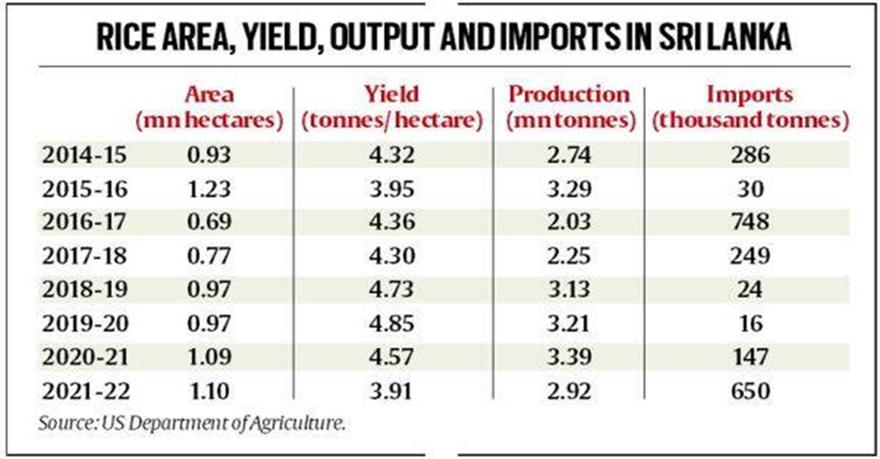
Research Problem cont.
However as a whole today Sri Lanka’s paddy production has fallen 13.9% in 2021-22 (April-March) and average yield per hectare by 14.4%, even as imports have soared to a five-year-high(Statistics, 2022)
Therefore this research was conducted to study the paddy production in Imbulpe DS division in Rathnapura district Sri Lanka.

Slide 7
Research Questions
What was the average yield of paddy before 2021 in this area?
What are the average yield of paddy in 2021 and 2022 (After banning chemical fertilizer and agrochemicals) in this area?
What are the cost for agrochemicals for paddy before and after the banding of chemical fertilizer and agrochemicals in this area?
What are the socio-economic factors of paddy farmers who use chemical fertilizer and agrochemicals in this area?
What are the farmers attitudes of banning chemical fertilizer and agrochemicals in this area?
What are the alternatives for chemical fertilizer and agrochemical introduced by the government and use by farmers in this area?

Slide 8
Objectives
Broad objective.
To analyze the impacts of changing the policy on fertilizers and other agro-chemicals during 2019- 2022 for the paddy cultivation in Imbulpe DS division in Sri Lanka
Specific objectives
To identify the annual average yield before the banning of chemical fertilizer and agrochemicals.
To compare the average yields of paddy before and after banning of chemical fertilizer and agrochemicals.
To compare the cost of production before and after banning of chemical fertilizer and agrochemical.
To determine farmers’ level of awareness about the impact of use of Chemical fertilizer and agrochemical.
To determine the farmers attitude on chemical fertilizer and agrochemical and banning chemical fertilizer and agrochemicals.
To find out possible alternative for chemical fertilizer and agrochemical currently use by the farmers.

Slide 9
Conceptual Framework
Yield in the past
Yield at Present
Cost of Production
Paddy Cultivation
Banning of Agrochemicals
Level of Awareness
Attitude
Socio-economic factors
Cost in past
Alternative

Slide 10
Operationalization table
Objective | Variable | Measurement | Analysis Method
To identify the annual yield before the banning of chemical fertilizer and agrochemical. | Annual yield | Annual yield per KG | Descriptive Statistics
To compare the average yields of paddy before and after banning of chemical fertilizer and agrochemical | Yield before the banning Yield after the banning | Metric tons/ hectare Metric tons/ hectare | Paired sample t-test
To compare the cost of production before and after the banning of chemical fertilizer and agrochemical. | Cost of production after and before banning of agrochemicals. | Rs/acres | Paired sample t-test
To determine farmers’ level of awareness about the impact of use of chemical fertilizer and agrochemical. | Level of awareness (high, moderate, poor) Source of the awareness (internet, agriculture instructor, other farmers) | 5-Point Likert scale | Descriptive statistics

Slide 11
Operationalization table cont.
Objective | Variable | Measurement | Analysis Method
To determine the farmers’ attitude on chemical fertilizer and agrochemical and banning of chemical fertilizer and agrochemical. | Agrochemicals is badly affected for the health, is cause for many other troubles, is a good act, is the best solution for herbicides, is the main reason for chronic kidney disease, is easy to use. | 5-Point Likert scale | Descriptive statistic
To find out possible alternative for chemical fertilizer and agrochemical currently use by the farmers. | Use another alternatives use of self-innovative things. | 5-Point Likert scale | Descriptive statistic

Slide 12
Research Method
Study Location | Study area located within Imbulpe DS division in Rathnapura district of the country. Muththettuwegama,Seelagama & Kubalgma divisions were randomly select..
Target Population | Paddy farmers in Imbulpe DS division are the target population. 3 GN divisions were selected.
Sample Size | A sample of 120 farmers was selected for the study.
Sample Technique | The study employed a simple random sampling technique for the study a sample of 120 farmers was chosen using a simple random selection process.
Data Collection Method | Primary Data -Household survey using pre-tested questionnaire
 | Secondary Data - Article, Magazines, Annual reports(central Bank), Research Journal in relevant industry.
Data Analysis | Descriptive statistic, Paired T test using SPSS version 25 software.

Slide 13
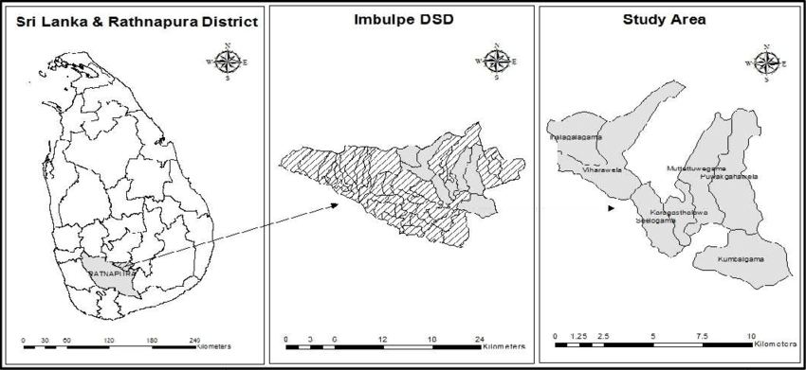
Research location: Rathnapura District,Imbulpe DS Division
Research location | Rathnapura district, Imbulpe DS Division
Sample size | 120
GN division | Number of farmers
Muththetuwegama | 40
Kubalgama | 40
Seelagama | 40

Slide 14
Results & Discussion
Socio-economic Information

Slide 15
Socio-economic information cont.

Slide 16
Socio-economic information cont.

Slide 17
Objective 01:To identify the annual yield(Kg/Ac/Year) before the banning of chemical fertilizer and agrochemicals
Descriptive Statistics
 | N | Mean
Annual average yield | 120 | 2213.7500
Valid N (listwise) | 120
Annual average yield=2213.75Kg

Slide 18
Objective 02: To compare the average yields(Kg/Ac/Seasonal) of paddy before and after banning of chemical fertilizer and agrochemicals. Objective 03: To compare the cost of production(Rs/Ac/Seasonal) before and after banning of chemical fertilizer and agrochemical
Paired Samples Statistics
 |  | Mean | N | Std. Deviation | Std. Error Mean
Pair 1 | Yield Before banning | 1106.88 | 120 | 130.879 | 11.948
 | Yield After banning | 434.79 | 120 | 65.097 | 5.942
Pair 2 | Cost before banning | 25550.00 | 120 | 4066.361 | 371.206
 | Cost after banning | 55891.67 | 120 | 6459.695 | 589.687

Slide 19
Results and discussion cont.
Paired sample test
 |  | Paired Differences |  |  |  |  | T | df | Sig.(2-tailed)
 |  | Mean | Std. Deviation | Std. Error Mean | 95% Confidence Interval of the Difference
 |  |  |  |  | Lower | Upper
Pair 1 | Yield Before banning -Yield After banning | 672.083 | 106.146 | 9.690 | 652.897 | 691.270 | 69.360 | 119 | .000
Pair 2 | Cost before banning - Cost after banning | -30341.667 | 4613.637 | 421.165 | -31175.616 | 29507.717 | -72.042 | 119 | .000

Slide 20
Objective 04: To determine farmers’ level of awareness about the impact of use of Chemical fertilizer and agrochemical.
Serial No | Statement | Mean | Std. Deviation | Remark
Level of awareness about the impact of use of chemical fertilizer
1 | Chemical fertilizers help to enhance the yield. | 1.63 | .579 | Agree
2 | Chemical fertilizers are badly affected for health and it causes many diseases | 2.48 | .565 | Agree
3 | Chemical fertilizers are badly affected for environment. | 2.57 | .644 | Neutral
4 | Mainly chemical fertilizers are import from other countries. | 2.03 | .628 | Agree
Level of awareness about the impact of use of other agrochemicals
5 | Other agrochemicals help to enhance the yield | 1.80 | .656 | Agree
6 | Other agrochemicals are badly affected for health and it causes many diseases | 2.42 | .528 | Agree
7 | Other agrochemicals are badly affected for environment | 2.50 | .756 | Neutral
8 | Mainly other agrochemicals are import from other countries | 2.31 | .658 | Agree
1-Strongly Agree,2- Agree,3-Neutral,4-Disagree,5- Strongly Disagree

Slide 21
Farmers source of getting knowledge (n=120, total cases= 222)
 |  | Responses |  | Percent of Cases
 |  | N | Percent
Source | Agricultural instructor | 105 | 47.3% | 91.3%
 | Agrochemical retail shops | 52 | 23.4% | 45.2%
 | Advertisements | 53 | 23.9% | 46.1%
 | Internet | 7 | 3.2% | 6.1%
 | other | 5 | 2.3% | 4.3%
Total |  | 222 | 100.0% | 193.0%

Slide 22
Objective 05: To determine the farmers attitude on chemical fertilizer and agrochemical and banning chemical fertilizer and agrochemicals.
Serial No | Statement | Mean | Std. Deviation | Remark
Farmers’ attitude on sudden banning of chemical fertilizer and other agrochemicals.
1 | Aware about the chemical fertilizer and other agrochemicals importation ban | 1.67 | .585 | Agree
2 | Chemical fertilizer and other agrochemicals import banning is a good act | 4.32 | .594 | Disagree
3 | Chemical fertilizer and other agrochemicals import banning will help to control the diseases cause for human | 2.73 | .670 | Neutral
4 | Chemical fertilizer and other agrochemicals import banning helps to move towards the organic farming | 2.55 | .684 | Neutral
5 | Chemical fertilizer and other agrochemicals import banning helps to protect the environment | 2.48 | .594 | Agree
6 | Chemical fertilizer and other agrochemicals import banning causes to reduce the yield | 1.97 | .654 | Agree
7 | Chemical fertilizer and other agrochemicals import banning cause farmers to move away from farming. | 1.82 | .889 | Agree

Slide 23
Farmers’ attitude on move from inorganic farming to organic farming.
1 | Organic farming is a successful method for paddy cultivation | 3.85 | .589 | Disagree
2 | Prefer to cultivate 100% Organically | 4.27 | .626 | Disagree
3 | Prefer to cultivate 50% Organically and 50% inorganically | 2.91 | .674 | Neutral
4 | Prefer to cultivate 25% Organically and 75% inorganically | 2.21 | .634 | Agree
5 | Prefer to cultivate 75% Organically and 25% inorganically | 4.01 | .572 | Disagree
6 | Not prefer to use Organic farming | 2.83 | .813 | Neutral

Slide 24
Objective 06: To find out possible alternative for chemical fertilizer and agrochemical currently use by the farmers.
No | Alternatives for Chemical Fertilizer | Percentage (%)
1 | Compost | 45
2 | Cow Manure | 8
3 | liquid fertilizer | 57
4 | Poultry Manure | 10

Slide 25
Alternatives for pesticides
No | Alternatives for Pesticides | Percentage
1 | Neem oil | 77.5%
2 | Wood ash | 22.5%

Slide 26
Alternatives for Herbicides
Hand weeding
No Successful Alternatives for herbicides. Only thing is hand weeding Removing harmful weeds.

Slide 27
Conclusion
Chemical fertilizer and agrochemical banning huge affect for the present situation of paddy cultivation in Imbulpe DS division.
According to results of this study, the yield has declined about 50% with banning.
And also, cost of production has doubled compare to before banning.
In present, farmers have average knowledge about utilization agrochemical and chemical fertilizer.
While majority of farmers disagree with the fertilizer banned, they mention that currently use organic fertilizer are not suitable for paddy cultivation

Slide 28
Recommendation
Government should gradually convert farmers to organic paddy cultivation without doing it at once. So government should carefully work on this type of policy formulation.
Department of agriculture should conduct research and find suitable alternatives for chemical fertilizer and agrochemicals.
Department of agriculture should do training and education for the farmers to prepare organic fertilizer and do organic farming successfully.

Slide 29
References
Damodaran, H. (2022) Sri Lanka: fall in rice output and the economy https://indianexpress.com/article/explained/sri-lanka-crisis-fall-in-rice-output-and-the-economy-7865051/
Malkanthi, S. H. P., Sandareka, U. G., Wijerathne, A. W., & Sivashankar, P. (2019). Banning of Glyphosate and its Impact on Paddy Cultivation: A study in Ratnapura District in Sri Lanka. Journal of Agricultural Sciences – Sri Lanka, 14(2), 129. https://doi.org/10.4038/jas.v14i2.8515
Iqbal S. et al. (2021) Chemical Fertilizers, Formulation, and Their Influence on Soil Health. In: Hakeem K.R., Dar G.H., Mehmood M.A., Bhat R.A. (eds) Microbiota and Biofertilizers. Springer, Cham. https://doi.org/10.1007/978-3-030-48771-3_1
Statistics, D. of C. (n.d.). Grama Niladhari Divisions Statistics - 2020 [Review of Grama Niladhari Divisions Statistics - 2020]. In http://www.statistics.gov.lk/Population/StaticalInformation/GND_Reports/2020/Hambantota (pp. 1–48). Department of Census & Statistics. Retrieved March 6, 2022, from http://www.statistics.gov.lk/Population/StaticalInformation/GND_Reports/2020/Hambantota

Slide 30
References cont.
Paddy Cultivation in Sri Lanka | Traditional Agriculture Practices of Sri Lanka. (n.d.). Www.dilmahconservation.org. https://www.dilmahconservation.org/arboretum/traditional-agriculture/the-paddy-field-kumbura--9efdbda3f4ea423817f0b89f95e6f499.html
• Marambe, B., & Herath, S. (2019). Banning of herbicides and the impact on agriculture: the case of glyphosate in Sri Lanka. Weed Science, 68(3), 246–252. https://doi.org/10.1017/wsc.2019.71
Chandrasena, J.P. (1989) “A survey of Rice - field weeds in Ratnapura and Kurunegala Districts of sri lanka,” Journal of the National Science Foundation of Sri Lanka, 17(2), p. 187. Available at: https://doi.org/10.4038/jnsfsr.v17i2.8220.

Slide 31
ACKNOWLEDGEMENT
Internal supervisor, Prof. S.H.P Malkanthi, Senior Lecturer, Department of Agribusiness , Management, Faculty of Agricultural Sciences, Sabaragamuwa University of Sri Lanka.
External supervisor, Ajith Ranasinghe, general manager, Sabaragamuwa chamber of commerce and industry.
Prof. D.A.M. de Silva, Head of the Department of Agribusiness Management , Faculty of Agricultural Sciences, Sabaragamuwa University of Sri Lanka
Mr. I.C Hettiarachci, Lecturer, Training coordinator, Department of Agribusiness Management, Faculty of Agricultural Sciences, Sabaragamuwa University of Sri Lanka.

Slide 32
Thank You

