Slide 1
Development of a smoked tender jackfruit (Artocarpus heterophyllus) product that resembles meat-based barbeque, as a high-value vegan food for the export market
L.A.M.B. Liyanaarachchi, G.D.K Kumara, W.A.H. Champa, N. Jayathilake
Faculty of Agricultural Sciences, Sabaragamuwa University of Sri Lanka, Belihuloya, Sri Lanka.
Innovation and Service Support Center, Faculty of Livestock, Fisheries, and Nutrition, Wayamba University of Sri Lanka.
Worga Naturals (Pvt).Ltd, meepavita, Dompe, Sri Lanka.

Slide 2
Content for the presentation
Introduction
Objectives
Material and Methods
Results and Discussion
Conclusion and Recommendations
References

Slide 3
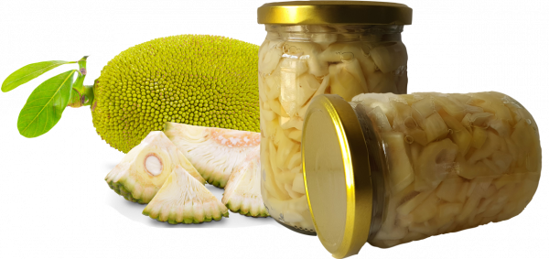
Introduction
Jackfruit (Artocarpus heterophyllus) is a dicotyledonous plant that belongs to the family Moraceae.
Tender jackfruit is the most favorite maturity stage to consume as a vegetable.
It has a huge potential to develop as value added products for the export market.

Slide 4
Objectives
General objective
To develop a smoked tender jackfruit (Artocarpus heterophyllus) product that resembles meat-based barbeque, as a high value novel vegan food catering to the export market
Specific objectives
To develop smoked value added tender jackfruit with unique flavor and taste
To evaluate physicochemical and organoleptic attributes of the developed product
To assess the presence of health hazardous smoke residue compounds in the developed product
To evaluate the self-life of the developed product

Slide 5

Material and Methods
Research location
Innovation and Service Support Center, Faculty of Livestock, Fisheries, and Nutrition, Wayamba University of Sri Lanka.

Slide 6
Material and Methods cont.…
Primary sample preparation
Treatment designed according to the response surface method
Screening of samples for secondary sample preparation
Secondary sample preparation
Sensory evaluation
Selection of most suitable treatment combination for final product
Product finalization
Improve the product attributes as per the comments of the sensory evaluation
Select final product

Slide 7
Material and Methods cont.…
Application of Response Surface Methodology (RSM)
Variable selection (Most suitable wood amount, temperature, time duration)
Experimental design according to the Box-Behnken Design (BBD)
Construction of the predicted model (Regression and ANOVA tests)
Determination of the optimal conditions (Contour plots)
Fifteen possible treatment combinations were selected and each treatment consisted with three replicates

Slide 8
Material and Methods cont.…
Selected Independent variables (Paranagama et al., 2022, Mondal, 2013).
Variable | Temperature (°C) |  |  | Smoking duration (min) |  |  | Needed wood amount for smoking (g)
Levels of variables | 70 °C | 80 °C | 90 °C | 15 min | 20 min | 25 min | 100 g | 150 g | 200 g
Selected dependent variables
Texture (hardness)
Colour (L*) value

Slide 9
Material and Methods cont.…
Sensory evaluation
Nine point Hedonic scale (Wichchukit and O’Mahony, 2015)
Two different sensory evaluation tests ( A local panel and a foreign panel)
Six different sensory attributes were tested (colour, appearance, odor, taste, texture and overall acceptability)
Six types of samples were provided
Three cubes of tender jackfruit from each sample were provided to each panelist

Slide 10
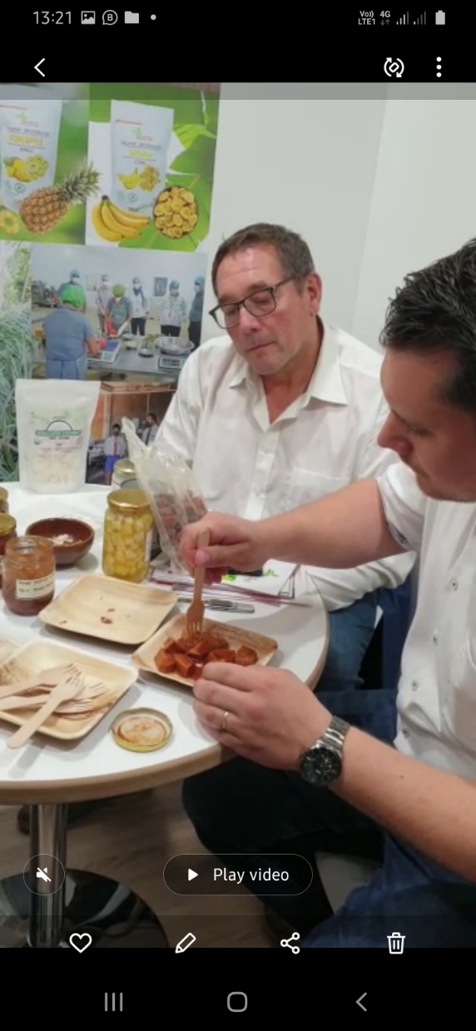
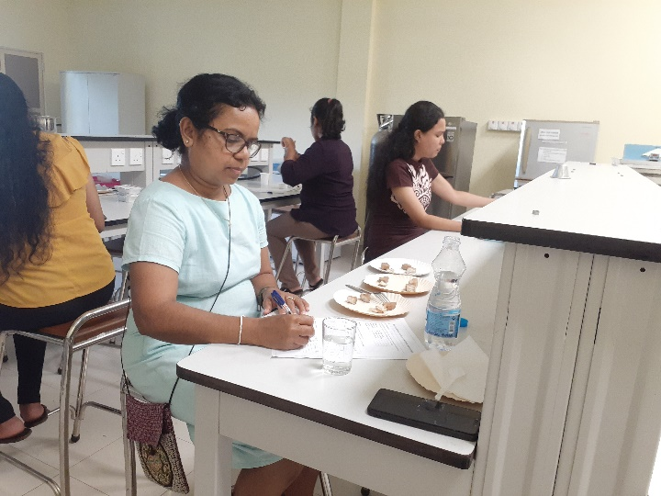

Material and Methods cont.…
Sensory evaluation by local panelists
Sensory evaluation by foreign panelists in Germany

Slide 11
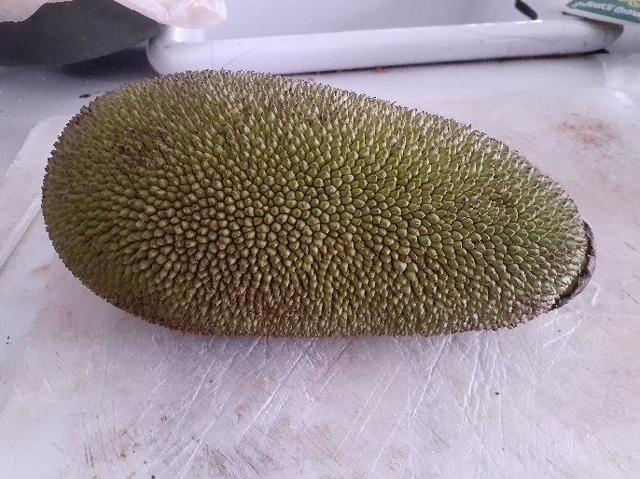
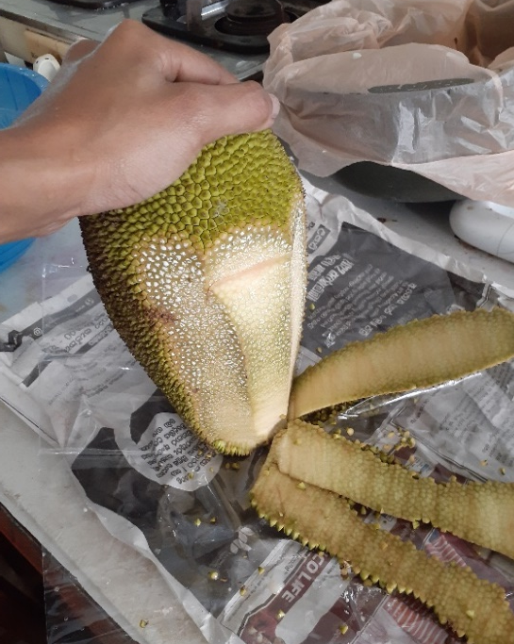
Material and Methods cont.…
Selecting uniform tender jackfruit at correct maturity stage (60-70 days old (Pritty and Sudheer, 2019)
Cleaned, washed and peeled off
Cut in to 3 cm x 2.5 cm size cubes
Steam under pressure (Using pressure cooker under 1bar pressure and 100°C temperature for 15min)

Slide 12
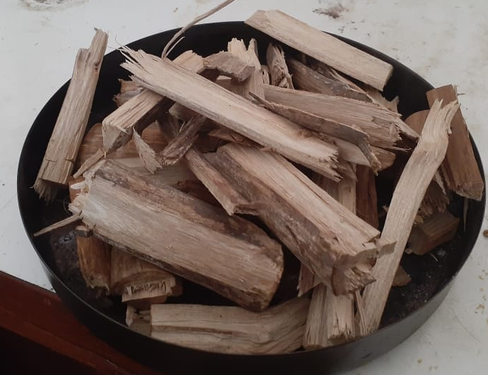
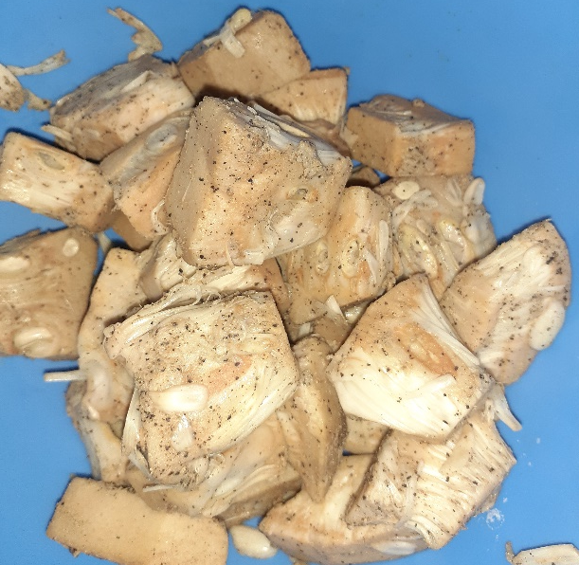
Material and Methods cont.…
Marinating with 1% salt and 0.5% black pepper for 4 hours
Smoking at 80°C temperature up to 20 min using 150g of cinnamon fire woods in smoking chamber
Vacuum packaging (HDPE) bags 80 µm gauge
Storage under refrigerator conditions (-4° C)

Slide 13
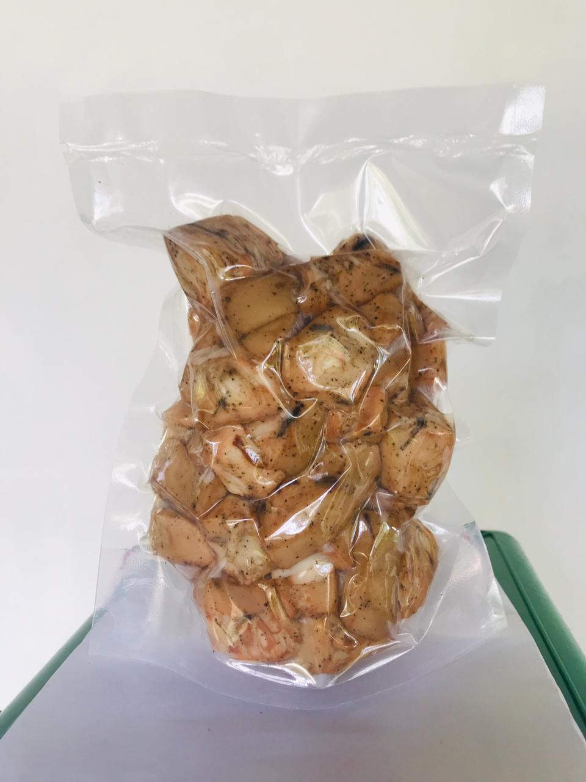
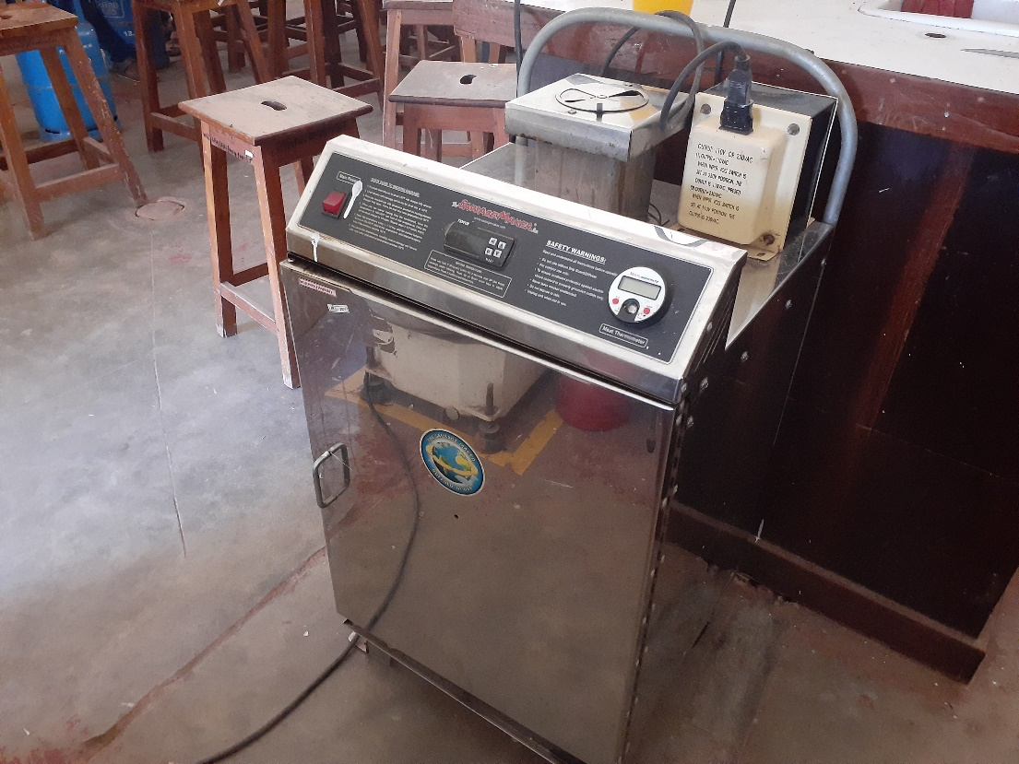
Material and Methods cont.…
Smoking chamber
Smoked tender jackfruit product

Slide 14
Material and Methods cont.…
Evaluation of physiochemical parameters of smoked tender jackfruit product
proximate composition | Testing method
Moisture content | Hot air oven method
Crude Protein | Kjeldahl method
Crude fat content | Soxhlet Extraction Method
Carbohydrate | By subtracting the sum of crude protein, crude lipid, crude fiber, and ash
Ash content | Muffle furnace
Crude fiber content | Weende method
pH | pH meter
Brix value | Hand refractometer
Colour | Chroma meter
Texture | Texture Analyser

Slide 15
Material and Methods cont.…
Microbial count analysis
Total plate count and yeast and mold count were tested in final product as initial count, after 2 weeks and after 4 weeks (pour plate method)
Testing the residual effect of smoking treatment
selected polycyclic aromatic hydrocarbons (PAHs) on the smoked product was tested using high performance liquid chromatography (HPLC) method
  Benzo[a]pyrene BaP
  Benzo[a]anthracene (BaA)
  Chrysene (CHR)
  Benzo[b]fluoranthene (BbFA)

Slide 16
Material and Methods cont.…
Data Analysis
Response surface methodology to assess the relationship between Wood amount, temperature and time duration on texture and color- Minitab 16.0 software package
Friedman test for sensory data analysis - Minitab 16.0 software package
Graphical analysis were done by using Microsoft Excel package

Slide 17
Results and Discussion
Selection of suitable treatment combination for product development
Effect of different combinations of factors for change texture
Ideal texture value (N)
0.768047 + 0.01

Slide 18
Results and Discussion
Ideal texture value (N)
0.768047 + 0.01
There was a significant difference (P<0.05) between squared effect of smoking duration, wood content vs smoking duration and smoking duration vs smoking temperature on the change of texture in smoked tender jackfruit product.

Slide 19
Results and Discussion
Effect of different combinations of factors for change colour
Ideal colour value (L*) 42.94333 + 0.57

Slide 20
Results and Discussion
Ideal colour value (L*) 42.94333 + 0.57
There was a significant difference (P<0.05) according to the smoking duration of the samples, The squared effect of wood content, Squired effect of smoking temperature and wood content vs smoking temperature is effect on the change of L* colour value

Slide 21
Results and Discussion
Results of Sensory Evaluation
Selected samples for sensory analysis
S1- Boiled only without smoking with 0.5 % salt and 0.5 % pepper ( as control)
S2- Boiled only without smoking with 0.5 % salt ( as control)
S3- Smoked at 150 g wood content + 80° C temperature +20 min with 0.5 % salt and 0.5 % pepper
S4- Smoked at 150 g wood content + 80 °C temperature +20 min with 0.5 % salt only
S5- Smoked at 150 g wood content + 70 °C temperature +15 min with 0.5 % salt and 0.5 % pepper
S6- Smoked at 150 g wood content + 70 °C temperature +15 min with 0.5 % salt only

Slide 22
Results and Discussion
S1- Boiled only without smoking with 0.5 % salt and 0.5 % pepper ( as control)
S2- Boiled only without smoking with 0.5 % salt ( as control)
S3- Smoked at 150 g wood content + 80° C temperature +20 min with 0.5 % salt and 0.5 % pepper
S4- Smoked at 150 g wood content + 80 °C temperature +20 min with 0.5 % salt only
S5- Smoked at 150 g wood content + 70 °C temperature +15 min with 0.5 % salt and 0.5 % pepper
S6- Smoked at 150 g wood content + 70 °C temperature +15 min with 0.5 % salt only

Slide 23
Results and Discussion
S1- Boiled only without smoking with 0.5 % salt and 0.5 % pepper ( as control)
S2- Boiled only without smoking with 0.5 % salt ( as control)
S3- Smoked at 150 g wood content + 80° C temperature +20 min with 0.5 % salt and 0.5 % pepper
S4- Smoked at 150 g wood content + 80 °C temperature +20 min with 0.5 % salt only
S5- Smoked at 150 g wood content + 70 °C temperature +15 min with 0.5 % salt and 0.5 % pepper
S6- Smoked at 150 g wood content + 70 °C temperature +15 min with 0.5 % salt only

Slide 24
Results and Discussion
Microbial analysis of the smoked tender jackfruit samples.
TPC- SLSI recommended level <10⁶
Yeast & Mold- SLSI recommended level <10²
Sample | Test | Initial (Cfu/g) | After 2 weeks (Cfu/g) | After 4 weeks (Cfu/g)
Boiled tender jackfruit | Total plate count | 5.3 | Not in edible condition | Not in edible condition
 | Yeast & mold count | Not detected | Not in edible condition at this point | Not in edible condition at this point
Smoked tender jackfruit | Total plate count | 3.2 | 7.4 | 1.67 X 10¹
 | Yeast & mold count | Not detected | Not detected | Not detected

Slide 25
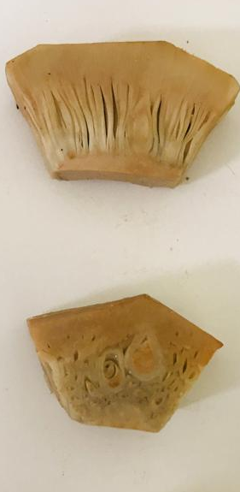
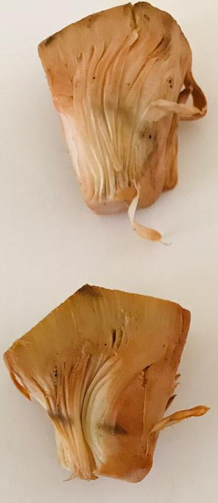
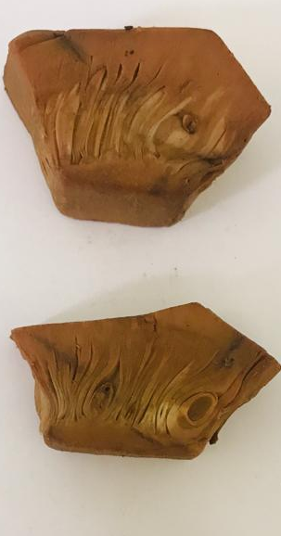
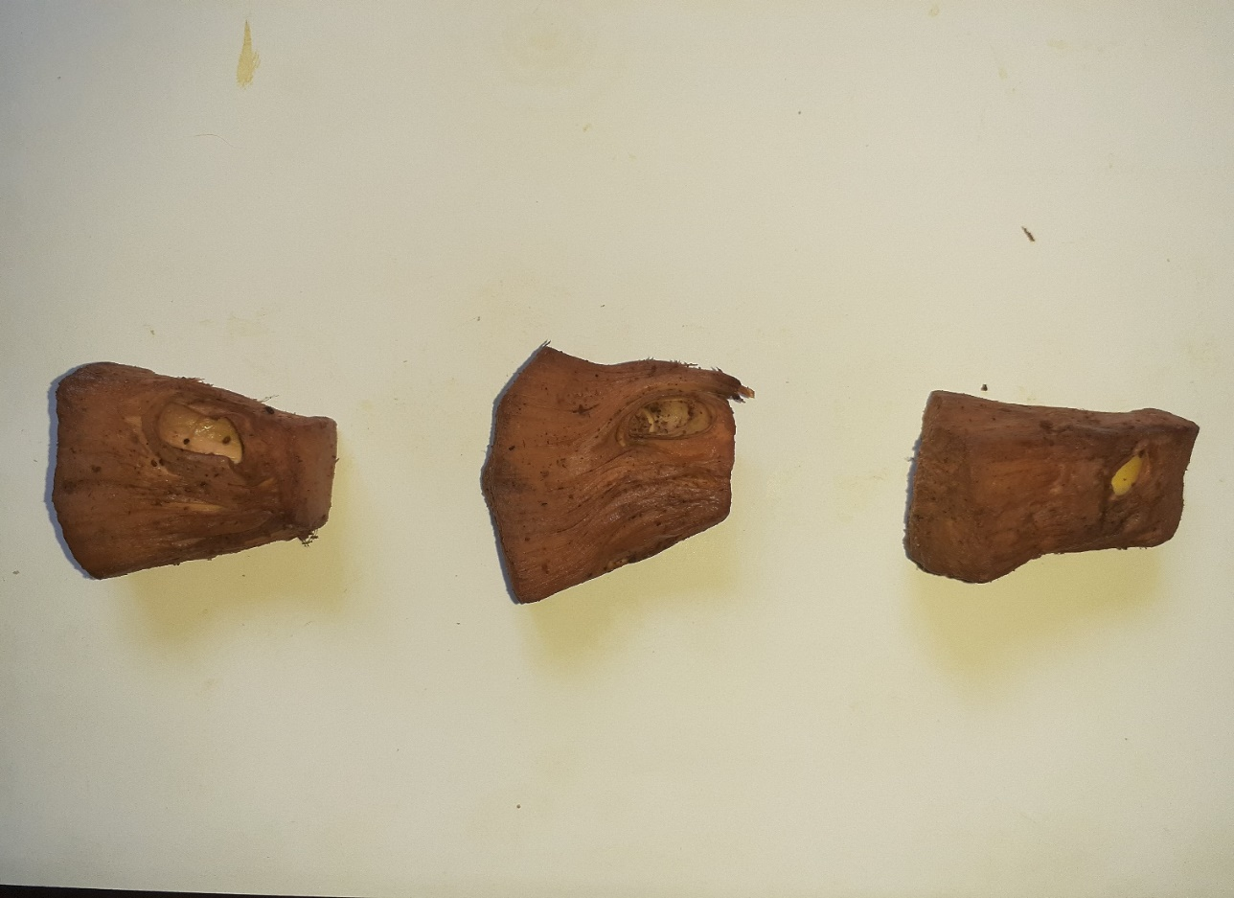
Results and Discussion
Colour guide for preparation of smoked tender jackfruit
Samples
Non smoked
15 min smoked
20 minutes smoked
30 minutes smoked
Note :- Smoked at 80°C temperature
Number 3 sample is the ideal sample
L* 56.77 + 3.19
a* 2.61 + 1.03
b* 14.63 + 3.08
L* 44.9 + 2.41
a* 3.99 + 0.61
b* 12.21 + 1.24
L* 42.74 + 2.41
a* 5.55 + 0.64
b* 11.42 + 1.31
L* 36.55 ± 0.63
a* 18.75 ± 0.55
b* 18.10 ± 0.48
1
2
3
4

Slide 26
Results and Discussion
pH value change of the final product
(Murashev et al., 2022)

Slide 27
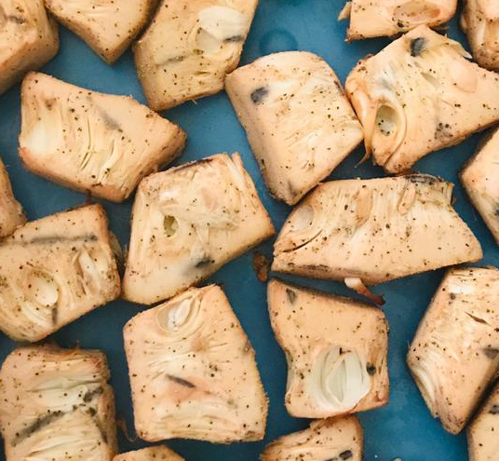
Results and Discussion
Proximate composition of Smoked Tender Jackfruit

Slide 28
Results and Discussion
Total cost per 1 kg of smoked tender jackfruit
Comparative benefit than commercially available product
Description | Total cost (Rs)
Raw tender jackfruit 150 kg | 12000.00
Black pepper 750 g | 2200.00
Salt 1.5 kg | 210.00
Vacuum pouch | 5000.00
Transport | 10000.00
Fuel and electricity | 5000.00
Total | 34410.00
Total cost for 1kg of Smoked tender jackfruit
Product = 350.00
Price of a comparable product
in the market (1kg) = 1500.00
Profit from proposed = 1500 – 350
product = 1150.00
Profit % = 328.57 %
Profit is three times as cost

Slide 29
Conclusion
The most suitable wood content, smoking duration and smoking temperature for smoked tender jackfruit product development is 150 g, 20 min and 80 °C respectively (per 1 kg).
The product is rich with fiber but low with fat.
The product was free with PAH4 marker.
The microbial growth is slow due to smoking effect of the product.
The demand for the product from foreign buyers due to its unique organoleptic attributes of the product.
Cost benefit analysis shows lot of promise of earning foreign exchange by exporting the product with very high profit.

Slide 30
Recommendations
Further studies need to be carried out,
To determine PAHs deposition at different temperature values and smoking durations.
To improve the flavor by using different types of fire woods
To testing different methods for enhance the shelf-life of the product.

Slide 31
References
Benjakul S. and N. Aroonrueg. (1999), Effect of Smoke Sources on Quality and Storage ability of Catfish Fillet (Clarias macrocephatus gunther). Journal o f food quality. 22: 213-224.
Eissa, H.A., Fouad, G.M. and Shouk, A.E.A., 2009. Effect of some thermal and chemical pre‐treatments on smoked oyster mushroom quality. International journal of food science & technology, 44(2), pp.251-261.
Foster, W.W. and Simpson, T.H., 1961. Studies of the smoking process for foods. I.—the importance of vapours. Journal of the Science of Food and Agriculture, 12(5), pp.363-374.
Goswami, C. and Chacrabati, R. (2015) Jackfruit (Artocarpus heterophylus), Nutritional Composition of Fruit Cultivars. Elsevier Inc. Available at: https://doi.org/10.1016/B978-0-12-408117-8.00014-3.
Heymann H.J., Hedndrick H.B., Karrasch M.A., Eggeman M.K. and Ellersieck M.R. (1990). Sensory and chemical characteristics of fresh pork roasts cooked to different centre temperatures. Journal o f Food Science. 55:613-617.

Slide 32
Thank You

