Slide 1
Effect of Selected Commercial Rooting Hormones on Air-Layering of Jackfruit (Artocarpus heterophyllus Lam.)
K.W.A.S.P.Thakshila-16AGA1308
Crop Production Technologies
Department of Export Agriculture
Faculty of Agricultural Sciences
Sabaragamuwa University of Sri Lanka
External Supervisor
Dr.Ravinda Lakshan Senanayake
Assistant Director of Agriculture (Research)
Fruit Crop Research and Development station
Gannoruwa, Peradeniya.
Internal Supervisor
Prof. P.K.Dissanayake
Department of Export Agriculture
Sabaragamuwa University of Sri Lanka

Slide 2
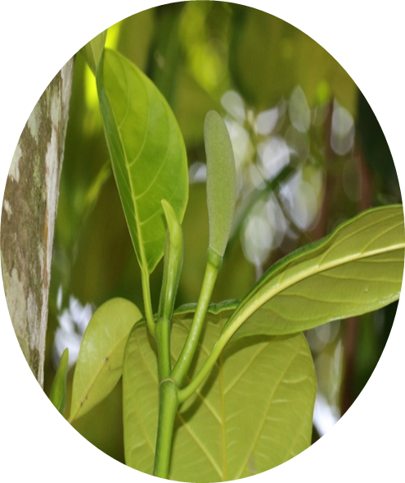
Content for the presentation
Introduction
Objectives
Material and Methods
Results and Discussion
Conclusion and Recommendations
References

Slide 3
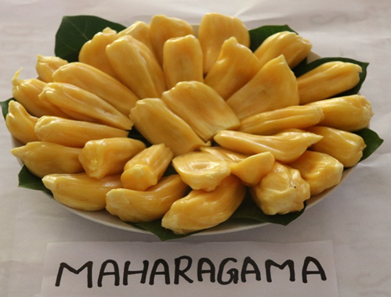
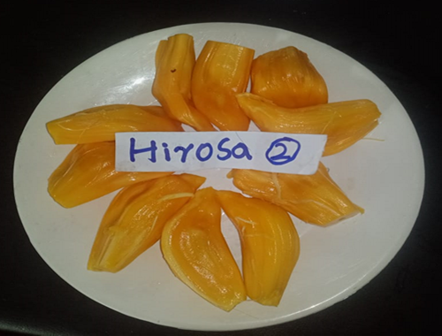
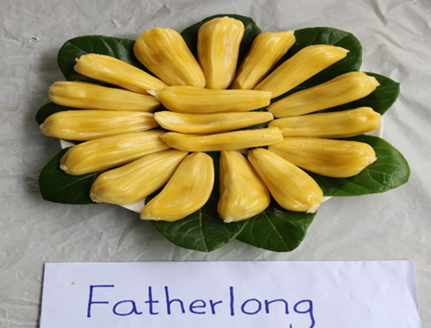
Introduction
Jack fruit-Artocarpus heterophyllus Lam.
Family-Moraceae
“Maharagama” Variety
“Hirosa” Variety
“Farther Long” Variety

Slide 4
Research problem
Seed germination within the fruit is a problem.
Mainly propagated by seeds, there is a genetic variation.
Grafting Incompatibility due to the use of different rootstock.
Fungal infection around the graft union due to latex secretion.
These issues are prominent in the "Father Long" variety.

Slide 5
Objectives
To evaluate the effect of commercial rooting hormones IBA(Roocta) and NAA(Plant fix) on air-layering of Jackfruit(“Maharagama”, “Hirosa” and “Farther long”).

Slide 6
Material and Methods
Experimental Location
Fruit Crops Research & Development Station, Gannoruwa, Peradeniya.
Plant material
Three jack fruit varieties 'Father Long', 'Maharagama' and 'Hirosa’. plants were selected for this experiment.

Slide 7
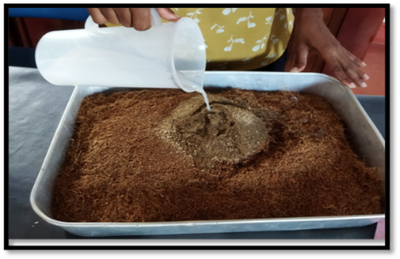
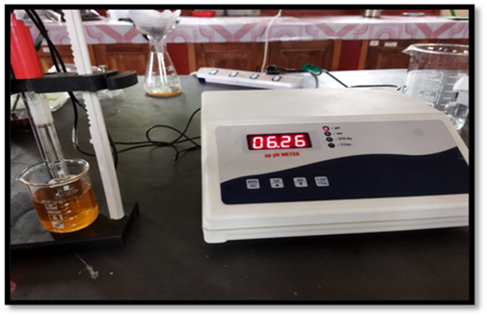
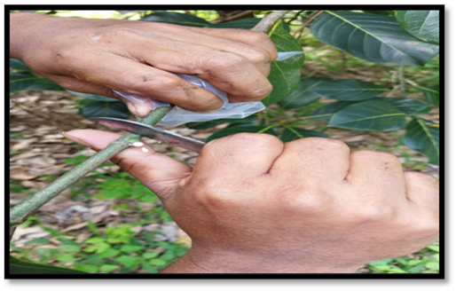
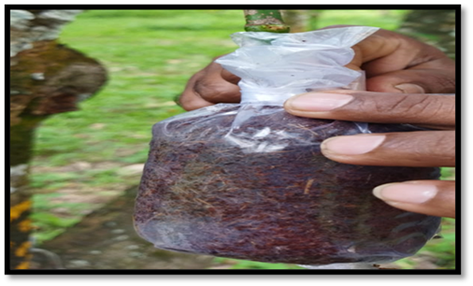
Material and Methods
Mixing coir media
Checking pH and EC of media
Removal of bark
Cover both ends with polythene tape
Media filling

Slide 8
Experimental design
Randomized complete block design(RCBD)
This experiment was conducted separately using three Jackfruit
varieties.
3 Replicates.
3 Treatments.(Roocta-0.35%, Plant fix-4.5%,Distilled water)

Slide 9
Results and Discussion

Slide 10
Survival percentage

Slide 11
Callus diameter(mm)
Callus weight(g)
a
a
a
a
a
P>0.05
NS
P>0.05
NS

Slide 12
Root primordia weight(g)
Root primordia diameter(mm)
a
a
b
b
a
a
P>0.05
NS
P<0.05
s

Slide 13
Survival percentage

Slide 14
Callus diameter(mm)
Callus weight(g)
a
a
b
b
b
b
P<0.05
S
P<0.05
S

Slide 15
Root primordia weight(g)
Root primordia diameter(mm)
a
a
b
b
b
b
P<0.05
S
P<0.05
S

Slide 16
Survival percentage

Slide 17
Callus diameter(mm)
Callus weight(g)
a
a
a
a
a
b
P<0.05
S
P>0.05
NS

Slide 18
Root primordia weight(g)
Root primordia diameter(mm)
a
a
b
b
b
b
P<0.05
S
P<0.05
S

Slide 19
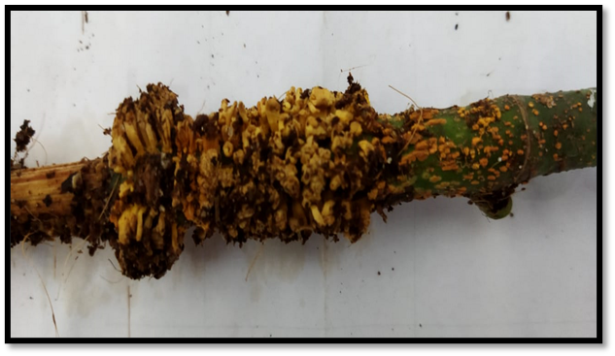
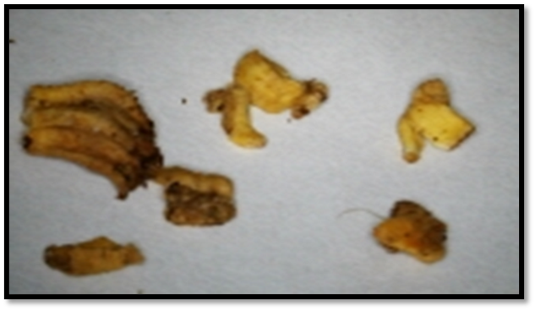
Conclusion and Recommendations
It is concluded that in treatments with commercial rooting hormones the maximum values of effectiveness were obtained in plant fix rooting hormone.
Root primordia
Root primordia

Slide 20
References
Edirimanna, E.R.S.P., Sanjeewa, K.K.A., Rajapakse, R.G.A.S., Kohombange, S., Rathnayake, A.K., De Silva, K.R.C. and Dissanayake, D.C.K.K., (2019). Effect of Chitosan on Growth Parameters of Rootstock and Grafting Success of Jack Fruit (Artocarpus heterophyllus) Variety Father Long. International Journal of Scientific and Research Publications, 9(5), pp.592-598.
Singh, A.K. and Singh, G.N., (2004). Effect of IBA and NAA on rooting of air layers of jackfruit (Artocarpus heterophyllus Lam.). Sci. Hort, 9, pp.41-46.

Slide 21
Thank You

