Slide 1
Estimation of precise and accurate soil porosity with respect to spatial variability of particle density in different textured soil in catena
Chandana J.L.A.I.^{1*}, LP Vidhana Arachchi¹, DDMO Dissanayake¹
¹Department of Export Agriculture, Faculty of Agricultural Sciences, Sabaragamuwa University of Sri Lanka, Belihuloya, Sri lanka.

Slide 2
Content
Introduction
Objectives
Material and Methods
Results and Discussion
Conclusion and Recommendations
References

Slide 3
Introduction
Soil - The thin layer of material covering the earth surface,
- Due to the weathering of rocks,
- Mainly of minerals, organic materials, air, water and living biota.
The soil condition such aeration status, soil water status, and nutrient status govern crop root growth thereby crop production.
Soil condition mainly depend on soil physical , chemical, and biological properties of soils. Out of those properties , soil physical properties are the key factors govern crop root growth and proliferation.

Slide 4
The soil particle density (PD) is one of the fundamental soil physical properties, and is defined as the mass per unit volume of the solid components.
An accurate measurement for this is required to calculate soil porosity and to estimate derived parameters of soil porosity.
Total porosity of soils is changed with the spatial variability of bulk density and particle density of different textured soils.

Slide 5
Research problem
The average value for particle density is assumed as 2.65 g cm⁻³.
But this value may vary with different soil textures and cannot be applied to Interpret precise and accurate total porosity of different soils.
Those inaccurate values can lead to misleading true values of porosity and aeration conditions at different locations even within the soil catena.

Slide 6
Objectives
To interpret precise and accurate soil total porosity in different textured soils.
To study the accurate and precise interrelationship of soil conditions with respect to true values of physical parameters, such as, particle density, bulk density, soil texture and soil porosity.

Slide 7
Material and Methods
Soil Samples collection
Soil types were concerned as treatments
Soil samples were collected from different catena in the faulty farm as,
(Well, moderately, poorly drained soil.)
From random soil sampling,
Beach sand ,
River Sand,
Grinded boulders, soil samples were collected
10 soil samples were collected from each soil types
0-15cm
15-30cm

Slide 8
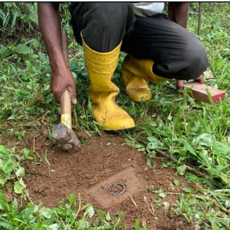
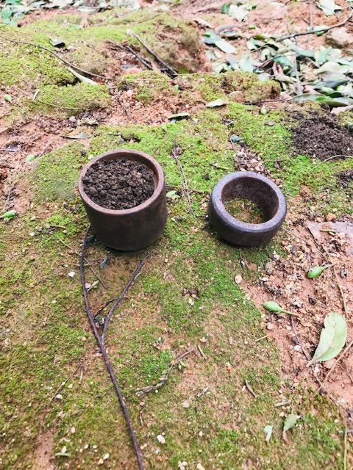
Soil Sample collection
Figure 1.Soil sample collection using augur
Figure 2.Soil sample collection using core
Figure 3.Soil filled core sample

Slide 9
Soil sample preparation for laboratory analysis
Stones and other plant debris were removed in the soil samples
Soil samples were air dried and oven dried
For PD and texture: soil samples were sieved from 2mm mesh
Soil samples were separated for different practical's
After that each of the lab practical were conducted in laboratory

Slide 10
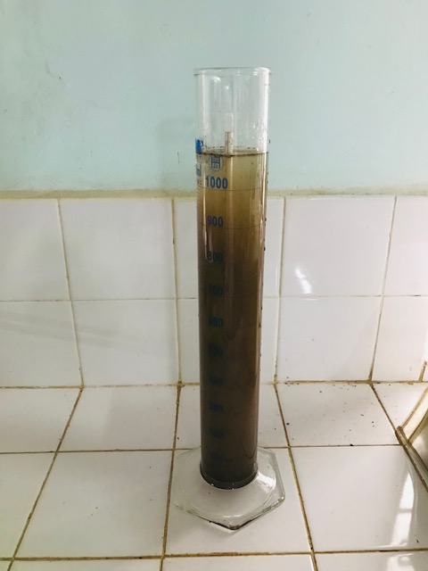
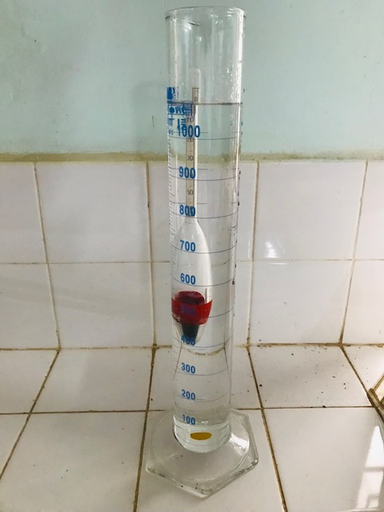
Laboratory analysis
Texture …
The texture is proportion of mineral particles (Bouyoucos, 1962)
(sand , slit, and clay ) in the soil (Hydrometer method).
Figure 4. Testing of soil texture
Figure 5. Blank experiment

Slide 11
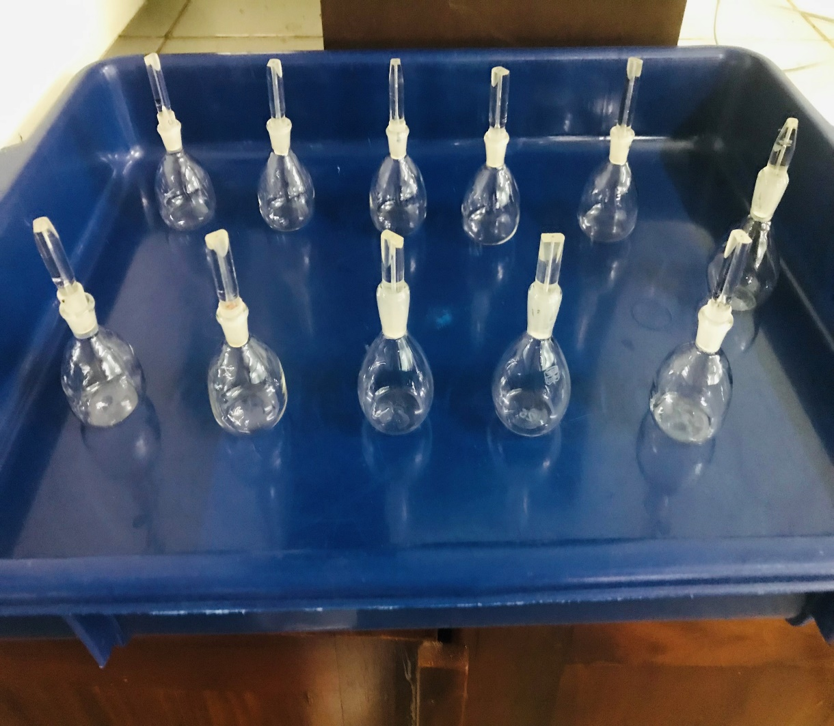
Soil porosity …
$Porosity\left(Pt\right)=\left\{1−\frac{Bulk Density \left(Pb\right)}{Particle Density\left(Pd\right)}\right\}x100\%$
Particle density…
Particle density is weight per unit volume of the
solid portion of soil (pycnometer method)
(Giuseppe et al. 2016)
The assumed average value is 2.65 g/${cm}^{−3}$.
Particle density = Ms/Vs
Ms = weight of soil Vs = solid volume
(Gallipoli and Bruno 2022)
Figure 6. Testing of soil particle density

Slide 12
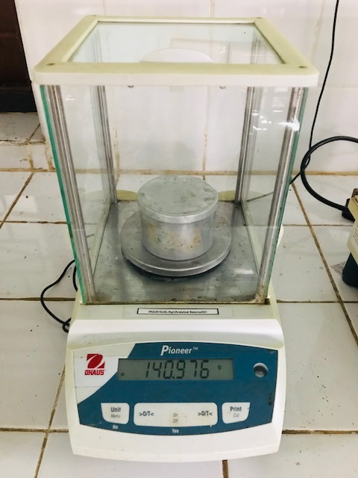
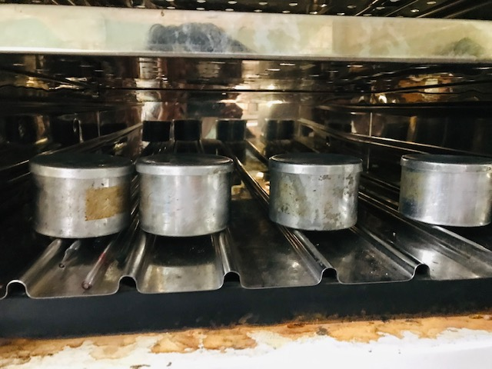
Soil Bulk density
The ratio of the weight of soil sample to the volume of the soil (core method) (Blake,1965). Bulk density = Ms/Vt
Ms = weight of soil Vt = total volume
Figure 7. Weight of the fresh soil sample
Figure 8. Oven dry soil sample

Slide 13
Data Analysis
Statistical data analysis were carried out in SAS software.(SAS version
9.4 was released 2020)
On assessing the;
The differences among the treatment means – One way ANOVA
and Post hoc test- TUKEY
Association among soil parameters - Pearson correlation analysis

Slide 14
Results and Discussion
Comparison of the calculation of porosity using assumed value for PD and measured value for PD in different soil types. (0-15cm)
2.65 gcm¯³
0.59
0.83
0.81
0.13
0.15
Graph 01. Variance between Assume and True Particle density (0-15 cm)

Slide 15
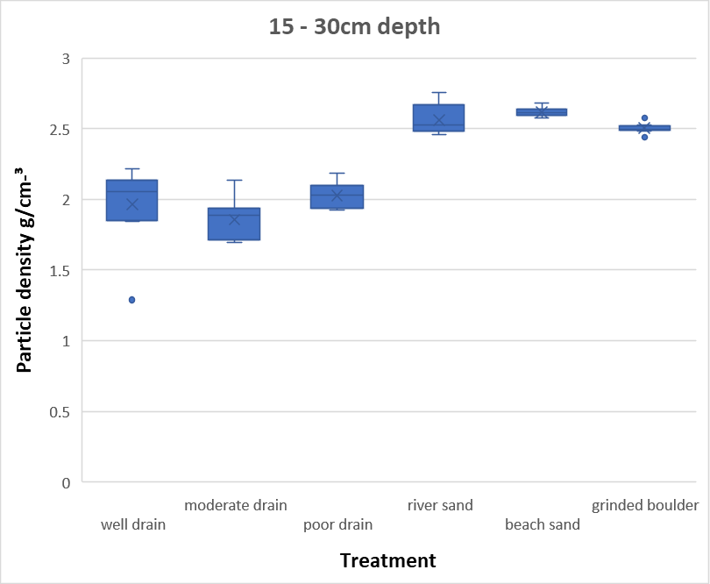
Comparison of the calculation of porosity using assumed value for PD and measured value for PD in different soil types. (15-30cm)
2.65gcm¯³
0.55
0.75
0.57
0.15
0.17
Graph 02. Variance between Assume and True Particle density (15-30 cm)

Slide 16
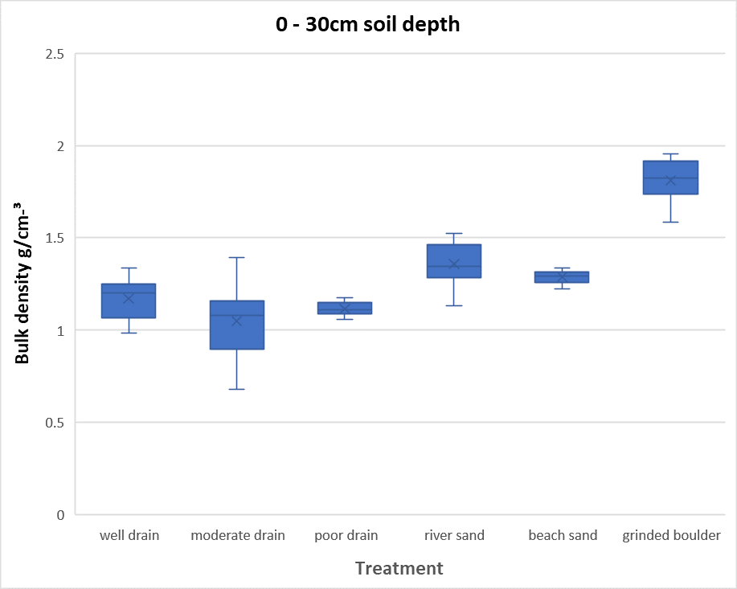
Comparison of the calculation of porosity using BD in different soil types.
1.96 gcm¯³
Maximum Bulk density
0.68 gcm¯³
Minimum Bulk density
Graph 03. Bulk density values likes between minimum and maximum value

Slide 17
Compare the true and assumed porosity in different soil types
14.4%
13.5%
11.6%
1.1%
4.12%
Graph 04. Variance between Assume and True porosity in different soil type

Slide 18
True and Assume porosity value in different soil type
Graph 05. True and Assume porosity value in different soil type

Slide 19
According to the results, there is no significant difference in soil depth (P<0.05 )
According to the results, soil type has significant difference (P<0.05)
There is not significant difference in soil depths and soil type (P<0.05)

Slide 20
Well drain
True porosity= 44.12%
Assume porosity=55.750%
Porosity of Soil Catena in Faculty Farm
Well drain soil variance = 11.63%
Moderate drain soil variance= 14.35%
Poor drain soil variance= 13.68%
Moderate drain
True porosity=48.90%
Assume porosity=63.25%
Poor drain
True porosity=44.75%
Assume porosity=58.437%

Slide 21
Correlation of soil particle density and soil texture
The correlation between the sand and soil particle density was statistically significance of the P<0.05 level with a Pearson correlation co-efficient of sand.it show that there is a positive linear correlation between particle density and sand.
Graph 06. Correlation between particle density and sand

Slide 22
Correlation of soil particle density and soil texture.
The correlation between the particle density and clay was statistically significance at the P<0.05 level with a Pearson correlation coefficient of clay.
There is a strong negative linear relationships between the clay.
Graph 07. Correlation between particle density between clay

Slide 23
Correlation of soil particle density and soil texture.
The correlation between the particle density and silt was statistically significance at the P<0.05 level with a Pearson correlation co-efficient of silt.
There is a strong negative linear relationships between the silt.
Graph 08. Correlation between particle density and silt

Slide 24
Conclusion and Recommendations
Calculated particle density significantly varied within the soil catena of faculty farm.
Thus the calculated true values of total porosity within the soil catena of faculty farm were significantly varied and true values of total porosity will be extremely useful to formulate precise and accurate management strategies for sustainable crop production.

Slide 25
References
Armah, J. R.M., and B. C. Ball. 1994. “A Functional Model of Soil Porosity Used to Interpret Measurements of Gas Diffusion.” European Journal of Soil Science 45 (2): 135–44. https://doi.org/10.1111/j.1365-2389.1994.tb00494.x.
Blake, G. R. 2015. “Particle Density.” Methods of Soil Analysis, Part 1: Physical and Mineralogical Properties, Including Statistics of Measurement and Sampling, no. 4949: 371–73. https://doi.org/10.2134/agronmonogr9.1.c29.
Blanco-Canqui, Humberto, R. Lal, W. M. Post, R. C. Risaralda, and M. J. Ship Italo. 2006. “Organic Carbon Influences on Soil Particle Density and Rheological Properties.” Soil Science Society of America Journal 70 (4): 1407–14. https://doi.org/10.2136/sssaj2005.0355.
Bouyoucos, George John. 1962. “ Hydrometer Method Improved for Making Particle Size Analyses of Soils 1 .” Agronomy Journal 54 (5): 464–65. https://doi.org/10.2134/agronj1962.00021962005400050028x.

Slide 26
Thank You

