Slide 1
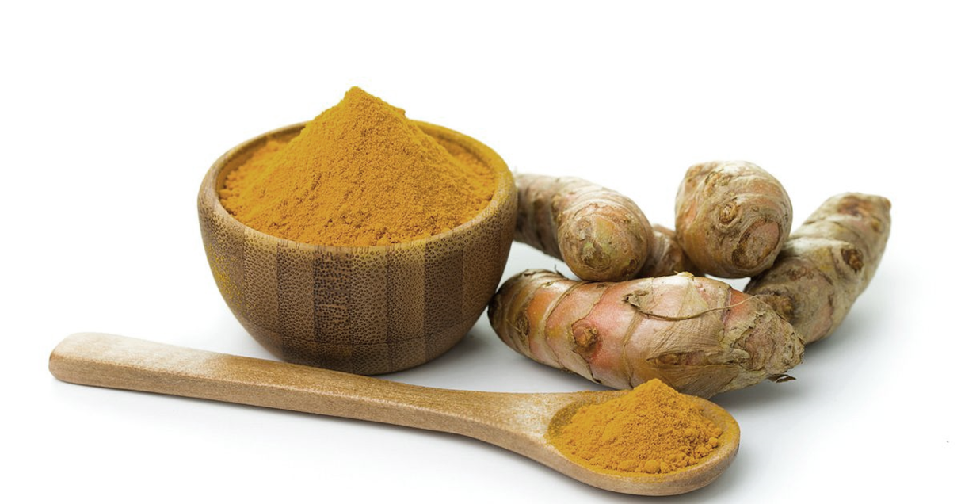
AN INVESTIGATION OF CONSTRAINTS ASSOCIATED WITH TURMERIC SUPPLY – CHAIN IN SRI LANKA
WTN Upasena, HSR Rosairo, KPDA Pathirage
Department of Agribusiness Management
Sabaragamuwa University
of Sri Lanka

Slide 2
Content
Introduction
Objectives
Material and Methods
Results and Discussion
Conclusion and Recommendations
References

Slide 3
Introduction
Turmeric (Curcuma longa) is renowned as the “’golden spice” and there are better cultivation conditions available in Sri Lanka.
The world’s giant turmeric producers are India, Myanmar and Indonesia.(Trade Map,2020)
Turmeric is grown in 25,506 mt in Sri Lanka, with a total export quantity of 69.3 mt worth Rs.86.3 million reported in 2020 (Central Bank report, 2020).
In terms of Sri Lanka,
Kurunegala district 85ha
Kegalle district 134 ha
Kandy district 423 ha
Matale district 87 ha

Slide 4
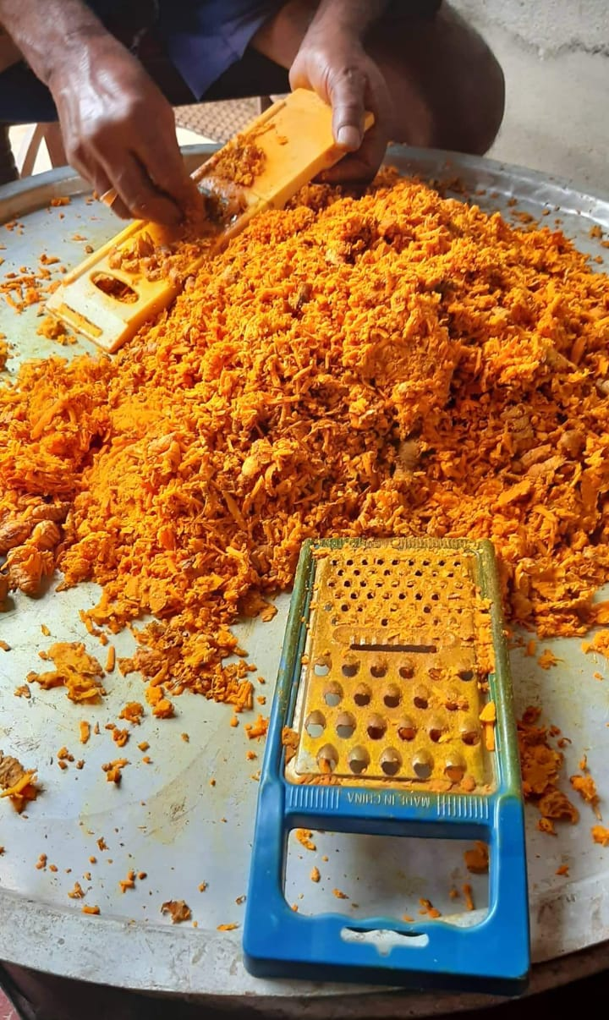
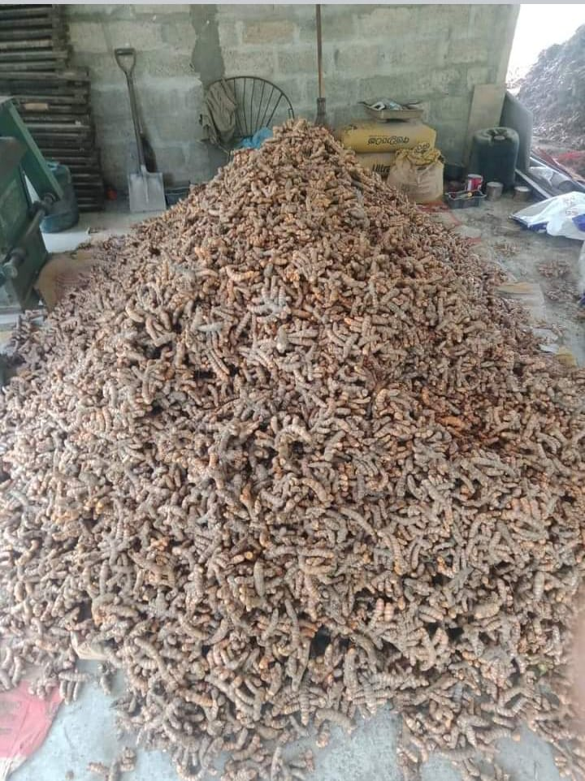
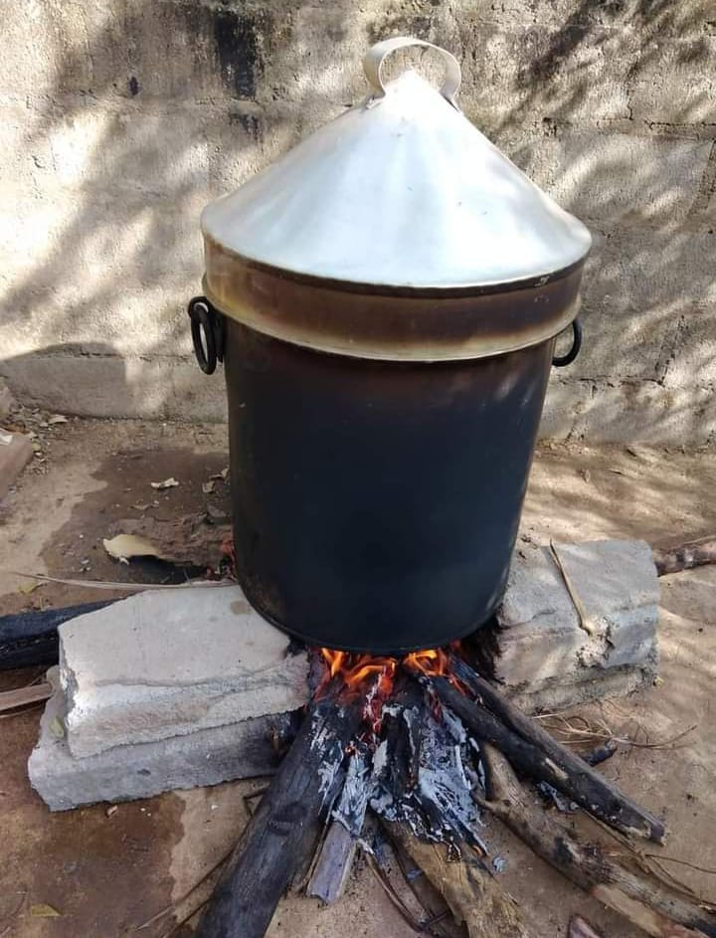
Introduction
In 2017 , 97% (USD 7 million) of domestic turmeric was imported from India (IPS,2020) . In 2020 , import restrictions imposed by the Sri Lankan government and it created great chance to boost domestic production of turmeric.
To increase the efficiency among the supply chains and to increase the fair share for the partners, identification of exact constraints which affect for their activities are highly important.

Slide 5
Objectives
Broad Objective
To determine the constraints faced by the local supply chain for turmeric in Sri Lanka and to identify remedial strategies to rectify this issue.
Specific Objectives
To understand the relationship among (stakeholders) in the local turmeric supply chain by mapping the supply chain.
To identify the buying patterns of Turmeric among the consumers from marketing point of view.
To identify the challenges faced by the downstream and upstream nodes of the supply chain for turmeric.
To recommend strategies to develop the turmeric supply chain to have a strong industry in Sri Lanka .

Slide 6
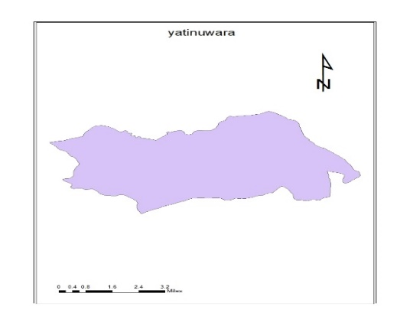
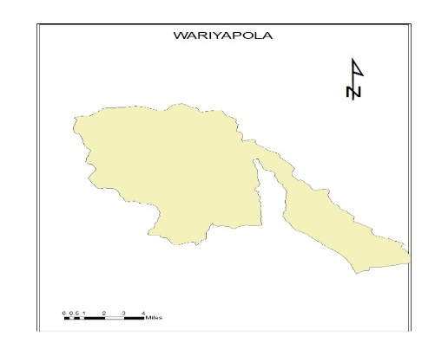
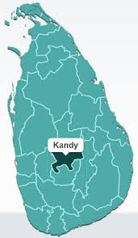
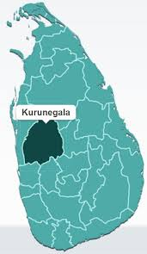
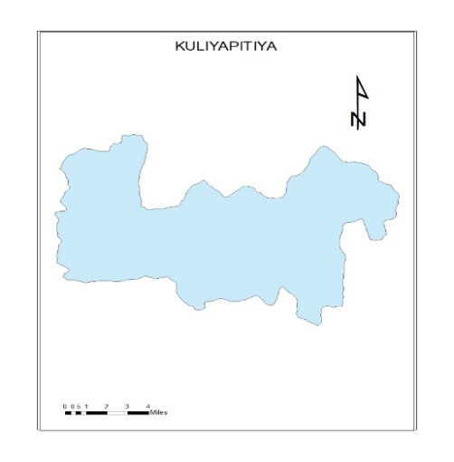
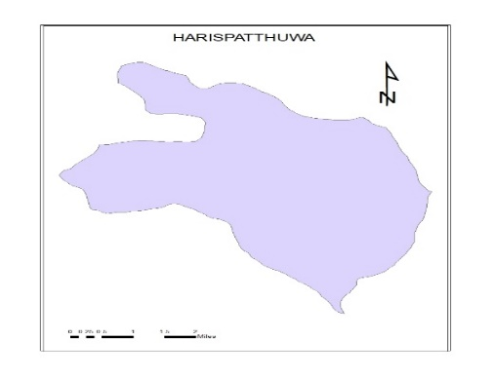
Material and Methods
In Kandy District, Turmeric has the highest extent accounting for 32% of hectare, total cultivated lands out from other districts.
As the cultivation extent data Kurunegela is the another one of the most cultivated land for the turmeric.

Slide 7
Research approach : Deductive Approach
Data collection Methods :
Data analysis tools :
Primary
Secondary
Questionnaires
Focus group Discussion
In depth Interview
Field observation
Other researches
Government census
3. Department of export agriculture
Sample size
-SPSS statistical software version 25
-MS excel
Total 362 partners
-farmers 100
-Customers 200
-Retailers 20
-Wholesalers 20
- Collectors 22

Slide 8
Objective 01:To understand the relationship among partners in the local turmeric supply chain by mapping the supply chain and cost analysis of the producer.
Farmers –Kurunegala and Kandy
Collectors- Pilimathalawa and Kuliyapitiya
Wholesalers- Pettah Market
Retailers- Kurunegla town and Pilimathalawa
Spice Manufacturers- Colombo
Customers- Colombo
Affiliation Agencies- Department of Export Agriculture, Govijana sewa, Banks (loan Schemes)
These actors were involved with activities such as harvesting, sorting, collecting, packing, storing, producing and marketing.

Slide 9
Chain Supporters
Supply Chain Map of Turmeric in the Study Area

Slide 10
Gross Profit Margin Calculation
$Gross profit Margin of retailers= \frac{consumer price−farmgate price }{consumer price}∗100$
= 4500-1500*100/4500
=66%
This always related to the final price or the price paid by the end consumer and it has expressed as a percentage.

Slide 11
Objective 02: To identify the buying patterns of Turmeric usage among the consumers from marketing point of view .
Variable | Cronbach’s Alpha | No.of items | Significant or not
Product Quality | 0.795 | 5 | Accepted
Satisfaction | 0.756 | 4 | Accepted
Availability | 0.886 | 6 | Accepted
Product Attributes | 0.875 | 6 | Accepted
The alpha coefficient associated with the items , should be more than .75 to be acceptable.

Slide 12
Dependent variable
Purchase Behavior
Independent variables
Age
Gender
Education Level of consumer
Number of family members
Income level of the family
Market distance
Price of the product
Value addition
Purpose of purchase
Assuming that no assumptions have been violated,
Model Summary of Regression Analysis
Model | R | R Square | Adjusted R Square | Std Error of the estimate
1 | .856ª | .733 | 0.717 | 185.081152
R value can be considered to be one measure of the quality of the prediction of the dependent variable.
R=0.865 is good level of prediction.
Independent variables explain 73.1% of the variability of dependent variable (R square )
BSc. Food Business Management: Department of Agribusiness Management

Slide 13
Objective 03: To identify the challenges (constraints) facing by the downstream and upstream nodes part of the supply chain for turmeric.
Constraints faced by farmers
Constraints | Frequency | Percentage | Std.dev | Mean | Total
Higher labor cost | 59 | 59.6% | 49..320% | 51.52% | 100%
Lack of processing technology | 49 | 49.5% | 50.252% | 51.52% | 100%
Lack of storage facilities | 67 | 52.5% | 50.190% | 40.40% | 100%
Higher cost of seeds | 45 | 63.8% | 48.349% | 50.51% | 100%
Financial weakness | 46 | 53% | 48.626% | 4747% | 100%
Transportation Problems | 57 | 55.2% | 50.129% | 36.36% | 100%
Low price | 33 | 44% | 49.943% | 37.37% | 100%
Impact of Pestilence | 22 | 48.5% | 49943% | 46.46% | 100%
Natural Disasters | 39 | 52.3% | 50.231% | 44.44% | 100%

Slide 14
Constraints faced by the Retailers
Constraints | Frequency | Percentage | Std.dev | Mean | Total
Packet damages | 13 | 59.1% | .50324 | 40.9091% | 100%
Pest attacks | 16 | 72% | .45584 | 27.2727% | 100%
Discoloration | 15 | 68% | .47673 | 31.8182% | 100%
Price Fluctuations | 12 | 77.3% | .43893 | 42.7273% | 100%
Shortage of the product | 10 | 45% | .44893 | 62.7273% | 100%
Lack of storage facilities | 14 | 63% | .423893 | 30.72735 | 100%

Slide 15
Constraints faced by the Collectors
Constraints | Frequency | Percentage | Std.dev | Mean | Total
Low pricing Scheme | 10 | 45% | .45584 | 27% | 100%
Bargaining power of the buyers | 15 | 59.1% | .50324 | 40% | 100%
Low product quality at purchase | 13 | 63.6% | .49237 | 36.3% | 100%
Government barriers (fertilizer banned) | 14 | 68.2% | .47673 | 31% | 100%
Economic Crisis | 16 | 72.4% | .47673 | 59% | 100%
Seasonality | 9 | 40.9% | .50324 | 50% | 100%
External Competition | 11 | 50% | .51177 | 22% | 100%
Product deterioration during storage | 17 | 77% | .42893 | 32% | 100%

Slide 16
Constraints faced by Wholesalers
Constraints | Frequency | Percentage | Std dev | Average | Total
Price Settings | 18 | 72% | 45826 | 12% | 100%
Storage problem | 11 | 44% | 50662 | 15% | 100%
Transportation issues | 6 | 24% | 43589 | 17.6% | 100%
Legal Framework | 10 | 40% | 50000 | 16% | 100%
Higher Labor cost | 12 | 45% | 50662 | 15.6% | 100%
Scarcity of high quality raw materials | 10 | 40% | 50000 | 16% | 100%
Seasonality | 13 | 52% | 50990 | 14.8% | 100%

Slide 17
Conclusion and Recommendations

Slide 18
References
Berardini, A. (2019). https://barnboken.net/index.php/clr/article/view/417. Barnboken, 42.
Central Bank of Sri Lanka. (2020). Central Bank of Sri Lanka. https://www.cbsl.gov.lk/
Kodithuwakku, S. (2014, April 24). Analysis of Vegetable Supply Chains of Supermarkets in Sri Lanka.
Mould, G., Heizer, J., & Render, B. (1994). Production and Operations Management: Strategies and Tactics (3rd Edition). The Journal of the Operational Research Society, 45(5), 5
Fernando, R. (2021). Sri Lanka. Direct Jurisdiction. doi.org/10.5040/9781509936458.ch-015
Wibowo, B., Kusdiartini, V., Rahutami, I., Anugraheni, D. T., & Supriyanto, I. (2021b). FARMERS DEPENDENCY IN THE POTATO SUPPLY CHAIN IN BATUR, CENTRAL JAVA, INDONESIA. International Journal of Supply Chain, Operation Management and Logistics, 2(4), 01–13

Slide 19
Thank You

