Slide 1
The Influence of Stocking Density on Growth Performances of Neon Tetra (Paracheirodon innesi, Myers,1936) Under the Aquarium Conditions
MS Artharpaul ¹*, CN Walpita ¹, AR Mudalige ², KPNNS Jayarathne ²
¹ Department of Livestock Production, Faculty of Agricultural Sciences, Sabaragamuwa University of Sri Lanka
² National Aquaculture Development Authority of Sri Lanka (NAQDA)

Slide 2
Content for the presentation
Introduction
Objectives
Material and Methods
Results and Discussion
Conclusion and Recommendations
References

Slide 3
Introduction
Ornamental fish production provides an excellent business opportunity in
Sri Lanka A strong demand from both local and export markets (Heenatigala, 2007)
Guppy, Neon tetra, Platy, Swordtails, Molly, Angels, Goldfish, Zebra danio and Discus are the main ornamental fish species ruling the Sri Lankan export market
60% of the export trade is made up of freshwater fish such as Neon tetra and Guppy (EDB, 2021)

Slide 4
Neon tetra fish (Paracheirodon innesi)
Family : Characidae
Order : Characiformes
Diet : Omnivore
Breeding: Egg scatterer
Life expectancy : 6–8 years
Temperature:21–27°C
pH : 6.0–7.0

Slide 5
No research - About the influence of stocking density on growth performances of Neon tetra (Paracheirodon innesi) under the controlled conditions
It’s better to find the proper stocking density with appropriate controlled conditions

Slide 6
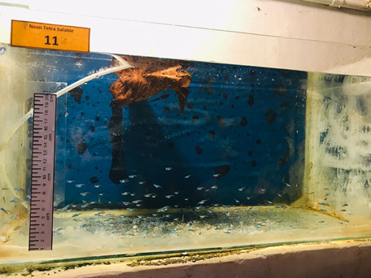
Objective
To determine the effect of stocking density of
Neon tetra (Paracheirodon innesi) on growth
performances,survival rate and to find the better
stocking density for culture in glass tanks

Slide 7
Material and Methods
This study was carried out in 6 weeks in National Aquaculture Development Centre (NAQDA) – Ornamental Fish Breeding Centre in Ginigathhena
A completely randomized design (CRD) 16 glass tanks (2 𝑓𝑒𝑒𝑡×1𝑓𝑒𝑒𝑡×1𝑓𝑒𝑒𝑡)
The fry rearing was conducted at four densities 2 fry/liter, 3 fry/liter, 4 fry/liter and 5 fry/liter, respectively with four replicates

Slide 8
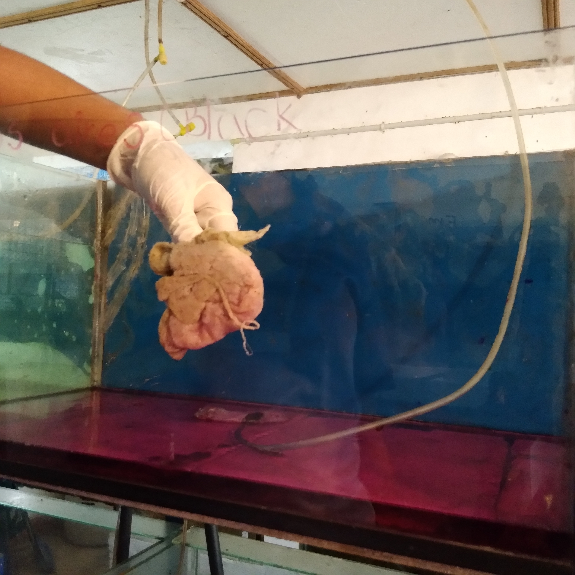
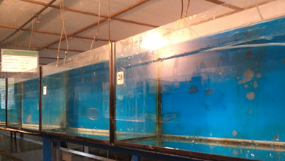
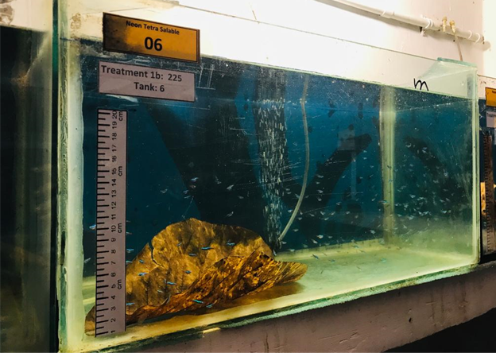
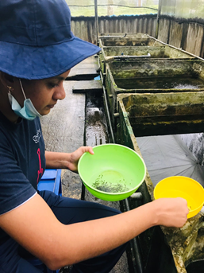
Preparation of glass tanks
(TBL = 1+.00046 cm )
-Sterilized glass tanks-
-Washing glass tanks with the
use of a KMnO₄ solution-
-One of a glass tank prepared for experiment-
-Sorting 1cm sized Neon tetra fry-

Slide 9
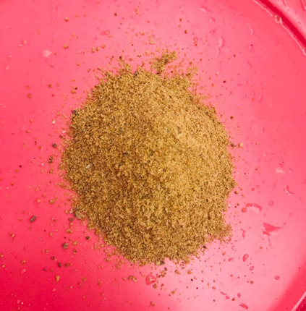
Feeding of neon tetra (Paracheirodon innesi) fry
Feeding formulated powder feed at a rate of 10%
of the body weight
Feeding amount was increased weekly at a rate of 25%
Feeding trial was continued up to 06 weeks
-Formulated powder feed-
The formulated powder feed 1kg of commercial feed (CP=40%,CF=8%, GE=3500Kcal), 300g of fish meal, 10g of vitamin B, 10g of vitamin C and 10g of vitamin E

Slide 10
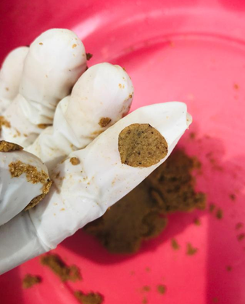
Feed flakes were made from formulated powder feed before feeding
The feed doses were proportional to the number of fry in each treatment
Neon tetra fish fry were fed 3 times per day (8.00, 11.00 and 15.00)
-Feed flakes-

Slide 11
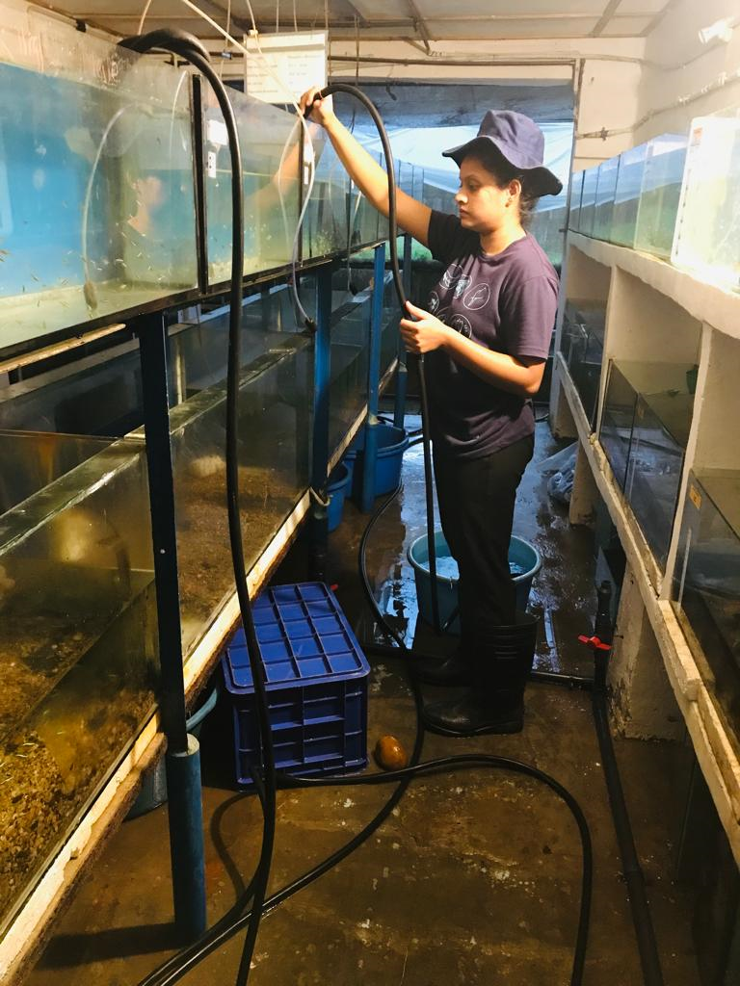
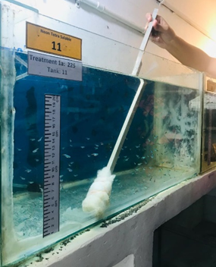
Management practices
Every day in the morning and evening
25% of water was replaced with fresh water
-Siphoning the glass tanks-
Bottom and the sides of each tanks were wiped out once a week.
-One of a glass tank is wiping-

Slide 12
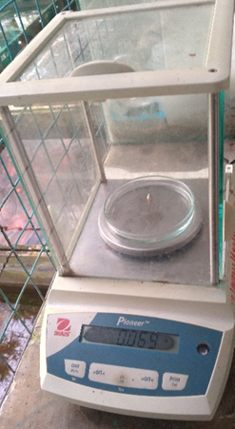
Taking measurements
30 number of Neon tetra
(Paracheirodon innesi) fry
- Weighed, measured their total body length
once every two weeks
-Weighing and measuring total length of Paracheirodon innesi fry-

Slide 13
Water quality parameters :
pH, Diisssolved Oxygen (DO) and Temperature
Measured two times per day (8.00 and 16.00) in once in two days
Measured two times per day (8.00 and 16.00) in once a week
Ammonia level in the water

Slide 14
Data analysis
The data were tabulated and analyzed statistically using SPSS statistical package
(version 23) and MS Excel to determine whether there will be differences in means
of variables among treatments
Duncken test was used to compare the means between treatments
All statistical tests were considered significant at (P < 0.05) by using One-way Analysis of Variance (ANOVA 1)

Slide 15
Results and Discussion
Body Weight

Slide 16
Body Weight Gain (BWG)

Slide 17
Total Body Length

Slide 18
Body Length Gain

Slide 19
Specific Growth Rate
ln (final fish weight) - ln (initial fish weight)
x100
Specific growth rate (SGR, % ) =
Time (days)
(Darve et al., 2016)

Slide 20
Feed Intake

Slide 21
Feed Conversion Ratio (FCR)
Feed Conversion Ratio =
Quantity of feed taken
Weight increased
(Jabeen et al., 2004)

Slide 22
Condition Factor ( K-factor)
Weight (g)
K-factor =
× 100
(Mozsár et al., 2015)
Length (cm) ³

Slide 23
Survival Rate
Survival (%) = No. survived fish
No. initial fish
x 100
(Sanaye et al., 1936)

Slide 24
- 2 fry per liter -
- 3 fry per liter -
- 4 fry per liter -
- 5 fry per liter -

Slide 25
Water Quality Parameters
pH
Dissolved Oxygen level (DO)
Temperature
No Significant difference

Slide 26
Ammonia Level

Slide 27
Conclusion and Recommendations
Conclusions: - Among the tested stocking densities 2 and 3 fry per liter are the best
- None of the stocking densities tested, affect the survival of Neon tetra fry
Recommendation: It is recommended to use 3 fry per liter as the stocking density for culturing Neon tetra fry

Slide 28
References
keda, T., & Kohshima, S. (2009). Why is the neon tetra so bright? coloration for mirror-image projection to confuse predators? “mirror-image decoy” hypothesis. Environmental Biology of Fishes, 86(3), 427–441. https://doi.org/10.1007/s10641-009-9543-y
Saxby, A., Adams, L., Snellgrove, D., Wilson, R. W., & Sloman, K. A. (2010). The effect of group size on the behaviour and welfare of four fish species commonly kept in home aquaria. Applied Animal Behaviour Science, 125(3-4), 195-205.
Chapman, F. A., Colle, D. E., Rottmann, R. W., & Shireman, J. V. (1998). Controlled Spawning of the Neon Tetra. Progressive Fish-Culturist, 60(1), 32–37. https://doi.org/10.1577/1548-8640(1998)060<0032:CSOTNT>2.0.CO;2
Sanaye, S. V., Singh, H., & Tibile, R. M. (n.d.). Growth and survival of neon tetra, Paracheirodon innesi (Myers, 1936) fry fed mixed zooplankton, formulated feed and combination thereof. Scholars Research Library Annals of Biological Research, 2012(12), 5665–5668. Retrieved from www.scholarsresearchlibrary.com http://scholarsresearchlibrary.com/archive.html

Slide 29
Darve, S. I., Wani, G. B., & Singh, H. (2016). Dietary Lipid Requirements for Neon tetra (Paracheirodon innesi): A Valuable Ornamental fish. SKUAST Journal of Research, 18(2), 146–153. Retrieved from https://www.indianjournals.com/ijor.aspx?target=ijor:skuastjr&volume=18&issue=2&article=012
Jabeen, S., Salim, M., & Akhtar, P. (2004). Feed Conversion Ratio of Major Carp Cirrhinus Mrigala Fingerlings Fed on Cotton Seed Meal, Fish Meal and Barley. Pakistan Veterinary Journal, 24(1), 42–45.
Mozsár, A., Boros, G., Sály, P., Antal, L., & Nagy, S. A. (2015). Relationship between Fulton’s condition factor and proximate body composition in three freshwater fish species. Journal of Applied Ichthyology, 31(2), 315–320. https://doi.org/10.1111/jai.12658

Slide 30
Acknowledgement
The author wish to thank,
Prof. C.N Walpita (Internal Superviser), Department of Livestock Production,Faculty of Agricultural Sciences,
Sabaragamuwa University of Sri Lanaka
Mr. K.P.N.N.J Jayarathne (External Superviser), OIC, Aquaculture Development center, Ginigathhena (NAQDA)
Mr. A.R Mudalige, Fish Genetic Specialist, Aquaculture Development center, Dambulla (NAQDA)
Mr. N.M.R.S Rajasinghe, OIC, Aquaculture Development center, Kalawewa (NAQDA)
Prof. S.P Jayaweera (Head of the Department), Department of Livestock Production,Faculty of Agricultural
Sciences, Sabaragamuwa University of Sri Lanaka
Mr. M.Naveenan, Lecturer, Department of Livestock Production,Faculty of Agricultural Sciences, Sabaragamuwa
University of Sri Lanaka
Mr. M.K.C Priyadarshana, Research Assistant, Department of Livestock Production,Faculty of Agricultural Sciences,
Sabaragamuwa University of Sri Lanaka

Slide 31
Thank You

