Slide 1
Present Status of Post-harvest Practices of Guava (Psidium guajava), Bitter Gourd (Momordica charantia), and Long Bean (Vigna unguiculata ssp. sesquipedalis) in Anuradhapura and Kurunegala Districts.
A.M.R.N Bandara ¹ , Prof: G.D.K Kumara ¹, Mr. W.M.C.B Wasala ²
¹ Department of Export Agriculture, Faculty of Agricultural Sciences, Sabaragamuwa University of Sri Lanka, ² National Institute Of Post-harvest Management, Anuradhapura.

Slide 2
Content for the presentation
Introduction
Objectives
Methodology
Results and Discussion
Conclusion
Recommendations
References

Slide 3
Introduction
Guava, bitter gourd and long bean farming is significant in Anuradhapura and Kurunegala districts.
20-40 % vegetables
30-40 % fruits
Improper post-harvest management practices
Quantitative losses
Whole seller
Retailer
Consumer
Farmer
Collector
Transporter
Qualitative losses
Guava, bitter gourd and long bean supply chain

Slide 4
Objectives
Overall objective
To investigate the present status of post-harvest management practices of guava, bitter gourd, and long bean with respect to major stakeholders in the supply chain.
Specific objectives
To study the problems and challenges faced by stakeholders involved in the guava, bitter gourd, and long bean supply chain Kurunegala and Anuradhapura districts.
To investigate the main causes of post-harvest losses in guava, bitter gourd, and long bean supply chain Anuradhapura and Kurunegala districs.
To propose some measures to improve the current post-harvest management practices to reduce the postharvest losses in guava, bitter gourd, and long bean supply chain.

Slide 5
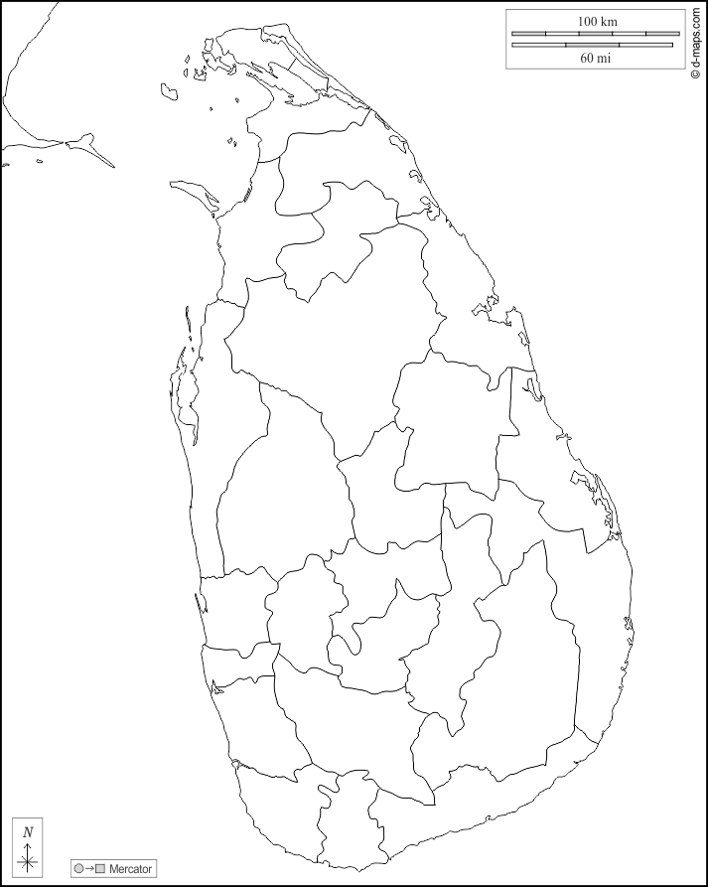
Methodology
Study Area
Farmers were selected randomly from villages of 3-4 DS divisions in Anuradhapura and Kurunegala districts.
Other stakeholders were selected randomly from market places and economic centers in respective districts.
Anuradhapura
Kurunegala

Slide 6
Methodology cont.
Experimental Design
Study Sample
Qualitative and quantitative data on postharvest handling, packaging, and other relevant information were gathered from 213 stakeholders.
Sample size
213
Anuradhapura 148
Kurunegala 65

Slide 7
Methodology cont.
Data collection method
Data were gathered through a field survey
Pre-tested semi structured questionnaires formulated separately for each category of stakeholders, were used.
All respondents were contacted through face-to-face interviews or through phone calls.
Each stage of stakeholders in the supply chain were asked the same questions separately based on the questionnaire.

Slide 8
Methodology cont.
Collected data
From farmers
Harvesting maturity stage
Harvesting tools and methods
Harvesting time of the day
Grading
Packaging material
Selling method
Specific post-harvest practices
From collectors, transporters, whole-sellers, and retailers
Packaging material
Selling methods
Transportation method
Transportation time in the day
Transportation distance
From consumers
Purchasing practices
Place of purchase
Preference of grading
Packaging details
Displaying details

Slide 9
Methodology cont.
Statistical analysis
Descriptive statistics were presented as percentages.
Chi-square tests were conducted with frequency analysis to measures qualitative data.
SPSS statistical package version 26.0 was used to data analysis.

Slide 10
Results and Discussion
Farmer - Anuradhapura

Slide 11
Result and discussion cont.

Slide 12
Result and discussion cont.
Collector - Anuradhapura

Slide 13
Result and discussion cont.

Slide 14
Result and discussion cont.
Transporter - Anuradhapura

Slide 15
Result and discussion cont.
Wholesaler - Anuradhapura

Slide 16
Result and discussion cont.
Retailer - Anuradhapura

Slide 17
Result and discussion cont.
Consumer - Anuradhapura

Slide 18
Result and discussion cont.
Farmer - Kurunegala

Slide 19
Result and discussion cont.

Slide 20
Result and discussion cont.
Collector - Kurunegala

Slide 21
Result and discussion cont.
Transporter - Kurunegala

Slide 22
Result and discussion cont.
Wholesaler - Kurunegala

Slide 23
Result and discussion cont.
Retailer - Kurunegala

Slide 24
Result and discussion cont.
Consumer - Kurunegala

Slide 25
Result and discussion cont.
P(.000) < 0.05

Slide 26
Result and discussion cont.
P(.201) > 0.05

Slide 27
Result and discussion cont.
P(.200) > 0.05
P(.000) < 0.05

Slide 28
Result and discussion cont.
P(.000) < 0.05
P(.100) > 0.05

Slide 29
Result and discussion cont.
P(.539) > 0.05

Slide 30
Conclusion
Farmers in both districts have considerable knowledge about harvesting practices
Not many farmers, collectors, transporters, wholesalers and retailers have knowledge about packaging and transportation of commodities.
Bulk transportation leads to mechanical damages due to compression, impact, and vibration at the transporter level.
Majority of stakeholders do not use safe packaging methods.

Slide 31
Recommendations
Need to conduct training and awareness programs on post-harvest handling, transporting and safe packaging
Promote and facilitate the use of plastic crates
Bring legislation to make the use of plastic crates mandatory.

Slide 32
References
Esham, M. and Usami, K. (2006) ‘Procurement behavior of the fruit and vegetable industry in Sri Lanka’, Journal of Agricultural Sciences, 2(3), p. 36. Available at: https://doi.org/10.4038/jas.v2i3.8135.
R. T. Gunarathna and Y. Mahinda Bandara, "Post Harvest Losses and the Role of Intermediaries in the Vegetable Supply Chain," 2020 Moratuwa Engineering Research Conference (MERCon), 2020, pp. 378-383, doi: 10.1109/MERCon50084.2020.9185197.
Herath, M.M., Dissanayake, C.A.K., Wasala, W.M.C.B., Somakanthan, N. and Gunawardhane, C.R., 2021. The effect of improved postharvest practices on the postharvest losses and quality of mango fruit in Sri Lanka's supply chain. Journal of Horticulture and Postharvest Research, 4(4), pp.509-520.

Slide 33
References cont.
Kader, A.A. (2005) Increasing Food Availability and Reducing Postharvest Losses of Fresh Produce. Proceedings of the 5th International Postharvest Symposium, Verona, 6-11 June 2004, 2169-2175
Rajapaksha, L., Gunathilake, D.C., Pathirana, S.M. and Fernando, T., 2021. Reducing post-harvest losses in fruits and vegetables for ensuring food security—Case of Sri Lanka. MOJ Food Process Technols, 9(1), pp.7-16.
Vidanapathirana, R., Hathurusinghe, C.P., Rambukwella, R.O.S.H.I.N.I. and Somarathne, T.G., 2012. A Study on value chain of Pineapple and Banana in Sri Lanka.
Wasala, W.M.C.B., Dissanayake, C.A.K., Dharmasena, D.A.N., Gunawardane, C.R. and Dissanayake, T.M.R., 2014. Postharvest losses, current issues and demand for postharvest technologies for loss management in the main banana supply chains in Sri Lanka. Journal of Postharvest Technology, 2(1), pp.80-87.

Slide 34
Thank You

