Slide 1
Potential Application of Gizzard Fat in Manufacturing of Emulsion type Chicken Sausages
BWYNB Wijayathunga^{1*}, DMA Gunarathne¹

Slide 2
Content
Introduction…………………………………………………………………………….
Research problem………..………………………………………………………….
Research Objectives…………………………………………………………………
Significance of the study………………………………………………………….
Materials and Methods……………………………………………………………
Results and discussion……..………………………………………………………
Conclusion..……………………………………………………………………………..
References……………………………………………………………………………….
2

Slide 3
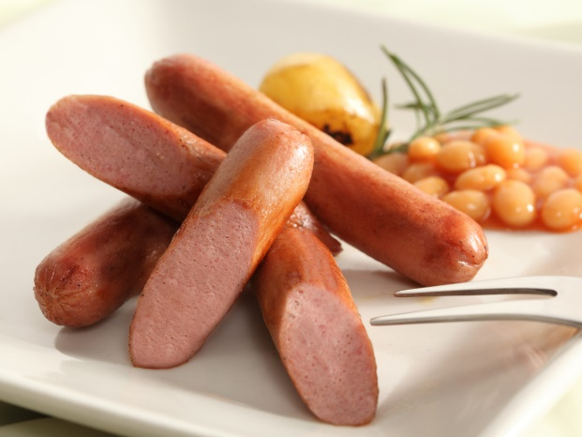
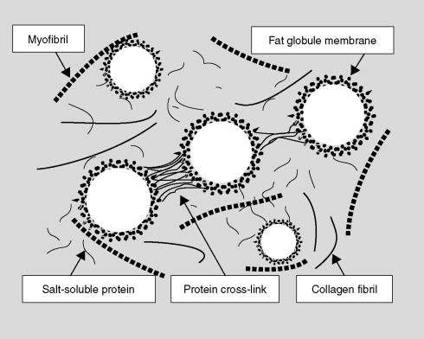
Introduction
Chicken sausage is a type of sausage made from ground chicken meat. These sausages include other ingredients and fillers
An emulsion-type sausage is a mixture of meat, fat, water, spices, and additives in which fat is dispersed more or less uniformly in a continuous, highly hydrated protein matrix
Figure 1- Chicken sausage
Figure 2- Meat emulsion
https://ars.els-cdn.com/content/image/3-s2.0-B012464970X001197-gr5.jpg
Emulsions made of chicken or pork skin are widely used in cooked sausage production as they are inexpensive and add bite and firmness (Gerhard Feiner, 2006)
3

Slide 4
Introduction (cont.)
Introduction
The rapid growth in chicken meat production and consumption resulted in large amount of by-products
The use of by-products would contribute to the development of a sustainable food industry while increasing the value of this sector
Amoung these chicken by-products, abdominal and gizzard fat is usually considered as waste
It may be possible that the abdominal and gizzard fat that remains inside the poultry carcass, could be used as fat source for the production of chicken sausages
4

Slide 5
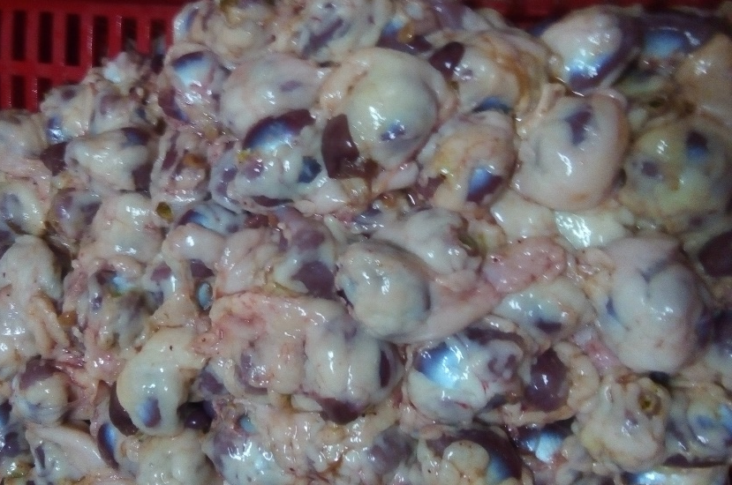
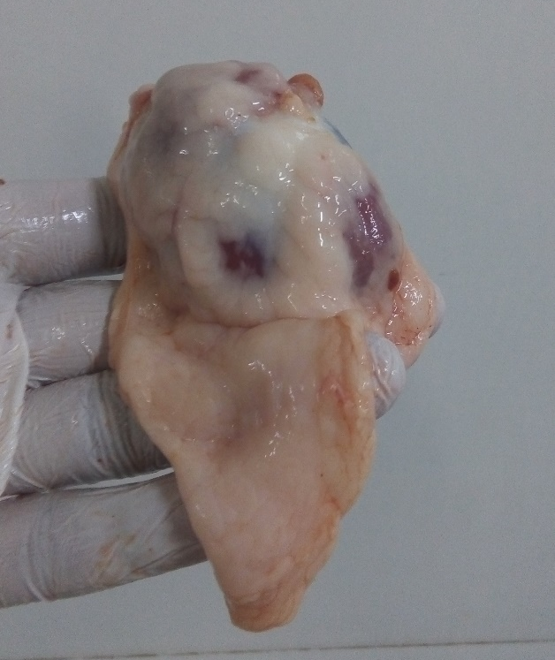
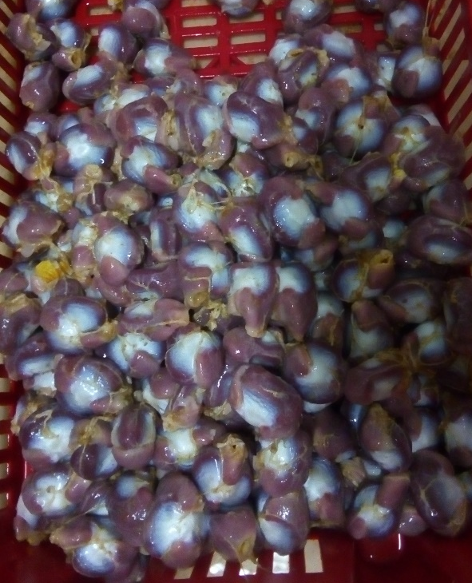
Introduction (cont.)
Gizzard fat showed a higher unsaturated fat content than that of chicken skin (Lina et al. 2020) and thus more healthier than chicken skin
Figure 4 - Gizzards before defattening
Figure 3 - Gizzard with surrounded fat
Figure 5 - Gizzards after defattening
5

Slide 6
Introduction ( cont.)
Nutritionally superior these fats could be a promising alternative for traditionally used chicken skin, in sausage making
Until now, abdominal and gizzard fat has been discarded by meat producers together with viscera, feathers, and blood for rendering and further processing
6

Slide 7
Research Problem
Although gizzard fat has a potential to be used as a fat source for chicken sausage, little has been done to explore its potential applications
7

Slide 8
To produce an emulsion type chicken sausage incorporating gizzard fat by replacing the chicken skin and
Research Objectives
To evaluate the physiochemical properties of the final product
To evaluate the organoleptic properties of the final product
To identify a best level for incorporation of Gizzard fat in chicken sausage manufacturing.
8

Slide 9
Research Methodology and Materials
Research location
Meat science laboratory and Livestock laboratory, Department of Livestock Production Faculty of Agricultural Sciences, SUSL
Chemistry laboratory, Department of Export Agriculture Faculty of Agricultural Sciences, SUSL
Cinnamon laboratory, Department of Agri business Management Faculty of Agricultural Sciences, SUSL
9

Slide 10
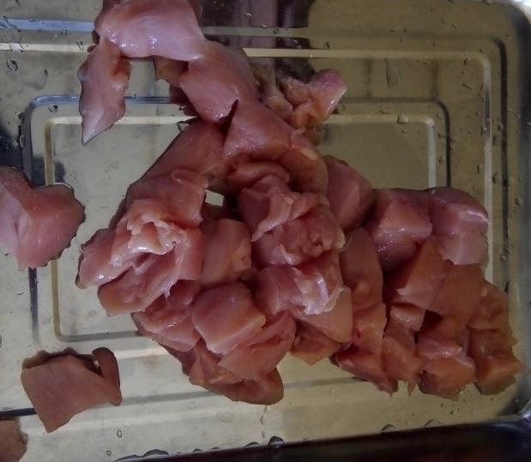
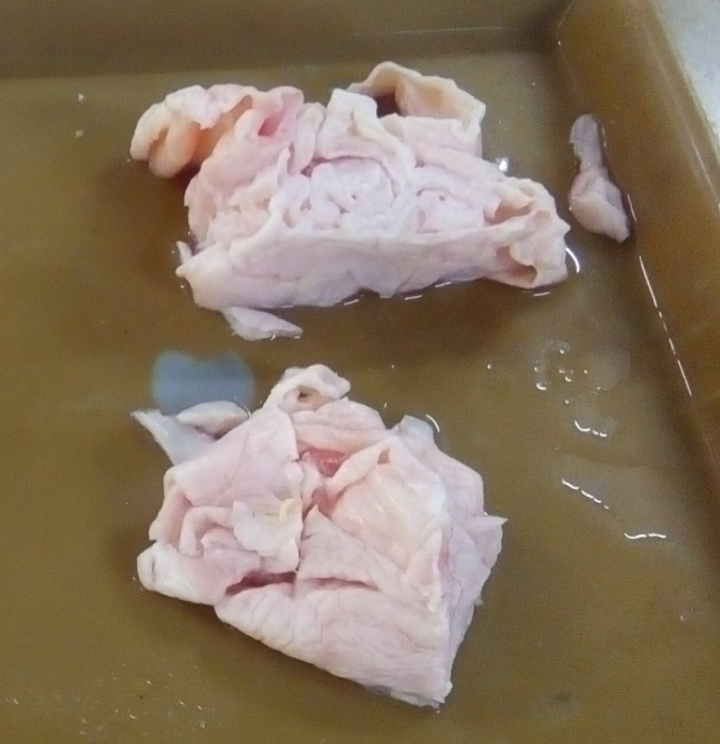
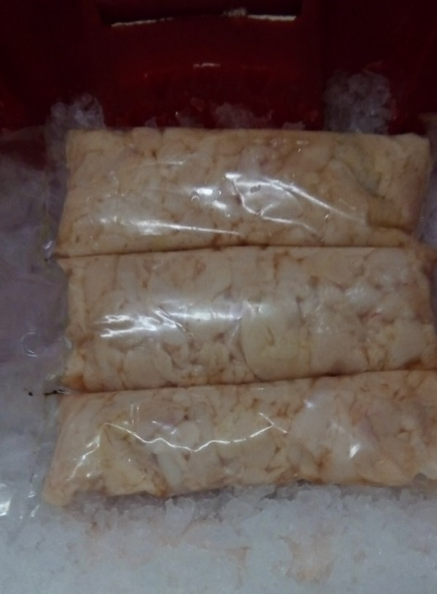
Research Methodology and Materials cont.
Major raw materials
1. Gizzard fat
2. Chicken breast meat
3. Loose meat (Chicken skin)
4. Salt
5. Ice water
6. Rusk Powder
7. Corn flour
8. Sugar
9. Spices
10. Additives
Figure 6 : Chicken breast meat
Figure 7 - Loose meat
Figure 8 - Gizzard fat
10

Slide 11
Research Methodology and Materials cont.
Research Design
Four different formulations of sausage samples were produced (Table1). Each formulation was replicated 3 times, The treatment levels were designed based on previous studies
Table 1 : Research design
Sample | Chicken Skin (%) | Gizzard fat %
Control | 100% | -
50% Gizzard fat | 50% | 50%
75% Gizzard fat | 25% | 75%
100% Gizzard fat | - | 100%
11

Slide 12
Research Methodology and Materials cont.
Sausage recipe
Ingredient % | Sample formulations
 | Control (100% skin fat) | 50% Gizzard fat | 75% Gizzard fat | 100% Gizzard fat
Meat | 70 | 70 | 70 | 70
Ice water | 5 | 5 | 5 | 5
Skin fat | 15.2 | 7.6 | 3.8 | -
Gizzard Fat | - | 7.6 | 11.4 | 15.2
Rusk | 6.2 | 6.2 | 6.2 | 6.2
Salt | 2 | 2 | 2 | 2
Sugar | 0.3 | 0.3 | 0.3 | 0.3
Pepper | 0.3 | 0.3 | 0.3 | 0.3
Cinnamon | 0.2 | 0.2 | 0.2 | 0.2
Ginger powder | 0.2 | 0.2 | 0.2 | 0.2
Corn flour | 0.1 | 0.1 | 0.1 | 0.1
Sodium phosphate | 0.3 | 0.3 | 0.3 | 0.3
Ascorbic acid | 0.1 | 0.1 | 0.1 | 0.1
Sodium nitrate (ppm) | 156 ppm | 156 ppm | 156 ppm | 156 ppm
Total | 99.92 | 99.92 | 99.92 | 99.92
Table 2 : Sausage recipe
12

Slide 13
Research Methodology and Materials cont.
Production flow chart of Sauasge
Mincing – 700g of chicken breast, loose meat and Gizzard fat were minced separately
Bawl chopping – Three minuites while mixing fat, ice water (maintaing emulsion temprature <18˚C) and all the other ingredients
Stuffing into cellulose casins – 20mm
200 g of raw emulsion, stored
<4 ˚C
Cooking
Cooked upto 85˚C of celcious using oven (90 min)
13

Slide 14
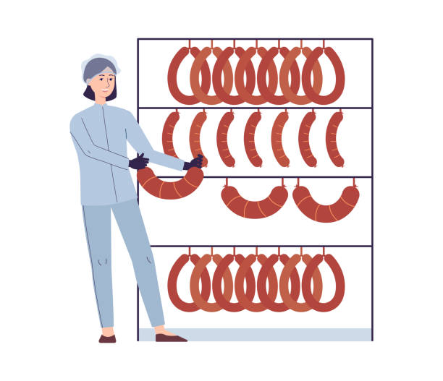
Research Methodology and Materials cont.
Production flow chart of Sauasge (cont.)
Chilling
< 4˚C for 20 Minuites
Peeling
Packing – Two sausages per one pack
Frozen storage
< -18 ˚C
14

Slide 15
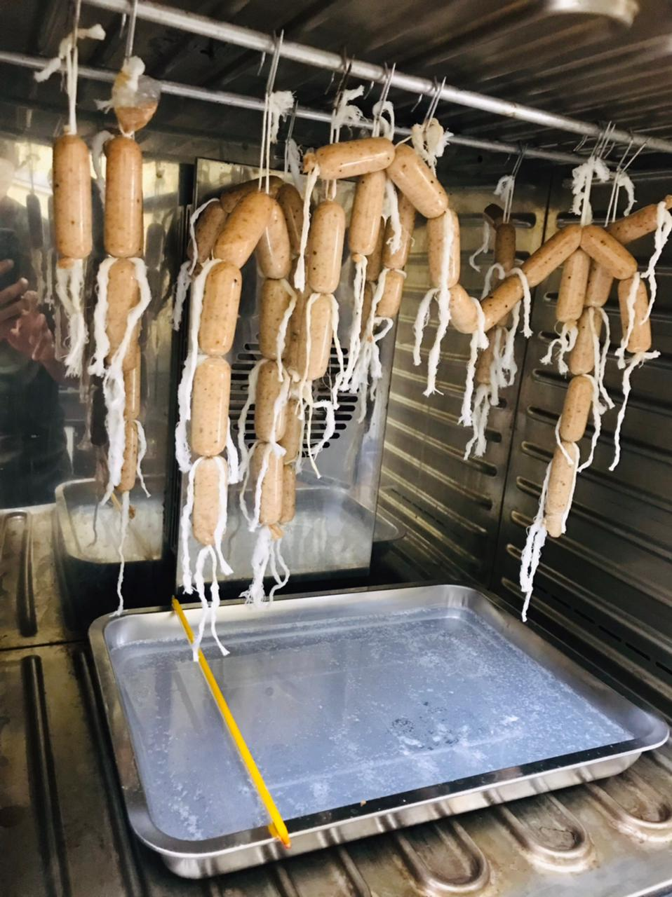
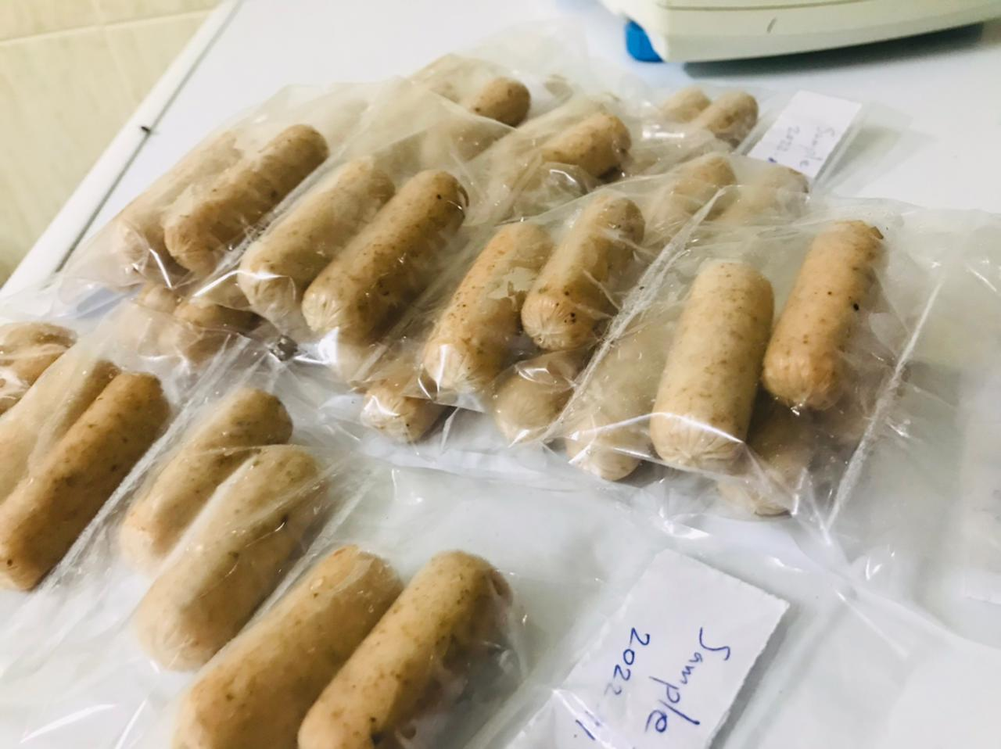
Figure 7 - Loose meat
Cooking
Packed sausages before freezing
Figure 8 - sausage cooking
Figure 9 - packed sausages
15

Slide 16
Research Methodology and Materials cont.
Physicochemical characteristics of final product
1. Proximate composition
Moisture
Crude Protein
Crude Fat
According to methodologies described by AOAC.
2. Cooking loss
(Weight of sausage before cooking - Weight of sausage after cooking)
Cooking loss % = ------------------------------------------------------------------------------------------ X 100
Weight of sausage before cooking
According to the method described by Ayo et al. (2008)
16

Slide 17
Physicochemical characteristics of final product cont.
3. Emulsion stability
Total expressible fluid (TEF ) = . (Weight of sample + weight of tube) – (Weight of pellet + Weight of tube)
TEF
Total expressible fluid % = ----------------------------- x 100
Weight of sample
According to the method described by Hughes et al. (1997)
4.Water holding capasity (WHC)
(Weight of final sample) – (weight of raw sample)
WHC % = ------------------------------------------------------------------ X 100 (weight of raw sample)
According to the method described by Lin and Huang (2003)
17

Slide 18
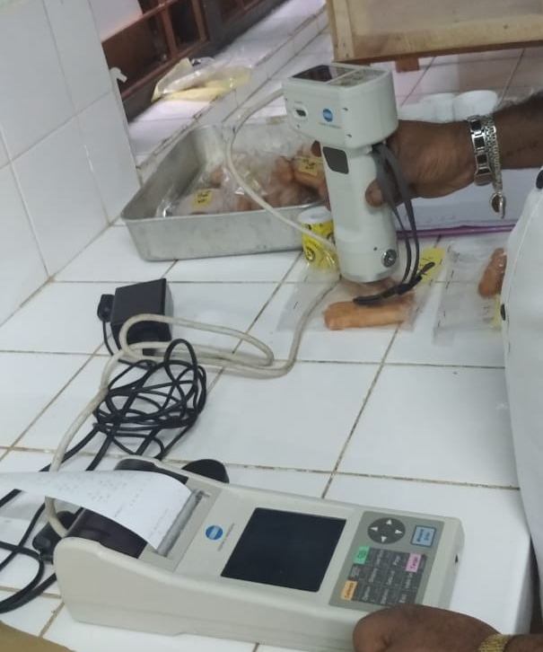
Physicochemical characteristics of final product (cont.)
5. pH
Determined using a digital pH meter (HACH HQ40D multi – Germany)
6. Colour
Measured by Chroma meter (CR-400/410-Japan)
Figure 10 - colour testing of sausages
7. Texture
Measured by Texture Analyzer (TA-Hdi, Stable Micro Systems).
18

Slide 19
Research Methodology and Materials cont.
Methodology
Sensory characteristics of final product
Flavor
Juiciness
Texture
Colour
Overall accepability
Gizzard fat added samples were compared with control sample
5-point hedonic scale
Tested Sensory attributes
35 Panelist
19

Slide 20
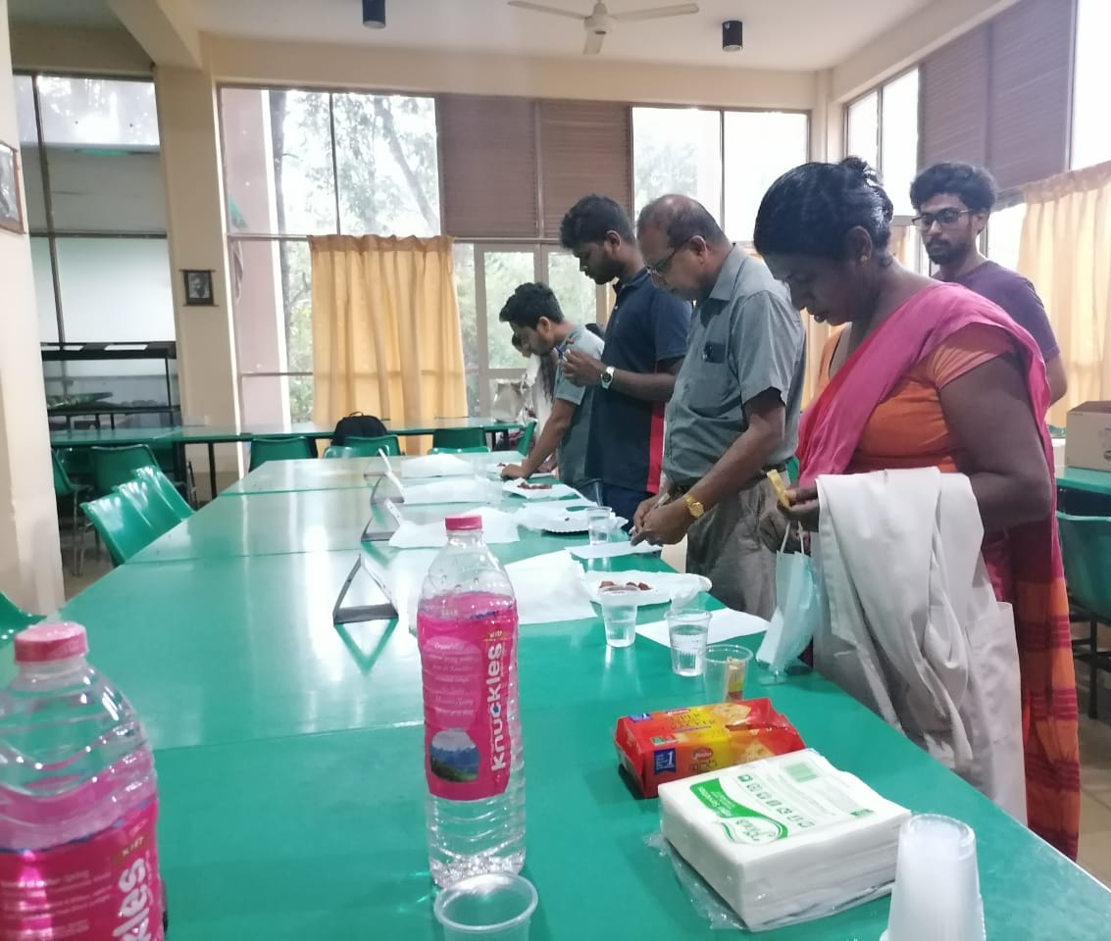
Figure 11 - Evaluation for sensory attributes of sausages
20

Slide 21
Research Methodology and Materials cont.
Data analysis
Data were statistically analyzed by using analysis of variance ( One way ANOVA) evaluating at a significant cut off of p < 0.05 using SAS program.
Significance of the differences among treatment mean values were compared by using Tukey's mean comparison test.
The sensory data were analysed by Friedman test in SPSS statistics 26.0 version.
21

Slide 22
Results and Discussion
Proximate composition of crude Protein, crude fat and moisture of sausage samples
Table 3 : proximate composition
Sample | Control | 50% Gizzard fat | 75% Gizzard fat | 100% Gizzard fat
Protein % | 25.9 ± 0.896ª | 25.1 ± 2.377ª | 21.15 ±0.556^{ab} | 18.6± 0.129^{b}
Fat % | 8.85 ± 0.043^{c} | 11.45 ± 0.357^{b} | 14.5 ± 0.103ª | 14.75 ± 0.101ª
Moisture % | 60.36± 0.316ª | 58.16 ± 0.979^{ab} | 56.2±1.329^{b} | 52.46 ±0.377^{c}
Means of duplicates (crude protein and crude fat) and means of triplicates moisture ± Standard Deviation (SD). Means followed by different small letters in the same column (effect of treatments) are significantly by tukey,s test (p<0.05). 50% Gizzard fat: formulation of sausage using gizzard fat : skin fat=50:50; 75% Gizzard fat formulation of sausage using gizzard fat : skin fat=75:25; 100% Gizzard fat formulation of sausage using 100% gizzard fat.
Incorporation of gizzard fat significantly reduced the protein content while significantly increasing the fat content with the increased amount of gizzard fat. The moisture content significantly decreased with the increased level of gizzard fat.
22

Slide 23
Results and Discussion (cont.)
Cooking loss of sausage samples
Incorporation of gizzard showed a declining trend of cooking loss.
The cooking loss of Gizzard fat incorporated sausages, decreased with the increased level of gizzard fat.
Figure 12: - Cooking loss of sausage samples
Data expressed as means ±SEM.Statistical differences (p<0.05)
23

Slide 24
Results and Discussion (cont.)
Water holding capacity of sausage samples
The WHC of the treated samples significantly (p > 0.05) increased with the addition of gizzard fat.
The cooking loss has an apparent inverse proportionate to WHC
Figure 13: - Water holding capacity of sausage samples
Data expressed as means ±SEM.Statistical differences (p<0.05)
24

Slide 25
Results and Discussion (cont.)
Emulsion stability of sausage samples
The emulsion stability significantly improved with the addition of gizzard fat.
The most stable emulsion was exhibited from 75% and 100% gizzard fat added samples
Lower the TEF% = Higher Emulsion stability
Figure 14: - Emulsion stability of sausage samples
Data expressed as means ±SEM.Statistical differences (p<0.05)
25

Slide 26
Results and Discussion (cont.)
pH of sausage samples
As shown in the chart, the pH of the treated samples significantly (p > 0.05) differ with the addition of gizzard fat.
Higher levels of gizzard fat incorporation lower the pH.
Figure 15: - pH of sausage samples
Data expressed as means ±SEM.Statistical differences (p<0.05)
26

Slide 27
Results and Discussion (cont.)
Texture (Hardness) of sausage samples
Sausages with harder texture was produced with the addition of gizzard fat
This suggest that gizzard fat strengthen protein matrix of chicken sausages than chicken skin.
Figure 16: - Texture (Hardness) of sausage samples
Data expressed as means ±SEM.Statistical differences (p<0.05)
27

Slide 28
Results and Discussion (cont.)
Surface colour of sausage samples
Table 04 : - Surface colour of sausage samples
Data expressed as means ±SEM.Statistical differences (p<0.05)
Sample | Control | 50% Gizzard fat | 75% Gizzard fat | 100% Gizzard fat
Lightness (L*) | 62.26 ± 2.51ª | 64.75 ±1.97ª | 67.26 ±1.79ª | 69.98± 0.82ª
Redness (a*) | 6.34 ± 0.4ª | 6.66 ± 0.19ª | 4.66 ± 0.24^{b} | 4.37 ± 0.13^{b}
Yellowness (b*) | 15.87± 0.33ª | 17.46 ± 0.31ª | 15.99±0.58ª | 15.61 ±0.39ª
The addition of gizzard fat had no significant impact on the lightness and yellowness of surface color but redness was decreased as the concentration of gizzard increased.
28

Slide 29
Results and Discussion (cont.)
Core colour of sausage samples
Table 05 : - Core colour of sausage samples
Data expressed as means ±SEM.Statistical differences (p<0.05)
Sample | Control | 50% Gizzard fat | 75% Gizzard fat | 100% Gizzard fat
Lightness (L*) | 71.38 ± 0.47ª | 70.47 ± 1.16ª | 72.30 ± 0.6ª | 70.29± 1.8ª
Redness (a*) | 6.15 ± 0.27ª | 5.73 ± 0.22 ^{ab} | 4.79 ± 0.23^{b} | 4.71 ± 0.23^{b}
Yellowness (b*) | 6.15± 0.38ª | 5.73 ± 0.49^{ab} | 4.79± 0.13^{b} | 4.71 ± 0.87^{b}
The core colour redness (a*) and yellowness (b*) found to significantly reduce with the addition of gizzard fat
29

Slide 30
Results and Discussion (cont.)
Sensory attributes of chicken sausage prepared by incoporation of Gizzard fat
Liked extremely | Liked | Neither liked or disliked | Disliked | Disliked extremely
5 | 4 | 3 | 2 | 1
Figure 19 - Sensory attributes of chicken sausage prepared by incoporation of Gizzard fat
Data expressed as means
30

Slide 31
Results and Discussion (cont.)
Sensory attributes of chicken sausage prepared by incoporation of Gizzard fat
Table 6 : Sensory attributes of chicken sausage prepared by incoporation of Gizzard fat, Data expressed as means, Statistical differences 5% significance level
Sensory attribute | Estimated Mean |  |  |  |  | Significant difference (Yes/No) between treatments (p value < 0.05 = significant)
 | Samples |  |  |  | p value
 | Control | 50% Gizzard fat | 75% Gizzard fat | 100% Gizzard fat
Colour | 4.11ª | 3.46^{b} | 3.51^{b} | 3.77^{ab} | 0.002 | Yes
Texture | 3.37ª | 3.26ª | 3.31ª | 3.40ª | 0.424 | No
Juiciness | 2.77ª | 2.91ª | 3.03ª | 3.17ª | 0.266 | No
Overall acceptability | 3.51ª | 3.40ª | 3.40ª | 3.69ª | 0.516 | No
Flavour | 3.51ª | 3.80ª | 3.63ª | 3.49ª | 0.167 | No
There is a significant difference of colour, was found among control with 50% Gizzard fat and 75% Gizzard fat incorporated samples.
31

Slide 32
Conclusion
The replacement of chicken skin with gizzard fat significantly affect the physicochemical and sensory properties of chicken sausages.
The study concluded that the sausages incorporated with gizzard fat, particular at the level of 75% and 100% improved the total fat content, water holding capacity, emulsion stability, cooking yield, hardness, and sensory properties indicating it’s potential application as an alternative for traditional skin.
32

Slide 33
References
Abdolghafour, B. and Saghir, A., 2014. Development in sausage production and practices-A review. Journal of meat science and technology, 2(3), pp.40-50.
Alahakoon, A.U., Jo, C. and Jayasena, D.D., 2016. An overview of meat industry in Sri Lanka: A comprehensive review. Korean Journal for food science of animal resources, 36(2), p.137.
Aleson-Carbonell, L., Fernandez-Lopez, J., Perez-Alvarez, J.A. and Kuri, V., 2005. Functional and sensory effects of fibre-rich ingredients on breakfast fresh sausages manufacture. Food Science and Technology International, 11(2), pp.89-97.
Álvarez, D. and Barbut, S., 2013. Effect of inulin, β-glucan and their mixtures on emulsion stability, color and textural parameters of cooked meat batters. Meat science, 94(3), pp.320-327.
Ayo, J., Carballo, J., Solas, M.T. and Jiménez-Colmenero, F., 2008. Physicochemical and sensory properties of healthier frankfurters as affected by walnut and fat content. Food Chemistry, 107(4), pp.1547-1552.
Carballo, J., Barreto, G. and Colmenero, F.J., 1995. Starch and egg white lnfluence on properties of bologna sausage as related to fat content. Journal of Food Science, 60(4), pp.673-677.
Cliche, S., Amiot, J., Avezard, C. and Gariepy, C., 2003. Extraction and characterization of collagen with or without telopeptides from chicken skin. Poultry science, 82(3), pp.503-509.
Cofrades, S., Carballo, J. and Jiménez-Colmenero, F., 1997. Heating rate effects on high-fat and low-fat frankfurters with a high content of added water. Meat science, 47(1-2), pp.105-114.
da Silva, S.L., Amaral, J.T., Ribeiro, M., Sebastião, E.E., Vargas, C., de Lima Franzen, F., Schneider, G., Lorenzo, J.M., Fries, L.L.M., Cichoski, A.J. and Campagnol, P.C.B., 2019. Fat replacement by oleogel rich in oleic acid and its impact on the technological, nutritional, oxidative, and sensory properties of Bologna-type sausages. Meat science, 149, pp.141-148.
De Silva, R.P. and Dayawansa, N.D.K., 2021. Climate change vulnerability in agriculture sector: an assessment and mapping at divisional secretariat level in Sri Lanka. Earth Systems and Environment, 5(3), pp.725-738.
Department of Animal Production and Health (2020). Livestock statistical bulletin 2020. 1-43.
Desmond, E., 2006. Reducing salt: A challenge for the meat industry. Meat science, 74(1), pp.188-196.
Feddern, V., Kupski, L., Cipolatti, E.P., Giacobbo, G., Mendes, G.L., Badiale‐Furlong, E. and de Souza‐Soares, L.A., 2010. Physico‐chemical composition, fractionated glycerides and fatty acid profile of chicken skin fat. European Journal of Lipid Science and Technology, 112(11), pp.1277-1284.
33

Slide 34
References
Henchion, M., McCarthy, M., Resconi, V.C. and Troy, D., 2014. Meat consumption: Trends and quality matters. Meat science, 98(3), pp.561-568.
Godfray, H.C.J., Aveyard, P., Garnett, T., Hall, J.W., Key, T.J., Lorimer, J., Pierrehumbert, R.T., Scarborough, P., Springmann, M. and Jebb, S.A., 2018. Meat consumption, health, and the environment. Science, 361(6399), p.eaam5324.
Guerra, I.C.D., Félex, S.S.S., Meireles, B.R.L.M., Dalmás, P.S., Moreira, R.T., Honório, V.G., Morgano, M.A., Milani, R.F., Benevides, S.D., Queiroga, R.C.R.E. and Madruga, M.S., 2011. Evaluation of goat mortadella prepared with different levels of fat and goat meat from discarded animals. Small Ruminant Research, 98(1-3), pp.59-63.
Hautrive, T.P., Oliveira, V.R.D., Silva, A.R.D.D., Terra, N.N. and Campagnol, P.C.B., 2008. Physicochemical and sensorial analyses of ostrich hamburger. Food Science and Technology, 28, pp.95-101.
Herrera, M., 2008. Taking Advantage of by-Products or Waste in the Poultry Industry for the Production of Animal Meal. Virtual Pro, Bogotá, Colombia.
Honikel, K.O. and Hamm, R., 1994. Measurement of water-holding capacity and juiciness. In Quality attributes and their measurement in meat, poultry and fish products (pp. 125-161). Springer, Boston, MA.
Huff-Lonergan, E. and Lonergan, S.M., 2005. Mechanisms of water-holding capacity of meat: The role of postmortem biochemical and structural changes. Meat science, 71(1), pp.194-204.
Hughes, E., Cofrades, S. and Troy, D.J., 1997. Effects of fat level, oat fibre and carrageenan on frankfurters formulated with 5, 12 and 30% fat. Meat science, 45(3), pp.273-281.
Kwon, H.N. and Choi, C.B., 2015. Comparison of lipid content and monounsaturated fatty acid composition of beef by country of origin and marbling score. Journal of the Korean Society of Food Science and Nutrition, 44(12), pp.1806-1812.
Lima, J.L., Assis, B.B., Olegario, L.S., Galvão, M.D.S., Soares, Á.J., Arcanjo, N.M., González-Mohino, A., Bezerra, T.K. and Madruga, M.S., 2021. Effect of adding byproducts of chicken slaughter on the quality of sausage over storage. Poultry Science, 100(8), p.101178.
Lin, K.W. and Huang, C.Y., 2008. Physicochemical and textural properties of ultrasound-degraded konjac flour and their influences on the quality of low-fat Chinese-style sausage. Meat Science, 79(4), pp.615-622.
OECD, F., 2022. OECD-FAO Agricultural Outlook 2022-2031.
34

Slide 35
References
Oreopoulou, V. and Tzia, C., 2007. Utilization of plant by-products for the recovery of proteins, dietary fibers, antioxidants, and colorants. In Utilization of by-products and treatment of waste in the food industry (pp. 209-232). Springer, Boston, MA.
Peña-Saldarriaga, L.M., Fernández-López, J. and Pérez-Alvarez, J.A., 2020. Quality of chicken fat by-products: lipid profile and colour properties. Foods, 9(8), p.1046.
Peña-Saldarriaga, L.M., Pérez-Alvarez, J.A. and Fernández-López, J., 2020. Quality properties of chicken emulsion-type sausages formulated with chicken fatty byproducts. Foods, 9(4), p.507.
Rahardjo, R., Wilson, L.A. and Sebranek, J.G., 1994. Spray dried soymilk used in reduced fat pork sausage patties. Journal of food science, 59(6), pp.1286-1290.
Razick, S., Munas, H. and de Mel, N., 2021. Reviewing the Data Dissemination Practices of Sri Lanka’s Department of Census and Statistics.
Savadkoohi, S., Hoogenkamp, H., Shamsi, K. and Farahnaky, A., 2014. Color, sensory and textural attributes of beef frankfurter, beef ham and meat-free sausage containing tomato pomace. Meat science, 97(4), pp.410-418.
Choe, J. and Kim, H.Y., 2019. Quality characteristics of reduced fat emulsion-type chicken sausages using chicken skin and wheat fiber mixture as fat replacer. Poultry Science, 98(6), pp.2662-2669.
Herrero, A.M., Ordóñez, J.A., de Avila, R., Herranz, B., De la Hoz, L. and Cambero, M.I., 2007. Breaking strength of dry fermented sausages and their correlation with texture profile analysis (TPA) and physico-chemical characteristics. Meat science, 77(3), pp.331-338.
Savic, I.V., 1985. Small-scale sausage production (pp. 21-35). FAO.
Stone, H. and Sidel, J.L., 1985. Sensory Evaluation Practices Academic Press. San Diego, 2nd.
Hui, Y.H., 2014. Handbook of fermented meat and poultry. John Wiley & Sons.
Youssef, M.K. and Barbut, S., 2011. Fat reduction in comminuted meat products-effects of beef fat, regular and pre-emulsified canola oil. Meat Science, 87(4), pp.356-360.
Chiu, M.C., Gioielli, L.A. and Grimaldi, R., 2008. Structured lipids from chicken fat, its atearin and medium chain triacyglycerol blends: I-Fatty acid and triacyglycerol compositions. Química Nova, 31, pp.232-237.
Quiles, A., Llorca, E., Moraga, G. and Hernando, I., 2022. Clean Label Foods with Reduced Fat Content. In The Age of Clean Label Foods (pp. 103-133). Springer, Cham.
35

Slide 36
Acknowledgment
Prof. D.M.A. Gunerathne, Senior Professor, Department of Livestock Production, FAS,SUSL
Mr Udara Sandaruwan, Manager, Quality Assurance, LG farm Pvt. Limited, Minneriya.
All the staff members, LG farm Pvt.Ltd Minneriya.
Dr. T.S.P. Jayaweera, Head, Department of Livestock Production, Dr. D.D. Wickramanayake, Coordinator of Industrial Training Program, and all the lecturers of the FAS,SUSL
Dr. J.B.D.A.P Kumara, Head, Department of, Department of Export Agriculture, of the FAS,SUSL.
Professor. D A M Silva, Head, Department of, Department of Agri business management, of the FAS,SUSL.
Mrs Yasawathi, technical officer, Livestock Laboratory, Department of Livestock Production, FAS,SUSL
Mrs Kumari, Lab assistant, meat science Laboratory, Department of Livestock Production, FAS,SUSL
All of my friends who supported to do the reasearch.
36

Slide 37
Thank you
37

