Slide 1
A Functional Analysis of Pedotransfer Functions to Predict the Crop Growth in Tropical Sri Lankan Soils: A Comparative Study
U.G.N.U.Wimalasiri , Eranga M.Wimalasiri
Department of Export Agriculture, Faculty of Agricultural Sciences, Sabaragamuwa University of Sri Lanka, Belihuloya, Sri Lanka

Slide 2
Content for the presentation
Introduction
Objectives
Material and Methods
Results and Discussion
Conclusion and Recommendations
References

Slide 3
Introduction
Existing soil measurements
Granulometry
Bulk Density
Organic matter content
pH
CEC
…….
……..
……
……
Soil hydraulic parameters
Permanent wilting point (PWP/DUL)
Field capacity (FC/LL15)
Pedotransfer functions
Crop and environment models

Slide 4
Objectives
Main objective
To evaluate the performance of pedotransfer functions on the paddy (Oryza sativa) yield.
Specific Objective
To analyze the sensitivity of pedotransfer functions on the paddy (Oryza sativa) yield.

Slide 5
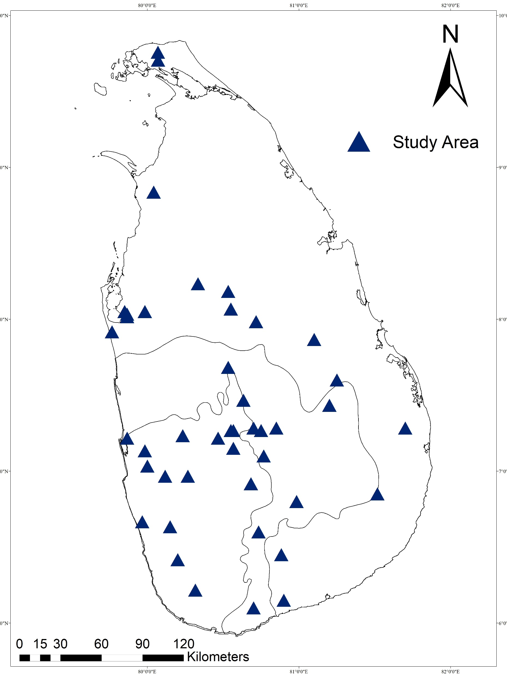
Material and Methods
Study Area
Fourty three locations (43) representing the
three climatic zones of Sri Lanka.

Slide 6
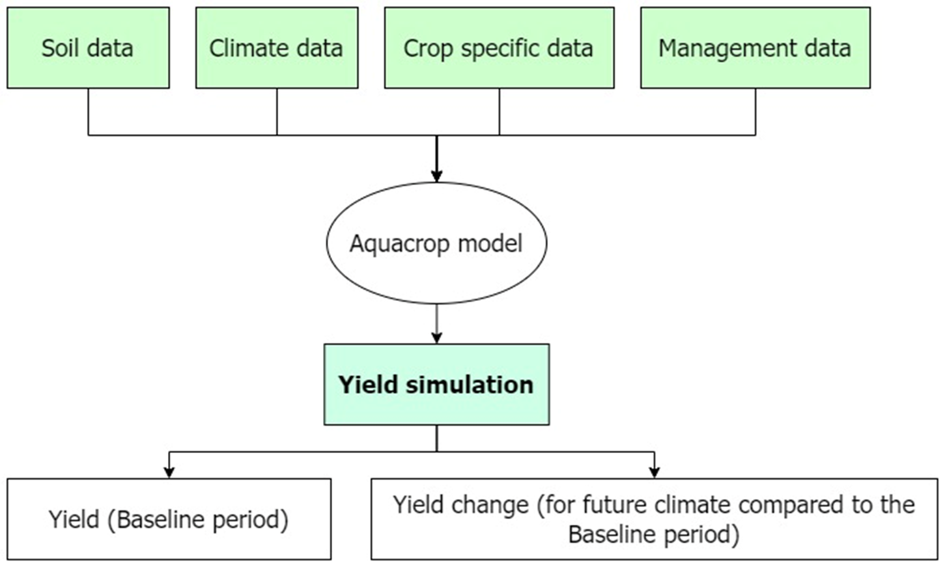
Model description
The Oryza module of Agriculture Productions System Simulator (APSIM – version 7.10).
Figure : Overview of APSIM model

Slide 7
Model input parameters
Soil parameters
First version of the nation-wide open 3D soil database of Sri Lanka (Wimalasiri et al., 2020)
Pedotransfer functions (15) (Wimalasiri et al., 2022)
Crop parameters
Published literature (Nissanka et al., 2015)
Crop model
APSIM
Simulation
Yield of rice
Management parameters
According to the Department of agriculture (DOA) recommendations
Climate parameters
The Modern-Era Retrospective Analysis for Research and Applications (AgMERRA) global gridded climate forcing dataset
(https://data.giss.nasa.gov/impacts/agmipcf/agmerra/)

Slide 9
Data interpolation and mapping
Average yield of rice
(43 locations)
APSIM
ArcGIS
Yield Prediction Maps
Simulation
Interpolation
(Ordinary kriging method)

Slide 10
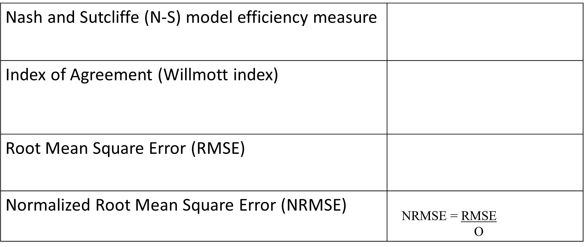
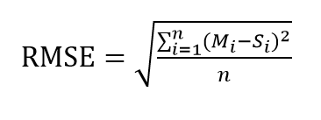
Statistical evaluation
Table: statistical evaluation methods

Slide 11
Sensitivity analysis
Used Gaussian Emulation Machine for Sensitivity Analysis (GEM-SA)
Input and output parameters
Inputs – 10 Soil parameters , output – weight of rough rice
Generation of a set of input points
Build of the emulator using GEM-SA software
Sensitivity analysis using GEM-SA software
Performance evaluation of emulators
Figure: Flowchart of the sensitivity analysis procedure (Gunarathna, Sakai and Kumari, 2019)

Slide 12
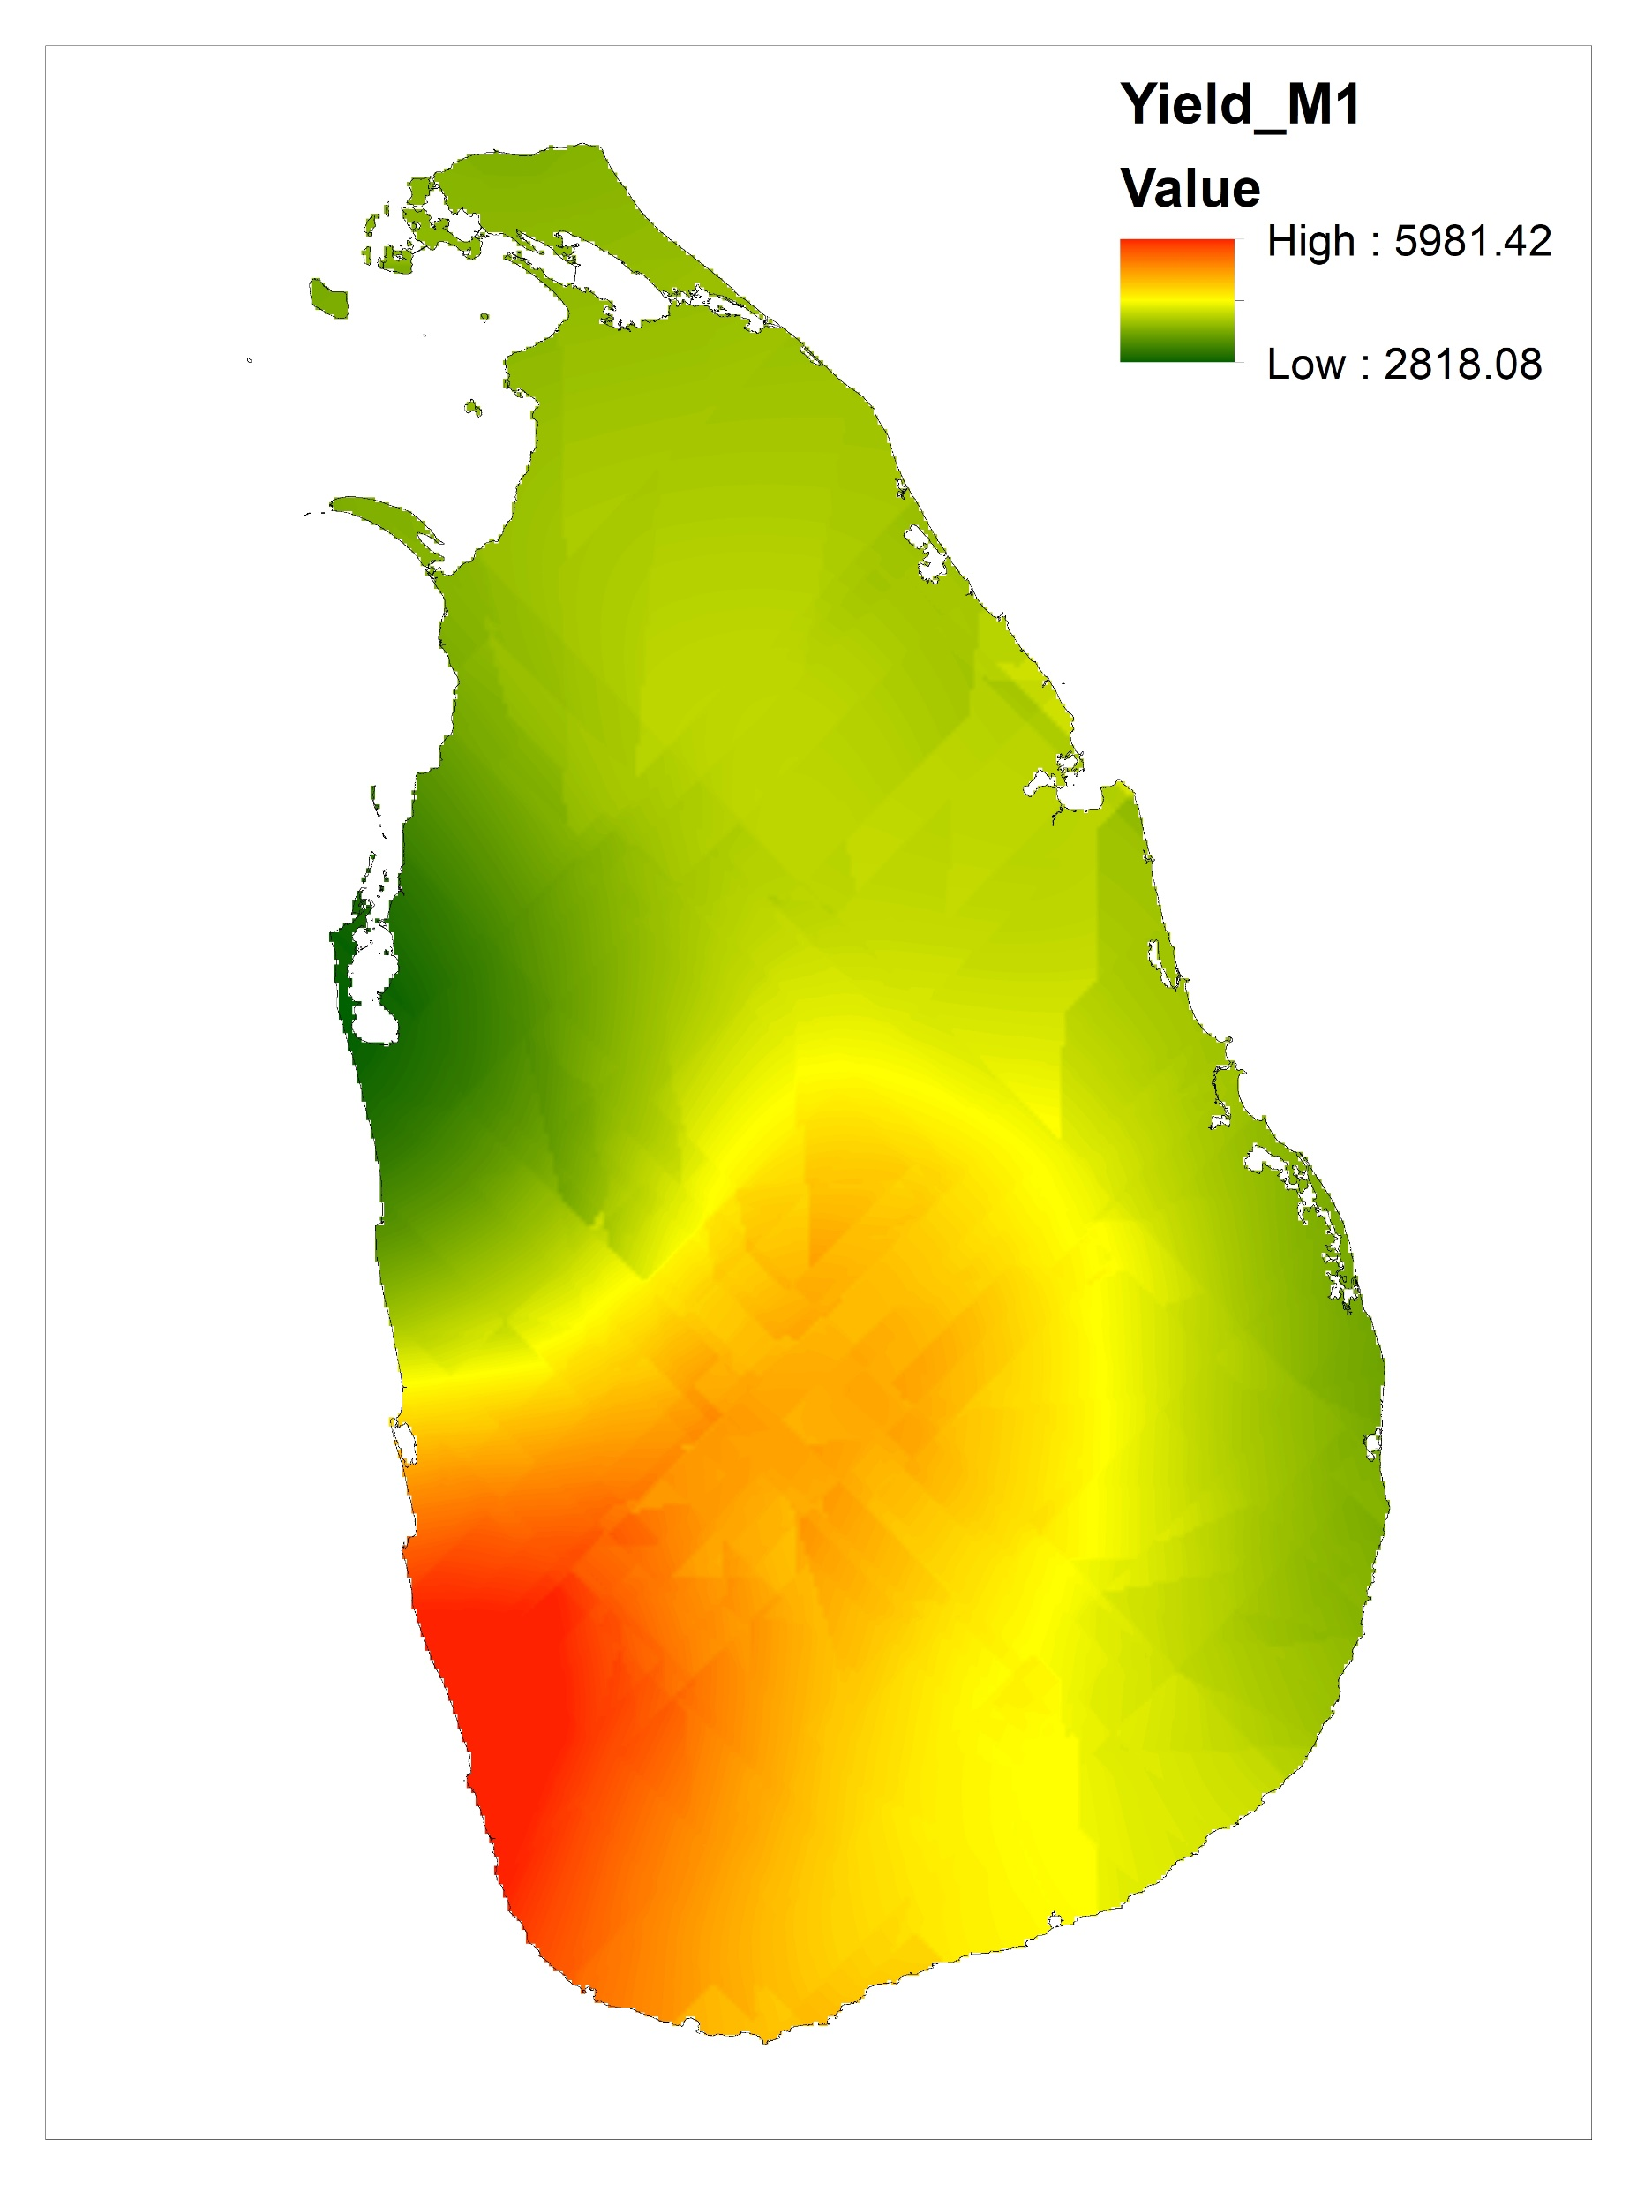
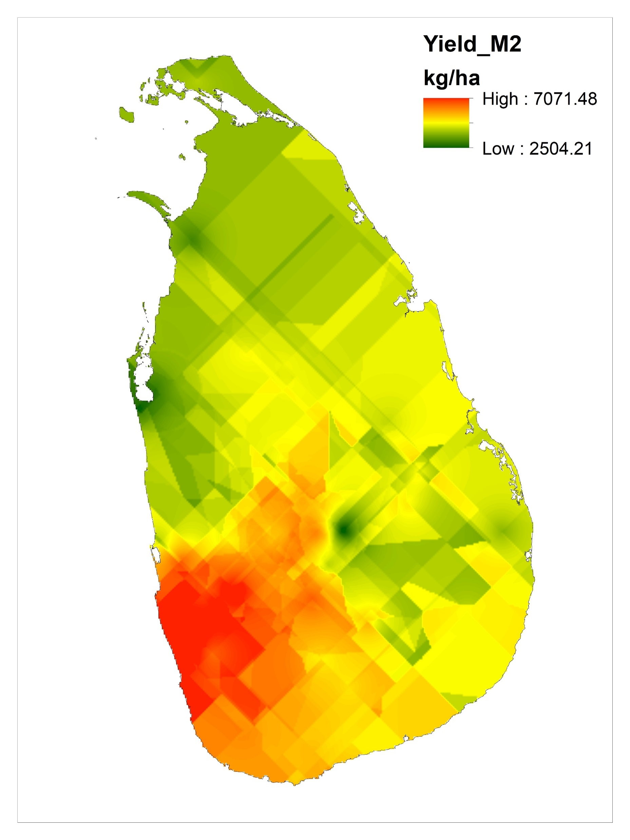
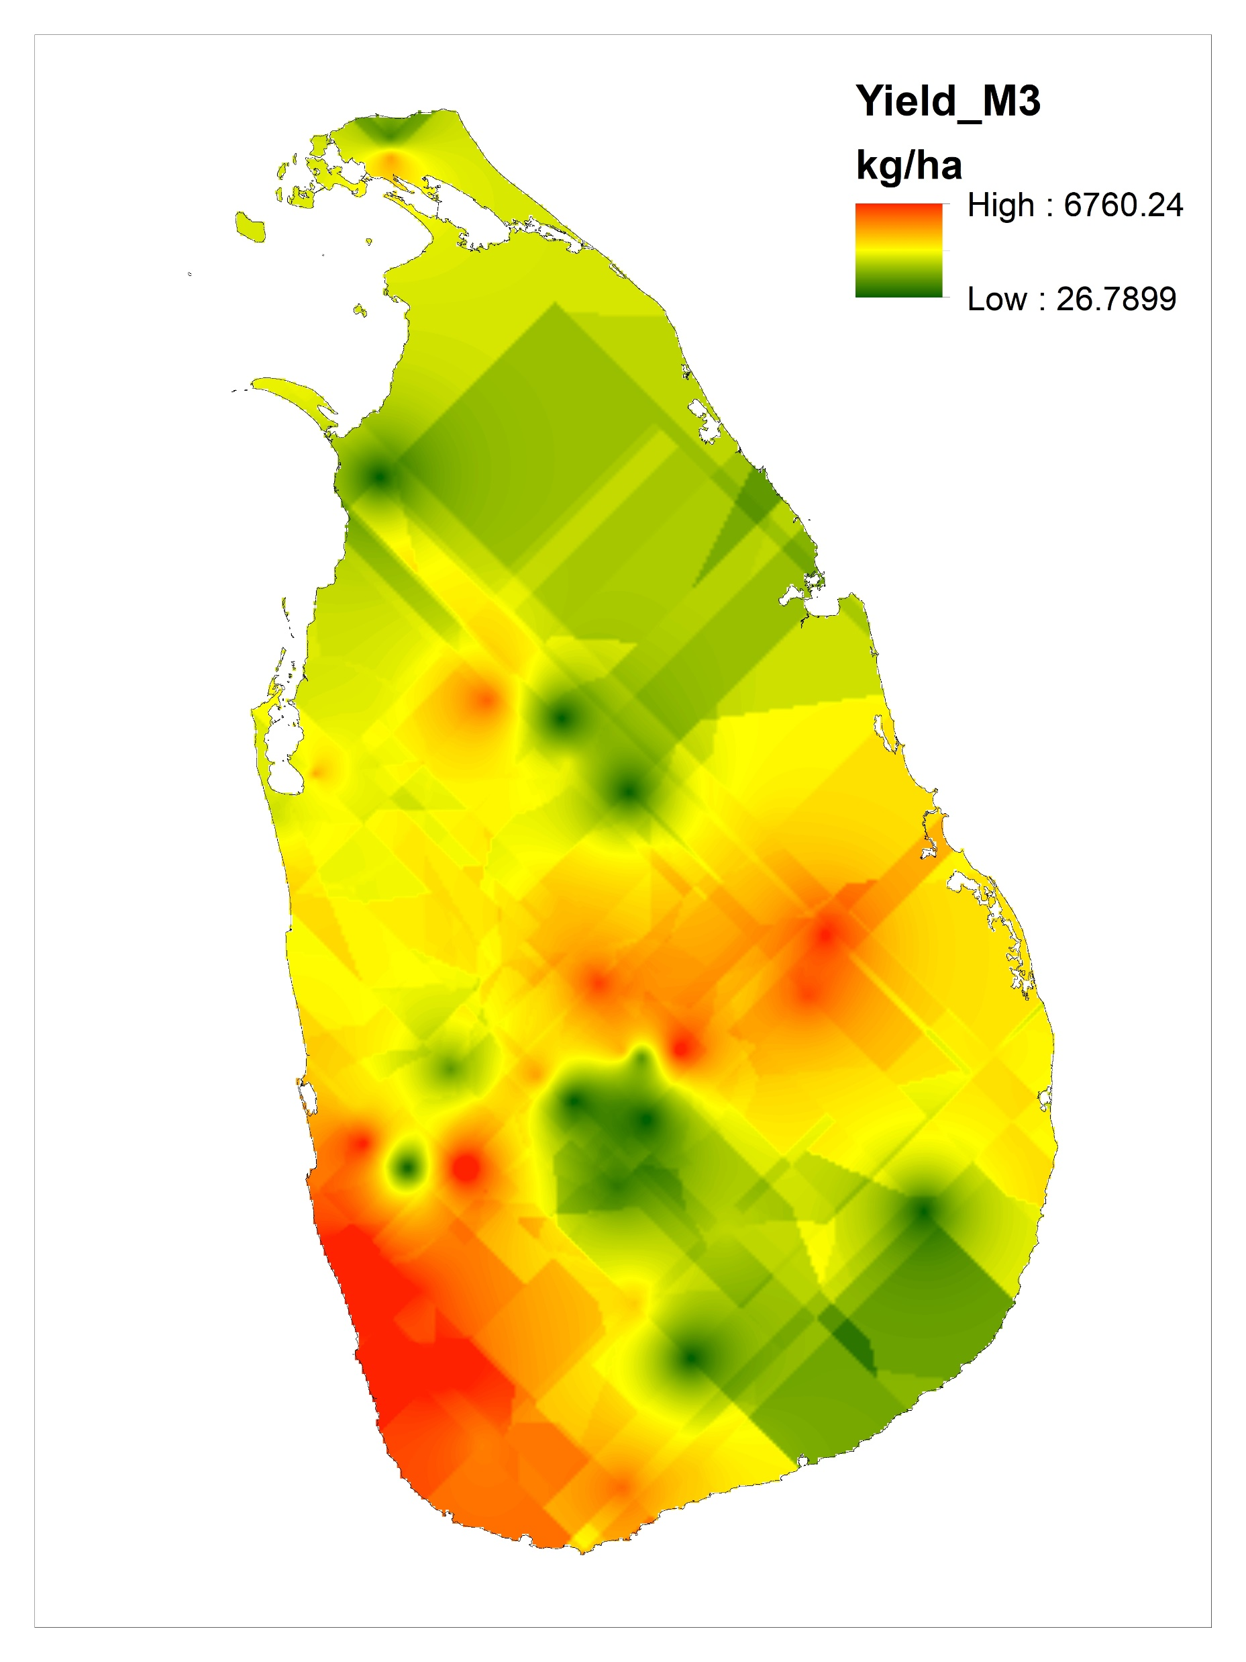
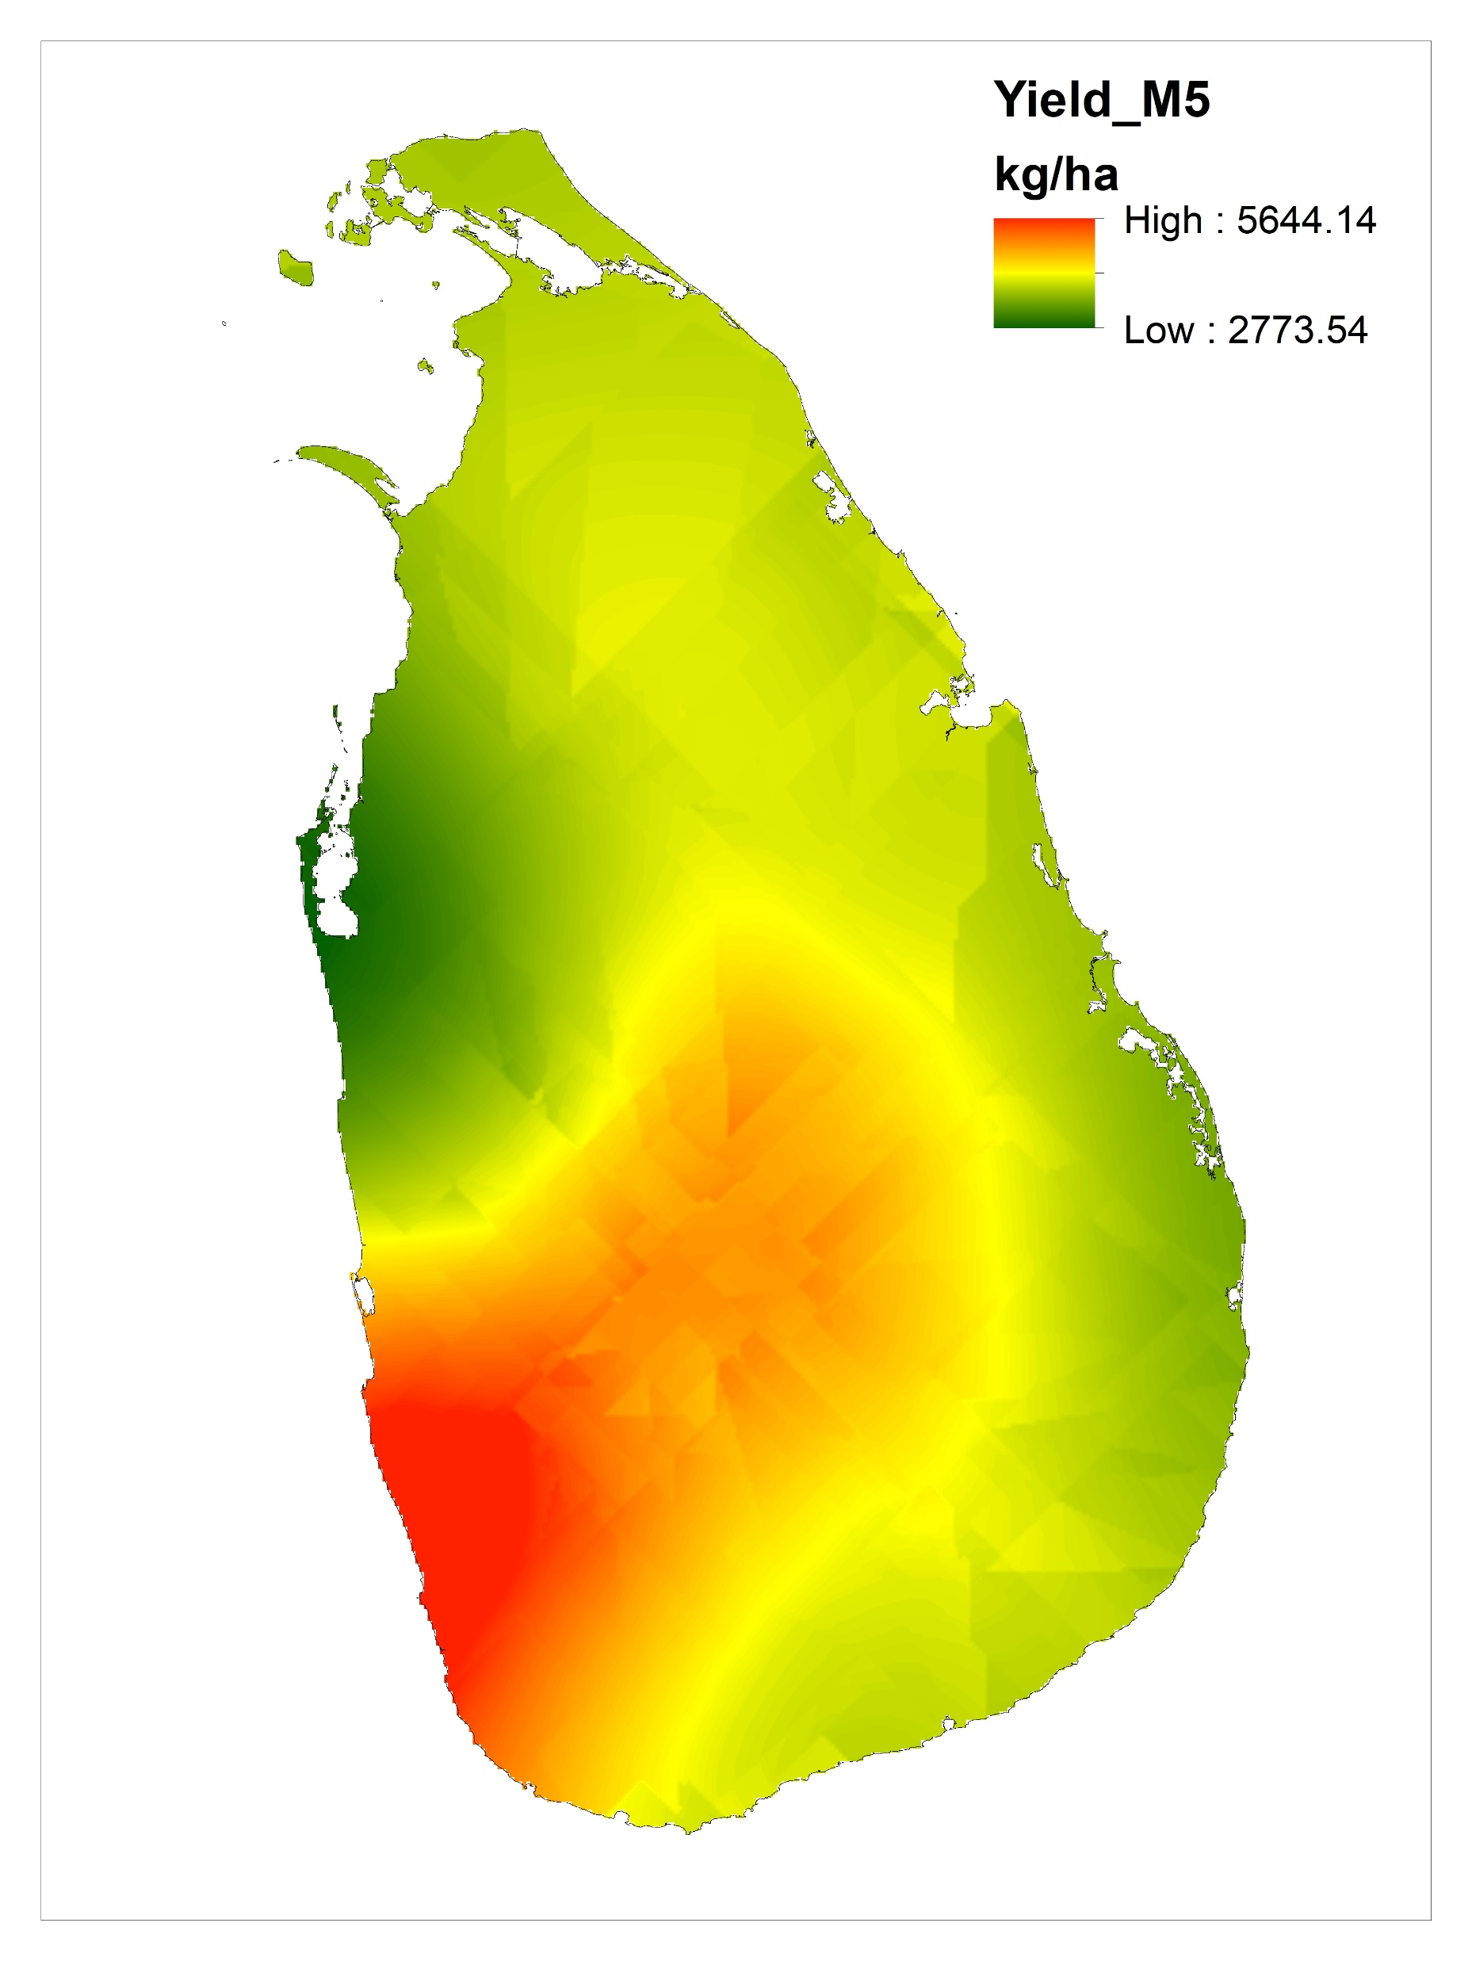
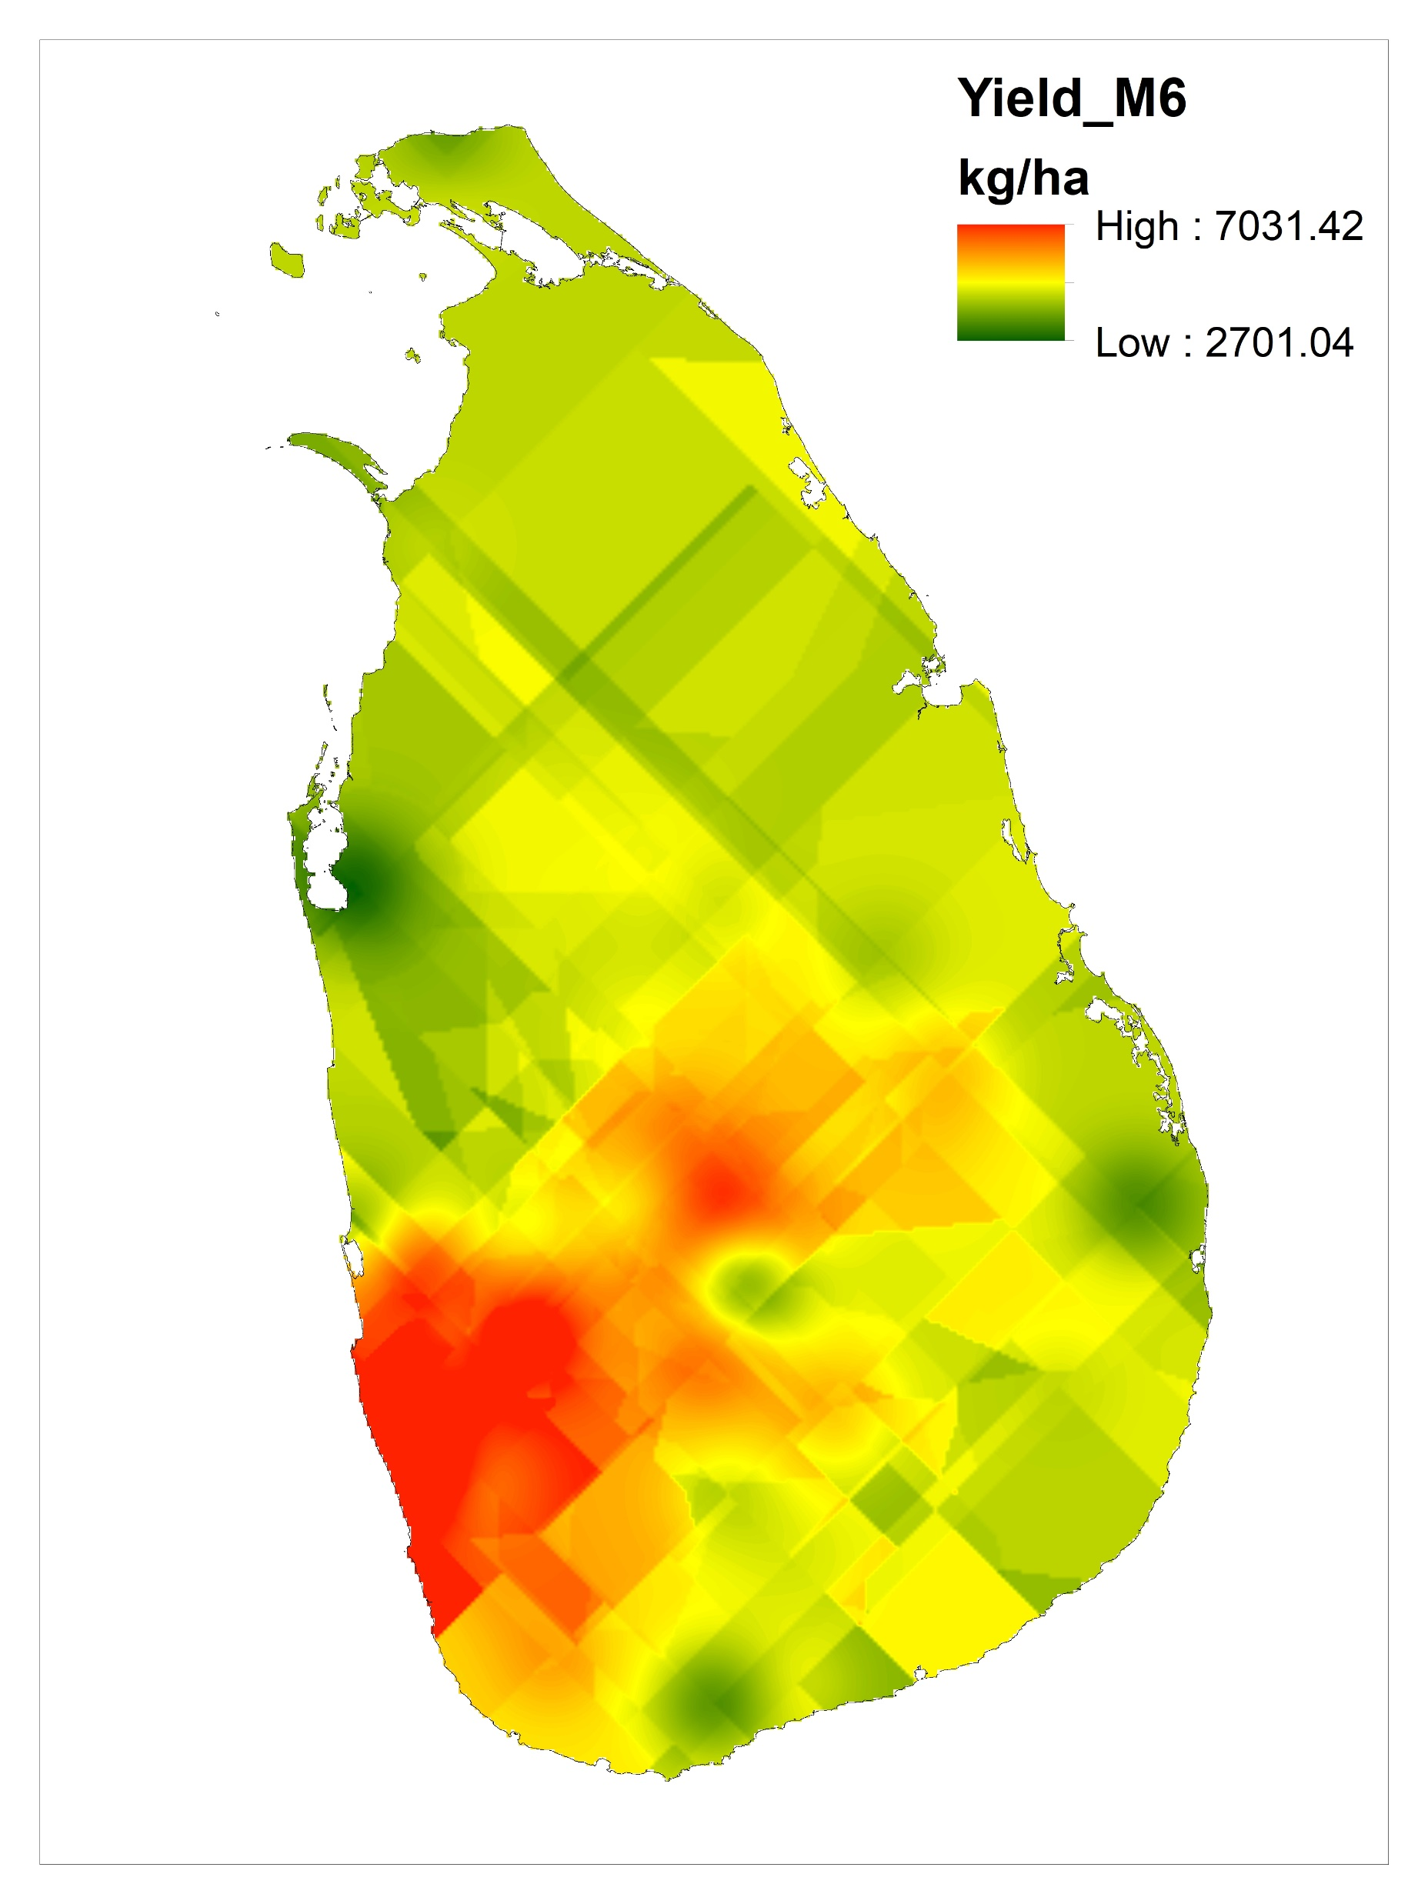
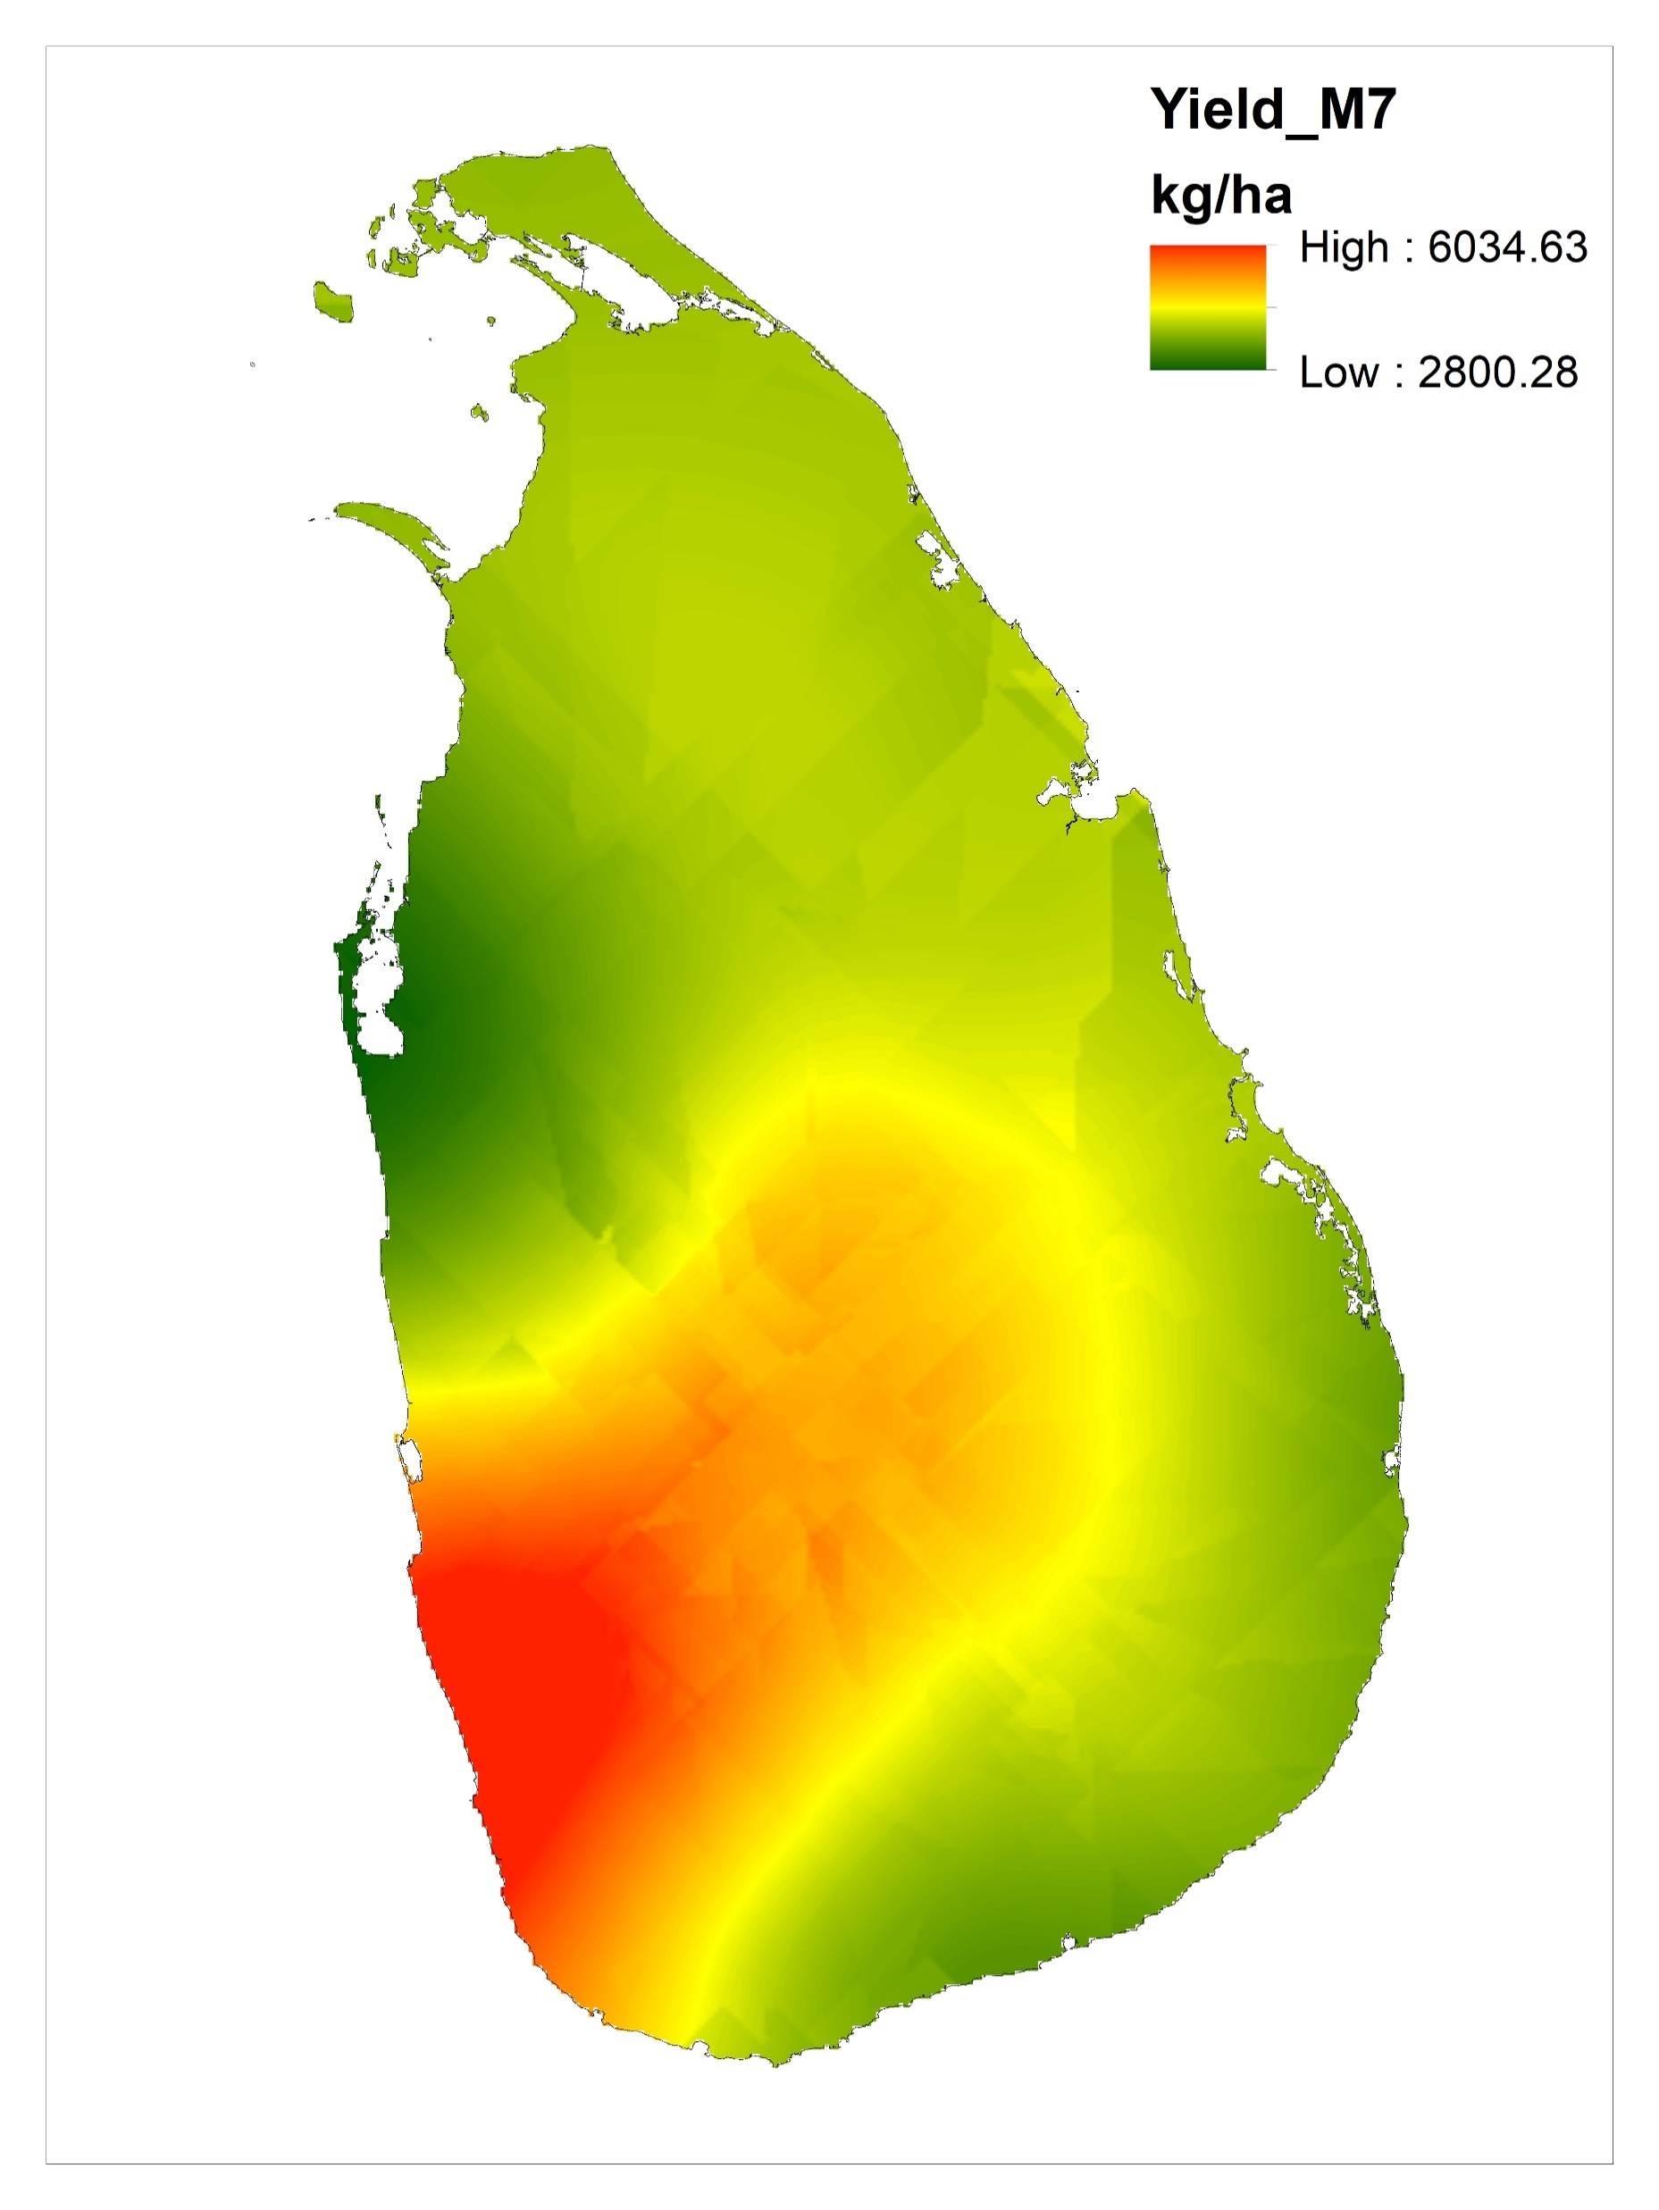
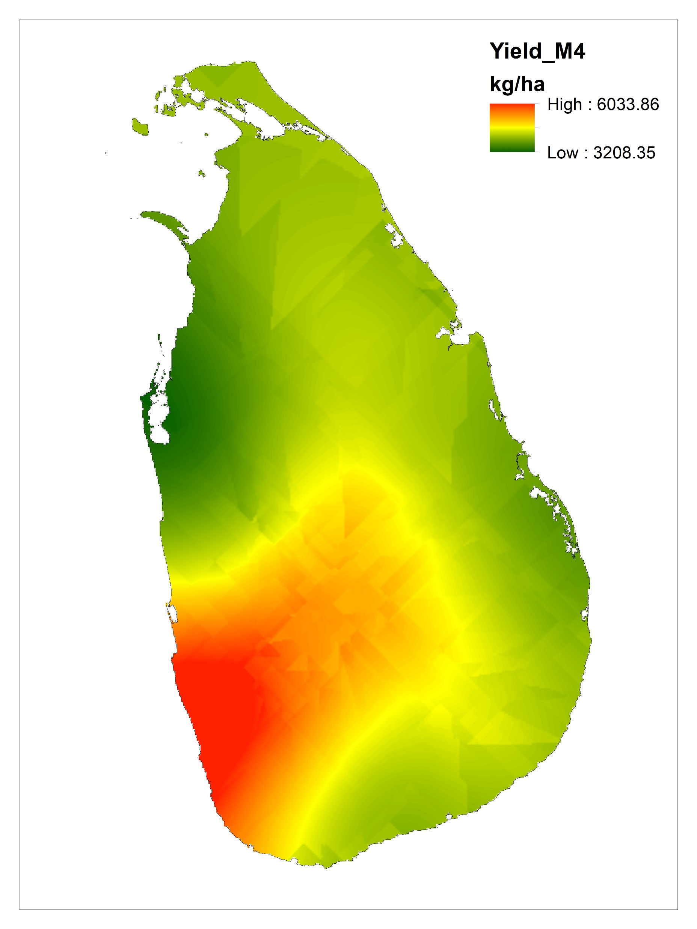
Results and Discussion
O
M1
M2
M3
M4
M5
M6
M7

Slide 13
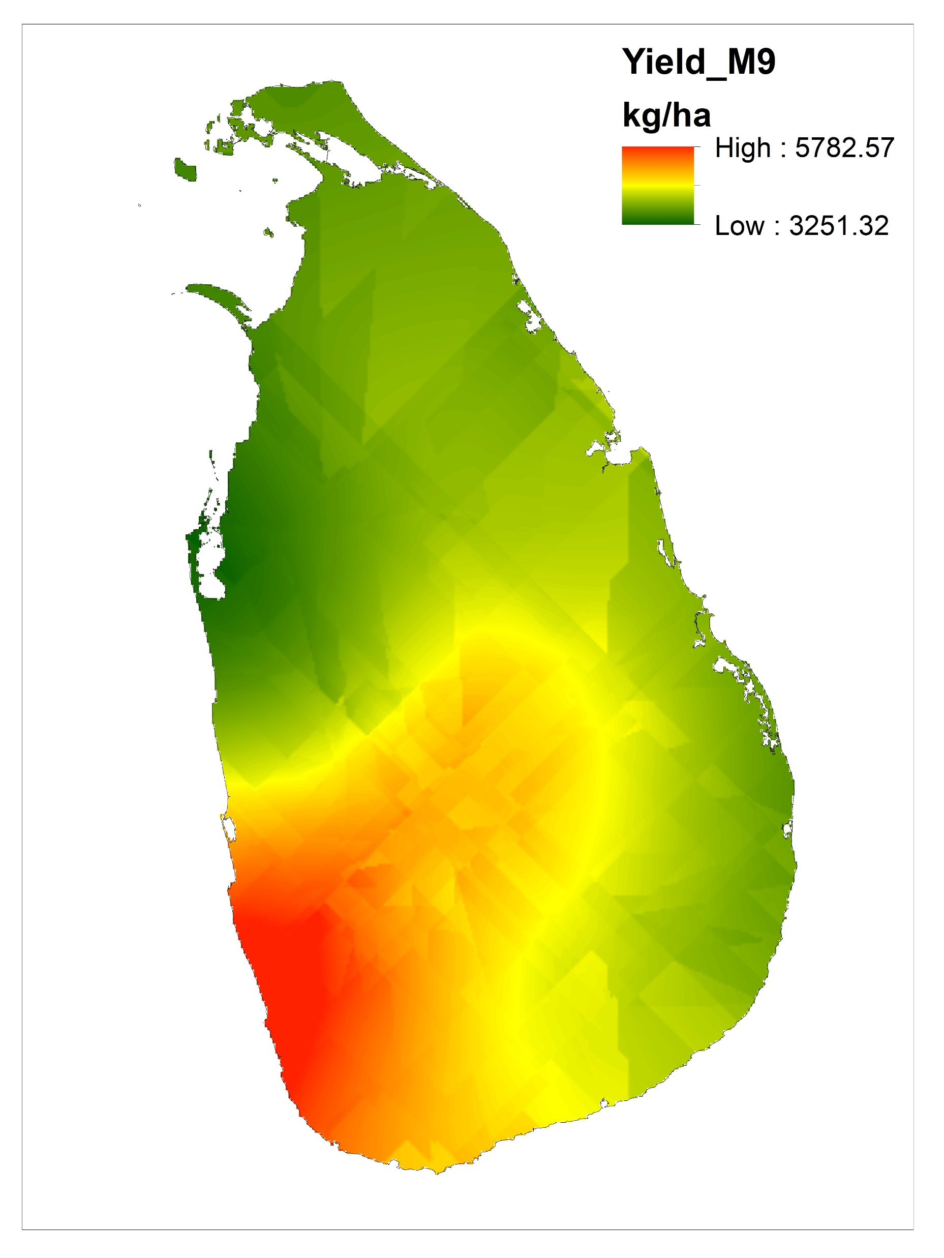
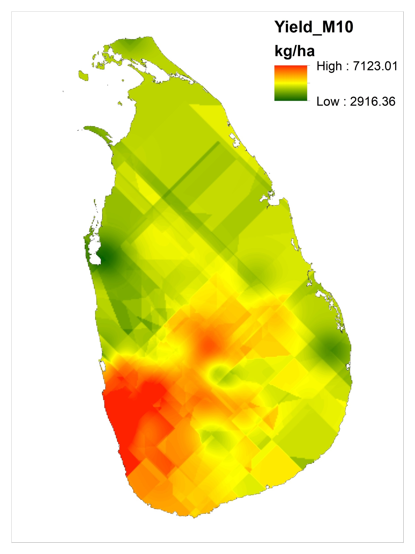
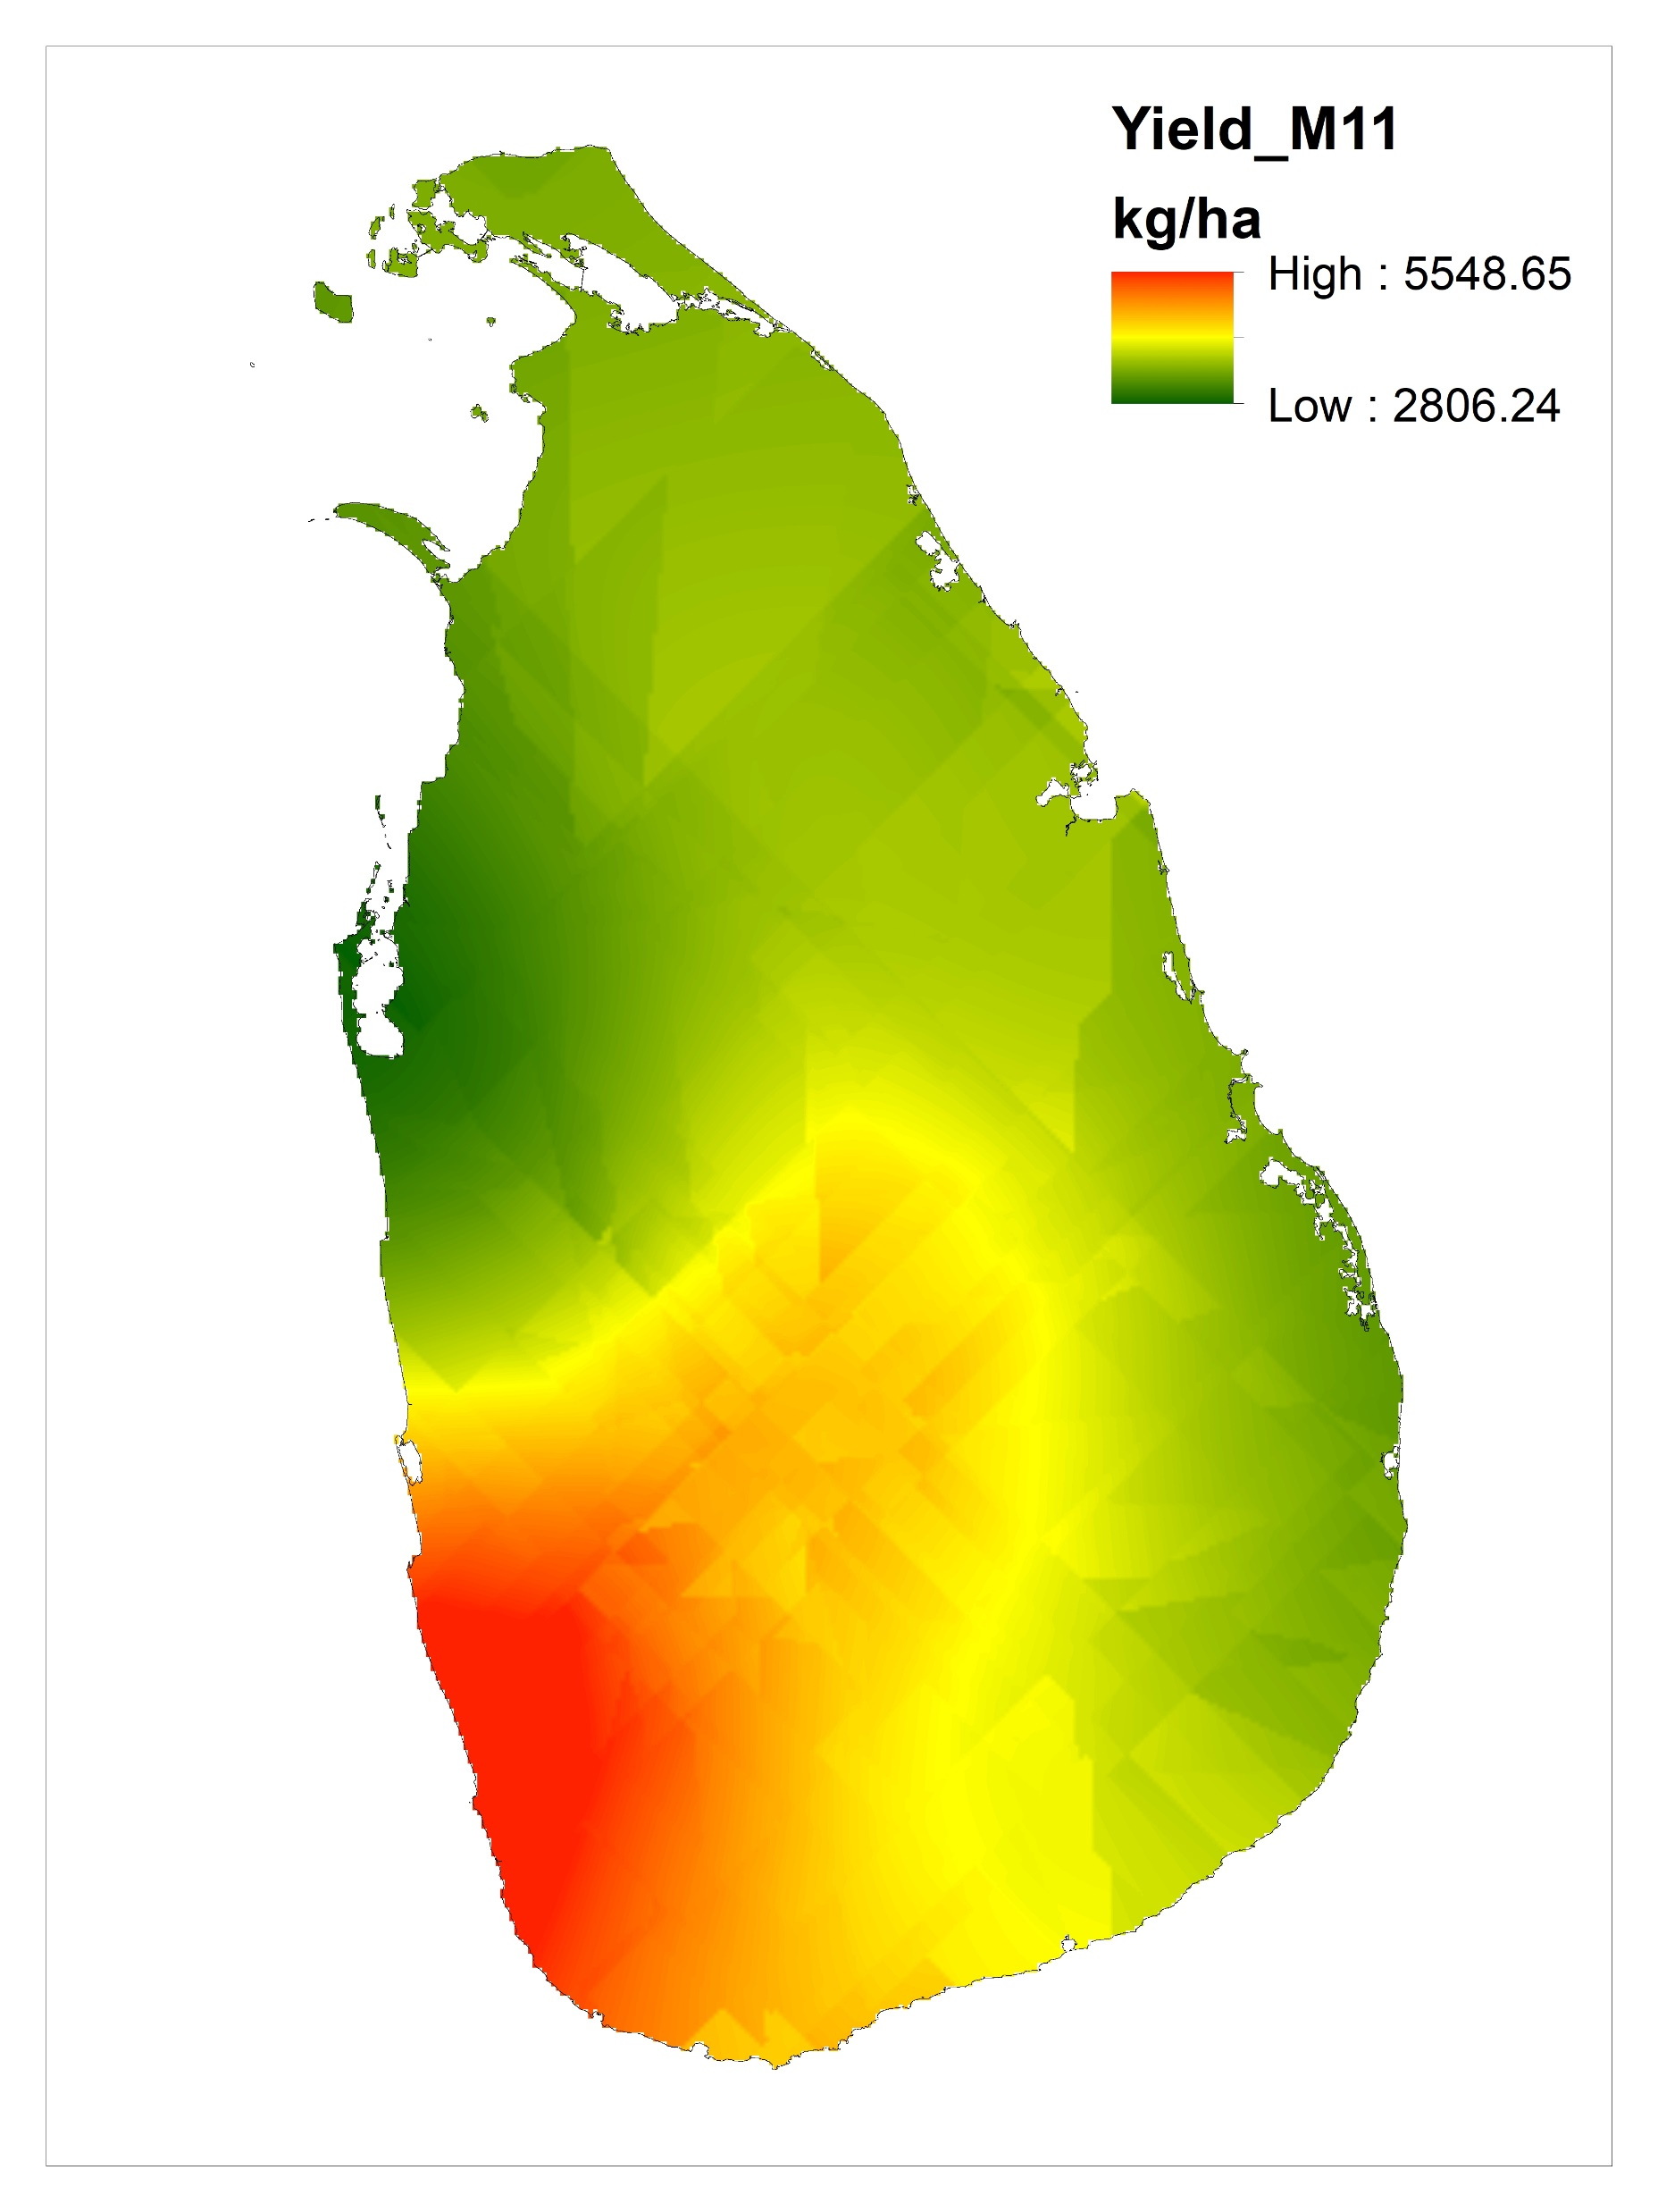
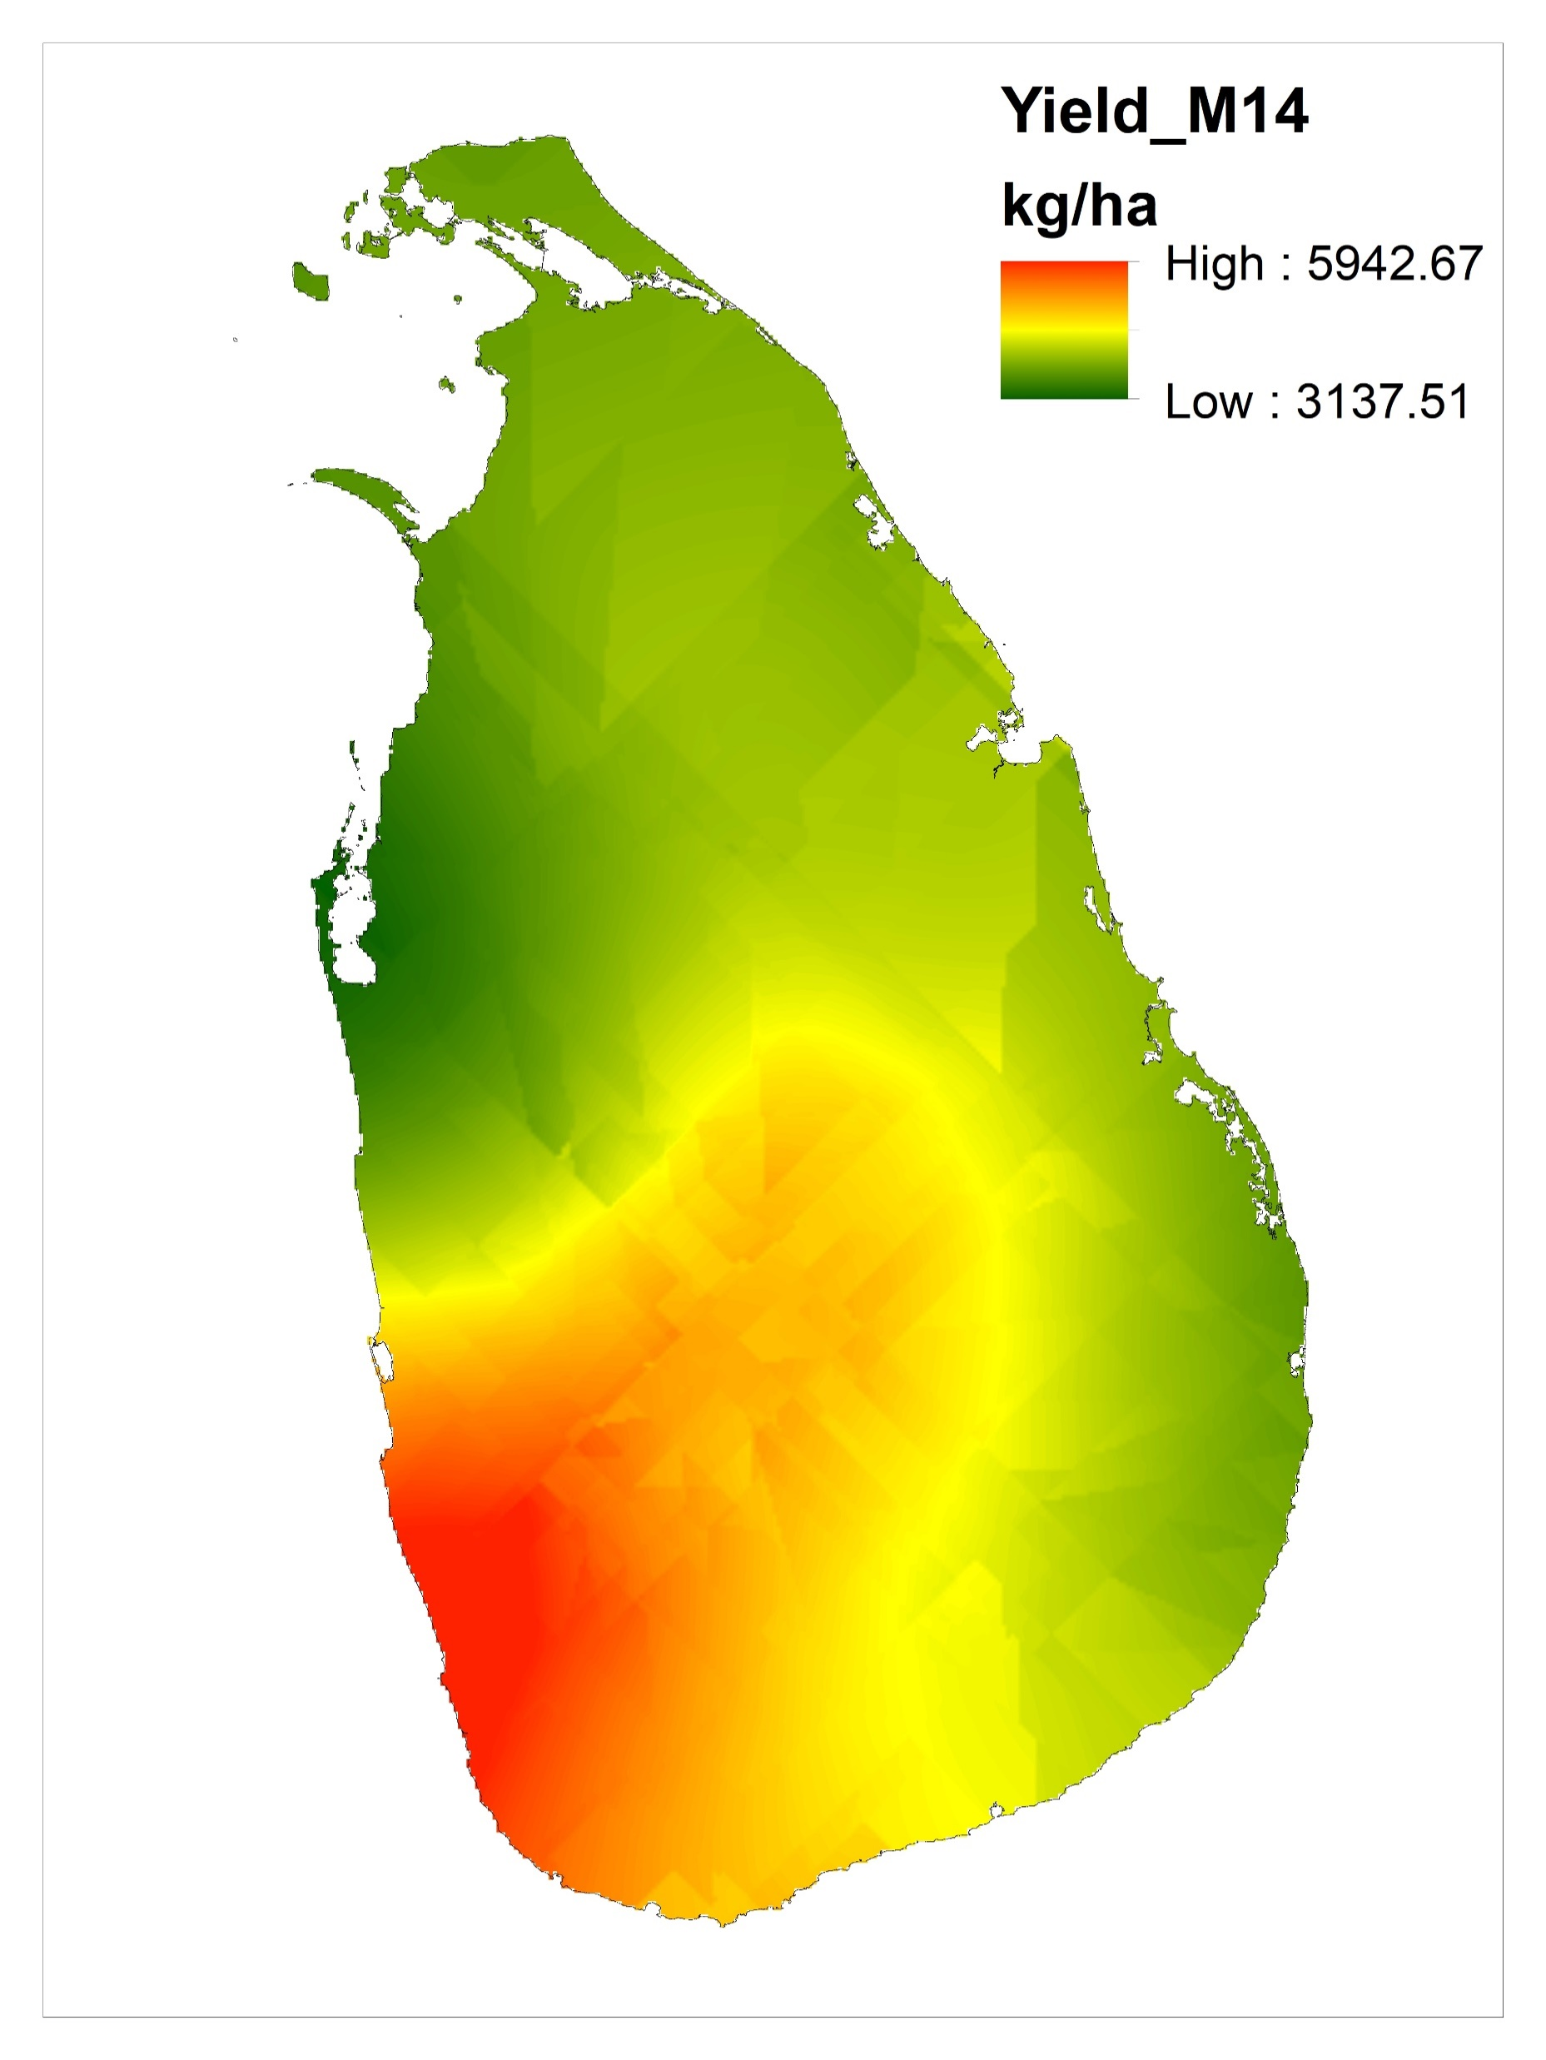
M8
M9
M10
M11
M12
M13
M14
M15

Slide 14
Error maps

Slide 15
Correlation analysis
To quantify the degree to which two variable are related
Table: Results of correlation analysis
Pearson r | M1 | M2 | M3 | M4 | M5 | M6 | M7 | M8 | M9 | M10 | M11 | M12 | M13 | M14 | M15
r | 0.976 | 0.7882 | 0.4493 | 0.8569 | 0.9146 | 0.9219 | 0.9103 | 0.01296 | 0.9625 | 0.9544 | 0.946 | 0.9698 | 0.9637 | 0.9649 | 0.9511
95% confidence interval | 0.9559 to 0.9870 | 0.6392 to 0.8802 | 0.1722 to 0.6605 | 0.7494 to 0.9204 | 0.8469 to 0.9531 | 0.8595 to 0.9572 | 0.8395 to 0.9507 | -0.2885 to 0.3121 | 0.9313 to 0.9796 | 0.9169 to 0.9752 | 0.9020 to 0.9706 | 0.9445 to 0.9836 | 0.9336 to 0.9803 | 0.9356 to 0.9809 | 0.9110 to 0.9734
R squared | 0.9527 | 0.6213 | 0.2019 | 0.7343 | 0.8365 | 0.8499 | 0.8286 | 0.000167 | 0.9263 | 0.9109 | 0.895 | 0.9404 | 0.9288 | 0.9309 | 0.9046
P value
P (two-tailed) | <0.0001 | <0.0001 | 0.0025 | <0.0001 | <0.0001 | <0.0001 | <0.0001 | 0.9343 | <0.0001 | <0.0001 | <0.0001 | <0.0001 | <0.0001 | <0.0001 | <0.0001
P value summary | **** | **** | ** | **** | **** | **** | **** | ns | **** | **** | **** | **** | **** | **** | ****
Significant? (alpha = 0.05) | Yes | Yes | Yes | Yes | Yes | Yes | Yes | No | Yes | Yes | Yes | Yes | Yes | Yes | Yes

Slide 16
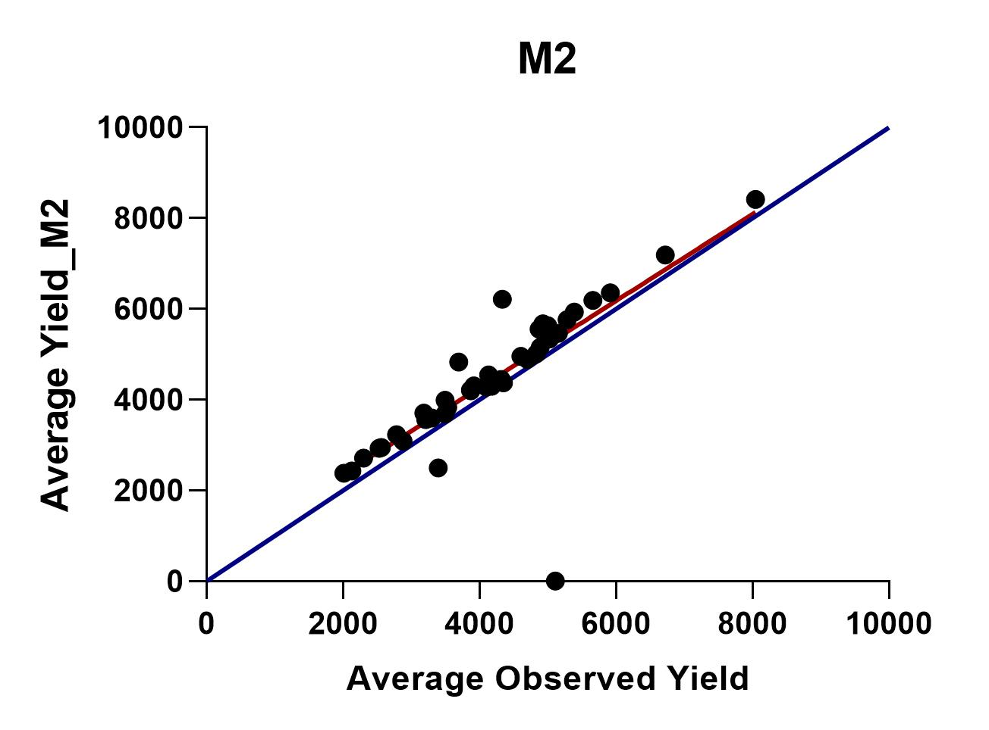
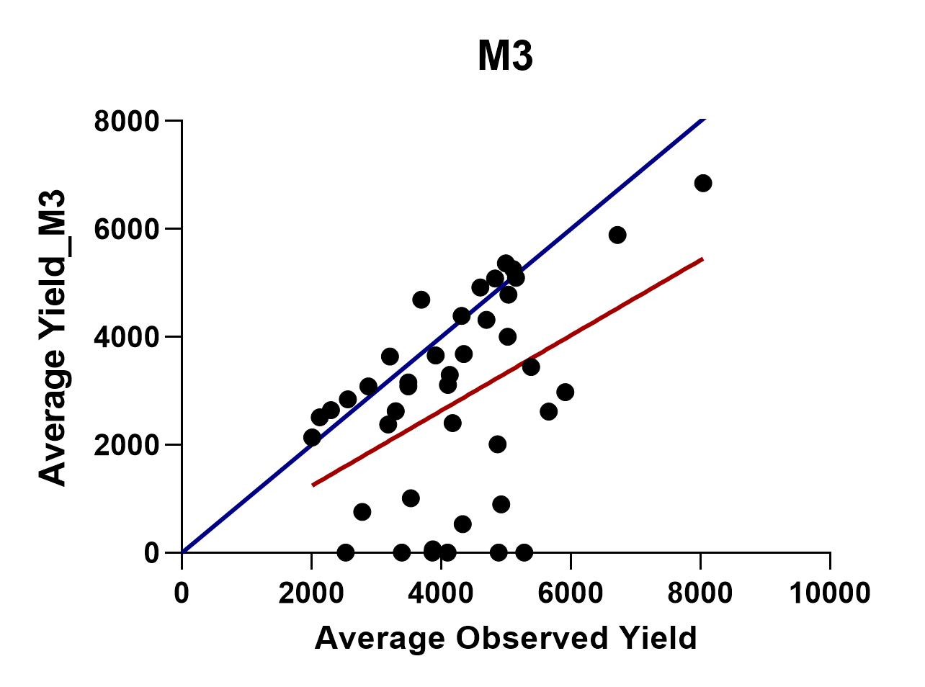
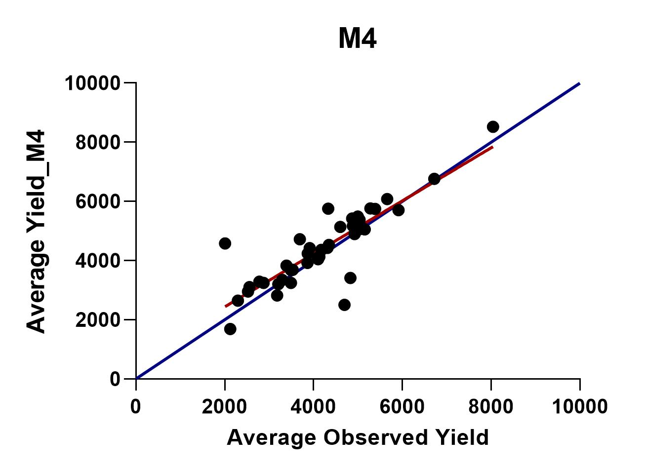
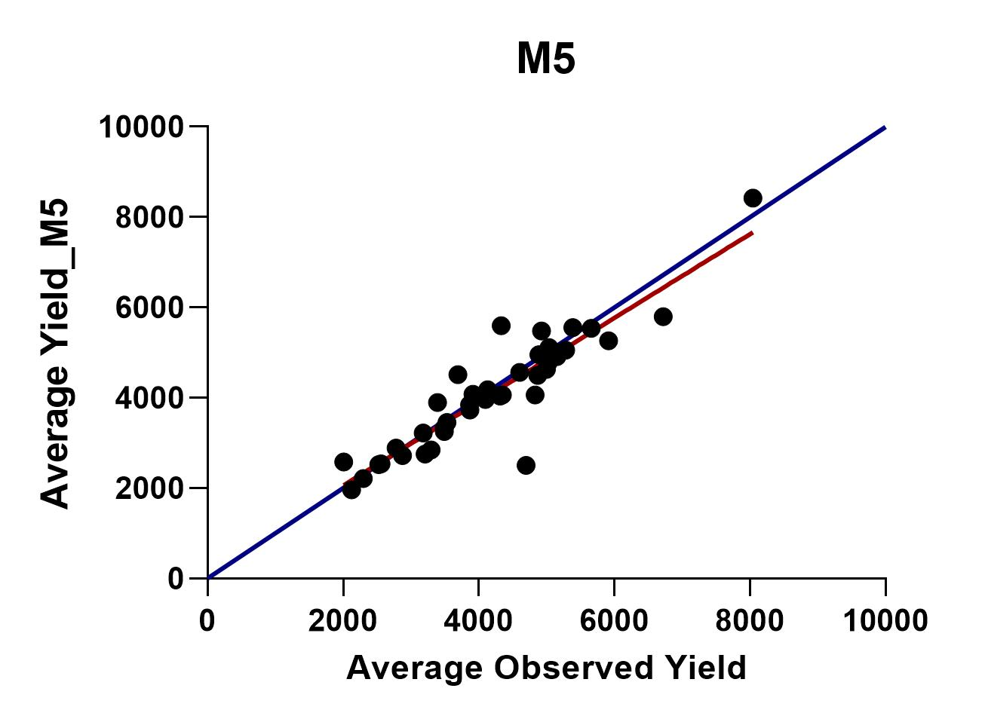
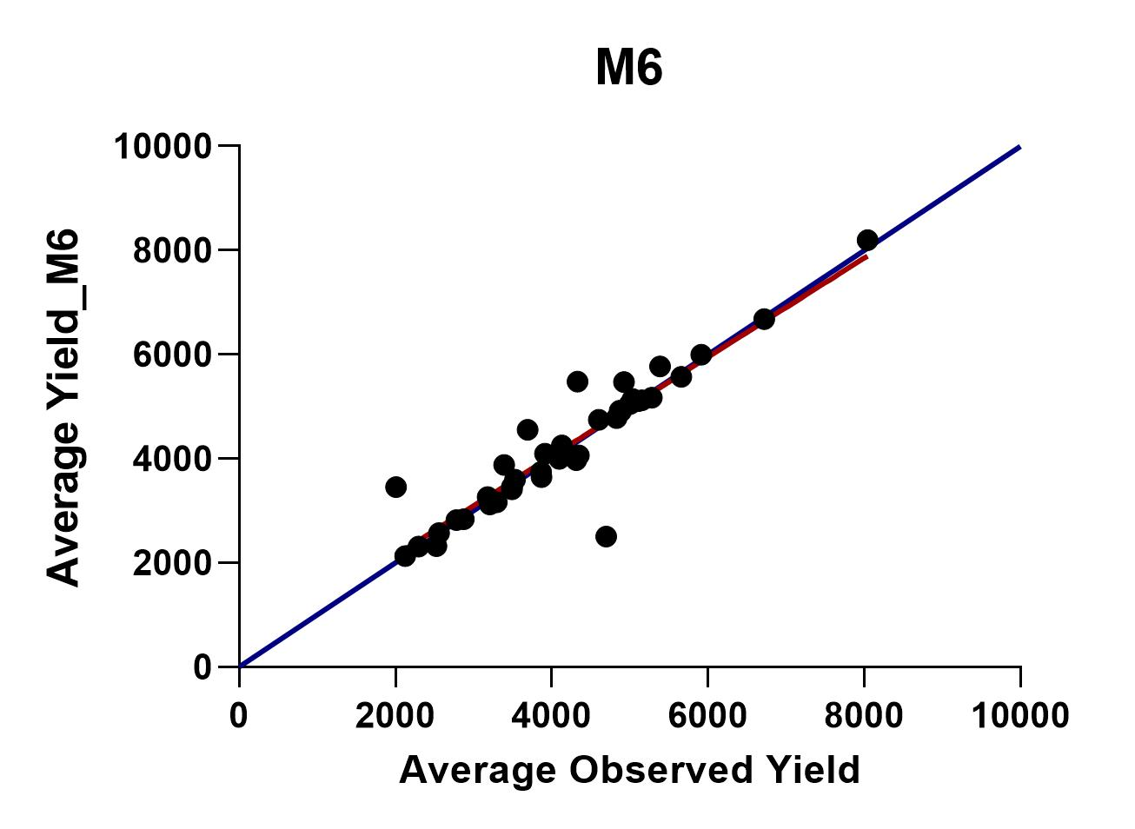

Slide 17
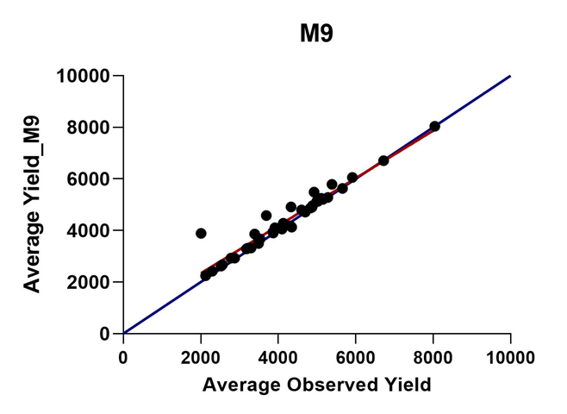
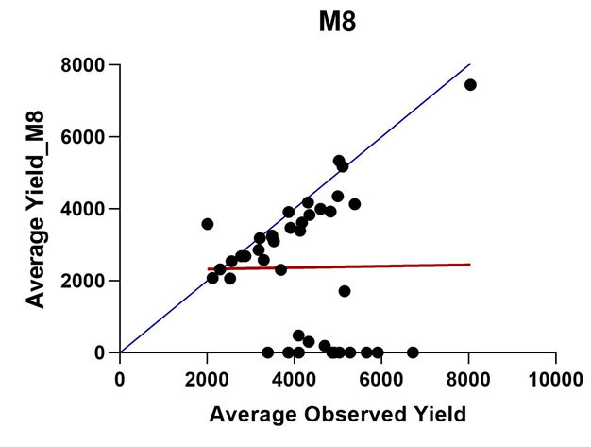
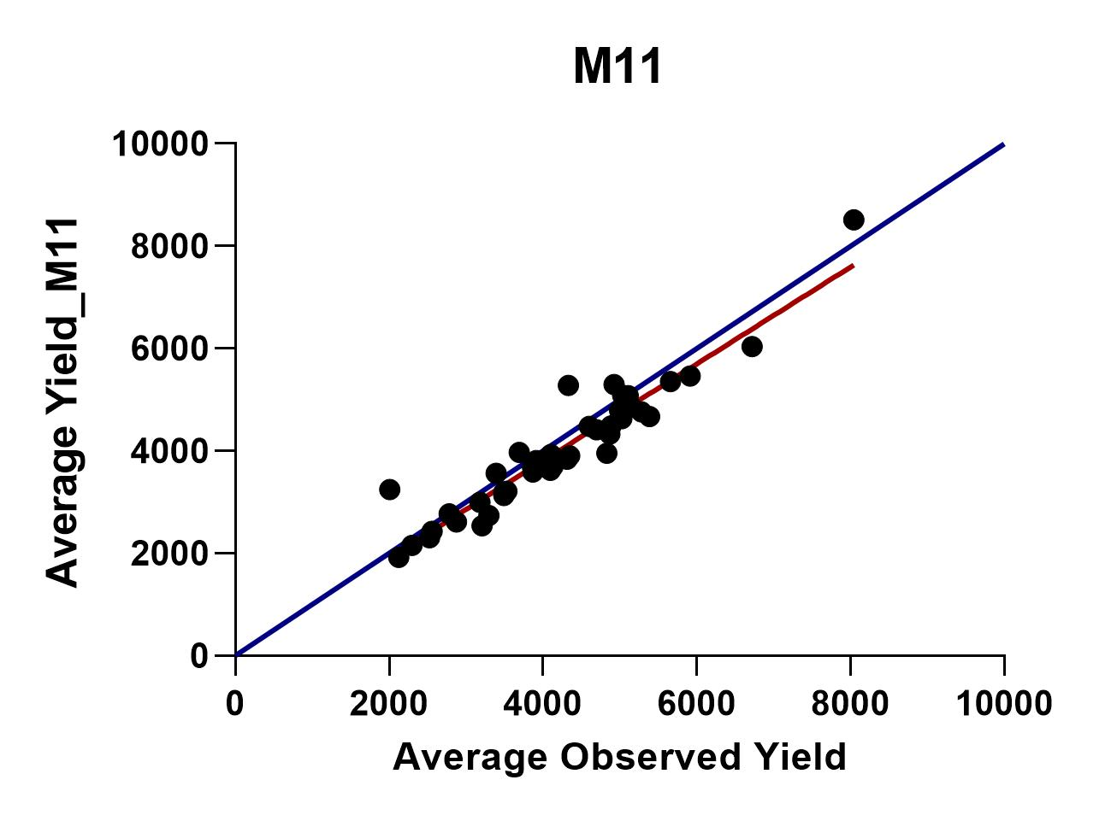
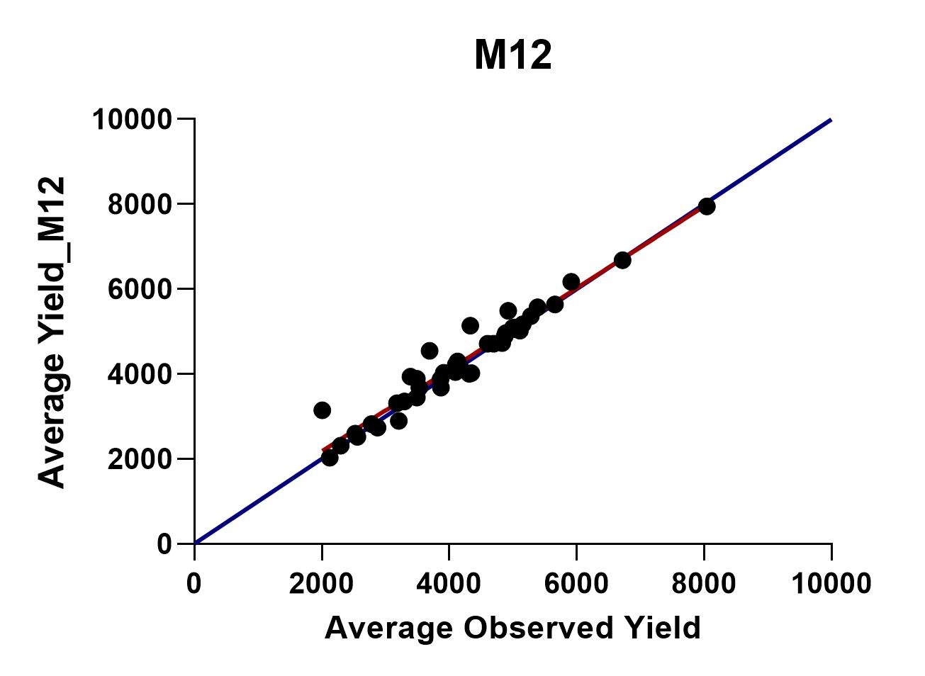
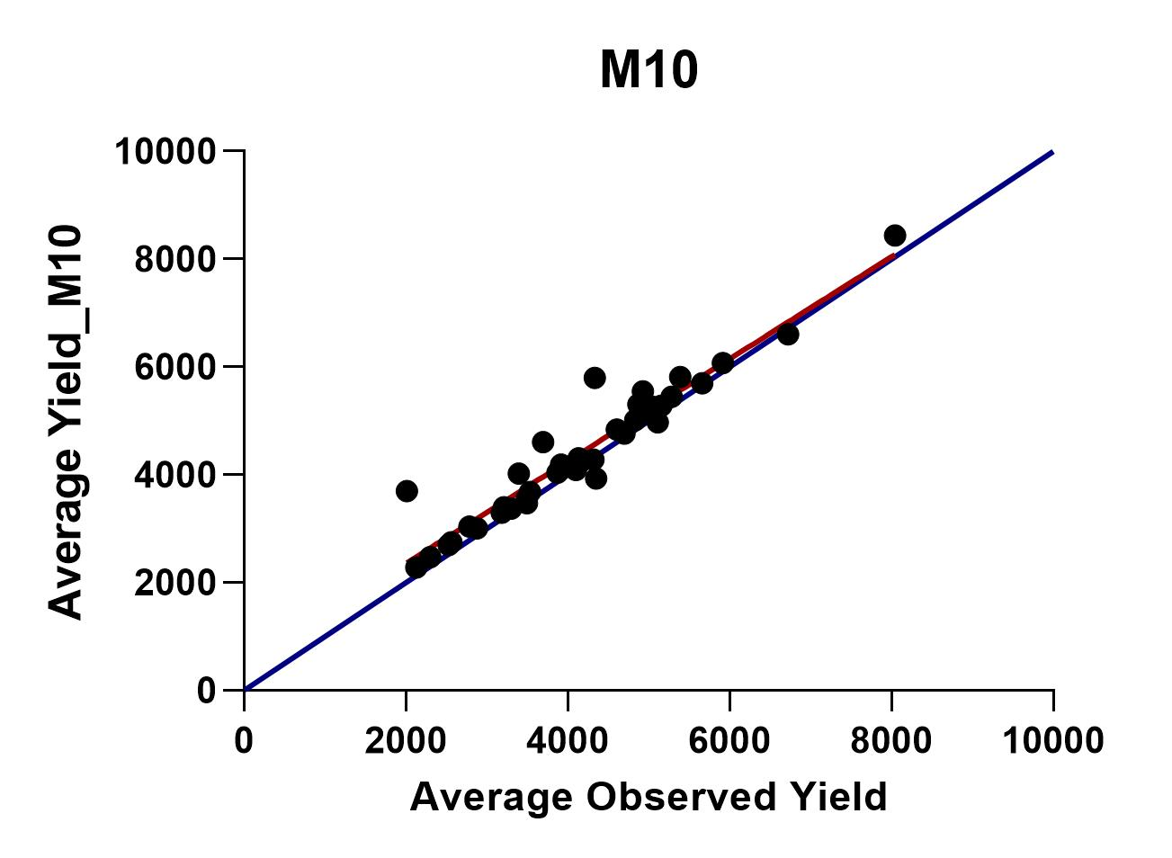

Slide 18
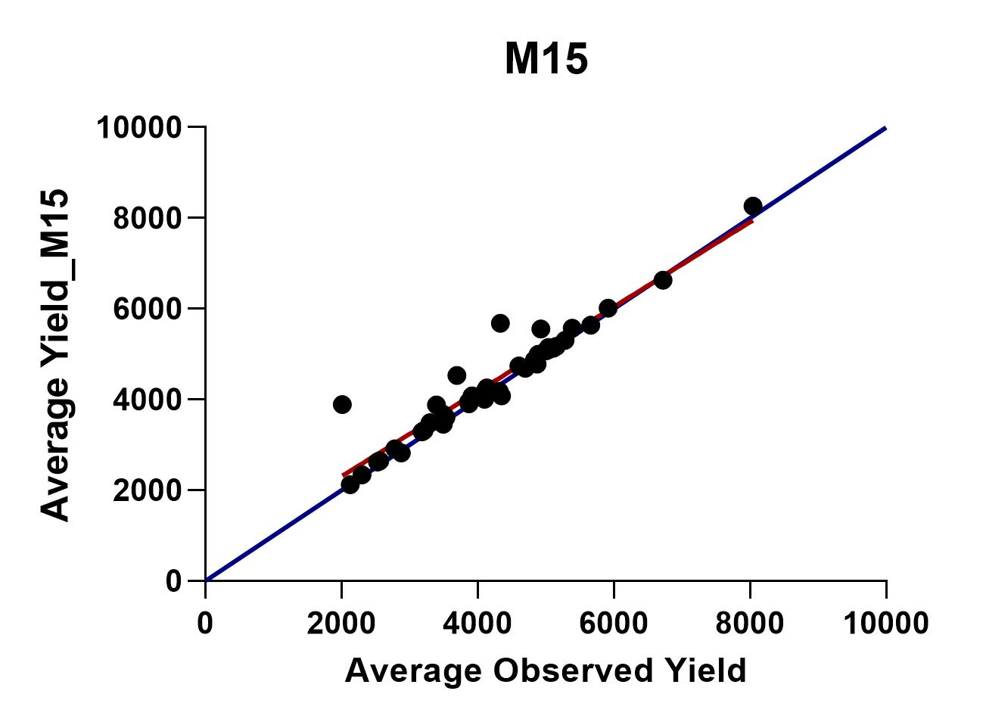
Figure: correlation analysis results plots

Slide 19
Statistical Evaluation
Table: results of statistical evaluation

Slide 20
According to the statistical evaluation,
M8<M3<M2<M4<M7<M5<M6<M11<M10<M15<M14<M9<M13<M1<M12
Least agreement
Good agreement
The simulation of function M12 (Oliveira et al. 2002) showed the best agreement
The simulation of function M8 (Dijkerman 1988) showed the least agreement

Slide 21
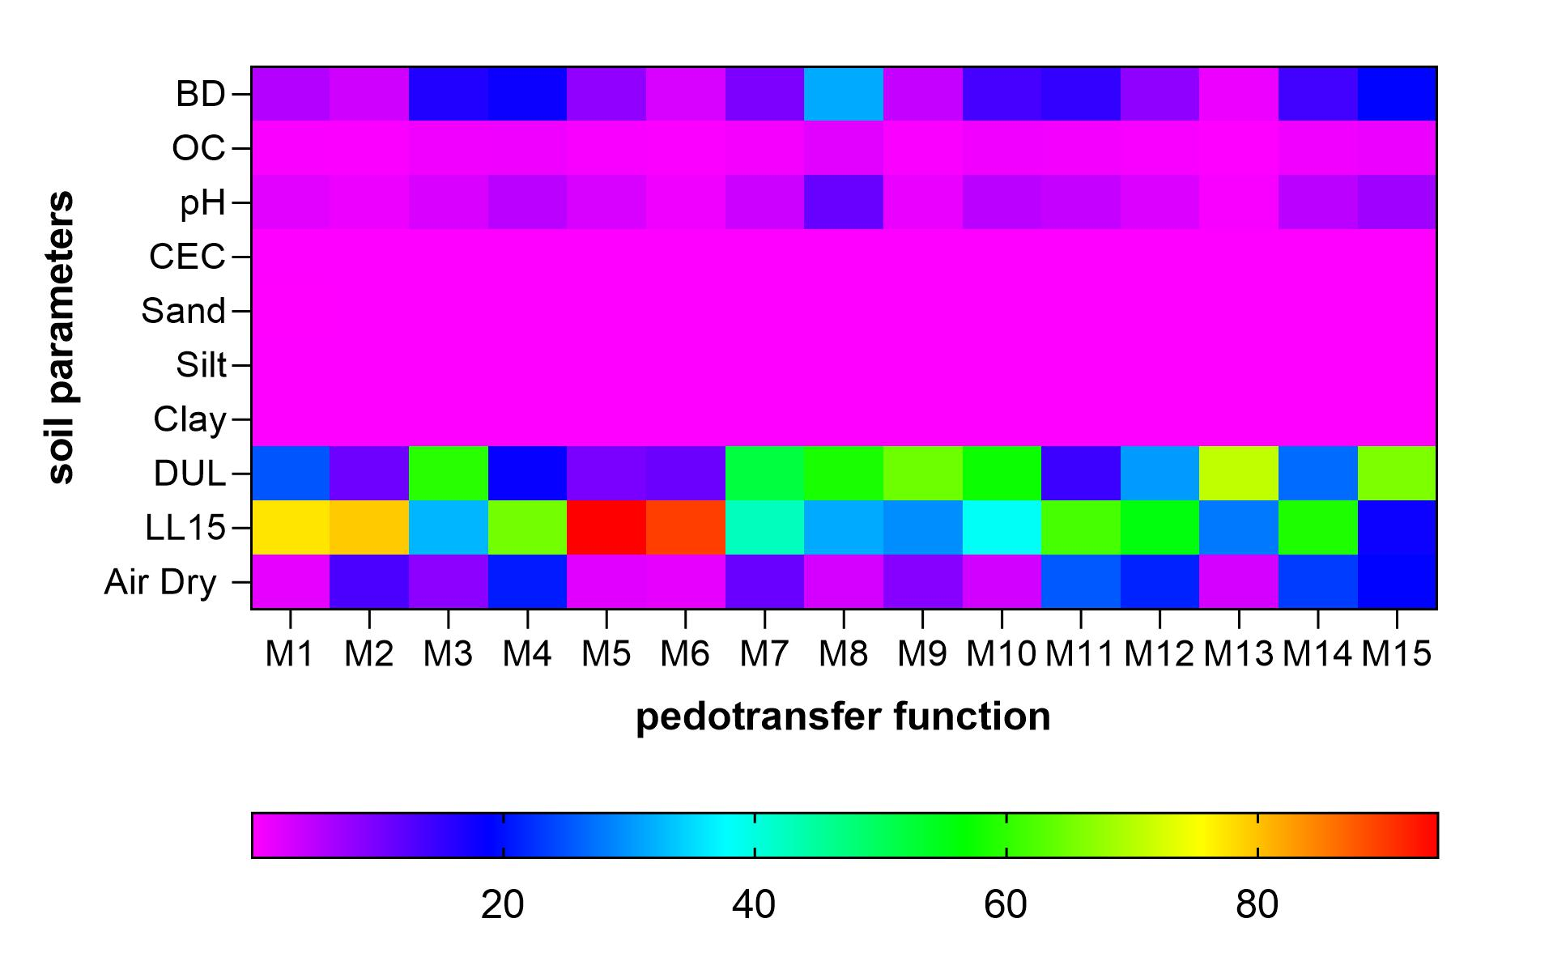
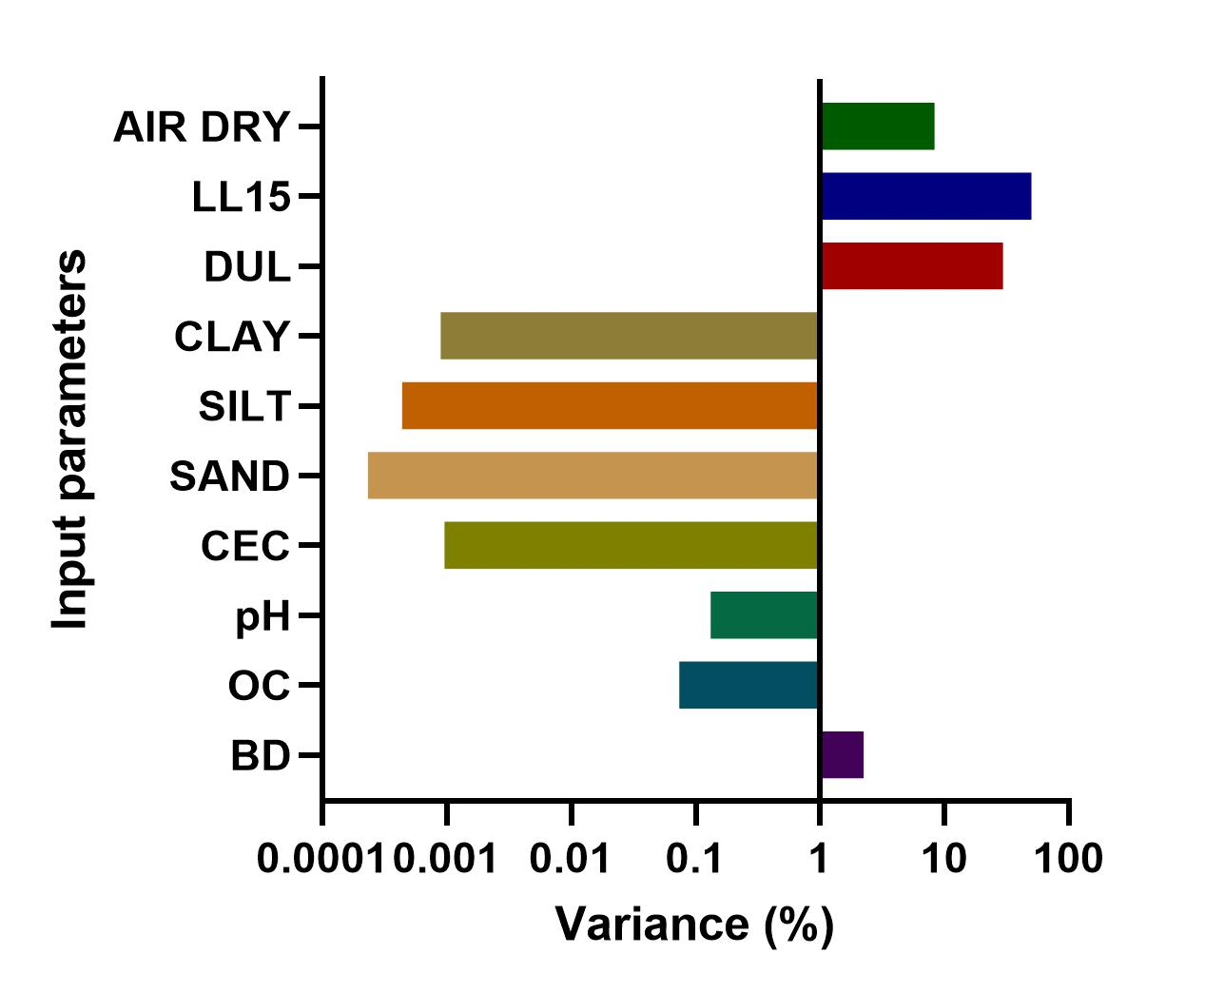
Sensitivity analysis
Figure: Variation of the sensitivity index of different soil inputs
Figure: Sensitivity of soil parameters on rice yield
Highly sensitive to the drained upper limit (DUL) and drained lower limit (LL15)

Slide 22
Conclusion and Recommendations
The PTF 12 (Oliveira et al. 2002) is the most preferred and PTF 8 (Dijkerman 1988) is the least accurate PTF to predict the crop yield in process-based crop models for tropical Sri Lankan soils.
APSIM–Oryza model is highly sensitive to the drained upper limit/ field capacity (DUL) and drained lower limit/ permanent wilting point (LL15).
The proper estimation soil moisture is vital to the accurate simulation of rice yield in process based crop model.

Slide 23
References
Gunarathna, M. H. J. P., Sakai, K., Nakandakari, T., Momii, K., Kumari, M. K. N., & Amarasekara, M. G. T. S. (2019). Pedotransfer functions to estimate hydraulic properties of tropical Sri Lankan soils. Soil and Tillage Research, 190, 109–119.
Gunarathna, M.H.J.P., Sakai K., Kumari M.K.N., & Manjula Ranagalage, (2020). ‘A functional analysis of pedotransfer functions developed for Sri Lankan soils: Applicability for process-based crop models’, Agronomy, 10(2), pp. 1–19. doi:10.3390/agronomy10020285.
Minasny, B., Hopmans, J. W., Harter, T., Eching, S. O., Tuli, A., & Denton, M. A. (2004). Neural networks prediction of soil hydraulic functions for alluvial soils using multistep outflow data. Soil Science Society of America Journal, 68(2), 417–429.
Wimalasiri, E.M. et al. (2020) ‘The first version of nation-wide open 3D soil database for Sri Lanka The first version of nation-wide open 3D soil database for Sri Lanka’, Data in Brief, 33(September), p. 106342. doi:10.1016/j.dib.2020.106342.

Slide 24
Thank You

