Slide 2
Opportunity Analysis for Value-Added Banana Chips Production Using Substandard Bananas in Commercial Farms
DMYR Dayananda1*, AW Wijeratne1
1Faculty of Agricultural Sciences, Sabaragamuwa University of Sri Lanka

Slide 3
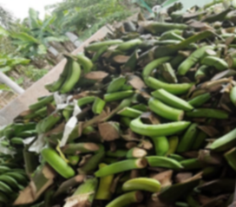
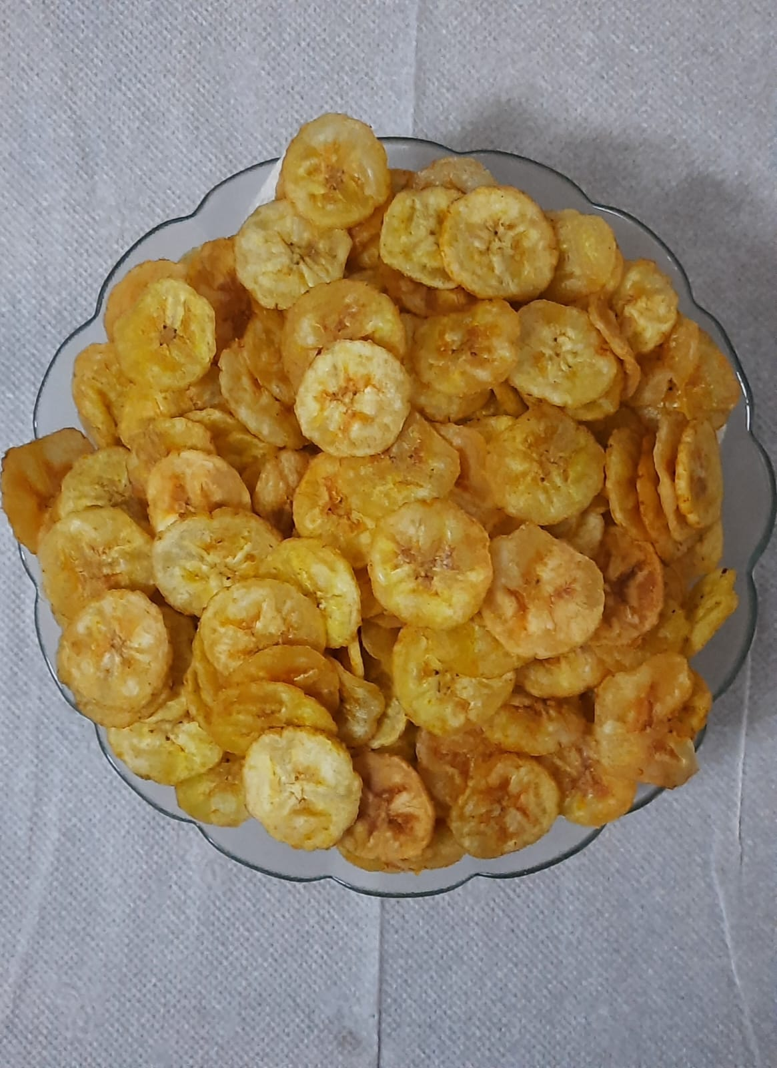
Content for the presentation
Introduction
Objectives
Material and Methods
Results and Discussion
Conclusion and Recommendations
References

Slide 4
Introduction
Sri Lanka as an agricultural economic country where banana is one of the most important fruit crops cultivated. There are nearly 60,000 ha of land is under banana cultivation in Sri Lanka. It covers about 54 per cent of the total fruit lands (Athukorala,2016).
Cavendish, Ambul, Kolikuttu, Seeni, Rathambala and Ambun are the most popular varieties grown in the country and can be grown all over the island (Vidanapathirana,2012).
Cavendish (Musa cavendishii) is the worldwide cultivated commercial banana subgroup which mainly focuses on the export market.

Slide 5
Introduction
It has been estimated that between 15-50% of the total banana production, which reaches the packing house in commercial farms, does not meet retailer specifications and those are rejected (Stanley,2017).
The reasons are fresh damage, handling damage, transport damage, pest damage, storage damage and not fulfilling the standard sizes or over sized banana fingers.
Physiological damages of fruits undermine the quality and market price of the product (Robinson 1996).

Slide 6
Objectives
Main Objective
Development of value-added banana chips by utilizing refuse banana in order to gain profit to the commercial farm.
Sub Objectives
To develop the banana chips by using refused banana.
To analyze the sensory properties of the product.
To determine the microbiological properties of the product.
To function a market analysis for the product.
To identify the feasibility and benefits of the research project for the commercial banana farm.

Slide 7
Material and Methods
Study Location – CIC Quality Banana Project, Hingurakgoda.
Laboratory Tests – CIC Food and Nutrition Laboratory, Palwehera.
Sensory Analysis - A panel of 20 members work in CIC Agri Business, Hingurakgoda.
Customer Analysis – Randomly selected 60 individuals in Hingurakgoda, Lankapura and Medirigiriya Divisional Secretariats.
Feasibility Analysis - Cash Flows, Net Present Value, Internal Rate of Return of the project and Cost Beneficial Analysis.
Data Collection Methods – Questionnaire Survey, depth interview, field observations, published reports and E-books.
Statistical Analysis Tools – IBM SPSS Software 21, Microsoft Excel.

Slide 8
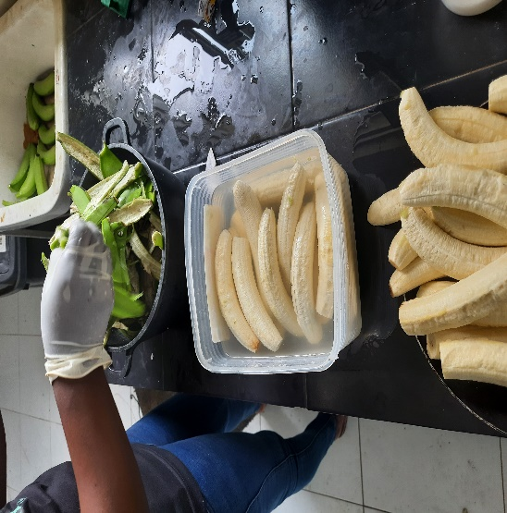
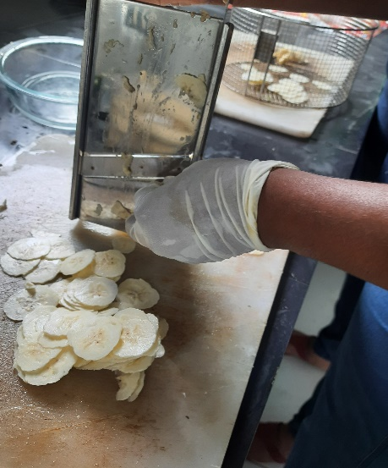
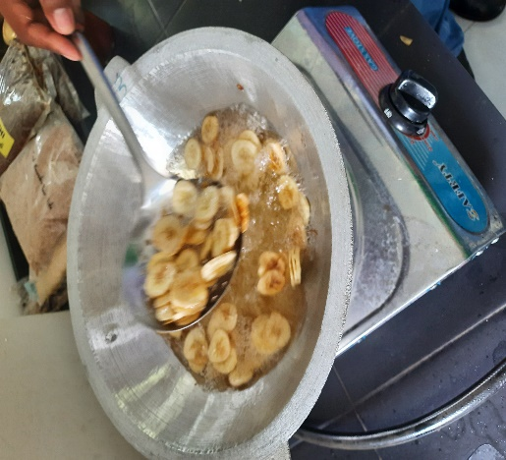
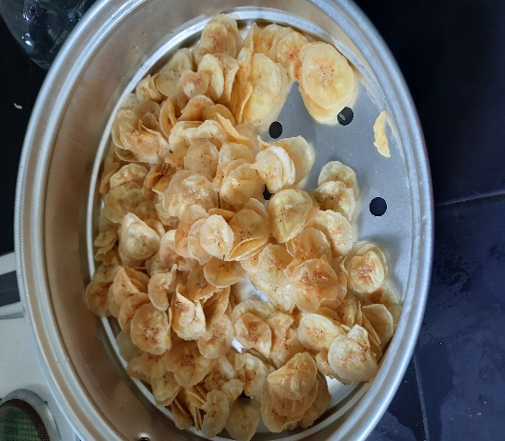
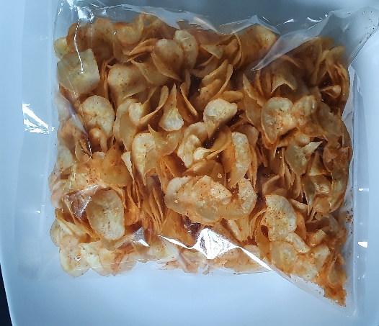
Material and Methods
Banana Chips Preparation Process
Peeling (as quickly as possible to avoid browning)
Soaking in Citric Acid Solution
Slicing into 1.5mm thick slices
Blanching (@ 90°C with 0.1% KMS,10-15 minutes) KMS,10-15 minutes)
Sieving
Drying
Frying
Banana chips tasting by using salt or spices + salt or sugar.
Packaging and Store.

Slide 9
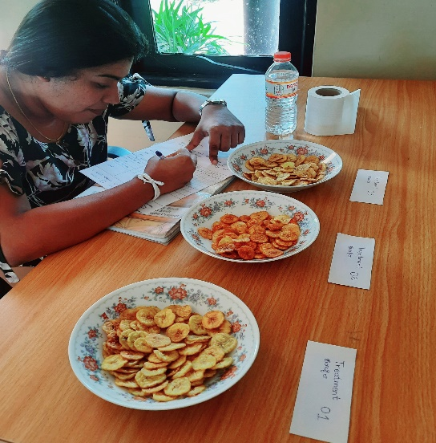
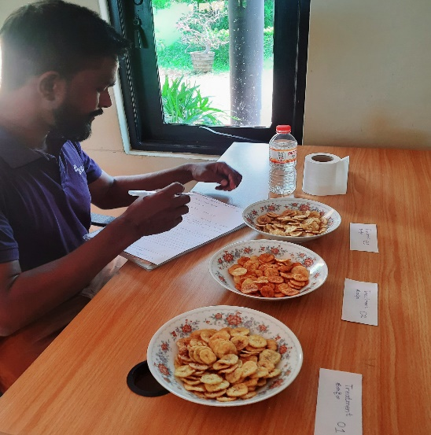
Results and Discussion - Sensory Evaluation
Significant Value of Sensory Characteristics
Sensory characteristics | Significant value (p value)
Appearance | 0.000*
Aroma | 0.055
Colour | 0.246
Prominent in banana taste | 0.607
Texture (crispiness) | 0.261
Taste | 0.004*
Overall acceptability | 0.003*
Note: *P < 0.05

Slide 10
Results and Discussion - Sensory Evaluation
Mean Rank of Sensory Characteristics
Aroma | Treatment 1 | Treatment 2 | treatment 3
Aroma | 1.83 | 2.28 | 1.9
Appearance | 1.33 | 2.35 | 2.33
Colour | 1.8 | 2.23 | 1.98
Prominent in banana taste | 1.93 | 1.93 | 2.15
Texture (crispiness) | 1.85 | 2.18 | 1.98
Taste | 1.58 | 2.38 | 2.05
Overall acceptability | 1.58 | 2.45 | 1.98
NOTE: Treatment 1 - salt added banana chips (control sample), Treatment 2 - salt and chile added banana chips, Treatment 3 - sugar added banana chips

Slide 11
Results and Discussion - Sensory Evaluation
Radar chart of Sensory characteristics of three treatments

Slide 12
Results and Discussion - Microbiological Analysis
Results of Microbiological Analysis
Date | Sample | Enterobactor | Coliform | E.Coli | TPC | Yeast | Mould
05.04.2022 | Control Banana Chips | ND | ND | ND | ND | ND | ND
 | Spicy Banana Chips | ND | ND | ND | ND | ND | ND
 | Sweet Banana Chips | ND | ND | ND | ND | ND | ND
20.04.2022 | Control Banana Chips | ND | ND | ND | ND | ND | ND
 | Spicy Banana Chips | ND | ND | ND | ND | ND | ND
 | Sweet Banana Chips | ND | ND | ND | ND | ND | ND
05.05.2022 | Control Banana Chips | ND | ND | ND | 20 | 40 | ND
 | Spicy Banana Chips | ND | ND | ND | 15 | 10 | ND
 | Sweet Banana Chips | ND | ND | ND | 30 | 50 | ND
20.05.2022 | Control Banana Chips | ND | ND | ND | 70 | >100 | ND
 | Spicy Banana Chips | ND | ND | ND | >100 | >100 | ND
 | Sweet Banana Chips | ND | ND | ND | 40 | 60 | ND

Slide 13
Results and Discussion - Customer Analysis
Customer Previous Experienced with the Banana Chips
Previously consumed banana chips or not
Yes | 45%
No | 55%
Frequencies of previous banana chips consumption
Many times, eat before | 6.7%
Never eat | 15.0%
One time eat before | 8.3%
Several times eat before | 30.0%
From where those were bought before
Retail Stores | 25%
Restaurants | 9%
Street Food Carts | 30%
Supermarkets | 26%
Online buying Platforms | 0
Social Media | 0
Locations outside the country | 6%
Other (Homemade) | 4%

Slide 14
Results and Discussion - Customer Analysis
Customer Reactions and Comments for Tasted Banana Chips Sample
Characteristics | %
Texture of Banana Chips
Soft | 0
Crunchy on the outside and soft on the inside | 11.7%
Totally crunchy | 78.3%
Colour of Banana Chips
Light-golden | 65%
Golden | 25%
Dark golden | 0
Flavor of Banana Chips
Spicy Taste | 75.0%
Sweet Taste | 10.0%
Salty Taste | 5.0%

Slide 15
Results and Discussion - Customer Analysis

Slide 16
Results and Discussion - Customer Analysis

Slide 17
Results and Discussion - Customer Analysis

Slide 18
Results and Discussion -Feasibility and Benefits Analysis
Main Assumptions
Parameter | Assumption
Working days per month | 25 days
Working hours per day | 09 hours
Green banana requirement capacity per day | 800Kg
Green banana conversion ratio into banana chips | 20%
Banana chips output per day | 160Kg
Labour requirement per day | 6 unit per 1500/=
Non-current asset depreciation | 25%
Interest on loan | 25% per 5 years
Project period of evaluation | 5 years

Slide 19
Results and Discussion -Feasibility and Benefits Analysis
Initial Capital Expenditure
Equipment | Cost
Banana Slicing Machine | 525,000.00
Oil Bath Equipment | 35,000.00
Trays | 20,000.00
Burner | 50,000.00
Microwave Dryer | 70,000.00
Total | 700,000.00

Slide 20
Results and Discussion -Feasibility and Benefits Analysis
Costing of Banana Chips
Item | Value per day | Value per Kg
Green banana cost for chips | 80,000.00 | 500.00
Cost of oil (15l @ rs.750/=) | 11,250.00 | 70.31
Chile/salt/etc. | 8,000.00 | 50.00
Firewood/gas | 6,000.00 | 37.50
Labour wages (6 units per day @ rs.1500/unit) | 9,000.00 | 56.25
Depreciation | 583.33 | 3.65
Production over head | 4,000.00 | 25.00
Packing cost (rs/kg @ rs.50) | 8,000.00 | 50.00
Distribution cost | 10,000.00 | 62.50
Total cost per day and cost per kg | 136,833.33 | 855.21

Slide 21
Results and Discussion -Feasibility and Benefits Analysis
Assumptions of the cash flow preparation in below;
Cost of Capital @25%.
Direct cost expenses are inflated by 2% per annum.
Residual value of Assets after five years (Mn) – zero.
Working capital recovered after 5 years - 50%.
Production quantity will be increase by 01Mt per year.
01Kg of banana chips is priced based on customer analysis data. Therefore, Rs.950 /= of price as the 1 kg of banana chips were considered in this study.

Slide 22
Results and Discussion -Feasibility and Benefits Analysis
Projected Cash Flows
 | Year 0 | Year 1 | Year 2 | Year 3 | Year 4 | Year 5
Production/Sales Qty. (Mt) | - | 48 | 49 | 50 | 51 | 52
Turnover | - | 45,600 | 46,512 | 47,442 | 48,391 | 49,359
Capital Cost | (700) | - | - | - | - | -
Direct Cost
Banana consumption | - | (24,000) | (24,970) | (25,968) | (26,997) | (28,057)
Other materials | - | (7,575) | (7,881) | (8,196) | (8,521) | (8,855)
Labour wages | - | (2,700) | (2,892) | (3,090) | (3,295) | (3,507)
Packing materials | - | (2,400) | (2,497) | (2,597) | (2,700) | (2,806)
Production OH | - | (1,200) | (1,248) | (1,298) | (1,350) | (1,403)
Distribution cost | - | (3,000) | (3,121) | (3,246) | (3,375) | (3,507)
Administration cost | - | (480) | (499) | (519) | (540) | (561)
WC Adjustment | (5,157) | (249) | (261) | (273) | (285) | 3,112
Taxation | - | - | - | - | - | -
Net Cash flow | (5,857) | 3,996 | 3,143 | 2,254 | 1,329 | 3,775

Slide 23
Results and Discussion -Feasibility and Benefits Analysis
Projected NPV & IRR Calculation
 | Year 0 | Year 1 | Year 2 | Year 3 | Year 4 | Year 5
Net Cash flow | (5,857) | 3,996 | 3,143 | 2,254 | 1,329 | 3,775
Rate | 1.000 | 0.800 | 0.640 | 0.512 | 0.410 | 0.328
Discounted cash flow | (5,857) | 3,197 | 2,012 | 1,154 | 545 | 1,238
NPV | 2,289
IRR | 45%
Project NPV @ 25% of discounting rate.

Slide 24
Cost Benefit Ratio for Value Added Banana Chips Production by Using Refused Bananas
Cost Benefit Ratio for Costs and Benefit Ratio Calculation for Selling Raw Refused Green Banana
Item | Value
Total Return | 238,272,000
Total Cost | 223,507,000
Net Return | 14,765,000
B: C Ratio | 1.066060571
Item | Value
Total Return | 100000000
Total Cost | 125000000
Net Return | -25,000,000
B: C Ratio | 0.8
Assumption ; Banana chips production is increased from 1Mt per years. Hence, green banana requirement also increased yearly basis. The following table consist with green banana requirement for banana chips production yearly basis.

Slide 25
Conclusion
The study was done to identify the recover value of cosmetically damaged bananas by developing value-added banana chips.
There are three types of banana chips were prepared to select the best sample in order to offer to the market.
Sensory analysis concludes that, Treatment 02 (Spicy banana chips sample) can be selected for ideal sample for mass production.
Result of the microbial study conclude that product is under safe limit within 30 days of ambient storage.

Slide 26
Conclusion
The consumer analysis results conclude that most people in the sample area (Higurakgoda, Madirigiriya and Lankapura) have not consumed banana chips before.
Customer analysis results revealed that most of the participants liked the texture to be perfectly crispy, the color to be light golden, and the taste to be mostly spicy.
The results of the advertising exposure revealed the product display board, retailer recommendations, print media and social media are the most influential sources of information about the new product in this area.
Identification feasibility and benefit analysis concluded developing banana chips are more profitable than selling the raw refused green banana.

Slide 27
Recommendations
Banana chips production by using refused banana was the easy method for recover the cost of refused banana .
However, entrepreneur or farmer need to consider doing feasibility analysis to the location before start the production of banana chips for cost mitigating method.
Thickness of banana slices, pretreatments, temperature and packaging are the major parameter for quality banana chips. Hence, giving significant attention for the parameters are more important to generate high quality banana chips output.

Slide 28
References
Anyasi, T. A., Jideani, A. I., & Mchau, G. R. (2013). Functional properties and postharvest utilization of commercial and noncommercial banana cultivars. Comprehensive Reviews in Food Science and Food Safety, 12(5), 509-522.
Anuar, M. S., & Nor, M. Z. M. (2018). Drying, colour and sensory characteristics of ‘Berangan’banana (Musa Accuminata) flesh dried using a microwave oven. Malaysian Journal of Halal Research Journal (MJHR), 1(1), 10-14.
Athukorala, W., & Karunarathna, M. (2016) Farmer preferences for Banana diversity and Genetically Modified Banana in Sri Lanka: Application of Choice Experiment Method.
Borah, P. P., & Nayak, P. K. (2013). Quality characteristics of dried jahaji banana chips after deep fat frying. Int J Agric Food Sci Technol, 4(9), 901-908.
Dhake, K., Jain, S. K., & Lakhawat, S. S. (2019). Value addition in green banana for rural employment generation. Food Engineering, 59(1), 1-11.
Kamran, M., Saleem, N., Jamil, K., Rauf, M., Umar, Z. N., & Tarar, O. M. (2008). Studies on the preparation and evaluation of sweet banana chips. Pak J Food Sci, 18(1-4), 44-49.
Lages, L. F. (2016). VCW—Value Creation Wheel: Innovation, technology, business, and society. Journal of Business Research, 69(11), 4849-4855.
Mahendran, T., & Prasannath, K. INFLUENCE OF DIFFERENT PROCESSING METHODS ON THE QUALITY OF DRIED BANANA.
Molla, M. M., Nasrin, T. A. A., & Islam, M. N. (2009). Study on the suitability of banana varieties in relation to preparation of chips. Journal of Agriculture & Rural Development, 81-86.
Pandya, R., & Yadav, K. C. (2014). Study on effect of pretreatments and microwave drying on banana chips. IOSR Journal of Agriculture and Veterinary Science IOSR-JAVS, 77, 04-10.
Stanley, R. (2017). Commercial feasibility of banana waste utilisation in the processed food industry. Hort Innovation: Sydney, Australia.
Subbaiah, K. V., Jagadeesh, S. L., Manjula, R., & Rani, N. S. (2018). Value Added Studies in Banana as a Commercial Enterprise. Journal homepage: http://www. ijcmas. com, 7(03), 2018.
Wasala, W. M. C. B., Dissanayake, C. A. K., Dharmasena, D. A. N., Gunawardane, C. R., & Dissanayake, T. M. R. (2014). Postharvest losses, current issues and demand for postharvest technologies for loss management in the main banana supply chains in Sri Lanka. Journal of Postharvest Technology, 2(1), 80-87.
Vidanapathirana, R., Hathurusinghe, C. P., Rambukwella, R. O. S. H. I. N. I., & Somarathne, T. G. (2012). A Study on value chain of Pineapple and Banana in Sri Lanka.

Slide 29
Thank You

