Slide 1
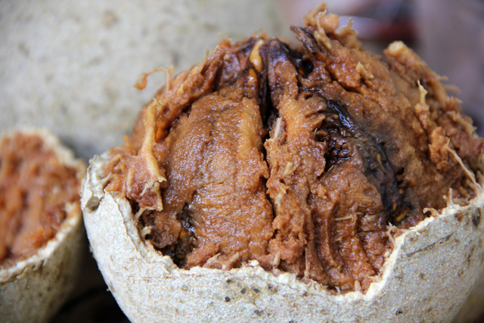
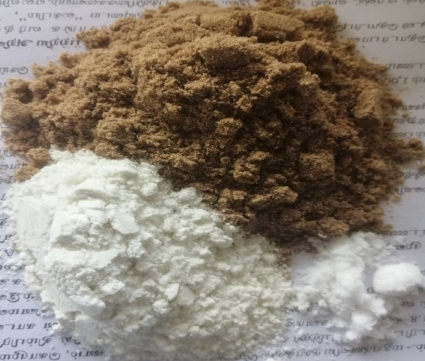
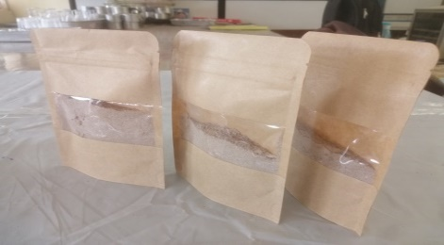
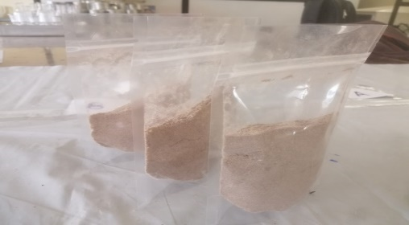
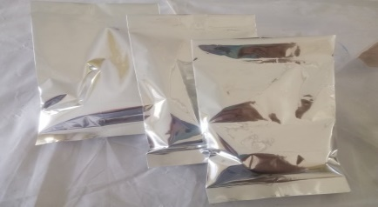
Development and Quality Evaluation of a Wood Apple Powder-based instant Beverage Mix
G.T.N. Gunasekara¹, I.R. Liyanage² and G.D.K. Kumara¹
¹Department of Export Agriculture, Faculty of Agricultural Sciences, Sabaragamuwa University of Sri Lanka
²Grain Legumes and Oil Crops Research and Development Centre, Angunukolapelessa, Sri Lanka

Slide 2
Content
Introduction
Objectives
Material and Methods
Results and Discussion
Conclusion and Recommendations
References

Slide 3
Introduction
Wood apple (Limonia acidissima L.) belongs to the Family Rutaceae and is native to Asia and widely distributed in India, Sri Lanka, China and Indonesia.
Plays an important role in food processing industry owing to its nutritional and food value.
The medicinal and curative properties of wood apple make it significant.

Slide 4
Objectives
General Objective
To develop a wood apple (Limonia acidissima L.) powder-based instant beverage mix
Specific Objectives
To identify the wood apple variety (of three) with the best physical, nutritional and health properties for dry powder preparation
To develop a wood apple powder-based instant beverage mix with best organoleptic qualities
To evaluate the shelf life of the wood apple powder-based instant beverage mix in selected packages

Slide 5
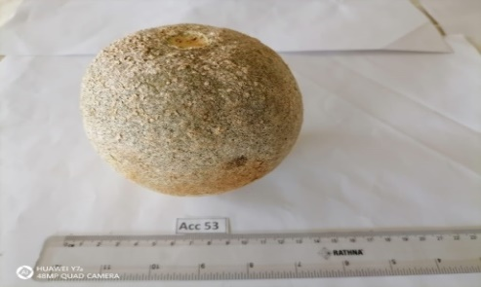
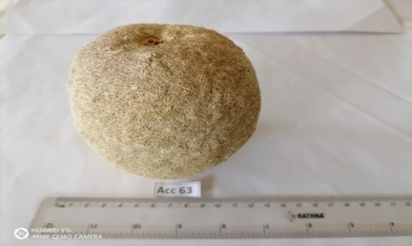
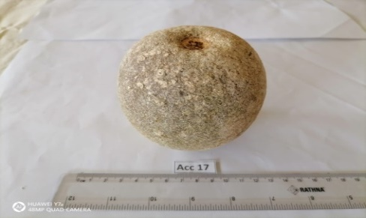
Methodology
Experimental Location
Food Science Laboratory of Grain Legumes and Oil Crops Research and Development Center, Angunukolapelessa, Department of Agriculture.
Experimental materials
Fully ripe ANK wood apple 1, ANK wood apple 2 and Accession No 17 wood apple varieties were collected from the research field, Angunukolapelessa.
A
B
C
Figure 01: A –ANK Wood apple 1, B- ANK Wood apple 2, C-Accession No - 17

Slide 6
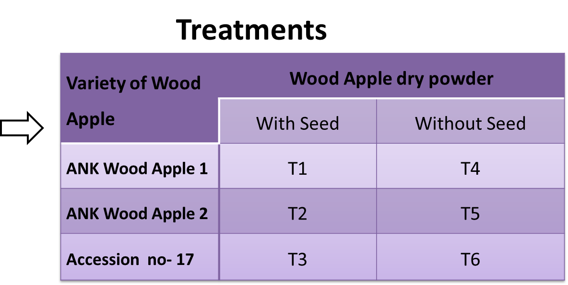
Methodology Cont…
Experiment 2 - Developed the wood apple powder-based instant beverage mix
Experiment 1 - Selected the best variety for dry powder preparation

Slide 7
Experiment I : Observations and data collection
Proximate Composition Analysis (AOAC method -2000)
Moisture content %
Crude Protein Content %
Crude Fat Content %
Ash Content %
Carbohydrates %
Total Soluble Solid Content (Brix value)
Color (Digital Colorimeter )
pH value (pH meter)
5. Water Activity (Water Activity Meter)
6. Titratable Acidity
7. Solubility %
8. Total Phenolic Content (Folin-Ciocalteu assay)
9. Antioxidant activity (2-diphenyl-1-picrylhydrazyl.’s free radical ( DPPH) scavenging assay-2001 ).

Slide 8
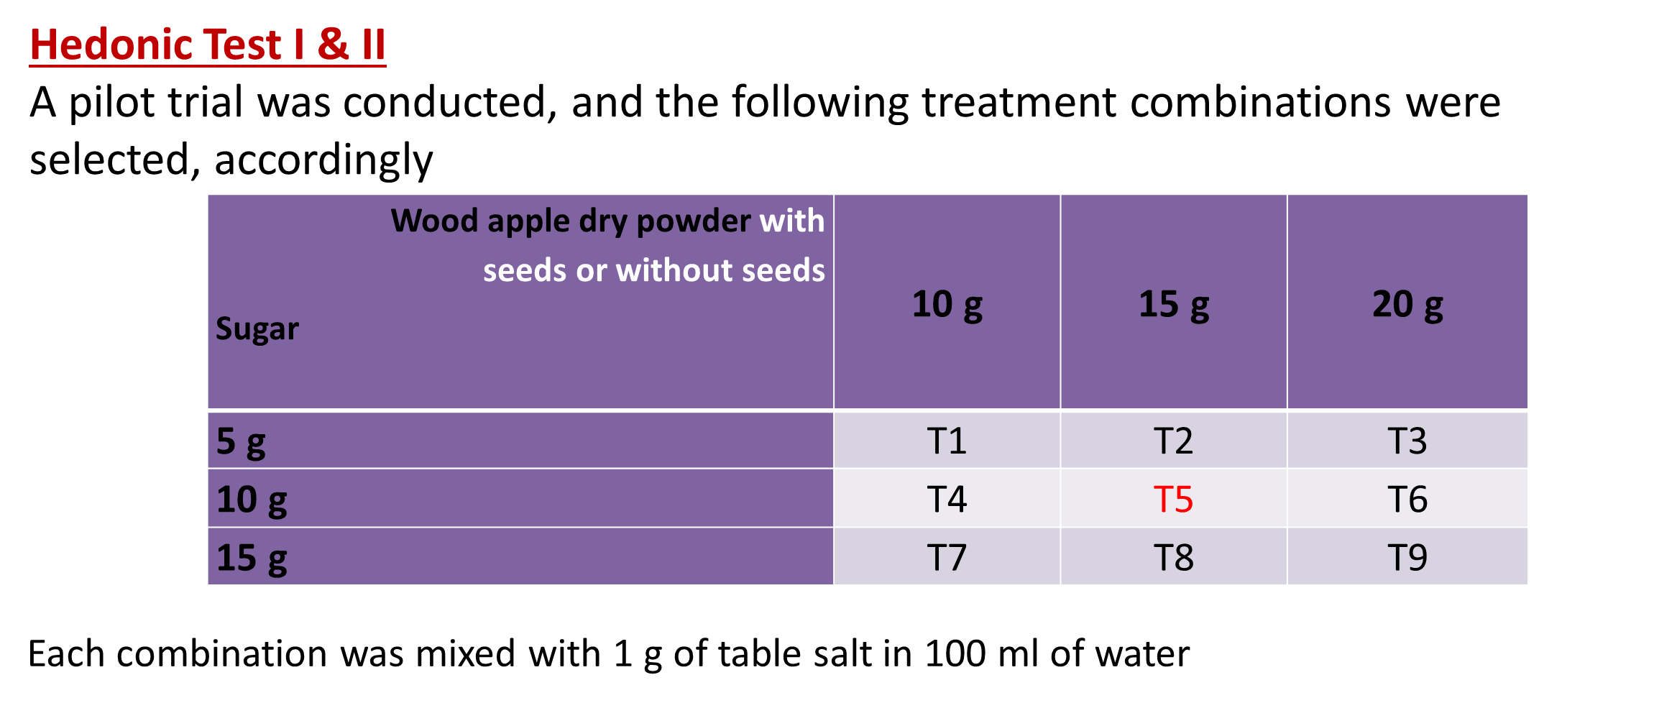
Methodology Cont…
Experiment 2- Development of wood apple powder-based instant beverage mix

Slide 9
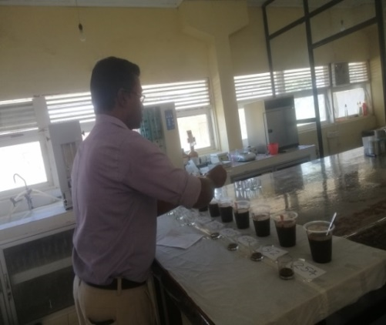
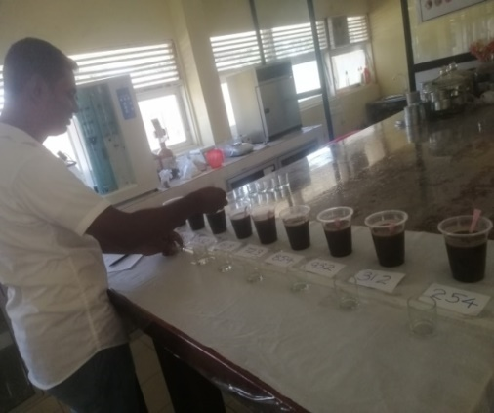
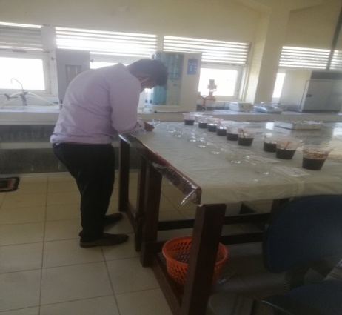
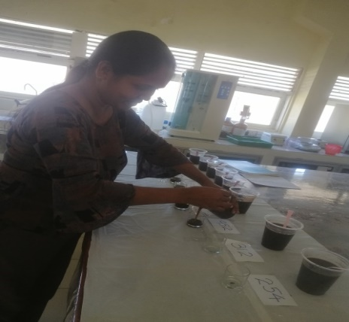
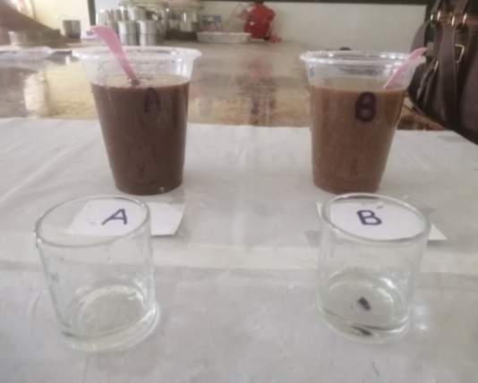
Hedonic Test I ( Wood apple dry powder with seeds
Hedonic Test II ( Wood apple dry powder without seeds
Paired Preference Test
Total Soluble Solid Content (Brix value)
pH value
Water Activity
Microbial Analysis (Total Plate count & Fungal Count)
Final Product

Slide 10
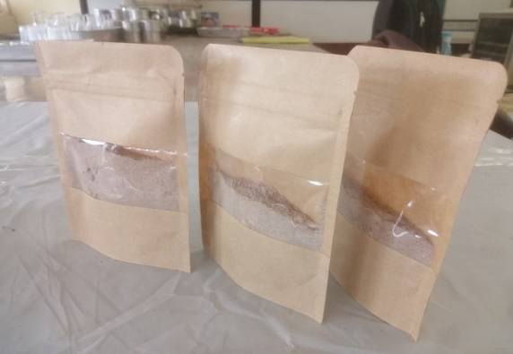
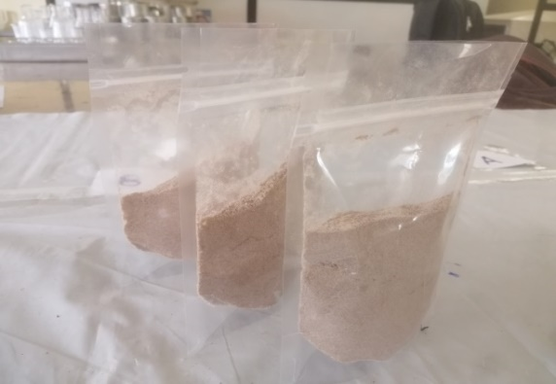
Selection of the Best Packaging Material for the wood apple powder-based instant beverage mix
A
B
C
A: Kraft paper standup zip lock pouch with rectangle window
B: Transparent polythene standup zip lock pouch,
C: Silver Laminated (single layered) sealed pouch,

Slide 11
Data Analysis
The experiment was designed in Complete Randomized Design (CRD) with three replicates. Data were analyzed by Analysis of Variance with (ANOVA) Duncan’s Multiple Range Test (DnMRT) mean separation.
Friedman test was conducted to analyze sensory evaluation and data were analyzed by using Statistical Analysis System (SAS) and Statistical Package for the Social Sciences (SPSS) software.

Slide 12
Results and Discussion

Slide 13
Selection of the Best Variety of Wood Apple to prepare Wood Apple dry powder
Variety - wise proximate composition analysis of wood apple dry powder
Variety | Moisture % | Crude Fat % | Crude Protein % | Ash % | Carbohydrates %
Dry powder without seeds Accession No-17 ANK Wood apple 01 ANK Wood apple 02 | 18.43^{b} ± 0.24 17.51^{c} ± 0.36 19.86ª ± 0.53 | 0.91ª ± 0.06 0.29^{c} ± 0.09 0.63^{b} ± 0.01 | 10.13ª ± 0.70 07.41^{b} ± 0.33 08.23^{b} ± 0.51 | 6.75ª ± 0.40 5.74^{b} ± 0.40 6.11^{ab}± 0.33 | 64.42^{b} ± 0.26 69.09ª ± 0.65 64.69ª ± 0.66
Dry powder with seeds Accession No- 17 ANK Wood apple 01 ANK Wood apple 02 | 15.89^{b} ± 0.31 13.71^{c} ± 0.43 16.49ª ± 0.20 | 5.44ª ± 0.24 4.40^{b} ± 0.53 4.59^{b} ± 0.33 | 12.09ª ± 0.45 10.01ª ± 0.28 10.35ª± 0.30 | 5.97ª ± 0.43 5.37ª ± 0.28 5.38ª ± 0.51 | 61.20^{b} ± 0.45 66.17ª ± 0.61 62.94^{ab} ± 0.31
(Vijayakumar et al., 2013)

Slide 14
Variety-wise Physical properties analysis of wood apple dry powder
Variety | pH | Brix (1:2 dilution) | Acidity % | Solubility % | Water Activity
Dry powder without seeds Accession No- 17 ANK Wood apple 01 ANK Wood apple 02 | 3.01ª ± 0.02 2.95^{c} ± 0.03 2.98^{ab} ± 0.01 | 10.33ª ± 0.58 08.33^{b} ± 0.58 08.33^{b} ± 0.58 | 11.90ª ± 1.5 11.09a ± 1.13 11.53a ± 0.77 | 50.06ª ± 2.88 49.71ª ± 0.34 45.76ª ± 3.31 | 0.55ª ± 0.01 0.42^{c} ± 0.01 0.50^{b} ± 0.00
Dry powder with seeds Accession No- 17 ANK Wood apple 01 ANK Wood apple 02 | 3.05ª ±0.01 2.93^{c} ± 0.03 2.96^{b} ± 0.01 | 7.66ª ± 0.58 7.33ª ± 0.58 7.33ª ± 0.58 | 12.74ª ± 0.39 11.82^{b} ± 0.03 12.52^{ab} ± 0.21 | 44.56^{ab} ± 0.93 46.05ª ± 0.71 43.40^{b} ± 0.78 | 0.49ª ± 0.01 0.42^{b}± 0.00 0.48ª ± 0.01
(Vijayakumar et al., 2013)

Slide 15
Variety-wise Physical properties analysis of wood apple dry powder Cont……
Variety | Color
 | Lightness | Chroma | Hue
Dry powder without seeds Accession No- 17 ANK Wood apple 01 ANK Wood apple 02 | 27.09^{b} ± 0.93 32.35ª ± 1.09 28.65^{b} ± 2.95 | 14.39 ^{b} ± 0.36 18.88 ª ± 0.33 17.81 ª ± 1.01 | 58.23 ^{b} ± 0.26 60.75ª ± 0.79 60.45 ª ± 0.49
Dry powder with seeds Accession No- 17 ANK Wood apple 01 ANK Wood apple 02 | 25.69^{b} ± 0.74 40.58ª ± 2.61 28.43^{b} ± 2.35 | 7.44 ^{b} ± 0.60 19.28 ª ± 0.35 17.91^{a b} ± 1.25 | 59.14 ^{b} ± 1.44 64.59 ª ± 0.06 60.71 ^{b} ± 1.29

Slide 16
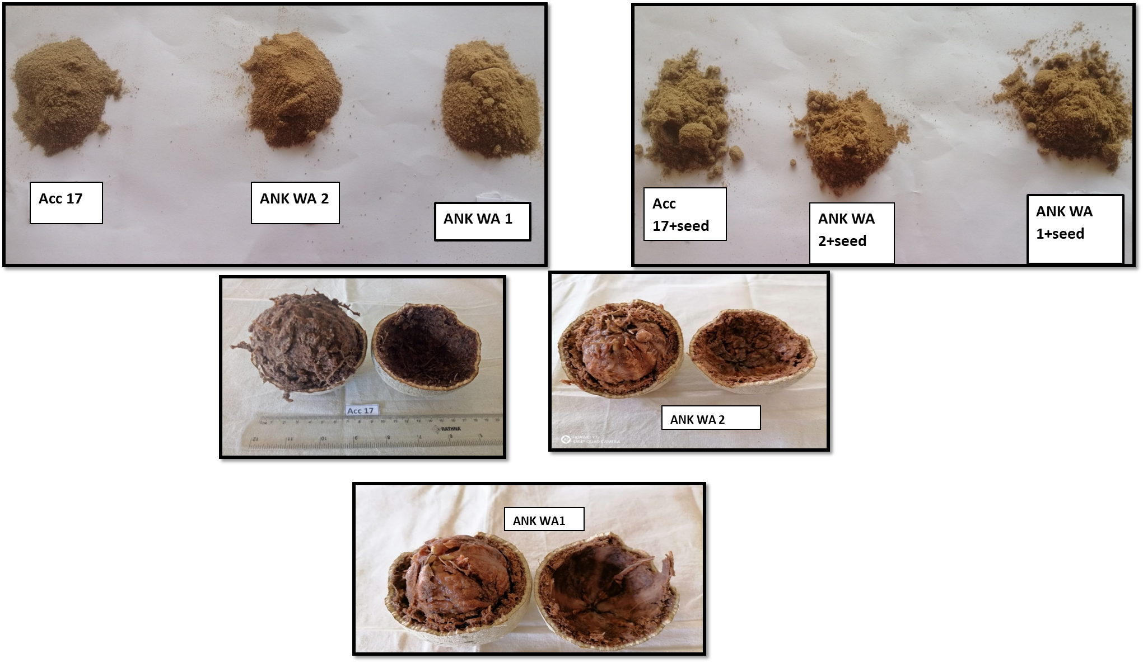
Figure 2: Color differences- A: Accession No17, B: ANK wood apple 02 ,C: ANK wood apple 01

Slide 17
Free Radical Scavenging Activity
(Vijayakumar et al., 2013)

Slide 18
Total Phenolic Content
Variety | TPC (mg of GAE/ 100g of sample)
 | Wood apple dry powder without seeds | Wood apple dry powder with seeds
Accession No- 17 ANK Wood apple 01 ANK Wood apple 02 | 437.92^{b} ± 0.01 535.18ª ± 0.01 392.00^{c} ± 0.00 | 386.59^{b} ± 0.01 621.64ª ± 0.02 248.81^{c} ± 0.00
(Vijayakumar et al., 2013)
TPC of Nelli (Phyllanthus emblica) – 295.94mg of GAE/ 100g (Jayathilake et al., 2015)

Slide 19
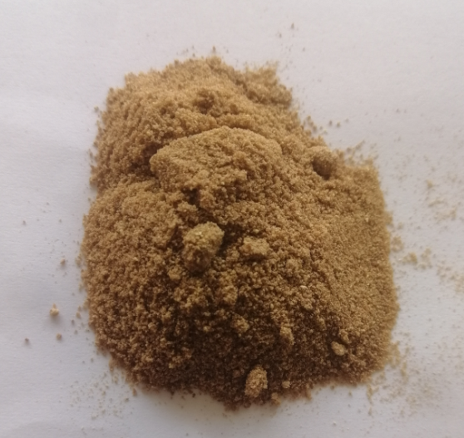
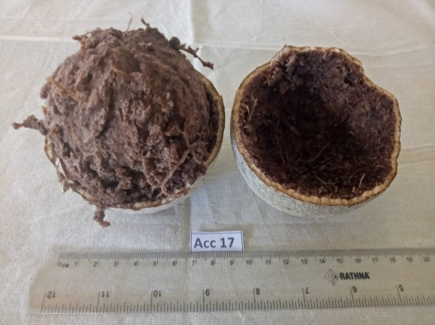
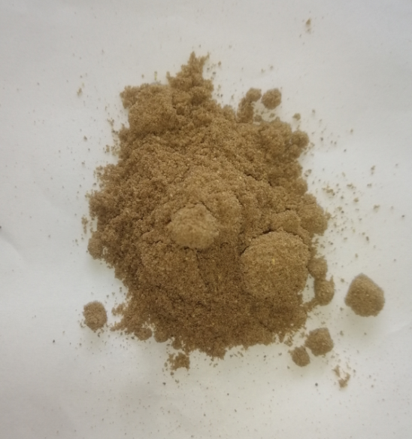
Yield of Wood Apple dry powder
10 % of wood apple dry powder without seeds
15 % of wood apple dry powder with seeds
01 kg of fresh wood apple fruits

Slide 20
Sensory Evaluation
T5
T5

Slide 21
Nutrient composition of wood apple powder-based instant beverage mix
Moisture content - 10.24 %
Fat Content - 3.25%
Ash Content - 7.32%
Crude protein - 5.17 %
Water Activity - 0.47
Brix value - 13.13 %
Solubility - 68.98%
pH - 3.08

Slide 22
Physical properties of the final product in
selected packaging materials
Water activity - <0.6
RTS Brix – 10% -Min( Food & Drag administration quality parameters )

Slide 23
Microbial analysis of final product
Storage period | Total Plate Count (cfu/ml) |  | Fungal Count(cfu/ml)
Final product Initial stage One month |  | ND 8 | ND 5
(TPC – 10⁴ CFU / g , YMC – 10² CFU / g) ( Food & Drag administration Microbial quality guidelines (Circular No: 2013-010))

Slide 24
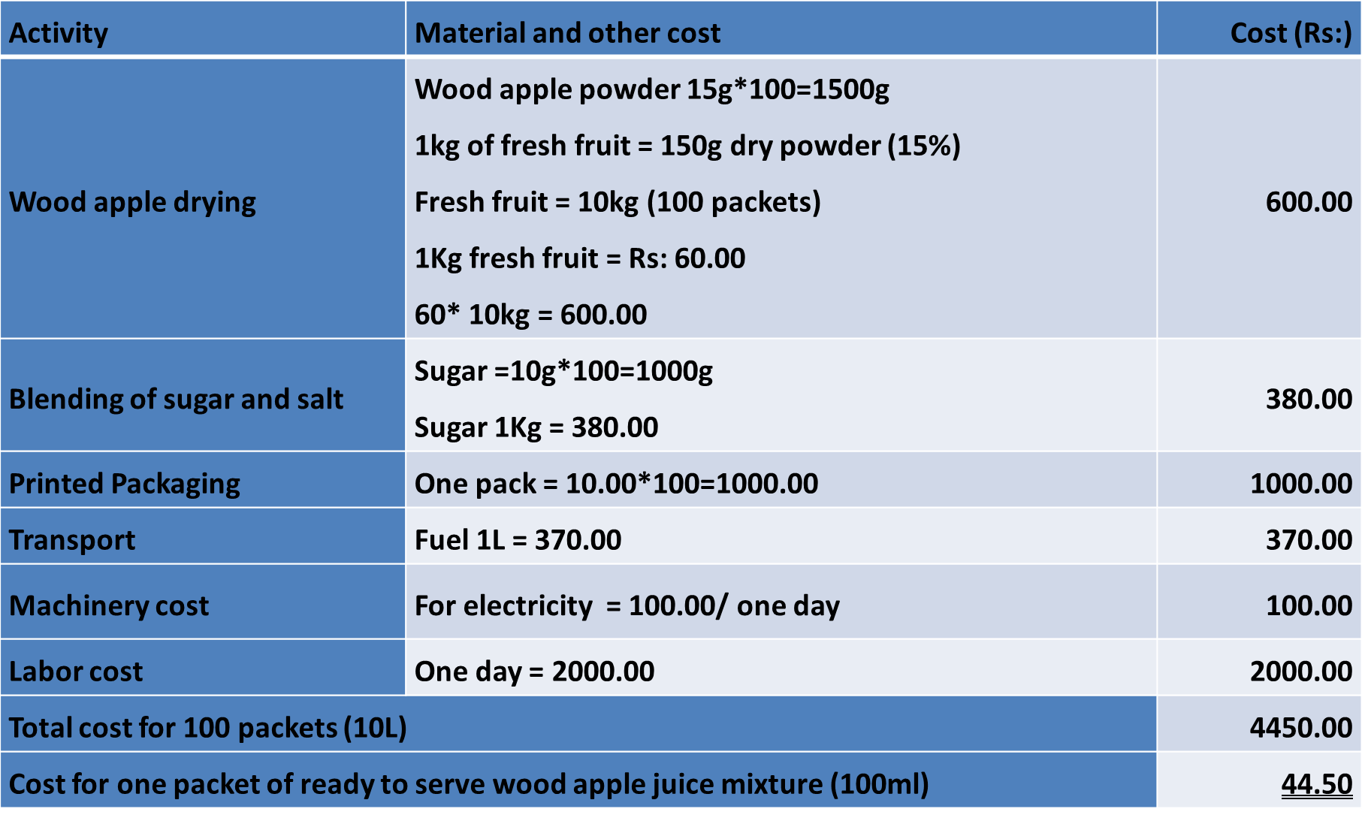
Cost of production of final product

Slide 25
Profit analysis
Market price of wood apple fresh juice (200ml) = 170.00
Cost for one packet of ready to serve wood
apple juice mixture (200ml) = 44.50*2
Cost for 200ml = 89.00
Selling price of final product = 150.00
Profit = 150-89 = Rs: 61.00

Slide 26
Conclusions
Accession no 17 which has the richest nutritional value while having best physical properties from both categories for dry powder preparation.
The highest nutrient content is recorded by the wood apple dry powder with seeds.
Yield of dry powder with seeds by using fresh wood apples is 15%.
T5 (15g of wood apple dry powder, 10g of brown sugar and 1g of table salt dissolved with 100 ml of water) of both categories (with seeds and without seeds) shows the best organoleptic qualities .
T5 which composed of 15 g of wood apple dry powder with seeds, 10 g of brown sugar and 1g of table salt dissolved with 100 ml of water has the highest overall acceptance.
Quality parameters under all three packaging materials namely, Kraft paper standup zip lock pouch with rectangle window, Silver Laminated (single layered) sealed pouch and Transparent polythene standup zip lock pouch were in favorable range after one month of shelf –life.

Slide 27
Suggestions
Need to evaluate the shelf life of the wood apple powder-based instant beverage mix more than one month.
Studies need to be carried out to develop novel products/value added products/ fortified products by incorporating nutritive wood apple dry powder to increase its popularity especially among young generation.

Slide 28
References
AOAC (2005), Official Methods of Analysis of the Association of Analytical Chemists International, 18th ed. Gathersburg, MD U.S.A.
Ikram, E.H.K., Eng, K.H., Jalil, A.M.M., Ismail, A., Idris, S., Azlan, A., Nazri, H.S.M., Diton, N.A.M. and Mokhtar, R.A.M. (2009), Antioxidant capacity and total phenolic content of Malaysian underutilized fruits. Food Composition Analysis., 22: 388-393.
K.H. Sarananda, T.U. Thillakawardane and B. Alexander (2017), Production of health-friendly, ready-to-serve fruit drinks from underutilized local fruits from Sri Lanka, Sri Lanka Journal of Food and Agriculture (SLJFA), ISSN: 2424-6913.
Vijayakumar, Punitha, T.K. and Banupriya, L. (2013), Drying characteristics and quality evaluation of wood apple (Limonia acidissima L.) fruit pulp powder, International Journal of Current Research, 2 : pp.147-15.
SLSI (2010), Specification for Ready-To-Serve Fruit Drinks. Sri Lanka Standards 729, pp 3-17.

Slide 29
Thank You

