Slide 1
Incorporation of Jack Fruit (Artocarpus heterophyllus) Seeds Flour and Bread Fruits(Artocarpus altilis) Flour as Substitutes of Bread Crumbles in Manufacturing of Chicken Sausages
W.A.K.Darshanie, T.S.P.Jayaweera ,M.P.Senanayake
Faculty of Agricultural Sciences, Sabaragamuwa University of Sri Lanka, Belihuloya, Sri Lanka
JP Poultry Products(Pvt)ltd

Slide 2
Content for the presentation
Introduction
Objectives
Material and Methods
Results and Discussion
Conclusion and Recommendations
References

Slide 3
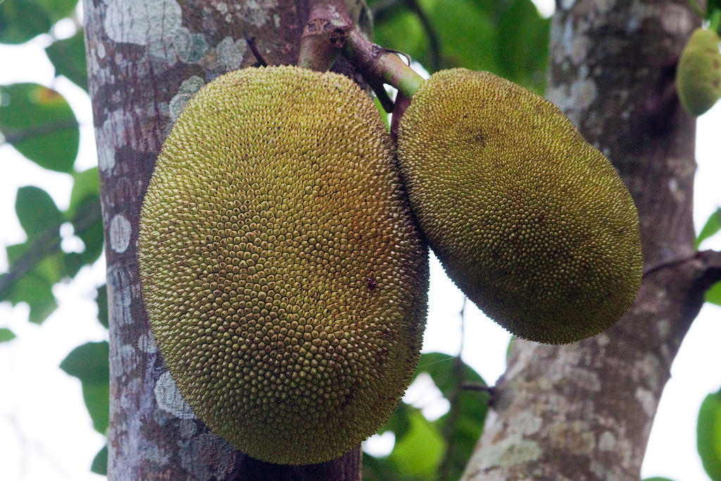
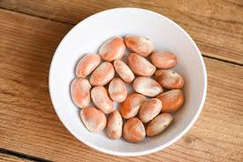
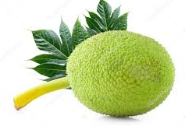
Introduction
Jack Fruit (Artocarpus heterophyllus)
Origin-Western Ghats rain forests in the southwest of India
Monoecious tree - Moraceae family
Seed and pulp are edible
Bread Fruit (Artocarpus altilis)
Moraceae family
The flesh is creamy white or yellow color and it is edible

Slide 4
Nutritional Compositions
Jack Fruit Seed Flour Bread fruit Flour
Nutrients | Content
Protein | 13.23%
Carbohydrate | 73.72%
Fat | 1.25%
Moisture | 6.29%
Crude Fiber | 3.09%
Ash | 2.72%
Nutrient | Percentage
Protein | 5.49%
Carbohydrates | 76.61%
Fat | 1.49%
Moisture | 11.42%
Ash | 2.06%
Crude Fiber | 2.93%
(Khan et al., 2017)
(Smitha,2021)

Slide 5
Functional Properties
Bread fruit Flour
Jack Fruit Seed Flour
Properties | Values
Water absorption capacity | 112.00%
Oil absorption capacity | 126.90%
Dispersibility | 30.00%
Swelling Powder | 3.62%
Per sent solubility | 1.80%
Forming capacity | 25.34%
Foam Stability | 33.00%
Bulk density (g/cm3) | 0.80
Property | Content
Water Holding Capacity | 154.7 ± 0.75%
Oil Absorption Capacity | 81.62 ± 0.94%
Least Gelling Concentration | 8.00 ± 0.61%
Bulk density (g/cm3) | 0.56 ± 0.02
(Smitha,2012)
(Source : Airani ,2007)

Slide 6
Nutritional Compositions and Functional Properties of Wheat Flour
Nutrient | Content(%)
Moisture | 12.86
Ash | 1.20
Protein | 10.76
Fat | 1.32
Crude Fiber | 1.4
Total Carbohydrates | 72.46
Properties | Values (%)
Water absorption capacity | 140
Oil absorption capacity | 146
Swelling Capacity | 17.60
Emulsion stability | 38.38
Foam capacity | 12.922
Foam stability | 1.94
Bulk density(g/cm3) | 0.762
Emulsion activity | 43.88
(Smitha,2021)
(Chandra, 2013)

Slide 7
Objectives
Major Objectives :-
To determine the potential of using jack fruit seed flour and bread fruit flour as alternative filler in Chicken sausage production
To study the cooking loss of chicken sausages with incorporate of jack fruit seed flour and bread fruit flour.

Slide 8
Material and Methods
Study Location :-
The research was conducted at ,
JP POULTRY PRODUCTS(PVT)LTD –Sausage manufacturing and Sensory Analysis
Livestock Laboratory of the Faculty of Agricultural Sciences Sabaragamuwa University of Sri Lanka – Proximate analysis and Physiochemical properties

Slide 9
Overall Procedure:-
Prepared three types of chicken sausages
Jack fruit seed flour incorporated chicken sausages(JFS)
Bread fruit flour incorporated chicken sausages(BFS)
Control(Bread crumbs)

Slide 10
Ingredients | JFS | BFS | Control
MSM | 2500g (50%) | 2500g (50%) | 2500g (50%)
Loose meat | 250g (5%) | 250g (5%) | 250g (5%)
Boneless meat | 1250g (25%) | 1250g (25%) | 1250g (25%)
Filler | 750g(15%) | 750g(15%) | 750g(15%)
Cinnamon powder | 2.5g (0.05%) | 2.5g (0.05%) | 2.5g (0.05%)
Chili powder | 15g (0.3%) | 15g (0.3%) | 15g (0.3%)
Nut meg | 2.5g (0.05%) | 2.5g (0.05%) | 2.5g (0.05%)
Crushed pepper | 20g (0.4%) | 20g (0.4%) | 20g (0.4%)
Coriander powder | 2.5g (0.05%) | 2.5g (0.05%) | 2.5g (0.05%)
Phosphate | 30 g (0.6%) | 30 g (0.6%) | 30 g (0.6%)
Vacuum salt | 75g (1.5%) | 75g (1.5%) | 75g (1.5%)
Curing salt | 2.5g (0.05%) | 2.5g (0.05%) | 2.5g (0.05%)
Ice crystals | 100g(2%) | 100g(2%) | 100g(2%)
JFS- Jack Fruit Seed Flour Incorporated Sausages(JFS)
BFS - Bread Fruit Flour Incorporated Sausages(BFS)
C - Control

Slide 11
Vacuum sealing
Receiving Raw materials
Manual packing
Grinding
Peeling
Weighing
Showering
Chopping
Stuffing and linking
Hanging and cooking

Slide 12
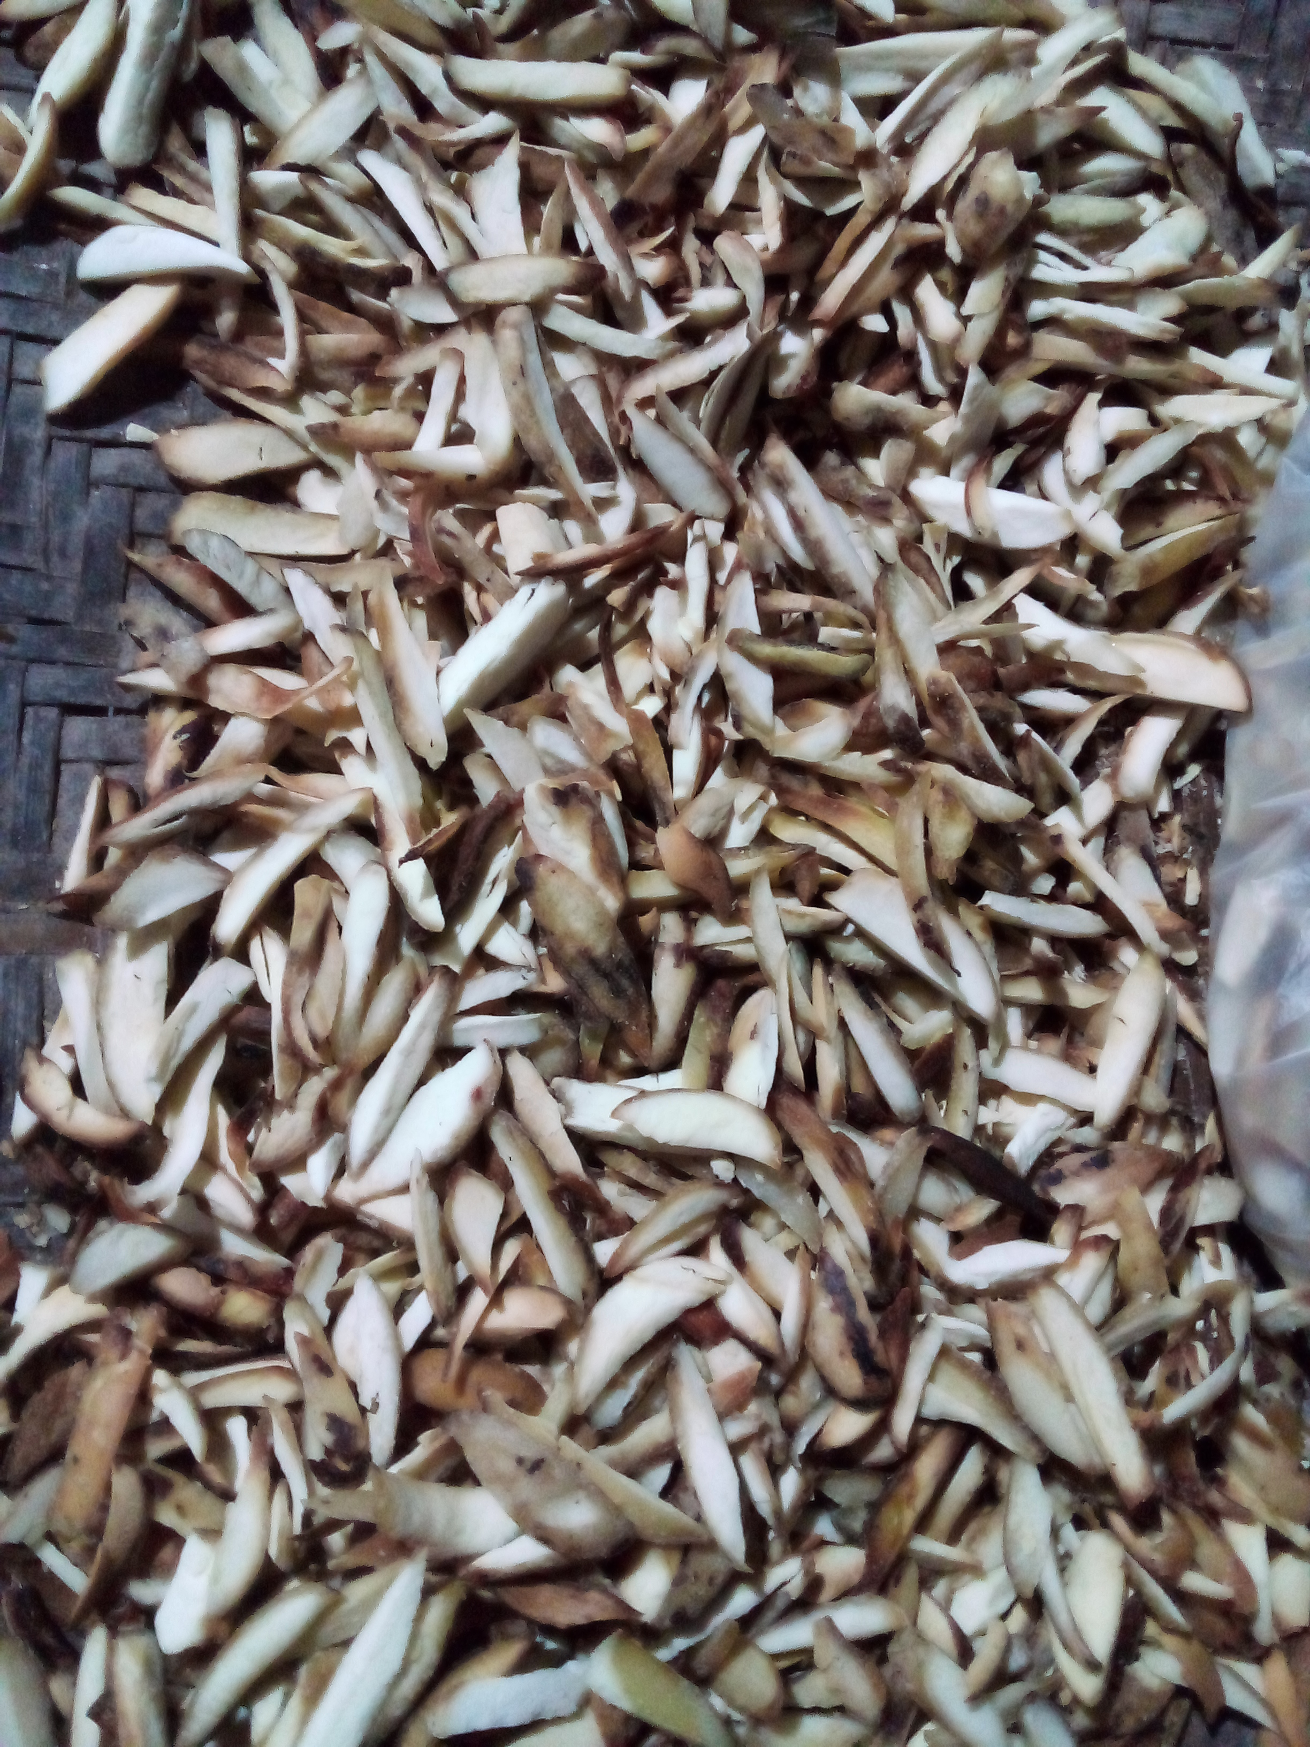
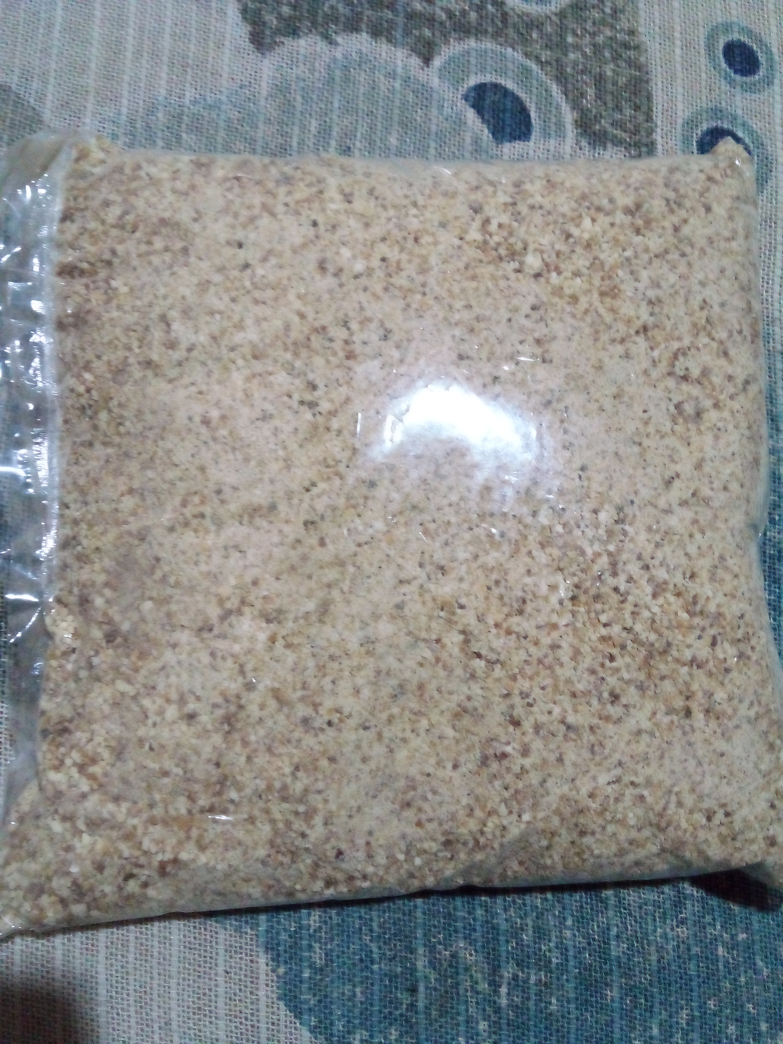
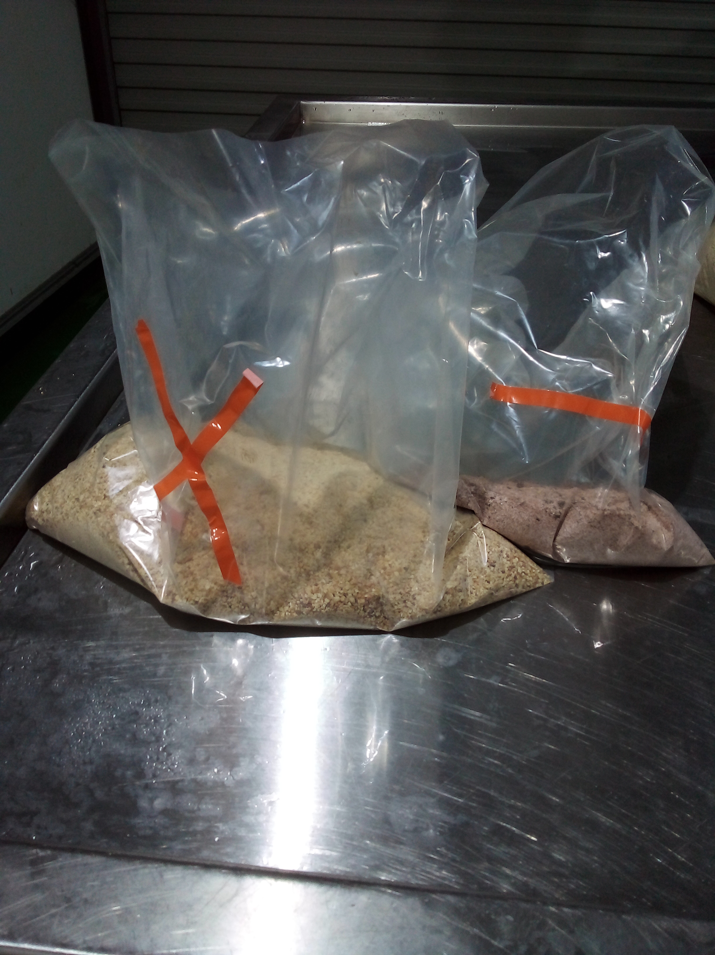
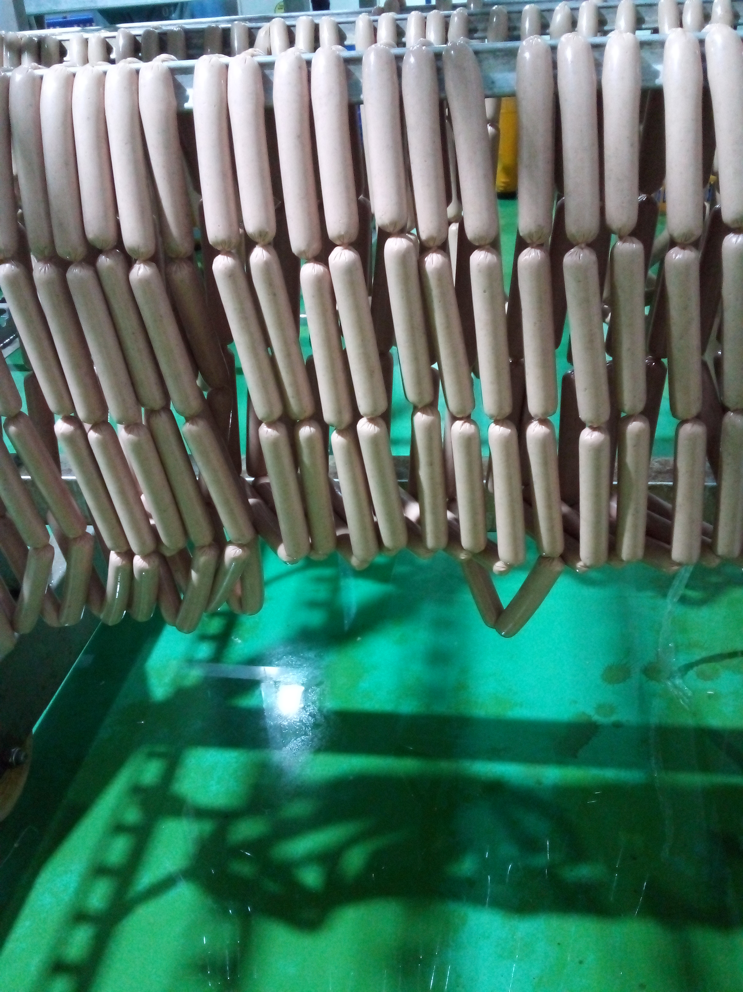
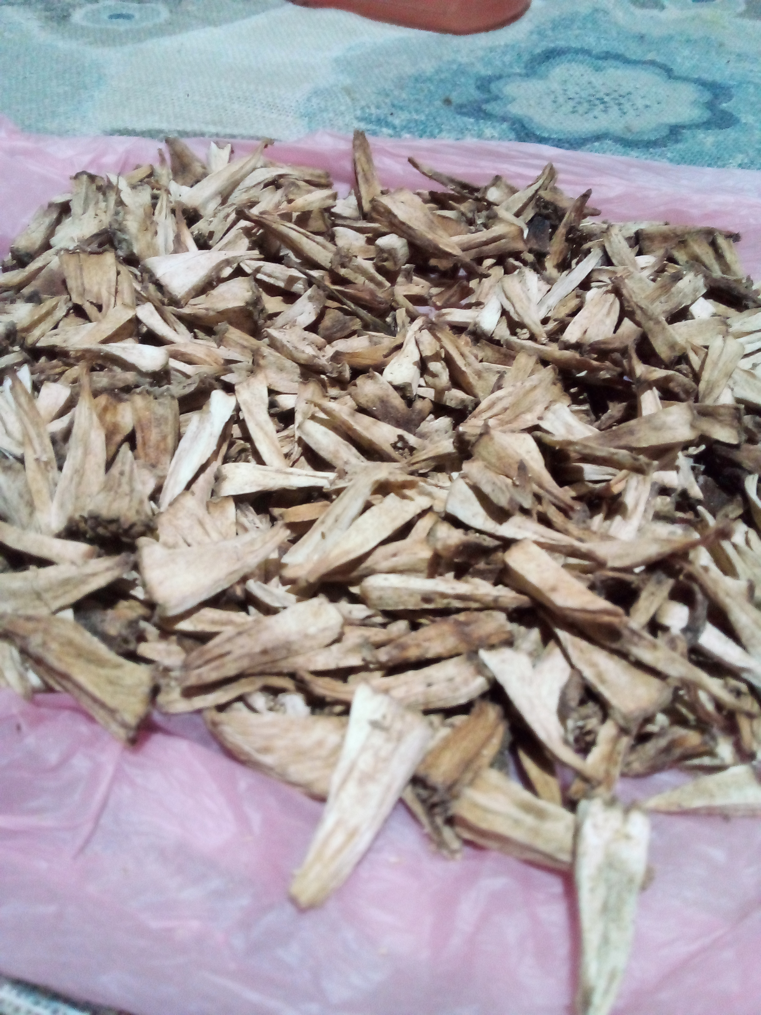
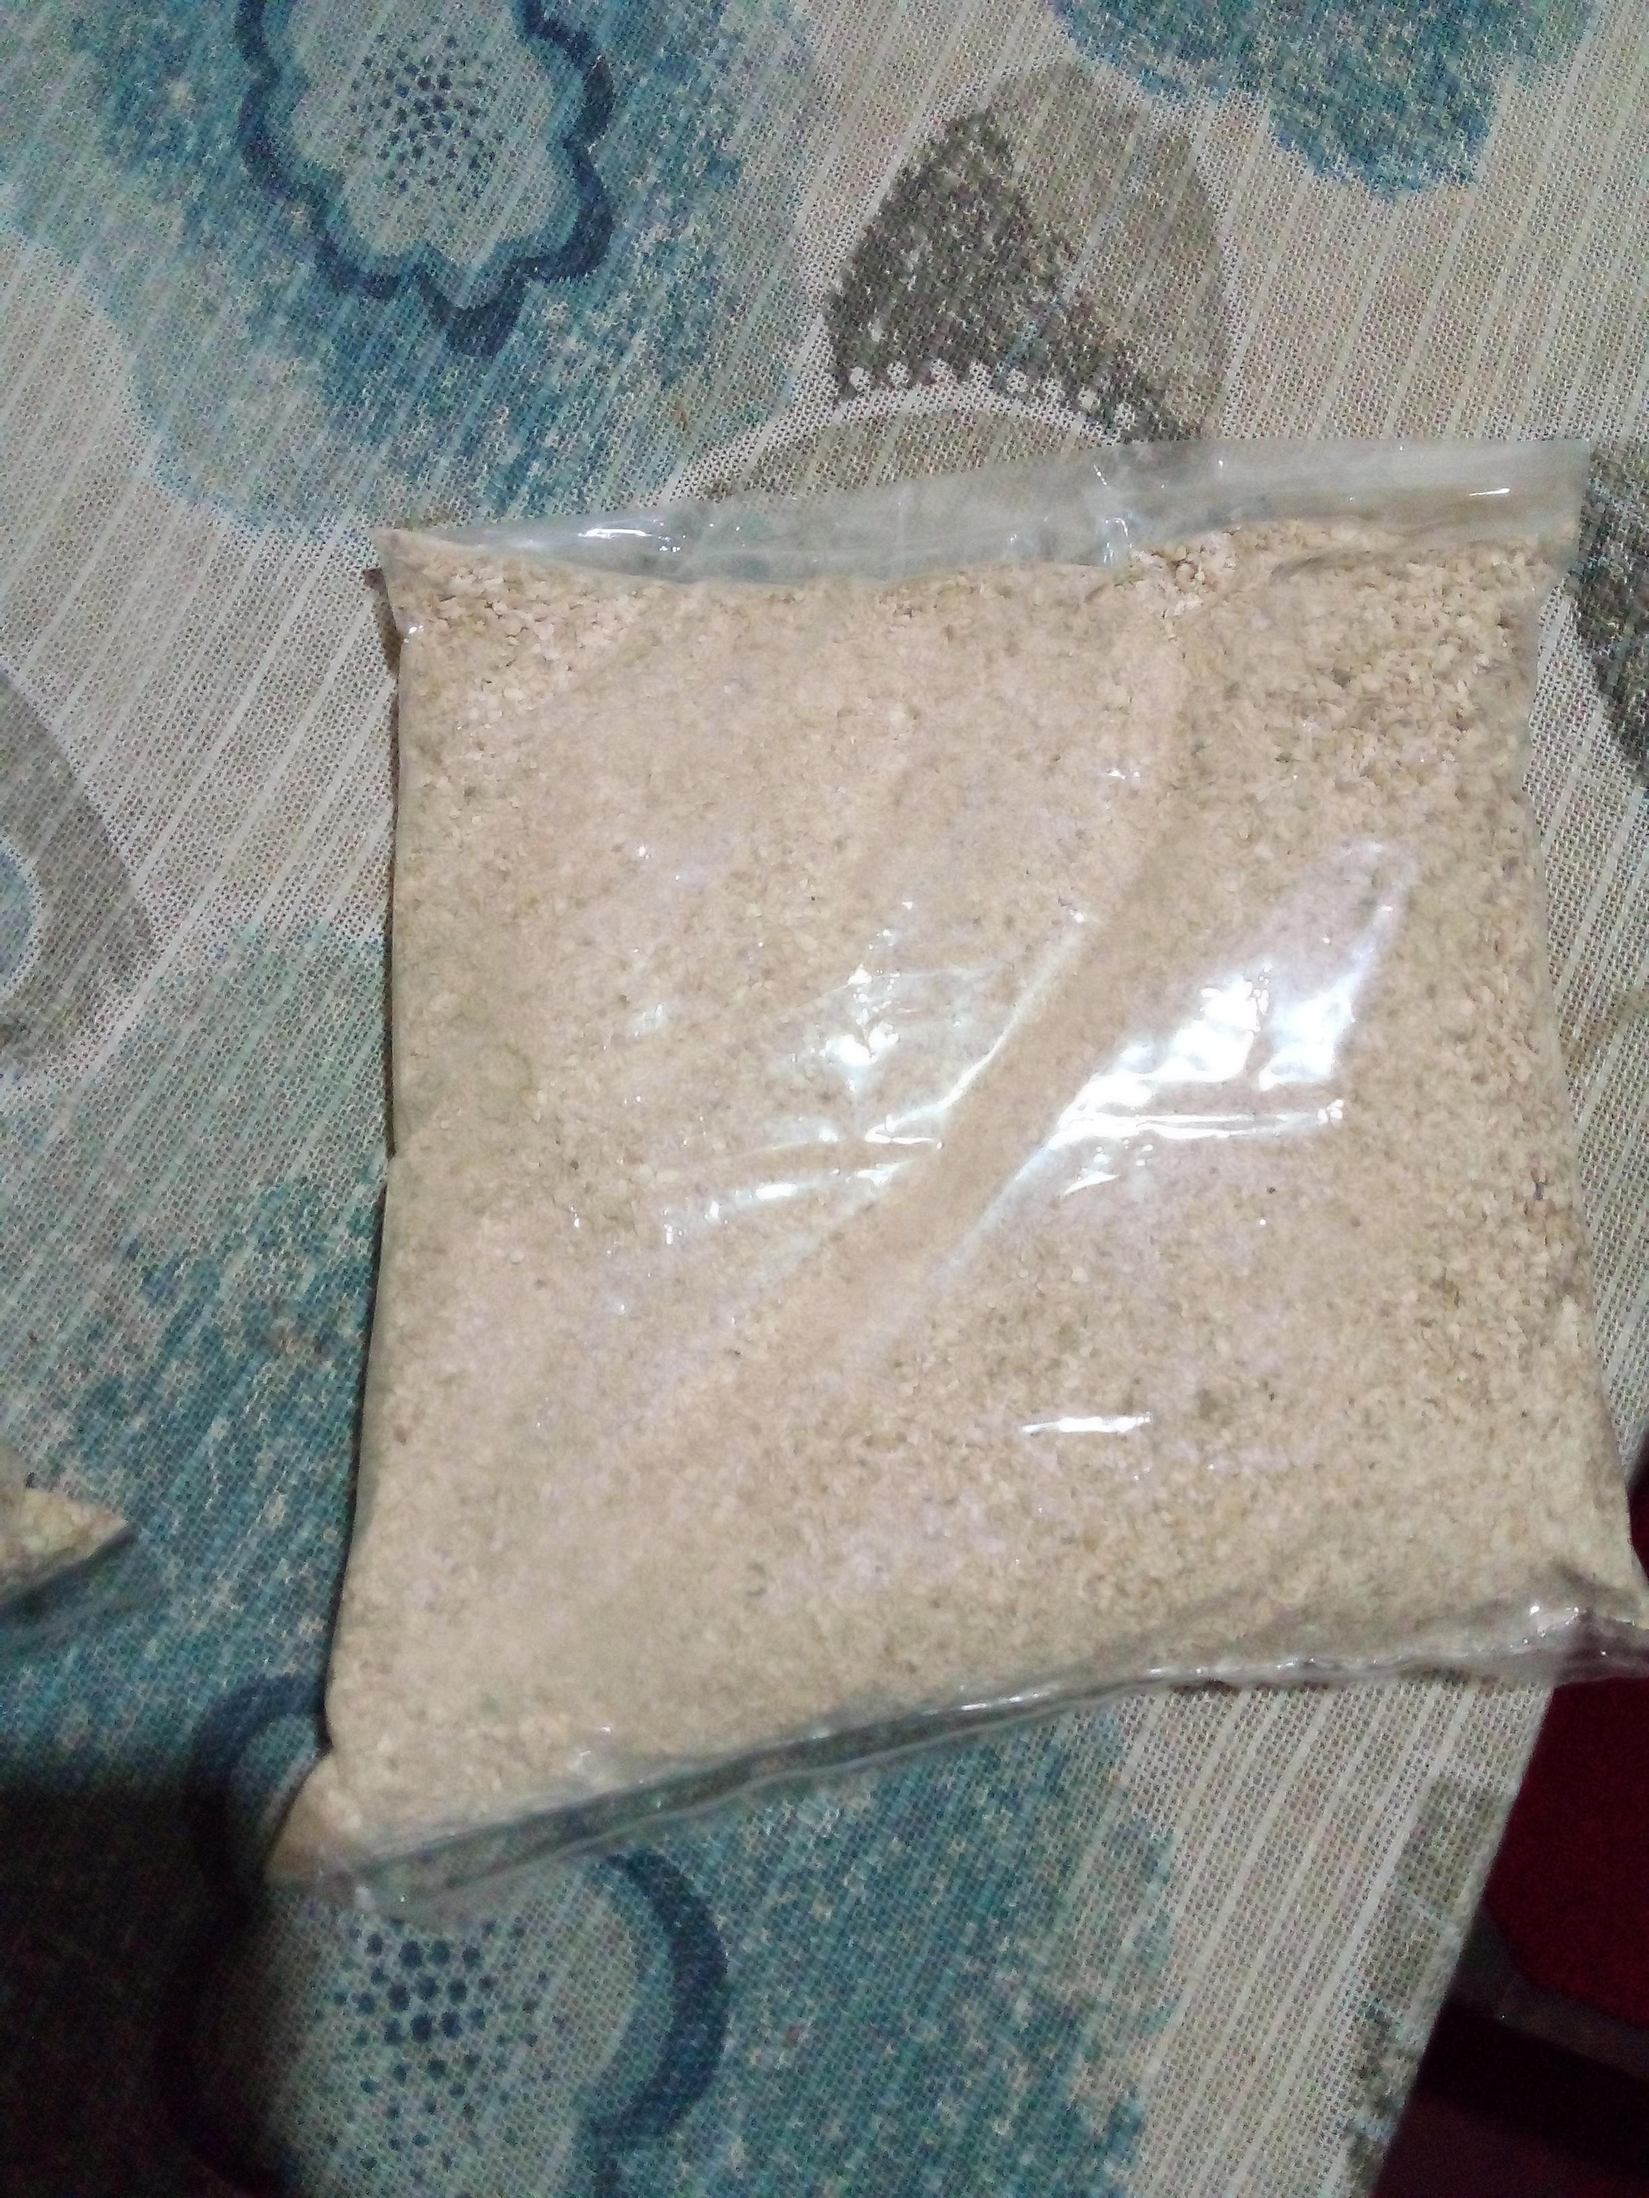
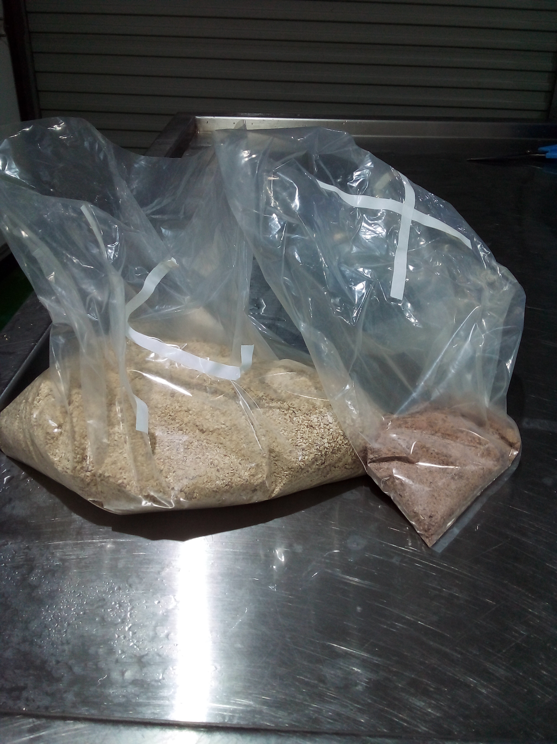
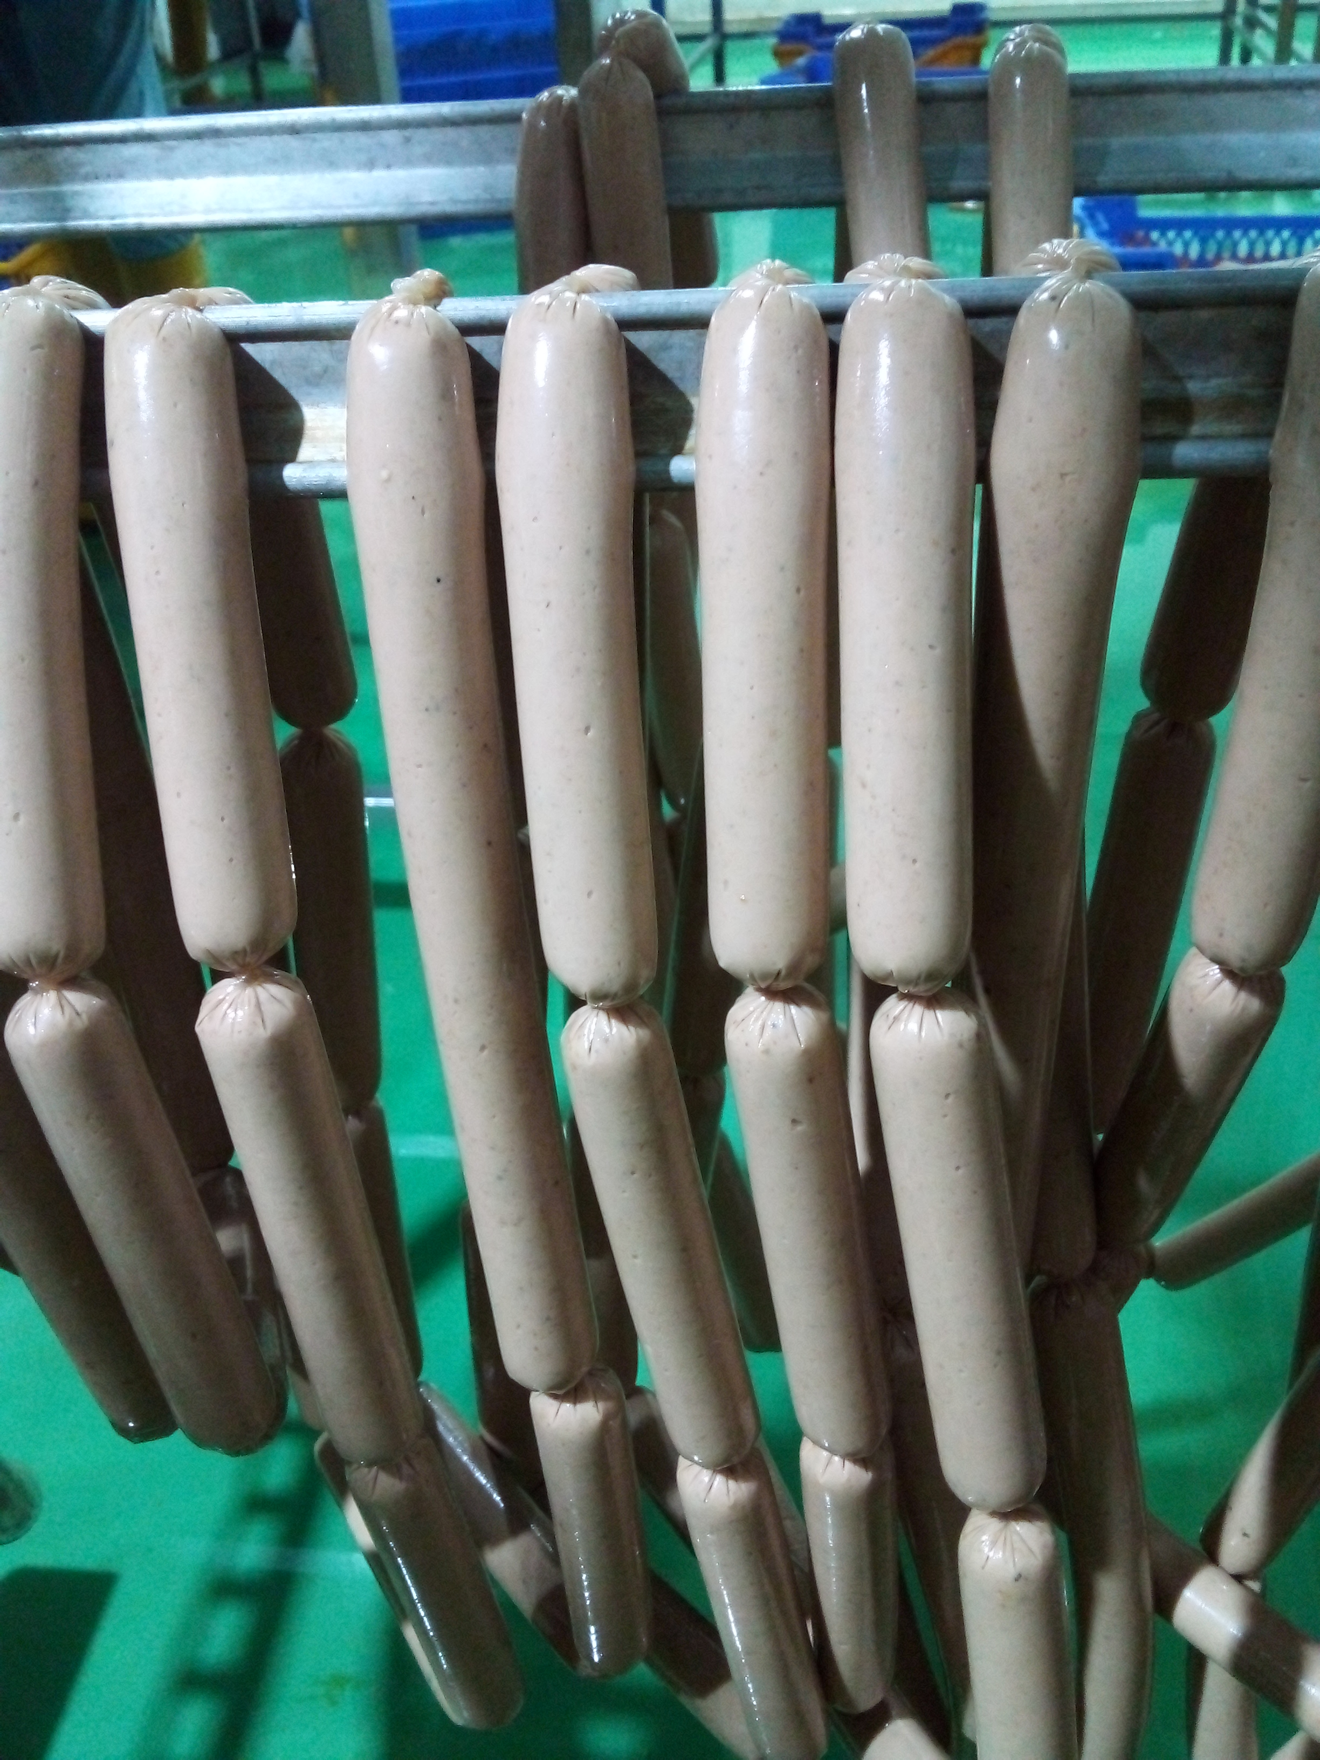
Dehydrated jack fruit seeds
Ground dehydrated Jack Fruit Seeds in to flour
Weighing
Sausages Manufacturing
Dehydrated bread fruit slices
Ground Dehydrated bread fruit slices in to flour
Weighing
Sausages Manufacturing

Slide 13
Analysis:-
Proximate analysis-Fat, Protein, Moisture, Ash, Fiber-(One way ANOVA)
Physiochemical Properties-pH, Water Holding Capacity, Cooking loss-(One way ANOVA)
Sensory Evaluation- Hedonic Scale(9 Points)

Slide 14
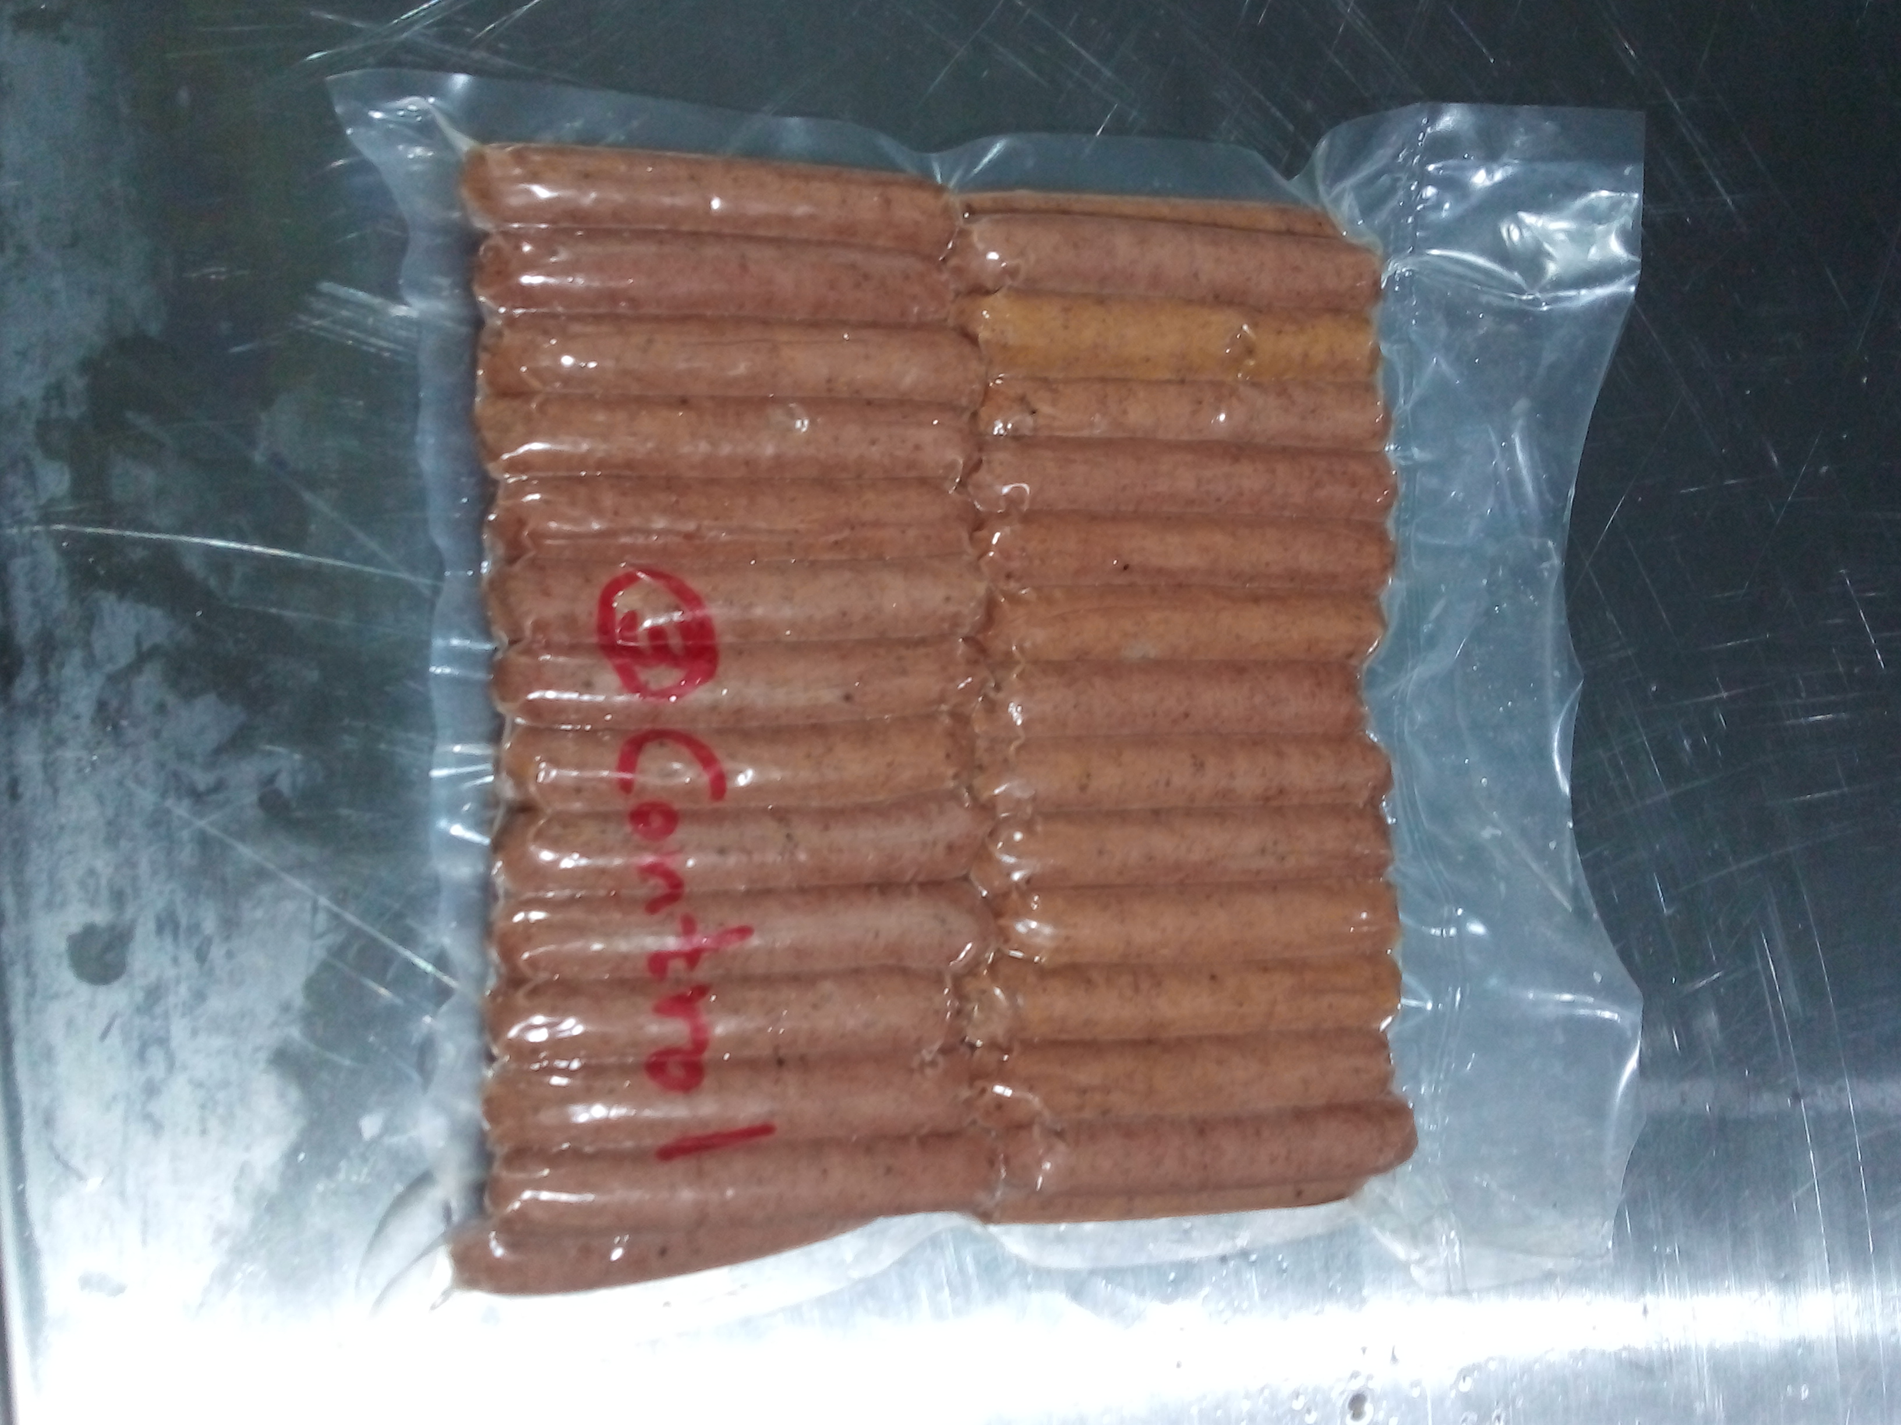
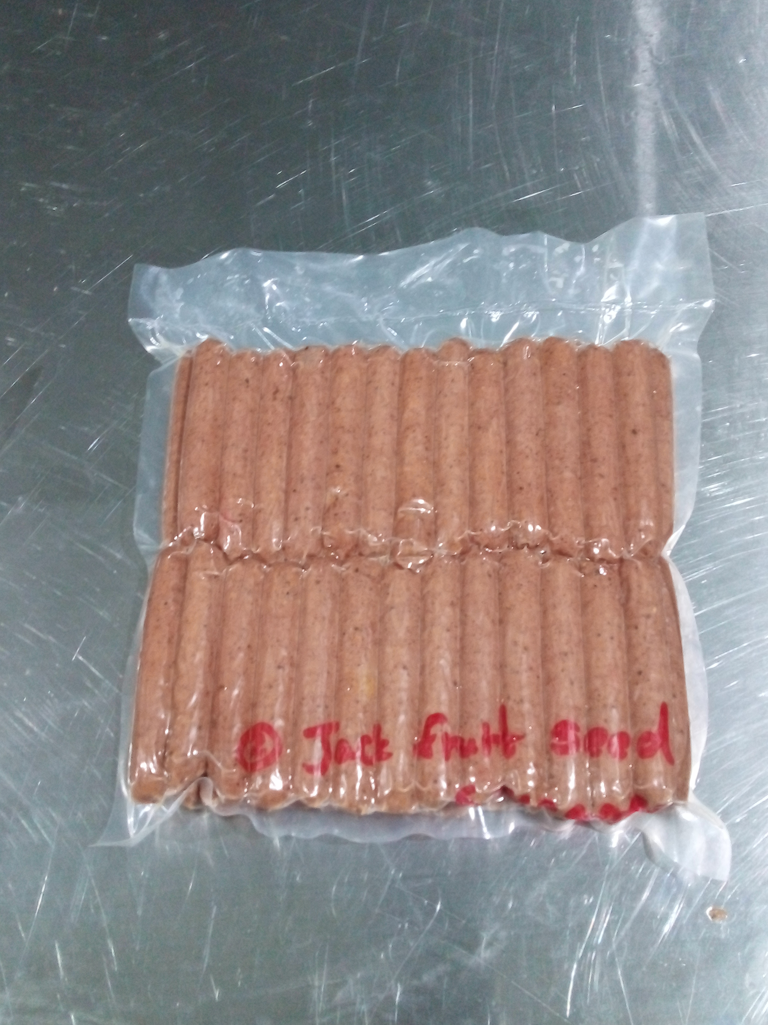
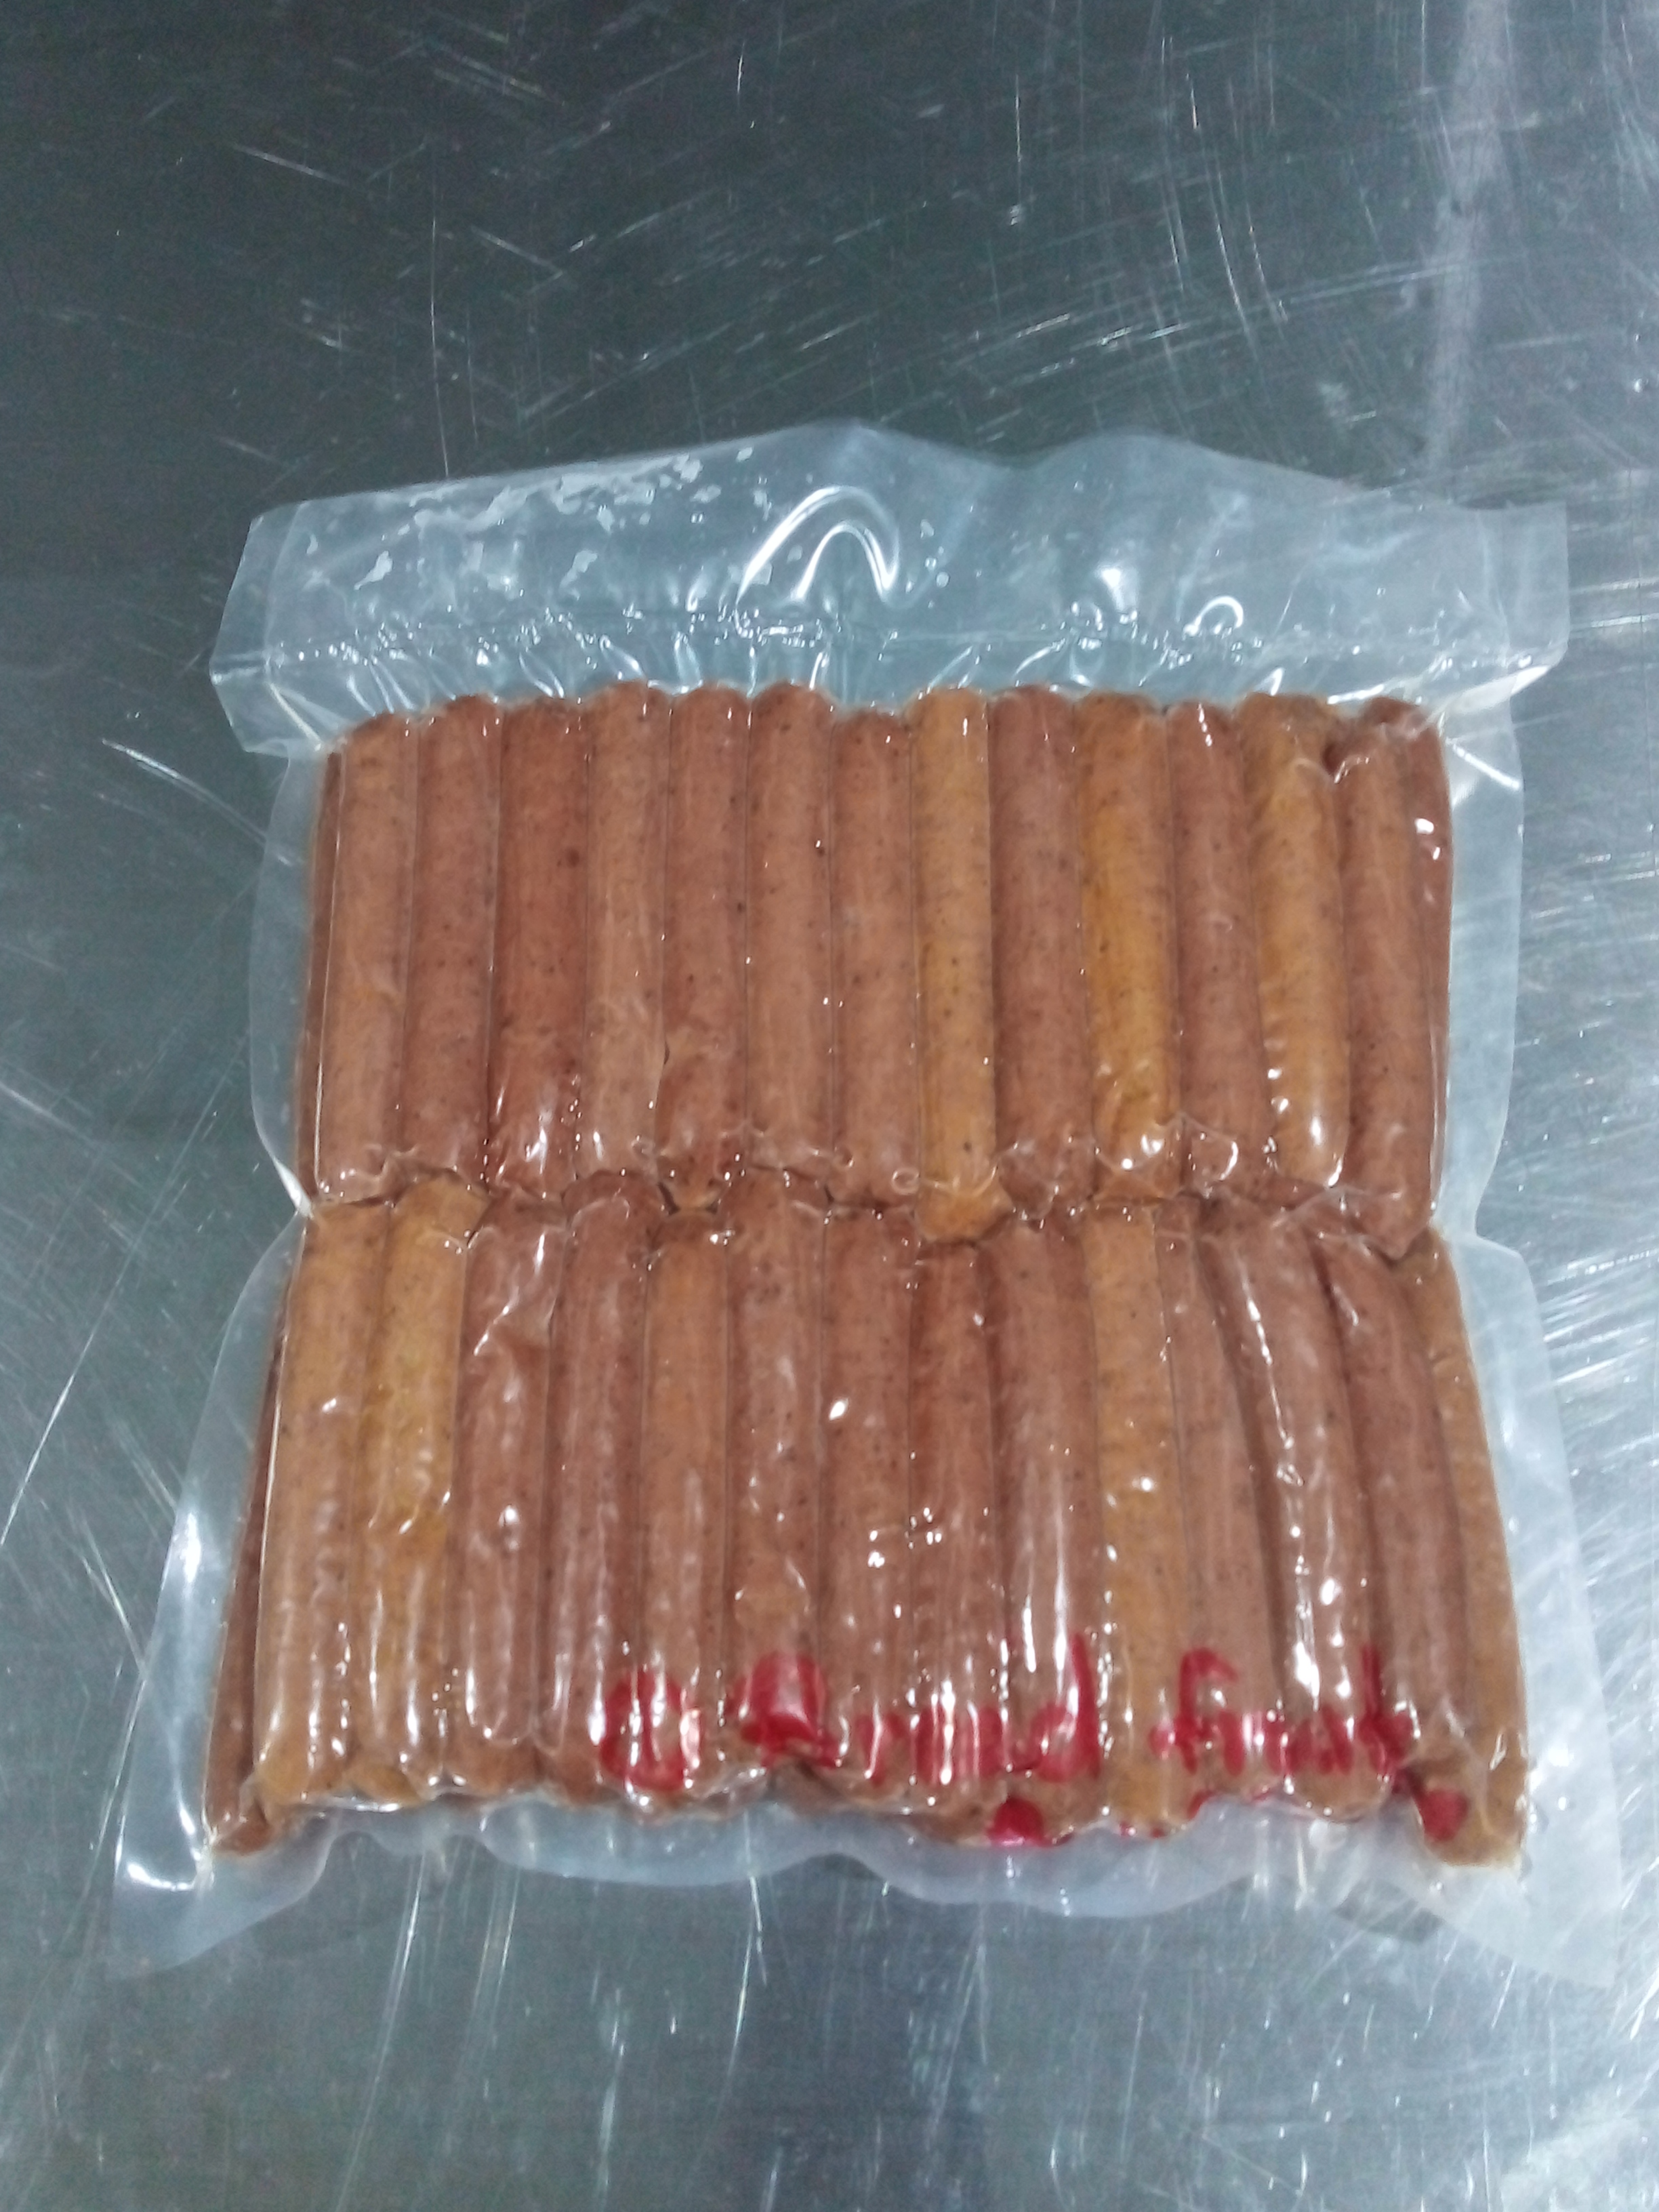
Results and Discussion
Final Products :-
Control
JFS
BFS

Slide 15
1)Moisture Content

Slide 16
2)Fiber Content %

Slide 17
3)Fat Content %

Slide 18
4)Protein Content %

Slide 19
5)Ash Content %

Slide 20
6)pH

Slide 21
7)Water Holding Capacity %

Slide 22
8)Cooking Loss(CL) %

Slide 23
9)Sensory Evaluation

Slide 24
Conclusion and Recommendations
There is a potential of using Jack fruit seed flour and bread fruit flour as a filler and Jack fruit seed flour can be considered as a better filler according to the organoleptic properties, proximate composition and WHC.
There is a minimum effect on cooking loss by incorporating jack fruit seed flour and bread fruit flour.(According to the Tukey test)

Slide 25
References
Joy, A. C. (2018). Nutrient and Phytochemical Composition of Jackfruit ( Artocarpus heterophyllus ) Pulp , Seeds and Leaves. 6(3), 27–32.
Johnson, T., & Brandt, J. (2018). Methods of freezing. (September).
Length, F. (2011). Functional and pasting characteristics of breadfruit ( Artocarpus altilis ) flours. 5(9), 529–535.
Palamthodi, S., Shimpi, S., & Tungare, K. (2021). Food Science and Applied Biotechnology. 4(March), 63–75.
Khan, S., Saqib, M., & Alim, M. (2017). Evaluation of quality characteristics of composite cake prepared from mixed jackfruit seed flour and wheat flour. Journal of the Bangladesh Agricultural University, 14(2), 219–227. https://doi.org/10.3329/jbau.v14i2.32697
Oke, K., Tijani, A. O., Abiola, O. T., Adeoye, A. K., & Odumosu, B. O. (2018). Effects of partial substitution of wheat flour with breadfruit flour on quality attributes of fried doughnut. Journal of Agricultural Sciences - Sri Lanka, 13(1), 72–80. https://doi.org/10.4038/jas.v13i1.8302
Smitha. (2012). Inquiry Training Model and Guided Discovery Learning. 5(9), 529–535. http://www.academicjournals.org/AJFS
Chandra, S. (2013). Assessment of functional properties of different flours. 8(38), 4849–4852. https://doi.org/10.5897/AJAR2013.6905

Slide 26
Thank You

