Slide 1
Factors Leading to Brand Loyalty in Selected Dairy Products in Sri Lanka
KKA Dilshan¹*, HSR Rosairo¹, DP Senadeera²
¹Department of Agribusiness Management, Faculty of Agricultural Sciences, Sabaragamuwa University of Sri Lanka
²CIC Dairies (Private) Limited, Ekala, Sri Lanka

Slide 2
Content
Introduction
Objectives
Material and Methods
Results and Discussion
Conclusion
Recommendations
References

Slide 3
Introduction
Dairy products are an integral part of food consumption and contain many nutrients like protein, calcium, phosphorus, and vitamins.
Main processed dairy products in the Sri Lankan market are milk powder, yoghurt, ice cream, curd, ghee, pasteurized milk, UHT milk, sterilized milk, flavored milk, butter, etc. (Vidanarachchi et al., 2019)
Highland, Pelwatte, Kotmale, Ambewela, CIC Creamoo, Rich Life, Chello, Anchor, etc. are the main dairy brands in the Sri Lankan market.
Brand loyalty is defined as positive feelings towards a brand and the dedication to purchase the same product or service repeatedly now and in the future from the same brand, regardless of a competitor's actions or changes in the environment. (Agutu, 2019)

Slide 4
Introduction
Brand loyalty occurs when one feels that a brand fulfills their expectations better than others and hence decides to make a repeat purchase as well as word-of-mouth marketing.
Some of the commonly used techniques for creating loyal customers are branding, promotion, pricing, product quality, and product differentiation. (Brakus et al., 2009)
In the Sri Lankan dairy industry, most of the past studies related to marketing have been done on areas like brand awareness, consumer perception, consumer buying behavior, and consumer purchase intentions.
The studies about brand loyalty in the dairy industry were found in international context but not much in the Sri Lankan context. Therefore this study will furnish the gap about brand loyalty in Sri Lankan dairy industry.

Slide 5
Objectives
Broad Objective:
To determine the factors affecting the brand loyalty of selected dairy products in Sri Lanka.
Specific Objectives:
To identify the level of brand loyalty among existing customers of selected dairy products in Sri Lanka.
To identify the consumer behavior towards selected dairy products in Sri Lanka.

Slide 6
Material and Methods
Research Design | Descriptive Research Design
Research Approach | Deductive Approach
Research Strategy | Survey Strategy
Study Location | All around the country
Sampling Frame | Consumers who use yoghurt, drinking yoghurt and curd
Sampling Technique | Convenience Sampling Technique
Sample Size | 302 respondents
Data Collection | Primary data – Structured questionnaire (Online: Google Form - 257 & Physically - 45) Secondary data – Past research studies & reports of census and statistics
Data Analyze | Regression Analysis Descriptive Statistics

Slide 7
Results and Discussion
Socio-demographic Characteristics of the Sample
Province distribution of the sample
Age distribution of the sample
Province | Frequency | Percentage
Central Province | 19 | 6.3%
Eastern Province | 2 | 0.7%
North Central Province | 10 | 3.3%
Northern Province | 6 | 2.0%
North Western Province | 22 | 7.3%
Sabaragamuwa Province | 48 | 15.9%
Southern Province | 89 | 29.5%
Uva Province | 14 | 4.6%
Western Province | 92 | 30.5%
Age group | Frequency | Percentage
Below 20 years | 27 | 8.9%
21-30 years | 118 | 39.1%
31-40 years | 83 | 27.5%
41-50 years | 44 | 14.6%
Above 50 years | 30 | 9.9%

Slide 8
Results and Discussion cont.
Gender distribution of the sample
Marital status of the sample
 | Frequency | Percentage
Male | 134 | 44.4%
Female | 168 | 55.6%
 | Frequency | Percentage
Single | 123 | 40.7%
Married | 179 | 59.3%

Slide 9
Results and Discussion cont.
Education level of the sample
Employment status of the sample
 | Frequency | Percentage
Up to O/L (grade 11) | 16 | 5.3%
Up to A/L (grade 13) | 121 | 40.1%
Diploma/ Higher national diploma | 49 | 16.2%
University | 116 | 38.4%
 | Frequency | Percentage
Government sector job | 41 | 13.6%
Private sector job | 99 | 32.8%
Student | 126 | 41.7%
Self-employed / own business | 26 | 8.6%

Slide 10
Results and Discussion cont.
Determine the factors affecting the brand loyalty of selected dairy products in Sri Lanka.
Multiple Linear Regression Analysis
Model Summary
Model | R | R square | Adjusted R Square | Std. Error of the Estimates | Sig. F Change
1 | 0.722 | 0.522 | 0.512 | 0.549 | 0.000
Predictors: (Constant), Quality, Price, Packaging, Advertising, Trust on the brand, Availability Dependent Variable: Brand Loyalty
According to the model summary table, the adjusted R square is 0.512 with a statistical significance of P<0.05. This suggests that 51.2% of the variants in Brand Loyalty (outcome/dependent variable) was predicted from Product Quality, Price, Packaging, Advertising, Trust on the brand, and Availability (predictor/independent variables).

Slide 11
Results and Discussion cont.
ANOVA
Model | Sum of Squares | df | Mean Square | F | Sig.
Regression | 95.974 | 6 | 15.996 | 53.104 | 0.000
Residual | 87.955 | 292 | 0.301
Total | 183.929 | 298
The ANOVA table shows the overall significance of the regression. The P value 0.000 is less than 0.05 and it means the independent variables (Product Quality, Price, Packaging, Advertising, Trust on the brand, Availability) statistically significantly predict the dependent variable (Brand Loyalty).

Slide 12
Results and Discussion cont.
Coefficients
Model | Unstandardized Coefficients |  | Sig.
 | B | Std. Error
(Constant) | 0.316 | 0.221 | 0.154
Product Quality | 0.142 | 0.063 | 0.025
Price | -0.009 | 0.052 | 0.869
Packaging | 0.094 | 0.063 | 0.134
Advertising | -0.063 | 0.047 | 0.176
Trust on the brand | 0.563 | 0.058 | 0.000
Availability | 0.150 | 0.057 | 0.009
The coefficients table shows the significance of individual parameters. The significance values of Product Quality (0.025), Trust on the brand (0.000), and Availability (0.009) are less than 0.05 P-value.
This means these three variables are individually statistically significant variables and are making a significant unique contribution to the prediction of Brand Loyalty.

Slide 13
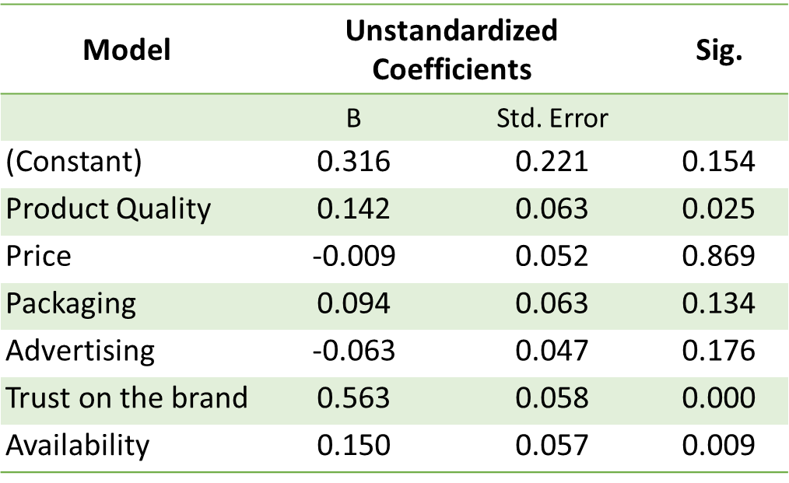
Results and Discussion cont.
The unstandardized coefficient β value for Product Quality is 0.142. This means that for each one unit increase in Product Quality, there is an increase in Brand Loyalty of 0.142 times units.
The unstandardized coefficient, β value for Trust on the Brand is 0.563. This means that for each one unit increase in Trust on the Brand, there is an increase in Brand Loyalty of 0.563 times units.
The unstandardized coefficient, β value for Availability is 0.150. This means that for each one unit increase in Availability, there is an increase in Brand Loyalty of 0.150 times units.

Slide 14
Results and Discussion cont.
From the above results, the following linear regression equation can be derived:
Y = β₀ + β₁X₁ + β₂X₂ + β₃X₃ + Ɛ
Ŷ = 0.316 + 0.142X₁ + 0.563X₂ + 0.150X₃ + Ɛ
Brand Loyalty = 0.316 + 0.142 Product Quality** + 0.563 Trust on the Brand*** + 0.150 Availability*** + Ɛ
** = Significant at 0.05 *** = Significant at 0.01

Slide 15
Results and Discussion cont.
Hypothesis Testing
Hypothesis | Status
H₁: Brand loyalty is significantly positively affected by product quality of selected dairy products. | Accepted
H₂: Brand loyalty is significantly negatively affected by price of selected dairy products. | Rejected
H₃: Brand loyalty is significantly positively affected by packaging of selected dairy products. | Rejected
H₄: Brand loyalty is significantly positively affected by advertising of selected dairy products. | Rejected
H₅: Brand loyalty is significantly positively affected by trust on the brand of selected dairy products. | Accepted
H₆: Brand loyalty is significantly positively affected by availability of selected dairy products. | Accepted

Slide 16
Results and Discussion cont.
Level of brand loyalty among existing customers of selected dairy products in Sri Lanka
Brand Loyalty | Mean | Std. Deviation | Agreement
I always buy my favorite brand’s milk products. | 3.87 | 1.051 | Agree
My favorite milk brand would be my first choice. | 4.12 | 1.061 | Agree
I recommend my favorite milk brand to others. | 4.01 | 1.049 | Agree
I am satisfied with my favorite milk brand and it fulfills my expectations. | 4.08 | 0.943 | Agree
I do not shift to other milk brands with their promotions. | 3.46 | 1.136 | Agree
If my favorite milk brand’s products are not available in one grocery, I search for them in other groceries. | 3.39 | 1.116 | Neutral
I search for the details of other milk products from my favorite brand. | 3.60 | 1.039 | Agree
Composite variable | 3.79 | 0.786 | Agree
Agreement Criteria: Strongly Disagree (1.00-1.80), Disagree (1.81-2.60), Neutral (2.61-3.40), Agree (3.41-4.20), Strongly Agree (4.21-5.00) by Sözen and Guven (2019)

Slide 17
Results and Discussion cont.
Consumer behavior towards selected dairy products in Sri Lanka
Frequency of use the dairy products
Place where buy the dairy products
 | Frequency | Percentage
Once / twice a day | 68 | 22.5%
Two / three times a week | 128 | 42.4%
Once a week | 59 | 19.5%
Once a month / rarely | 47 | 15.6%
 | Frequency | Percentage
Supermarket | 106 | 35.1%
Grocery / Retail shop | 182 | 60.3%
Café / Tea shops / Canteen | 11 | 3.6%
Other | 3 | 1.0%

Slide 18
Results and Discussion cont.

Slide 19
Conclusion
The main intension of this study was to identify the factors leading to brand loyalty in selected dairy products in Sri Lanka.
The results of multiple linear regression analysis indicated that Product Quality, Trust on the Brand, and Availability have statistically significant relationships with Brand Loyalty. All these three independent variables have a positive relationship with Brand Loyalty.
Also, the findings of this study indicated that consumers of selected dairy products are brand loyal.
Most of the respondents (79%) had a favorite brand/s of dairy products, while the most consumed dairy product is yoghurt.

Slide 20
Recommendations
Dairy products manufacturing companies should be more concerned with product quality, trust on the brand, and availability than product price, packaging, and advertising to build a loyal customer base for their brands.
When developing policies and strategies, dairy product manufacturers should prioritize increasing brand loyalty among existing customers.

Slide 21
References
Agutu, S. A. (2019). Effect of Brand Perception on Consumer Loyalty to Packaged Milk Products in Kenya.
Hair, J. F. (1998). Multivariate Data Analysis with Readings. Prentice-Hall.
J. Josko Brakus, B. H. (2009). Brand experience: What is it? How is measured? Does it affect loyalty? Journal of Marketing.
J.K. Vidanarachchi, H. C. (2019). Dairy Industry in Sri Lanka: Current Status and Way Forward for a Sustainable Industry.
Langman, L. (2012). Commoditization. The Wiley-Blackwell Encyclopedia of Globalization.
Sözen, E., & Güven, U. (2019). The Effect of Online Assessments on Students’ Attitudes Towards Undergraduate-Level Geography Courses. International Education Studies.

Slide 22
Thank You

