Slide 1
EFFECT OF DIFFERENT MULCHES ON WATER CONSERVATION IN CARROT (Daucus carota L.) GROWN DISTURBED AND UNDISTURBED SOILS
E.M.R. Janaka¹*, M.A.P. Mayakaduwa², Lal P. Vidhana Arachchi¹
¹Department of Export Agriculture, Faculty of Agriculture Sciences, Sabaragamuwa University of Sri Lanka
²Agricultural Research Station, Seetha Eliya, Nuwara-Eliya, Sri Lanka

Slide 2
CONTENT
Introduction
Objectives
Material and Methods
Results and Discussion
Conclusion and Recommendations
References

Slide 3
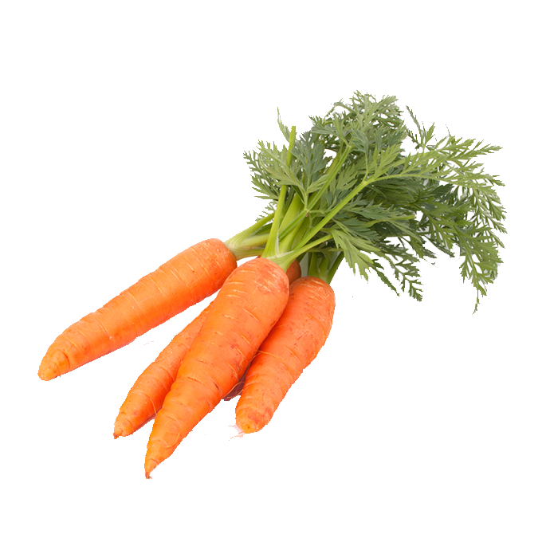
INTRODUCTION
Carrot - Family Apiaceae
- Biennial plant
- Growing as an annual
Important
Soil Moisture
Plant Growth
Water stress - diminishes plant growth
- reduce root development
- the attractiveness of carrots
- lower marketable quality and quantity

Slide 4
During the growing season,
Soil water stress reduces yield and quality (Baba and Simon, 2015)
Rapid soil moisture depletion
Impact
Plant growth
Soil characteristics
Moisture retention
Soil temperature
Is it Beneficial ?
Introducing Mulching Materials
Water Saving Techniques
Conserve Soil moisture

Slide 5
RESEARCH OBJECTIVES
General Objective
To evaluate the effect of mulching materials on soil water conservation and thermal regulation in disturbed and undisturbed Carrot grown soil
Specific Objective
To quantify the impact of various mulching materials on the growth and yield of carrot

Slide 6
To Determine,
Soil properties
Soil Moisture Retention
Soil Temperature Regulation
Impact of Different Mulches
Daucus carota growth
Plant’s growing cycle
Quality and Quantity of the yield
An appropriate type of mulch to use and obtain a positive influence on the plants in both disturbed and undisturbed soils

Slide 7
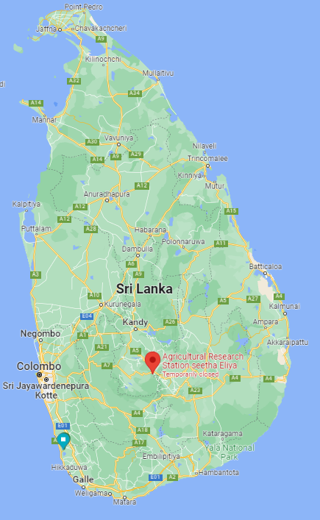
MATERIAL AND METHODS
Experimental area
Research Location
– Agricultural Research Station - Seetha Eliya

Slide 8
MATERIAL AND METHODS (Cont.)
Soil Characterization
Table 01. Initial soil properties of the experimental site
Property of the soil | Method | Value
Physical Propertyies
Texture | Hydrometer method
Sand (%) |  | 56.858
Clay (%) |  | 30.218
Loam (%) |  | 12.924
Bulk Density (Pb) (gcm3⁻) | Core sample method | 1.156
Particle Density (Pd) (gcm3⁻) | Pycnometer method | 1.910
Porosity (Pt) (%) | Pt = [1-(Pb/Pd)] x 100 | 39.476
Water holding capacity (%) | Core sample method | 31.291
Chemical properties
pH | pH meter by soil: water; 1:1 method | 5.982
EC (mS/m) | EC meter by soil: water; 1:5 method | 341.417
Nutrients
Organic Matter content % | Walkley and Black method | 4.167
Available Phosphorus mg/kg | Olsen method | 308.000
Available Potassium mg/kg | Olsen method | 14.030

Slide 9
MATERIAL AND METHODS (Cont.)
TREATMENTS
Factor A
Land Preparation method
D1: Undisturbed soil
(zero ploughing)
D2: Disturbed soil
(Ploughing 30cm depth)
Factor B
Mulches
T1: Control
T2: Gliricidia leaves
T3: Citronella grass
T4: Paddy husk
T5: Sawdust
T6: Black polythene
T7: Transparent polythene

Slide 10
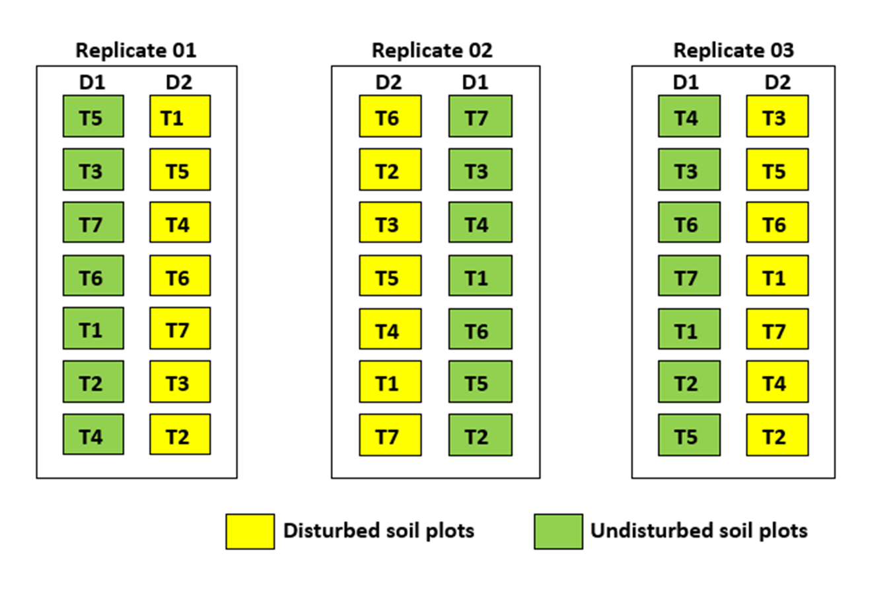
MATERIAL AND METHODS (Cont.)
Experimental design
Split Plot Design
Figure 1. Experimental design

Slide 11
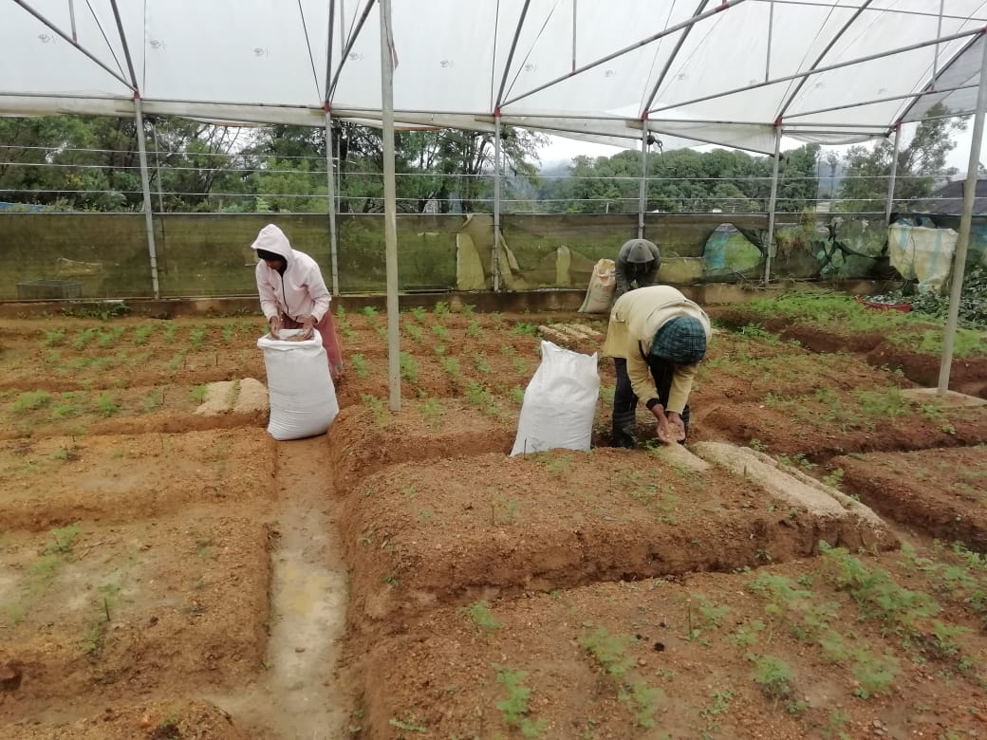
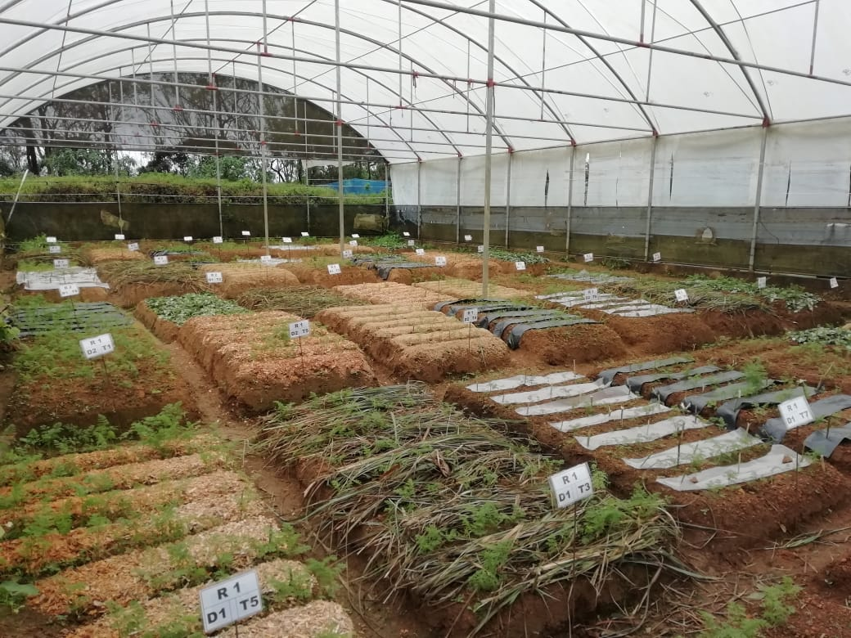
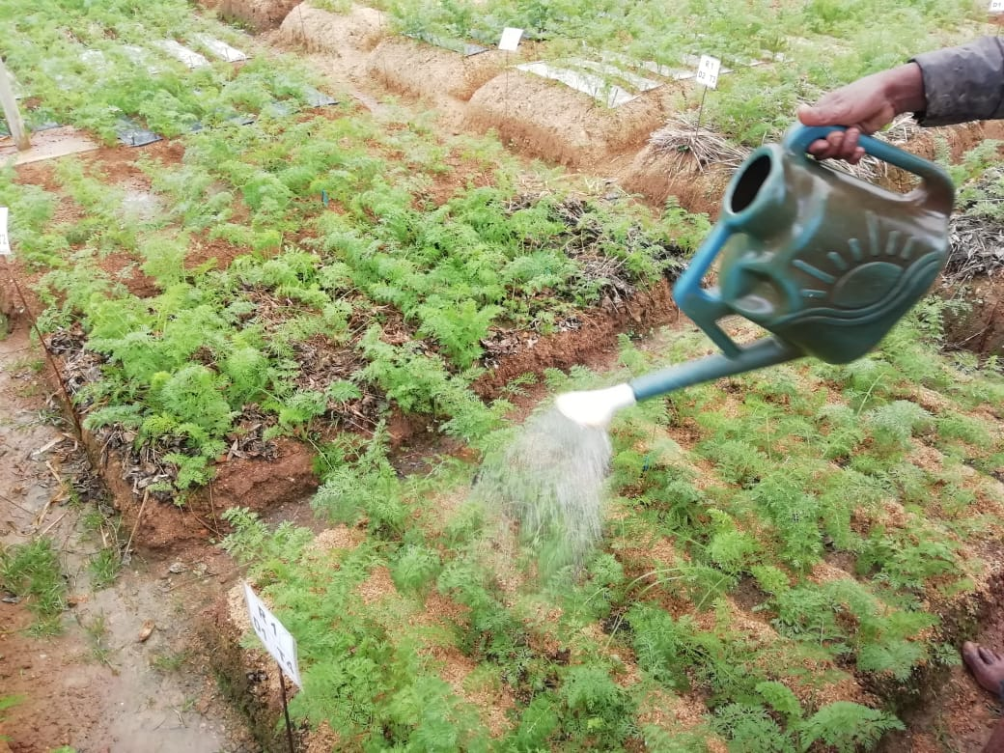
MATERIAL AND METHODS (Cont.)
Crop establishment and management
-DOA recommendation
Irrigation – manually
- After mulching 32L at 5 days irrigation interval
Mulch application
- 6 weeks after sown (Organic mulches - 5 cm, polythene mulches - 750 gauge)
Figure 2. Application of mulch
Figure 3. After mulch application
Figure 4. Manual irrigation

Slide 12
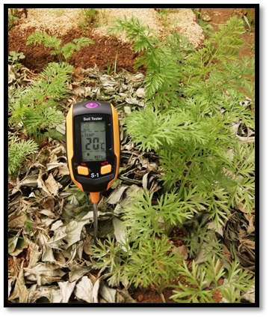
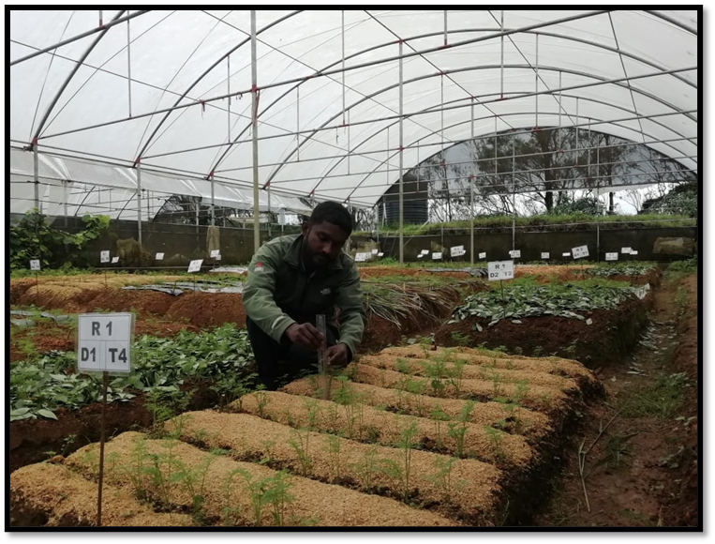
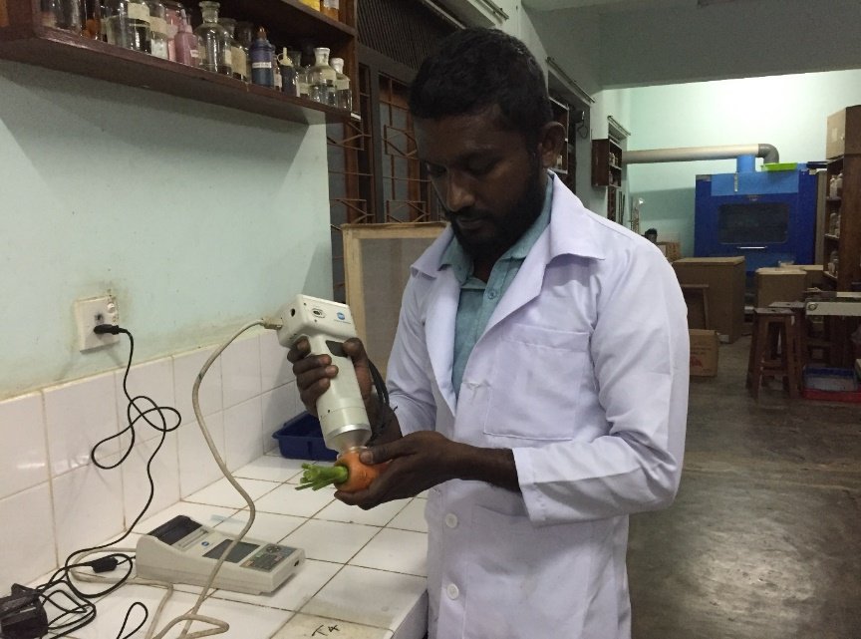
MATERIAL AND METHODS (Cont.)
Data collection
Soil – Soil water retention, and Active root zone temperature
Plant growth – Plant height, number of leaves
Yield – Root length, Root diameter, Root colour, Root weight/plant, Root yield/plot, Marketable yield/plot, Fork root %
Figure 5. Soil thermometer
Figure 6. Measuring plant height
Figure 7. Experimental design

Slide 13
MATERIAL AND METHODS (Cont.)
Data Analysis
Data organize - Microsoft Excel version 2019
Data Analysed - ANOVA Proc GLM procedure at 95% confidence level
(SAS® OnDemand for Academics)
Mean separation - Tukey test

Slide 14
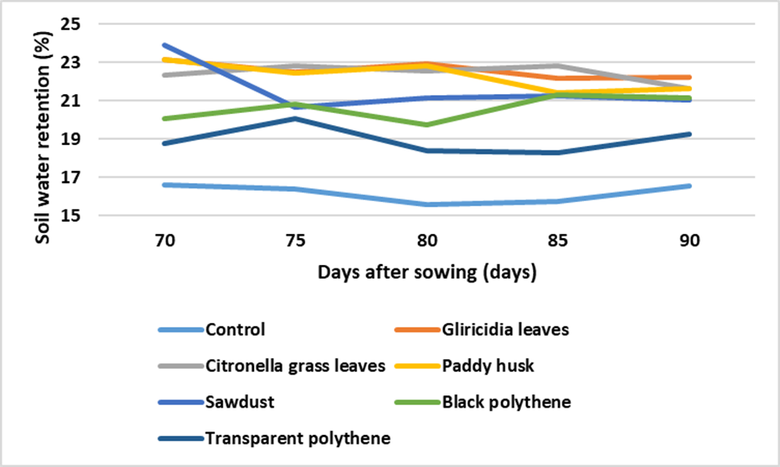
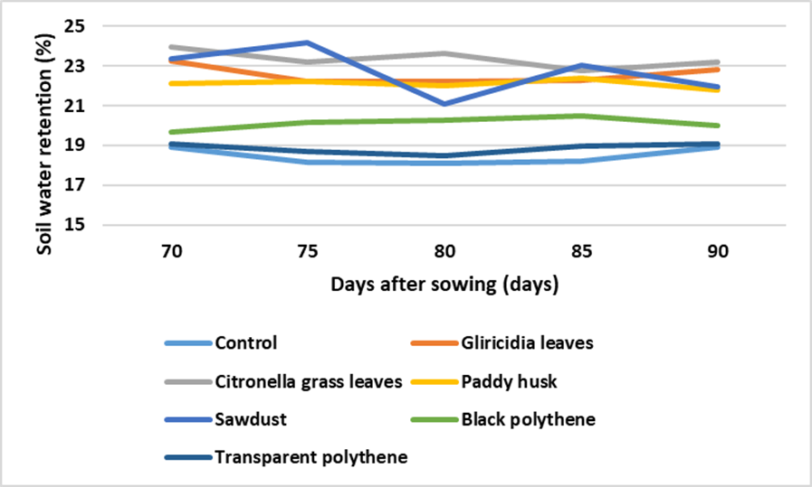
RESULT AND DISCUSSION
Dynamics of Soil Water Retention
Figure 8. Effect of treatments on soil water retention on undisturbed soil
Figure 9. Effect of treatments on soil water retention on disturbed soil
Significant effect (p<0.05) of ploughing and mulching on soil water retention
Highest and significantly similar (p<0.05) soil water retention - Citronella grass, Paddy husk, and Gliricidia leaves mulches

Slide 15
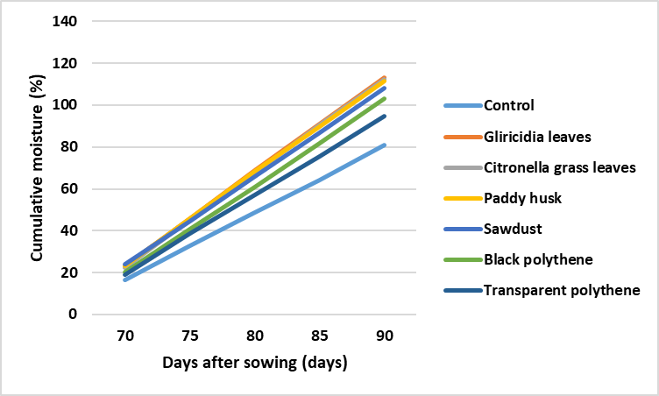
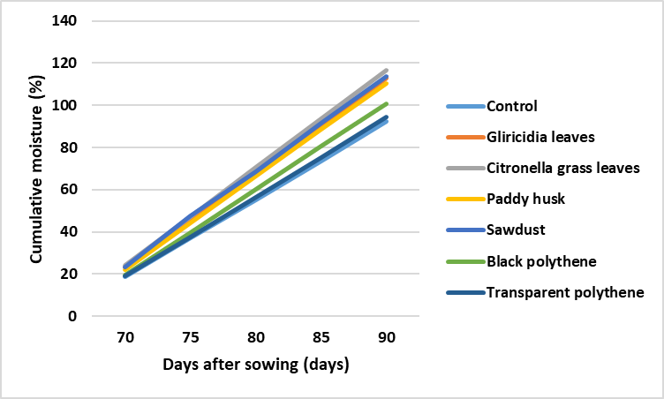
RESULT AND DISCUSSION (Cont.)
Dynamics of Cumulative Soil Water Retention
Figure 10. Effect of treatments on cumulative soil water retention on undisturbed soil
Figure 11. Effect of treatments on cumulative soil water retention on disturbed soil
Significant effect (p<0.05) of mulching on cumulative soil water retention
Highest and significantly similar (p<0.05) cumulative soil water conservation - Citronella grass, Paddy husk, and Gliricidia leaves mulches

Slide 16
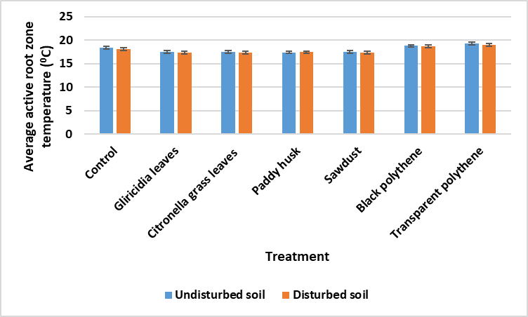
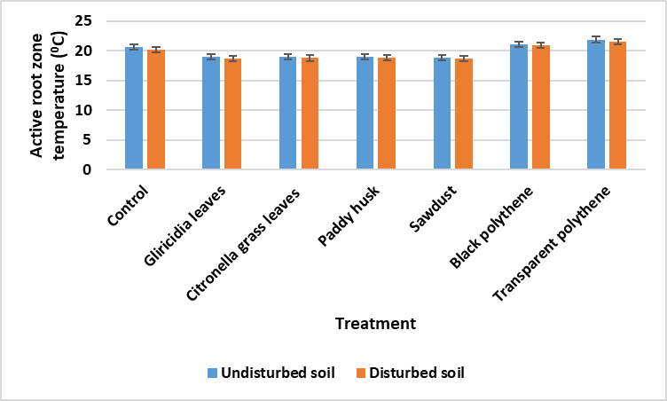
RESULT AND DISCUSSION (Cont.)
Dynamics of active root zone temperature
Figure 12. Effect of treatments on average soil temperature at 10.00 am
Figure 13. Effect of treatments on average soil temperature at 2.00 pm
Significant effect (p<0.05) of mulching on active root zone temperature
Beneficial thermal improvement - Citronella grass leaves and Paddy husk mulches

Slide 17
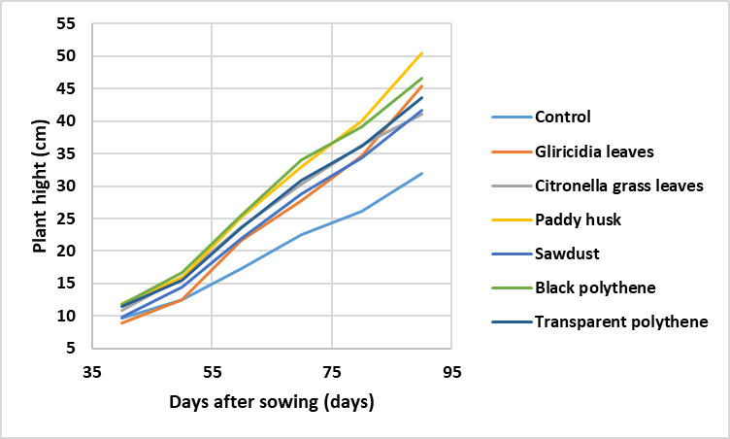
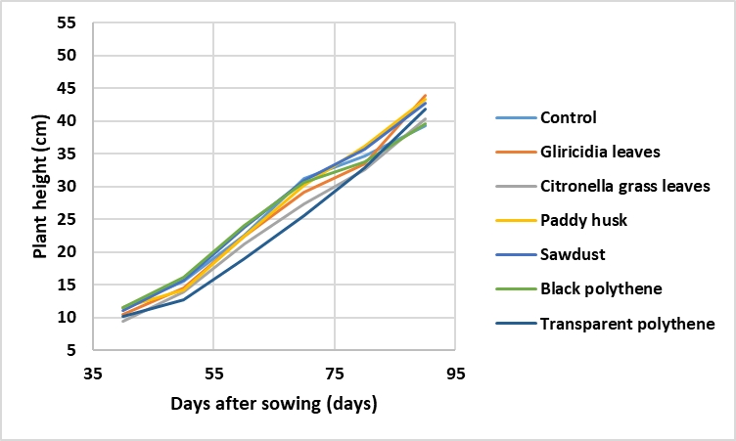
RESULT AND DISCUSSION (Cont.)
Dynamics of Plant height
Figure 14. Effect of treatments on plant height in undisturbed soil
Figure 15. Effect of treatments on plant height in disturbed soil
NO Significant effect (p>0.05) of ploughing or mulching on plant height

Slide 18
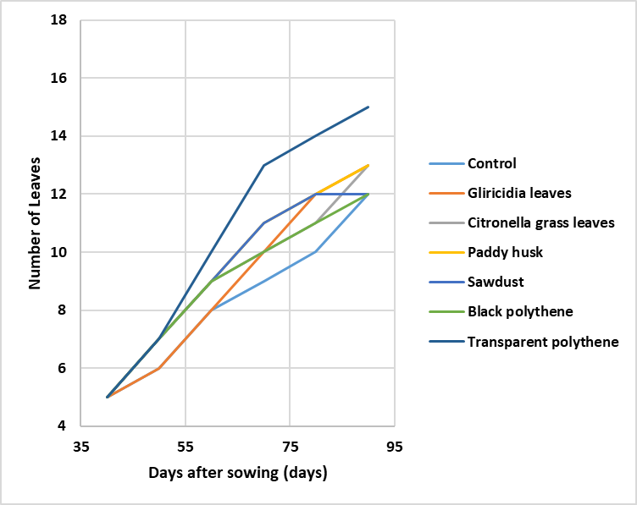
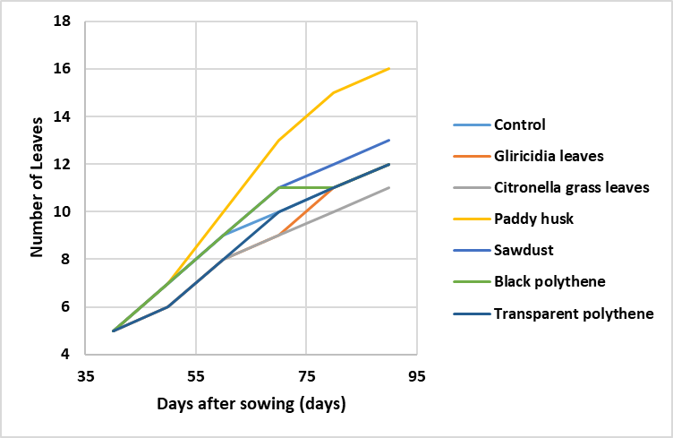
RESULT AND DISCUSSION (Cont.)
Dynamics of the number of leaves per plant
Figure 16. Effect of treatments on number of leaves per plant in undisturbed soil
Figure 17. Effect of treatments on number of leaves per plant in disturbed soil
NO Significant effect (p>0.05) of ploughing or mulching on number of leaves per plant

Slide 19
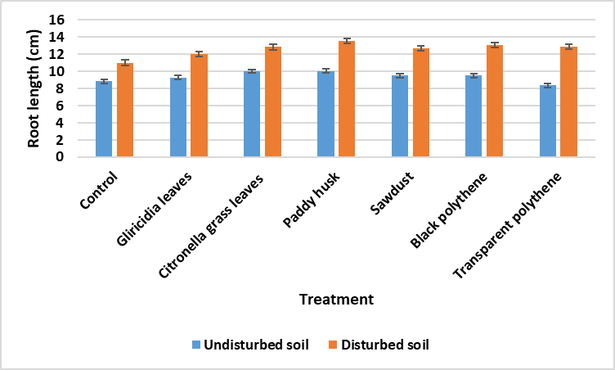
RESULT AND DISCUSSION (Cont.)
Dynamics of the root length
Significant effect (p<0.05) of ploughing on root length
Highest root length - Paddy husk mulch in both soils
Least root length
- Control in both soils
Figure 18. Effect of treatments on root length of the plants at the harvesting

Slide 20
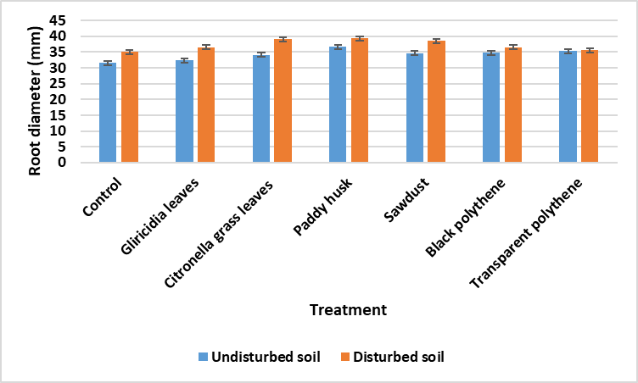
RESULT AND DISCUSSION (Cont.)
Dynamics of the root diameter
Significant effect (p<0.05) of ploughing on root diameter
Highest root diameter - Paddy husk mulch in both soils
Least root diameter
- Control in both soils
Figure 19. Effect of treatments on root diameter of the plants at the harvesting

Slide 21
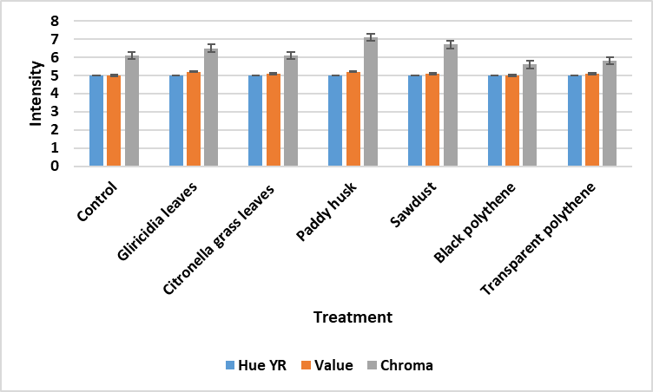
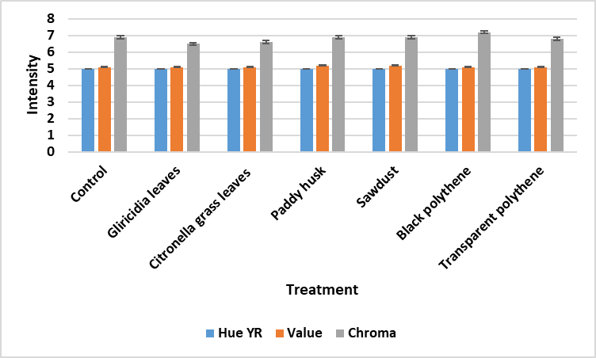
RESULT AND DISCUSSION (Cont.)
Dynamics of the root colour
NO Significant effect (p>0.05) of ploughing and mulching on Hue and values
Significant effect (p<0.05) of ploughing and mulching on Chroma values
Figure 20. Effect of treatments on hue, value, and chroma values of roots in undisturbed soil
Figure 21. Effect of treatments on hue, value, and chroma values of roots in disturbed soil

Slide 22
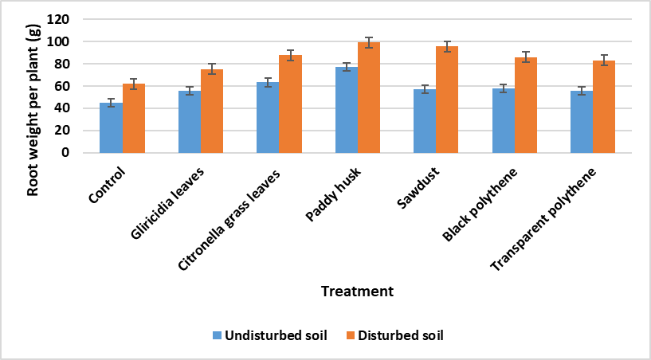
RESULT AND DISCUSSION (Cont.)
Dynamics of the root weight per plant
Significant effect (p<0.05) of ploughing and mulching on root weight/plant
Highest root weight/plant - Paddy husk mulch in both soils
Least root weight
- Control in both soils
Figure 22. Effect of treatments on root weight per plant

Slide 23
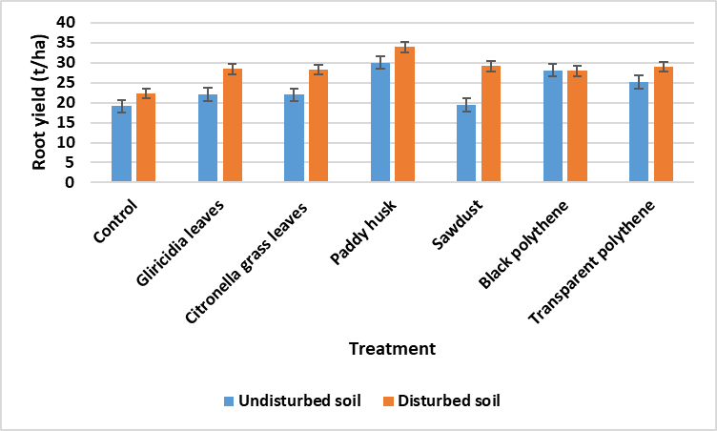
RESULT AND DISCUSSION (Cont.)
Dynamics of the root yield /ha
Significant effect (p<0.05) of ploughing and mulching on root yield/ha
Highest root yield/ha - Paddy husk mulch in both soils
Least root yield/ha
- Control in both soils
Figure 23. Effect of treatments on root yield /ha

Slide 24
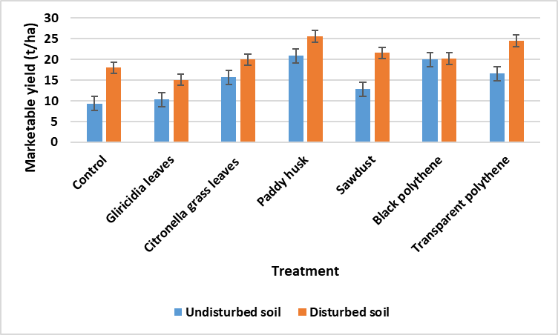
RESULT AND DISCUSSION (Cont.)
Dynamics of the marketable yield /ha
Significant effect (p<0.05) of ploughing and mulching on marketable yield /ha
Highest marketable yield/ha - Paddy husk mulch in both soils
Figure 24. Effect of treatments on marketable yield/ha

Slide 25
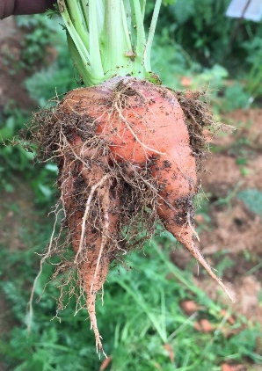
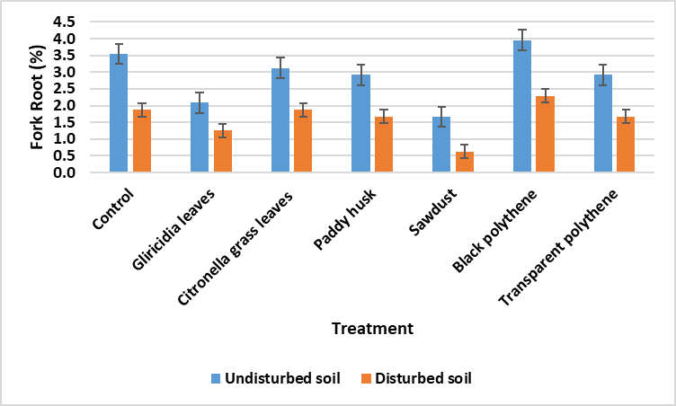
RESULT AND DISCUSSION (Cont.)
Dynamics of the fork root %
Figure 26. Fork root in carrot
Significant effect (p<0.05) of ploughing on fork root %
High fork root %
- undisturbed soil
Highest average fork root %
- Black polythene mulch and control
Figure 25. Effect of treatments on fork root percentage

Slide 26
CONCLUSION AND RECOMMENDATIONS
The highest water retention was observed in Citronella grass, Paddy husk, and Gliricidia leaves established undisturbed and disturbed soils, thereby high carrot yield
Beneficial thermal improvement that affects carrot yield was observed in Citronella grass and Paddy husk mulch
Results generated from the study are extremely useful to formulate soil water conservation packages to recommend farmers for sustainable carrot cultivation

Slide 27
REFERENCES
Ahmad, B., Hassan, S. and Bakhsh, K.H.U.D.A., 2005. Factors affecting yield and profitability of carrot in two districts of Punjab. International Journal of Agriculture and Biology, 7(5), pp.794-798.
Dyśko, J. and Kaniszewski, S., 2007. Effect of drip irrigation, N-fertigation and cultivation methods on the yield and quality of carrot. Journal of Fruit and Ornamental Plant Research, 67(1), pp.25-33.
Nortje, P.F. and Henrico, P.J., 1985, November. The influence of irrigation interval on crop performance of carrots (Daucus carota L.) during winter production. In International Symposium on Fruit & Vegetables for Processing 194 (pp. 153-158).
Sørensen, J.N., Jørgensen, U. and Kühn, B.F., 1997. Drought effects on the marketable and nutritional quality of carrots. Journal of the Science of Food and Agriculture, 74(3), pp.379-391.

Slide 28
