Slide 1
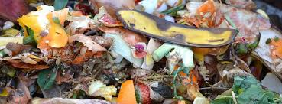
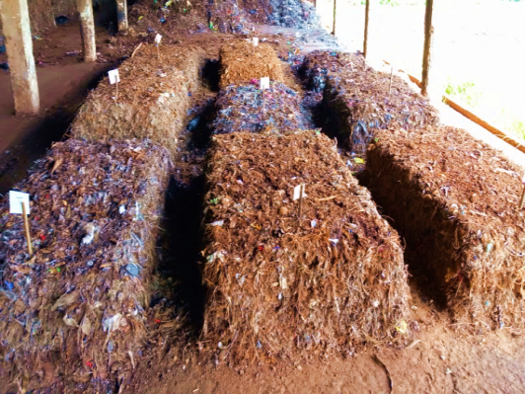
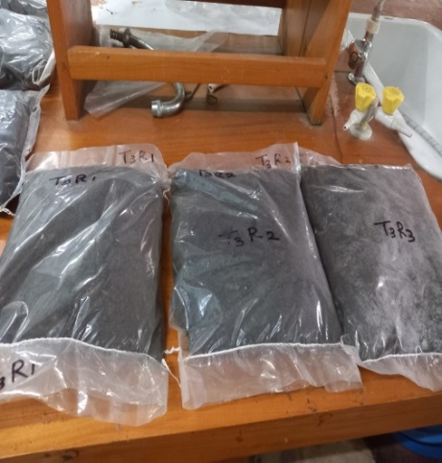
Special Organic Fertilizer Formulation from Municipal Solid Waste as the Major Feedstock
Arunoda K.G.A ,16 AGA 1251
Module Agri-Environmental Resources Management
Department of Export Agriculture
Faculty of Agricultural Sciences
Sabaragamuwa University of Sri Lanka
Internal Supervisor : Prof. PI Yapa
External Supervisor : Mr. A.M.C.L Andadola, Public Health Inspector, Department of Health, MOH, Urban council Balangoda

Slide 2
Content for the Presentation
Introduction
Research problem
Objectives
Methodology
Results and discussion
Conclusions
Suggestions
References
Acknowledgement

Slide 3
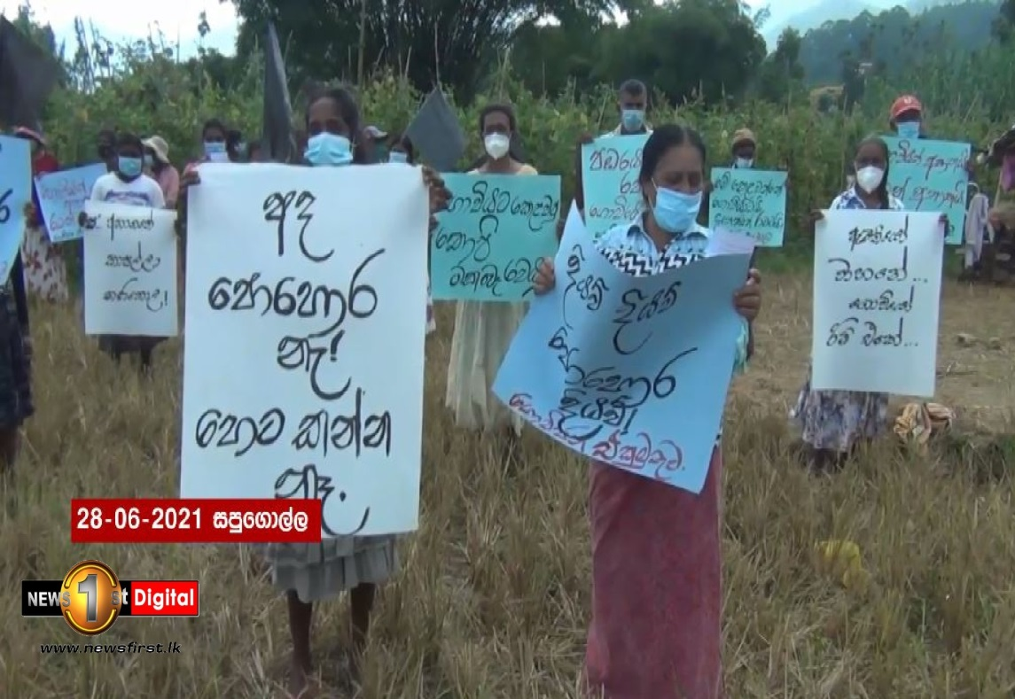
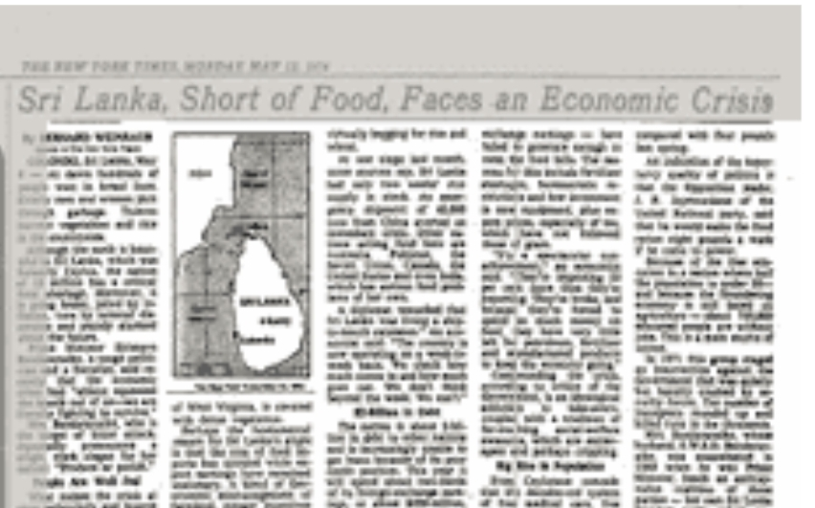
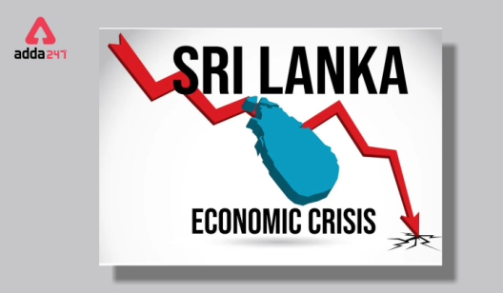
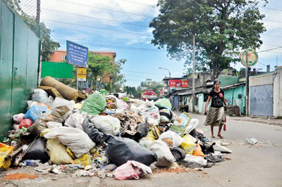
Introduction

Slide 4
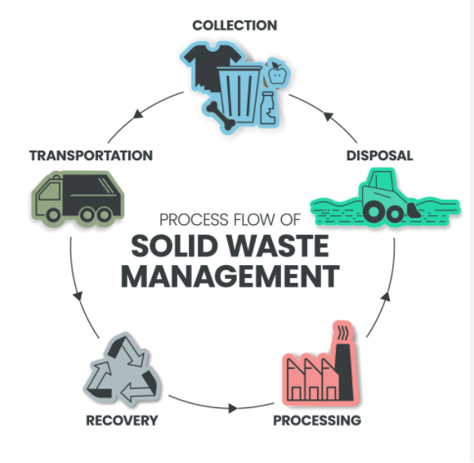
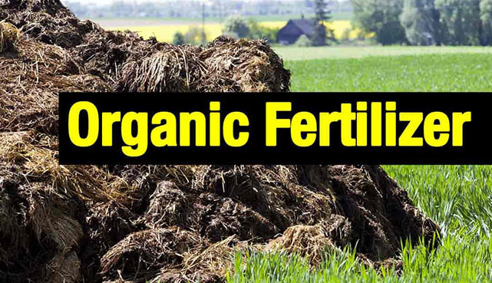
Introduction con..
Both fertilizer and waste related problems

Slide 5
Introduction con…
The challenge will be the production of organic fertilizer to replace chemical fertilizers without compromising the agricultural production.
Therefore, this study mainly focused on producing a high-quality organic fertilizer formulation to meet the demand of modern high-yielding crops.

Slide 6
Research problem
The use of organic fertilizers made from MSW(municipal solid waste) has not gained popularity in Sri Lanka. Why?
Poor response from crops
Deficient in major essential plant nutrients (e.g. N,P,K)
Contamination with toxic trace elements
Deficient in humic substances
So, waste management centers face problems in marketing their products.

Slide 7
Objectives
Broad objective
To produce special organic fertilizer formulation for high yielding crops using MSW as the main feedstock.
Specific objectives
To enhance the contents of N,P and K in the fertilizer.
To minimize the contamination of fertilizer from toxic trace elements and organic residues.

Slide 8
Material and Methods
Faculty of Agricultural Sciences, Sabaragamuwa University of Sri Lanka
Research Locations
Waste management and training center, Balangoda, Bankiyawatta

Slide 9
Material and Methods con…
Collection
MSW
Processsing
MSW
Preparation of other raw materials
Biofertilizer production
Biocharcoal production
Special formulation of MSWC
Management of windrows
Sample preparation
Chemical analysis
Overview of the methodology

Slide 10
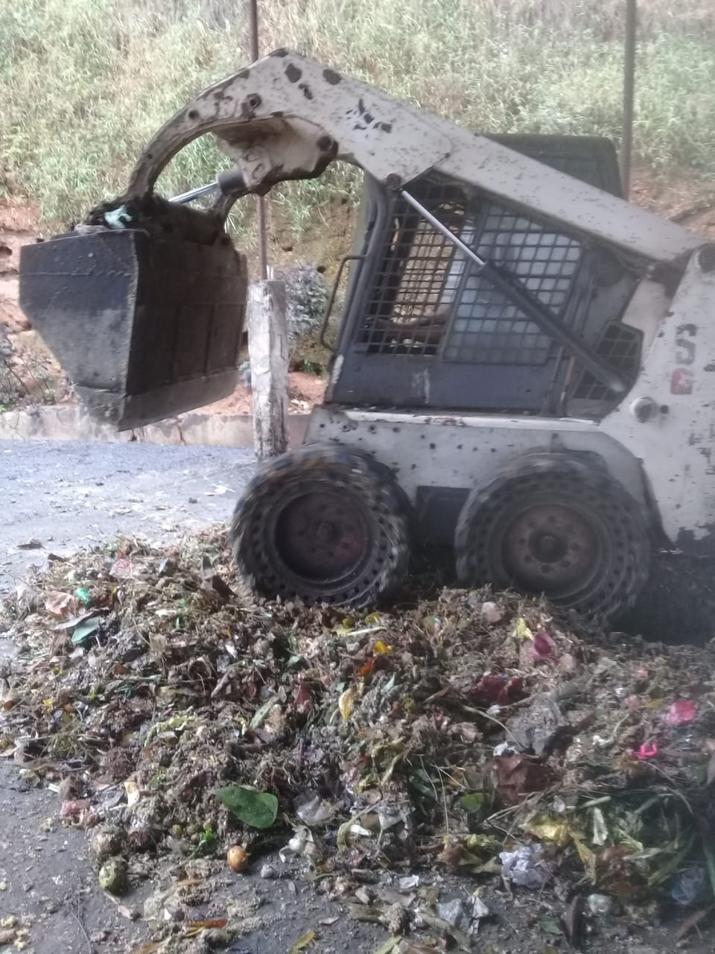
Material and Methods con…
Collection of MSW
Sorted out biodegradable MSW from a one truck load of MSW.
Processing of MSW
Degradable MSW
Grinding MSW using bobcat machine
(particle size 2 to 3 inches)

Slide 11
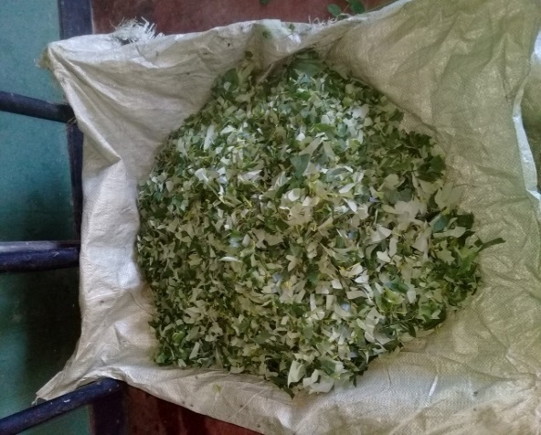
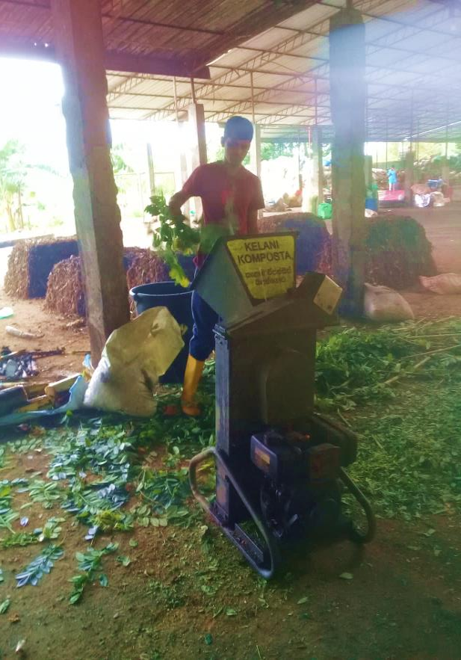
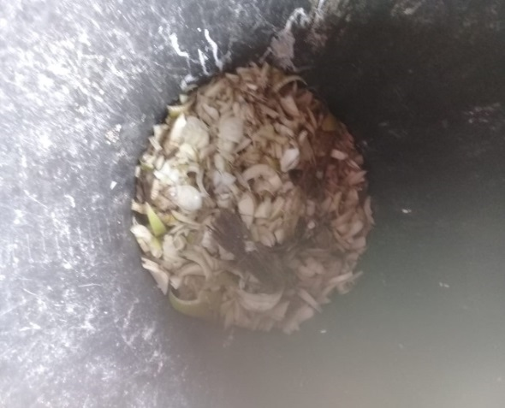
Materials and Methods con…
Preparation of additional raw materials
Chopped gliricidia (N)
Shredder machine
Chopped banana waste (K)

Slide 12
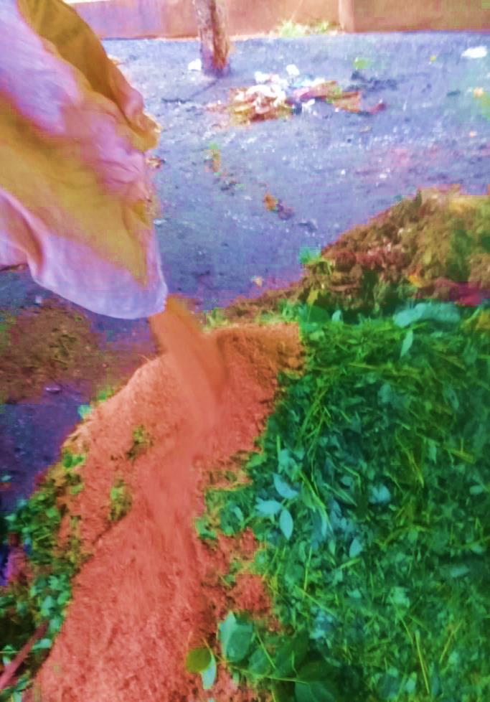
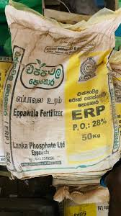
Material and Methods con..
Other raw materials
Saw dust(lignified materials for humus production)
ERP(rock phosphate)(P)
Saw dust
Rockphosphate

Slide 13
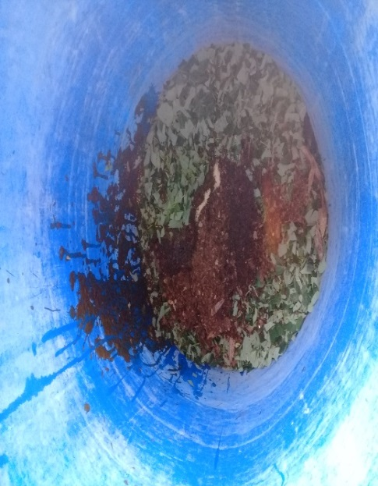
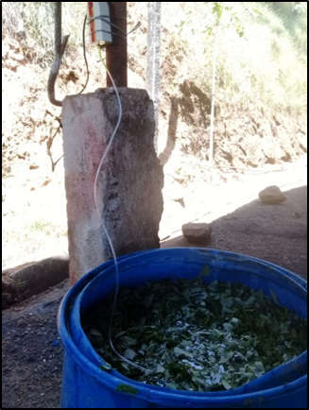
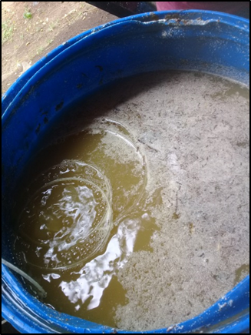
Material and Methods con..
Preparation of Bio fertilizer
Pine forest soil 100g
(p solubalizing microbes)
Brown sugar 2Kg
Cow dung 500g
Gliricidia 5Kg
Well water(chlorine free)
Electric aerator (aeration)
Bio fertilizer
(After 7 days)

Slide 14
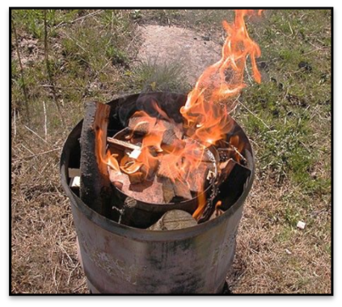
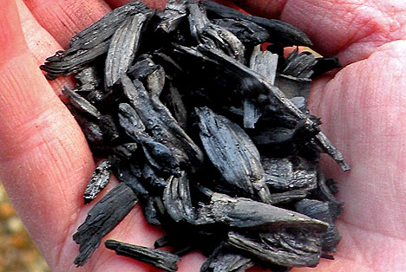
Material and Methods con..
Double barrel method
Bio charcoal

Slide 15
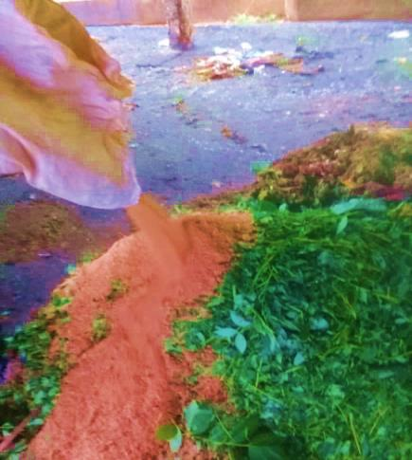
Material and Methods con..
Grinded MSW
N source
(Gliricidia)
P source
(ERP)
K source
(Banana waste)
Lignified materials
(Saw dust)
Effective microbial
culture
Neutralizing agent
(Biocharcoal)
Special organic fertilizer formulation

Slide 16
Material and Methods con..
Volume basis%
Treatments | Composition
T1 | MSW degradable (95%) + Old compost(5%) (Inoculum used by the Municipality)
T2 | MSW degradable (50%) + Gliricidia leaves (10%)+ Saw dust (30%)+ ERP(10%) (Biofertilizer 33 liters as an additive)
T3 | MSW degradable (50%) + Gliricidia leaves (10%)+ Saw dust (20%)+ ERP (5%) + Banana waste (10%) + Biochar ( 5% ) (Biofertilizer 33liters as an additive)

Slide 17
Experimental Layout
Randomized complete block Design (RCBD)
Replicated three times
T1R1
T1R2
T1R3
1m
T2R3
T2R2
T2R1
1.5m
1.5m
Width – 1.2m
T3R1
T3R3
T3R2

Slide 18
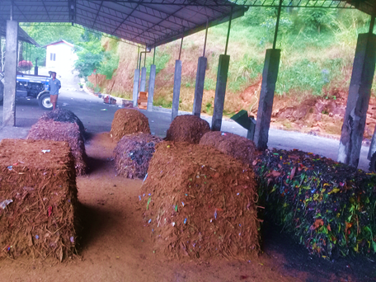
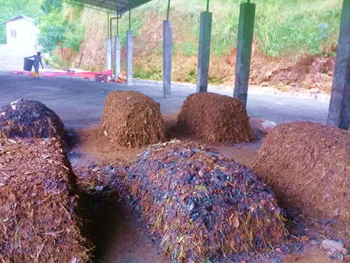
Materials and methods con..
Stages of compost windrow pile
1st week
3th week
Maturation stage
2nd week

Slide 19
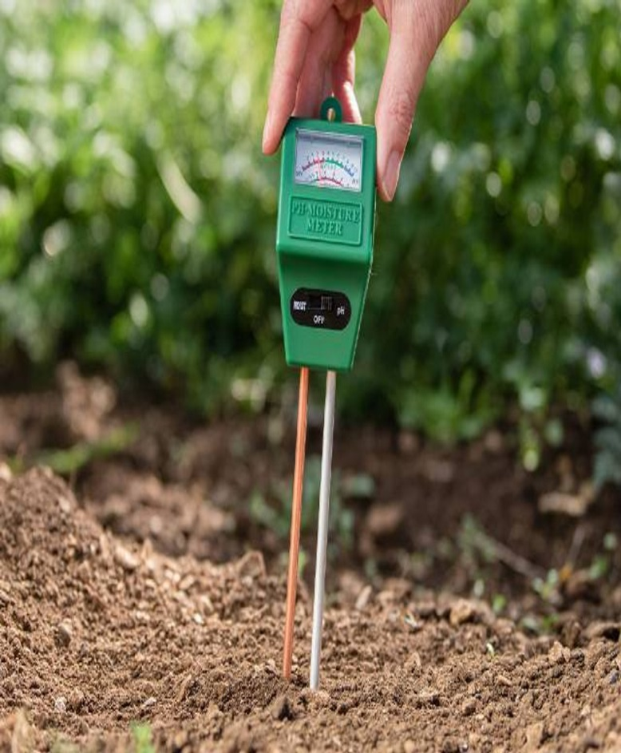
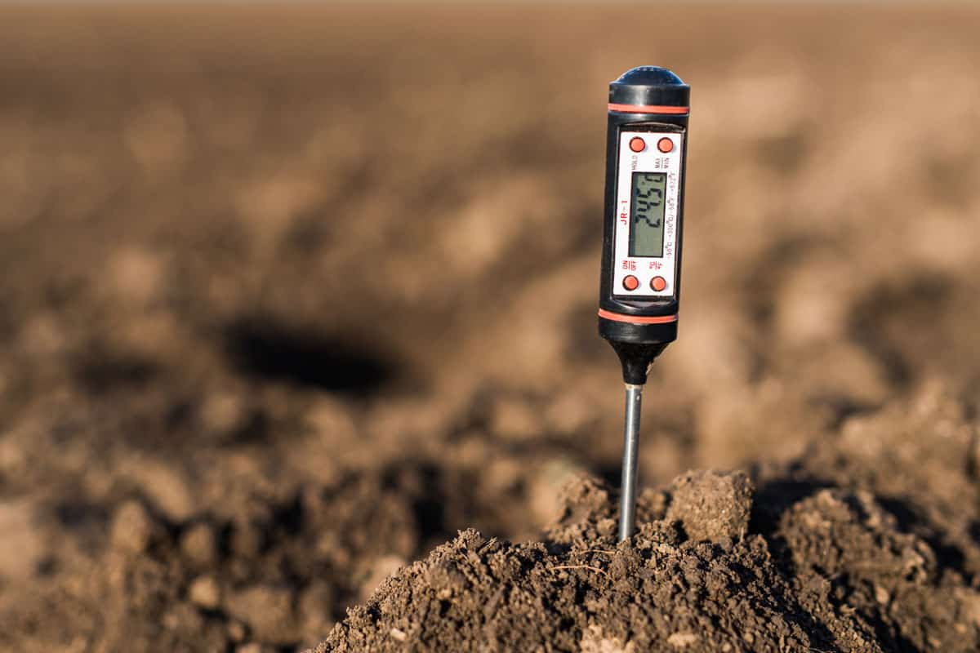
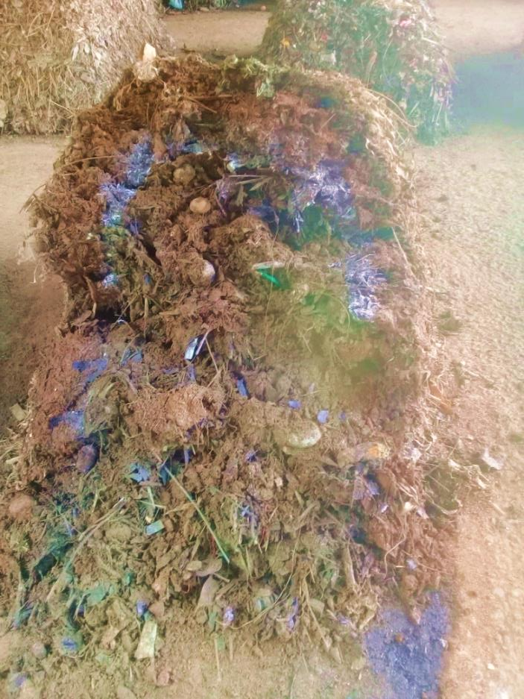
Materials and Methods con..
Management of the windrow piles
Turning using bobcat
( twice per week)
Measuring moisture and pH
using pH moisture probe
Measuring temperature using thermometer

Slide 20
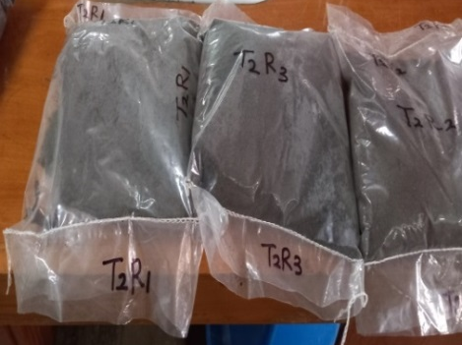
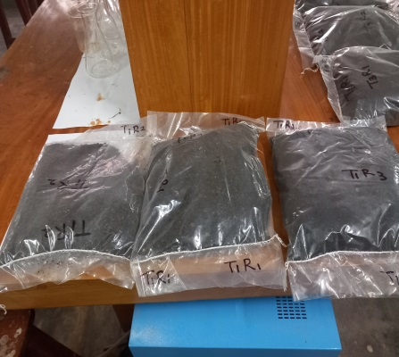
Material and Methods con..
Compost sample preparation
Grinding
Air dried
Sieved <2mm
Treatment 1 samples
Treatment 2 samples
Treatment 3 samples

Slide 21
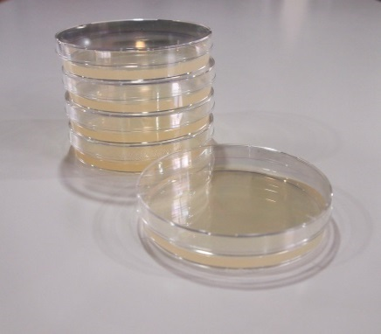
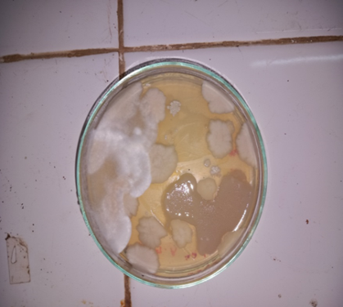
Materials and Methods Con..
Bio fertilizer samples
Dilution technique
Preparation of culture media PDA (Potato Dextrose Agar)
Culturing bio fertilizer
Sub culturing
Identification of isolated microbial species
Morphological
10¯³

Slide 22
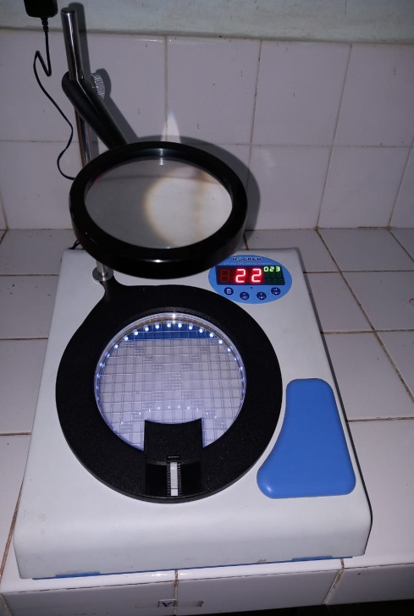
Material and Methods con..
Microbial diversification in bio fertilizer
According to morphology by their margin, form, elevation
10¯³
Microbial species count- 16
Margin- 6
Elevation- 4
Form- 6
Colony count machine

Slide 23
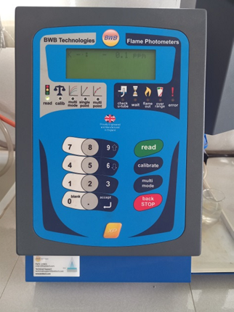
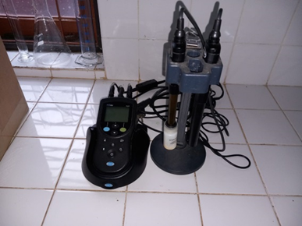
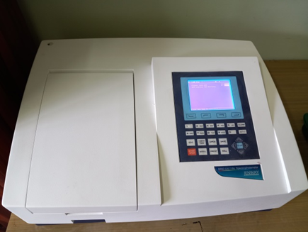
Material and Methods con..
Compost chemical analysis and data collection
Flame photometer
pH and EC meter
Spectrophotometer
pH level and EC level
(Chacha, 2014)
Available phosphorous
(Olsen et al., 1954)
Available
potassium
(Warncke.D and Brown. J.R, 1998)

Slide 24
Data analysis
One -way ANOVA procedure of statistical Analysis System (SAS)
Significant treatment differences were separated by Turkey’s multiple range test at P < 0.05.
Graphed by Microsoft excel software.

Slide 25
Results and Discussion

Slide 26
The available phosphorous in the compost

Slide 27
Available potassium in the compost

Slide 28
pH level in the compost

Slide 29
Electrical conductivity level in the compost

Slide 30
Conclusions
MSW can be used as a feedstock to produce high quality organic fertilizer for high yielding crops.
Culture used is effective in increasing phosphorous fertility status of the fertilizer.
In addition to neutralizing the acidity, addition of biocharcoal in to the compost significantly improve the phosphorous nutrient status of the organic fertilizer.
Use of banana waste will be helpful in improving potassium content of the sample.

Slide 31
Suggestions
Properly monitored waste management program to collect well sorted solid waste should be a practical and sustainable solution to recover significant fraction of solid waste while minimizing problems caused by degradable waste fraction.
Further research will be required to enhance the nutrient status of compost produced from municipal waste.
Treatment three should be further tested with crops in farming areas affected by soil acidity and related problems.

Slide 32
References
Ash, À. (2013) ‘Co-composting of Municipal Solid Waste with Sawdust : Improving Compost Quality’, 41(2), pp. 185–194. doi: 10.1002/clen.201100315.
Gunaruwan, T. L. and Gunasekara, W. N. (no date) ‘Management of Municipal Solid Waste in Sri Lanka : A Comparative Appraisal of the Economics of Composting’, pp. 27–45.
Kumar, V. and Singh, P. M. M. (2011) ‘Composting of Municipal Solid Waste: a Sustainable Waste Management Technique in Indian Cities’, International Journal of Current Research, 3(12), pp. 339–346. Available at: http://www.journalcra.com.
Lanka, S. et al. (2007) ‘Paper Presented at Conference on Developments in Forestry and Environment Management in Sri Lanka’.
Schübeler, P. (1996) ‘Conceptual Framework for Solid Waste Management in Law Income Countries, SKAT (Swiss Centre for Development Cooperation in Technology and Management)’.
Tognetti, C., Mazzarino, M. J. and Laos, F. (2007) ‘Improving the quality of municipal organic waste compost’, Bioresource Technology, 98(5), pp. 1067–1076. doi: 10.1016/j.biortech.2006.04.025.
UNEP (2005) ‘Solid waste management_(Volume II: Regional Overviews and Information Sources), CalRecovery, Inc. and UNEP International Environmental Technology Centre (IETC)’.
USEPA (1995) Decision Maker’s Guide to Solid Waste Management, Volume II, (EPA 530-R-95-023), Washington DC.
USEPA (2002) ‘Solid Waste Management: A Local Management with Global Impact’.
Visvanathan, C. (2006) ‘―Domestic solid waste management in South Asia‖ 3 R South Asia Expert Workshop, Kathmandu, Nepal.’, pp. 1–39.

Slide 33
Acknowledgement
Internal Supervisor, Prof. P.I Yapa, Department of Export Agriculture, Faculty of Agricultural Sciences, Sabaragamuwa University of Sri Lanka, Belihuloya.
Lecturer (probationary) Ms.Ovini Dissanayake, Department of Export Agriculture, Faculty of Agricultural Sciences, Sabaragamuwa University of Sri Lanka, Belihuloya.
External Supervisor, Mr A.M.C.L Andadola, Public Health Inspector, Authorized Officer Under the Food Act, urban council Balangoda.
All the staff member at waste management and training center whom help me for my research work.
All academic and non-academic staff members, Department of Export Agriculture, Faculty of Agricultural Sciences, Sabaragamuwa University of Sri Lanka.
My Parents, relations ,friends and all whom helped me.

Slide 34
Thank You

