Slide 1
POTENTIAL OF USING PESTICIDAL PLANT EXTRACTS IN MANAGING TERMITE DAMAGE IN SUGARCANE BUDS AND SETTS AT PLANTING
P. M. D. B. Weerasekara^{1*}, K. M. G. Chanchala², W. M. A. U. K. M. Wijesekara¹
¹Department of Export Agriculture, Faculty of Agricultural Sciences, Sabaragamuwa University of Sri Lanka
²Division of Crop Protection, Sugarcane Research Institute, Uda Walawe, Sri Lanka

Slide 2
Content
Introduction
Objectives
Material and Methods
Results and Discussion
Conclusion and Recommendations
References

Slide 3
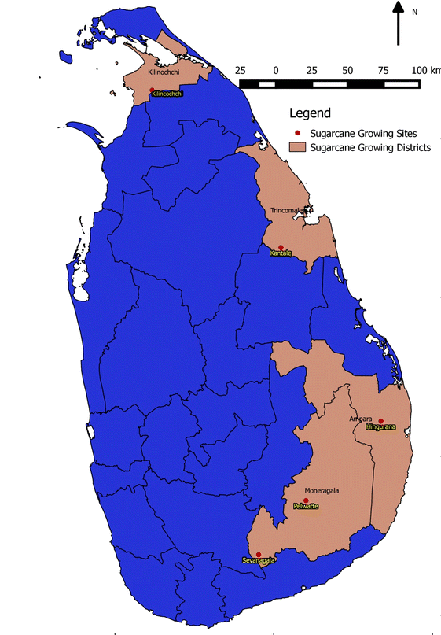
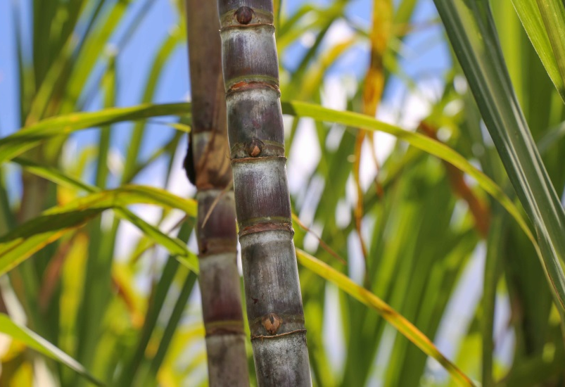
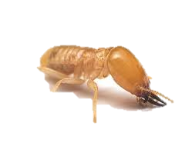
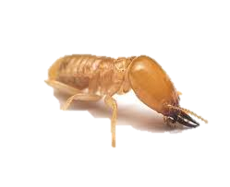
Introduction
Sugarcane is a widely used sugar - producing crop in the world.

Slide 4
Research Problem
Termites - Dry season pest
90 % - 100 % crop damage throughout the cropping period from planting to harvesting in rain-fed condition.
Control Measures
Chemical
Physical
Cultural
Pesticides are
Costly
Numerous negative side effects
Banded importation
Control measures
Plant extracts can be utilized efficiently,
Biodegradable
Environmentally friendly
(Blaske and Hertel, 2001)

Slide 5
Objectives
Overall Objective
To identify the potential of using pesticidal plant extracts from the available plants within the sugarcane ecosystem to manage the termite damage in sugarcane buds and setts at planting.
Specific Objectives
To identify the Lethal concentration (LC₅₀) of each plant extracts to control termite damage in sugarcane.
To select the most effective plant extract that can be used for managing termites.

Slide 6
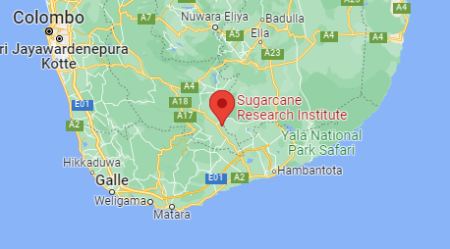
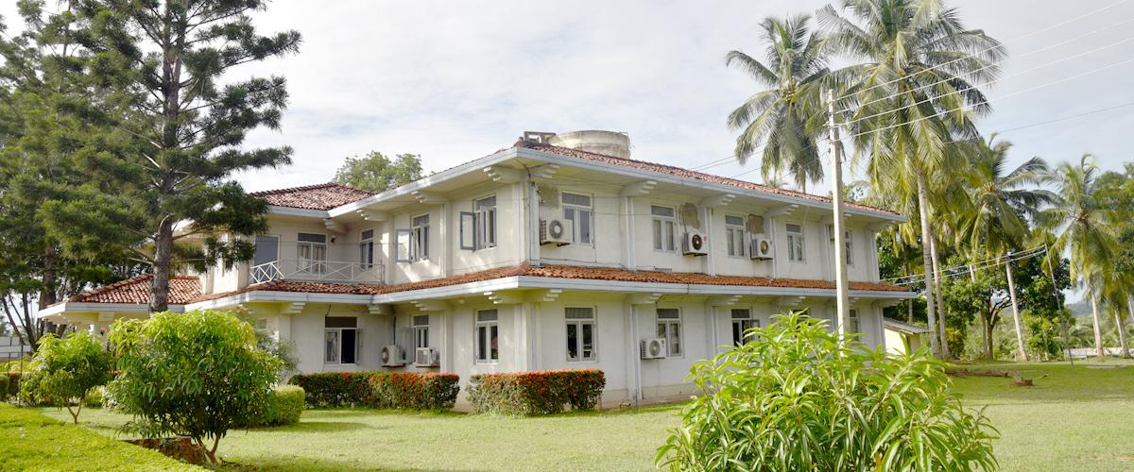
Material and Methods
The Study Area
Sugarcane Research Institute - Uda Walawe, Sri Lanka.
- Research farm (60 27’N, 80 52’E)
- Entomology laboratory

Slide 8
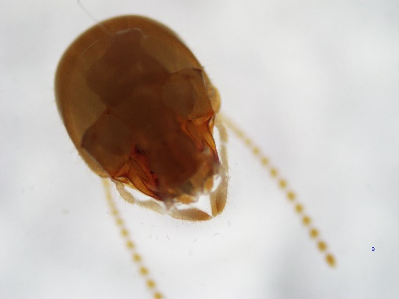
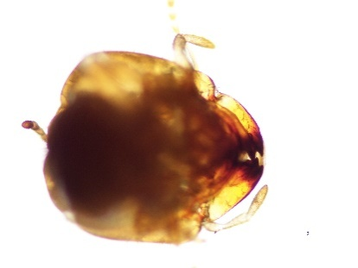
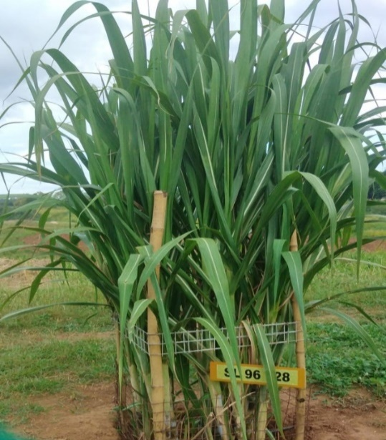
1. Identification of the naturally available Termite spp. in sugarcane ecosystem
Termite collection
Preserved under 70 % Ethanol
Termite species identification using a microscope
Identified termite species available in literature
(Fernando, 1977)
2. Selection of sugarcane variety
SL 96 128
12 months of age
Three budded setts used for the experiment

Slide 9
3. Selection of Pesticidal Plants
Pesticidal plants were selected considering,
Selected Pesticidal Plants for the experiment
Plant | Scientific Name | Family | Selected Parts
Pawatta | Adhatoda vasica | Acanthaceae | Leaves
Thel-edaru | Ricinus communis | Euphorbiaceae | Leaves
Marigold | Tagetes erecta | Asteraceae | Flowers
Marigold | Tagetes erecta | Asteraceae | Leaves
Nut grass | Cyperus rotundus | Cyperaceae | Rhizomes
Lantana | Lantana camara | Verbenaceae | Leaves
Neem | Azadirachta indica | Meliaceae | Seed
Gliricidia | Gliricidia sepium | Fabaceae | Leaves
Ipil-ipil | Leucaena leucocephala | Fabaceae | Leaves
Ipil-ipil | Leucaena leucocephala | Fabaceae | Pods
Traditional agricultural knowledge
Available literature
The availability of pesticidal plants in the sugarcane ecosystem in quantitative terms
Biodegradability
Environmentally friendliness

Slide 10
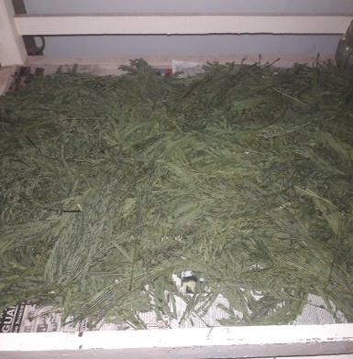
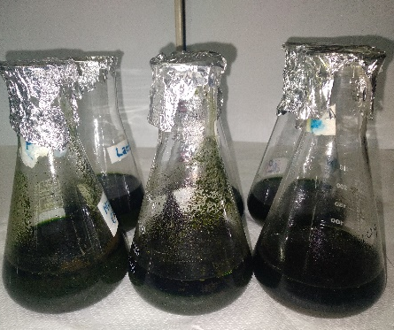
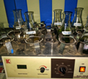
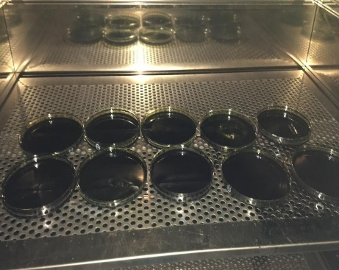
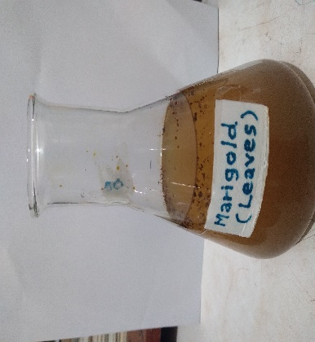
4. Preparation of Ethanolic Plant Extract
Drying plant parts under shade and milled into fine powder (Etuh et al., 2021)
(20 g) of dried plant materials were extracted at room temperature with 100ml of ethanol (96%) (Nikkon et al., 2009)
Shaken for about 6 hrs, leaf extracts were filtered through a Whatman No 01 filter paper
Filtered solution was evaporated in a water bath at 65℃ for about 72hrs it was kept in an oven at 45℃ (Ahmad et al., 2019)
The dried extract was dissolved in distilled water to give final concentrations (Michael et al., 2020)

Slide 11
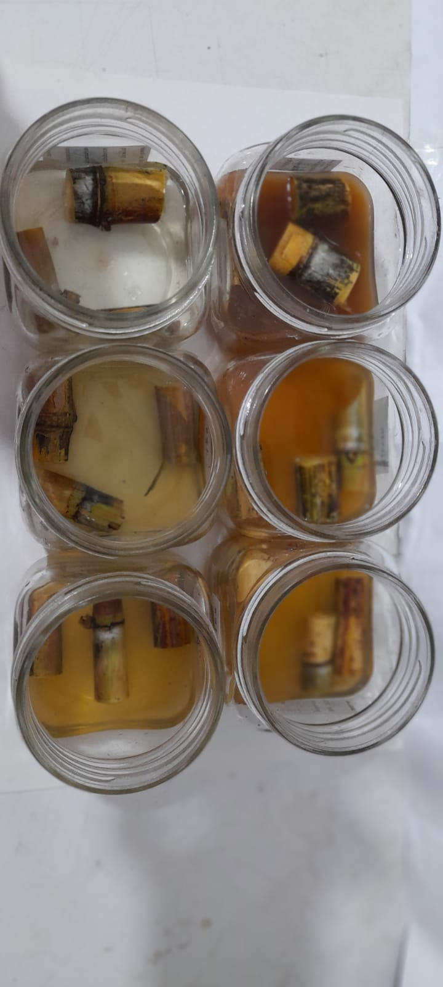
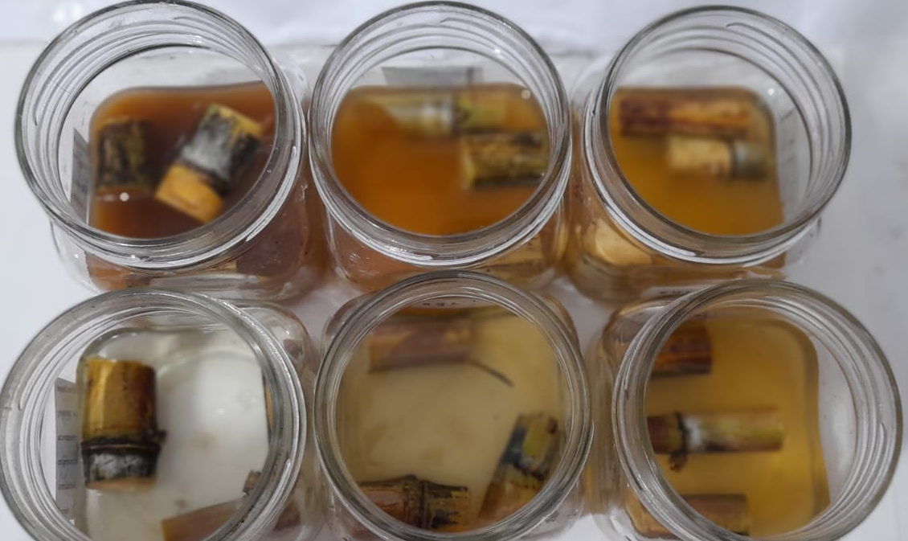
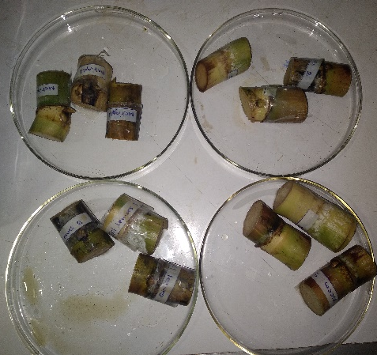
Plant Extract Application
Prepared filtrate was used for sett treatment at planting
Soaked in filtrate
Kept outside
Again, soaked in filtrate
15 min
15 min
15 min

Slide 12
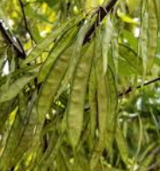
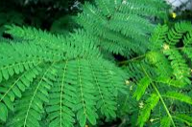
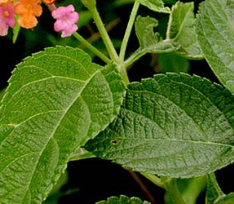
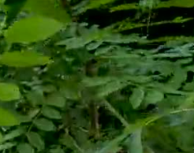
Choice Test
Preliminary Study
Termite Mortality Test
Choice Test
Twelve (12) treatments with three replicates were located in a circular manner ( RCBD ).
Ipil-Ipil pods
Ipil-Ipil leaves
Lantana
Gliricidia

Slide 13
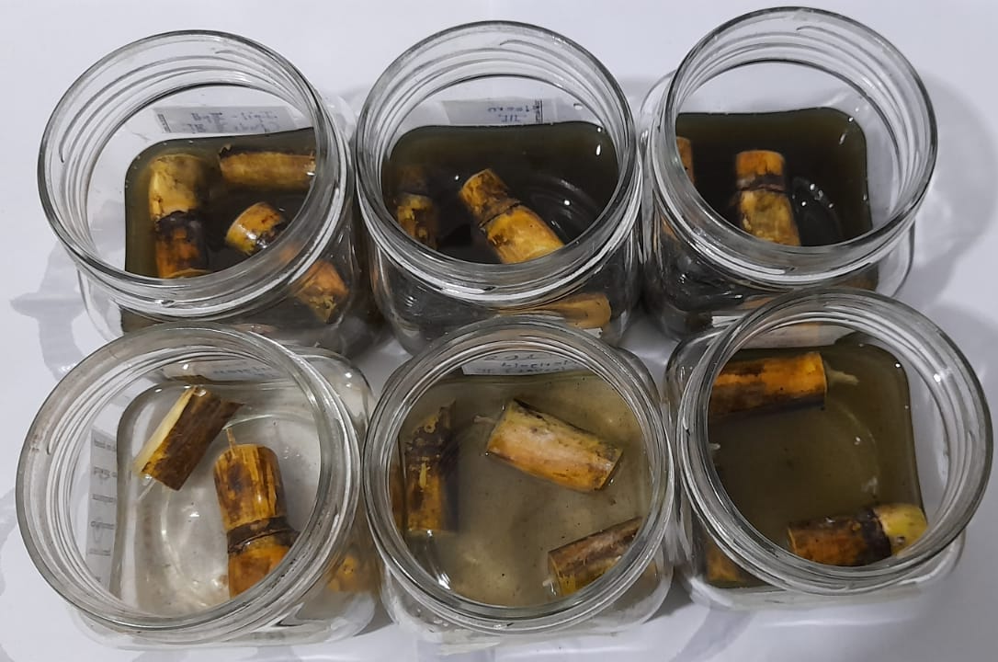
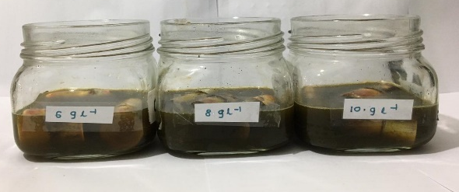
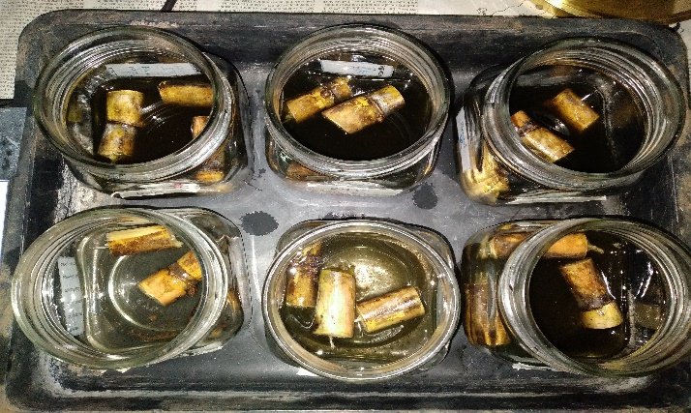
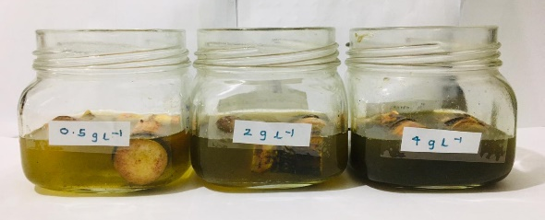
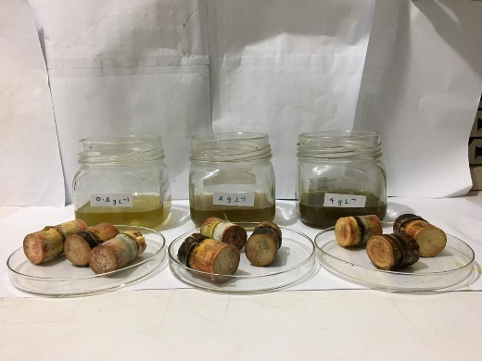
Termite mortality test (Randomized Complete Block Design)
(Randomized Complete Block Design was used with three replicates)
Selected plants from the choice test were used for the termite mortality test
Six concentrations (0.5 g/L, 2 g/L, 4 g/L, 6 g/L, 8 g/L, 10 g/L)
Plant extract treated sugarcane single budded setts were placed in the middle of the bottles
Termite mortality was observed during the time periods of 6 hr, 24 hr, 48hr and 72 hr, after introducing termites
Percentage mortality = $\frac{No of dead termite}{Total number of termite}× \frac{100}{1}$
(Cynthia et al., 2016)

Slide 14
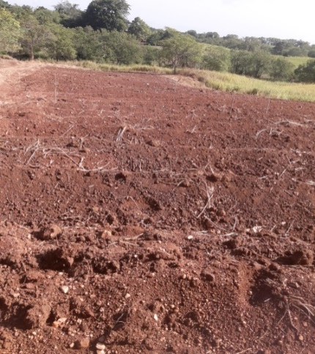
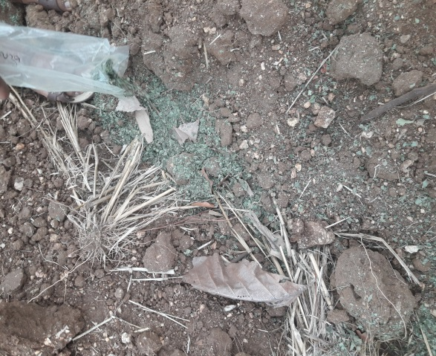
5. Land preparation and termite attraction
Termites are usually attract to the cow dungs.
After 1 week of cow dung application, several soil samples were taken randomly from the field to check proper termite attraction and distribution
Land preparation
Application of wetted cow dung

Slide 15
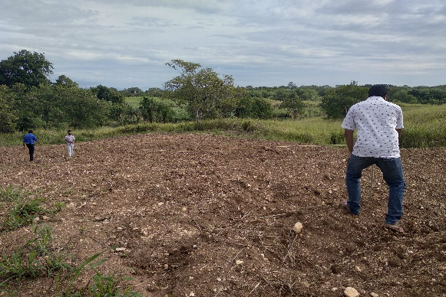
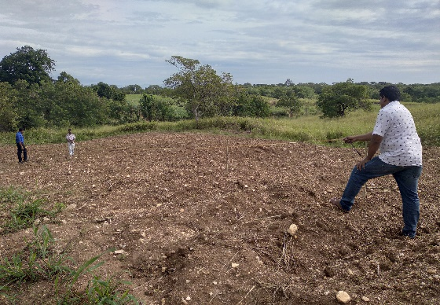
Field Study
Field plan
Treated sugarcane setts (1g /L) were used for field planting
Replicate 1 | 1m | Replicate 2 | 1m | Replicate 3
Water - Control |  | Lantana - Ethanolic |  | Ipil leaves - Ethanolic
Fipronil - Control |  | Gliricidia - Ethanolic |  | Fipronil - Control
Ipil pods - Ethanolic |  | Water - Control |  | Ipil pods - Ethanolic
Ipil leaves - Ethanolic |  | Ipil leaves - Ethanolic |  | Gliricidia - Ethanolic
Lantana - Ethanolic |  | Fipronil - Control |  | Water - Control
Gliricidia - Ethanolic |  | Ipil pods - Ethanolic |  | Lantana - Ethanolic
Four pesticidal plant extracts were selected from preliminary test was used as treatments in the field study
5m
Design : RCBD

Slide 16
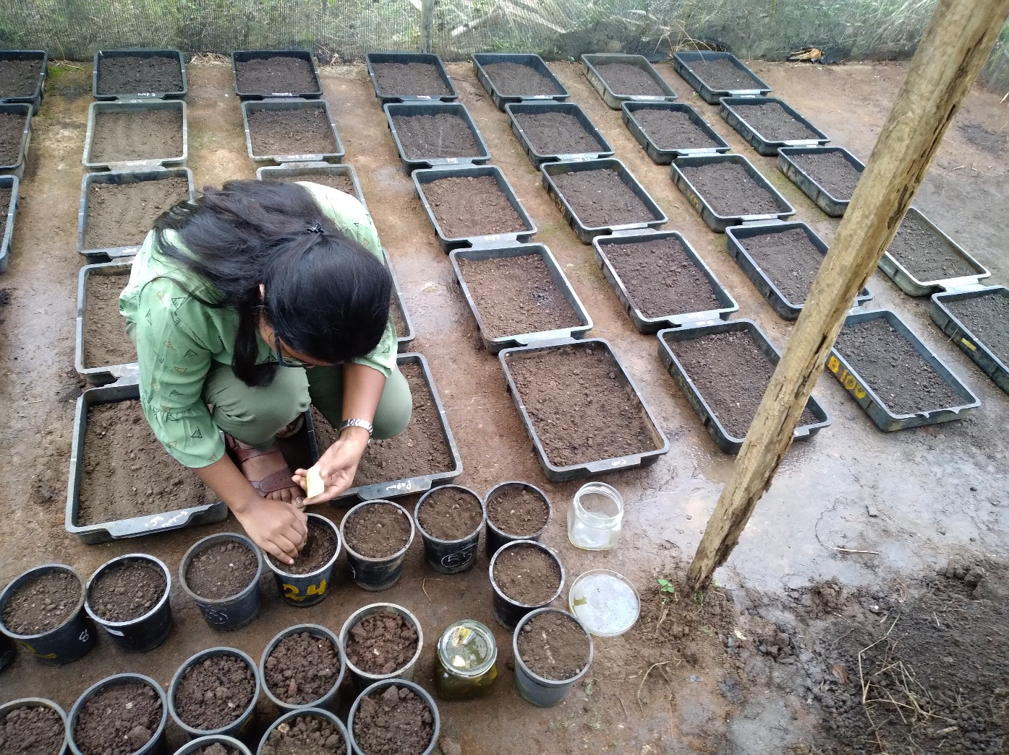
6. Data collection
Preliminary Study
Termite damage was recorded as a volume
Termite mortality percentage was calculated (Cynthia et al., 2016).
Field Study
After four weeks
Germination count
Plant characters ( Leaf number, 3rd leaf length, 3rd leaf width, root mass)
Damage type ( Bud damage, sett damage)

Slide 17
6. Data Analysis
Mean comparison and treatment comparison were done by using One-way ANOVA with Duncan’s Multiple Range Test.
50% lethal concentrations (LC₅₀) was interpolated from non-linear regression curve fit model using GraphPad Prism version 9.4.0.
Graphical illustrations were done by GraphPad Prism version 9.4.0.

Slide 18
Results and Discussion
Preliminary study
Choice test
P < 0.05
** - P < 0.01

Slide 19
Termite Mortality Test
Gliricidia leaf extract
Ipil-ipil leaf extract
Time exposed (hours) | LC₅₀ (g/l) | R²
6 | 33.76 ± 0.42 | 0.74
24 | 1.89 ± 0.25 | 0.70
48 | 1.10 ± 0.46 | 0.91
72 | 0.27 ± 0.309 | 0.99
Time exposed (hours) | LC₅₀ (g/l) | R²
6 | 7.35 ± 0.4 | 0.75
24 | 0.11 ± 0.29 | 0.89
48 | 0.22 ± 1.31 | 0.98
72 | 0.21 ± 0.93 | 0.99

Slide 20
Ipil - ipil pod extract
Lantana leaf extract
Time exposed (hours) | LC₅₀ (g/l) | R²
6 | 13.93 ± 0.23 | 0.74
24 | 0.019 ± 0.18 | 0.88
48 | 0.0063 ± 0.45 | 0.95
72 | 0.27 ±0.30 | 0.99
Time exposed (hours) | LC₅₀ (g/l) | R²
6 | 3.97 ± 0.70 | 0.75
24 | 0.48b ± 0.53 | 0.85
48 | 0.084 ± 0.45 | 0.95
72 | 0.00033 ± 0.0004 | 0.99

Slide 21
Field Study
Plant characters
Number of germinated buds four weeks after planting
Number of leaves four weeks after planting
NS - p > 0.05
IIP | Ipil-Ipil Pods
IIL | Ipil-Ipil Leaves
LL | Lantana Camara Leaves
GL | Gliricidia leaves
NC | Non-treated control (water)
TC | Treated control (Fipronil)

Slide 22
3rd leaf length four weeks after planting
3rd leaf width four weeks after planting
NS - p > 0.05
IIP | Ipil-Ipil Pods
IIL | Ipil-Ipil Leaves
LL | Lantana Camara Leaves
GL | Gliricidia leaves
NC | Non-treated control (water)
TC | Treated control (Fipronil)

Slide 23
Root mass four weeks after planting
NS - p > 0.05
* p > 0.1
IIP | Ipil-Ipil Pods
IIL | Ipil-Ipil Leaves
LL | Lantana Camara Leaves
GL | Gliricidia leaves
NC | Non-treated control (water)
TC | Treated control (Fipronil)

Slide 24
Field Study
Damage Type
Bud damage four weeks after planting
Sett damage four weeks after planting
ns p > 0.05
*** p < 0.001
IIP | Ipil-Ipil Pods
IIL | Ipil-Ipil Leaves
LL | Lantana Camara Leaves
GL | Gliricidia leaves
NC | Non-treated control (water)
TC | Treated control (Fipronil)

Slide 25
Conclusion and Recommendations
All ethanolic plant extract induced concentration and time-dependent toxicity on termites. Potency of order was as Lantana leaves > Ipil-ipil leaves > Ipil-Ipil pods > Gliricidia leaf.
There is no significant effect of ethanolic extract of tested plant parts on sugarcane sett germination and plant growth parameters except L. camara leaf extract (p < 0.001) on average root mass of sugarcane.
Ethanolic extract of L. camera has a potential to use in termite management in sugarcane with further evaluation.

Slide 26
Suggestion
Studies should be continued with different concentrations of Lantana camera to determine best treatment concentration and effective time duration.

Slide 27
References
Acda, M.N. (2014) ‘Chemical composition of ethanolic seed extract of Annona Squamosa L. and A. Muricata L. (Annonaceae) using GC-MS analysis’, Philippine Agricultural Scientist, 97(4), pp. 422–426.
Adejoro, F. and Lajide, L. (2019) ‘Termiticidal and Repellency Activity of Three Selected Tropical Woods against Subterranean Termite Worker (Macrotermes bellicosus)’, 37(1), pp. 34–40. doi:10.5829/idosi.wasj.2019.34.40.
Ahmad, F. et al. (2021) ‘Termites and Chinese agricultural system: applications and advances in integrated termite management and chemical control’, Insect Science, 28(1), pp. 2–20. doi:10.1111/1744-7917.12726.
Ahmed, N. et al. (2016) ‘Issue 2 Article 2 Part of the Biodiversity Commons, and the Biology Commons Recommended Citation Recommended Citation’, Journal of Bioresource Management, 3(2). doi:10.35691/JBM.6102.0049.
Ahmed, S. et al. (2011) ‘Evaluation of Plant Extracts on Mortality and Tunneling Activities of Subterranean Termites in Pakistan’, Pesticides in the Modern World - Pests Control and Pesticides Exposure and Toxicity Assessment [Preprint]. doi:10.5772/18999.

Slide 28
Thank You

