Slide 1
Impact of Current Economic Crisis on Operational Performance of Biscuit Industry in Sri Lanka
T.A.S Ayomi, Prof. H.S.R Rosairo
Department of Agribusiness Management, Faculty of Agricultural Sciences, Sabaragamuwa University of Sri Lanka.

Slide 2
Content for the presentation
Introduction
Objectives
Material and Methods
Results and Discussion
Conclusion and Recommendations
References

Slide 3
Introduction
Sri Lanka is facing challenges due to economic crisis.
Food manufacturing industries, biscuit and other confectionary food industries in Sri Lanka are affected Al-Jazeera (2022). Under these circumstances, several biscuit manufacturing companies failed to continue due to the severe pressure placed on them.
As the importations are fluctuated, the raw material shortage became a serious problem. Due to the dollar shortage, importing inputs were limited.
As most of the raw materials are imported, the industries had to wait for a long time without functioning Sunimalee (2022).

Slide 4
Introduction cont.
Some firms adopted good defensive tactics to guard against the crisis with a way to win the game. Vorhies (2021).
Economic crises have taught many lessons to the regulators, food manufacturers, and to the general public at large.
Even if the price of inputs goes up, industries have to clear their path as they have a social responsibility to feed the nation and keep the people healthy Al-Jazeera (2022).
The rise of the prices of raw materials and the uncontrollable price decisions of biscuits, made the consumers distracted from the biscuit manufacturers Sunimalee (2022).

Slide 5
Objectives
Main objective
The main objective of this study is to study the impact of current economic crisis on operational performance during this issue.
Specific objectives
To study the key economic parameters with relation to the biscuit industry in Sri Lanka within the current economic crisis.
To study the operational performance of the businesses in the biscuit industry in Sri Lanka.
To identify the strategies that the Sri Lankan biscuit industry has used to face the economic crisis.
To suggest methods to overcome issues that the industry has faced under economic crisis.

Slide 6
Material and Methods
Research Approach was Qualitative Analysis.
Research Design was Descriptive and Explanatory.
Considered population was Biscuit manufacturing companies in Sri Lanka.
Sample size was Five leading large and medium scale biscuit manufacturing companies in Sri Lanka. They were labelled as Firm A to E.
Sampling Technique was simple random sampling.
Unit of Analysis was a single biscuit manufacturing firm.
Time Horizon was cross sectional.
Data collecting tool was key informant interviews aided by an interview protocol with more than two officers in a firm.
Data Analysis was done by qualitative analysis and financial ratio analysis.

Slide 7
Results and Discussion
Internal factors
Organizational Structure
Laying off of employees.
Re-allocation of responsibilities.
Additional responsibilities to current employees.
Shifts in the management hierarchy.
Re-designing of team reporting requirements.
Job enlargement.
Changes in administrative procedures.

Slide 8
Results and Discussion cont.
Managerial Expertise
Planning.
Communication skills
Decision-making.
Delegation.
Problem-solving.
Motivating.

Slide 9
Results and Discussion cont.
Strategies used
Something affordable.
Mid sized packets.
Innovations.
Research and development.
Promotional activities.

Slide 10
Results and Discussion cont.
Employee skills
Skills that mostly helpful during the crisis situation according to the all 5 firms are,
Working with rapidly changing schedules.
Innovative skills.
Quick decision changing skill.
Skills of explaining the situation to subordinates.
Skill of engaging in multi tasks other than the own duties at the same time.
Skills of sales force and after sales services.

Slide 11
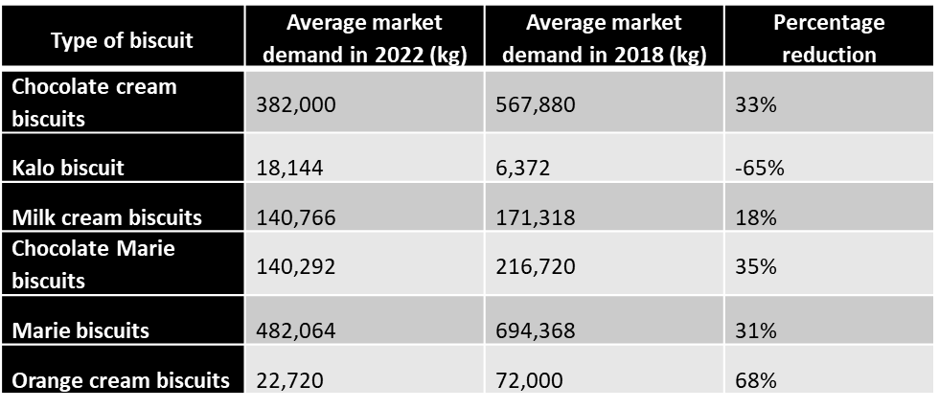
Results and Discussion cont.
External factors
Average market demand for biscuits in firm A; 2022 and 2019.
Source: Sales forecast report and the production report of firm A

Slide 12
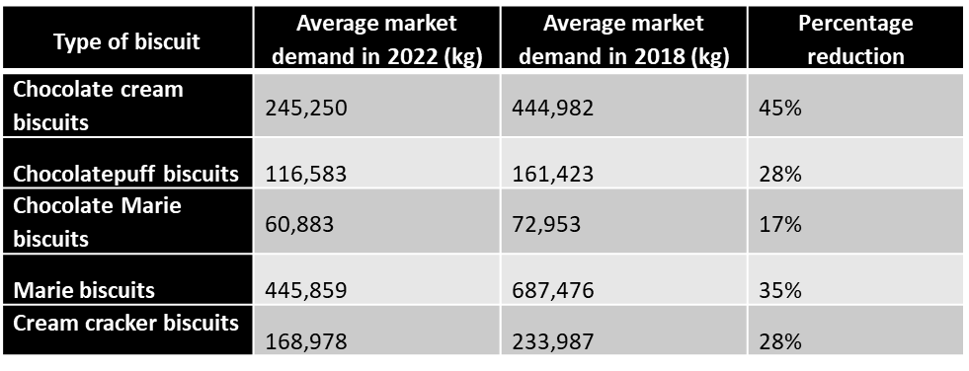
Results and Discussion cont.
Average market demand for biscuits of firm B; 2022 and 2018
Source: Sales forecast report and production report of firm B

Slide 13
Results and Discussion cont.
Average market demand for biscuits firm C; 2022 and 2018
Source: Sales forecast report and production report of firm C
.

Slide 14
Results and Discussion cont.
Average market demand for biscuits in firm D; 2022 and 2018
Source: Sales forecast report and production report of firm D
.

Slide 15
Results and Discussion cont.
Average market demand for biscuits in firm E; 2022 and 2018
Source: Sales forecast report and the production report of firm E.

Slide 16
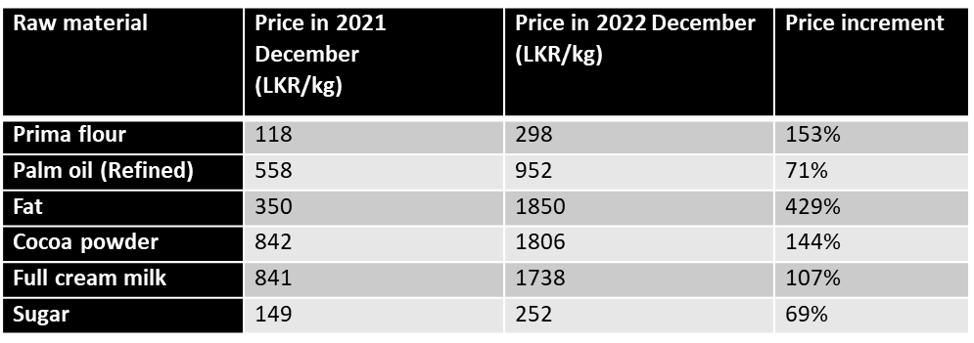
Results and Discussion cont.
Inflation
Changes of price of the main ingredients - 2021 December-2022 December.

Slide 17
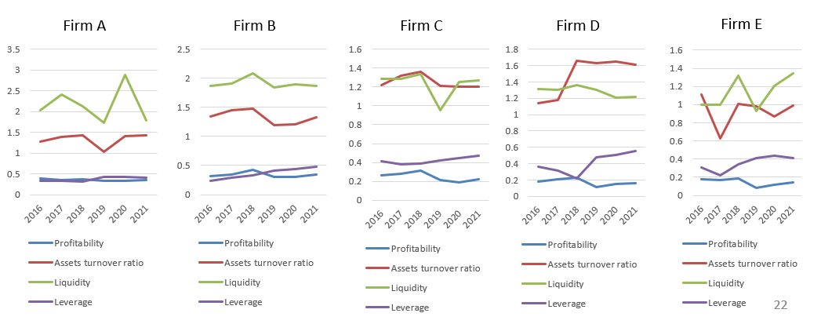
Results and Discussion cont.
Financial ratio analysis
Changes in financial ratios of firms during year 2016 and 2021

Slide 18
Results and Discussion cont.
Fuel shortage
All the firms A, B, C, D and E had to pay unexpected amount of money for fuel as the power cuts were frequently happened and power generators used for the power supply of machine functioning.
Electricity bills, fuel charges, transportation costs and raw material costs rocketed within few months.
Monthly electricity bills risen from nearly LKR 15 million to around LKR 30 million.
They changed the schedule their production plan by considering power cut schedule.
Expenditure for gas has been increased by 163 per cent.

Slide 19
Results and Discussion cont.
Policy changes
Recently, Sri Lankan government has imposed a policy of limiting importation of raw materials.
This has ultimately affected for biscuit manufacturing firms due to lack of required raw materials on time. Therefore, supply can’t fulfil the demand and productions can’t be done continuously. Sri Lanka’s economy contracted by 3.6 % last year.
According to the Central Bank of Sri Lanka, the Sri Lankan rupee depreciated by over 10 per cent against the dollar this year.
Biscuit manufacturers have taken many discussion rounds with responsible parties to remove import barriers for essential raw materials for the productions.

Slide 20
Results and Discussion cont.
Trade factors
Sri Lankan government imposes a value-added tax (VAT) on imports rates from 8 to 15 percent on most goods including the raw materials of biscuit manufacturing such as fat and cocoa powder.
A special commodity levy (SCL) is charged on some imported food items after the crisis.
The SCL rates on basic food items are changed frequently, creating uncertainty for importers. Locally manufactured products are not subject to SCL.
Items subject to SCL typically include sugar, vegetable fats, vegetable oil, margarine and butter are also subject to SCL which are imported as main ingredients for biscuit manufacturing.

Slide 21
Conclusion and Recommendations
Customers usually go for lower priced products without much consideration of their quality. It is the normal behavior that can be expected as firms are in a very stressful situation with the financial problems. Therefore, a greater awareness of the staff members of the biscuit manufacturing firms on various developments is also essential.
A team of well-qualified and experienced staff is required for biscuit manufacturing industry for which training and capacity building are essential. Crises have shown the importance of international relationships. Therefore, to tackle a crisis, international co-operation is required. Financial ratios which changed during the crisis are as follows,

Slide 22
Conclusion and Recommendations cont.
Profitability ratio of the biscuit industry has been reduced by 0.14.
liquidity ratio has been decreased by 0.18 and
Assets turnover ratio has been decreased by 0.24.
These reductions expose the industry to a financial risk. Leverage ratio has been increased by 0.25, which says company operational expense increasement. The results show that during this economic crisis period, the profitability of biscuit industry in Sri Lanka has been affected adversely.

Slide 23
Conclusion and Recommendations cont.
As a whole the demand for Sri Lankan biscuits has been decreased by 30 percent while cost of biscuit production has been increased by 162 per cent while biscuit prices has been increased by 260 per cent.
When considering the financial status and other facts found at discussions, firm A and B are performing better than C, D and E. As a whole after considering all the strategies used and the progress obtained, companies can be ranked as, A>B>C>D>E according to the operational performance during the economic crisis.

Slide 24
Conclusion and Recommendations
The size of the sales force and the number of distribution channels are both equally important. Providing additional training for the sales force, related to the effects of the crisis conditions.
Increasing the R&D budget, in spite of all the financial limitations imposed by a crisis, has an important impact on operational performance.
Promotion-centered general marketing strategy is effective in increasing company profits, one focusing on both product and promotion has a beneficial effect on sales, and one majoring on promotion and distribution has a positive effect on market share during a crisis situation.

Slide 25
References
Sunimalee,D. (2022), “Multiple Impacts in Sri Lanka from Ukraine War”.The Sunday Times.
Jazeera, A. (2022) “Sri Lanka to Suspend Foreign Debt Payments.” Business and Economy New,Al Jazeera, Al Jazeera, https://www.aljazeera.com/economy/2022/4/12/sri-lanka-to-suspend-foreign-debt-payments.
Sinha, A.K., Jain, A.K. (2004). “Emotional intelligence: Imperative for the organizationally relevant outcomes”. Psychological Studies, 49: 81-96.
Lockett, Hudson. (2022) “Sri Lanka's Currency Plunges to World’s Worst-Performing in Economic
Meltdown.” Subscribe to Read,Financial Times, Financial Times, https://www.ft.com/content/b6c91edf-d8b3-42d6-8eef-c42f2f2544b3.

Slide 26
References
6. George, A.S. SARAVANAN, V. (2020, April). THE SMOLDERING ISSUES OF LABOURERS PROBLEMS IN THE MIDST OF COVID-19 CATASTROPHE IN INDIA
7. Desk, N. (2022, April 4). Pandemic, inflation, foreign currency devaluation: Timeline of Sri Lanka's economic mayhem. News18. Retrieved from https://www.news18.com/news/world/pandemi c-inflation-foreign-currency-devaluationtimeline-of-sri-lankas-economic-mayhem4941245.html
8. Parkin, B. (2022, March 7). Ukraine crisis batters Sri Lanka's tea and tourism recovery strategy. Financial Times.
9. Karunatilake, H.N.S., (1986), The Banking and Financial System of Sri Lanka, Centre for Demographic and Socio-Economic Studies, Colombo. Kindleberger Charles P. and Robert Aliber, (2005), A History of Financial Crises, 5th ed, Wiley.

Slide 27
References
11. Zhuang, Juzhong, (2003), “Lessons of the Asian Financial Crisis: What can early Warning System Model Tell Us?”, Asian Development Review
12. Giles, Chris, and Megan Murphy, (2011), “IMF Calls for Banks to Pay More to Cover Risk”, The Financial Times, 3rd April, 2011.
13. Heath, Allister, (2011), “The Top Ten Real Causes of the Crisis”, http://goo.gl/jfzFh, February 10, 2011.
14. Hunter, William C,(ed), Kaufman, George G., (ed), and Krueger, Thomas H. (ed), (1999), “The Asian Financial Crisis: Origins, Implications and Solutions”, Boston, Kluwer Academic Publishers, ix, p. 526.
15. International Labour Organisation, (1998), The Social Impact of the Asian Financial Crisis, Bangkok: ILO Regional Office.
16. DeDee, K.J. and Vorhies, D.W. (1998), “Retrenchment activities of small firms during economic downturn: an empirical investigation”, Journal of Small Business Management

Slide 28
Thank You

