Slide 1
Tree Shaping Embedded Novel Agri-Tourism Venture: Evaluation of the Potential through a Case in Ingiriya
M.A.T. jayalath

Slide 2
Content for the presentation
Introduction
Objectives
Material and Methods
Results and Discussion
Conclusion and Recommendations
References

Slide 3
Introduction
Agritourism, farm tourism or agricultural tourism is the process of attracting visitors and travelers to agricultural areas, generally for educational and recreational purposes (Lamb, 2008; Veeck et al. 2006).
Diversification of agricultural activities and Opportunities for visitors to rest, relax, have fun and learn about farming are the general components. At present, Agritourism is promoted by many countries in the world aiming at sustainable rural areas

Slide 4
The art of Tree shaping is known as “Arboriculture” which is a natural and novel concept in the modern society which begins with an ancient technology.
Over the years, this technique had been neglected because of its tedious nature of time consumption and cost.
According to the arboriculture, the height of the plant will be increased with a flexible stem. With the examination of the woody plants, the tissue arrangement and the adaptation pattern under the natural condition are determined to create an aesthetic structural model formation with trees.
This gives them the opportunity to carry out tree therapy and some products along with agro-tourism processes.

Slide 5
Research Objectives
Broad Objective
This study mainly focuses on investigation of the applicability of tree shaping methods to create a novel agribusiness venture model.
Specific Objectives
To establish tree shaping designs to create a new agribusiness venture.
To investigate the applicability of tree shaping to create a new agribusiness venture.
To explore the ways that value addition could be done to the traditional agri-tourism concept through tree shaping.
To find the main attributes, and important issues and challenges of the agri-tourism sector in Ingiriya

Slide 6
Research Method
Research Location
Research Approach
Research Strategy and type
Data Collection Method
Statistical Methods
Sample Size
Deductive Approach
Survey method
Explanatory (Quantitative) Research
Field Trial of Tree shaping Models
Ingiriya area
Descriptive and Inferential
Primary data (Structured Questionnaire, In-depth interviews)
Secondary data (Article, Research Journal
300 Respondents

Slide 7
RESULTS

Slide 8
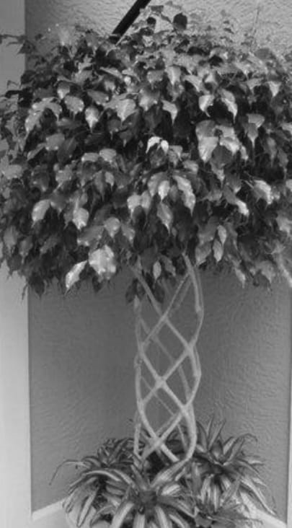
Reasons for Mind relax is the most influential reason under the first dimension
Variable PC1 PC2
Price of the cabana 0.252 0.284
Safety of a place 0.263 0.386
Nature Lover 0.206 0.218
Get a new experience 0.297 0.361
Healthy 0.273 -0.344
Space of tree cabana 0.261 -0.301
Choice of family 0.198 -0.387
Choice of fiends 0.295 -0.202
Numbers day for stay 0.272 -0.283
Nature of the trip 0.320 0.021
Mental Relax 0.307 -0.173
Easy to mediation 0.241 0.026
Mental freedom 0.215 0.082
Tree Therapy 0.305 0.274

Slide 9
Mind relaxation is the most influential reason under the first dimension
Perception towards “Tree therapy” is the second most influential reason under the first dimension
Nature of the trip is the third most influential reason under the first dimension
Safety is the most influential reason under the second dimension
Get a new experience is the second most influential reason under the second dimension

Slide 10
TITLE?
Variable Mean StDev Median
Price of the cabana 2.1923 0.9251 2.0000
Safety of a place 2.1923 0.7768 2.0000
Nature Lover 2.0962 0.8305 2.0000
Get a new experience 2.0385 0.8116 2.0000
Healthy 2.269 1.045 2.000
Space of tree cabana 2.163 1.133 2.000
Choice of family 2.1346 0.8819 2.0000
Choice of friends 1.9808 0.8474 2.0000
Numbers day for stay 2.4038 0.9606 2.0000
Nature of the trip 2.510 1.024 2.500
Mental Relax 2.346 1.189 2.000
Easy to mediation 1.7788 0.8585 2.0000
Mental freedom 2.0673 0.9166 2.0000
Tree Therapy 2.1635 0.9255 2.0000
Mean values of all the reasons are between 1.7-2.5 .
Therefore respondents valued dimensions as agree

Slide 11
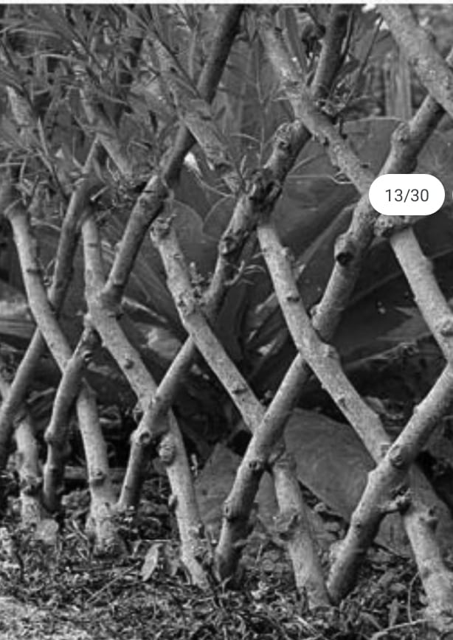
Factors affecting the choice of accommodation when going on a trip in Ingiriya area
Variable PC1 PC2
Price of accommodation place 0.303 0.450
Safety of accommodation place 0.398 0.152
Effect of family 0.366 -0.283
Effect of friends 0.368 -0.314
Numbers day for stay 0.321 0.567
Space facility 0.343 -0.519
Staying under the tree cabana 0.381 -0.014
Family Trip, Friends Trip 0.339 0.068

Slide 12
According to the PC 1 all the variables seem equally important when selecting an accommodation.
According to PC 2;
Numbers of days for stay is the most influential factor affecting the choice of accommodation when going on a trip in Ingiriya area
Price is the second most influential factor affecting the choice of accommodation when going on a trip in Ingiriya area

Slide 13
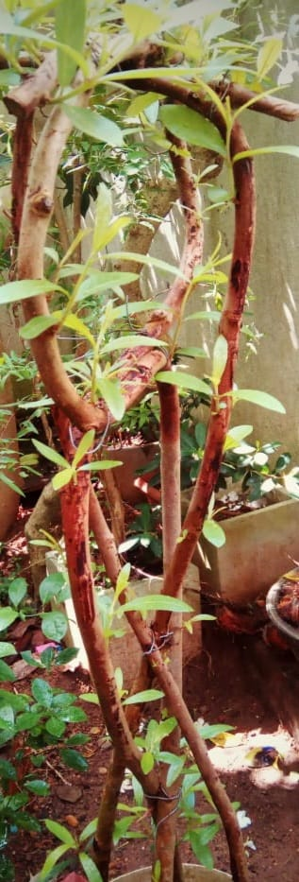
Variable Mean StDev Median
Price of accommodations place 1.9038 0.9504 2.0000
Safety of accommodation place 2.423 1.031 2.000
Effect of family 2.7788 1.0140 3.0000
Effect of friends 2.702 1.261 2.000
Numbers day for stay 2.3365 0.9513 2.0000
Space facility 2.2019 0.8855 2.0000
Staying under the tree cabana 2.423 1.040 2.000
Family trip, friends Trip 2.385 1.109 2.000
Mean values of all the reasons are between 1.9-2.7 .
Therefore respondents valued dimensions as agree.

Slide 14
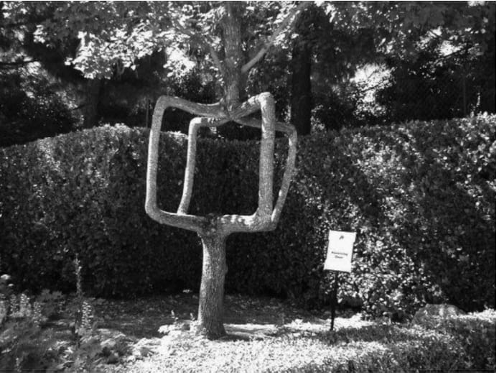
What type of attributes Applicable for Ingiriya area (Agri tourism sector)?
Variable PC1 PC2 PC3
Tourist spots are plentiful 0.233 0.308 0.454
quality environment 0.250 0.257 0.068
Wide transport 0.315 0.254 -0.002
Easy to Guide 0.120 0.246 0.597
Easy Reach Colombo 0.103 0.507 -0.384
Easily available tourist spots 0.265 0.081 -0.042

Slide 15
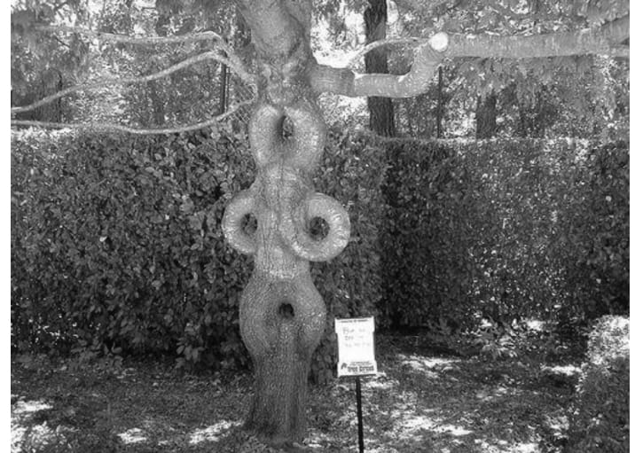
Wide transport facility is the most influential attribute under the first dimension
Easy reach to the Colombo city is the most influential attribute under the second dimension
Plentiful tourism spots are the most influential factor under the third dimension

Slide 16
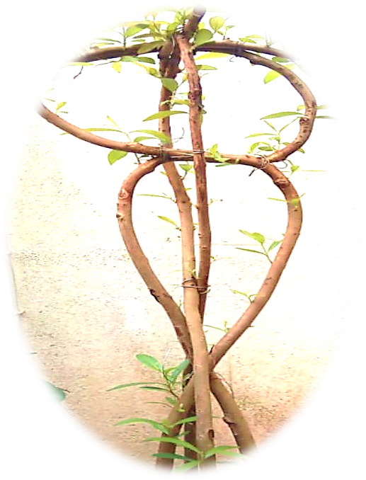
What types of issues for Ingiriya area (Agri tourism sector)
Poor accommodation 0.320 0.040 0.096
limited tourist spots 0.291 -0.274 -0.079
Minimum biodiversity 0.339 -0.219 -0.121
Limited transport 0.335 -0.155 -0.030
Limited signal for ICT 0.128 0.413 -0.482
Unavailablility of guides 0.304 -0.148 0.021
Increase population 0.291 -0.259 -0.147
No easily available T. spots 0.284 -0.207 -0.009

Slide 17
Minimum biodiversity is the most influential issue under the first dimension
Limited transport facility is the second most influential issue under the first dimension
Limited access to ICT facility is the most influential issue under the second dimension

Slide 18
Variable Mean StDev Median
Tourists spots are Plentiful 1.9231 0.8998 2.0000
Quality environment 1.9808 0.9949 2.0000
Wide Transport 1.9519 0.9071 2.0000
Easy to Guide 2.038 1.079 2.000
Easy reach Colombo 2.625 1.626 2.000
Easily available tourist spots 2.0971 0.9022 2.0000
Poor accommodation 1.9806 0.9699 2.0000
Limited tourist spots 2.510 1.149 2.000
Minimize biodiversity 2.308 1.150 2.000
Minimize transport 2.0096 0.9295 2.0000
Limited Signal 2.904 1.542 3.000
Unavailable guide 2.0769 1.0115 2.0000
Population increase 2.2212 1.0044 2.0000
No easily available T. spots 2.356 1.088 2.000

Slide 19
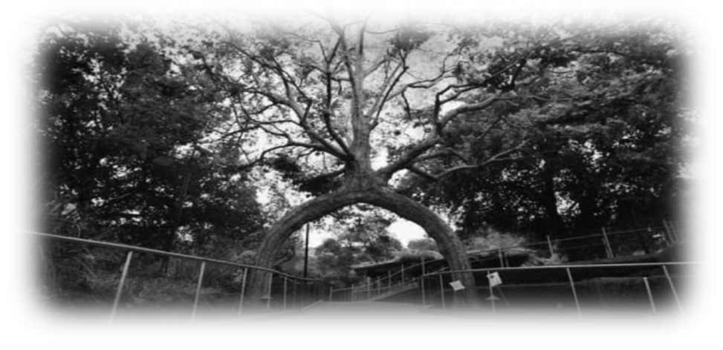
Mean values of all the attributes and issues are between 1.9-2.5 .
Therefore respondents valued dimensions as agree.

Slide 20
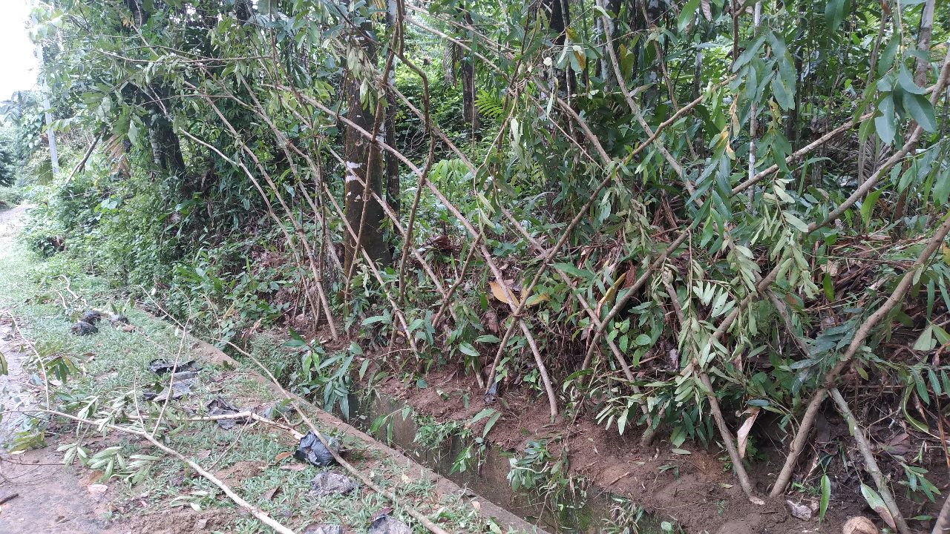
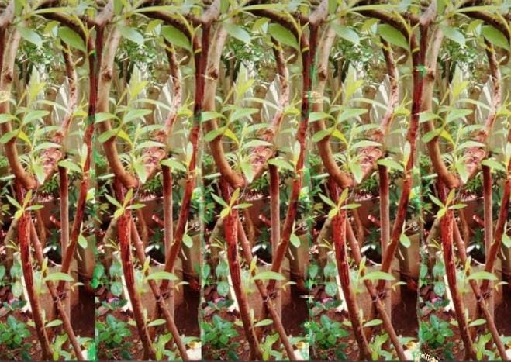
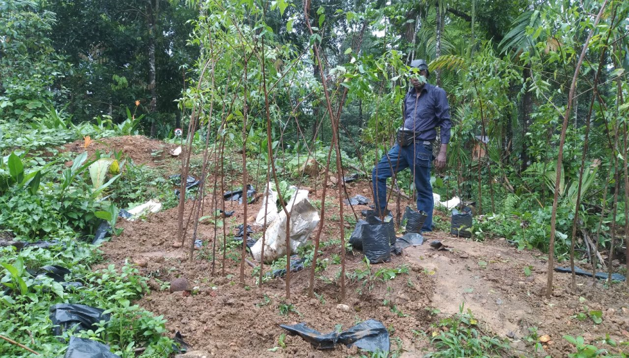
Feld trail
After about 4 months, we were able to make a very beautiful fence

Slide 21
conclusion
The factors influencing the choice of tree-shaping kabana by tourists are the mental freedom factor, i.e. H. the need to take a mental break and also the need to get nature, safety and new experiences related to the travel of tourists has a great influence on the choice of tree-shaping kabana. the reason
In this case, the main factor that must be considered when choosing a trip related to the Ingiriya area is the length (day) of stay and safety at the place of accommodation as important factors.
In addition, the main attribute when choosing a trip related to the Ingiriya region is the ability to easily provide transportation facilities, and also easy access to a large number of tourist attractions in Colombo District can be concluded as the main attribute.
Also related to Ingiriya area, minimum biodiversity is the main issue to visit and in some cases lack of transportation and lack of ICT facilities are the main issues.
Thus, in summary, in establishing tree-shaping kabana in this area, it is necessary to build a new experience for safety, price tourists, and also promote transportation facilities and ICT facilities.

Slide 22
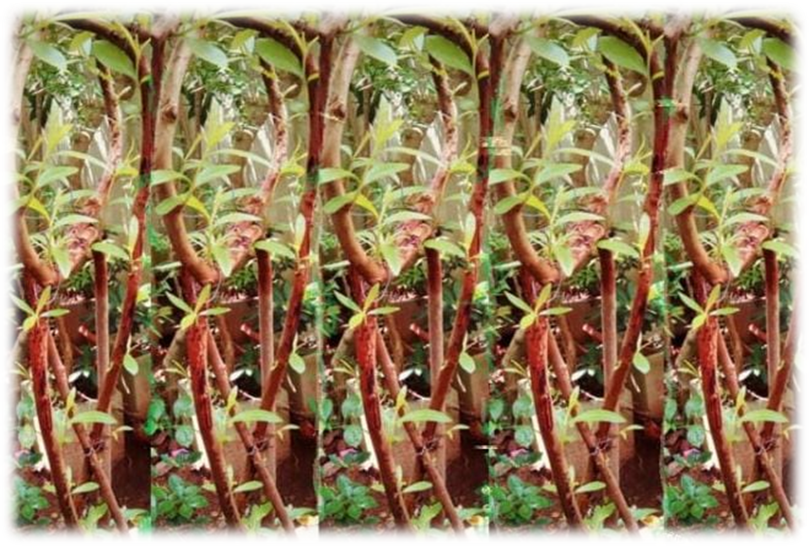
Prof. M. Amirthalingam of the C.P. Ramaswamy Environmental Education Centre says, “Research by scientists like Nayar, Ramamurthy and Agarwal suggests that the tree can absorb dust at the rate of 2.92 gm per sq.m. of leaf surface a day.” With constant trimming, the tree can be accommodated in just five sq.ft. of ground space (The hindu April 10, 2015)
Tree shaping concept is a good solution to reduce air pollution and we propose “Tree Therapy” to add values to conventional agri- tourism sector

Slide 23
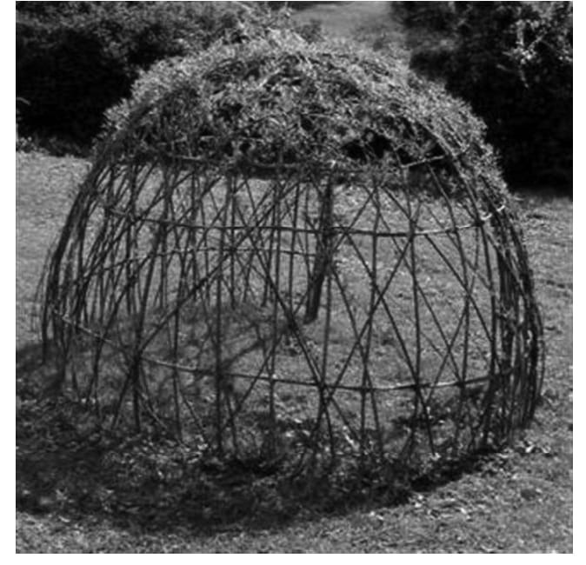
Limitation of the study
This study was conducted as a qualitative filed trial + a field survey which limits the researcher's ability to identify all the factors that can influence tourists' behavior as well as all the possibilities of the selected factors. Getting data from incoming tourists is not easy.

Slide 24
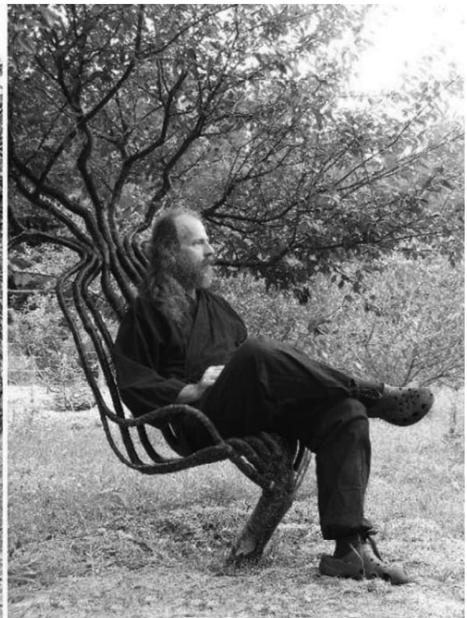
Further Research Opportunities
Through research,
According to the survey results, value addition to agro –tourism is a new opportunity in the sector to create a novel venture.
it has been possible to give a new face to the tourism industry.
Environmentally friendly and environmentally friendly.

Slide 25
References
Wicks, E . and Merrett, C. D (2003) Agritourism: An economic opportunity for Illinois.
http://www.iira.org/pubsnew/publication/IIRA- RRR-577.pdf.
S. H. P. Malkanthi1and J. K. Routry (2011) POTENTIAL FOR AGRITOURISM DEVELOPMENT: EVEDANCE FROM SRI LANKA
Rohana P Mahaliyanaarachchi (2015) Role of Agri Tourism as a Moderated Rural Business
RP Mahaliyanaarachchi, MS Elapata, M Esham(2019) Agritourism as a sustainable adaptation option for climate change
World Factbook (2011) Economy: Sri Lanka https://www.cia.gov/library/publications/theworld-factbook/geos/ce.html. Downloaded on 24th February 2011.
Alex, A. The vintage news. September 09, 2016. https://www.thevintagenews.com/2016/09/09/priorirty-focus-title-chair-grew-1903-handy-banker-trained-shaped-tree-grow-form-chairso/ (accessed January 21, 2020).
Badore, Margaret. Axel Erlandson's living Circus Tree sculptures. 02 18, 2014. https://www.treehugger.com/culture/axel-erlandsons-living-tree-sculptures.html (accessed 01 2020, 21).
Barthelemy, Daniel, and Yves Caraglio. "Plant Architecture: A Dynamic, Multilevel and Comprehensive Approach to Plant Form, Structure and Ontogeny." Annals of Botany 99, no. 3 (March 2007): 375-407.
Cook, P., and B. Northey. 3 methods of tree shaping. Dec 6, 2010. 〈http://inhabitat.com/interview-becky-northey-and-peter-pook-cook-on-the-tree-shaping-art-of-pooktre.
Godin, C, and H Sinoquet. "Functional–structural plant modelling." New Phytologist 166 (2005): 705-708.
Golan, Ezekiel. Method and a kit for shaping a portion of a woody plant in to a desired form. United States Patent US 7,328,532 B2. February 12, 2008.

Slide 26
Acknowledgement
In addition, I want to express my gratitude to my wonderful parents, brother, sister who always push me to reach my goals. Who has never left my side and for words of encouragement
And also dedicated to internal supervisor Prof A.W.Wijerathna
External supervisor Mr. M.S.T.D sumanadasa
Who has guided and Support me
Finally, I want to express my gratitude to all of my coworkers, and seniors who helped me complete this report effectively

Slide 27
Thank You

