Slide 1
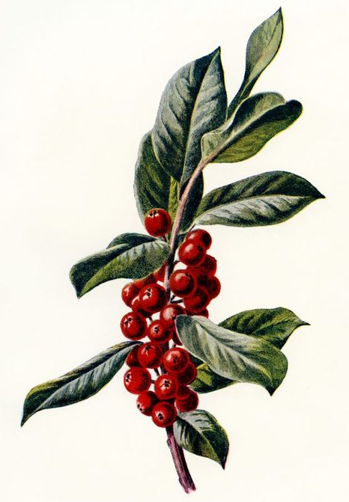
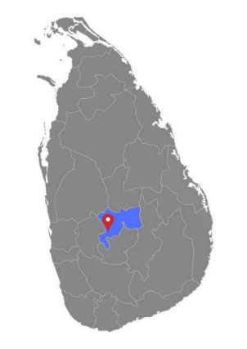
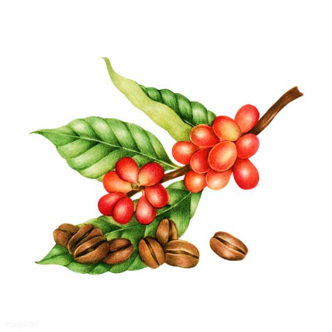
Factors Affecting Smallholder Coffee Production: A Study
in Kandy District, Sri Lanka
G.P. Darshani^{1*}, A.M.S.M.R.S.G. Bandara¹, P. Wattage¹
¹Department of Agribusiness Management, Faculty of Agricultural Sciences, Sabaragamuwa University of Sri Lanka
Introduction
With the re-emergence of coffee farming, coffee can be a significant source of export earnings to the Sri Lankan economy.
According to (MDF, 2020) most of the coffee is grown in the central highlands of Sri Lanka and there are approximately 5600 smallholder coffee farmers.
This study was focused on determining the factors affecting smallholder coffee production in Kandy district and to identify the problems faced by smallholder coffee producers.
Table 1: Coefficients
Model |  | Under standardized Coefficients |  | Std. Coefficients Beta | t | Sig.
1 |  | B | Std. Error
 | (Constant) | -199.705 | 108.643 |  | -1.838 | .068
 | Annual coffee income | .003 | .000 | .674 | 26.685 | .000
 | Land Capacity | 165.114 | 32.969 | .095 | 5.008 | .000
 | Number of coffee trees | .581 | .050 | .276 | 11.572 | .000
 | Harvesting at right stage | 74.220 | 34.110 | .031 | 2.176 | .031
Objectives
- To identify the effect of socio demographic factors on coffee production.
- To identify the impact of farm characteristics on coffee production.
- To find out the impact of production factors on coffee production.
- To find the impact of marketing factors on coffee production.
- To identify the constraints faced by coffee farmers in Kandy.
Results of the study
1 - 4 objectives,
- Based on survey data there were four independent variables were statistically significant for coffee production in Gampola, Kandy district.
- According to the regression results (Table 1), annual coffee income, land capacity, number of coffee trees and harvesting at the right stage had unstandardized coefficient respectively 0.003, 165.114, 0.581 and 74.220.
- Moreover, all these factors were positively affected the coffee production.
Regarding to the 5th objective,
- Coffee farmers were mainly constrained with labour supply, provision of capital and climate changes. They were further challenged by the market access issues and lack of technology.
Materials & Methods
- Research Location:
Gampola area, Kandy District
- Sample size:
139 Responders
- Sampling Method:
Simple random sampling technique
- Analyzing Method
Multiple linear regression
Fig 1: Research Location
Conclusion
It was further revealed that farmers were using stripping techniques to harvest coffee berries. As a result, the quality of the coffee beans was affected negatively.
The severe damage caused by monkeys during harvest was another problem that was revealed from the study.
As identified, government and other concerning bodies should give emphasis and encouragement to harvest at the right stage of coffee berries.
As well as it is recommended to establish a reliable, fair, and transparent price regulation between small holder coffee farmers and intermediaries.
Market Development Facility, 2020. Arabica Coffee value chain analysis, s.l.: s.n.
Bekele, A. & Guadie , T., 2020. Multiple Linear Regression Analysis on Factors Affecting Coffee Production in Bench-Shako Zone: In Case of Mizan-Aman District, Southwest Ethiopia. Advances in Bioscience and Bioengineering, pp. 24-30.
Agricultural Sciences Undergraduate Research Symposium 2023
Sabaragamuwa University of Sri Lanka

