Slide 1
Encourage Synchronize Flower Bud Initiation of Soursop (Annona muricata L.) by Using Synthetic Plant Growth Regulators
JCD Dinesh^{1*}, M Bulathkandage², GAH Galahitigama¹
1Department of Export Agriculture, Faculty of Agricultural Sciences, Sabaragamuwa University of
Sri Lanka, Belihuloya, Sri Lanka
2Fruit Research and Development Institute, Horana, Sri Lanka

Slide 2
Content for the presentation
Introduction
Objectives
Material and Methods
Results and Discussion
Conclusion and Recommendations
References

Slide 3
Introduction
The flower of soursop is hermaphroditic and protogynous; therefore, self-pollination is prevented. Due to the protogynous nature and low population density, fruits set up of natural pollination is deprived and There is no significant genetic difference between soursop plants (Pinto et al., 2005)
Soursop is an emerging fruit with higher commercial value in Sri Lanka. Demand for fresh fruit in domestic and overseas markets has been increasing since after discovering its medicinal importance (Coêlho de lima et al., 2011)

Slide 4
Objectives
Main objective
To Encourage synchronize flower bud initiation of Soursop (Annona muricata L.) by using synthetic plant growth regulators
Specific objectives
To study the impact of synthetic plant growth regulators on flower opening of Soursop
To examine the synthetic plant growth regulators on pollen viability of Soursop

Slide 5
Material and Methods
Experiment location
The experiment was conducted at Fruit Research and Development Institute, Horana
Experimental unit
All most evenly grown 5 years old plants selected
Experiment design
Randomized complete block design (RCBD) with three replicates

Slide 6
Material and Methods cont.…..
Experiment layout

Slide 7
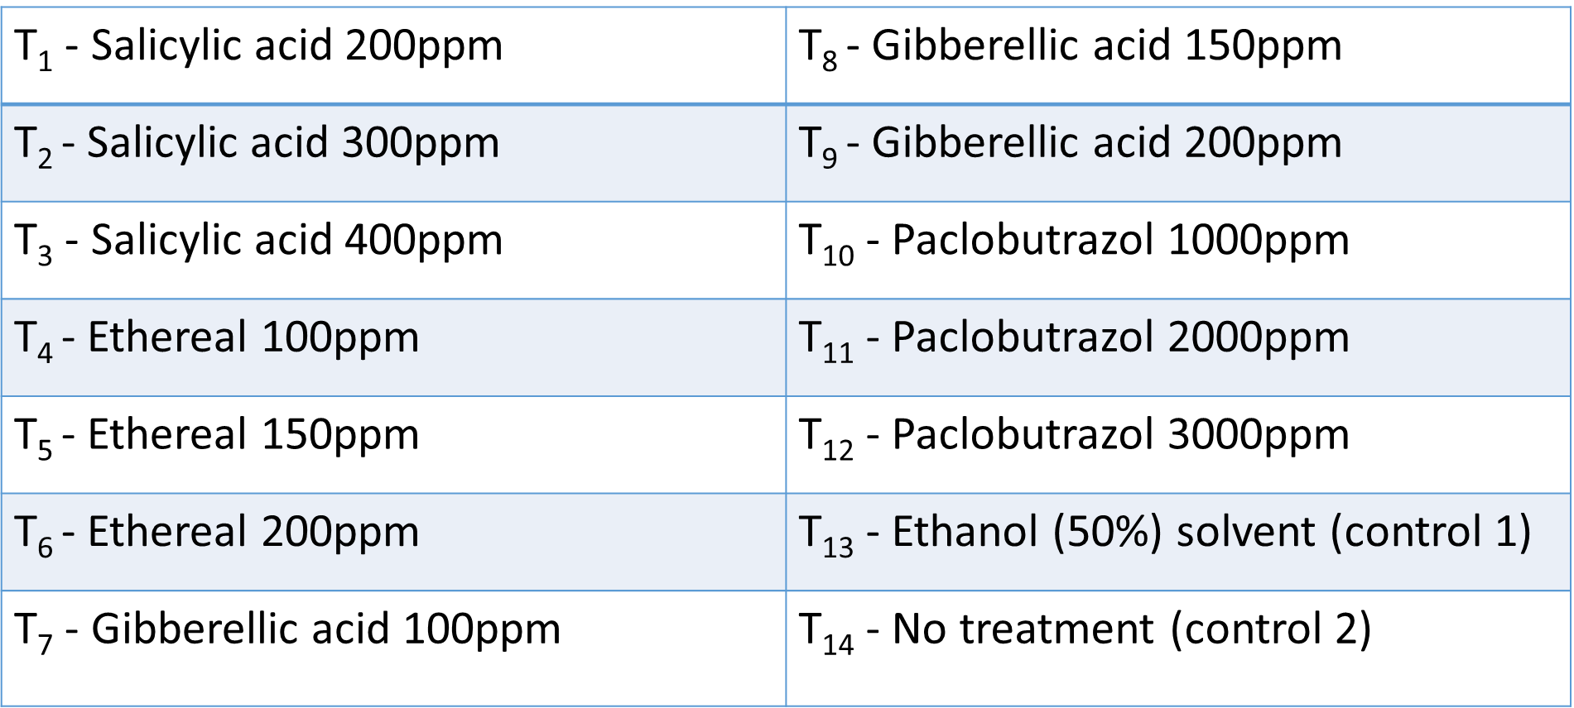
Material and Methods cont.…..
Treatments

Slide 8
Material and Methods cont.…..
Data collection
45 days after treatment application, the initiated flower bud count was taken; after that, every week newly initiated flower number was counted
Hypothesis
H0 - there is no effect on synthetic plant growth regulators on synchronize flower bud initiation
H1 - there is an effect on synthetic plant growth regulators on synchronize flower bud initiation

Slide 9
Material and Methods cont.…..
Data analysis
All the data were analysed by using SAS version.9.1 and graphical illustrations were done by Microsoft Excel 2016
Kruskal-Wallis test
ANOVA
Mean separation - Tukey test

Slide 10
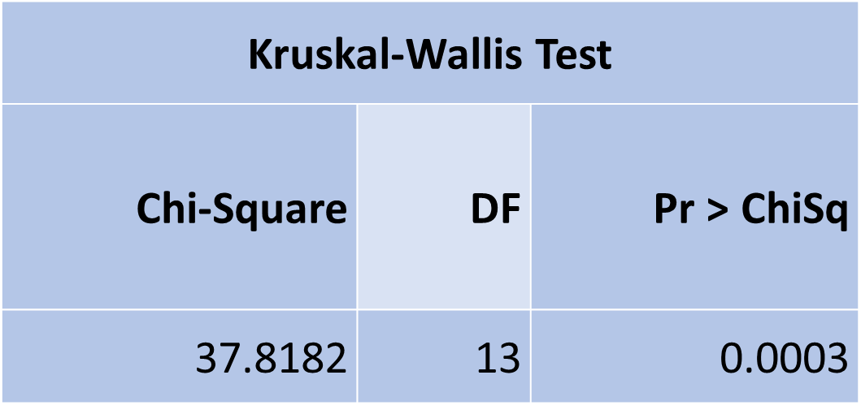
Results and Discussion
Impact of treatment on synchronised flower bud initiation (2nd week )
P-value 0.0003 < 0.05, the null hypothesis (Hₒ) is rejected, so there is an effect on synthetic Plant Growth Regulators on Synchronize Flower Bud Initiation

Slide 11
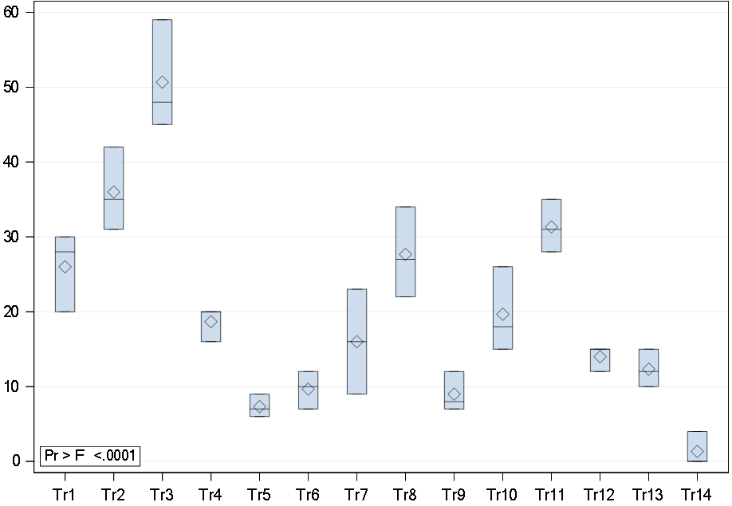
Results and Discussion cont.…..
T1 - Salicylic acid 200ppm
T2 - Salicylic acid 300ppm
T3 - Salicylic acid 400ppm
T4 - Ethereal 100ppm
T5 - Ethereal 150ppm
T6 - Ethereal 200ppm.
T7 - Gibberellic acid 100ppm
T8 - Gibberellic acid 150ppm
T9 - Gibberellic acid 200ppm
T10 - Paclobutrazol 1000ppm
T11- Paclobutrazol 2000ppm
T12 - Paclobutrazol 3000ppm
T13 - Ethanol (50%) solvent (control 1)
T14 - No treatment (control 2)
Distribution of the number of flower buds
Numbers of flowers
Treatment

Slide 12
Results and Discussion cont.…..

Slide 13
Results and Discussion cont.…..
Impact of treatment on synchronised flower bud initiation (1st week )
Source | DF | Sum of Squares | Mean Square | F Value | Pr > F
Model | 15 | 63.084 | 4.206 | 6.03 | <.0001
Treatment | 13 | 62.597 | 4.815 | 6.90 | <.0001

Slide 14
Impact of treatment on flower bud initiation (1st week)

Slide 15
Impact of treatment on synchronised flower bud initiation(2nd week )

Slide 16
Impact of treatment on flower bud initiation (2nd week)

Slide 17
Impact of treatment on synchronised flower bud initiation(3rd week )

Slide 18
Impact of treatment on flower bud initiation (3rd week)

Slide 19
Impact of synthetic growth regulators on pollen viability
Source | DF | Type I SS | Mean Square | F Value | Pr > F
trt | 13 | 3.80952381 | 0.29304029 | 0.31 | 0.9856
P-value was 0.9856 > 0.05, so the null hypothesis (Hₒ) is accepted, which means there is no significant effect of the chemical on pollen viability.

Slide 20
Impact of treatment on pollen viability

Slide 21
Impact of synthetic growth regulators on stigma size
Source | DF | Type I SS | Mean Square | F Value | Pr > F
trt | 13 | 0.01809524 | 0.00139194 | 1.17 | 0.3496
P-value was 0.3496 > 0.05, so the null hypothesis (Hₒ) is accepted, which means there is no significant effect of the chemical on stigma size.

Slide 22
Impact of treatment on stigma size

Slide 23
According to the literature………..
It is possible that salicylic acid influences other plant hormones, which are crucial for maintaining the auxin, cytokinin, and ABA balances (Shakirova, 2007).
Furthermore, salicylic acid has been used as a chelating agent for flower initiation (Martin et al., 2008).
There is a relationship between salicylic acid and flowering activity in the plant. For example, Jin et al., 2008 reported that induction is carried out by the SUMO E3 ligase, which suppresses the expression of the flowering locus.
In addition, salicylic acid boosts CO2 assimilation; consequently, the photosynthetic rate and mineral intake have been increased (Karlidage et al., 2009).

Slide 24
Conclusion and Recommendations
CONCLUSION
Results generated from this study revealed that foliar application of salicylic acid 400ppm solution has a promising impact of encouraging synchronized flower bud initiation of soursop two months after the application. There is no effective treatment for stigma size pollen viability and date of flower maturity (all matured 32 days after initiation).

Slide 25
Recommendations
This experiment must be undertaken until the fruit is developed, and repeated for another few seasons is a must. Conducting this experiment in all agroecological zones in Sri Lanka is essential.

Slide 26
References
Baba, T.R., Ali, A., Kumar, A. and Husain, M., (2017). Effect of exogenous application of salicylic acid and triacontanol on growth characters and yield of strawberry, Pharma Innovation Journal 2017; 6(11): 274-27
Bulathkandage, M., Eeswara, J.P., Madugith, T., Gunawardena, R., Dinesh, J.D.C. and Jayapal, R. (2019). Determination of harvesting indices and harvesting stage of Annona muricata L. (Sour soup) based on fruit growth. Annual Symposium of Department of Agriculture, Volume 21, Page 10.
Coêlho de lima, M.A. and Alvis, R.E., (2011) Soursop (Annona muricata L.), Brazilian Agricultural Research Corporation, Brazil.
El-Korany, A.E. and R.A. Mohamed., (2008). The use of antioxidants controls grey mould and enhances strawberry yield and quality. J. Agric. Env. Sci. Alex. Univ. Egypt. 7(1):1-38
Farooqi, A.A. Parvatikar, S.R. and Nalawadi, U.G. (1970). Preliminary studies on the problem of fruit set in Annona reticulate L. Mysore Journal of Agricultural Sciences. 4(1):44-53.

Slide 27
Heenkenda, H.M.S., Pushpakumara, D.K.N.G., Ranil, R.H.G. and Thantirige, M.K. (2011). Chapter 9: Annona, Annona species. In: Pushpakumara, D.K.N.G., Gunasena, H.P.M. and Singh, V.P. (eds) Underutilized fruit trees in Sri Lanka. Volume 2.
Jin JB, Jin YH, Lee J (2008). The SUMO E3 ligase, AtSIZ1, regulates flowering by controlling a salicylic acid-mediated floral promotion pathway and through effects on FLC chromatin structure. Plant Journal 53, 530–540
Karlidag H.; Yildirim E. and Turan M., (2009). Salicylic acid ameliorates the adverse effect of salt stress on strawberries. Sci Agric, 66: 180-187. Doi:10.1590/S0103-9016200900020000
Masarirambi, M. T., Shongwe, V. D., Chingwara, V., (2010). The effect of GA3 and ethephon on synchronization of coffee (Coffea arabica L.) flowering and berry ripening. Department of Horticulture, University of Swaziland, P.O. Luyengo, Swaziland.
Pinto, A. C. de Q., Cordeiro, M. C. R., de Andrade, S. R. M., Ferreira, F. R., Filgueiras, H. A. de C., Alves, R. E. and Kinpara, D. I., (2005). Annona species, International Centre for Underutilized Crops, University of Southampton, Southampton, U.K.

Slide 28
Shakirova F.M., (2007). Role of the hormonal system in manifesting growth promoting and anti-stress action of salicylic acid. In: Hayat S. and Ahmad A (eds) Salicylic Acid, A Plant Hormone, Springer, Dordrecht, Netherlands, p:69-90. Doi:10.1007/1-4020-5184-0
Tongumpai, p., Hongsbhanich, N. and Hoi, V.C., (1989).’ Culture for flowering regulation of mango in Thailand. Acta horticulturae.239: 17-20.
Venkataraman, R., Seth, P.N. and Maheswari, S.C., (1970). Studies on the growth and flowering of a short-day plant.

Slide 29
Thank You

Slide 30
Tests for Normality
Test | Statistic |  | p Value
Shapiro-Wilk | W | 0.97976 | Pr < W | 0.0559
Kolmogorov-Smirnov | D | 0.06394 | Pr > D | >0.1500
Cramer-von Mises | W-Sq | 0.06444 | Pr > W-Sq | >0.2500
Anderson-Darling | A-Sq | 0.60411 | Pr > A-Sq | 0.1166

Slide 31
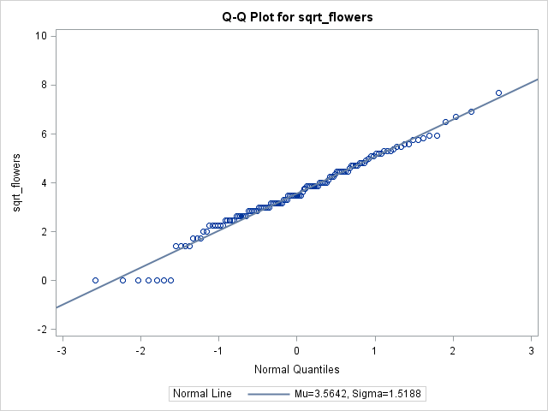

Slide 32
Calculate ppm
Ethereal 40% (E)
T4 – 0.25ml/l
T5 – 0.5ml/l
T6 – 0.75ml/l
Salicylic acid 100% (S.A.)
T1 - 0.2g
T2 - 0.3g
T3 - 0.4g
Dissolve in 100% ethyl Alcohol and add distilled water to tied up
Gibberellic (100%) (GA3)
T7 – 0.1g
T8 – 0.15g
T9 – 0.2g
Dissolve in 50% ethyl Alcohol and add distilled water to tied up
Paclobutrazol (20%) (P)
T10 – 5g/m
T11 – 7g/m
T12 – 9 g/m
Graeme amount × canopy length as meters
E.g.: - 3m canopy T10 plant 5g × 3m = 15g/m

Slide 33
