Slide 1
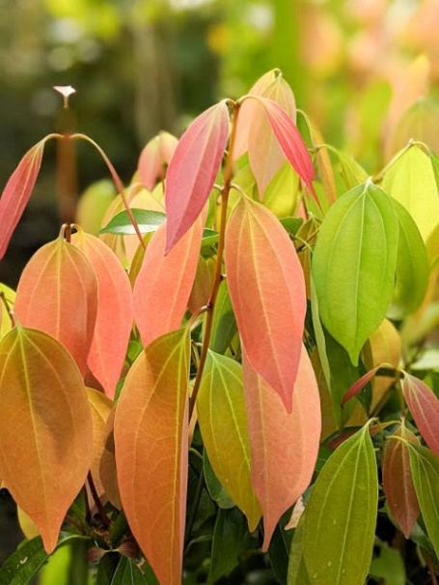
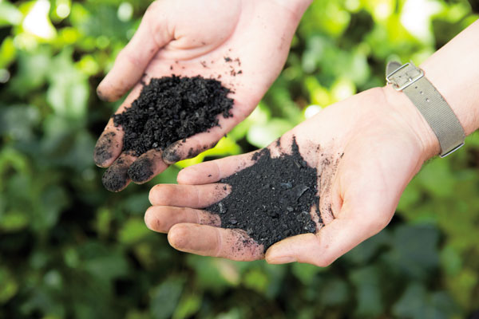
Nutrient Exchange by Cinnamon (Cinnamomum zeylanicum Blume) Wood Biochar as Affected by the Methods of Preparation
H.M.A.S.U. Wijayasundara
16AGA1313
Module Agri Environmental Resource Managent
Department of Export Agriculture
Faculty of Agricultural Sciences
Sabaragamuwa University of Sri Lanka
Internal Supervisor:
Prof. P.I. Yapa
Department of Export Agriculture
Faculty of Agricultural Sciences
Sabaragamuwa University of Sri Lanka
External Supervisor:
K.H.G.M. Tharanga
Assistant Director (Research)
Soil and Plant Nutrient Division
National Cinnamon Research and Training Center

Slide 2
Content for the presentation
Introduction
Objectives
Material and Methods
Results and Discussion
Conclusion and Recommendations
References

Slide 3
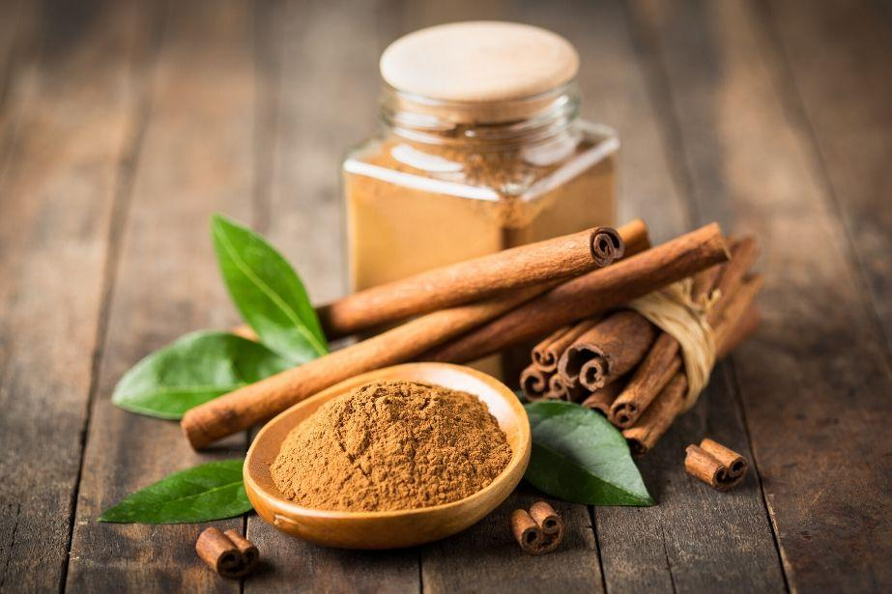
Introduction
Ceylon cinnamon – Cinnamomum zeylanicum Blume
Family – Lauraceae
One of the most economically important, perennial spice crop.
Sri Lanka is the world true cinnamon producer and exporter.
Cinnamon wood remain as residue in most parts of the country and cinnamon wood is available year-round as byproduct.

Slide 4
Research problem
Chemical fertilizer use in many agricultural lands under conventional farming is not cost-effective.
After peeling, cinnamon wood remains as residues in this industry. Cinnamon sticks mostly use as firewood ever since in Sri Lanka.
Preparation biochar using cinnamon wood can be used as value added product.
Farmers have not enough idea about biochar preparation using cinnamon wood.
In farmer level, check the best method of biochar preparation.

Slide 5
Objective
To study the effect of different methods of biochar preparation using cinnamon wood in relation to nutrient exchange properties.

Slide 6
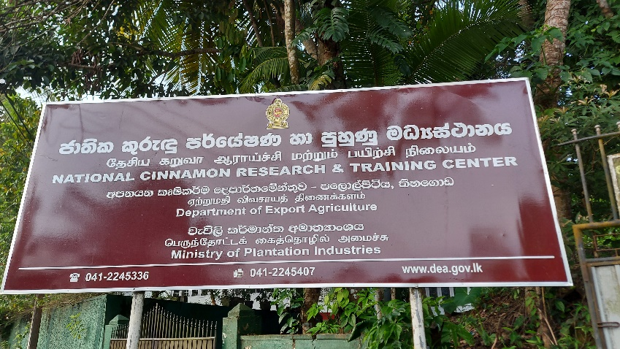
Material and Methods
Experimental Location
The experiment was conducted in Soil and Plant Nutrition division of National Cinnamon Research and Training center of the Department of Export Agriculture, Palolpitiya, Thihagoda, Matara.
Experimental Design
The study was arranged into a Complete Randomized Design (CRD) With six treatment and three replicates.

Slide 7
Treatments

Slide 8
Biochar preparation methods

Slide 9
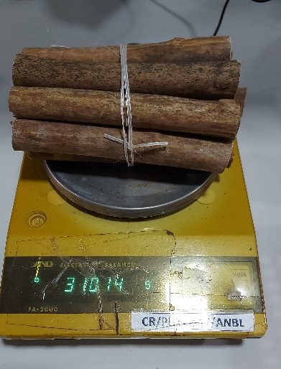
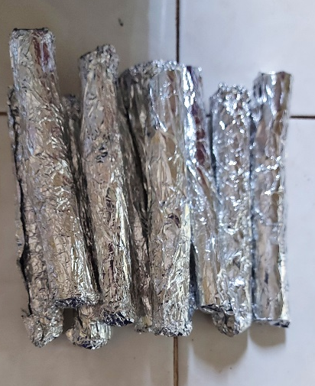
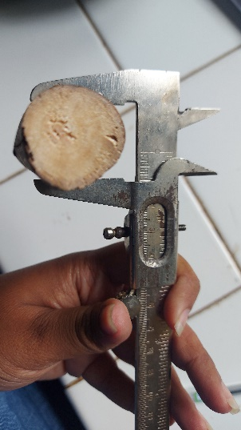
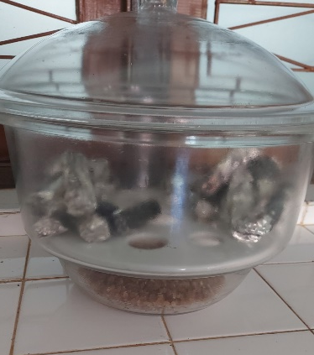
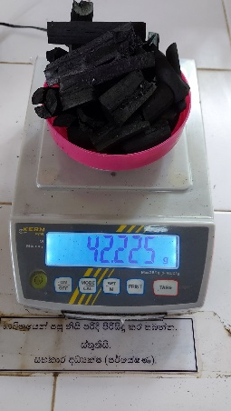
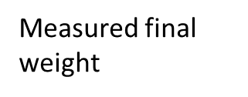
Muffle Furnace method at 600 ̊C, 1hour
Feedstock was cut into 6 inch pieces using a saw.
Diameter of each sticks was measured and initial weight was measured.
Each 6 inch piece was wrapped by aluminum foil and 10 pieces were kept for one time in muffle furnace and burned it under 600 ̊C in 1 hour.
Then burned wood pieces were kept in desiccator.
finally, final weight was measured.
Wrapped by using aluminum foil
Measured the diameter
Measured the initial weight
Put into muffle furnace
Kept in desiccator
9

Slide 10
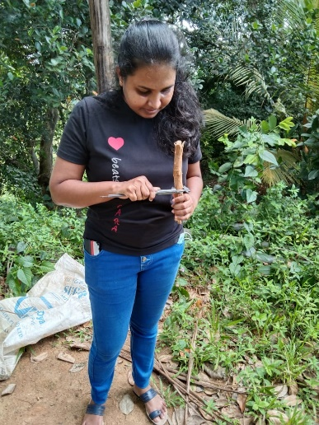
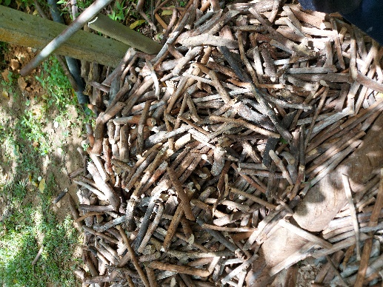
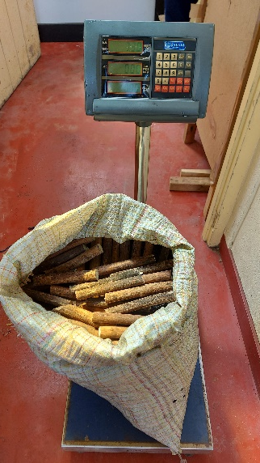
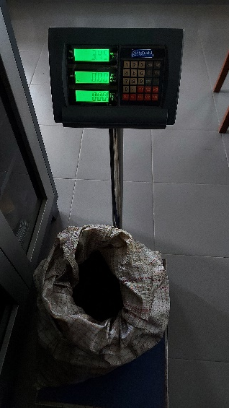
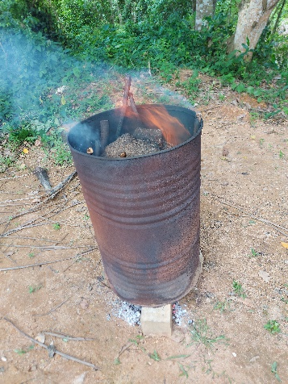
Double barrel method at 70min & 90min
Feedstock was cut into pieces using knife.
Then diameter and length were measured randomly selected wood pieces using vainer caliper and ruler.
Initial weight was measured.
16kg of sticks were filled into the inner barrel and then it was sealed.
Outer barrel was filled with 15kg and 25kg of sticks.
then sticks of outer barrel were burned about 70min and 90min.
Finally, final weight was measured.
Cinnamon wood feedstock
Measured diameter and length
Measured initial weight
Measured final weight
Double barrel method
10

Slide 11
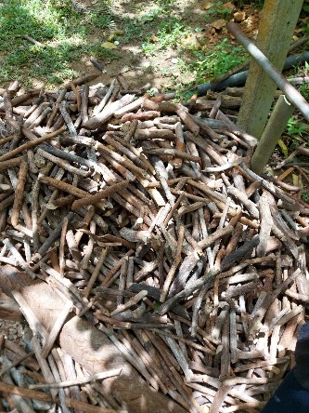
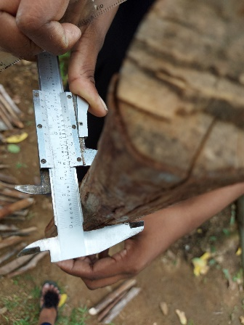
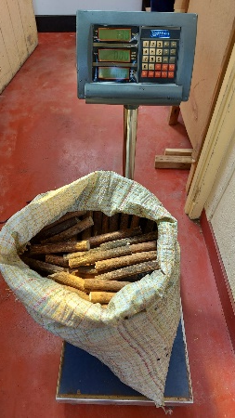
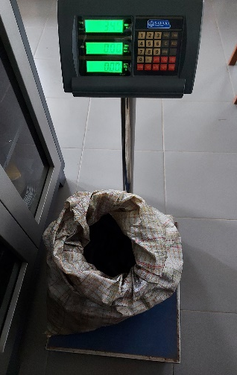
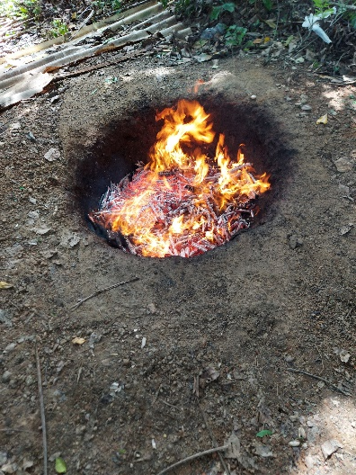
Cone pit method at 50min & 70min
Feedstock was cut into pieces using a knife.
Then diameter and the length were measured randomly selected wood pieces using Vernier caliper and ruler.
Initial weight was measured.
Pit was filled with cinnamon wood pieces and burned them about 50min & 70min.
Finally, final weight was measured.
Cinnamon wood feedstock
Measured the diameter & length
Measured initial weight
Measured final weight
Burned the cinnamon wood pieces

Slide 12
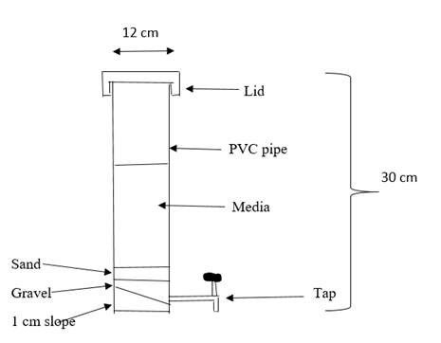
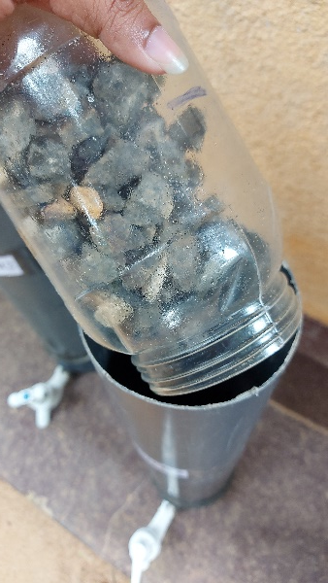
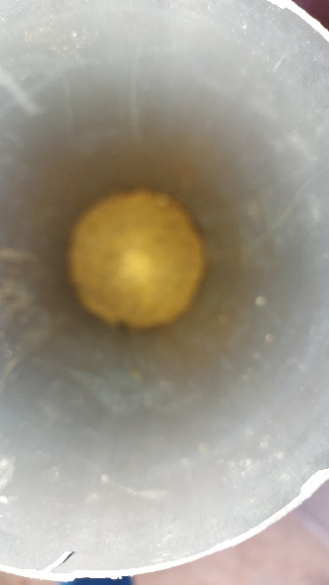
Column preparation
18 columns were prepared using PVC pipe.
A nylon mesh (1mm²) was placed on bottom of the PVC column.
Then 5cm of gravel and 5cm of sand layer were filled to the bottom of each column respectively.
Gravel filled into the column
Sand filled into the column

Slide 13
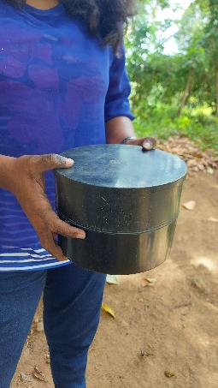
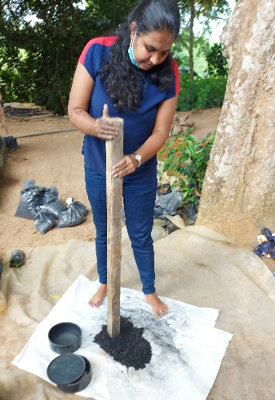
Media preparation
Preparation of subsoil
Subsoil was air dried and sieved by using 2mm sieve.
Preparation of biochar
Prepared biochar materials were grinded and sieved by 2mm sieve.
Sieved by 2mm sieve
2mm sieved subsoil
Biochar was grinded
Sieved by 2mm sieve
2mm sieved biochar

Slide 14
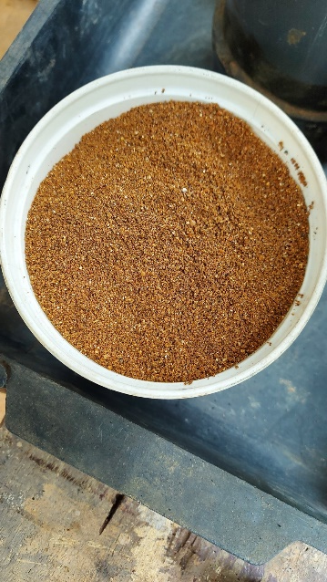
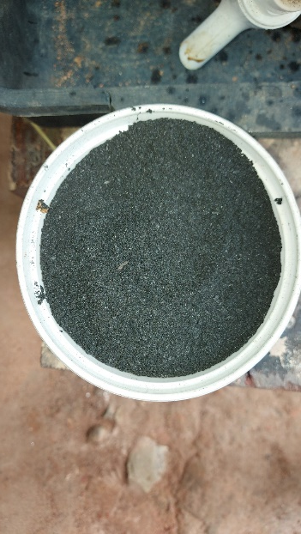
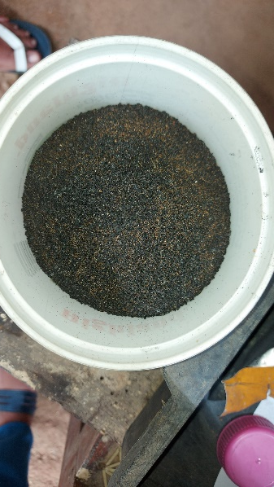
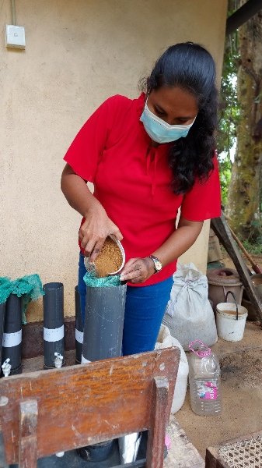
Media filling
2mm sieved subsoil was filled into 3 columns as a control.
Then 2mm sieved subsoil and 2mm sieved biochar materials that was prepared by using different methods were mixed and filled into the other columns in equal volume according to volume basis.
1 cup of subsoil
1 cup of biochar
Media (subsoil + biochar)
Media filling

Slide 15
Experimental procedure
Get initial sample to test chemical properties of the media
water was added to the media until it saturate and kept 24 hours
water was leached and measure the volume of each leachate
nutrient solution (20% Urea + 10% TSP + 10% MOP) was applied into the each columns with application rate of 600 ml

Slide 16
Top of the columns were covered using polythene to avoid the external disturbance
leachate was collected by using measuring cylinder and the volume was recorded
1L of water was filled and drain out after 24 hours
It was continuously done 2 month period and every 8days interval samples taken for the analysis

Slide 17
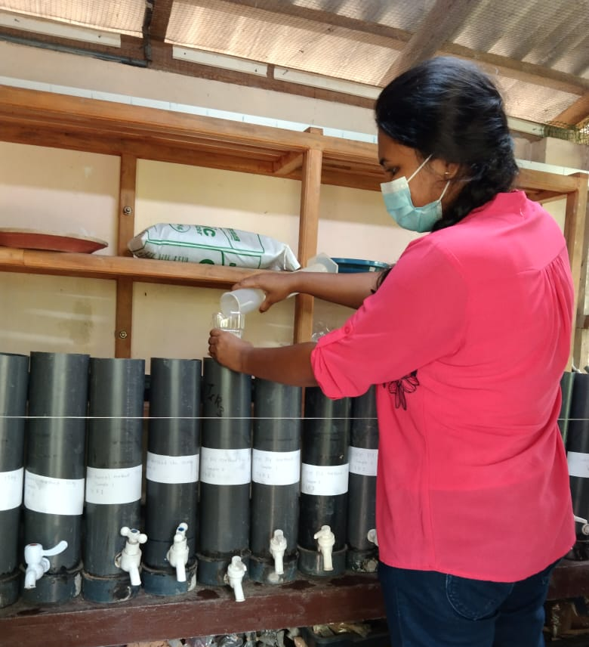
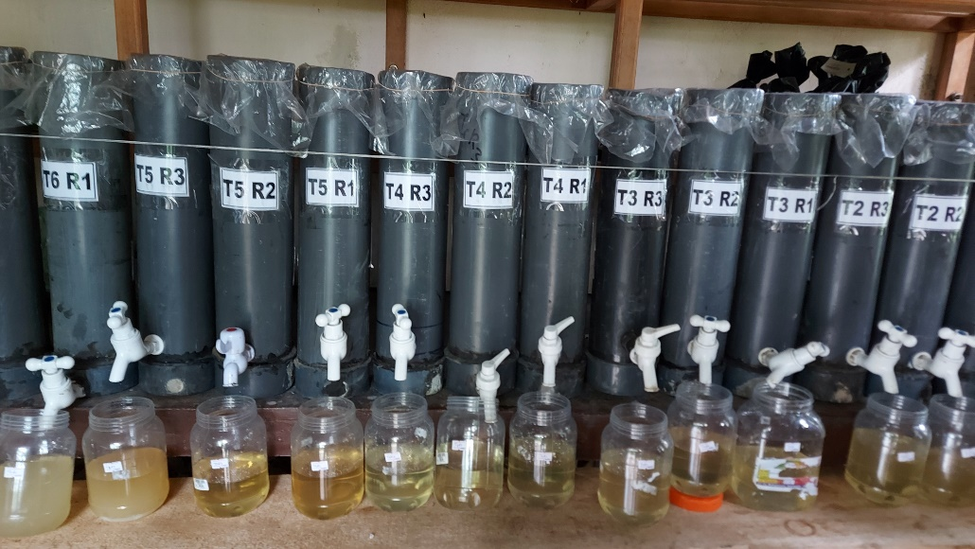
Data collection
The experiment was started on august, 2022 then each media samples in PVC pipe was collected for initial analysis.
Then nutrient solution was leached after water filling day and every 8 days interval leachate solution samples were collected for the analysis.
Finally, the experiment was finished on November, 2022 then each media samples in columns was collected for analysis.
Water was added
Leachate was collected

Slide 18
Initial and final media analysis
Total Nitrogen
By Kjeldahl method (Bremner and Mulvaney,1982)
Available Potassium
By Flame photometer(Black, 1965)
Available Phosphorus
By Olsen method (Olsen, et al., 1954)
pH
pH meter(Rimmer and Rodwell, 1995)
Electrical Conductivity (EC)
By Electrical Conductivity meter (Black, 1965)

Slide 19
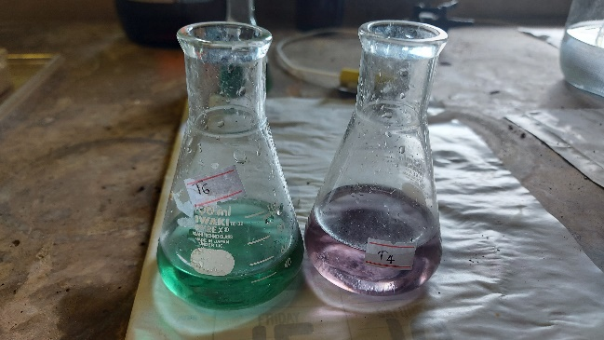
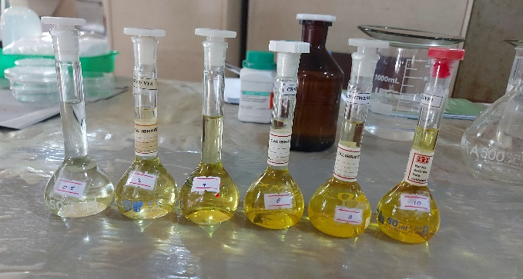
Leachate analysis
Total Nitrogen
By Kjeldahl method
Total Potassium
By acid digestion and read Flame photometer
Total Phosphorus
By acid digestion and read spectrophotometer
pH
By pH meter
Electrical Conductivity (EC)
By Electrical Conductivity meter

Slide 20
Data analysis
Data was analyzed using one way ANOVA.
Graphical illustrate was done by Microsoft Excel 2016.

Slide 21
Results and Discussion
Biochar and Nitrogen leaching

Slide 22
Biochar and leaching of Phosphorus

Slide 23
Biochar and leaching of Potassium

Slide 24
Biochar and pH in leachate

Slide 25
Biochar and Electrical Conductivity of leachate

Slide 26
Comparison of total nitrogen in initial and final media (mg/kg)

Slide 27
Comparison of available phosphorus in initial and final media (mg/kg)

Slide 28
Comparison of available potassium in initial and final media (mg/kg)

Slide 29
Comparison of pH in initial and final media

Slide 30
Comparison of Electrical Conductivity (EC) in initial and final media (dS/m)

Slide 31
Conclusion
Nitrogen lose from the soil can dramatically be reduced by treating the soil with Biochar in general.
Biochar produced using double barrel method is among the best in terms of nitrogen retention in the soil.
Phosphorus was lost in most treatments, but available phosphorus has in double barrel method 90 minutes in final media.
In addition to the retention of N, P and K, biochar also contributes P and K to the soil.

Slide 32
Recommendations
Further studies are needed to understand the long term effect of cinnamon wood biochar preparation methods on nutrient retention.
Further studies need to be carry out using mixtures of biochar produced from different raw materials and pyrolysis temperatures.

Slide 33
References
Black, C., 1965. Methods of soil analysis part 1, Madison,Wisconsin.USA:Am.Soc.Agron.Inc.Publi.
Bremner, J.M. and Mulvaney, C.S. (1982) Nitrogen-Total. In: Methods of soil analysis. Part2. Chemical and microbiological properties, Page, A.L., Miller, R.H. and Keeney, D.R. Eds.,American Society of Agronomy, Soil Science Society of America, Madison, Wisconsin,595-624.
Department of Export Agriculture. (2022). Cinnamon. Retrieved form
Fonseka, D. L. C. ., Aluthgamage, H. and Wickramaarachchi, W. W. U. I. (2018) ‘Present Situation of Cinnamon Industry in Southern Sri Lanka’, Int. J. Curr. Res. Biosci. Plant Biol., 5(8), pp. 63–70. doi: 10.20546/ijcrbp.2018.508.009.
Jayasanka, D. J., Jayasinghe, G. Y. and Maheepala, S. A. D. S. S. (2020) ‘Cinnamon Wood Biochar Characteristics and Application Rates Influence on Crop Growth and Properties of Problematic Soil in Southern Sri Lanka’, International Journal of Innovative Technology and Exploring Engineering (IJITEE), 9(3), pp. 30–33. doi: 10.35940/ijitee.C1006.0193S20.
Olsen, S., Cole, C., Watanabe, F. & Dean, L., 1954. Estimation of available phosphorous in soils by extraction with sodium bicarbonate. Circ. U.S. Dept., Volume 939, pp. 1 - 19.
Rimmer, D. L. and Rodwell, D. L. (1995) ‘Soil Science: Methods and Application.’, The Journal of Ecology, 83(2). doi: 10.2307/2261582.

Slide 34
Thank You

