Slide 1
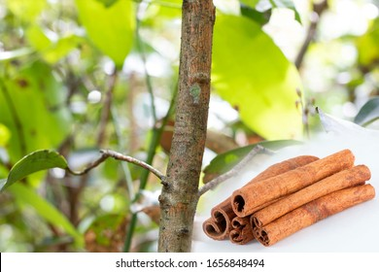
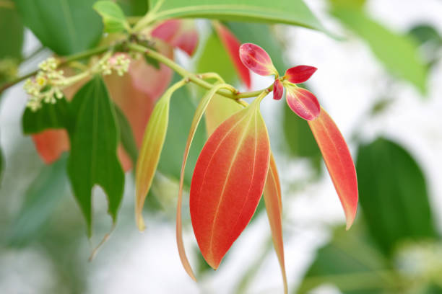
Impact of Above Ground Morphology of Cinnamon Plant on Yield and Processing: Traits desirable for Variety Improvement
K.P.S.Sewwandi (16AGA 1303)
Module: Crop Production Technology
Department of Export Agriculture
Faculty of Agricultural Sciences
Sabaragamuwa University of Sri Lanka

Slide 2
Content
Introduction
Objectives
Methodology
Results and discussion
Conclusions
Suggestions
References
Acknowledgement

Slide 3
Introduction
Ceylon cinnamon or True cinnamon known as Cinnamomum zeylanicum Blume
Native to Sri Lanka
Major export crop which contributes largely to the Sri Lankan economy
Ex: Approximately Rs. 45 ,000 million income generated in 2021
(Source; Annual performance report -2021, Department of Export Agriculture)
Potential annual yield 1500 kg/ha
Actual annual average yield 500 kg/ha (Aluthgamage et al., 2021)

Slide 4
Objectives
Main objective
To study the effect of morphological characteristics of cinnamon on bark yield
Specific objectives
To determine the relationship between stem characteristics with peeling time and yield
To develop best maturity stage in relation to morphological characteristics as a desirable trait for varietal improvement

Slide 5
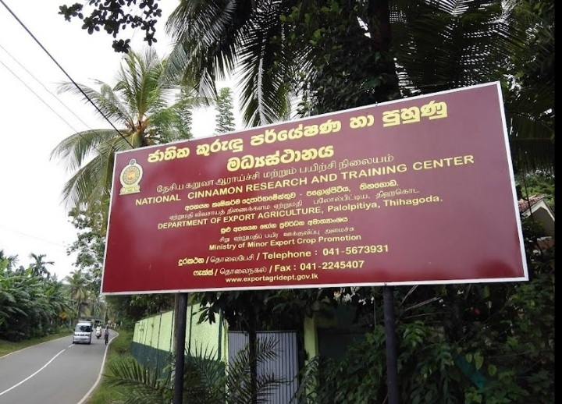
Methodology
Experiment location
National Cinnamon Research and Training Center (NCRTC), Department of Export Agriculture, Palolpitiya, Thihagoda, Matara

Slide 6
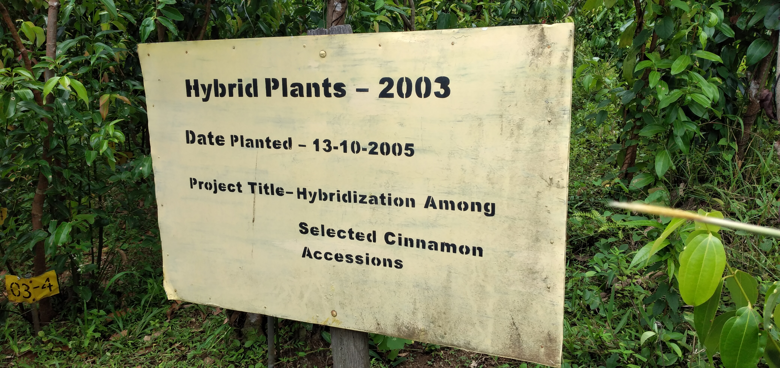
Experimental unit
Methodology cont...
Cinnamon plants /accessions of a hybrid progeny were used for the experiment
Figure 1 Planting material for the research

Slide 7
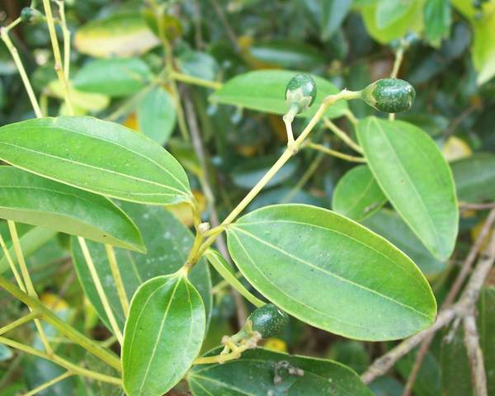
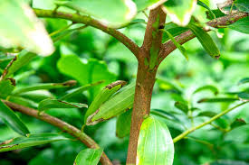
Evaluation of morphological characters
Methodology cont.…
Leaf characters
Stem characters

Slide 8
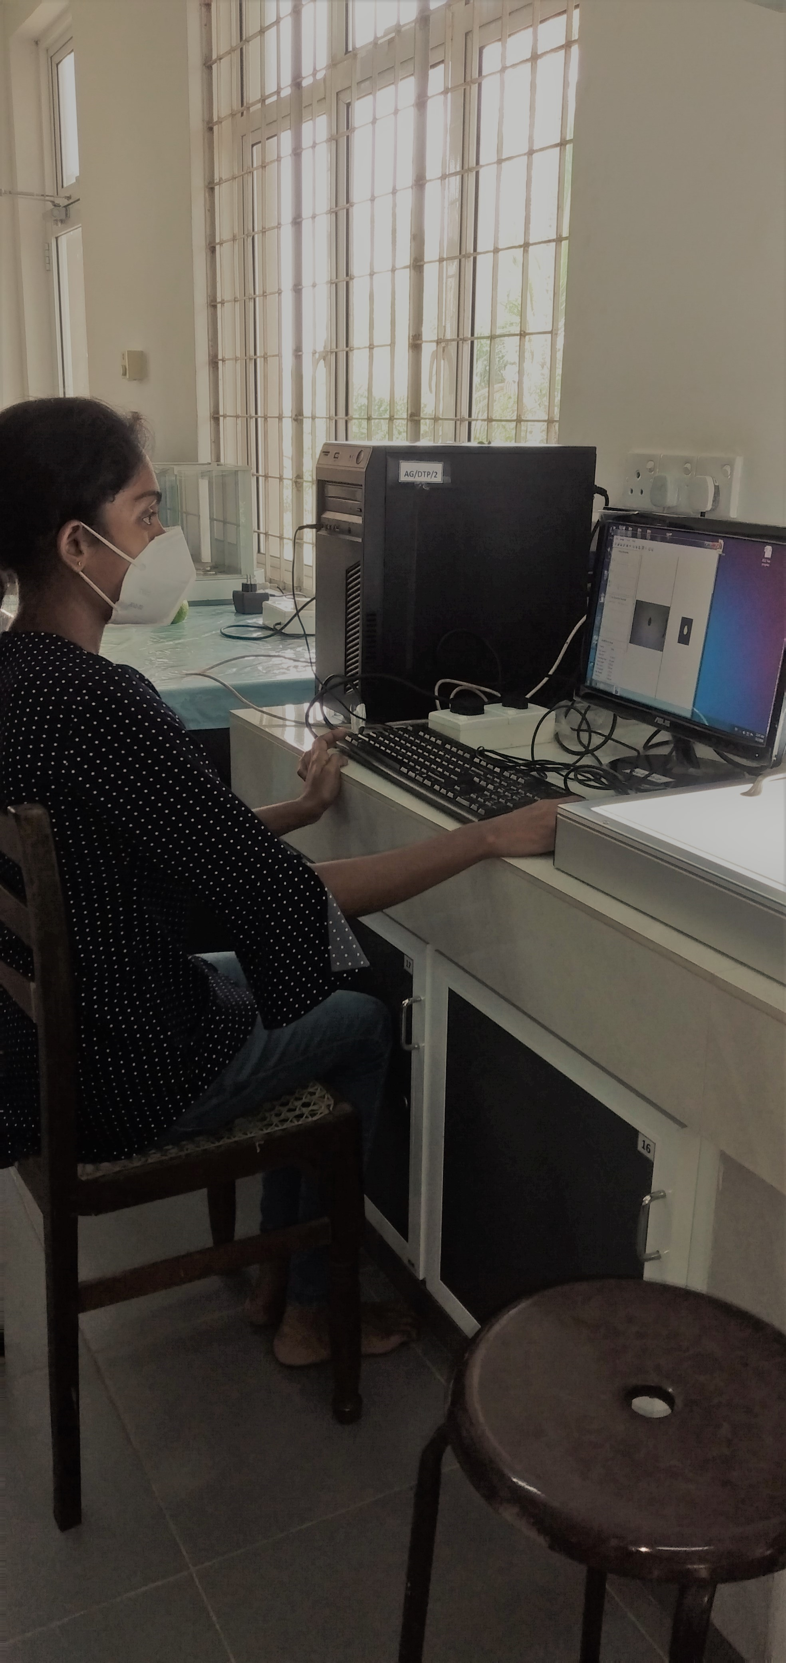
Methodology cont …
Evaluation of leaf characters
Leaf surface area- Measured by using leaf root analyzer
Canopy diameter-
Measured by using measuring tape
Figure 2 Measuring leaf surface area

Slide 9
Methodology cont …
b) Evaluation of stem characters
Internodal length - Five inter-nodal lengths were taken one feet height from the ground level
Internodal length
Figure 3 Internodal length of cinnamon plant

Slide 10
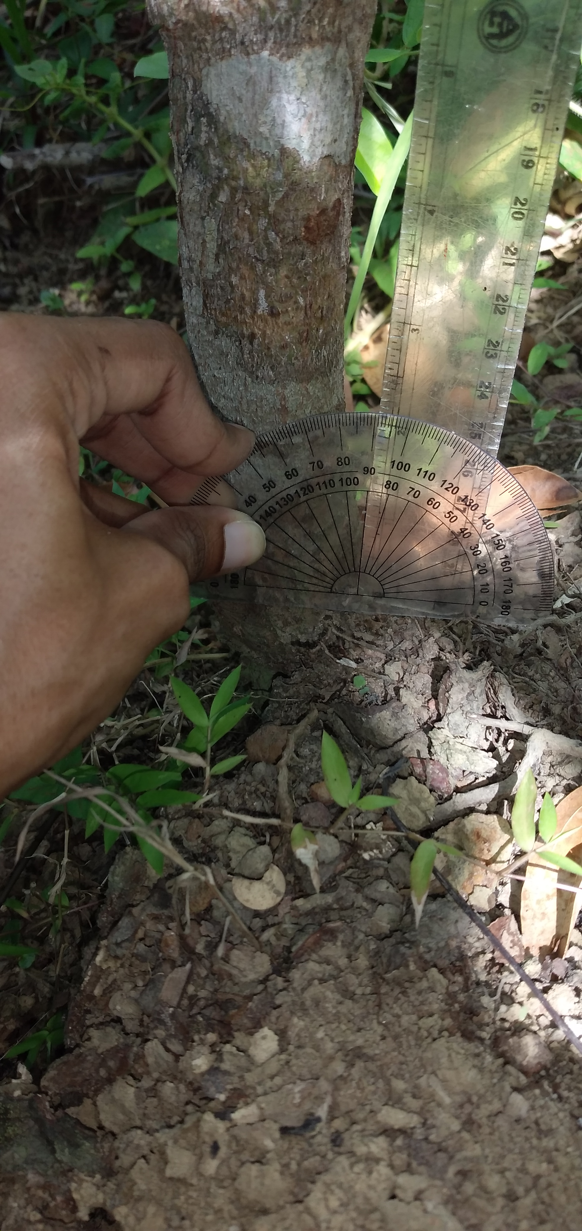
Methodology cont …
Shoot angle -
Angle between vertical plane and harvesting stem (θ) was measured as shoot angle
Vertical plane
Horizontal plane
Ground level
Figure 4 Screening for shoot angle

Slide 11
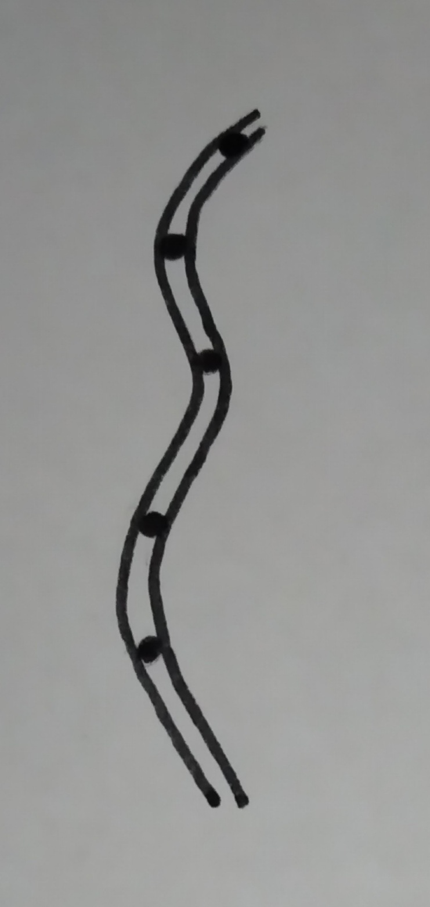
Stem straightness - - Main stem straightness data was taken by visual observation - Scored system used in this study as follows; Table 1 Stem straightness scoring data system
Methodology cont...

Slide 12
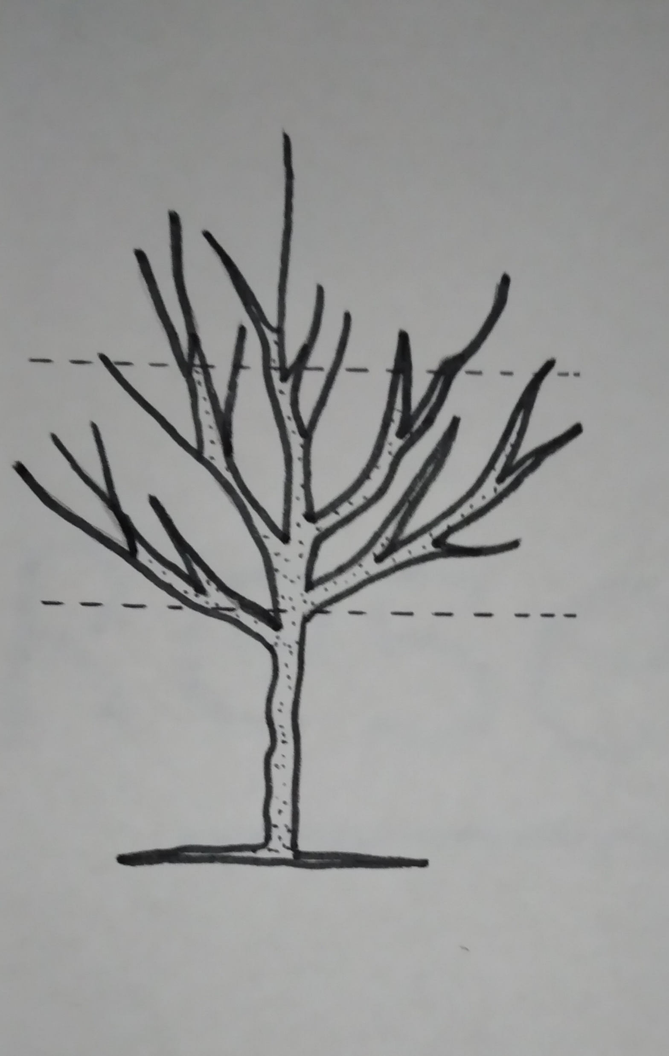
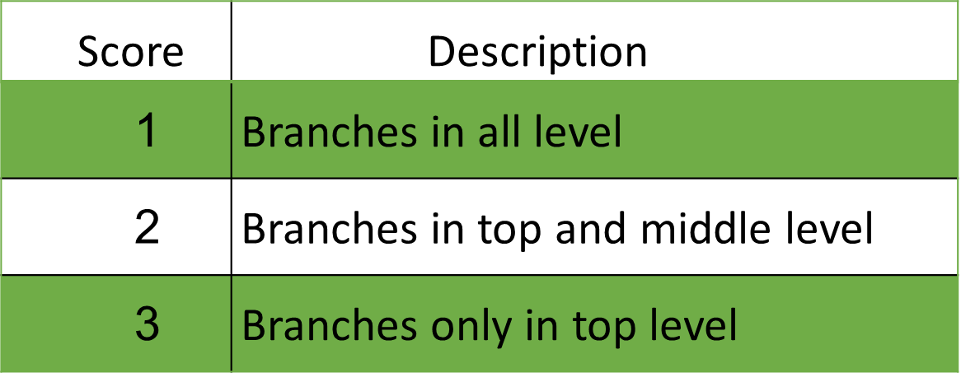
Branching habit -
Methodology cont...
-Plant heights were divided into three equal parts
-Branching habit scored by visual observation based
on score data system
Table 2 Branching habit scoring data system
Top level
Middle level
Bottom level
Figure 5 Level of plant for screening branching habit

Slide 13
Methodology cont …
Number of nodes in harvestable stems –
Number of nodes in harvestable stems were recorded by counting nodes in each stem

Slide 14
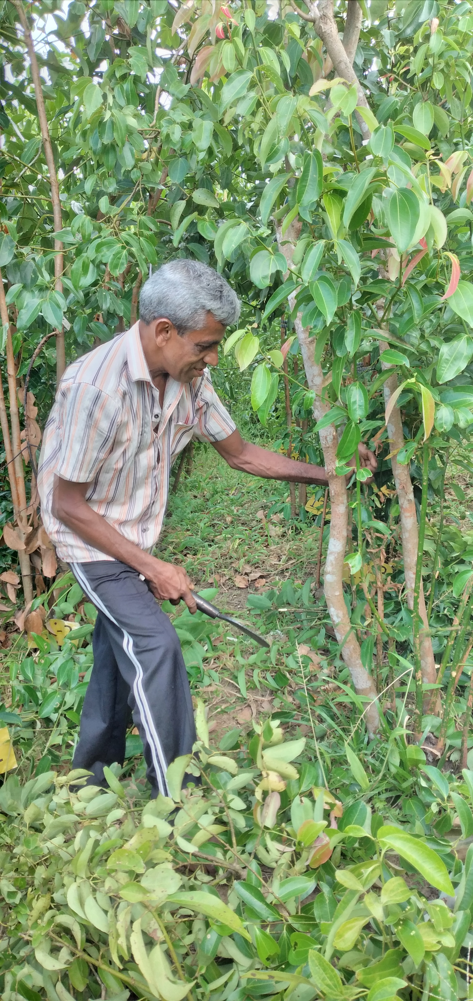
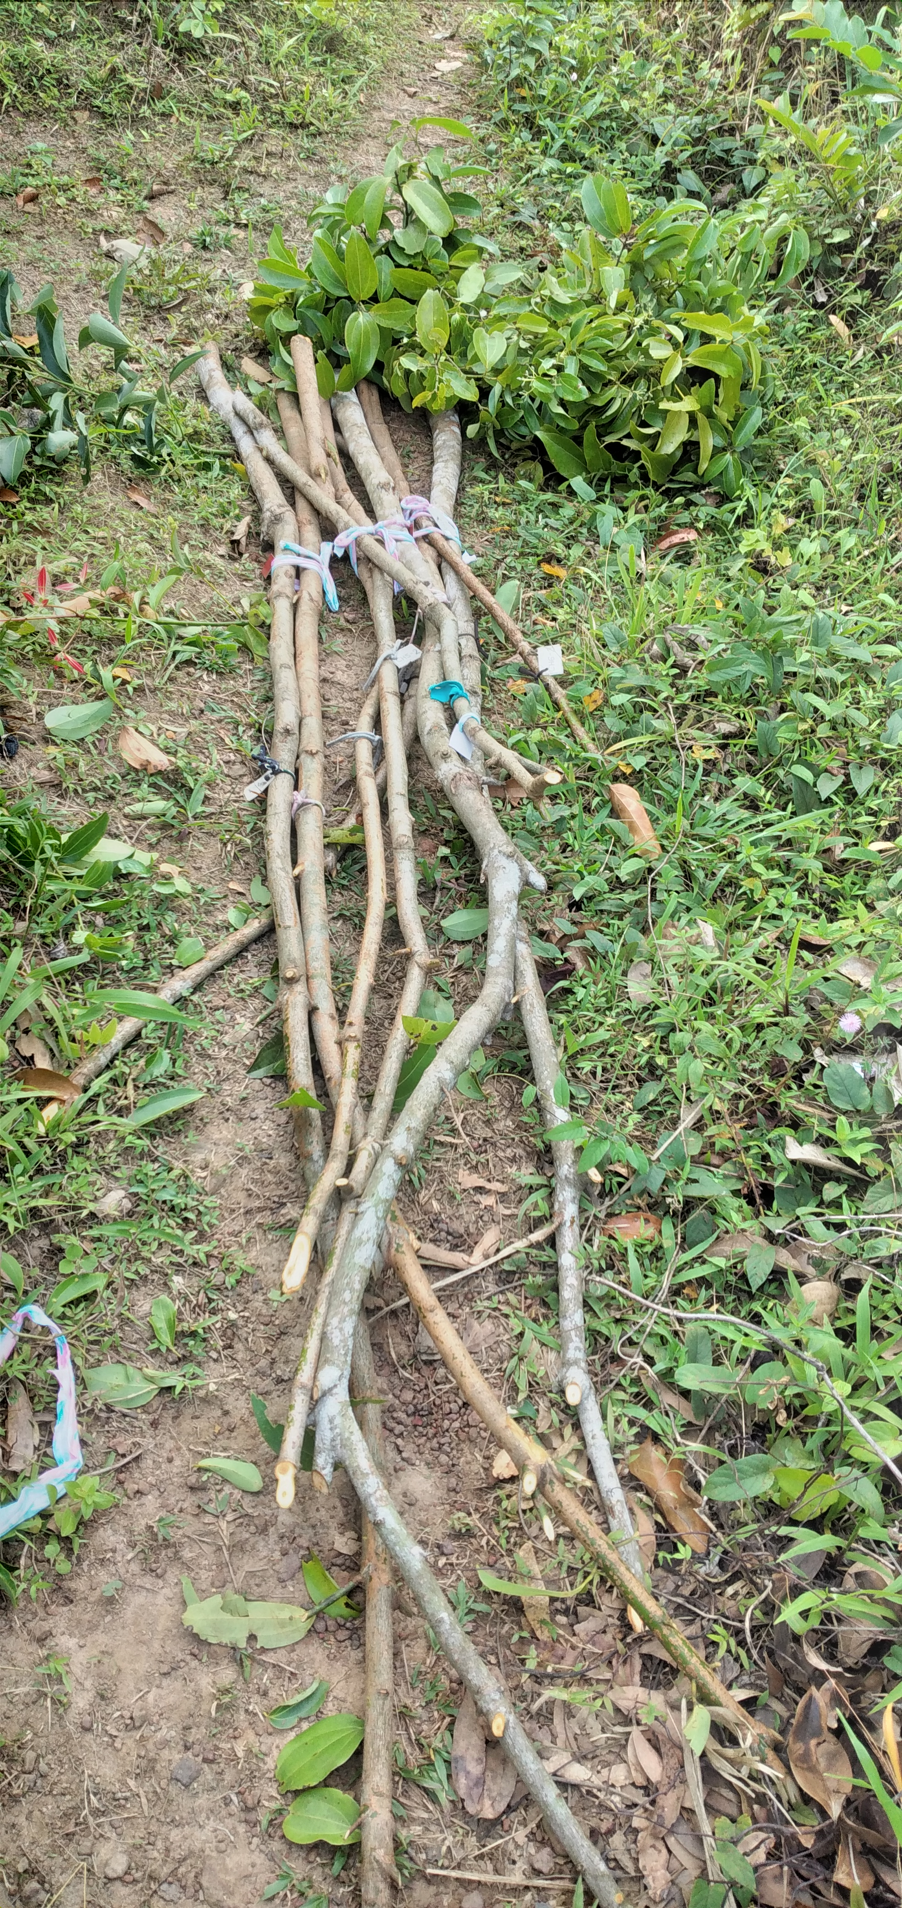
Evaluation of yield parameters
Methodology Cont…
Length of the harvested stem - All the harvestable and mature stems in each plant were harvested from the field by taking the maximum stem length and measured by using measuring tape
Figure 6 Harvesting of Cinnamon

Slide 15
Peelability-
Methodology Cont…
Data related to peelability was done while peeling process based on scored data system
Table 3 Peelability scoring data system

Slide 16
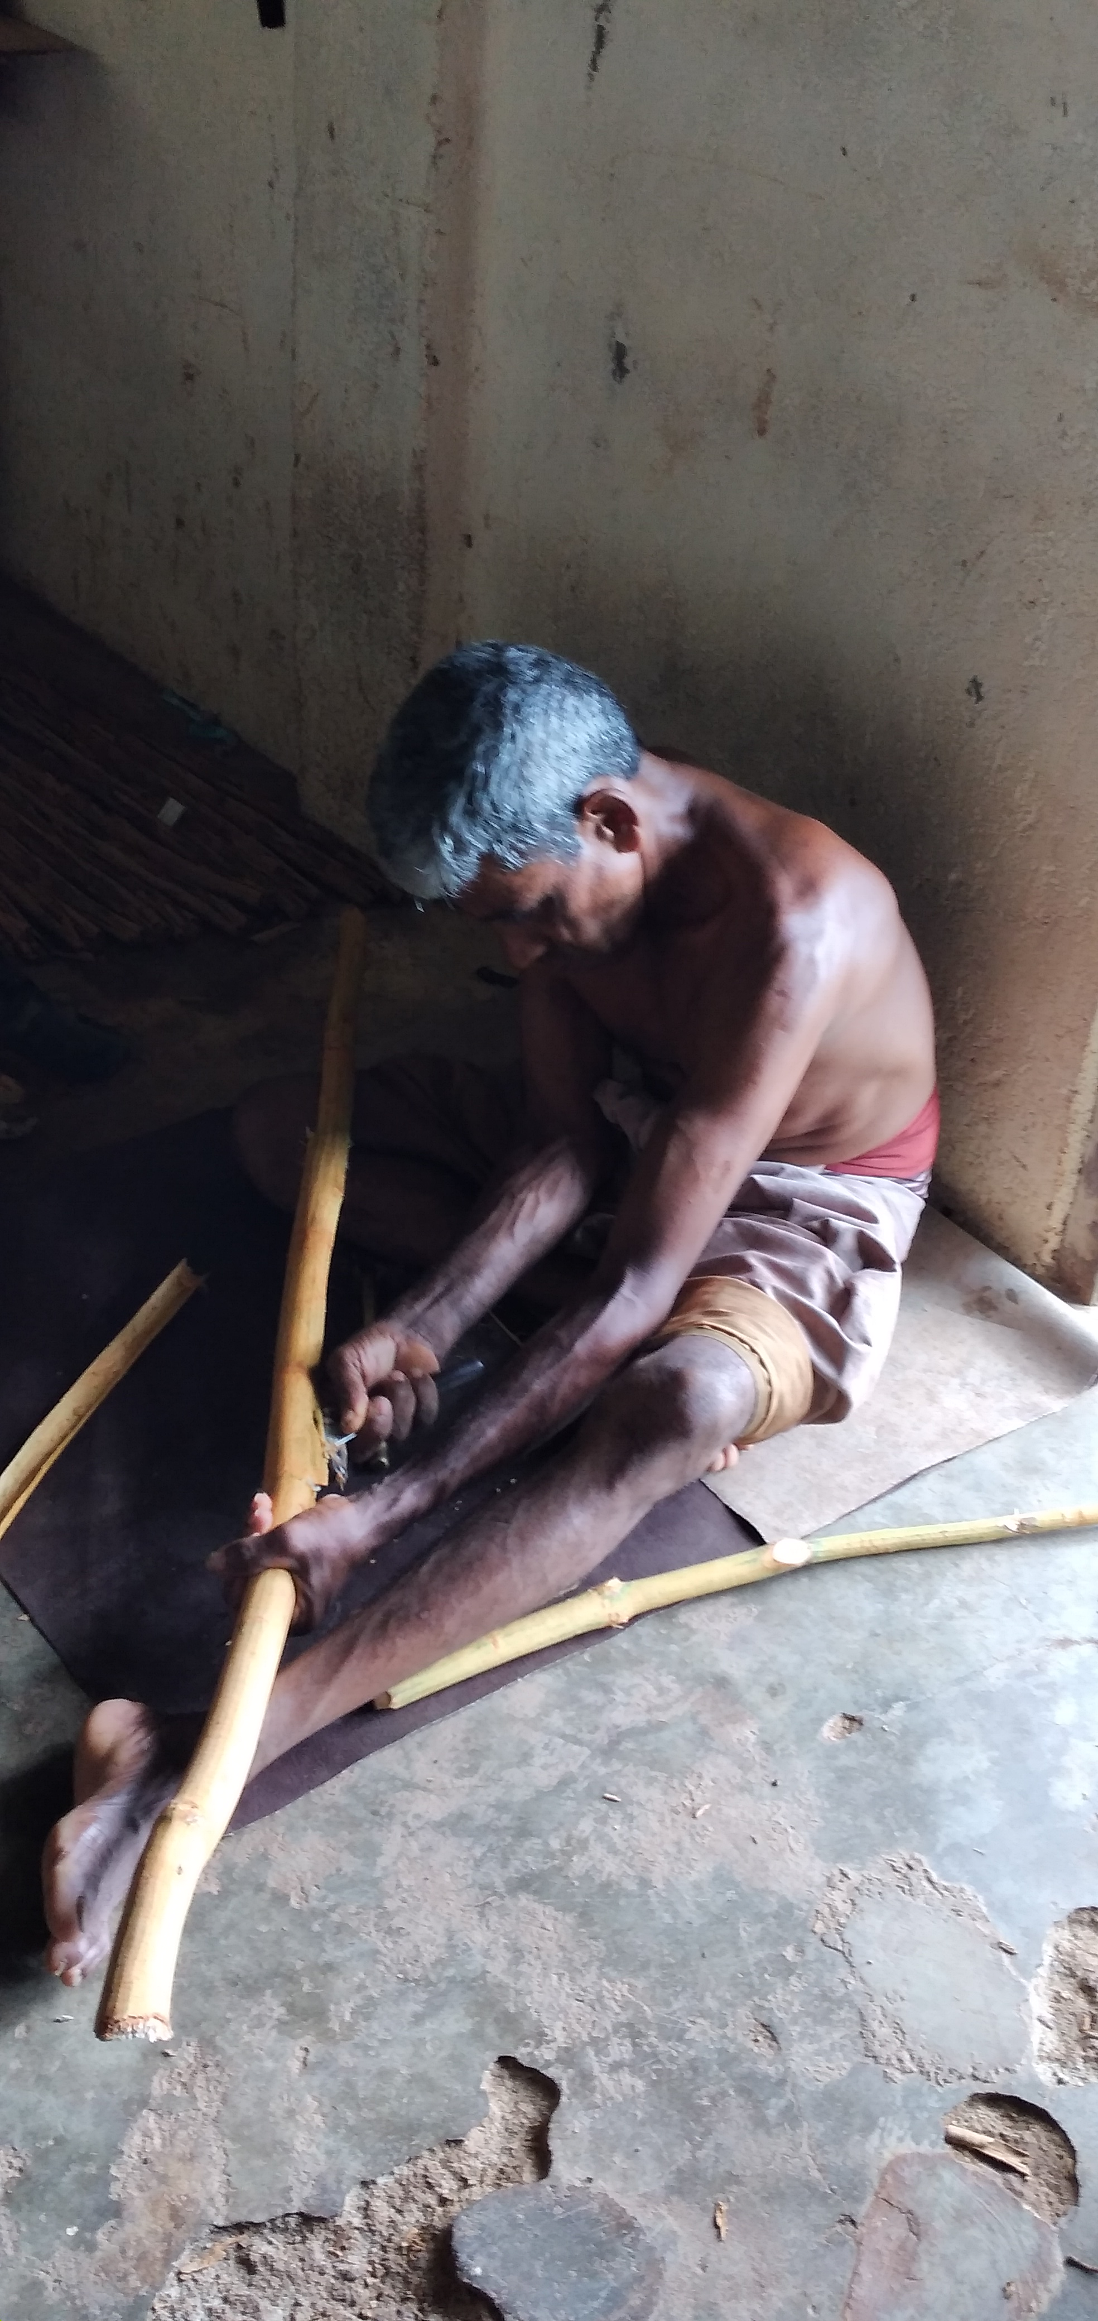
Peeling time -
Methodology Cont…
The time used to peel each stem was recorded
separately using stop watch
Figure 7 Peeling of cinnamon bark

Slide 17
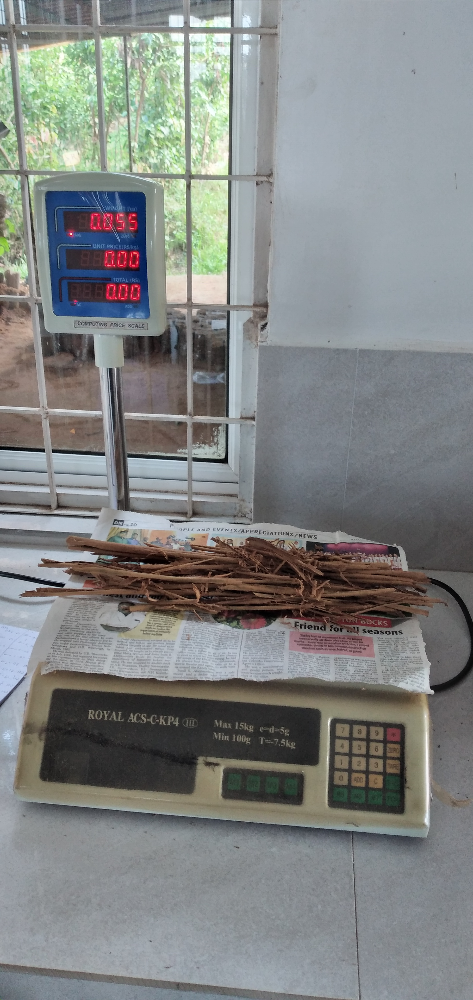
Total dry bark weight -
Methodology Cont…
Peeled bark of each replicate was dried for 5 days under shade condition and dry weight was measured separately
Figure 8 Weighing dry bark weight

Slide 18
Data analysis
Methodology Cont…
All the data were analyzed by statistical software IBM SPSS statistics (version 25)
Pearson correlation analysis and regression analysis were performed to study the effect of morphological characters on bark yield and processing
Then cluster analysis was performed to cluster the accessions. After that one-way ANOVA was performed based on the clusters that formed to identify the effect of morphological and yield parameters on clusters

Slide 19
Results and discussion

Slide 20
Impact of morphological characters on bark yield and peeling time
Results and discussion cont...
Table 4 Results of Pearson correlation analysis
 | Dry bark yield | Peeling time
Internodal length | 0.315** | - 0.134
Stem straightness | - 0.305** | 0.271*
Shoot angle | 1.71 | - 0.227*
Leaf surface area | -0.064 | 0.064
Number of nodes | 0.551** | 0.428**
Canopy spread | 0.605** | 0.072
Branching habit | 0.167 | - 0.148
** Correlation is significant at the 0.01 level.
* Correlation is significant at the 0.05 level.

Slide 21
According to the literature….
Results and discussion cont...
Cinnamon plants with large leaves had high bark yield (Wijesinghe and Gunarathna,2001)
Moreover, the bark yield had a significant positive correlations with canopy spread and tree erectness (Liyanage et al., 2021)

Slide 22
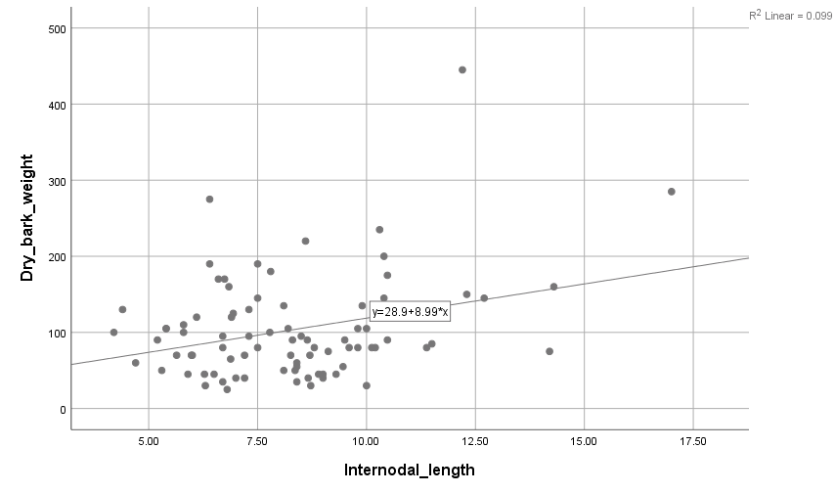
Results and discussion cont...
Dry bark weight (g)
Dry bark weight (g)
Maximum canopy diameter (cm)
Average internodal length (cm)
Figure 9 Relationship between maximum canopy diameter with dry bark weight
Figure 10 Relationship between average internodal length with dry bark weight

Slide 23
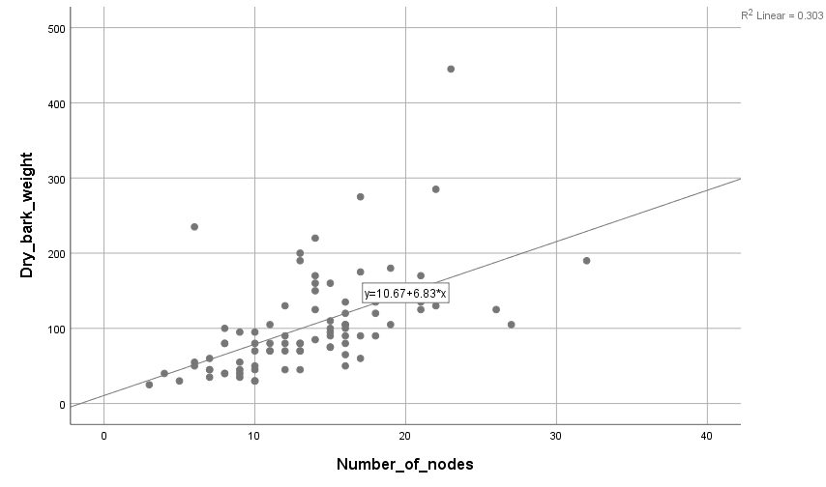
Results and discussion cont..
Dry bark weight (g)
Dry bark weight (g)
Stem straightness
Number of nodes
Figure 11 Relationship between stem straightness with dry bark weight
Figure 12 Relationship between number of nodes with dry bark weight

Slide 24
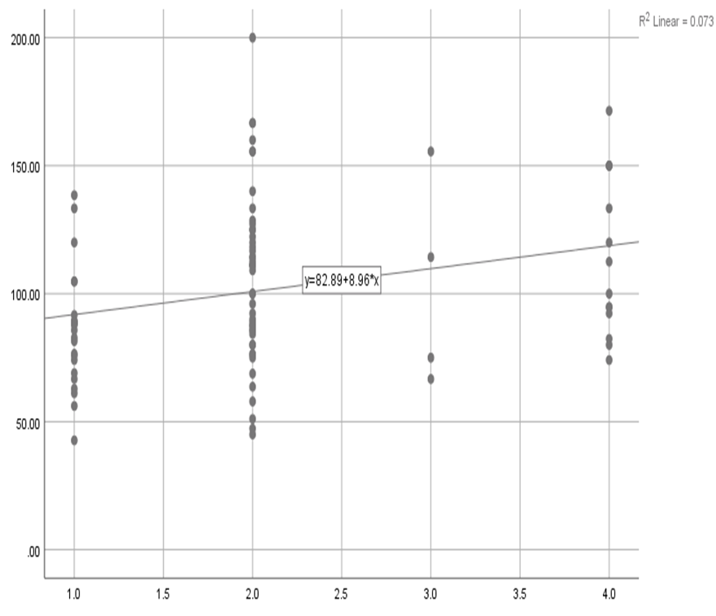
Results and discussion cont..
Peeling time (min)
Peeling time (min)
Number of nodes
Stem straightness
Figure 13 Relationship between number of nodes with peeling time
Figure 14 Relationship between stem straightness with peeling time

Slide 25
Results and discussion cont..
Peeling time (min)
Shoot angle
Figure 15Relationship between shoot angle with peeling time

Slide 26
Results and discussion cont..
Cluster 1
Cluster 2
Cluster 3
Figure 16 Dendrogram to illustrate the relationship between tested cinnamon accessions based on morphological characteristics

Slide 27
Table 4 Comparison of the clusters
Results and discussion cont...

Slide 28
Conclusions
Internodal length, stem straightness, canopy spread, and number of nodes in the stem had significant impact on bark yield of cinnamon
Stem straightness, shoot angle, and number of nodes in the stem had significant impact on peeling time
Out of 45 accessions, three clusters were identified. Among them cluster 3 was given the best performance
Thus, accessions in cluster-3 have high potential to utilize for future cinnamon improvement programs

Slide 29
Suggestions
It would be better if we can repeat the experiment in the future using same accessions
This experiment should be applied to a large population to confirm the accuracy of the results

Slide 30
References
Aluthgamage, H.N., Fonseka, D.L.C.K. and Benaragama, C.K. (2021) ‘Study the cinnamon (Cinnamomum verum J. Presl) yield indices under modified planting systems’, Tropical Agricultural Research and Extension, 24(2), pp. 116.
Azad, R. (2016) ‘Morphological variation of cinnamon (Cinnamomum verum Persl) germplasm in Matara District of Sri Lanka’, 2(1), p. 9.
Liyanage, N.M.N (2021) ‘Identification of superior Cinnamomum zeylanicum Blume germplasm for future true cinnamon breeding in the world’, Journal of Food Composition and Analysis, 96, pp. 103-106.
Gruenwald, J., Freder, J. and Armbruester, N. (2010) ‘Cinnamon and Health’, Critical Reviews in Food Science and Nutrition, 50(9), pp. 822–834.
Jeewanthi, R.K.C., De Silva, A.M. and Weddagala, T. (2020) ‘Value Creation and Food Products of Cinnamon’, in R. Senaratne and R. Pathirana (eds) Cinnamon. Cham: Springer International Publishing, pp. 363–376.

Slide 31
Acknowledgement
Mr. G.A.H.Galahitigama (Internal supervisor), Department of Export Agriculture, Faculty of Agricultural Sciences, Sabaragamaguwa Universiy of Sri Lanka, Belihuloya.
Mrs. S.N.Weerasuriya (External supervisor), Research and Development Officer, Division of Agronomy and Crop Improvement, National Cinnamon Research and Training center (NCRTC), Thihagoda.
Dr. J.B.D.A.P. Kumara, Head of the Department of Export Agriculture, Faculty of Agricultural Sciences, Sabaragamuwa University of Sri Lanka.
Ms. D.D.M.Ovini Dissanayake, Department of Export Agriculture, Faculty of Agricultural Sciences, Sabaragamuwa University of Sri Lanka.
All academic and non- academic staff members, Department of Export Agriculture, Faculty of Agricultural Sciences, Sabaragamuwa University of Sri Lanka.
All staff members and labors of National Cinnamon Research and Training Center, Thihagoda.

Slide 32
Thank You….

