Slide 1
Comparative Assessment of the Effectiveness of Fresh Coconut Paste over Conventional Coconut Milk for Domestic Usage
SKAIH Senarathna^{1*}, BGRR Bandara², HPDT Hewa Pathirana², LP Vidhana Arachchi¹, and DDMO Dissanayake¹
¹Department of Export Agriculture, Faculty of Agricultural Sciences, Sabaragamuwa University of Sri Lanka
²Coconut Processing Research Division, Coconut Research Institute, Lunuwila, Sri Lanka

Slide 2
Content for the presentation
Introduction
Objectives
Material and Methods
Results and Discussion
Conclusion and Recommendations
References

Slide 3
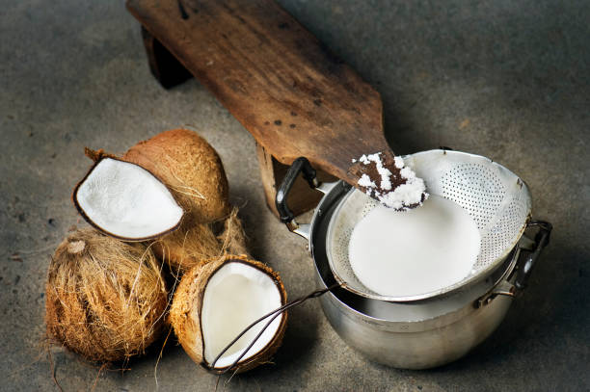
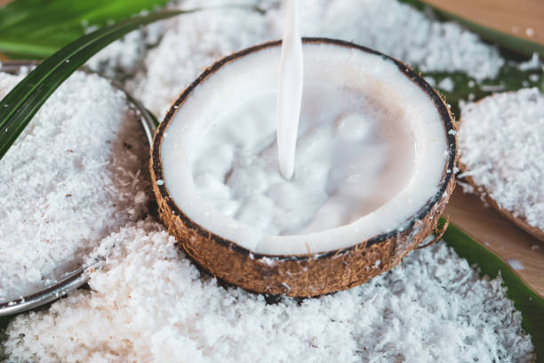
Introduction
White color aqueous extract of coconut endosperm (kernel)
Coconut Milk Coconut (Cocos nucifera)

Slide 4
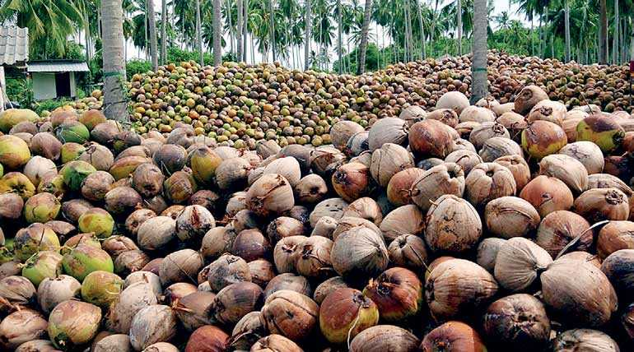
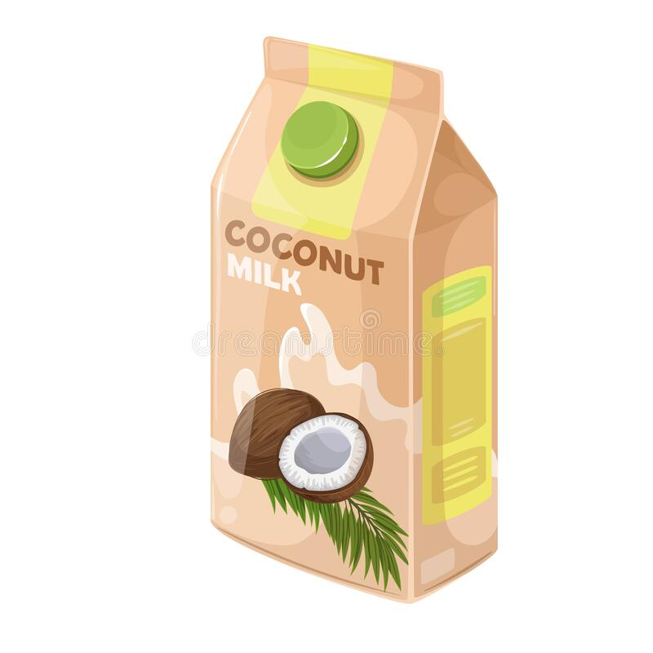
Problem statement
Domestic consumption
70%
Efficiency
only 25%
Ready-to-use product
Only 30% industrial level
(Samarajeewa, 2002)

Slide 5
Objectives
To evaluate proximate composition of fresh coconut paste.
To examine sensory properties of fresh coconut paste and conventional coconut milk.
To analyze the storage stability of fresh coconut paste under refrigerated conditions.
To study the consumer acceptability and cost benefit analysis of fresh coconut paste.

Slide 6
Material and Methods
Production of Fresh Coconut Paste
Proximate analysis
Sensory evaluation
Consumer survey
Microbial count analysis
Calculation of coconut saving by using FCP
Cost-benefit analysis
Data analysis

Slide 7
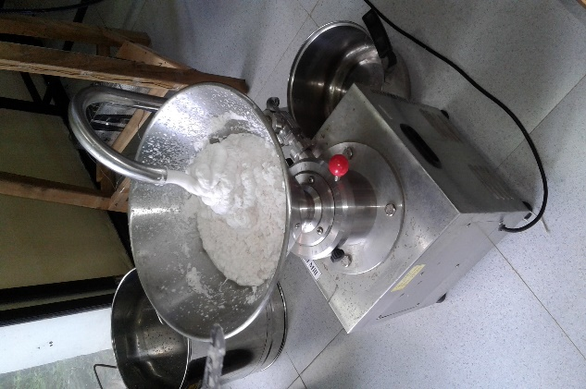
Production of Fresh Coconut Paste
Produce at Wayamba University of Sri Lanka, Makandura.
Scrape coconut endosperm
Add water (1kg of scraped coconut require 700 mL of water)
Pass through the colloid mill
Form viscous coconut paste

Slide 8
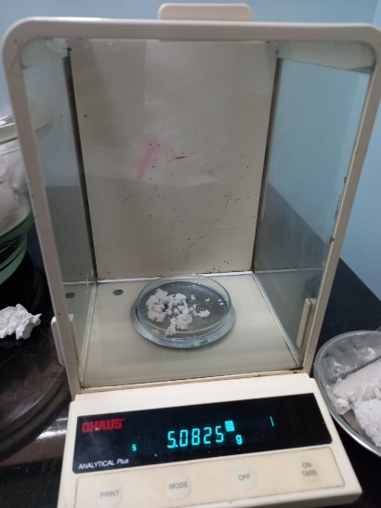
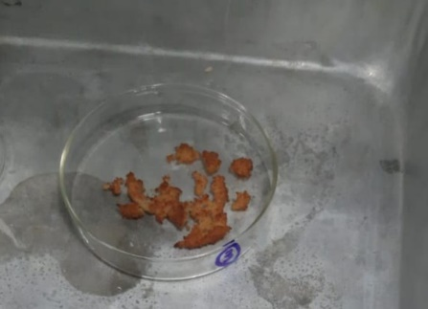
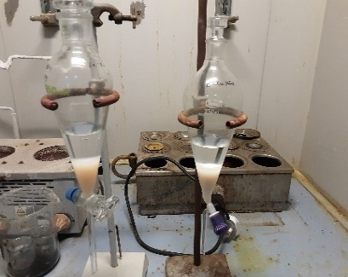
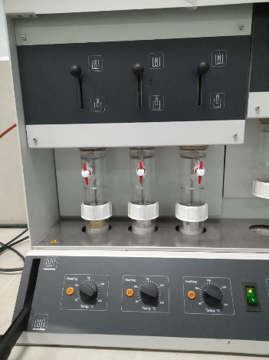
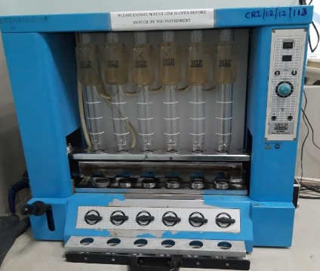
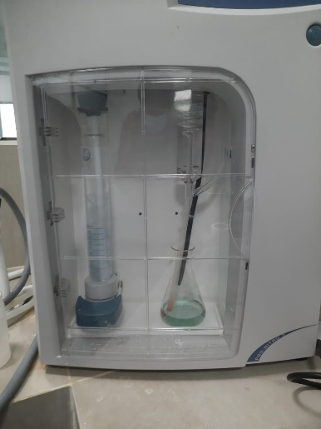
Proximate Analysis
Moisture content
Oven dried method (AOAC method 925.40).
Ash content
AOAC method 900.02
Fat content
AOAC method 905.02
Protein content
Kjeldahl method (AOAC Method 991.20).
Fiber content
Weende method according to AOAC.
Free fatty acid
Method of SLS 98:1988
(Association of Official Analytical Chemists, 1999); (Sri Lanka Standard Institution, 1988)

Slide 9
Sensory Evaluation
Preparation of fresh coconut paste
Get 100g of fresh coconut paste
Add 100 mL water and mix with coconut paste
Preparation of conventional coconut milk
Scrape coconut endosperm
Get 100g of scraped coconut
Get coconut milk from the paste
Add 100 mL water and mix with scraped coconut
Extract coconut milk by hand squeezing for 1min & 30 sec.
Strain coconut milk
Sample preparation
30 semi-trained panelists
Prepare dhal curry
Get sensory attributes
- Appearance
- Odor
- Taste
- Mouth feel
- Overall acceptability
Evaluate - Five- point hedonic scale.

Slide 10
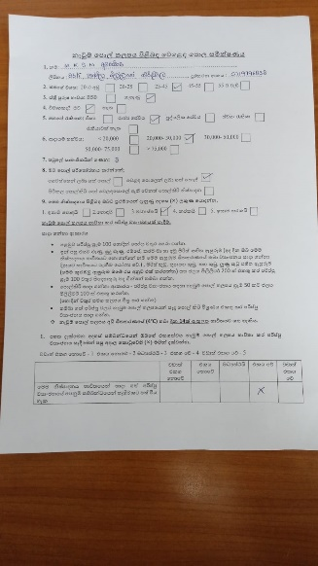
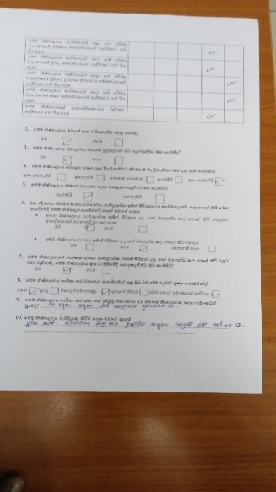
Consumer Survey
150 consumers from Gampaha & Colombo districts.
Provide 50g of fresh coconut paste packets with an instruction to prepare dhal curry.
Provide consumer survey questionnaire to study
- demographic information
- sensory attributes
- consumer preference and perception of the study area.
After 2 weeks, collect questionnaire.

Slide 11
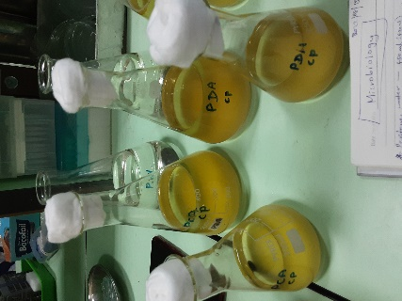
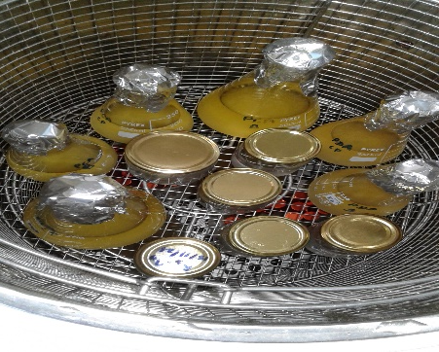
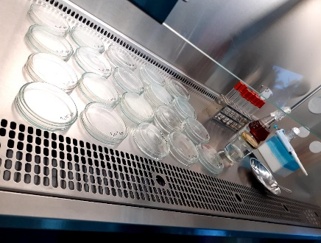
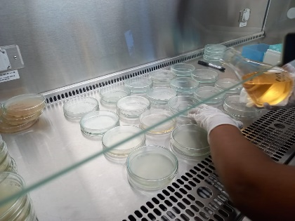
Microbial Count Analysis
Pour plate method according to SLS 516: 1991
Total plate count (PCA media)
Yeast and mold count (PDA media)
Get microbial count of the product on processing day, after 14 days and 21 days at refrigerator conditions (4°C).

Slide 12
Cost-benefit Analysis
Estimate
- Initial cost
- Benefit

Slide 13
Data Analysis
IBM SPSS Statistics version 25 software package
Sensory evaluation data (Non parametric data)
- Friedman test at 95% confidence level.
- Results report as sum of rank for each attribute.
Sensory attributes of consumer survey data
- Sign test at 95% confidence level.
Other non parametric data in consumer survey
- descriptively analyze using Microsoft Excel 2013.
Proximate analysis data (Parametric data)
- one sample t-test at 95% confidence level.
- results report as mean ± SD.

Slide 14
Results and Discussion

Slide 15
Proximate Composition
Composition of Fresh Coconut Paste
Composition of undiluted coconut milk (coconut cream)
Parameters | Composition % (w/w) |  | Composition % (w/w) | References
Moisture | 67.46 ± 0.72 |  | 57.00 ± 1.63 | (Alyaqoubi et al., 2015)
Fat | 27.89 ± 0.40 |  | 35.80 ± 2.27 | (Alyaqoubi et al., 2015)
Protein | 1.27 ± 0.01 | Vs. | 3.10 ± 0.71 | (Alyaqoubi et al., 2015)
Crude fiber | 1.29 ± 0.04 |  | 0.01 ± 0.02 | (Zafisah et al., 2018)
Ash | 0.73 ± 0.08 |  | 0.84 ± 0.08 | (Alyaqoubi et al., 2015)
Carbohydrate | 2.63 ± 0.44 |  | 5.5 ± 0.25 | (Seow and Gwee, 1997)

Slide 16
*** P<0.05
FCP vs. UCM ***
FCP vs. UCM ***

Slide 17
*** P<0.05
FCP vs. UCM ***
FCP vs. UCM ***

Slide 18
ns P>0.05
* P<0.05
FCP vs. UCM ns
FCP vs. UCM ***

Slide 19
Sensory Evaluation

Slide 20
Consumer survey
More than 65% belongs to the age category 25- 45 years.
More than 85% are females.
Over 75% are married.
Over 60% of consumers received a gross monthly income between Rs. 30000- Rs. 50000.
Number of family members per household – average is four.
Demographic Information

Slide 21
Coconut Consumption Pattern

Slide 22
First impression for Fresh Coconut Paste as a product

Slide 23
Sensory Attributes

Slide 24
Consumer Preference & Perceptions
The idea of being able to be used Fresh Coconut Paste as substitute for coconut milk

Slide 25
Willingness to use Fresh Coconut Paste, if it has high nutrition value
Willingness to buy Fresh Coconut Paste
Willingness to introduce Fresh Coconut Paste for others

Slide 26
Number of people can consume 50g of Fresh Coconut Paste
Most preferred quality after cooking dhal curry using Fresh Coconut Paste

Slide 27
Microbial count analysis
Total Plate Count of Fresh Coconut Paste during storage at refrigerated condition (4°C)
APCC (1994)

Slide 28
Yeast and Mold Count of Fresh Coconut Paste during storage at refrigerated condition (4°C)
SLS 516/2 Sec 1: 2013 ISO 21527 -1: 2008

Slide 29
Free Fatty Acid content in fresh coconut paste
 | After 4 days of production | After 2 weeks of production
FFA (% of luaric acid by weight) | 0.06 ± 0.02 | 0.11 ± 0.01
Maximum FFA content of coconut oil
< 0.1% (% of lauric acid by weight)

Slide 30
Coconut saving by using Fresh Coconut Paste (FCP)
Actual coconut usage in FCP
Calculation:
Average moisture content of FCP = 67.46% (W/W)
Moisture content in 50g of FCP = 50g × 67.46%
= 33.73g
Actual coconut amount in FCP = (50 – 33.73)g
= 16.27g
Actual coconut amount in FCP as % = 32.54%

Slide 31
Cost- benefit Analysis
Type of Coconut Milk | Coconut consumption per household per day | Cost (Rs) | Coconuts saved per year compared to hand squeezing | Amount saved per household per year compared to hand squeezing (Rs)
CCM | 01 | 110 | - | -
FCP | 1/4 | 31 | 274 | 28,680

Slide 32
Conclusion and Recommendations
Conclusion
FCP has higher fiber content compared to CCM and acceptable range of storage at refrigeration condition of FCP was 2 weeks.
There is a high possibility to accept the FCP as coconut milk substitute through higher scoring sensory qualities, willingness to buy and introduce other and easiness of usage.
Significant amount of coconut and household cost per year can save by using FCP compared to CCM.

Slide 33
Recommendation
The consumer survey should be carried out throughout the Sri Lanka by selecting representative samples from each province.
Further study to find sustainable technique for improving nutritional quality and preserving fresh coconut paste with improved technology or chemical treatments both in domestic and industrial scales.

Slide 34
References
Alyaqoubi, S., Abdullah, A., Samudi, M., Abdullah, N. (2015) ‘Study of antioxidant activity and physicochemical properties of coconut milk (pati santan) in Malaysia’, Journal of Chemical and Pharmaceutical Research, 7(4).
Association of Official Analytical Chemists (1999) Official Methods of Analysis of AOAC international. 16th edn. Edited by P. Cunniff. Gaithersburg, USA: AOAC International.
Samarajeewa, S. R. (2002) ‘an Econometric Analysis of Consumer Demand’, 18(02), pp. 1–13.
Seow, C. C. and Gwee, C. N. (1997) ‘Coconut milk: Chemistry and technology’, International Journal of Food Science and Technology, 32(3), pp. 189–201. doi: 10.1046/j.1365-2621.1997.00400.x.
Sri Lanka Standard Institution (1988) ‘Sri Lanka Standard: Specification for desiccated coconut- first rivision’. Colombo 08: Sri Lanka Standard Institution.
Sri Lanka Standard Institution (2017) ‘Requirement for edible coconut oil: SLS 32: 2017’ . Colombo 08: Sri Lanka Standard Institution.
Zafisah, N. S., Yusof, Y.A., Ali, M.A., Roslan, N. S. (2018) ‘Processing of raw coconut milk for its value addition using spray and freeze drying techniques’, Journal of Food Process Engineering, 41(1), pp. 1–11. doi: 10.1111/jfpe.12602.

Slide 35
Acknowledgment
Internal supervisor Senior Prof.Lal P Vidhana Arachchi, Department of Export Agriculture, Faculty of Agricultural Sciences, Sabaragamuwa University of Sri Lanka.
External supervisor Dr. Chandi Yalegama, Head, Coconut Processing Research Division, Coconut Research Institute, Lunuwila
Research officer Ms. Ranahansi Bandara, Coconut Processing Research Division, Coconut Research Institute, Lunuwila
Co-supervisor Lecturer Ms. Ovini Dissanayake, Department of Export Agriculture, Faculty of Agricultural Sciences, Sabaragamuwa University of Sri Lanka.
All the staff members of Coconut Processing Research Division, Coconut Research Institute, Lunuwila
Everybody who supported me.

Slide 36
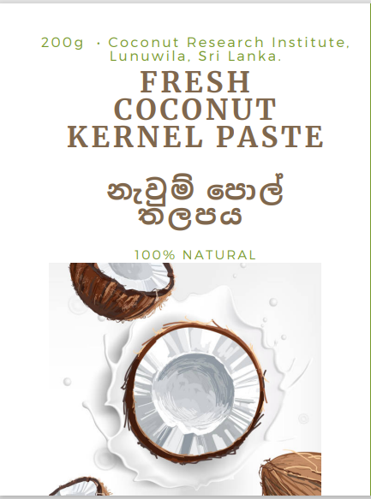
Thank You

