Slide 1
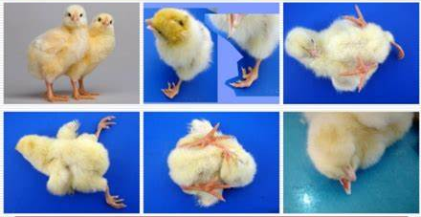
Influence of Breeder Age and Egg Weight on Hatchability and Chick Quality of Cobb 500 Broiler Breeder
KCS Pieris^{1*}, MAJP Munasinghe¹, KATC Kulawansa²
¹Department of Livestock Production, Faculty of Agricultural Sciences, Sabaragamuwa University of Sri Lanka
2. NLDB Miriswatta farm, Millewa, Sri Lanka

Slide 2
Content for the presentation
Introduction
Objectives
Material and Methods
Results and Discussion
Conclusion and Recommendations
References

Slide 3
Introduction
Poultry production supplies the majority of household food and income in developing countries. Therefore continuous broiler production is one of the essential components in the industry.
Aim of commercial hatcheries:
Higher hatchability
Higher number of fertile eggs
Good quality chicks with high growth potential
Uniform chicks
Chick quality depends on:
Pre incubation factors
Incubation factors

Slide 4
Pre incubation factors influence day old chick quality;
With the broiler breeders age:
In older breeders: Egg weight increases, shell thickness decreases, proportion of yolk increases
In younger breeders: Better albumen quality, thicker shell.
With the egg handling and storage time:
Hatchability is depressed by prolonged storage.
Effect increases with storage time after the initial six day period.
Incubation factors influence day old chick quality in the way of chick hatching weight, body length, activity, yolk sac uptake, navel closure and also post hatch performance.

Slide 5
Objectives
Broad objective
Comparative evaluation of the quality of chicks produced under different age groups (36 weeks and 49 weeks) of breeders and different weight groups of eggs (58 – 63g, 64 – 69g, and 70 – 75g).
Specific objective
To evaluate the effect of broiler breeder age (36 weeks and 49 weeks) and egg weight (58 – 63g, 64 – 69g, and 70 – 75g) on incubation and chick quality parameters.

Slide 6
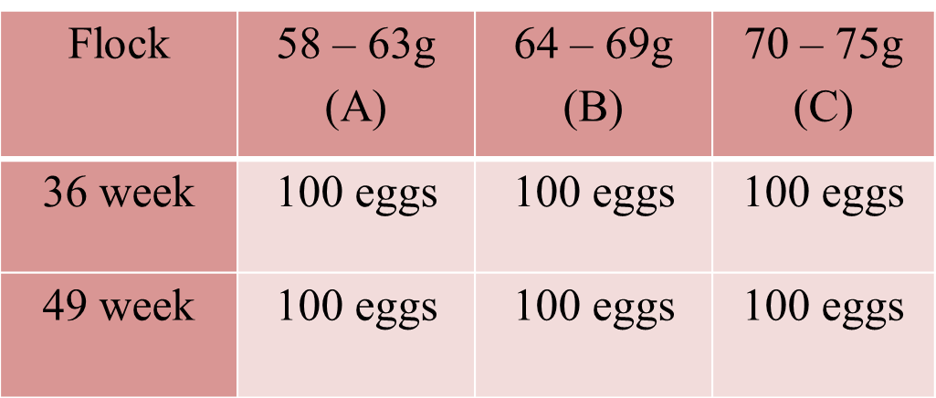
Material and Methods
Study location: Hatchery unit at NLDB Miriswatta farm, Millawa, Horana
Research Design:

Slide 7
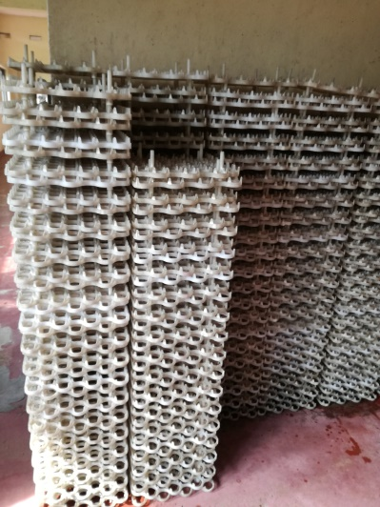
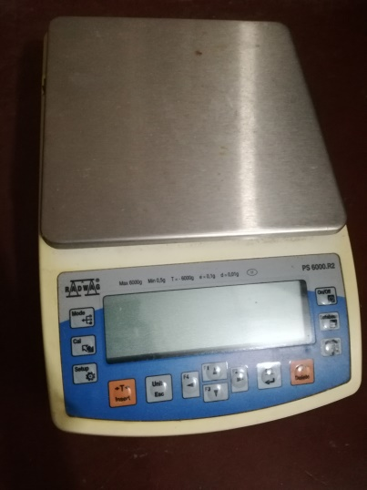
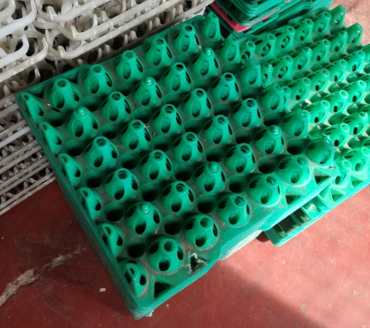
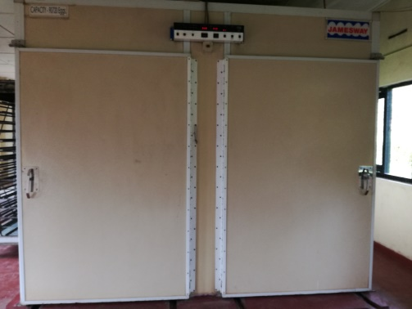
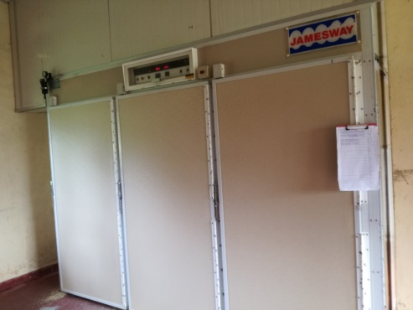
Materials
Top loading balance
Hatchery trays
Egg trays
Hatch baskets
KMnO4
Formalin
Machines
Cool room
Jamesway setter machine
Jamesway hatcher machine
Hatchery trays
Top loading balance
Egg trays
Setter machine
Hatcher machine

Slide 8
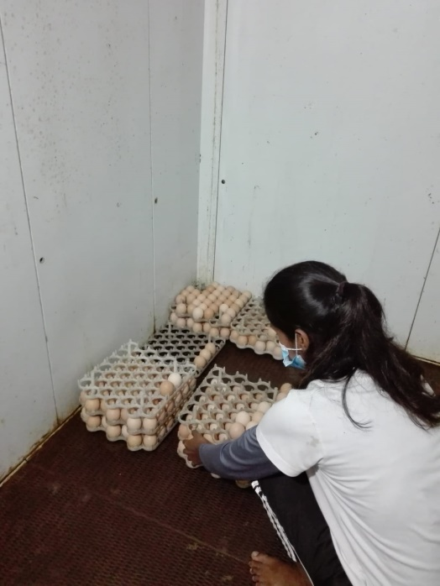
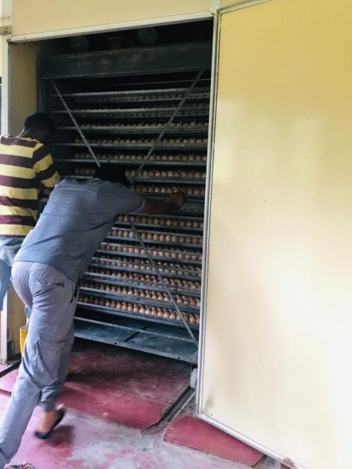
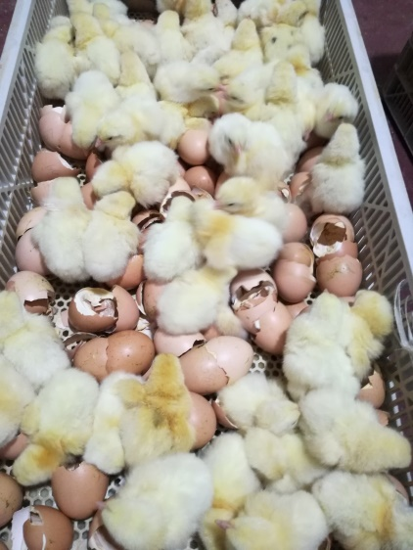
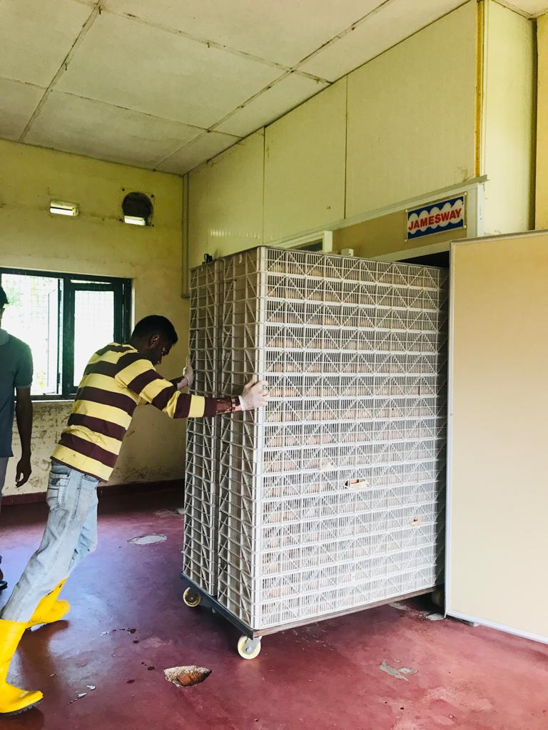
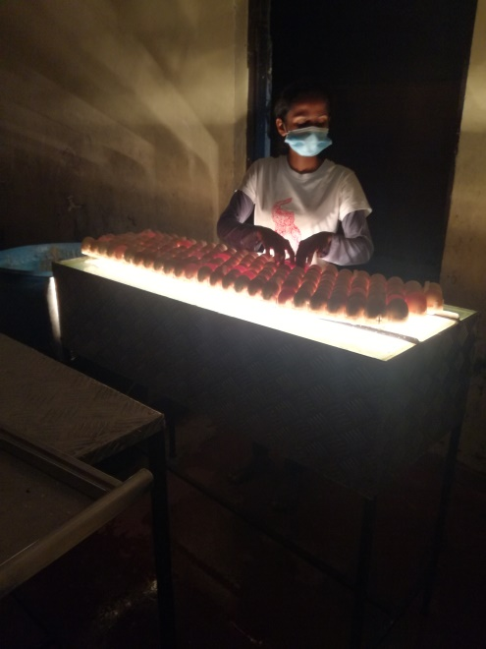
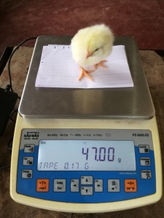
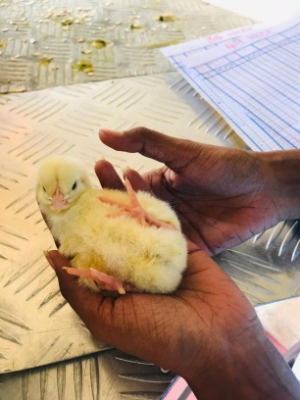
Egg selection
Egg Storage
Egg loading
Chick pull
Egg candling
Egg transfer
Chick quality
assessment

Slide 9
Parameters
Incubation parameters
Moisture loss
Hatchability
Hatch of fertile
Chick yield
Embryonic mortality
Chick quality parameters
Tona score
Chick weight

Slide 10
Statistical Analysis
Data analysis was done using two way ANOVA with help of SAS: Version 9.04.01M6P11072018 (The significant level were declared at p=0.05).
Descriptive statistics were calculated using Microsoft Excel for windows 10.

Slide 11
Results and Discussion
Chick quality parameters:
36 Week
(N=50)
Tona score in the two ages of broiler breeders and three egg weight group categories

Slide 12
36 Week
49 Week
Chick weight in the two ages of broiler breeders and three egg weight group categories

Slide 13
Incubation parameters:
Hatchability in the two ages of broiler breeders and three egg weight group categories

Slide 14
Hatch of fertile % in the two ages of broiler breeders and three egg weight group categories

Slide 15
Moisture loss % in the two ages of broiler breeders and three egg weight group categories

Slide 16
Embryonic mortality % in the two ages of broiler breeders and three egg weight group categories

Slide 17
Chick yield % in the two ages of broiler breeders and three egg weight group categories

Slide 18
Conclusion and Recommendations
Egg weight and breeder age were not significant with chick quality.
The chick quality and incubation parameters decreasing with increasing the breeder age (Hatchability and hatch of fertile decrease and embryonic mortality increase).

Slide 19
References
Iqbal, J. et al. (2016) ‘Effects of egg size (weight) and age on hatching performance and chick quality of broiler breeder’, Journal of Applied Animal Research, 44(1), pp. 54–64. doi:10.1080/09712119.2014.987294.
Iqbal, J. et al. (2017) ‘Effects of egg weight on the egg quality, chick quality, and broiler performance at the later stages of production (week 60) in broiler breeders’, Journal of Applied Poultry Research, 26(2), pp. 183–191. doi:10.3382/japr/pfw061.
Jabbar, A. (2017) Effect of Broiler Breeders Age on Hatchability, Candling, Water Loss, Chick Yield and Dead in Shell. Available at: www.wvj.science-line.com.
Willemsen, H. et al. (2008) ‘Critical assessment of chick quality measurements as an indicator of posthatch performance’, Poultry Science, 87(11), pp. 2358–2366. doi:10.3382/ps.2008-00095.
Wyatt, C.L., Weaver, W.D. and Beane, W.L. (1984) Influence of Egg Size, Eggshell Quality, and Posthatch Holding Time on Broiler Performance.

Slide 20
Thank You

