Slide 1
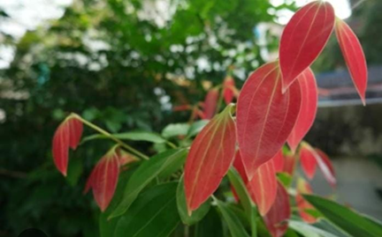
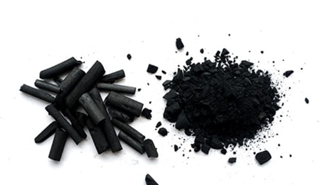
Effect of Cinnamon Wood (Cinnamomum zeylanicum Blume) Biochar as a Potting Media for Cinnamon Seedling
Madushika P.K.A.D.
16 AGA1281
Module - Agri Environmental Resource Management
Department of Export Agriculture
Faculty of Agricultural Sciences
Sabaragamuwa University of Sri Lanka
Internal Supervisor:
Prof. P.I.Yapa Department of Export Agriculture
Faculty of Agricultural Sciences
Sabaragamuwa University of Sri Lanka
External Supervisor:
K.H.G.M.Tharanga Deputy Director (Research) Soil and Plant Nutrition Division National Cinnamon Research and Training Centre

Slide 2
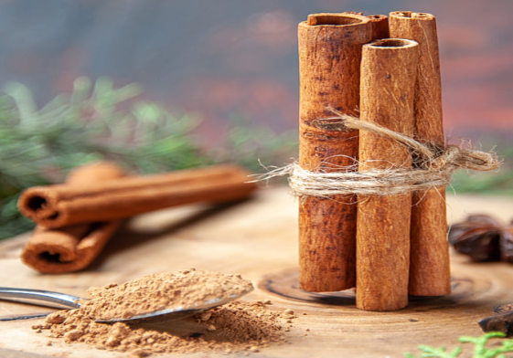
Content
Introduction
Objectives
Material and Methods
Results and Discussion
Conclusion and Recommendations
References

Slide 3
Introduction
Scientific name: Cinnamomum zeylanicum Blume
Family : Lauracae
The miracle spice of Sri Lanka, world largest producer and regular supplier
Cinnamon cultivation presently concentrated along the western and southern coastal belts of the Sri Lanka.
Cinnamon is cultivated on nearly 34,774 hectare at the present(Census and Statistics Sri Lanka, 2020).
Biochar produce from pyrolysis of organic waste with little or no available of air.

Slide 4
Problem Identification
The predominant potting components for cinnamon nurseries are top soil: cow dung: coir dust: coarse sand (1:1:1:1) (Cinnamon – Dept. of Export Agriculture, 2022).
Cinnamon production increased marginally to 20,866 metric tons in 2020 (Census and Statistics Sri Lanka, 2020).

Slide 5
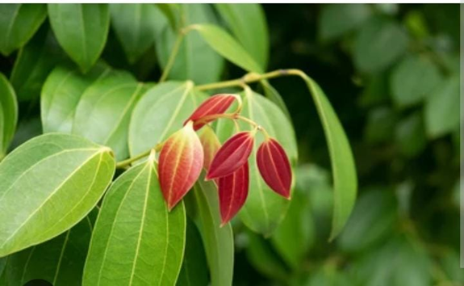
Objectives
To find out the effect of different preparation method and application rate of Cinnamon wood biochar as a potting mixture on growth of cinnamon seedlings.

Slide 6
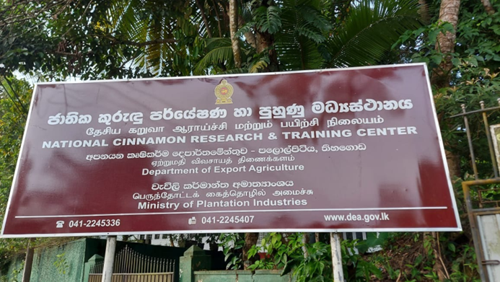
Material and Methods
1. Location
Soil and plant nutrition Division of National Cinnamon Research and Training Center, Palolpitiya, Thihagoda, Matara.

Slide 7
2. Experimental design
The experiment was conducted in a Split-Plot design with four replicates.
Main plot factor- Preparation method - Double Barrel method(60 minutes)
Cone Pit method(60 minutes)
Sub plot factor - Application rate of biochar as weight basis – 0%
2 %
4%
8%
7 treatment combination
Each block was contained nine pots with five plants

Slide 8
Table : Treatments of Experiment

Slide 9
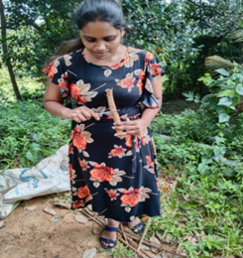
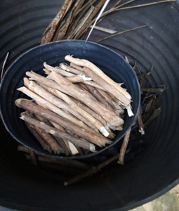
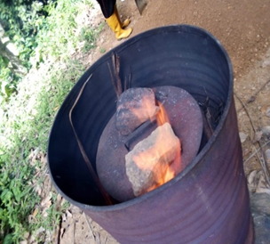
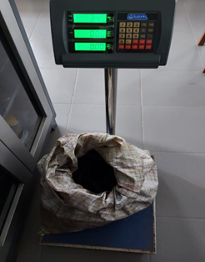
Double barrel method
6” of cinnamon wood biomass
Measuring diameter and length
16 kg of wood pieces was added in to inner barrel
12kg of burning materials was added to outer barrel
Final weight

Slide 10
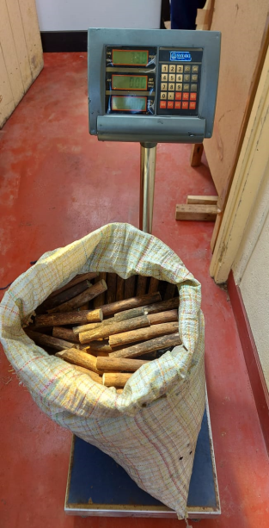
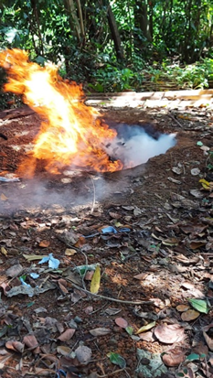
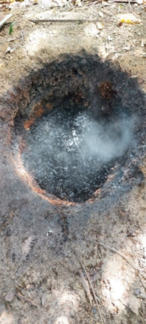
Cone pit method
6” of cinnamon wood biomass
Initial weight
Final weight
Burning

Slide 11
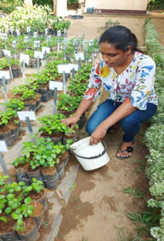
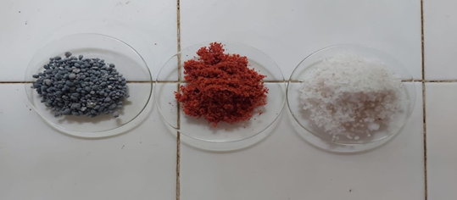
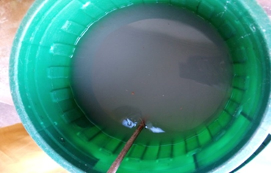
Treatment application
Two month after seed establishment process, Nutrient solution was applied with two weeks interval.
Urea, TSP (Triple Super Phosphate) and MOP (Muriate of Potash) was applied as nutrient solution by mixing with water. 30g of Urea, 15g of MOP and 15g of TSP were applied by mixing with 3 liter of water. That 3 liter nutrient solution was applied to 500 plots.

Slide 12
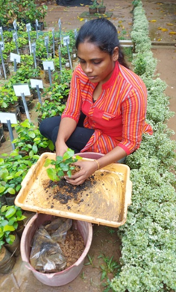
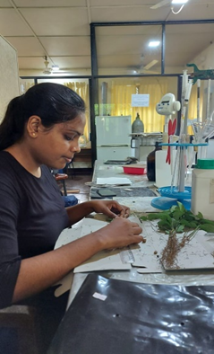
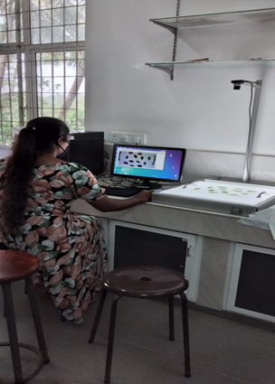
4. Data collection
Analysis of growth Parameters
Plant height(cm)
Shoot length(cm)
Leaf area(cm² )
Tap root length(cm)
Shoot dry mass(g)
Root dry mass(g)

Slide 13
Analysis of Chemical Properties in final Potting mixture

Slide 14
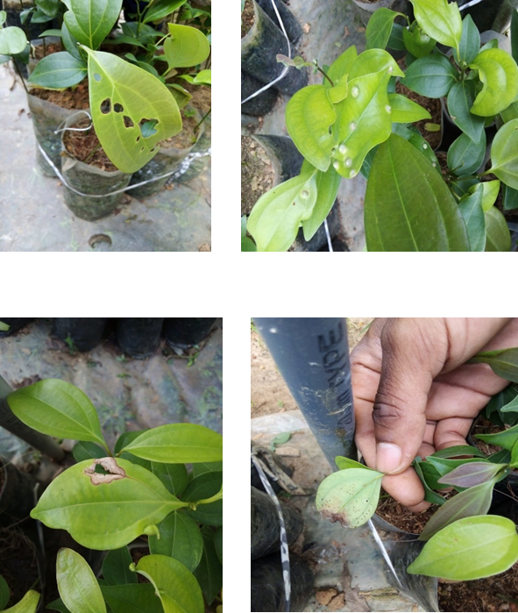
Pest and disease
Pest
Caterpillar attach
Thrips
Disease
Leaf blight
Upper leaf gall
Lower leaf gall

Slide 15
Statistical Data Analysis
The experimental data was analyzed by SAS 9.0 software version
Mean separation was done by Duncan's Multiple Range Test
Graphical analysis of data was done by MS excel-2010
Afterwards, all treatment combinations were compared with control plot; only sub soil by ANOVA test.

Slide 16
Results and discussion
Seed germination percentage

Slide 17
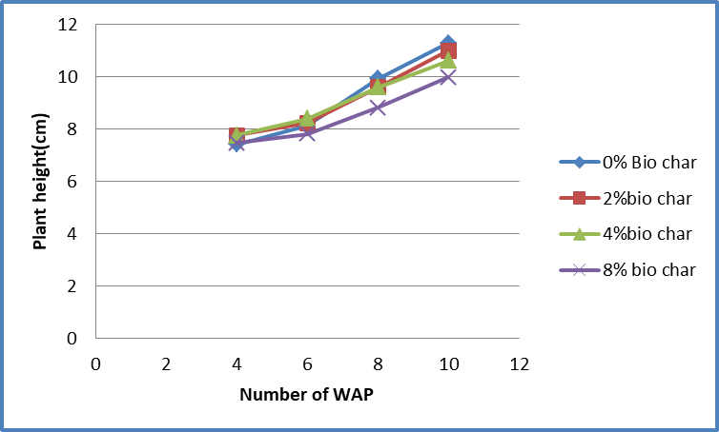
Plant height(cm)
Figure ; Variation of mean plant height with preparation methods
Figure ; Variation of mean plant height with application rate

Slide 18
** Significantly different (p<0.05)

Slide 19
Shoot length (cm)
P>0.05

Slide 21
Tap root length (cm)
P>0.05

Slide 23
Root dry mass (g)

Slide 25
Shoot dry mass(g)

Slide 27
Leaf area(cm²)

Slide 29
Main plot factor Upper leaf Leaf Leaf Thrips Lower leaf Gall (%) Caterpillar (%) Blight (%) (%) Gall (%)
1(Barrel method) 1.2638 2.5669 1.1138 1.4325 6.3838 2(Pit method) 1.6331 2.5894 1.1738 1.3588 5.1362
Significance NS NS NS NS NS
Sub plot factor
0% biochar 3.01ª 0.5375ª 3.5050ª 4.65ª 5.0050 2% biochar 0.8038^{b} 1.9275^{ab} 0.4888^{b} 0.06625^{b} 5.1163 4% biochar 1.0563^{b} 2.4075^{ab} 0.47^{b} 0.2238^{b} 6.7131 8% biochar 0.9238^{b} 1.44^{b} 0.1613^{b} 0.6425^{b} 6.2075
Significance ** NS ** ** NS CV 98.72135 98.88647 148.9461. 173.2757 50.93093 Significance ** NS NS NS NS
** significantly different (p<0.05)

Slide 30
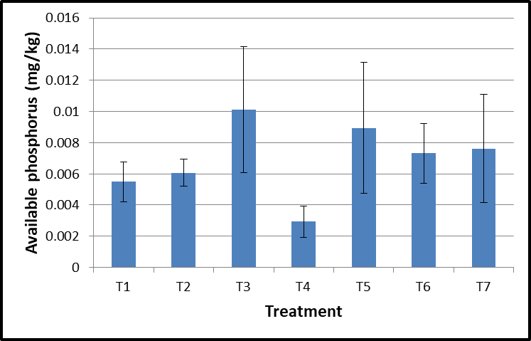
Exchangeable Potassium and available Phosphorus in final potting media
P<0.05
P<0.05

Slide 31
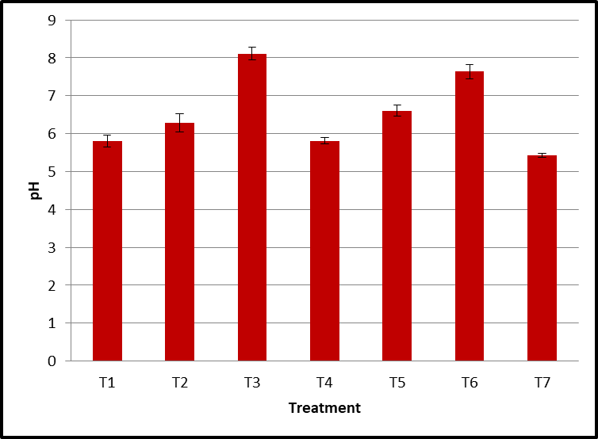
Variation of EC and pH in final potting media

Slide 32
Total nitrogen(ppm)

Slide 33
Conclusion
Barrel method is more effective in enhancing plant height than the pit method.
Addition of biochar (produced using barrel method) at the rate of 2% (w/w) is effective in promoting shoot dry mass and leaf area of cinnamon seedlings.

Slide 34
Recommendation
Further studies are needed to evaluate the effect of Cinnamon wood biochar at different rates and methods of preparation on growth of Cinnamon seedlings.

Slide 35
References
Ahmad, Z. et al. (2021) ‘Chemosphere Biochar modulates mineral nitrogen dynamics in soil and terrestrial ecosystems : A critical review’, Chemosphere, 278, p. 130378.
Black, C., 1965. Methods of soil analysis part 1, Madison,Wisconsin.USA: Am.Soc.Agron.Inc.Publi.
Bremner, J.M. and Mulvaney, C.S. (1982) Nitrogen-Total. In: Methods of soil analysis. Part 2. Chemical and microbiological properties, Page, A.L., Miller, R.H. and Keeney, D.R. Eds., American Society of Agronomy, Soil Science Society of America, Madison, Wisconsin, 595-624.
Li, C. et al. (2018) ‘Geoderma Impact of biochar addition on soil properties and water-fertilizer productivity of tomato in semi-arid region of Inner Mongolia , China’, 331(June), pp. 100–108.
Olsen, S., Cole, C., Watanabe, F. & Dean, L., 1954. Estimation of available phosphorous in soils by extraction with sodium bicarbonate. Circ. U.S. Dept., Volume 939, pp. 1 - 19.

